Slide 1
Joseph Dickerson, Community Partnership Manager
Email: Funding@sustainablect.org
Phone: 860-465-0256
Notes:
Lynn Introduction

Slide 2
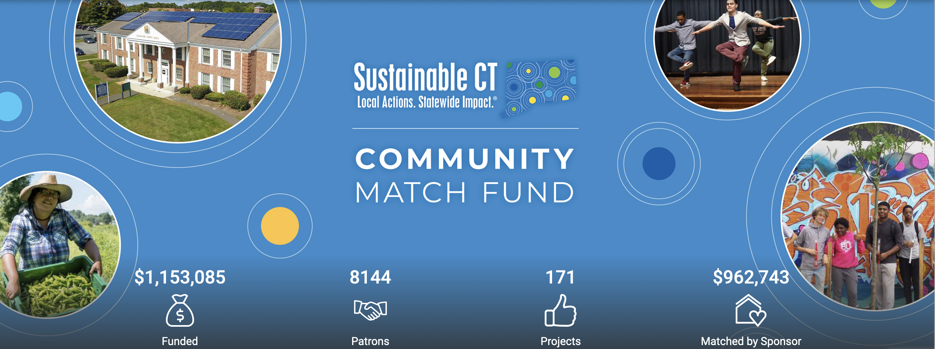

Slide 3
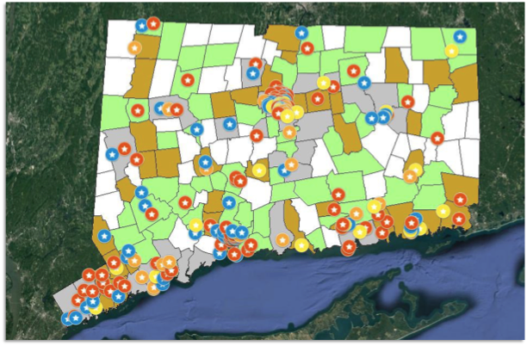
Statewide Presence
76% of towns participating
60% of CT population lives in a participating town
> 2,500 sustainability actions implemented

Slide 4
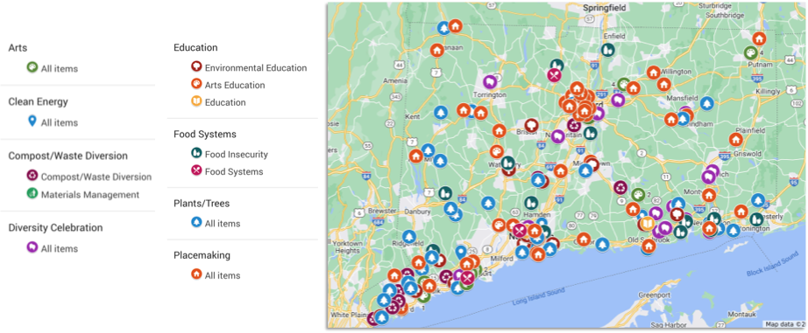
More than 200 Community-led Projects Statewide

Slide 5
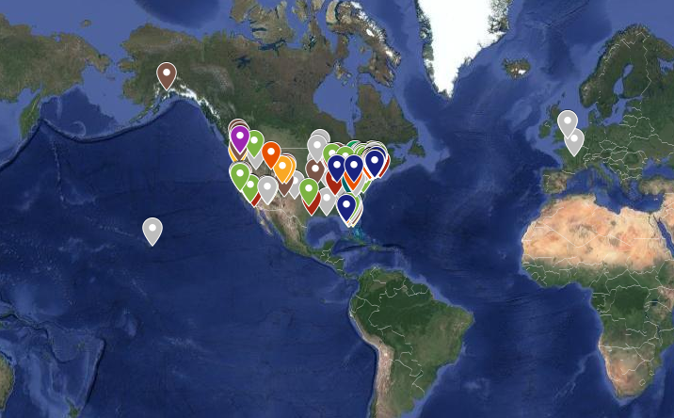
CMF Donors: Supporting Resilient Neighborhoods across CT

Slide 6
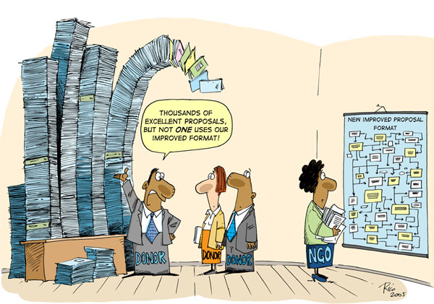
Fast, Flexible, Easy Funding
No application deadlines
No formal, standardized proposal
No lengthy review process
No staggered funds disbursement
No one-size-fits-all post-award reporting requirements

Slide 7
Sustainable CT Community Match Fund
$1-to-$1 matching grant for public, community-led sustainability projects
Up to $7,500 match for projects that align with our mission to create sustainable, equitable, & vibrant communities.
Up to $15,000 match for energy efficiency and renewable energy projects
Fast, Easy, Flexible: No application to submit, no deadlines, fast turn-around, minimal reporting requirements
Promotional and marketing support from Sustainable CT
Coaching to build crowdfunding page and fundraising success strategy

Slide 8
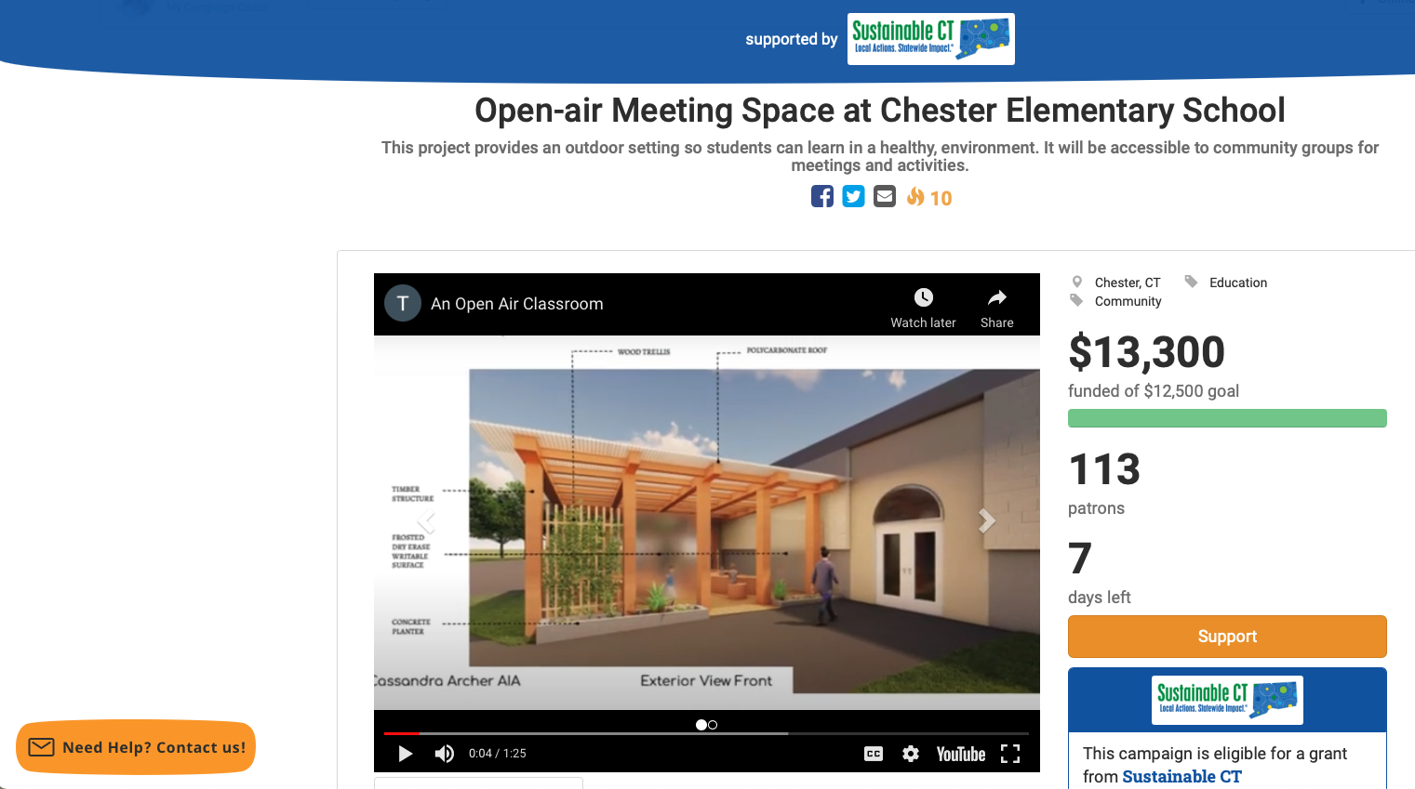
The Matching Dollars $$$
The match: Crowdfunding
50% of costs covered by Sustainable CT, with the other 50% raised through online crowdfunding
SCT grant is a match to many individual/community donations to each project
Challenge grant: raise half from local community, SCT matches half
Projects run crowdfunding campaigns with support from their fundraising partner, Patronicity.

Slide 9
General project eligibility
Project is located in a Sustainable CT registered city/town
Aligns directly with a Sustainable CT action or with an action’s objective
Has a public benefit and is inclusive of the community
Achieves a minimum number of donations to your crowdfunding campaign
(divide your crowdfunding goal by 100 to find the minimum donor threshold)
What’s eligible
Land & waterbody conservation
Improving walkability
Energy efficiency & renewables
Food waste diversion
Community gardens
Green infrastructure
Environmental justice
Creating green spaces
Composting
Farmers Markets
Improved public transportation
Environmental & climate programs/education
Activating public spaces
Arts & culture
Healthy & Sustainable food networks

Slide 11
How to apply:
Contact Sustainable CT’s Joseph Dickerson to discuss your idea:
(860) 465-0256 or funding@sustainablect.org.
No deadlines, funding cycles and a simple application → projects can be proposed at any time and can receive funding as long as Sustainable CT still has money in the match pool.
Eligible projects that are ready to go (have the capacity to begin the work, have/don’t need permits, etc.) can get started on their fundraising campaigns immediately once they have been approved by Sustainable CT.
To see current projects and learn more:
www.sustainablect.org/funding
www.patronicity.com/sustainablect

