Slide 1
Engaging as Partners to Achieve
Energy Savings and a Clean Energy Future
Enoch Lenge, Eversource
Supervisor, Energy Efficiency

Slide 2
Components of an Overall
General Clean Efficiency Strategy
Energy Efficiency
Building & Systems Commissioning
Renewable Energy
Transportation: EV Charging

Slide 3
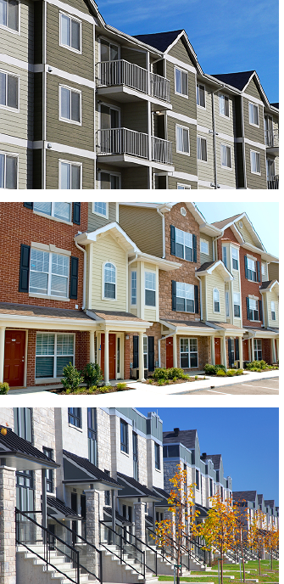
Multifamily Initiative
Upgrades to existing multifamily properties
Comprehensive, open-market approach
Apartments, condominiums, townhouses, buildings or complexes
5 or more units
Financial and technical assistance offerings
Past participating properties and multi-year projects
Income-eligible & market rate properties
  Income-eligible does not have to be subsidized
  2/3 of tenants at of below 60% SMI

Slide 4
Multifamily Measure Components
Direct Install Dwelling Unit Measures
Other Measures
Lighting Fixtures
Examples of Custom Measures
Air Sealing
Low-flow Faucet Aerators & Showerheads
LED Light Bulbs
Insulation
HVAC
Water Heaters
Windows
Appliances
Controls
Central HVAC Pipe Insulation
Central Mechanical Ventilation (retro commissioning or duct sealing)
Advanced Lighting Controls (data logging)
Steam Trap Studies
Domestic Water Booster Pumps
Duct Sealing
Chillers
Refrigerator Evaporator Fan Controls

Slide 5
Two Paths for Participation
Standard Path Energy Efficiency Project
  Targeted energy efficiency upgrade project to an existing property
  New Construction – ground up construction or gut rehabs
CHFA/DOH Competitive Funding
  Renovation projects (energy and non-energy related upgrades)
  New Construction – ground up construction or gut rehabs
  Receive Letter of Participation from utilities to submit with application for round of funding
  LOP process rolled out in 2016

Slide 6
Funding Process for CHFA/DOH Participation Letter
Project Initiation
Project Team Initiation & Kick-Off Meeting
*Proposal Review & Initial Submittal to Utility
Utility Review
Initial Review of Submittal
Letter of Participation (LOP) issued
Construction & Incentive Commitment
CHFA/DOH Funding Secured & Construction Started
Incentive Commitment from Utility Letter of Agreement (LOA)
Project Completion
Construction Complete & Utility Post Inspection
Incentive Payments Issued by Utility
*Proposal submittal must includes:
Scope of work
Multifamily Initiative Application
Project Fill Out Form
Notes:
This is essentially the same process for New Construction & MF Existing Buildings
Project Initiation – This could be the HERS rater or in the case of WBP the energy modeler
Proposal for RNC – Must include 40% drawings and must have have RNC initial application information for LOP preparation
Proposal for MF Existing Buildings
Scope of work
Multifamily Initiative Application
Project Fill Out Form

Slide 7
Project Incentive Structure
Standard One End-Use
Project
Comprehensive Multi-End Use Project
Up to 65% of project cost
Up to 90% of project cost
Up to 50% of project cost
Up to 75% of project cost
Income Eligible
Market Rate

Slide 8
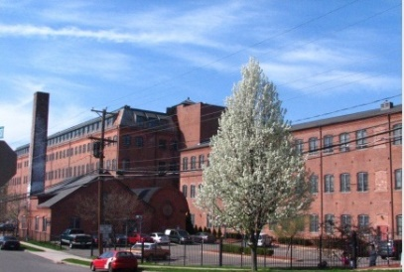
Case Study
Charles Street Apartments
Location: Meriden, CT
Stories: 3
# of Dwelling Units: 80
Meter Configuration: Individually Metered Electric & Natural Gas
Measures | Installed Cost | Incentive | Annual kWh Savings | Annual CCF Savings
Weatherization (Air Sealing, Duct Sealing LED Bulbs & DHW Savings) | $29,252.49 | $29,252.49 | 10,170 | 3,789
Dwelling Unit Lighting Fixtures | $62,843.95 | $12,199.24 | 12,468
Exterior & Common Area Lighting | $34,327.10 | $27,461.68 | 102,717
Apt. Furnace ECM Fan Motors | $30,000.00 | $20,000.00 | 30,800
Apt. AC Systems | $186,800.00 | $53,153.25 | 21,106
Common Area AC Systems | $14,800.00 | $6,962.25 | 2,764
Common Area Furnace ECM Fan Motors | $1,000.00 | $1,000.00 | 1,540
Heating System - Apt Gas Furnaces | $380,000.00 | $56,241.14 |  | 6,521
Common Area Furnaces | $26,802.00 | $12,317.94 |  | 1,808
Project Information
# Measures | Install Cost | Incentive | Comp Bonus | Total Incentive | % of Cost Covered
9 | $765,825 | $218,587 | $124,751 | $343,338 | 45%

Slide 9
Questions?
Multifamily Initiative
multifamily@Eversource.com

Slide 10

CT Electric Vehicle
Charging Program
PUBLIC UTILITIES REGULATORY AUTHORITY

Slide 11
The Goals
2022-2024 Eversource Goals
Program Area | Ports
Residential Single-Family L2 (1-4 units) | 12,000
Multifamily L2 (5+ units) | 970
Destination/Public L2 | 631
Workplace L2 (includes Light Duty Fleet) | 1,851
DCFC | 110
2022-2024 United Illuminating Goals
Program Area | Ports
Residential Single-Family L2 (1-4 units) | 3,000
Multifamily L2 (5+ units) | 437
Destination/Public L2 | 283
Workplace L2 (includes Light Duty Fleet) | 833
DCFC | 49
Charger Port Targets

Slide 13
Commercial EV Chargers
Incentive Levels
Location | EV Charger Type | Per Site Maximum Rebate Amounts | Property Type | Port Installation Requirements
Baseline | Level 2 | Up to $20,000 | Multifamily | 2
 |  |  | Public | 2
 |  |  | Workplace | 4
 | DCFC | Up to $150,000 | Any | 2
Underserved | Level 2 | Up to $40,000 | Multifamily | 2
 |  |  | Public | 2
 |  |  | Workplace | 4
 | DCFC | Up to $250,000 | Any | 2
Level 2:
Baseline: $20,000
Underserved: $40,000
DCFC:
Baseline: $150,000
Underserved: $250,000
Underserved Communities Map

Slide 14
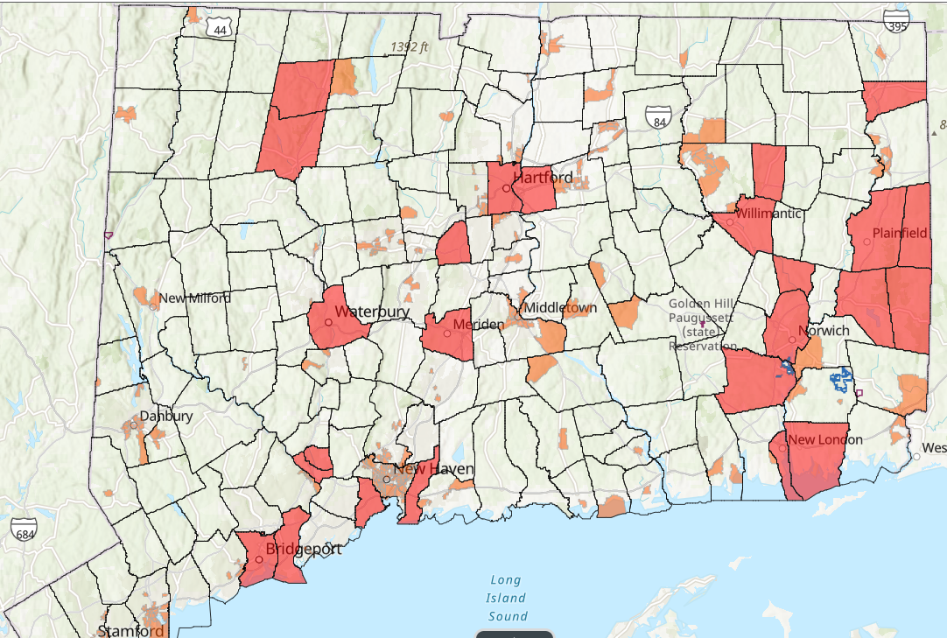
DEEP Connecticut 2021 Underserved & Environmental Justice Communities Map

Slide 15
Project Examples
Location Type (Baseline & Underserved) | Project Description | Measures | Proposed Total Cost | L2 Charger Cost | Make Ready Installation Cost | Proposed Rebate
Hartford (Underserved) | Medical office building (Workplace) | 4 Ports level 2 charging stations (single site) | $40,000 | $20,000 | $20,000 | $30,000
Stamford (Baseline) | 100 units Multifamily (4 building property) | 8 Ports level 2 charging stations (4 sites) | $80,000 | $40,000 | $40,000 | $60,000
New Haven (Baseline) | 6 level public parking garage | 6 Ports level 2 charging stations (3 sites) | $90,000 | $30,000 | $60,000 | $60,000
West Hartford (Baseline) | DCFC located at gas station | 2 Port DCFC station (single site) | $200,000 | $40,000 | $160,000 | $150,000

Slide 16
Commercial Project Process
Plan an Eligible Project & Get Proposal
Complete Installation and Activation
Submit Invoice & Payment Request Form
Installation Verification, if Requested
Apply to Program
Receive Incentive Reservation Letter
Receive Rebate

Slide 17


Applications & Program Guides
Residential Applications
Eversource
United Illuminating
Commercial Applications
Eversource
United Illuminating
Residential Guides
Eversource
United Illuminating
Commercial Guides
Eversource
United Illuminating

Slide 18

Program Websites
Residential:
Eversource
United Illuminating
Commercial:
Eversource:
United Illuminating
Program Support
This Photo by Unknown Author is licensed under CC BY-ND
United Illuminating
Application Support:
UIEVSupport@clearesult.com
(888) 978-1440
Program Support:
HomeEV@uinet.com
Eversource
Customer Support
EversourceEVSupport@clearesult.com
(888) 978-1440

Slide 19
