Slide 1
Radon Overview
Kimberly Ploszaj
Supervising Environmental Analyst
March 15, 2022
Environmental Health and Drinking Water Branch

Slide 2
Overview
What radon is
How it enters a home
Health effects
Testing and Mitigation

Slide 3
What is Radon?
A naturally-occurring radioactive gas
Colorless, odorless and tasteless
Found all over the U.S. in all types of buildings
  Old or new
  Drafty or well sealed
  With and without basements
Notes:
Radon is a radioactive gas that occurs in nature. Radon is one of the nation’s most important environmental threats – one that places people at risk in their own homes.
Radon cannot be detected by our senses. You can’t see smell or taste radon. The only way to know if your home has high levels of radon is to test for it.

Slide 4
Uranium Decay Chart
Radon
Radium
Uranium
Notes:
Radon is gas formed by the natural decay or radium which comes from the decay of radium. Both radium and uranium are very common elements present in soils and rock. Radon itself is not dangerous, but as it decays, the gas produces radiation in the form of microscopic particles that can cling to house dust or other airborne particles. Outdoors radon is diluted quickly and poses little threat, but when it migrated into a building and accumulates to unsafe levels, it can become a health hazard.

Slide 5
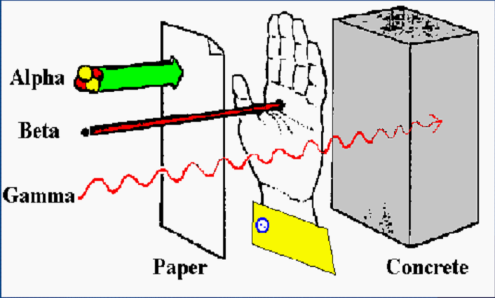
Radiation Types
Radon Penetrating Power

Slide 6
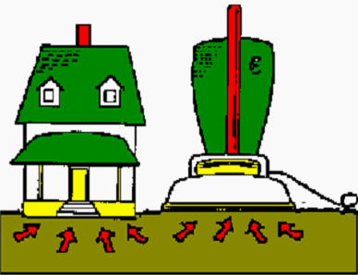
Why It Enters the Home
A home acts like a vacuum drawing gases inside
Driving force is from negative pressure

Slide 7
Radon and Its Health Effects
    Exposure to elevated radon levels increases a person’s risk of developing lung cancer
  No immediate health effects
  Radon causes no symptoms
  The radiation damages lung cells and DNA

Slide 8
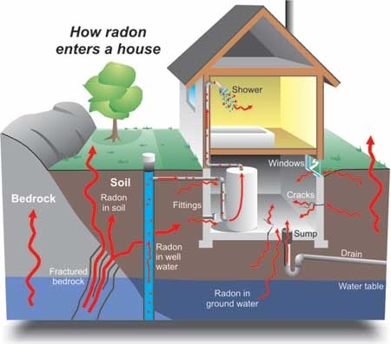
Cracks in solid floors
Construction joints
Cracks in walls
Gaps in suspended floors
Gaps around service pipes
Cavities inside walls
The water supply

Slide 9
EPA Action Level - Air
The EPA recommended action level for radon in air is 4.0 pCi/L
This action level is not a health-based standard
There is no safe level of radon
The EPA recommends that radon levels of > 4 pCi/L be reduced to decrease risk of developing lung cancer.
WHO recommendation: 2.7 pCi/L

Slide 10
Testing Is The Only Way To Know
Notes:
Because radon comes from geology, rock and soil, because geologic formations are not uniform, and because of all of the variables in house construction and occupancy patterns, one home can be high and the one next door low.
Note: it is not practical nor feasible to test the soil before constructing a home to predict what the radon level might be.

Slide 11
Radon Measurement
DPH recommends using a Nationally Certified Measurement Provider to test for radon
For a single building (single or multi-family), DPH recommends testing the lowest occupied space
A short-term testing device is placed for a minimum of 48 hours to 7 days depending on device used

Slide 12

Radon mitigation systems:
effective
relatively inexpensive
easy to install
Average Cost = $1,200

Slide 13
Radon Mitigation
DPH recommends using a Nationally Certified Mitigation Provider to perform radon mitigation
  Must be nationally certified through NRSB or NRPP
  Must be a home improvement contractor registered with CT’s Department of Consumer Protection

Slide 14


Slide 15
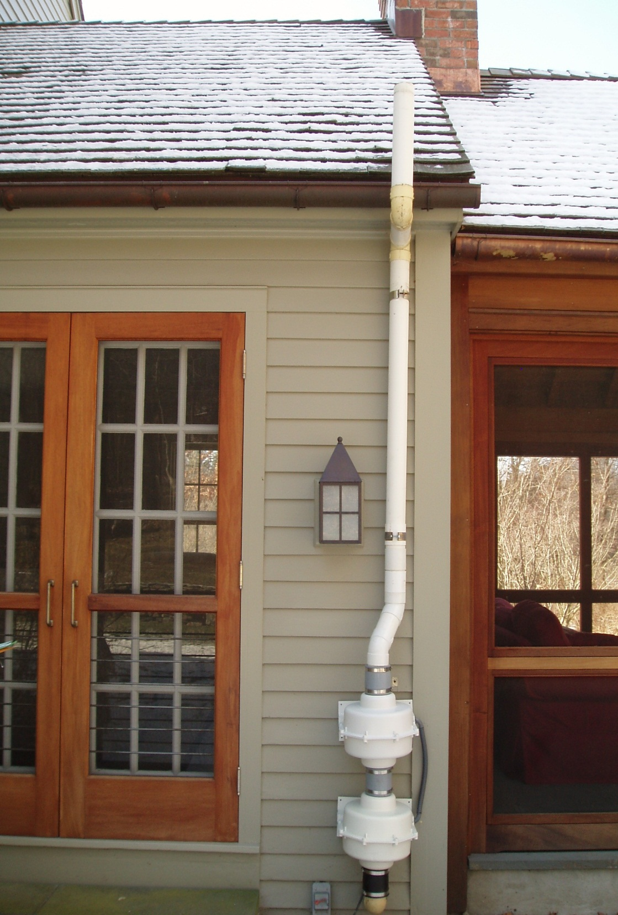

Slide 16
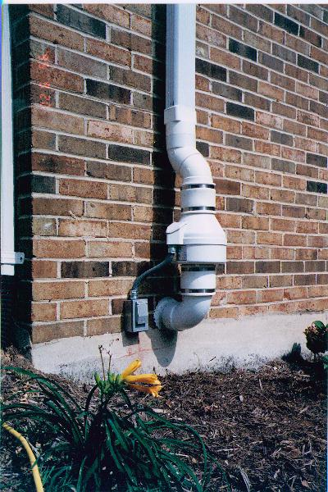
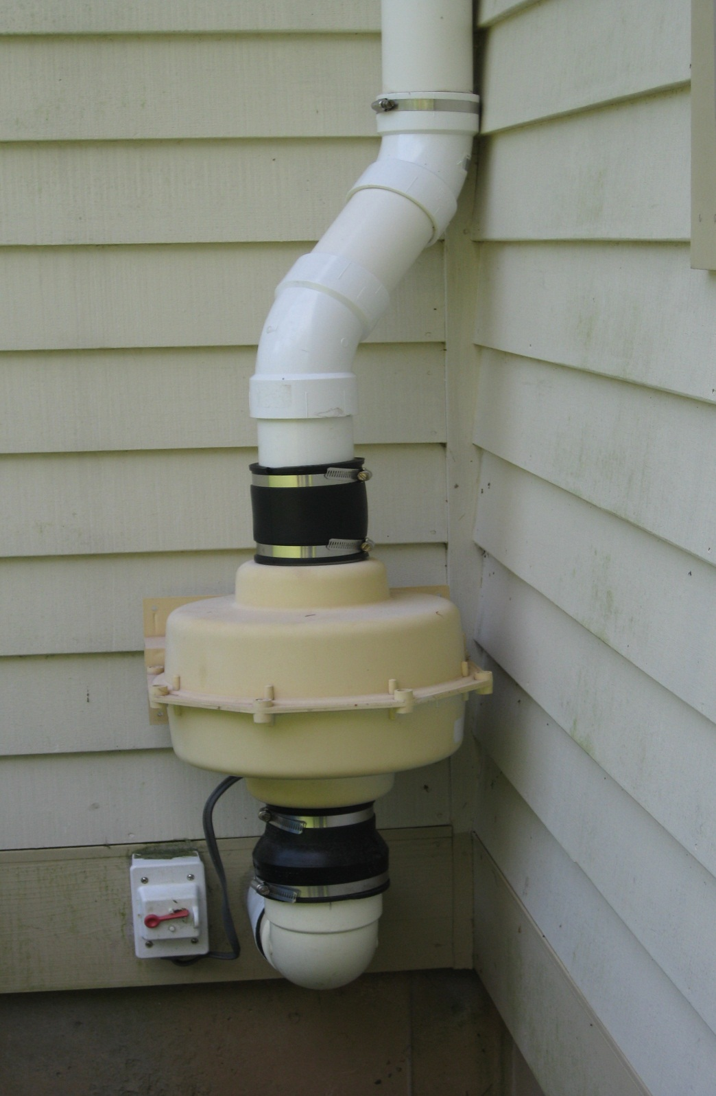

Slide 17


Slide 18
Contact Information:
Allison Sullivan
Supervising Environmental Analyst
State of Connecticut
Department of Public Health
(860) 509-8140
allison.sullivan@ct.gov

