Slide 1

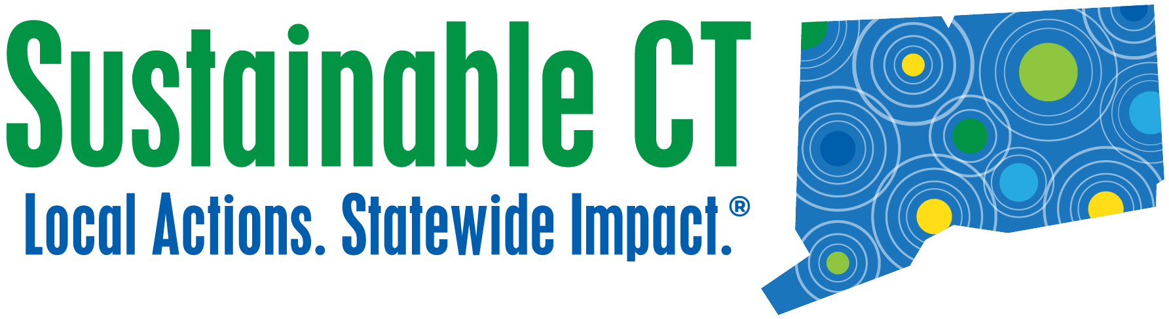
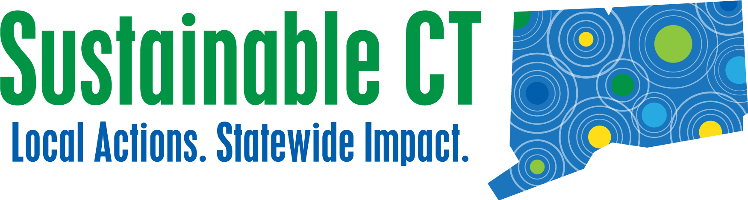
Notes:
Abe Salorio, Community Outreach Manager with Sustainable CT. Here to talk to you about Sustainable CT in general, but primarily our new funding resource, the Community Match Fund.
Before getting into things, how many of you are familiar with our organization? How many of you are here from a registered community? Certified? Bronze? Silver?

Slide 2
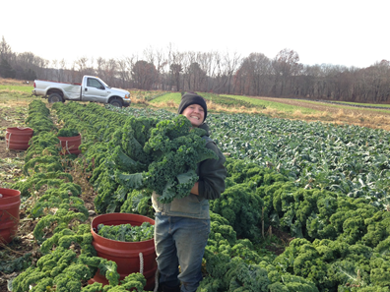
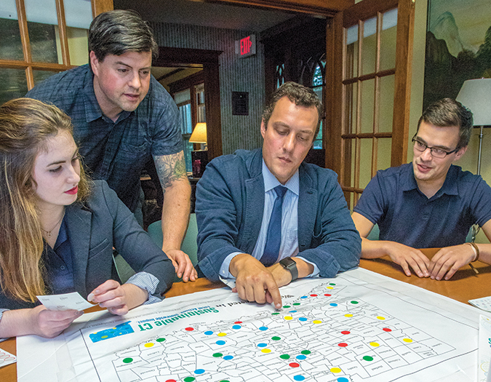
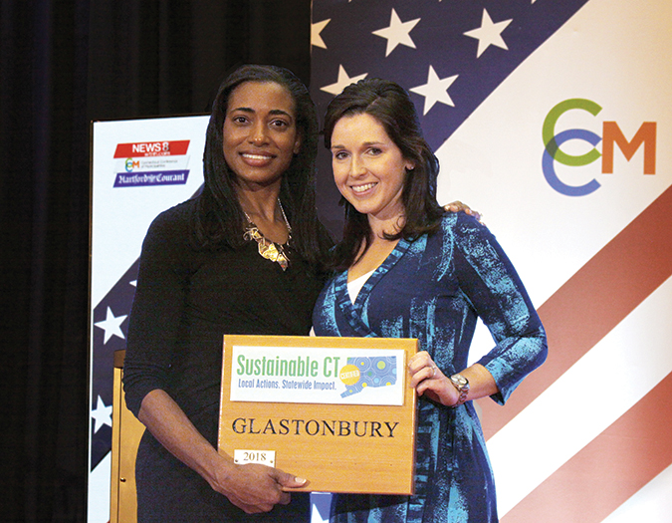
What is Sustainable CT?
Road Map
A menu of coordinated, voluntary actions to promote sustainability
Resources
Free technical support and funding to help communities implement actions
Certification
Recognizing communities for their sustainability achievements

Slide 3
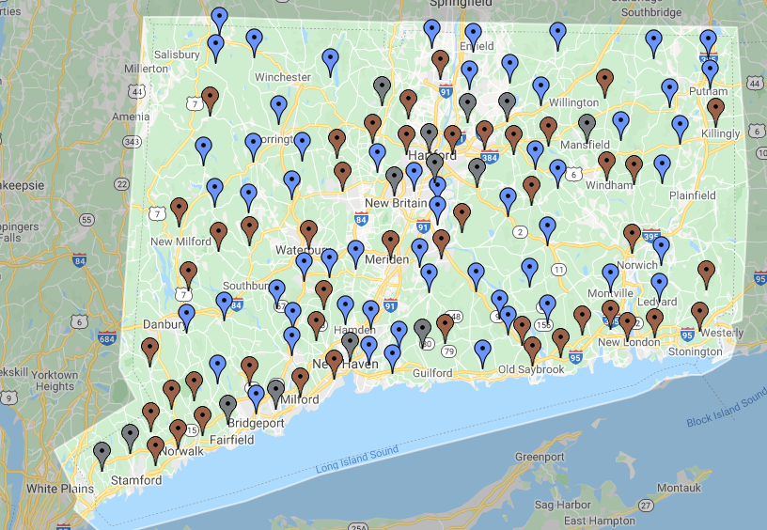
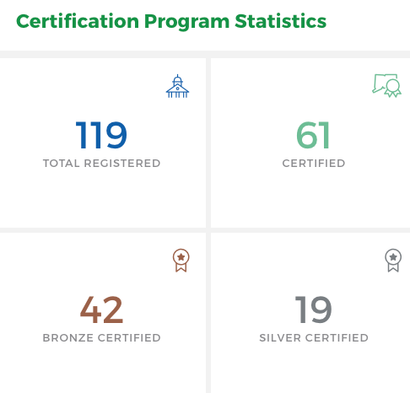
Municipal Engagement
Notes:
BRYAN –
Here’s an overview of municipal engagement. We now have 70% of towns participating in Sustainable CT.
The newest towns registered are: Farmington, Rocky Hill, and Derby

Slide 4
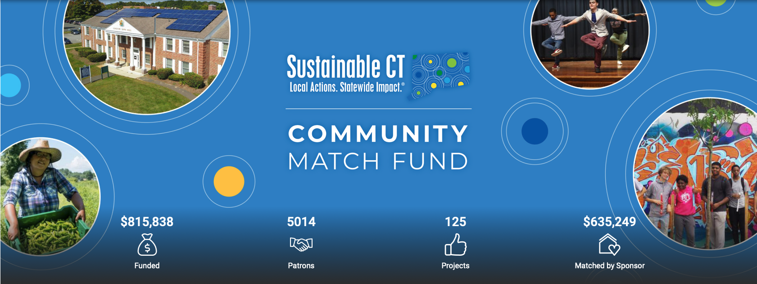
Sustainable CT Community Match Fund
Notes:
Talk about what the $1,000+ donations likely represents (grants, municipal dollars, corporate sponsorships, but also some individual donations based on the names).

Slide 5
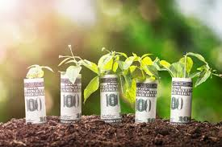

Matching grant program - how it works
  $1-to-$1 matching grant for public, community-led sustainability projects
    Up to $7,500 from Sustainable CT for any project that aligns with our work
    Higher match cap for energy efficiency and renewable energy projects (range has been $7,500 to $25,000)
    Project ideas that align loosely with a Sustainable CT action are eligible
  The match: Crowdfunding
    50% of costs covered by Sustainable CT, with the other 50% raised through online crowdfunding
    SCT grant is a match to many individual/community donations to each project
      Challenge grant: raise half from local community, SCT matches half
    Projects run crowdfunding campaigns with support from our fundraising partner, Patronicity.

Slide 6
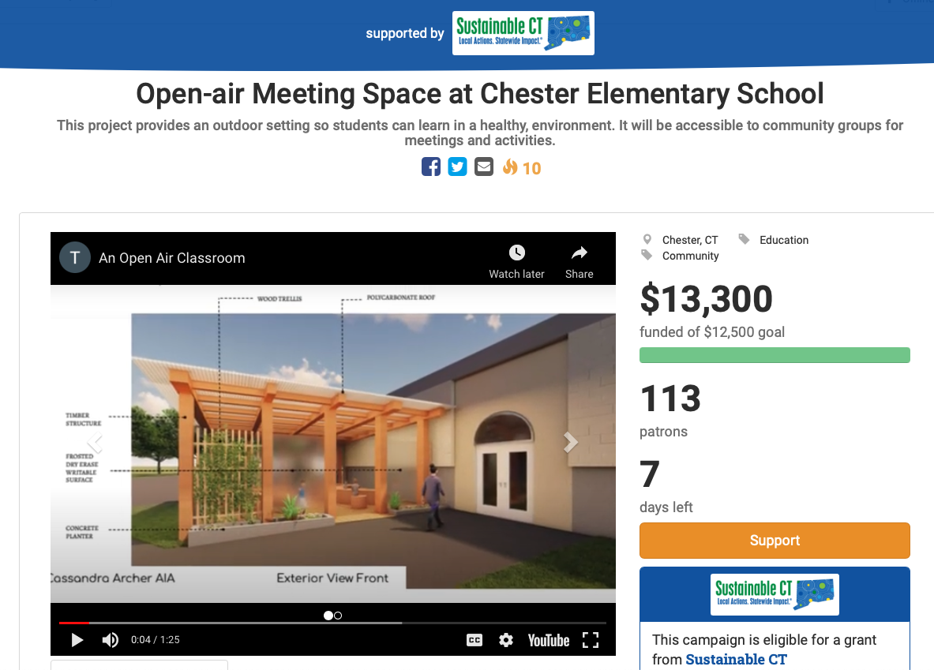
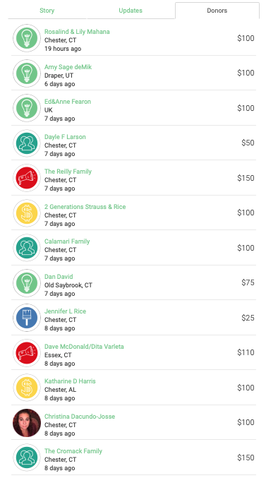
Crowdfunding – what this looks like
  www.patronicity.com/sustainablect
Crowdfunding – what this looks like

Slide 7
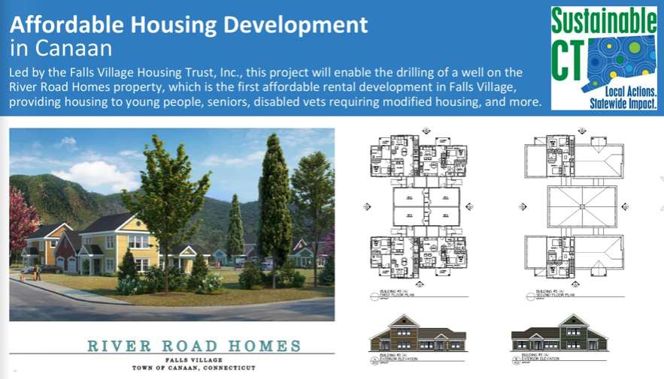

Slide 8

Match Fund Results: September 2019 – April 2021
125 Projects in 63 towns
$1,640,000 invested
  $845,000 from Sustainable CT
  $795,000 from crowdfunding
  5,000+ donors
$13,240 average project budget
  $6,176 SCT match
  Projects raise 121% of fundraising goal
40 donors per project
$50 median donation

Slide 9
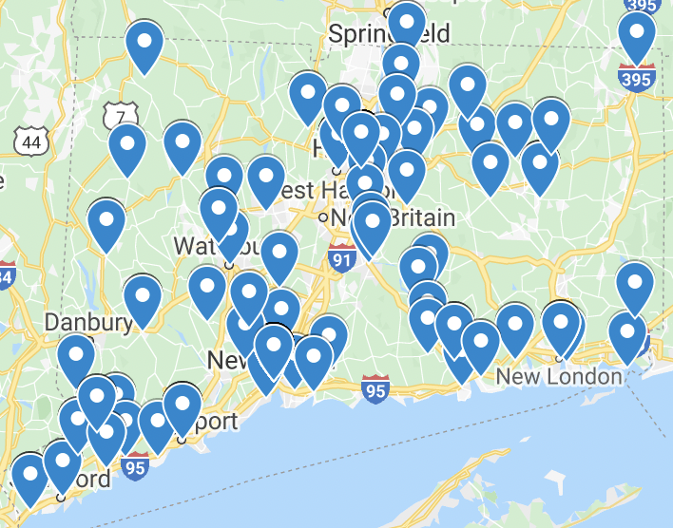
Projects by Town
Projects based in 63 towns:
Bethany, Bloomfield (2), Branford (3), Bridgeport (5), Bristol, Canaan (2), Chaplin (2), Cheshire, Chester (2), Columbia, Coventry, Cromwell, Deep River, East Haddam, East Hartford, East Haven, East Lyme (2), East Windsor, Enfield (2), Essex (4), Fairfield, Glastonbury, Greenwich (4), Groton, Haddam, Hamden, Hartford (25), Litchfield (2), Manchester, Mansfield, Middletown (2), New Canaan (3), New Haven (20), New London (4), New Milford (3), Newtown (3), North Branford, North Stonington, Norwalk (4), Old Lyme (2), Old Saybrook (2), Oxford, Portland (2), Ridgefield, Rocky Hill, Simsbury (2), South Windsor, Stamford (3), Stonington, Thomaston, Tolland, Vernon Warren, Waterbury West Hartford (7), West Haven, Weston (2), Westport, Wethersfield, Wilton (3), Windham (2), Woodbridge
Notes:
Mention the towns that have joined solely because of or at least partly because of outreach by or incentives through the CMF. “We also expect to see towns receiving certification points for CMF projects in April certification and then ongoing moving forward”.

Slide 10
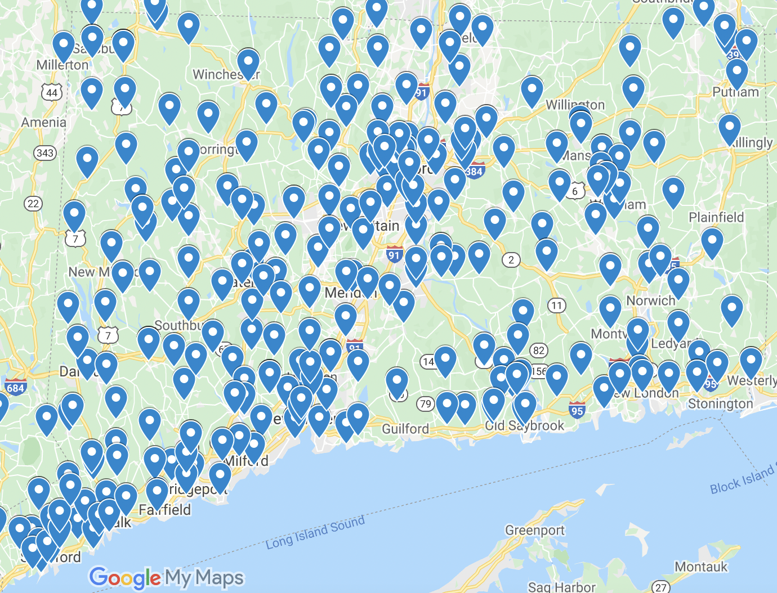
CT Donations
Notes:
Talk about what the $1,000+ donations likely represents (grants, municipal dollars, corporate sponsorships, but also some individual donations based on the names).

Slide 11
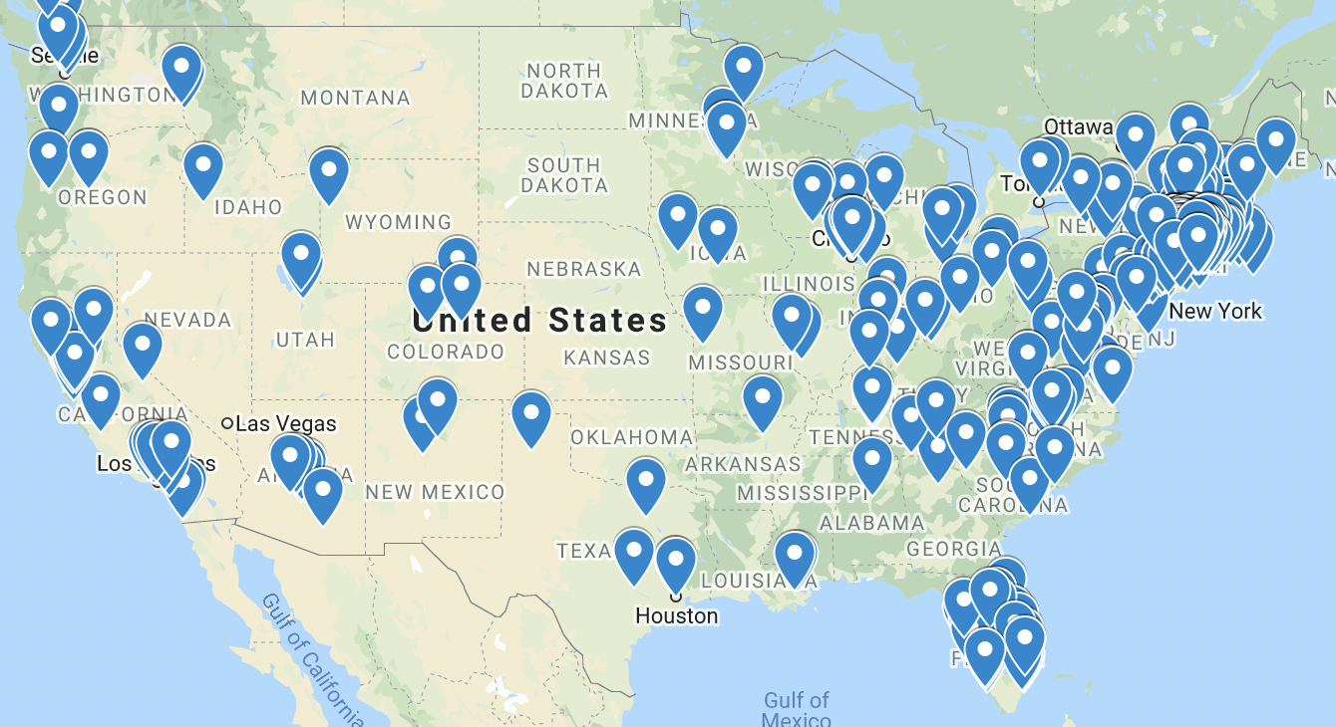
Nationwide Donations

Slide 12

General project eligibility
Project is located in a Sustainable CT registered city/town
Aligns broadly with Sustainable CT actions
Has a public benefit and is inclusive of your community
Receives at least 20 donations to your crowdfunding campaign
What we fund:
Land & waterbody conservation
Improving walkability
Energy efficiency & renewables
Food waste diversion
Community gardens
Green infrastructure
Environmental justice
Creating green spaces
Composting
Farmers Markets
Improved public transportation
Environmental & climate programs/education
Activating public spaces
Arts & culture
Healthy & Sustainable food networks

Slide 13
Who can participate?
ANYONE (no fiscal sponsor needed)
Community Match Fund projects can be led by anyone in a registered municipality
  Municipal staff and officials
  Housing authorities
  Schools
  Town committees
  Nonprofits & community groups
  Individual residents

Slide 14
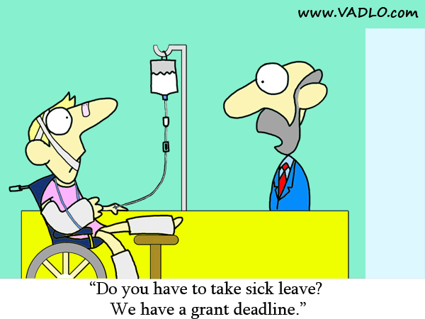
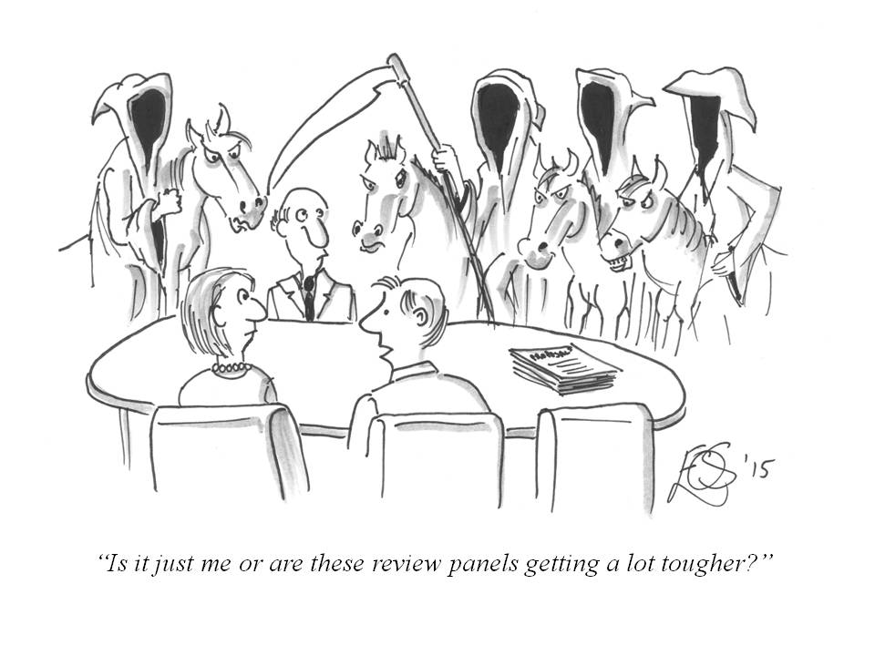
This is NOT a standard grant program

Slide 15

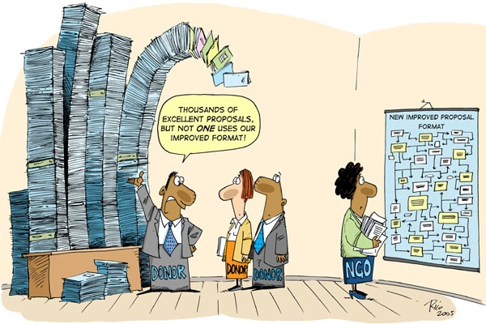

Fast, flexible, easy funding
No application deadlines
No formal proposal
No lengthy review process
No staggered funds disbursement
No time consuming & tedious grant reporting

Slide 16
How to apply:
Contact Abe to discuss what you have planned – 860-249-6680 or hildingsalorioa@easternct.edu.
There are no deadlines or funding cycles → projects can be proposed at any time and can receive funding as long as Sustainable CT still has money in the match pool.
Eligible projects that are ready to go (have the capacity to begin the work, have/don’t need permits, etc.) can get started on their fundraising campaigns immediately.

Slide 17
Questions?
Interested in talking about a project? Get in touch!
Email: hildingsalorioa@easternct.edu
Phone: 860-249-6680
To see current projects and learn more:
www.sustainablect.org/funding
www.patronicity.com/sustainablect

