Slide 1
Engaging as Partners to Achieve
Energy Savings
Enoch Lenge, Eversource
Supervisor, Energy Efficiency

Slide 2



#1 ENERGY PROVIDER IN THE NATION
3 states
4.3MM customers
$750 MM in Annual EE Investment
EE Team: 190 employees
NH
MA
#1 Ranking
CT

Slide 3

Connecticut: The Energy Efficiency Fund
OBJECTIVES
Advance the efficient use of energy
Reduce air pollution and negative environmental impacts
Promote economic development and energy security
$2.40 in electric system benefits for every $1 invested in energy efficiency
1998
Expanded to include natural gas programs
Created by legislature to provide cost-effective electric energy efficiency and load management programs
2005
Notes:
2005 - Expanded to include natural gas programs (electric and gas programs are fully integrated)

Slide 4


Multifamily Energy Efficiency Benefits
$
Reduced Property Operating Costs
Unit Owner/Tenant Comfort
Improved Quality

Slide 5
Components of an Overall:
General Energy Efficiency Strategy
Energy Efficiency
Building & Systems Commissioning
Renewable Energy

Slide 6
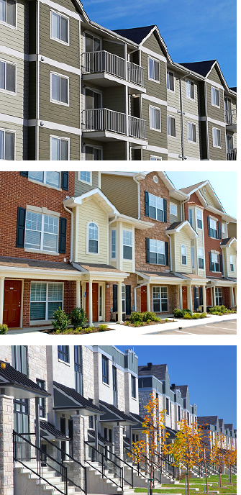
Multifamily Initiative
Upgrades to existing multifamily properties
Comprehensive, open-market approach
Apartments, condominiums, townhouses, buildings or complexes
5 or more units
Financial and technical assistance offerings
Past participating properties and multi-year projects
Income-eligible & market rate properties
  Income-eligible does not have to be subsidized
  2/3 of tenants at of below 60% SMI

Slide 7
Multifamily Measure Components
Direct Install Dwelling Unit Measures
Other Measures
Lighting Fixtures
Examples of Custom Measures
Air Sealing
Low-flow Faucet Aerators & Showerheads
LED Light Bulbs
Insulation
HVAC
Water Heaters
Windows
Appliances
Controls
Central HVAC Pipe Insulation
Central Mechanical Ventilation (retro commissioning or duct sealing)
Advanced Lighting Controls (data logging)
Steam Trap Studies
Domestic Water Booster Pumps
Duct Sealing
Chillers
Refrigerator Evaporator Fan Controls

Slide 8
Efficiency Strategy: Envelope
Tightening & Insulation
Control heat & air flow by reducing heat loss and drafts through walls, ceilings and floors
Air Sealing
Insulation
Triple-Pane Windows

Slide 9
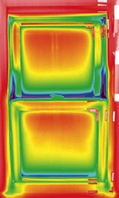
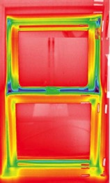
Emerging Technology:
Tripe Pane Windows
Designed offering for multifamily properties:
  Replacement projects
  Triple pane windows/sliding glass doors
  Must be U-Value of 0.20 or better
  Financial Incentive: more than covers 100% of cost difference
  Over 130 windows projects completed since 2015
  Over 30,000 triple pane windows installed since 2015

Slide 10
Efficiency Strategy:
High Efficiency Equipment
High Efficiency Equipment & Installation
LED Lighting
High Efficiency HVAC
High Efficiency DHW
ENERGY STAR Appliances
ECM Pumps & Fans
Controls – i.e. Wi-Fi thermostats

Slide 11
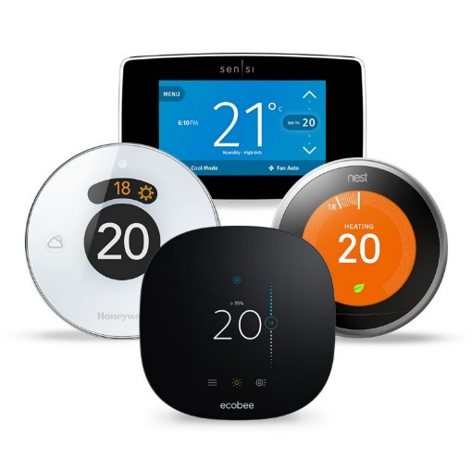
Emerging Technology: Wi-Fi/Smart Thermostats
Convenience
  Learns your temperature preference and automatically adjusts
Control
  Control of home’s heating and cooling remotely through your smartphone
Insight
  Equipment use and temperature data you can track and manage
Value
  Rental value through low-cost, highly visible “connected” thermostat that many renters are looking for

Slide 12
Two Paths for Participation
Standard Path Energy Efficiency Project
  Targeted energy efficiency upgrade project to an existing property
  New Construction – ground up construction or gut rehabs
CHFA/DOH Competitive Funding (SSHP, CHAMP, etc.)
  Renovation projects (energy and non-energy related upgrades)
  New Construction – ground up construction or gut rehabs
  Receive Letter of Participation from utilities to submit with application for round of funding
  LOP process rolled out in 2016

Slide 13
Funding Process for CHFA/DOH Participation Letter
Project Initiation
Project Team Initiation & Kick-Off Meeting
*Proposal Review & Initial Submittal to Utility
Utility Review
Initial Review of Submittal
Letter of Participation (LOP) issued
Construction & Incentive Commitment
CHFA/DOH Funding Secured & Construction Started
Incentive Commitment from Utility Letter of Agreement (LOA)
Project Completion
Construction Complete & Utility Post Inspection
Incentive Payments Issued by Utility
*Proposal submittal must includes:
Scope of work
Multifamily Initiative Application
Project Fill Out Form
Notes:
This is essentially the same process for New Construction & MF Existing Buildings
Project Initiation – This could be the HERS rater or in the case of WBP the energy modeler
Proposal for RNC – Must include 40% drawings and must have have RNC initial application information for LOP preparation
Proposal for MF Existing Buildings
Scope of work
Multifamily Initiative Application
Project Fill Out Form

Slide 14
Project Incentive Structure
Standard One End-Use
Project
Comprehensive Multi-End Use Project
Up to 75% of project cost
Up to 90% of project cost
Up to 50% of project cost
Up to 75% of project cost
Income Eligible
Market Rate
Note: Up to 100% of project cost paid for Direct Install Dwelling Unit Measures

Slide 15
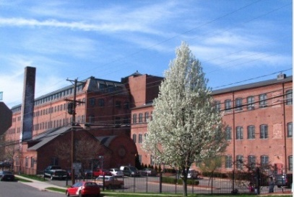
Case Study
Charles Street Apartments
Location: Meriden, CT
Stories: 3
# of Dwelling Units: 80
Meter Configuration: Individually Metered Electric & Natural Gas
Measures | Installed Cost | Incentive | Annual kWh Savings | Annual CCF Savings
Weatherization (Air Sealing, Duct Sealing LED Bulbs & DHW Savings) | $29,252.49 | $29,252.49 | 10,170 | 3,789
Dwelling Unit Lighting Fixtures | $62,843.95 | $12,199.24 | 12,468
Exterior & Common Area Lighting | $34,327.10 | $27,461.68 | 102,717
Apt. Furnace ECM Fan Motors | $30,000.00 | $20,000.00 | 30,800
Apt. AC Systems | $186,800.00 | $53,153.25 | 21,106
Common Area AC Systems | $14,800.00 | $6,962.25 | 2,764
Common Area Furnace ECM Fan Motors | $1,000.00 | $1,000.00 | 1,540
Heating System - Apt Gas Furnaces | $380,000.00 | $56,241.14 |  | 6,521
Common Area Furnaces | $26,802.00 | $12,317.94 |  | 1,808
Project Information
# Measures | Install Cost | Incentive | Comp Bonus | Total Incentive | % of Cost Covered
9 | $765,825 | $218,587 | $124,751 | $343,338 | 45%

Slide 16
Questions?
Multifamily Initiative
multifamily@Eversource.com
enoch.lenge@eversource.com

