Slide 1
2021 CDBG Application Workshop
Partnering with Green Bank: Green Initiative
March 2021

Slide 2
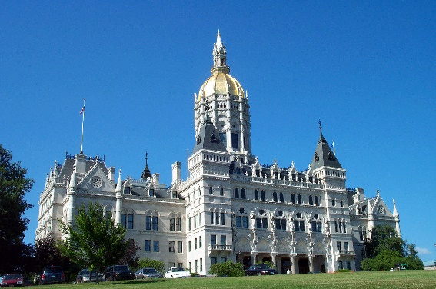
Connecticut Green Bank
Mission Statement and Goals
Confront climate change and provide all of society a healthier and more prosperous future by increasing and accelerating the flow of private capital into markets that energize the green economy.
Leverage limited public resources to scale-up and mobilize private capital investment in the green economy of Connecticut.
Strengthen Connecticut’s communities by making the benefits of the green economy inclusive and accessible to all individuals, families, and businesses.
Pursue investment strategies that advance market transformation in green investing while supporting the organization’s pursuit of financial sustainability.
2
2
Notes:
The CT Green Bank is a quasi-public entity, like CHFA, established by the CT legislature in 2011. The purpose of the organization is to support the state of CT in scaling the implementation of clean energy through financing programs and by using limited public funds to leverage private capital.
CGB also has a big focus on ensuring low- and moderate-income residents benefit from our programs.
We are primarily funded by a small surcharge on electric ratepayer bills.

Slide 3
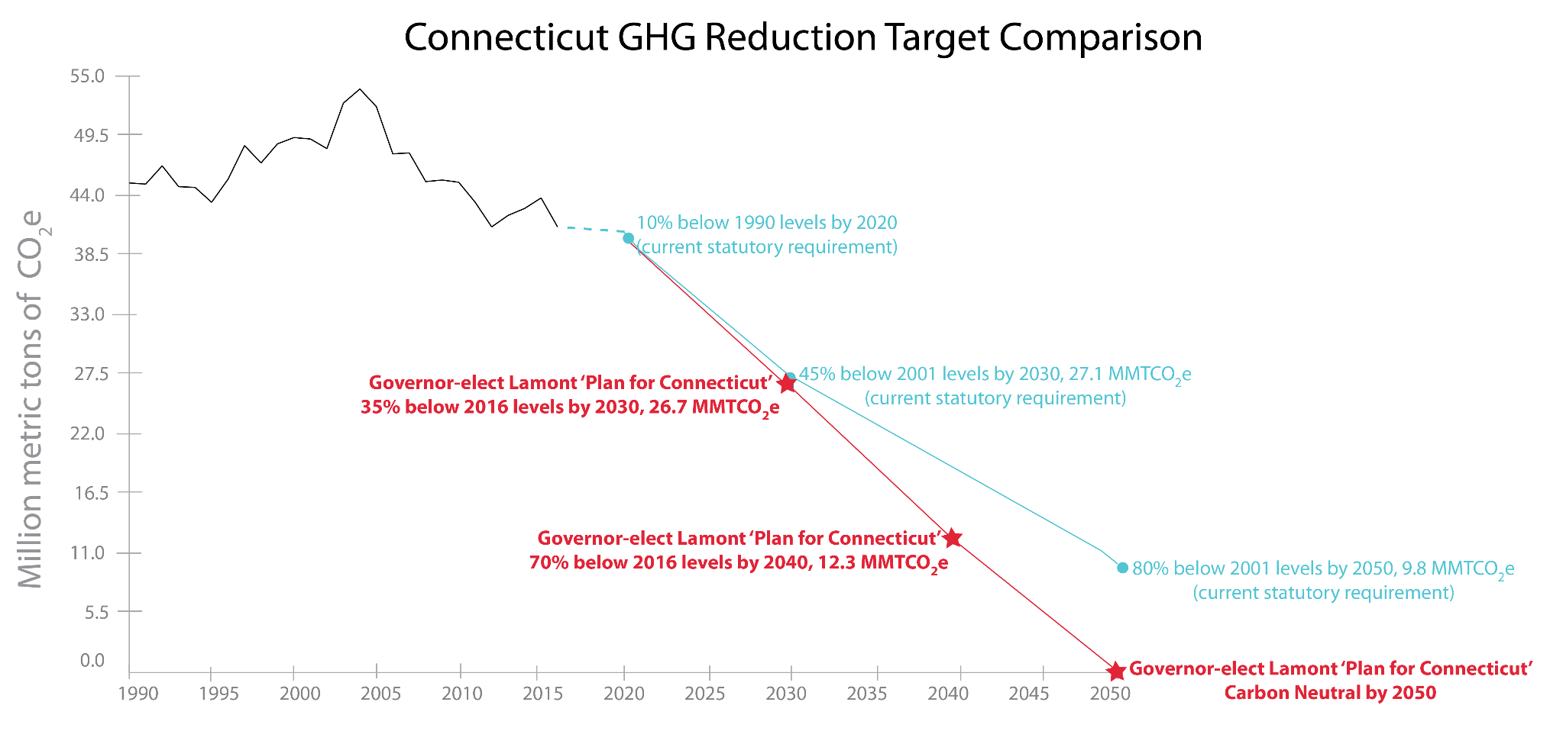
Gubernatorial Leadership
Confront Climate Change in Connecticut
R
R
M
L
R
L
“These targets are tougher than required under the Paris Agreement, but are achievable, measurable goals that will guide our state’s energy and environmental policy.”
3
3
Notes:
The good news is the state is on target to meet state 2020 carbon reduction goals (90% of 1990 levels). The next set of goals are going to be harder to achieve and they need to be.
Governor Lamont has signed his first executive order last September. It includes calling for a carbon free electric market by 2040. He charged the newly expanded Governor’s Council on Climate Change with meeting and monitoring this goal. His ambitious goals may require more stringent goals than those outlined in the current mandates adopted by the legislature. These goals were determined to be less costly and far healthier than the alternative of adapting to current GHG emission levels.
State targets include reducing electric demand and moving to zero-carbon energy generation. An overall 45% reduction in GHG emissions by 2030 from 2014 levels is required. This will be accomplished in part by putting a price on carbon.
The residential building sector is 17.5% of all emissions. The current target for the building sector is to reduce emissions by at least 34% from 2014 levels. Strategies identified are envelope improvements, moving to non carbon sources for heating & cooling, and education.
The Governor’s Council on Climate Change is currently working on developing specific strategies and mandates for achieving these targets. All of you on this call will be probably be engaged in developing specific solutions over the next few months. For example, a simple formula might be to reduce emissions of buildings built before 2014 by 34% and all buildings built after 2014 to net zero by 2030. Part of planning should include the consideration that a carbon tax or Carbon Cap and Trade System could substantially increase cost of utilities in the future. DOH and the Green Bank will be required to report on alignment with climate adaptation by December of 2021.
CHFA and DOH have always been national leaders in promoting green building through design standards, the QAP ranking, and client education. The Green Bank looks to continue to be a partner in achieving our mutual goals for affordability and survivability.

Slide 4
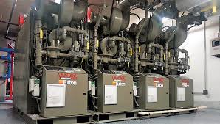
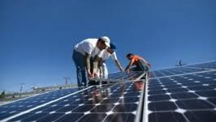

Applications of Clean Energy
Heating and cooling systems
Hot water systems
Building envelope
Lighting and appliances
Water efficiency
Renewable energy systems (solar PV,
solar thermal and others)
Conversion from oil or electric to gas
Qualified health and safety measures
Notes:
Clean energy technologies include energy efficiency measures and renewable energy. Energy efficiency reduces energy usage. Renewable technologies produce energy from clean and renewable sources, like the sun or wind, thus reducing carbon dioxide and other greenhouse gasses which cause global warming and climate change. This slide lists applications of EE and RE funded by CGB.

Slide 5
LIME Loan
Health & Safety Loan
Solar Solutions
Pre-Development Loan

Slide 6

Term Loan Program
Loans Improving Multifamily Efficiency
Loans Improving
Multifamily
Efficiency (LIME)
Type
Rate
Term
Criteria
All MFH
6.00 - 6.99%
5-20 years
EE: 1.3x ESCR
RE: 1.1x ESCR
Eligible costs:
    Implementation of energy efficiency and renewable energy improvements
    Up to 25% of loan proceeds may be used for non-energy efficiency improvements (structural, health/safety, etc.)
Possible Uses:
Mid-cycle properties - to help fund improvements if unable to take on mortgage debt
Fund gap between utility incentives and project costs; can often fund additional capital improvements.
Notes:
For properties serving LMI and market rate residents
"LIME loans can be structured to take the proposed energy upgrades into account as an independently financed project, or if a second mortgage is available, the property can be considered holistically for underwriting purposes. This second option allows for the potential to more easily serve properties with tenant-paid utilities."
Security:
UCC-1 filing and applicable collateral assignment

Slide 7

LIME Loan
Unlocking Cash Flows to Stabilize Property
East Meadow Condo Association, Manchester, CT
Description: | Lighting, boilers, roof replacement, insulation
Total Project Costs: Utility Incentives: Financed: | $654,000 $34,000 $620,000
Est Annual Savings: Annual Debt Service: | $79,000 $53,000, 1.48 DSCR
Est Free Cash Flow: | $26,000
Financing Terms: | 20 years, 6.00%
Payback Period: | 7.8 years
www.ctgreenbank.com/our-stories/#multifamily
Energy improvements can yield significant savings, unlocking cashflows that cover debt service and may fund other improvements.
Notes:
60% AMI, 82 units ($26K/82 = $317/unit/year)
Energy savings unlocked the cash flows to allow a loan that also included the roof to be replaced – it had been leaking persistently.
Overall improvements bumped them into a better insurance category, further saving property money and strengthening overall financial positions.
And this is an example where the utility incentives weren’t all that big – for many of the projects we are seeing, the incentives are much higher, so that is making the economics even better.

Slide 8

Health & Safety Loan Program
H&S Revolving Loan Fund
Type
Rate
Amt & Term
Loan Process
Term loan (LMI Properties only)
2.99%
$10K to $300K, up to 20 years
On-line application
Eligible costs (examples):
  Measures to contain, address, remove, or remediate mold, sources of mold, asbestos, lead paint, or other hazards.
  Amelioration or replacement of leaking pipes, failed roofs, defective combustion equipment, carbon monoxide sources, radon gas, knob and tube wiring, etc.
  Costs of relevant health and safety audits and assessments, and necessary professional services.
Type
Rate
Loan Process
Pre-development
Affordable properties 1.99%;
Market-rate properties 3.99%
Client pays 25%; program loans 75%
Funds technical assistance by New Ecology, Inc.
Funding to remove health and safety barriers that must be taken care of in order to implement energy improvements.
Notes:
Use of Health & Safety Loan Fund
Removing asbestos to allow mechanical design and pricing
Insufficient DOH funding
….
….

Slide 9

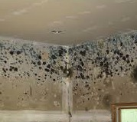
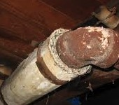
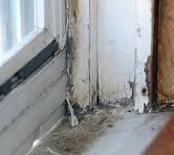
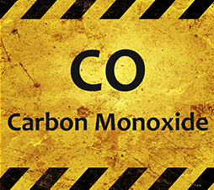

Health & Safety Measures Funded
Knob & Tube Wiring | Mold/ Water Leaks | Asbestos
Lead Paint | CO Off-Gassing | Radon
Funding to remove health and safety barriers that must be taken care of in order to implement energy improvements.

Slide 10
Pre-Development Loan
Navigator Loan Program
Type
Rate
Loan Process
Pre-development
Affordable properties 1.99%
Market-rate properties 3.99%
Client pays 25%; program loans 75%
Eligible costs:
Energy benchmarking, opportunity assessments, audits
Design, engineering and bidding work
Green charrettes and green physical needs assessments
Energy-related health and safety assessments
Costs to secure energy upgrade project financing
Type
Rate
Loan Process
Pre-development
Affordable properties 1.99%;
Market-rate properties 3.99%
Client pays 25%; program loans 75%
Funds technical assistance by New Ecology, Inc.
Covers costs to design, scope and price energy improvements.
Notes:
Existing buildings; new construction in some limited cases

Slide 11

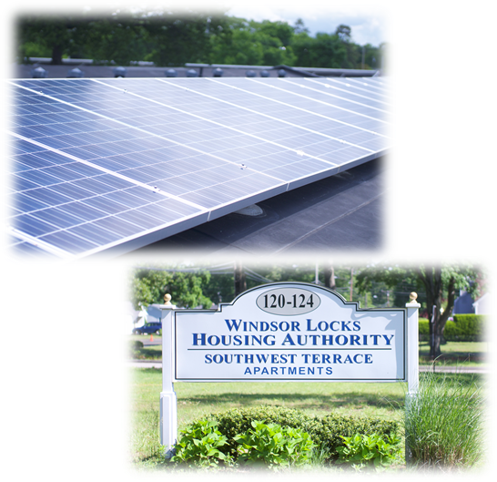
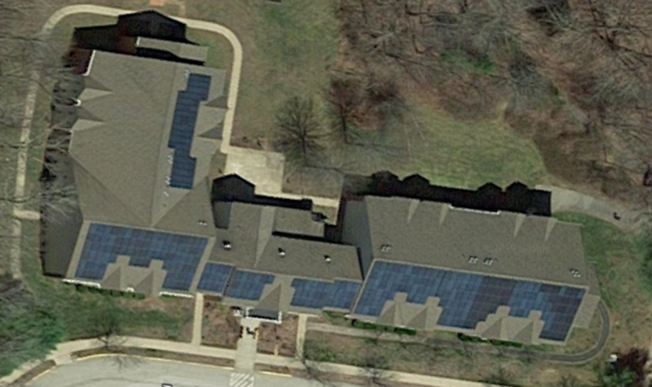
Solar Solutions
Criteria
Solar PPA
Must achieve electricity savings
Solar power purchase agreements provide a way for HA’s and non-profits, that can’t take advantage of solar tax incentives, to go solar.
Notes:
Images of Windsor Locks and Ashford HA’s shown here.
This program is based on net metering and incentives called solar recs and is winding down. The state is moving to a tariff-based incentive structure. The Green Bank is working on a new program structure that will work with tariffs. (We may simply pay you to lease your roof and allow us to generate solar power on it – more to come on this front.)

Slide 12

Thank You
Kim Stevenson
Director, Strategic Initiatives
Inclusive Prosperity Capital, o.b.o. Connecticut Green Bank
Kim.Stevenson@ctgreenbank.com
ctgreenbank.com/multifamily
multifamily@ctgreenbank.com

