Slide 1


Slide 2
Small Cities CDBG 2021
Virtual Application Workshop
Completing the e-Form
Notes:
We promised 2019 that we will deliver a paperless/web-based application to ring in the new year/new decade 2020…..Well Guess what? Here we are in 2021 and the web-based version is still not available, but we have this fantastic one we will continue to use until further notice.

Slide 3

Intent to Apply Form- Friday April 23, 2021
Application Handbook
Application Exhibits
Application Exhibit Checklist
Rating & Ranking
Documents requiring wet signatures
Application e-Form
Notes:
What are you going to need to get your application done this year?
For Intent to Apply:
Indicate name and email of person responsible for submitting your grant.
All documents requiring wet signatures must be held and available upon request in your Application folder within your respective municipality.

Slide 4
Application
General Information Page
Make sure to complete this section accurately
Notes:
Again this year, if you don’t complete this section accurately, your score will be negatively impacted.

Slide 5

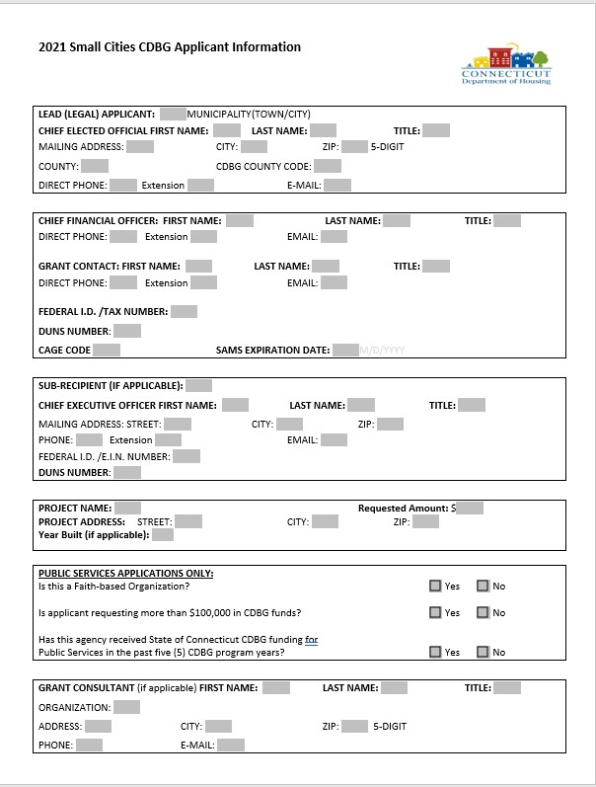
Notes:
So take the time to give us the real skinny…so e.g. if on this form you indicate your first selectman as Tom X, and you provide Kathy Y’s email and phone number or the Town’s general answer line…and we at DOH in order to review your application, must conduct detective work (i.e. speak with several different personnel in your offices before getting to the elected official), your application will be negatively scored appropriately so;
I believe it’s up to (-5).
We won’t hunt you down to get you the money you need.
Federal ID #
CAGE#/Cage Code (5 digit number the government assigns once you have been awarded a contract. if you get stuck not knowing the term or the question, you will have more help this year. There will be
hints provided by mousing over the word and an explanation should pop up. If not check the application handbook.

Slide 6
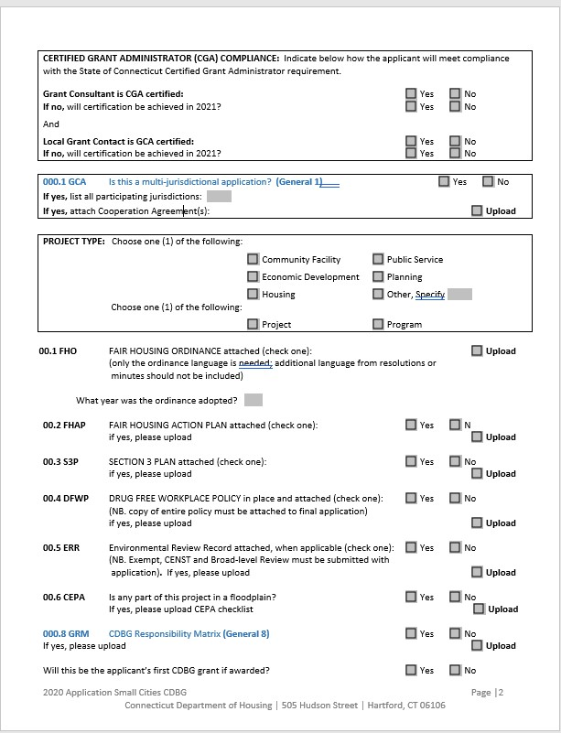
Notes:
Project Name
Give the address…we know not to leave sensitive information lying around or to redact addresses for a Domestic Violence shelter in the event of a FOIA. If you refuse to include this information, you will see a point deduction.
Indicate if your Consultant/Grant Administrator is CGA certified
Indicate if the local grant contact is CGA certified…
Listen up folks
If you are in this room today and not CGA certified, you must get certified by October 2021. The State will offer another opportunity this year for certification in Oct 2021.
If you have a current 2018, 2019, or 2020 grant and there is no CGA on staff/or not working with a Grant Administrator, your grant will be terminated for non-compliance.
Say goodbye to the days where municipalities state, “we are just the pass-through organization, we’re doing a favor for the HA”
CGA is a threshold item. If we don’t understand what you are doing when we do the initial review, your application will not be scored.

Slide 7
Citizen Participation
Fill in the table- answer the questions
Upload items..make certain the minutes contain information about PI use/reuse (if applicable). Get the admin staff or a super detail- oriented person to accurately capture the discussions at the public hearing.
If the meeting minutes don’t share specific points, you will not be scored. Minutes must be approved and certified.
We need to determine whether or not you completed the CIT PAT accurately.
Notes:
We will check the public notice used. Do not use shortened versions
We will check the dates of notices, times hearings held,
We will read through the minutes…looking for the PI (if applicable) be sure to highlight that section.

Slide 8
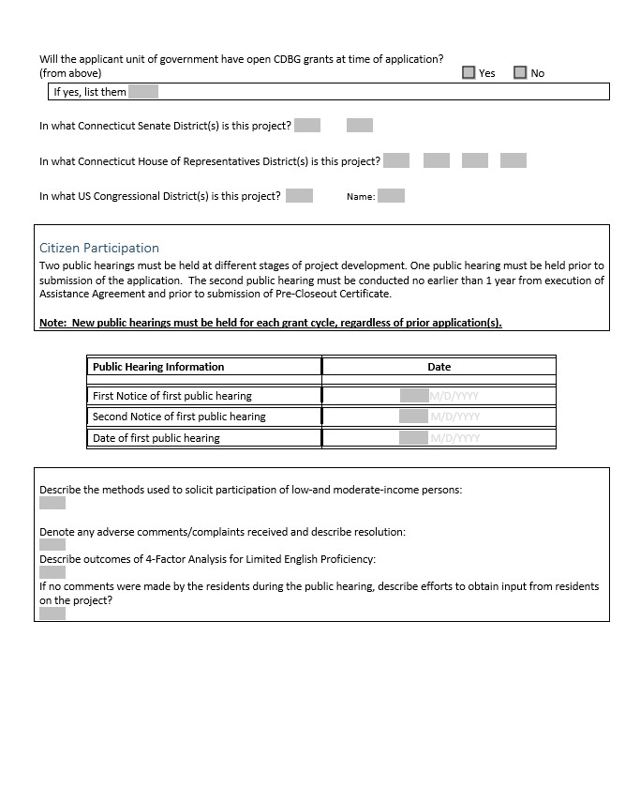

Slide 9
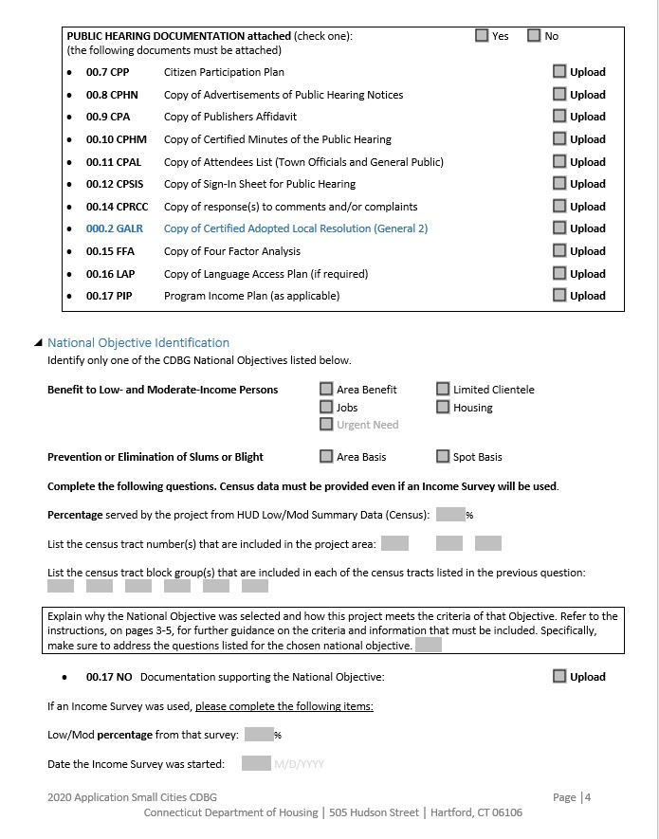

Slide 10
…Next National Objective
Jobs Housing
Urgent Need
Urgent Need
Select/check the appropriate box
Benefit Low/Mod
(Limited Clientele, Area Benefit, Housing)
Include census tract numbers if applicable
Notes:
Benefit Low Mod-
Is it Housing?
Limited Clientele
Area Benefit
Check one

Slide 11
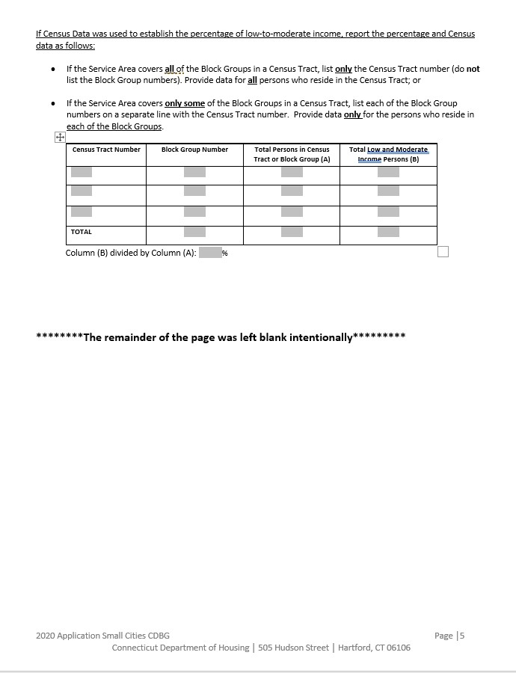

Slide 12

Complete Beneficiary info
#of Asians, # American/Native Indians, #Africans, #Hispanic, #Whites
#Handicapped, #Elderly People, #Female-headed Households etc.
Notes:
Pretty straight forward. Who will you be serving?

Slide 13
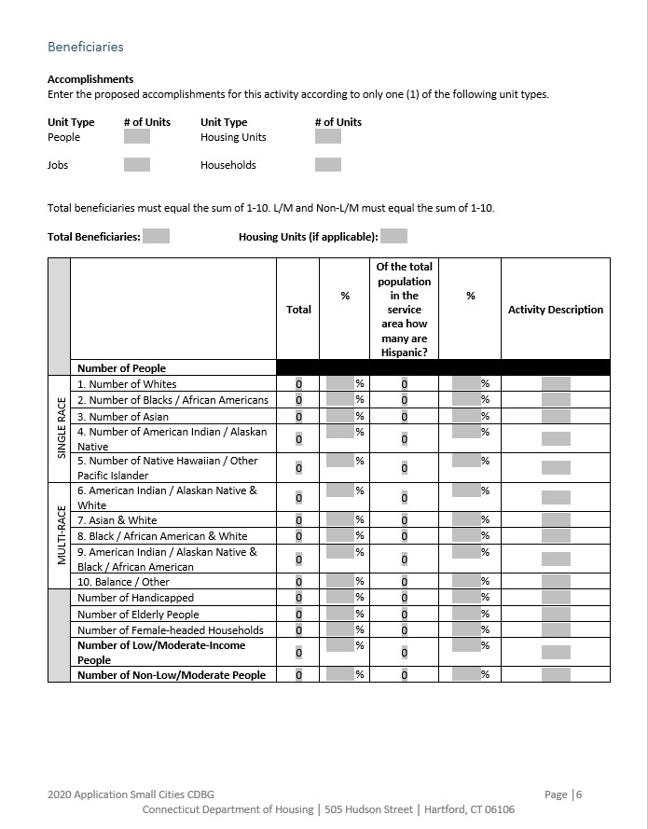

Slide 14

Sections 1.1
  A detailed description of actual physical activities or services that would be undertaken; purpose of your project?
2. Is the project being completed in phases? If so, why?
3. What is the nature of the project?
4. Whom is it designed to benefit?
5. What is the impact of the problem on Low/ Mod income persons?
Project Description.
Describe the proposed project/program.
Limit to 1000 words.
Notes:
What do I do? How do I fill 1000 words DOH will deem important and necessary…..what do you do? Reach for the handbook

Slide 15
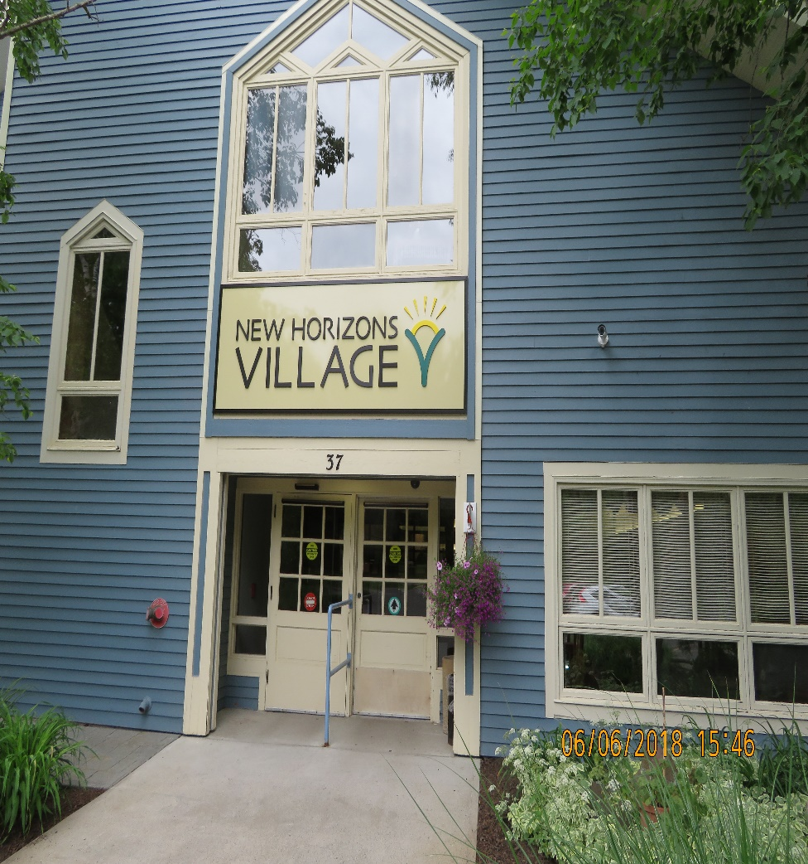
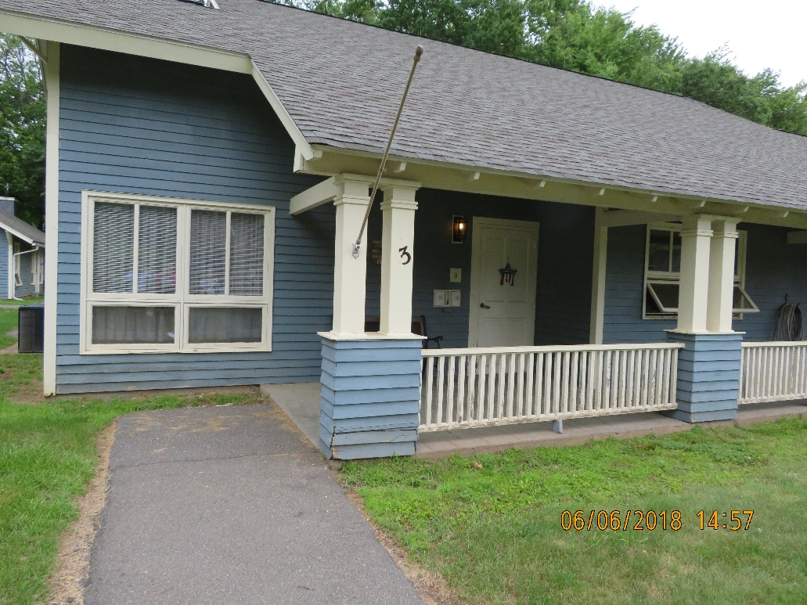
Section 2.1
Project Need
Notes:
Describe the need for the proposed project/program. Limit to 500 words.
Reach for the Handbook for the description on how to complete the 500 word narrative. Basically you need to show and tell us your story with not just words but utilize very descriptive photos.
When you're thinking/designing your project, think end goal. What do you folks want to achieve? Is it energy efficiency? Do you want to utilize green energy? Do you want the materials used on this project to be used responsibly? How best can we reduce the carbon footprint? Utilizing alternative energy sources? What do our residents need to help them age in place?

Slide 16
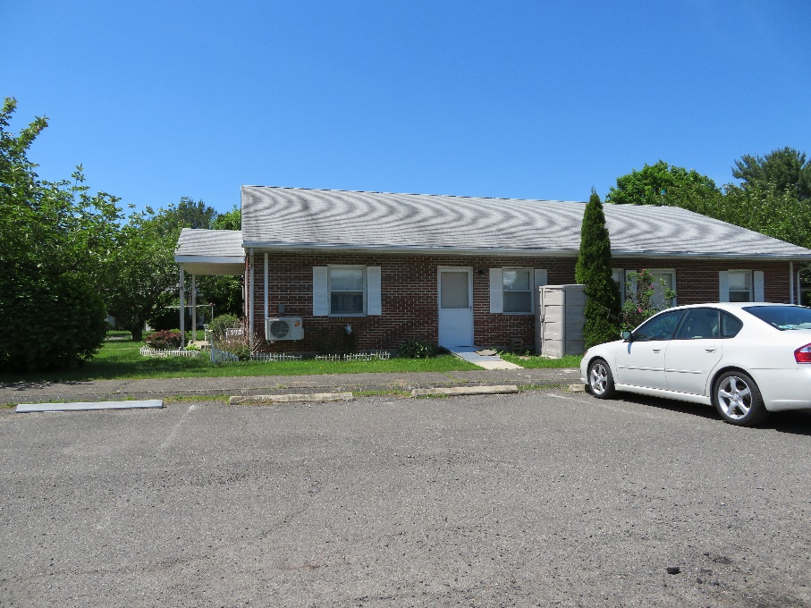
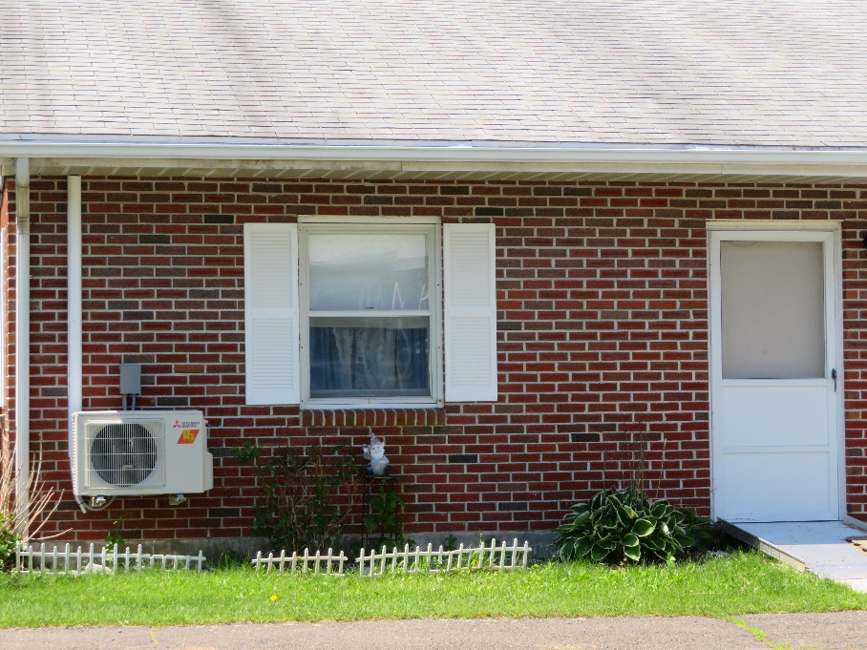
Campus Roofing, windows, entry doors

Slide 17
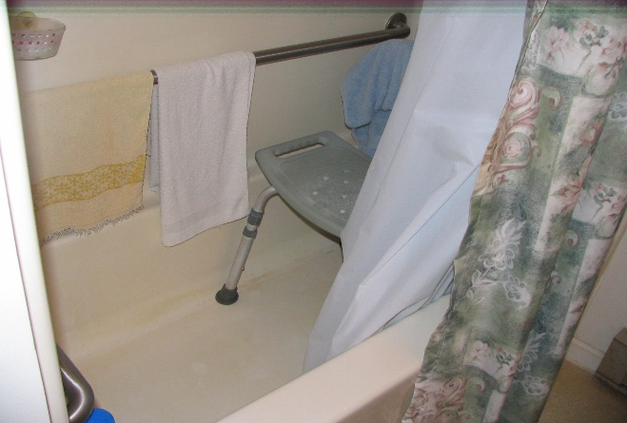
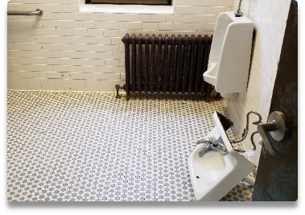
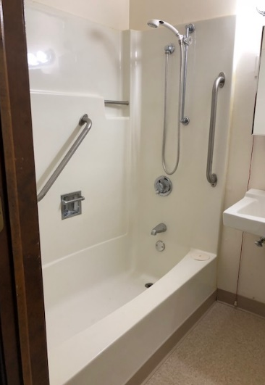

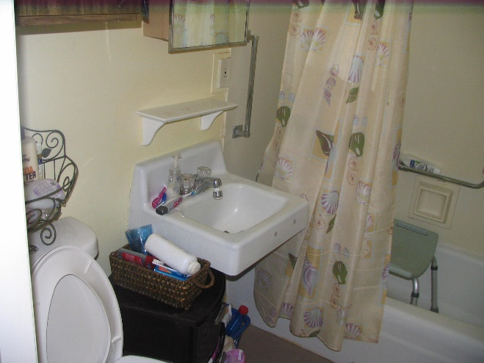
Do you have bathrooms that look like this and your residents are unable to age in place
trip hazards
Fixtures that look like this or are about to….
Bathrooms that look like this……
Notes:
Is a particular area/neighborhood in our town with many homes that look like this?

Slide 18
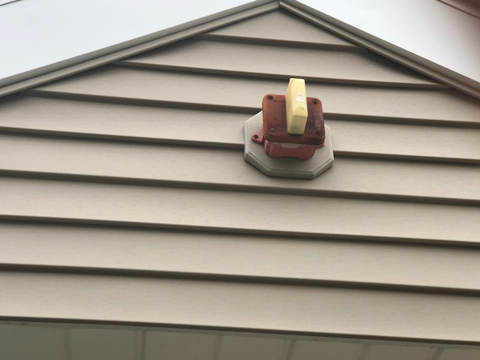
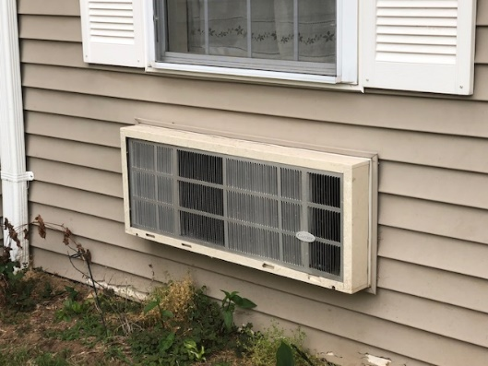
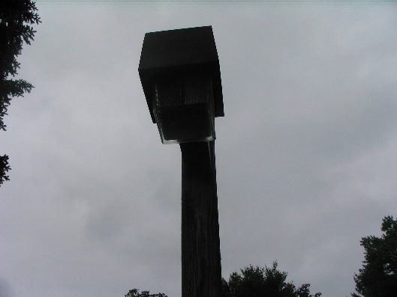
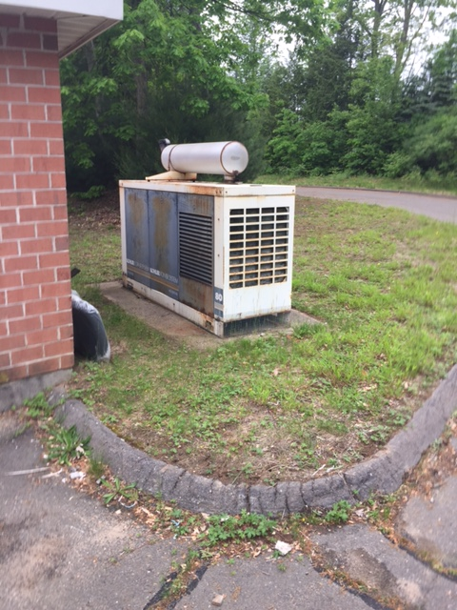
Campuses with ineffective health & safety fixtures that look like this
Inefficient/Retired AC Units
Poor Site Lighting/Unsafe for residents
Outdated Emergency Alarm Systems
Notes:
Is a particular area/neighborhood in our town with many homes that look like this?

Slide 19
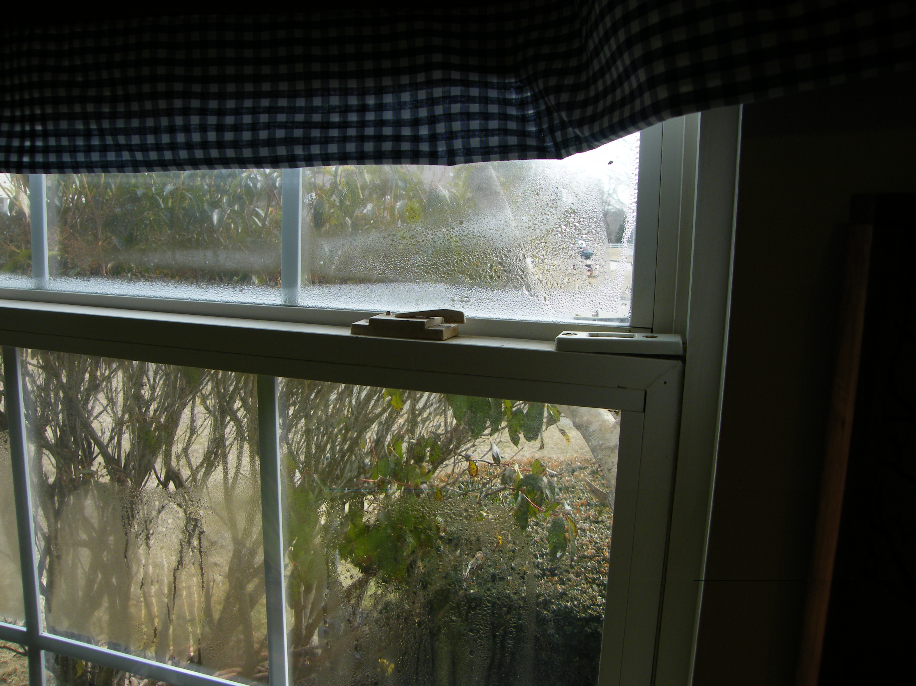
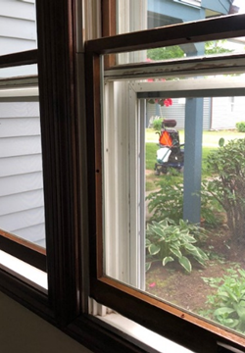
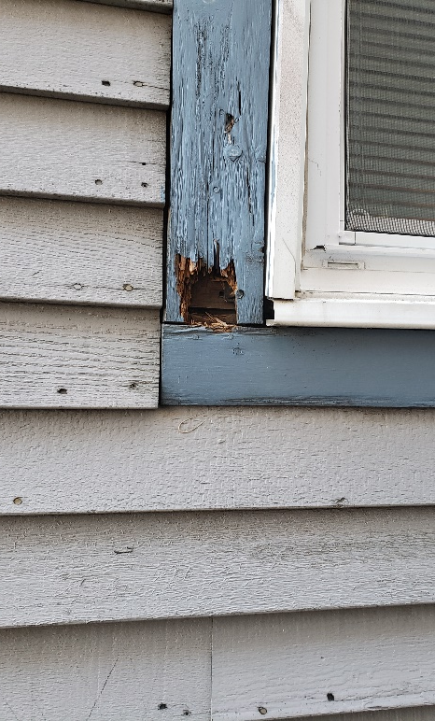

Rotten siding
Notes:
Do you know of a Housing Authority in your town that look like this?

Slide 20
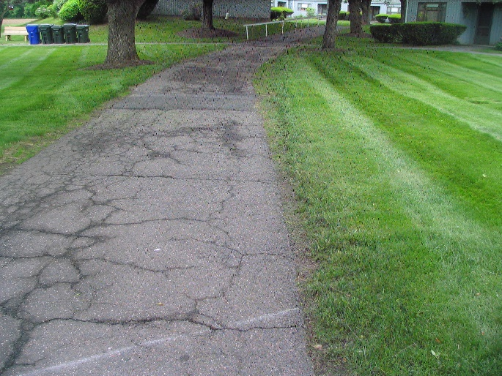
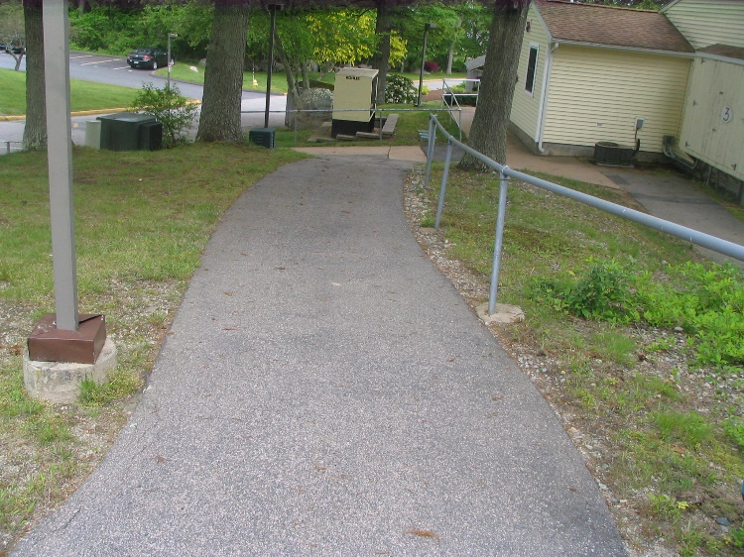
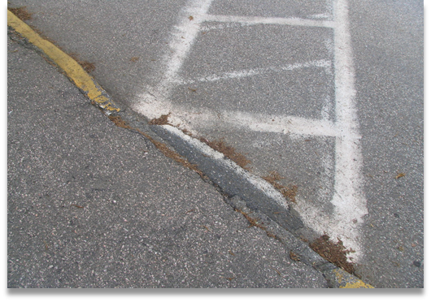
Dangerous steep sloping walkways (once upon a time considered safe)….
Curb cuts/walkways that look like this
Notes:
Do you know of a Housing Authority in your town that look like this?

Slide 21
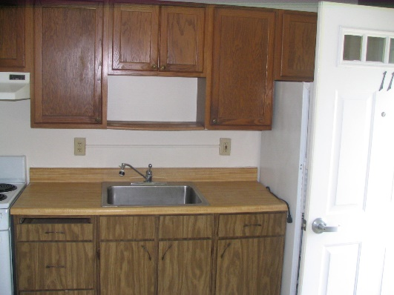
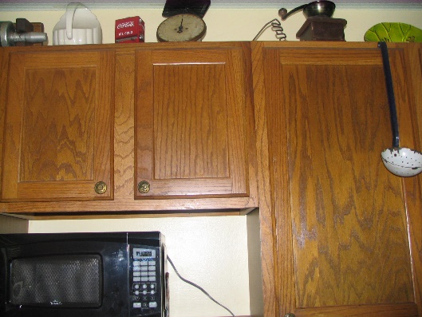
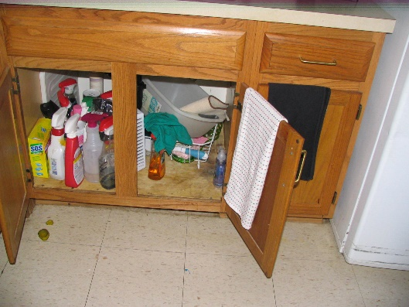
Cabinet drawers that no longer stay close
Cabinet doors that no longer stay close

Slide 22
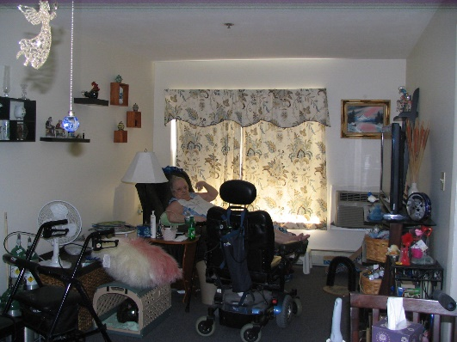
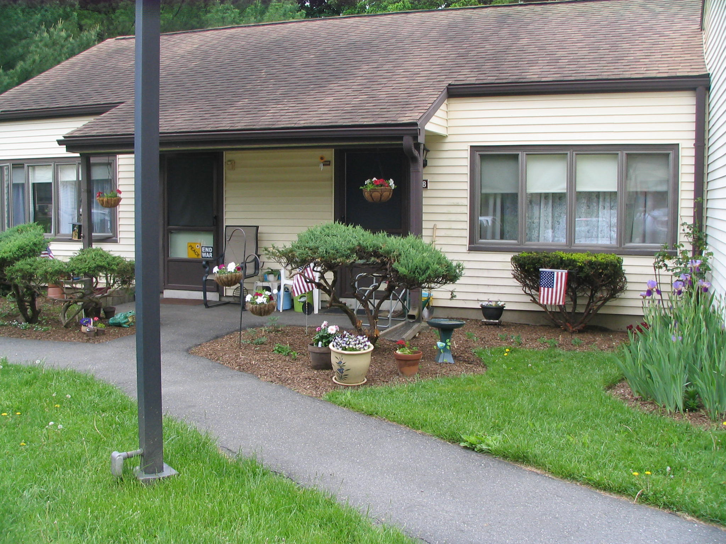
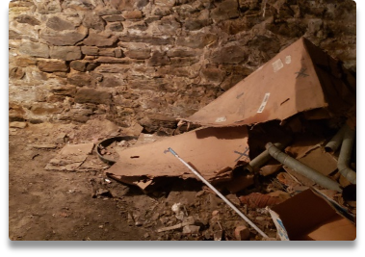
Insufficient turning radius to meet ADA requirements
Foundations that look like this…..

Slide 23



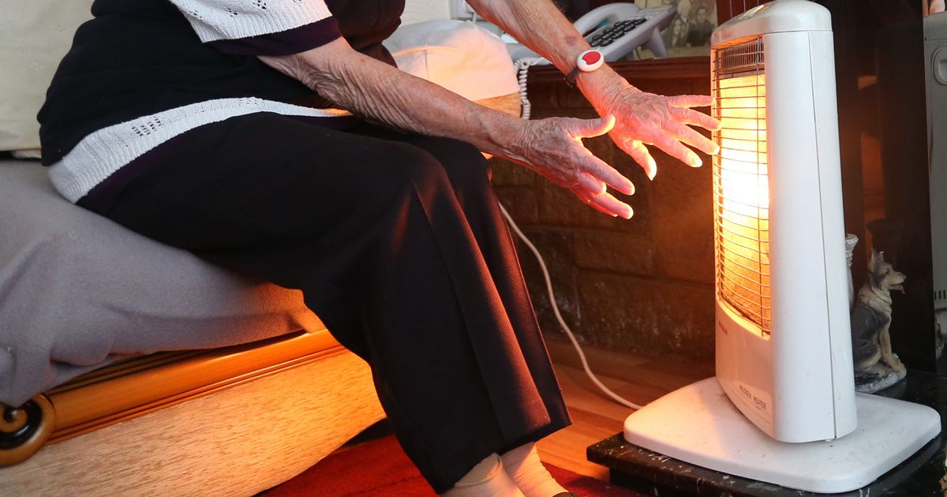
Residents complaining about
Notes:
You really should get together with your Town and put plans together to get going…….

Slide 24
3.1
Applicant
Capacity
Notes:
Who’s on your staff?
What are their qualifications?
Are there experienced folks on your team to help deliver a fantastic product?
How many years have they been practicing? Do they hold a current/valid CGA certificate?
Are they capable of guiding your project successfully?
Do they have design people on staff?
For PS
Describe the organizations/affiliate’s experience……

Slide 25

No thumb drive

Slide 26
File Naming Convention
General
Fair Housing
00.1 FHO (Fair Housing Ordinance)
Other
00.4 DFWP (Drug Free Workplace Policy)
00.3 S3P (Section 3 plan)
00.5 ERR (Environmental Review Record) Exempt, CENST and Broad level review for Housing Rehab.
000.3 GCOC (General 3 Cert. of Compliance…)
000.2 GALR (General 2 Adopted Local Resolution)
000.4 GAC (General 4 Application Certification)
000.5 GLA (General 5 Local Assurance)………and so on
00.2 FHAO (Fair Housing Action Plan)
00.6 CEPA (Connecticut Environmental Protection Act Checklist)
000.1 GCA (General 1 Corporate Agreement)
Notes:
General Includes pages 1-6 of the application

Slide 27
File Naming Convention
Section 1
1.1 PD (Project Description)
1.4 GN (GIN Notice)
Section 2
Project Need
Section 3
3.1 R
3.1.A
1.4.A RP (Relocation Plan)
3.1.B
Project Information
2.1 PN (Project Need Narrative)
Capacity
2.1.A WL (Waiting List)

Slide 28

Section 4
Project Feasibility & Merit
4.1 Budget Summary
4.2 Local leverage
Notes:
4.2 local leverage we are looking to see what your level of firm/Conditional commitment is at the time of application. We prefer to see firm commitments so put some skin in the game
Our partners Eversource, this year will work with applicants to prepare a firm commitment letter
Sustainable CT in collaboration with IOBY (in our back yard)
Green Bank/Green Initiatives….you’ll hear from them too with innovative ways to get to you to the end goal.

Slide 29
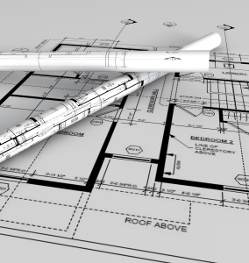
Section 4
Project Feasibility & Merit
Technical Compliance
4.4-4.7
4.5 and 4.5A Construction Documents- upload
(Provide drawing and specs electronically)

Slide 30
Community Impact
Section 5
5.1.A Community Impact Map
5.1.B Community Impact Map Narrative
5.2 Community Letters of Support
5.3 Resident Participation
Notes:
5.1.B Community Impact Map Narrative this year be sure to tell us about the neighborhood in the map, be sure to address all the points listed in the handbook
eg, Describe how the project will promote diversity and economic integration
Describe how this project will promote community members’ ability to contribute to their own well-being and that of their families and community (housing only).
Public Services Only – Identify locations where services will be provided.
5.2 List all Community Letters of Support letters of support received from those who provide and receive services in the project area, or represent those who are in need of services? We are not looking for letters from Town Department Heads.
Yes letters from the selectman is great, but do a little extra work and get support from regional planning agencies or other regional
organizations to demonstrate the relationship between the proposed activities and regional needs.
5.3 How does this project promote resident participation? If a housing authority activity, does it have a Resident Participation Plan? Looking closely this year at how well, residents are integrated with the planning process that affects where they live. Are there needs being met? Are the designs or plans to renovate apartments include the end user? Do they need shower stalls rather as opposed to a shallow tub (the common trip hazard). We are currently running a pilot with the project we are doing in Madison. Concord Meadows. The residents are actually shaping the design and improvements within the complex for the 2019 grant.

Slide 31
Fair Housing and Equal Opportunity
Section 6
6.1 Local Fair Housing Action Steps- PAST GRANTEES ONLY
  6.2 Section 3 Past Performance – PAST GRANTEES ONLY
  6.6 -6.10- NEW GRANTEES ONLY
  Section 504/ADA Notice
  Section 504/ADA Grievance Procedure
  Section 504/ADA Checklist for Existing Facilities etc.

Slide 32
Other….
Sections 7-9
7.0 Fiscal and Grants Management
8.0 Consistency with State Consolidated Plan
9.0 DOH Training
9.1 List any non-required yet relevant Housing & Community Development trainings attended by municipal staff within the last 2 years
Notes:
Please list any non-required relevant Housing & Community Development trainings attended by municipal staff within the last 2 years as it relates to this Small Cities grant application.
1 point for every training accepted up to 3 points.

Slide 33

End of Week/April 1,2021 https://portal.ct.gov/DOH/DOH/Programs/Small-Cities-Program
Check DOH’s Web site for application link
Notes:
All related documents will be available on our website

Slide 34


I’ll
Leave you with these parting words…….

Slide 35

Before you upload the 2021 application online
Have a Martini, Whiskey, Rum, Tea or maybe a large bowl of Ice Cream (if that’s your thing). We think you’ll need a few of whatever your poison is after this……
Notes:
If you came back for more after last year’s application, couldn’t get enough of us, then you know what to do next…..

Slide 36
But on a serious note…..
√ Review the application, cross check it against the
Application Handbook.
√ Review and complete the Exhibit Checklist
√ If you’ve checked the upload box on the application, that means you have an exhibit to name e.g. 000.3 GCOC and upload
√ Review the Rating and Ranking…see how you score
√ Complete and scan all required WET SIGNATURE Docs in BLUE INK;
DO NOT mail wet signature pages to DOH unless we request them …keep the original signature documents with the application.
√ Take a moment to congratulate all the folks around you for a great job pulling this all together.
This is great feel good work!
Notes:
Include the R&R with your materials
Tweak it if you must in order to get that extra point here and there.

Slide 37
Good Luck &
Thank You
Dominic Carew
Dominic.carew@ct.gov
860-270-8164

