Slide 1
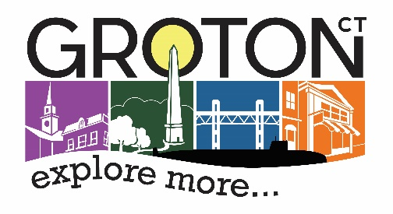
2017 CDBG Small Cities Award
MYSTIC RIVER HOMES
Town of Groton
Community Development
134 Groton Long Pt Road
https://www.groton-ct.gov/departments/plandev/cdev.php

Slide 2
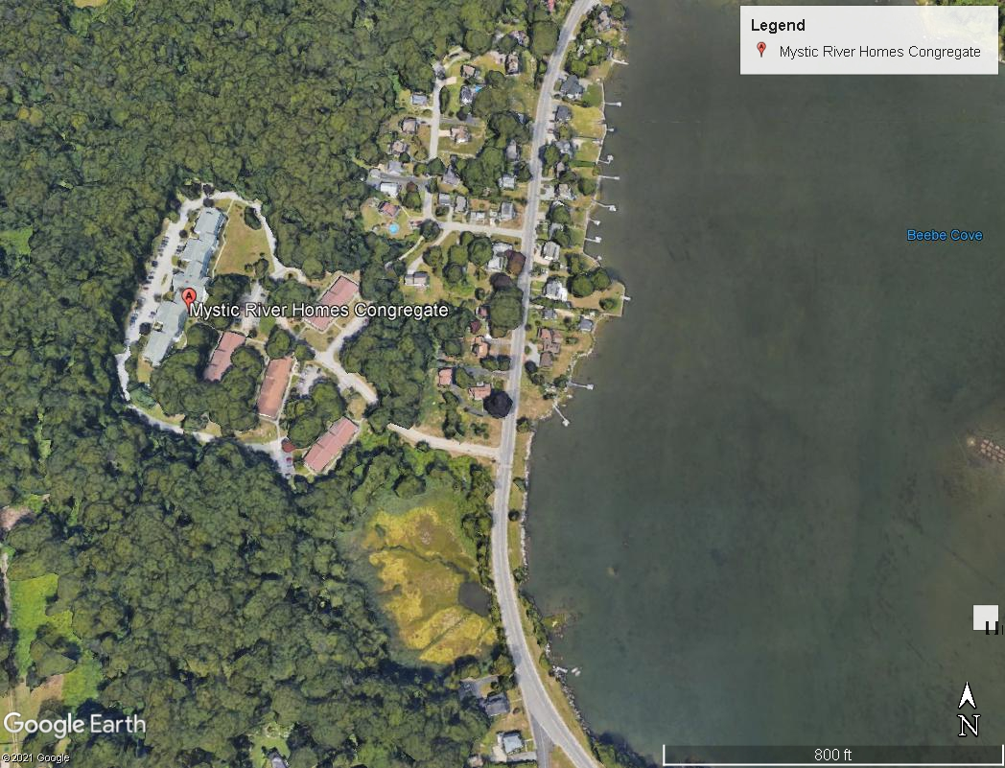
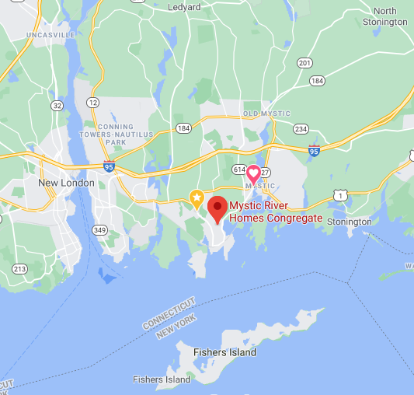

Slide 3
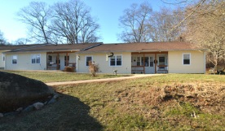
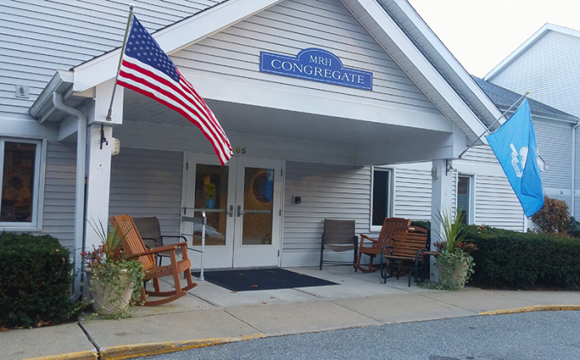
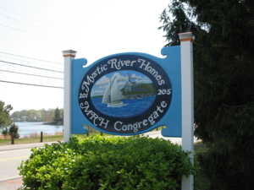
ABOUT
MYSTIC RIVER HOMES
The mission statement of Mystic River Homes, Inc. is to promote the social welfare of the community by providing, on a nonprofit basis, rental housing and related facilities and services appropriate for the special needs and living requirements of elderly or handicapped persons of low or moderate income without regard to their race, color, creed or national origin.
There are two housing complexes:
Mystic River Homes I-The Cottages, and
Mystic River Homes II, the Congregate
The Cottages provide 46 garden style apartments in four one-story buildings and the congregate provides 50 apartments

Slide 4
About the Project
This 2017 CDBG Small Cities application served the residents of Mystic River Homes.
The population served at Mystic River Homes is restricted by both age and income. (62/80% AMI)
The grant application was written for the town by the non-profit Eastern Connecticut Housing Opportunities (ECHO). The grant was administered through a three party relationship with the Town’s Economic and Community Development Division, Mystic River Homes, and ECHO.
$800,000 CDBG funding
$500,000 Mystic River Homes Contribution (HTCC Funding)
$178,488 Matching funds through USDA
Total Project Budget: $1,478,488

Slide 5
About the Project
The CDBG funds addressed ADA Accessibility as well as needed energy efficiency improvements including windows, storm and entry doors, walkway grading and resurfacing, and the installation of solar panels for the community room. Internal renovations included water heaters, kitchen cabinets and countertop replacements, flooring replacements, and bathroom upgrades.
MRH contributed a match in HTCC funds and in kind services allocated toward design and construction for roof replacements, including gutter work.
Funds were utilized to rehabilitate the facility on a unit by unit basis, incorporating code compliance improvements in all units as well as handicapped conversions to meet current codes in an additional three units.

Slide 6
Project Timeline
Plan Development
Roof Replacement
Window Replacement
Other Contracts- Interior Renovations
ADA Improvements

Slide 7
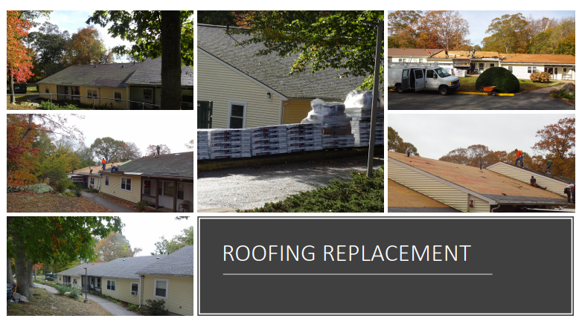

Slide 8
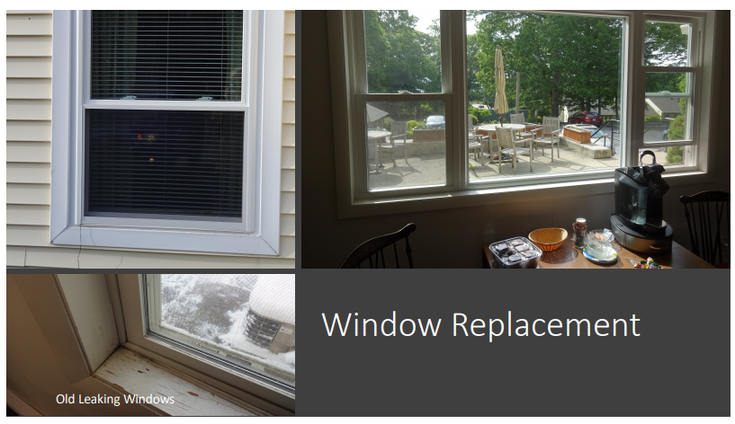

Slide 9
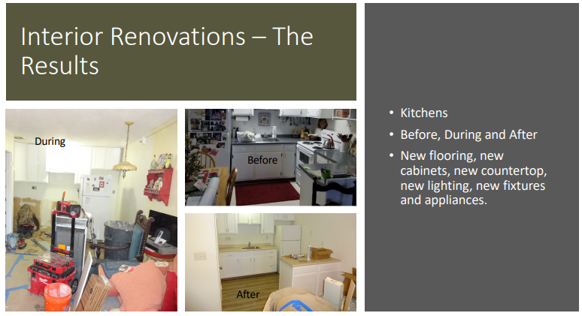

Slide 10
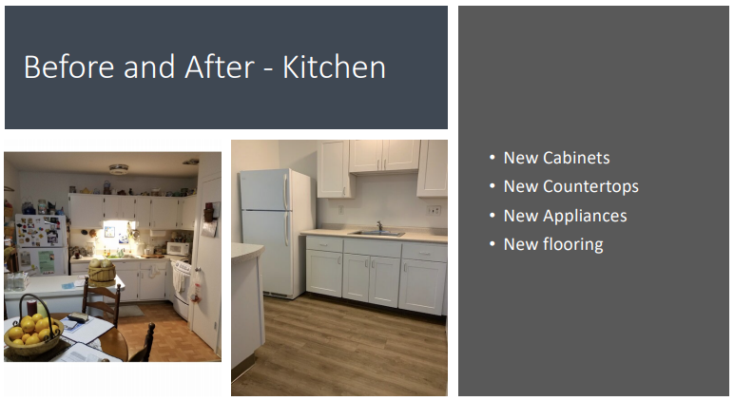

Slide 11
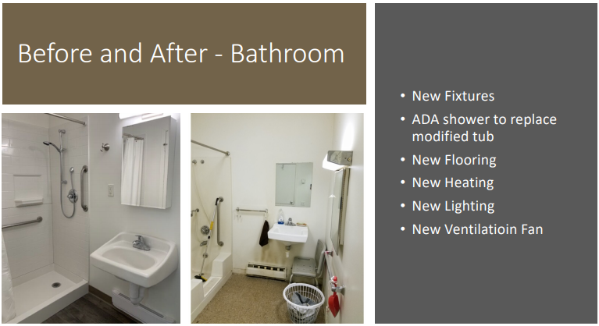

Slide 12
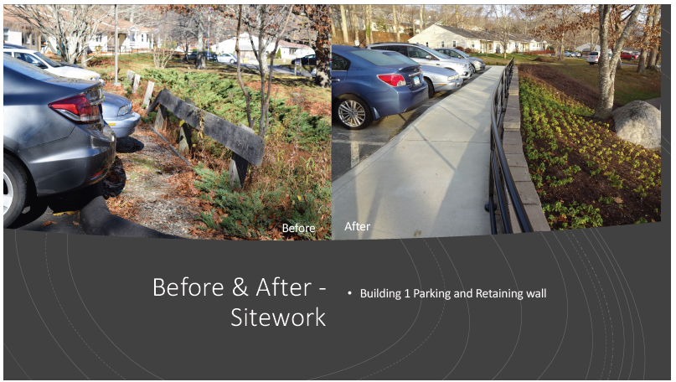

Slide 13
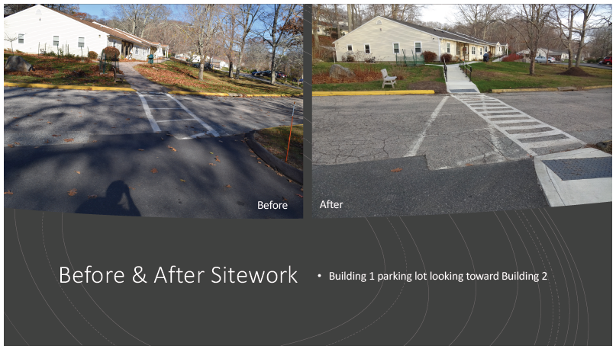

Slide 14
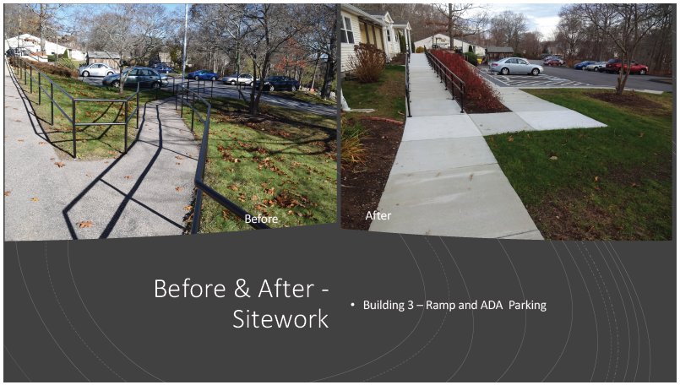

Slide 15
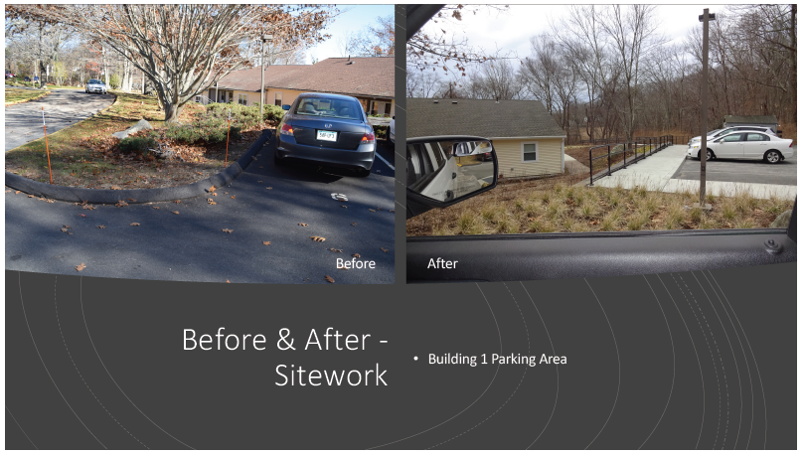

Slide 16
