Slide 1
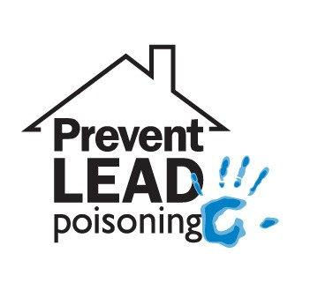

Lead Overview
CDBG
Small
Cities
January 28, 2020

Slide 2
Does this look lead safe?
Let’s take a look……

Slide 3
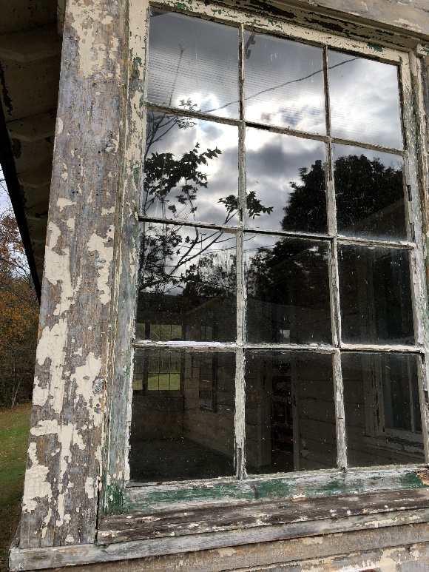
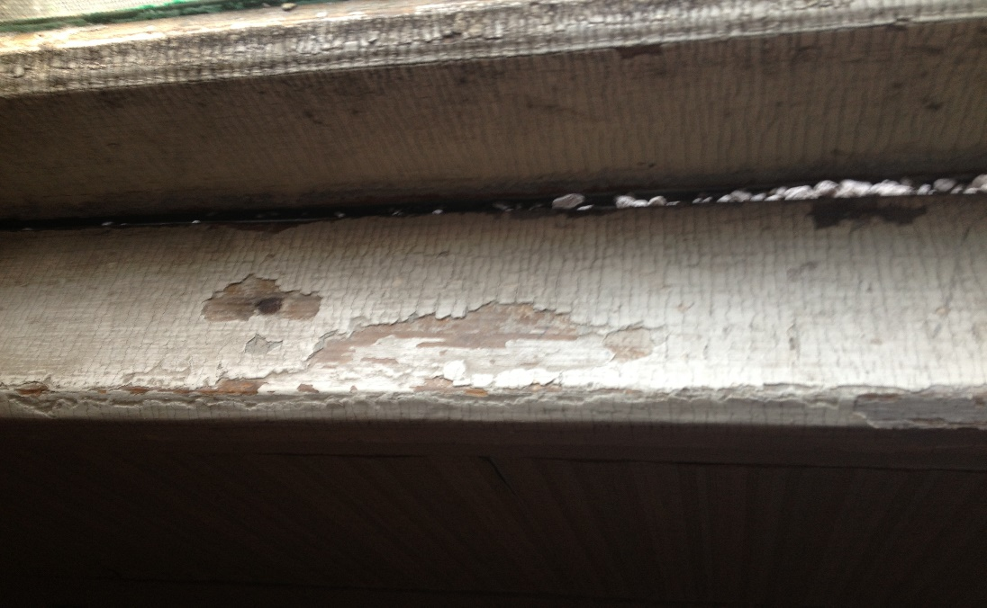
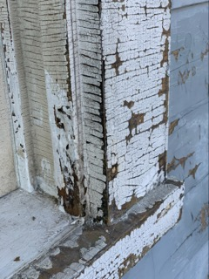
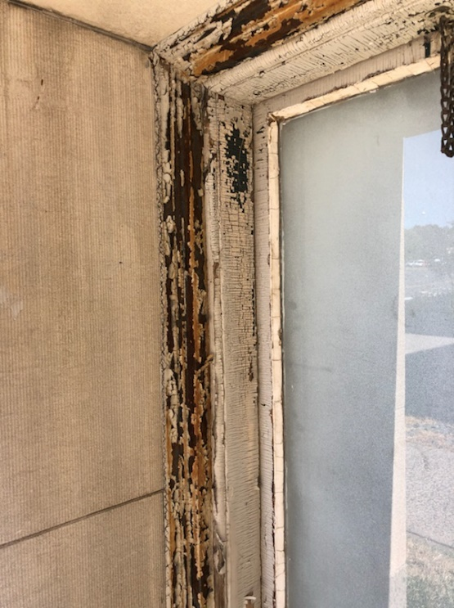

Slide 4
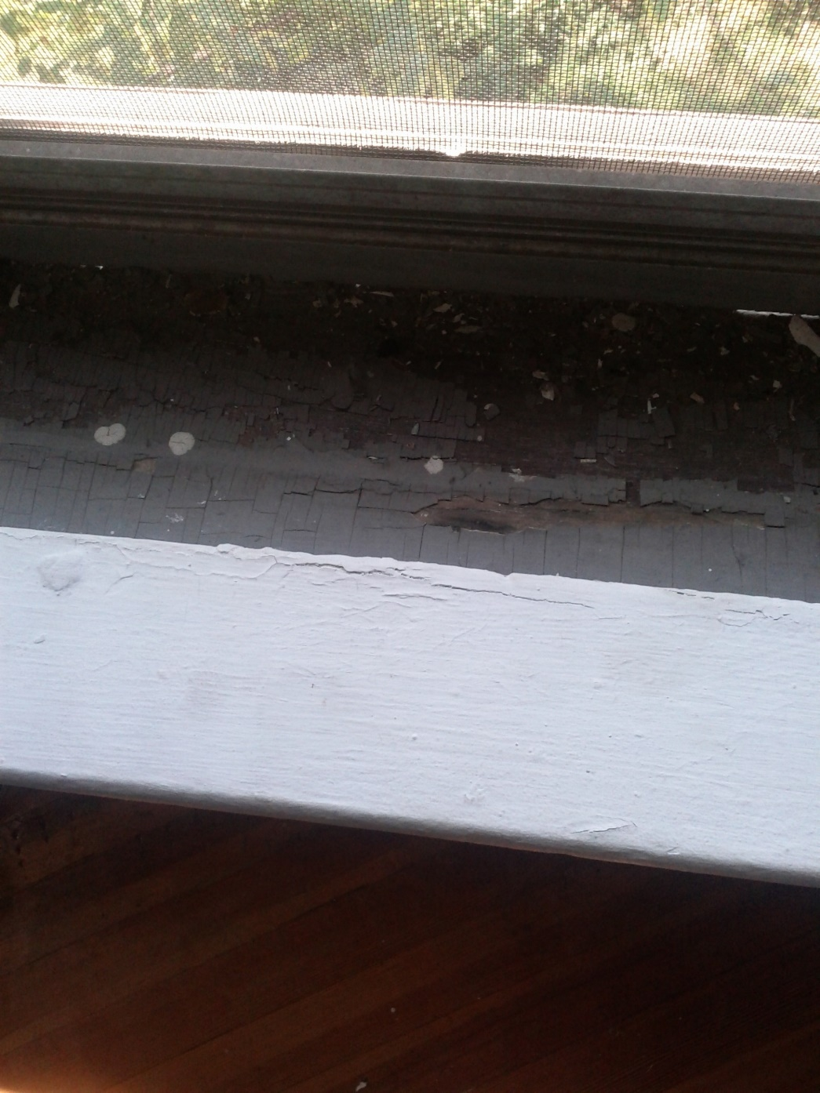
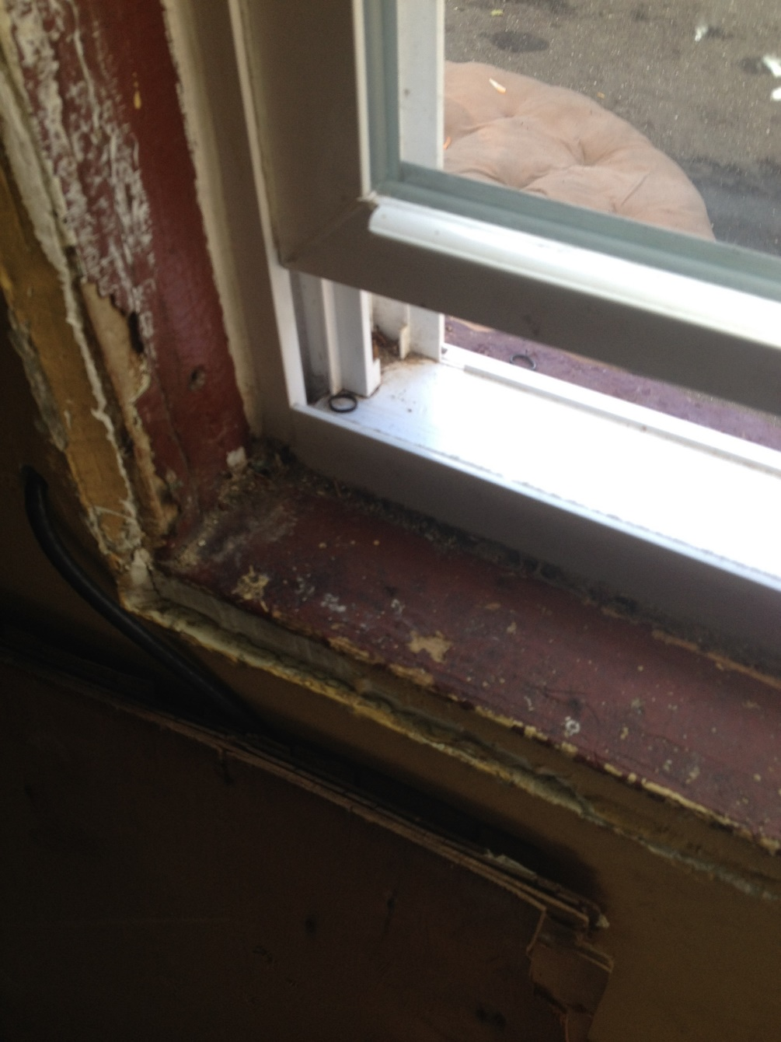

Slide 5
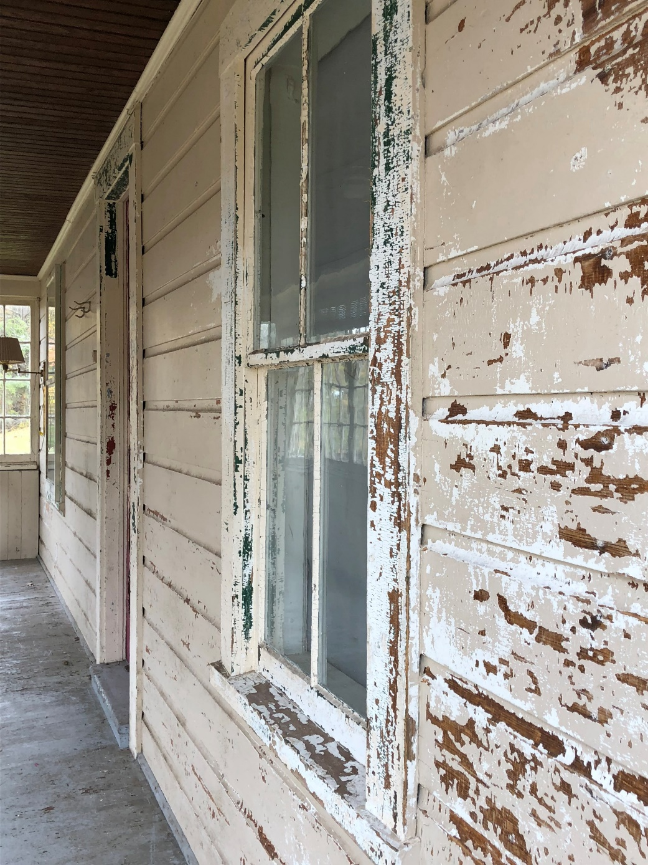
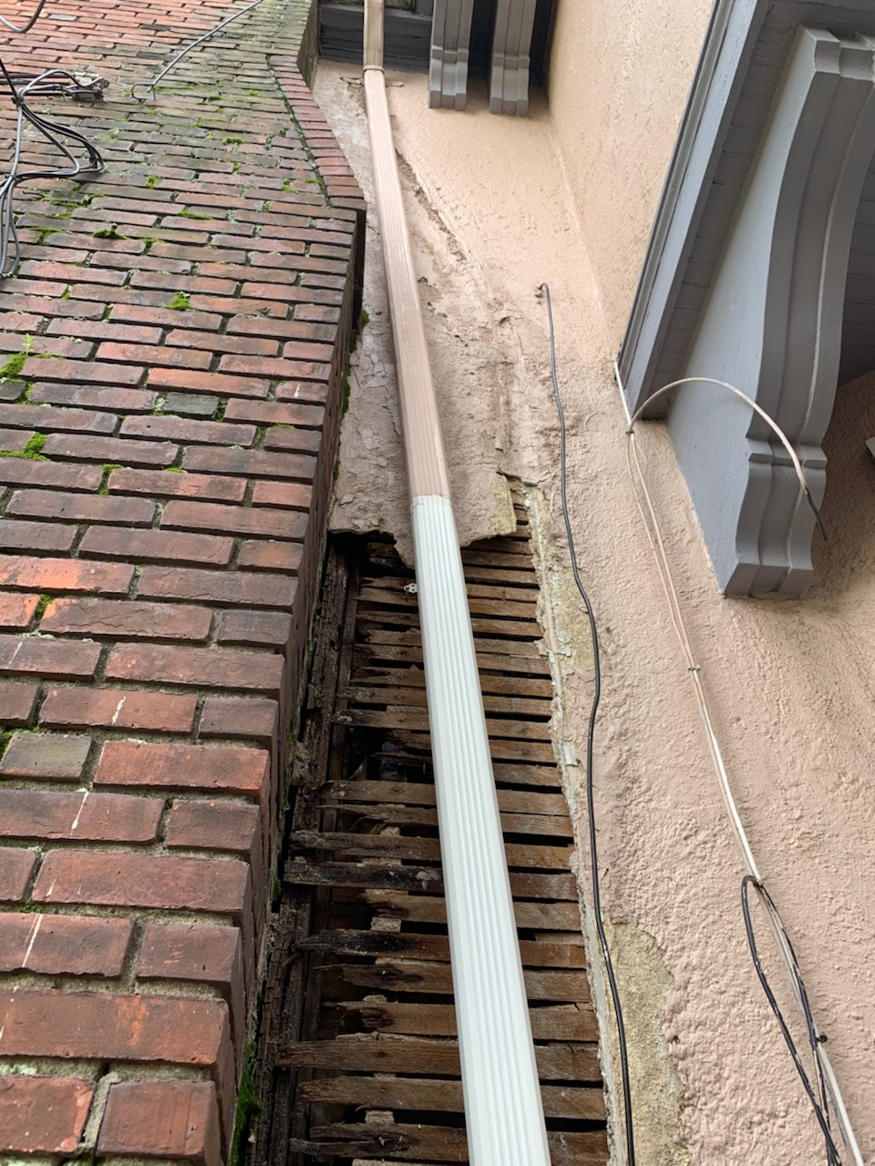

Slide 6
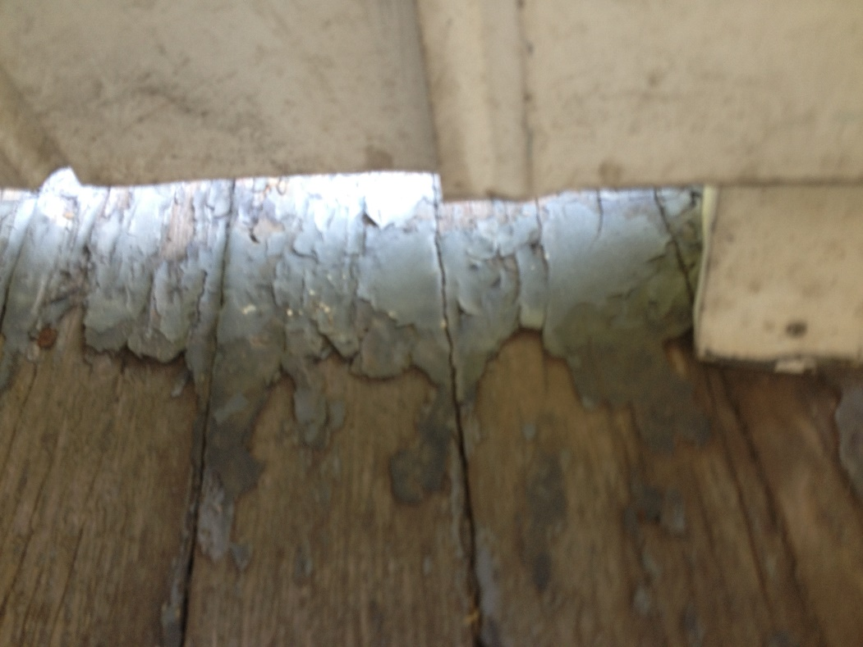
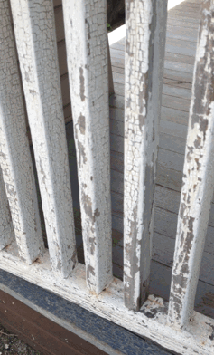
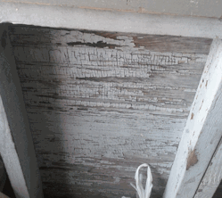

Slide 7
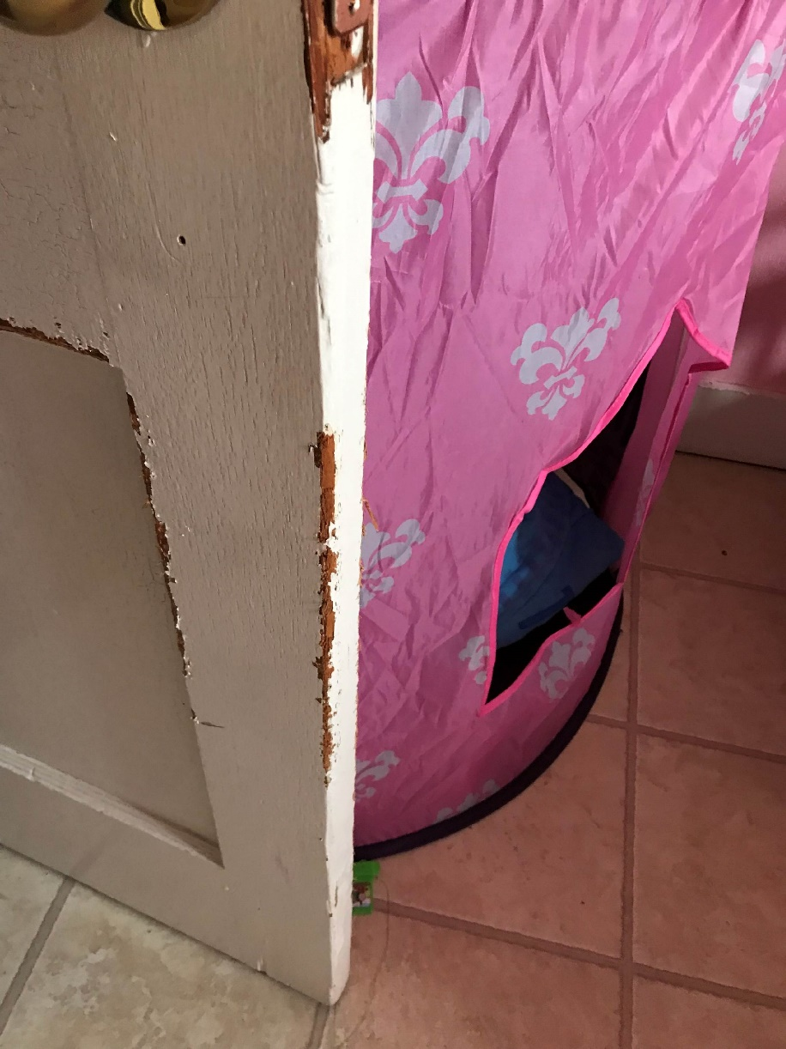
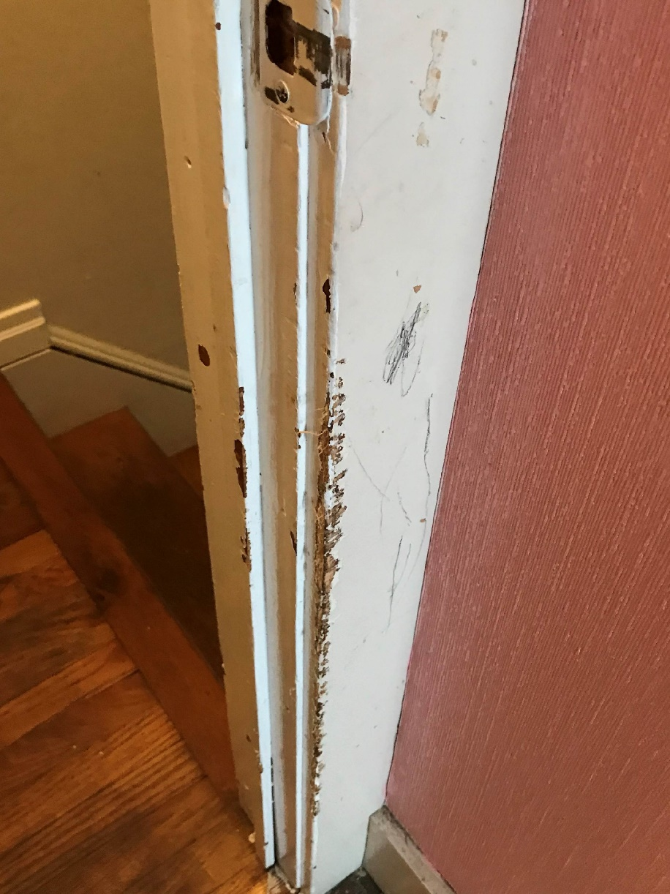

Slide 8

CDBG Small Cities Funding
CHART

Slide 9
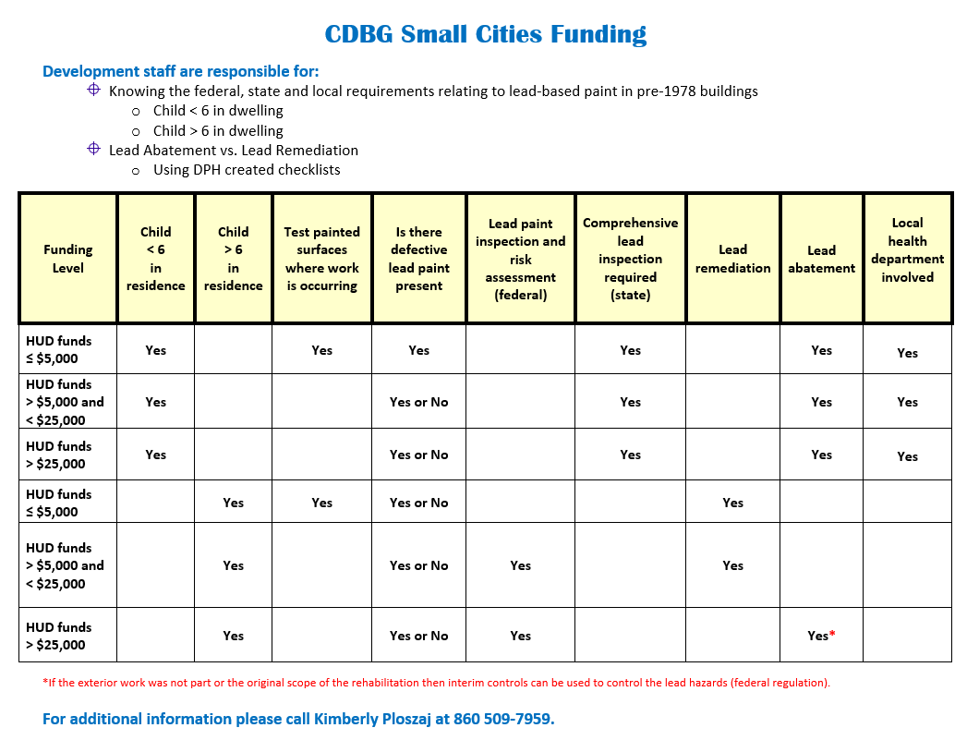

Slide 10


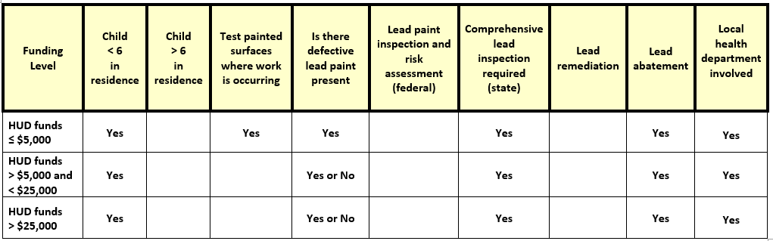
Child < 6 in residence

Slide 11

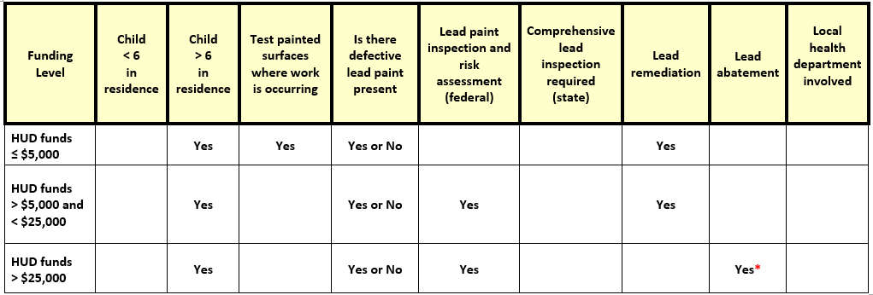
Child > 6 in residence
*If the exterior work was not part or the original scope of the rehabilitation then interim controls can be used to control the lead hazards (federal regulation).

Slide 12
Scenario 1:
A project costs $17,500
There are three children ages 11, 8 and 7 in residence
The property has not been tested for lead paint
Many areas at the property have defective paint
What are your next steps?

Slide 13
What is Required?

Slide 14

Child > 6 in residence

Slide 15

Answer:
Presence of defective paint
Testing of the painted surfaces for lead is required
All defective surfaces shall be remediated by a certified EPA RRP firm
The RRP firm shall employ workers/supervisor who have completed a HUD approved lead-safe work practice course
A lead remediation plan shall be developed
At the completion of the job, a DPH licensed lead consultant contractor must complete clearance dust wipes

Slide 16


Protect Your Family
EPA Renovate Right

Slide 17
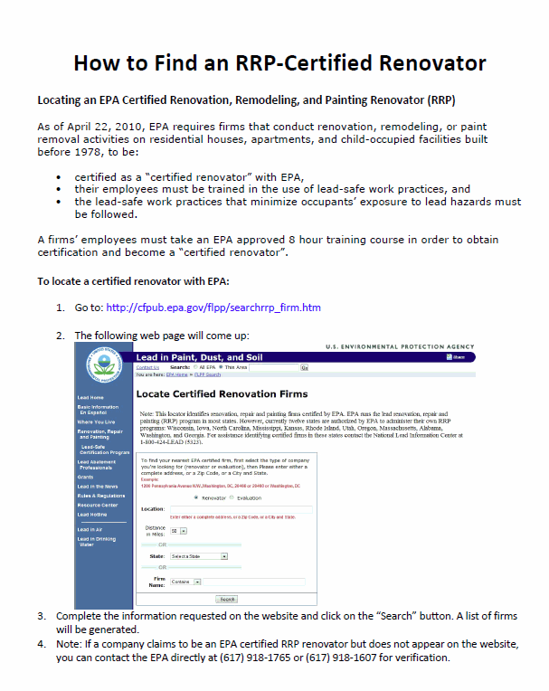

Slide 18
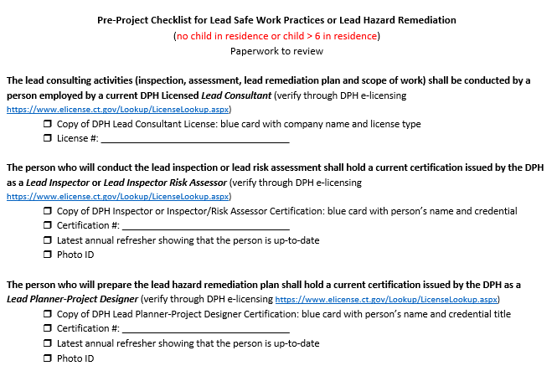

Slide 19
Scenario 2:
A project costs $33,000
There are two children ages 5 and 2 in residence
The defective paint has been tested for lead and is positive
What are your next steps?

Slide 20
What is Required?

Slide 21
Child < 6 in residence

Slide 22

Answer:
A child <6 years of age resides at the property and there is defective lead paint = a comprehensive lead inspection is required
The comprehensive lead inspection will identify all lead hazards in paint, dust, water and soil
All lead hazards shall be abated
All intact leaded surfaces shall be placed on a management plan
A lead abatement plan or a lead management plan shall be developed by a licensed lead consultant contractor

Slide 23

Answer:
A lead abatement plan shall be approved by the local health department before any work can begin
All abatement work shall be performed by a DPH licensed lead abatement contractor that employs certified supervisors and workers
At the completion of the job, a DPH licensed lead consultant shall complete clearance dust wipes

Slide 24
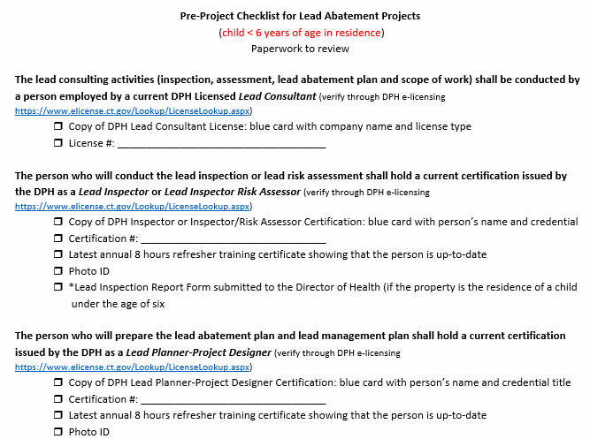

Slide 25

Challenges
Programs not……
using the pre-checklists
knowing the difference between lead remediation and lead abatement
involving licensed lead practitioners and the local health department when lead abatement is required
seeking approval for work order changes, for lead abatement projects, from the local health department
ensuring clearance dust wipes are required at the end of lead remediation and abatement work

Slide 26

When in doubt….
Call DPH
DPH has authority to take action for any lead abatement violations
EPA has authority to take action for any lead remediation violations

Slide 27

Questions

Slide 28
Contact Information
Kimberly Ploszaj
Epidemiologist
State of Connecticut
Department of Public Health
(860) 509-7959
kimberly.ploszaj@ct.gov

