Slide 1

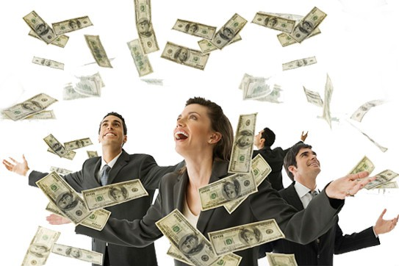
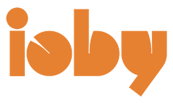
Sustainable CT Community Match Fund

Slide 2
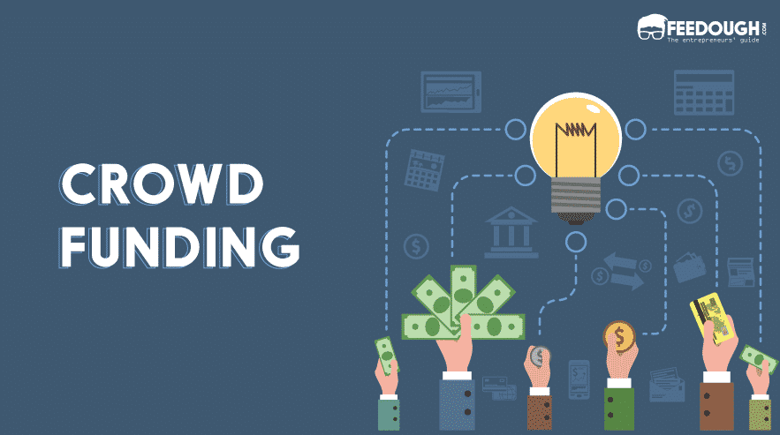
Program Overview
Up to $25,000 in dollar-for-dollar matching funds for sustainability projects
  We match what you raise as you raise it – contributions doubled in real-time
  Fundraising through online crowdfunding
    Contributions immediately matched by SCT
  One-on-one fundraising coaching & support
  Community collaboration & buy-in (literally!)
  Connections to partners, other municipalities, & other funding sources

Slide 3
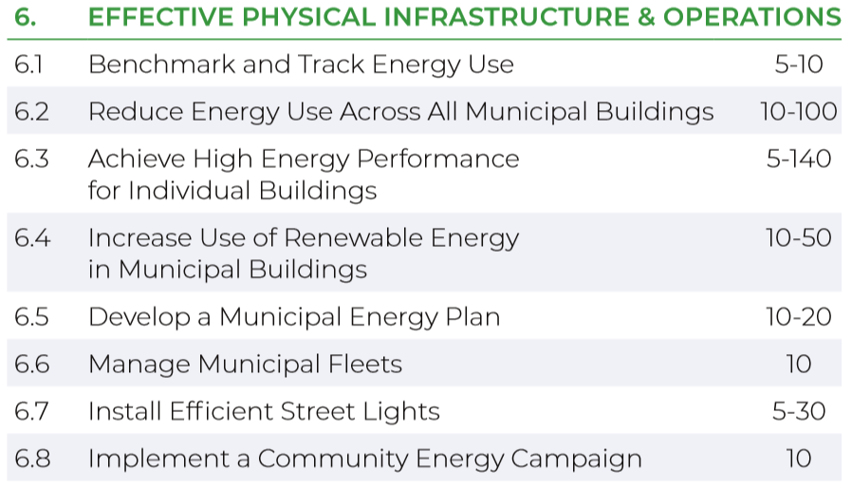
Our Focus: Energy Projects
Our Focus: Energy Projects
Reduce energy use intensity for municipal buildings and public spaces
Reduce energy use in individual municipal buildings or unique facilities
Increase the use of renewable energy in your municipal buildings and public spaces
Light your community with the most efficient bulbs available

Slide 4

General Project Eligibility
Located in a Sustainable CT registered town(s)
Align with Sustainable CT actions
Have a public benefit and be inclusive of your community

Slide 5
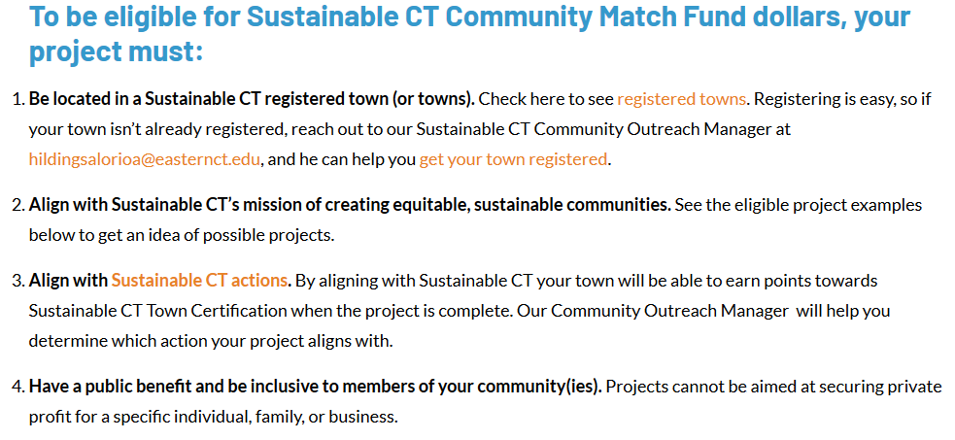
Detailed eligibility

Slide 6
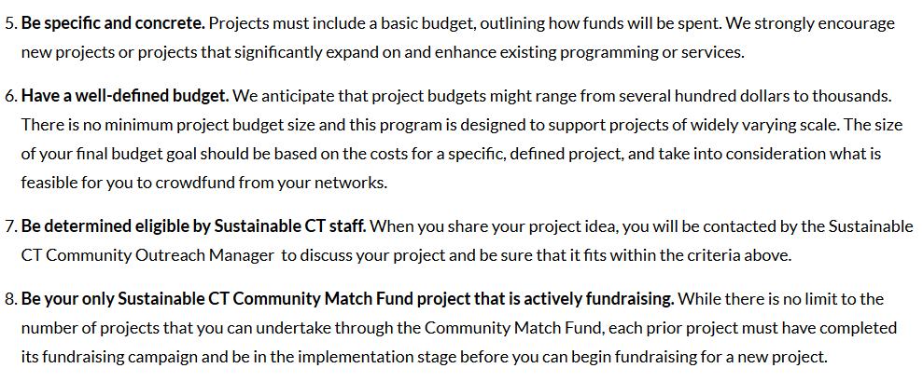
Detailed eligibility

Slide 7
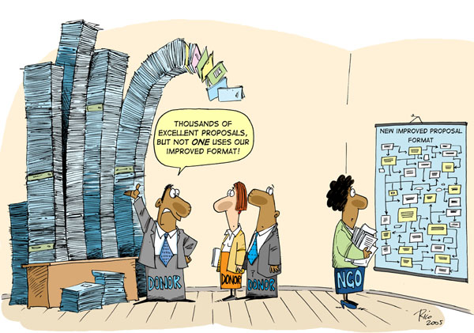
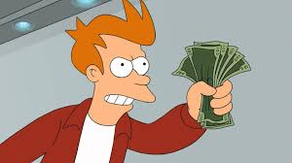

Access to the funding: fast, flexible, easy
No application deadlines
No formal, standardized proposal
No lengthy review process
No staggered funds disbursement
No one-size-fits-all post-award reporting requirements

Slide 8

Starting up a Match Fund project
1
2
3
Contact Abe to discuss project
Submit a project description, timeline & budget
Sustainable CT reviews for eligibility
If determined eligible:
    Connect with the municipality to introduce project and receive support
    Complete pre-fundraising survey with project timeline
    Build your project: begin working with ioby to create fundraising page
    Fundraise
    Implement project

Slide 9
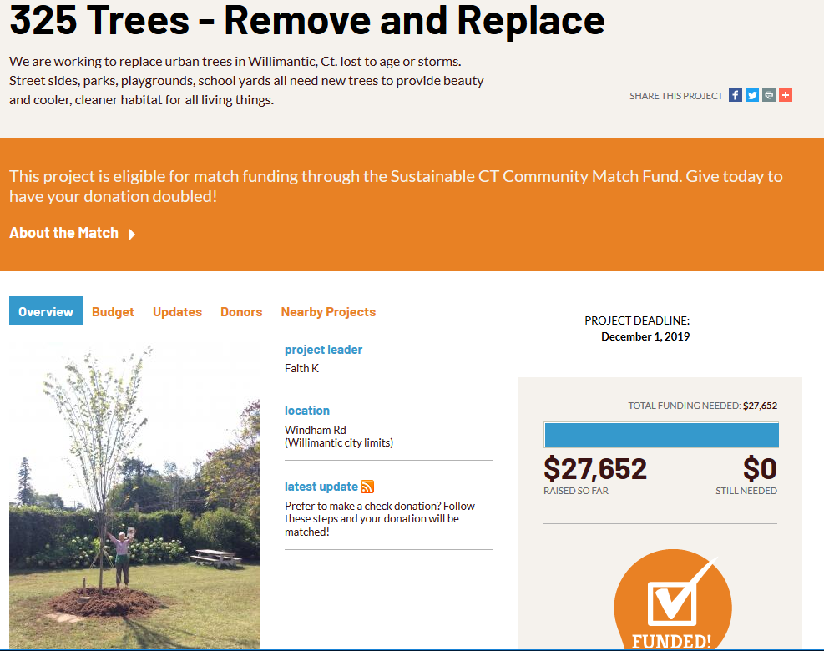
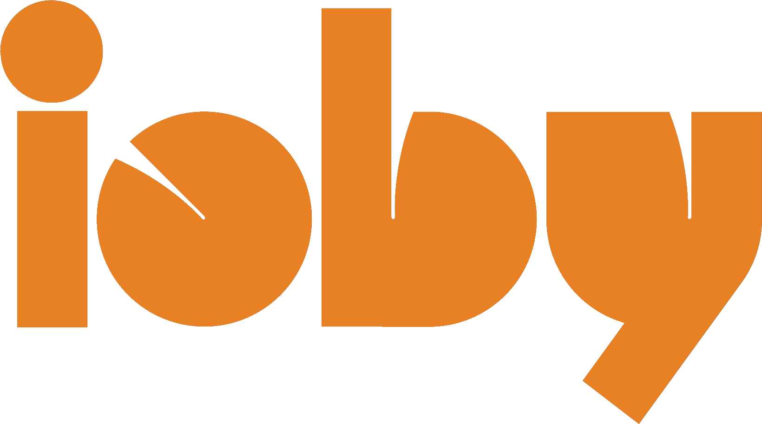

Slide 10
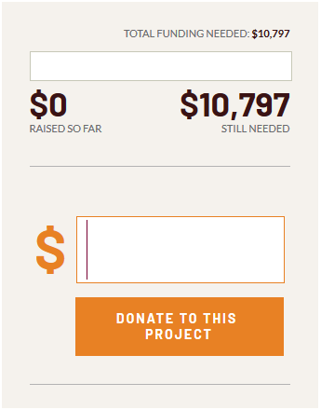
What kinds of contributions can be matched?
Donations can come from:
Individuals
Businesses
Nonprofits
Municipalities
Your own budget
Grants
All of these will be matched by Sustainable CT
  To be matched, they must be passed through to your ioby crowdfunding page

Slide 11
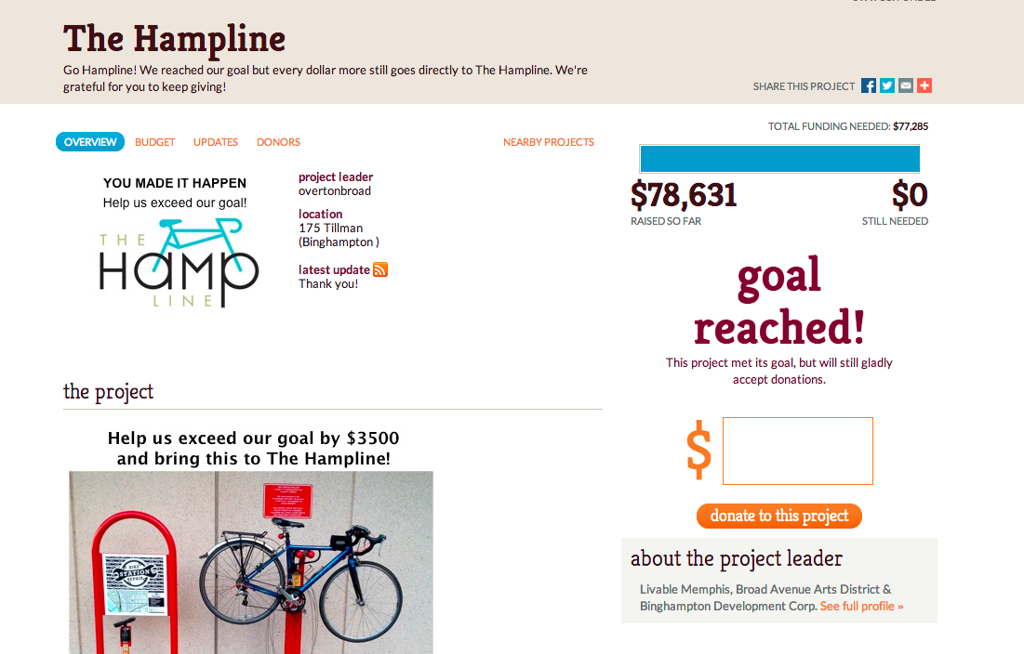

Slide 12
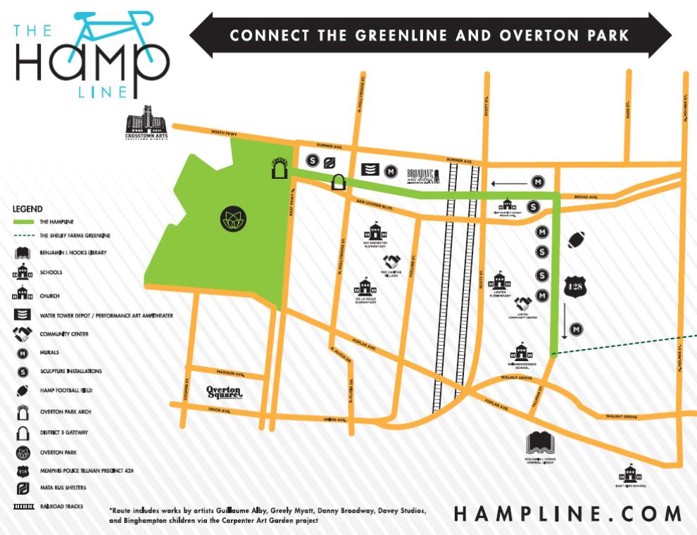

Slide 13
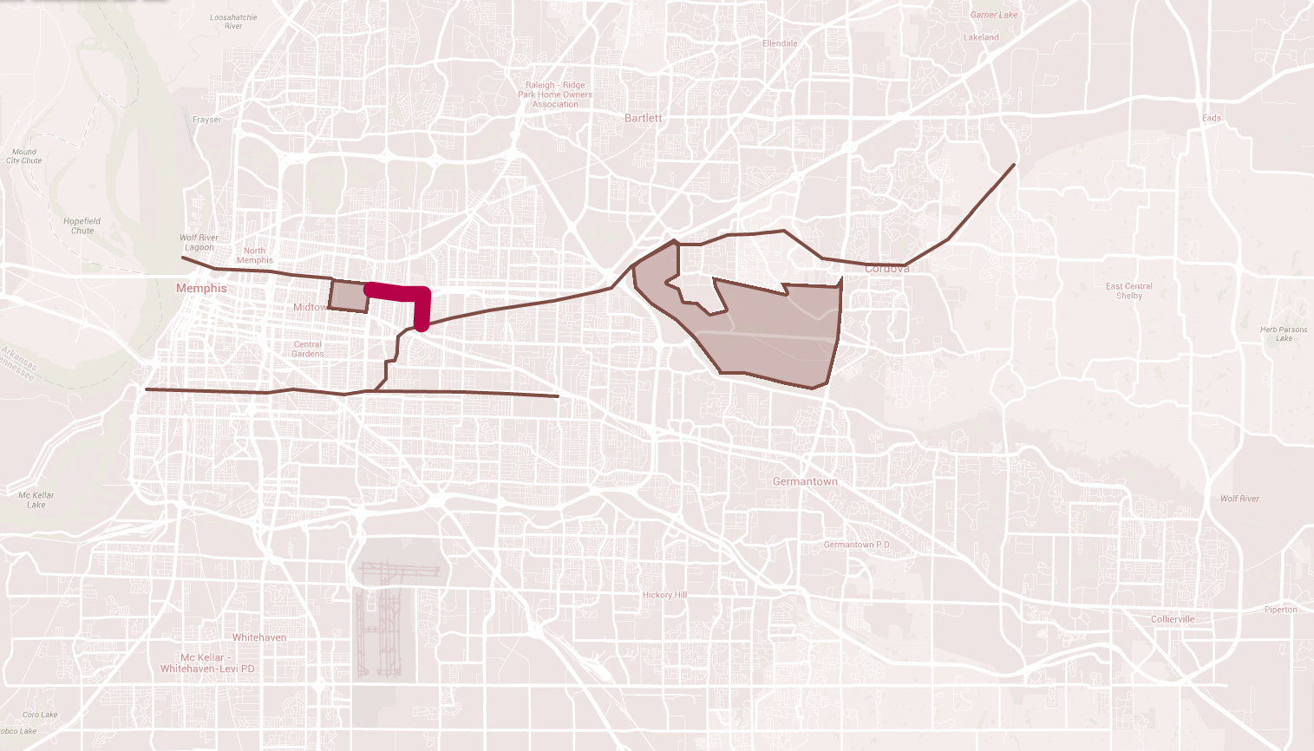

Slide 14
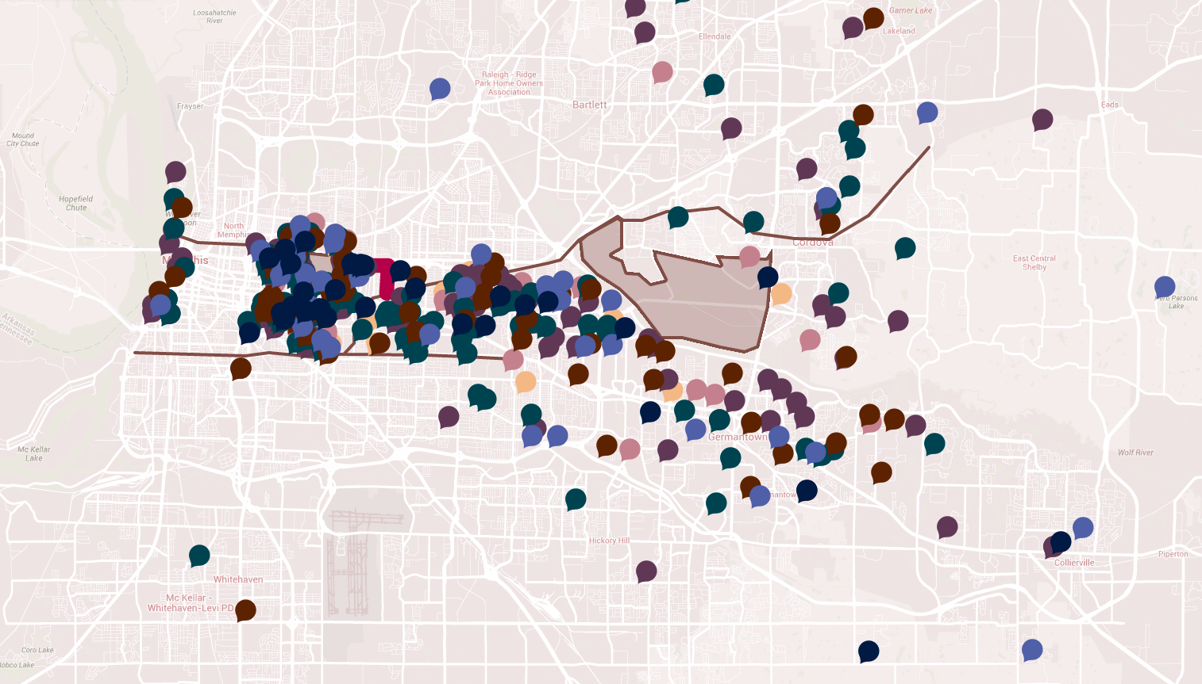

Slide 15
Why crowdfunding and why ioby?
“To me the greatest value from the ioby campaign was the public awareness building/support. It will pay longer term dividends beyond the $75,000+ that we raised.”
-Pat Brown
Broad Avenue Arts Alliance

Slide 16
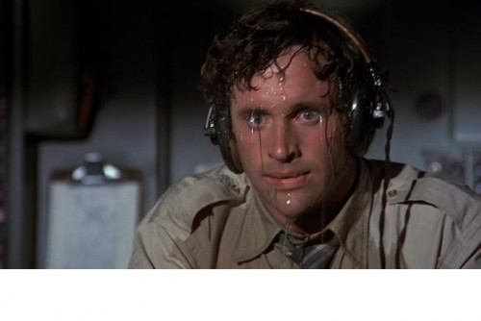
Questions?

