Slide 1
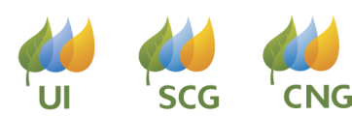

CDBG 2020 Application Workshop
January 28, 2020

Slide 2
Goals of the Multifamily Initiative
To provide resources for energy efficiency, renewable energy and related improvements to multifamily segment customers
To implement cost effective, comprehensive projects
To combine elements of residential and commercial program analytics and incentive structures for one seamless offering, increasing ease of participation for the customer.

Slide 3
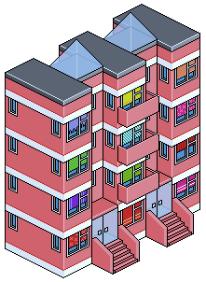
Eligible Multifamily Property Types
Any multifamily property with 5+ units
Not-for-profit, market rate and income eligible customers, including:
  Private Owners / Landlords
  Housing Authorities
  Housing Associations

Slide 4
Improvements to Consider
Building Envelope
  Air sealing
  Duct sealing
  Insulation
  Windows
Equipment Upgrades
  Boiler & furnace
  Hot water heaters
  Air conditioners & heat pumps
  ECM circulator pumps (heat loops and DHW recirculation)
  Appliances – Refrigerators, Dishwashers, Clothes Washers
Lighting
  LED screw-in bulbs
  LED dwelling unit fixtures
  LED exterior & common area fixtures
Water Saving Measures
  Reduced flow showerheads
  Reduced flow faucet aerators
Controls
  Boiler reset controls
  Occupancy sensors on lighting
  Variable speed drives on HVAC
  WiFi Thermostats

Slide 5
Multifamily Retrofit Project: Standard Process Flow
MF Application Submitted
Submit “MF Project Fill Out Form” & Proposals
Utility Letter of Agreement
Energy Efficient Measures installed
Energy assessment of property
Post Inspection & Payment
Pre-Inspection (if necessary)

Slide 6
Multifamily Energy Efficiency
Funding Process for CHFA/DOH Participation Letter
Project Initiation
Project Team Initiation & Kick-Off Meeting
*Proposal Review & Initial Submittal to Utility
Utility Review
Initial Review of Submittal
Letter of Participation (LOP) issued
Construction & Incentive Commitment
CHFA/DOH Funding Secured & Construction Started
Incentive Commitment from Utility Letter of Agreement (LOA)
Project Completion
Construction Complete & Utility Post Inspection
Incentive Payments Issued by Utility
*Proposal submittal must include:
Scope of work
Multifamily Initiative Application
Project Fill Out Form

Slide 7
Multifamily Retrofit Incentive Structure
Standard
Project
Comprehensive Project
Up to 75% of project cost based on estimated energy savings measure value
Up to 80% of project cost based on estimated energy savings measure value
Up to 40% of project cost based on estimated energy savings measure value
Up to 50% of project cost based on estimated energy savings measure value
Income Eligible
Market Rate
Note: Up to 100% of project cost paid for Direct Install Dwelling Unit Measures

Slide 8
CDBG Past Participant Example
New Horizons Village, Farmington
New Horizons Village
Energy Efficiency Measures |  | Incentive | Annual kWh Savings
1 | Exterior & Common Area Lighting | $55,660.96 | 60,234
2 | Wall & Attic Insulation | $3,068.35 | 304
3 | Community Room HVAC | $13,262.74 | 17,682
Totals |  | $71,992.05 | 78,220

Slide 9
CDBG Past Participant Example
Nathan Hale Terrace, Willimantic Housing Authority
Nathan Hale Terrace
Energy Efficiency Measures |  | Incentive | Annual kWh Savings | Annual CCF Savings
1 | Central Boiler Upgrades | $57,253.08 |  | 7,642
2 | Variable Frequency Drives (VFD) | $13,259.96 | 20,365
Totals |  | $70,513.05 | 20,365 | 7,642

Slide 10
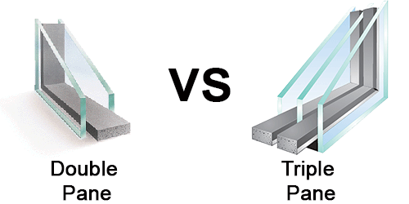
Market Transformation Measure Case Study:
The Triple Pane Window Story
Renovation projects considering new windows
The need: first-generation double pane windows installed in the 70’s & 80’s. These windows have broken seals, deteriorating sashes, and are inoperable
MF Initiative covered 100% of the cost to difference to go from Estar double pane to triple pane with U-value 0.22 or better
From 2015 to 2017 over 50 window projects completed in CT MF Initiative. Totaling over 14,000 windows & $1.7 million in incentives
Double Pane Windows
Triple Pane Windows
✔ Cost less than triple pane windows
✔ Can reduce up to 50% heat loss from existing windows
✔ Performs best with a fiberglass frame
X Less energy efficient
X Less durable than a triple pane unit
✔ Up to 30% more efficient than double pane
✔ Saves up to 2-3% on heating bills
✔ Less window condensation
✔ Fewer noticeable drafts
✔ Heavy weight makes stronger & longer life
X More expensive
X Some companies overcharge for triple pane windows
Utilities helped remove these barriers. Manufacturers and suppliers have supported this.

Slide 11
Contact Information to Submit Project:
UI / SCG / CNG:
Multifamily.Initiative@uinet.com
877-WISE USE
Eversource:
Multifamily Initiative Team
multifamily@eversource.com
877-WISE USE

Slide 12

Questions

