Slide 1


Slide 2
Small Cites CDBG 2020
Application Workshop
Completing the new
web-based/eForm

Slide 3

Application eForm
Application Handbook
Application Exhibits
Application Exhibit Checklist
Rating & Ranking
One (1) Thumb Drive for the entire application.
All hard copies with wet signatures (to be delivered with the thumb drive on April 3)

Slide 4
Application
General Information Page
Make sure to complete this section accurately

Slide 5


Slide 7
Citizen Participation
Fill in the table- answer the questions
Upload items..make certain the minutes contain information about PI use/reuse (if applicable). Get the admin staff or a detail- oriented person to accurately capture discussions.
If the meeting minutes don’t share specific points, you will not be scored.
We need to determine whether or not you completed the CIT PAT accurately.

Slide 8
…Next National Objective
Jobs Housing
Urgent Need
Urgent Need
Select/check the appropriate box
Benefit Low/Mod
(Limited Clientele, Area Benefit, Housing)

Slide 9

Complete Beneficiary info
#of Asians, # American/Native Indians, #Africans, #Hispanic, #Whites
#Handicapped, #Elderly People, #Female-headed Households etc.

Slide 10
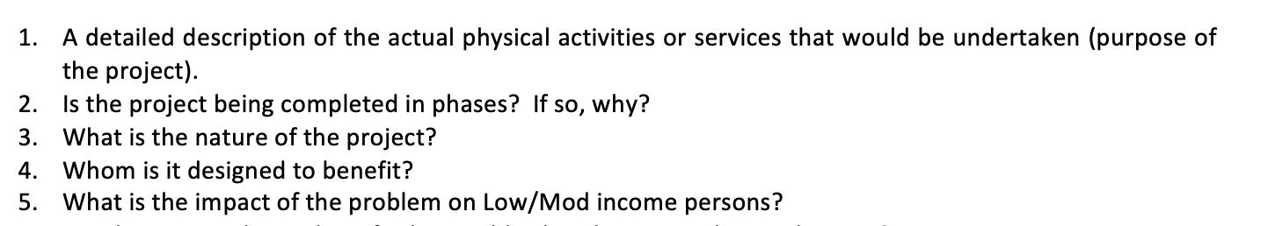
Sections 1.1
Program Description. Describe the proposed project/program. Limit to 1000 words.

Slide 11
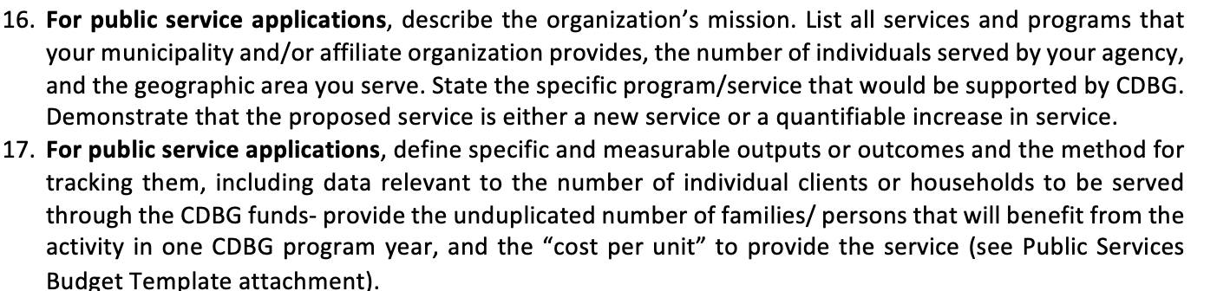
For Public Service

Slide 12
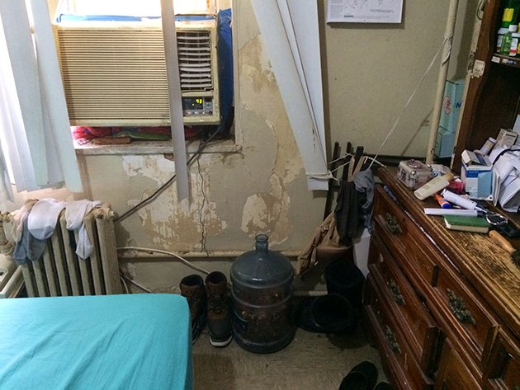
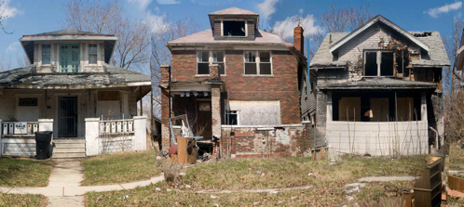
Section 2.1
Project Need

Slide 13
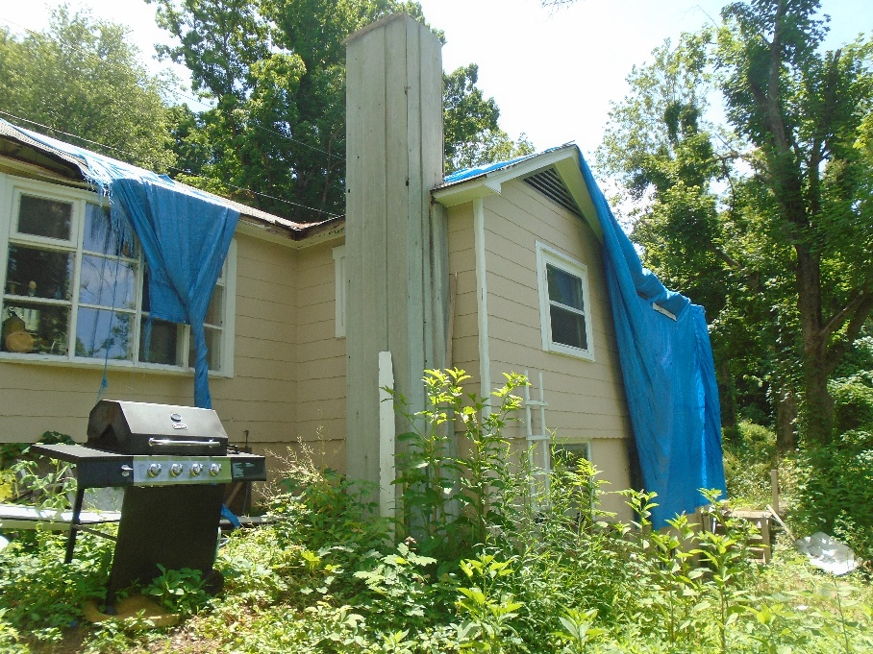
Or Projects that look like this

Slide 14
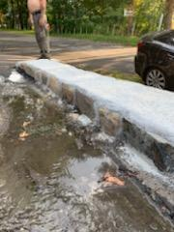
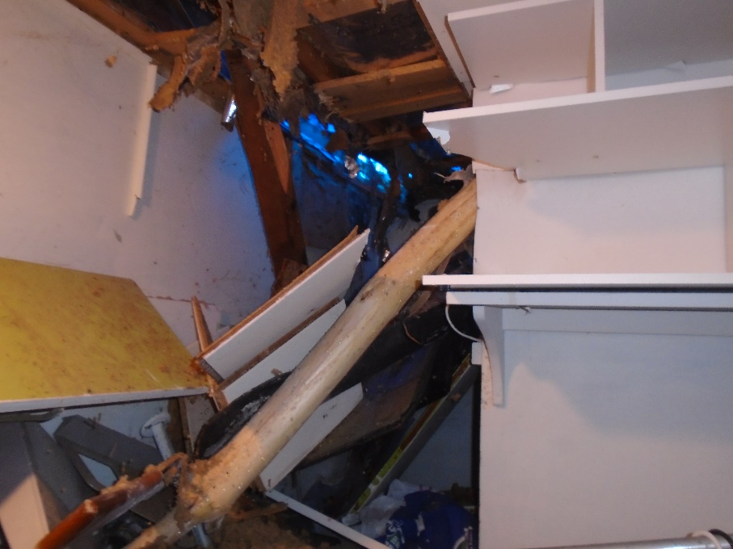

Slide 15
3.1
Applicant
Capacity

Slide 16

1 thumb drive

Slide 17
General
Include pages 1-5 of the application
Fair Housing Ordinance
Fair Housing Action Plan
Drug Free Workplace Policy
Section 3 plan
Environmental Review Record (Exempt, CENST and Broad level review for Housing Rehab).

Slide 18
Section 1
1.1
1.2
Section 2
Project Need
Section 3
3.1
3.1.A
1.3
3.1.B
Project Information
2.1
Capacity

Slide 19

Section 4
Project Feasibility & Merit
4.1 Budget Summary
4.2 Local leverage

Slide 20
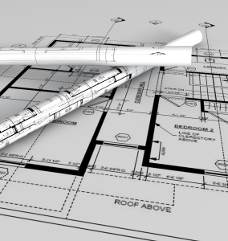
Section 4
Project Feasibility & Merit
Technical Compliance
4.4-4.7
4.5 and 4.5A Construction Documents- upload
(Provide drawing and specs electronically)

Slide 21
Community Impact
Section 5
5.1.A Community Impact Map
5.1.B Community Impact Map Narrative
5.2 Community Letters of Support
5.3 Resident Participation

Slide 22
Fair Housing and Equal Opportunity
Section 6
6.1 Local Fair Housing Action Steps- PAST GRANTEES ONLY
  6.2 Section 3 Past Performance – PAST GRANTEES ONLY
  6.6 -6.10- NEW GRANTEES ONLY
  Section 504/ADA Notice
  Section 504/ADA Grievance Procedure
  Section 504/ADA Checklist for Existing Facilities etc.

Slide 23
Other….
Sections 7-9
7.0 Fiscal and Grants Management
8.0 Consistency with State Consolidated Plan
9.0 DOH Training
9.1 List any non-required yet relevant Housing & Community Development trainings attended by municipal staff within the last 2 years

Slide 24

Week of March 1,2020
Check DOH’s Web site for application link

Slide 25


I’ll
Leave you with these parting words…….

Slide 26
Before you deliver the application to Hartford…..
Have a Martini, Whiskey, Rum, Tea or maybe a large bowl of Ice Cream (if that’s your thing)...
But on a serious note…..
√ Review the Application Handbook- cross check it against the application
√ Review the Exhibit Checklist
√ Review the Rating and Ranking…see how you score
√ Complete and include wet signature pages-that means real signatures in Blue ink.
√ take a moment to congratulate the folks around you for a great job pulling this all together. This is good work!

Slide 27
Good Luck &
Thank You

