Slide 1



Part 58 Basics Environmental Review
January 22, 2019

Slide 2
Keeping us on track Questions
Utilize the Parking Lots for questions.
Technical and Content questions will be addressed after the presentation.
Questions will also be part of today’s FAQs.

Slide 3
Objectives
• To wrap our heads around part 58 environmental reviews (familiarize with terms, forms, requirements)
To feel comfortable getting started with an environmental review for a project
To become aware of resources available to help completing an environmental review
Know where to look for more training on environmental reviews

Slide 4
Training Materials
Environmental Review (ER) Flowchart
ER Levels Information Sheets
Resource Links
*New* ER Partner Worksheets

Slide 5
What happened in 1969?
From Woodstock and a man on the moon to the Manson murders and the Stonewall riots; listed below are a few of the historic and memorable moments from that year.
  Sirhan Sirhan sentenced
  The Who releases "Tommy"
  "Midnight Cowboy" released
  Last episode of 'Star Trek' airs
  Chappaquiddick
  Muhammad Ali convicted
  The Manson murders
  The Miracle Mets

Slide 6
Most Importantly
The National Environmental Policy Act (NEPA) of 1969 was enacted by Congress to ensure that federal agencies consider and address environmental impacts resulting from the activities and projects they sponsor.
Congress subsequently enacted a series of statutes dealing with specific environmental issues
The US Department of Housing and Urban Development (HUD) developed its own set of regulations that implement NEPA and additional environmental statutes.
All HUD federally-assisted projects are subject to these requirements for environmental review and documentation.

Slide 7
National Environmental Policy Act of 1969
Requires Federal agencies to consider the environmental impact of proposed actions early on in the planning and decision making process.
A process designed to encourage public participation.
Requires that documents be available to the public.

Slide 8


TERMS
Project
Activity
Recipient
Responsible Entity
Certifying Official
Exempt
CENST
Categorically Excluded
RROF
NOI/RROF
EA
FONSI

Slide 9

Part 58: Responsible Entities
Responsible Entity (RE) assumes federal responsibilities
  • RE = a unit of general local government, tribe or State
Responsible Entity Certifying Officer
  • Evaluates the environmental review
  • Is responsible for scope and content
  • Makes environmental finding
  • Goes to court in a lawsuit
  Grantees must maintain an environmental review file for
  each activity that documents decision-making and process.

Slide 10

Who has these Responsibilities under Part 58
Receives the form from the RE certifying that the Environmental Review is complete?
Accepts public comments ?
Completes a form to authorize the release of funds?
Monitor REs for environmental compliance?
Provide technical assistance?

Slide 11
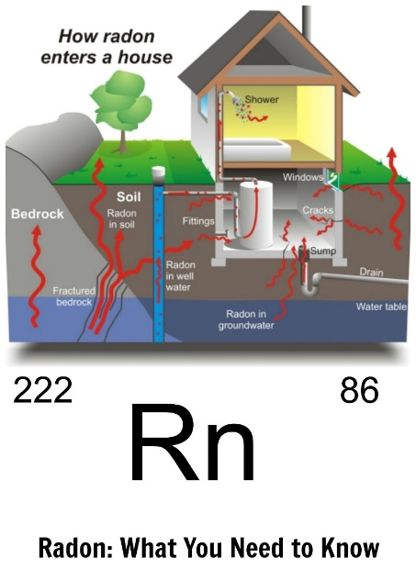
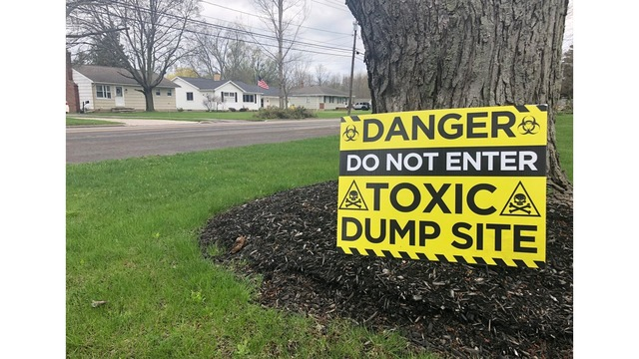

What is an Environmental Review?
Analysis of the impact of a project on the surrounding environment and vice versa.

Slide 12
The Objective
To document that our HUD funded projects are not harming the
environment and that the environment is not impacting our projects.
To provide decent, safe, and sanitary housing.
(Don’t commit funds before you do it.)

Slide 13
Environmental Golden Rule
Remember the other Golden Rule? Whoever holds the gold, makes the rules!!
Sec. 58.22 Limitations on activities pending clearance.
(a)Neither a recipient nor any participant in the development process, including public or private nonprofit or for-profit entities, or any of their contractors, may commit HUD assistance under a program listed in Sec. 58.1(b)on an activity or project until HUD or the state has approved the recipient's RROF and the related certification from the responsible entity.
In addition, until the RROF and the related certification have been approved, neither a recipient nor any participant in the development process may commit non-HUD funds on or undertake an activity or project under a program listed in Sec. 58.1(b) if the activity or project would have an adverse environmental.

Slide 14
The Environmental Review Process

Slide 15
Which Activities will Require an Environmental Review?
ALL OF THEM

Slide 16

Define the Project
Most important aspect of review!
Understand the actual physical project.
Describe what is happening.
Must include the entire project, not just portion being funded with HUD money.

Slide 17
Level of Review

Slide 18





Exempt Activities
Exempt Activities
Listed in 24 CFR 58.34(a):
Environmental, planning & design costs
Information & financial services
Administrative & management activities
Public services (no physical impact)
Inspections
Purchase of tools & insurance
Technical assistance & training
Payment of principal and interest
Temporary assistance for disaster or imminent threats

Slide 19


Categorically Excluded Not Subject to 58.5 (CENST) Activities
Listed in 24 CFR 58.35(b):
Tenant-based rental assistance
Supportive Services (healthcare, housing placement)
Operating costs (utilities, supplies)
Economic development costs (non-construction)
Pre-development costs
Maintenance
Supplemental Assistance
22

Slide 20


Categorically Excluded Subject To (CEST)
58.5 Activities
Categorically Excluded
Subject to 58.5 (CEST) Activities
Listed in 24 CFR 58.35(a): Narrowly defined activities with physical impacts
Acquisition, leasing, or disposition of vacant land or existing buildings with no change in land use
Acquisition or leasing of public facilities with no change in land use
Removal of barriers that restrict mobility and accessibility to elderly and handicapped

Slide 21

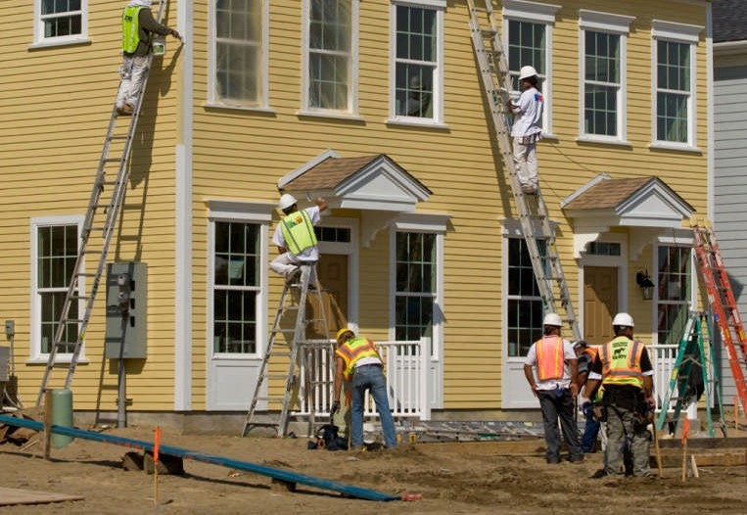
CEST Activities Continued
Rehabilitation, Repair, and Improvements
Public facilities and non-residential buildings: no change in land use, change in size or capacity < 20%
Multifamily residential: no change in land use, change in size or capacity < 20%, cost of rehab < 75% of cost of replacement after rehab
Single family residential: no change in land use, density < 4 units, footprint not in floodplain or wetland
The Environmental Review Record (ERR) must contain a well organized written record of the process and determinations made under this section.

Slide 22
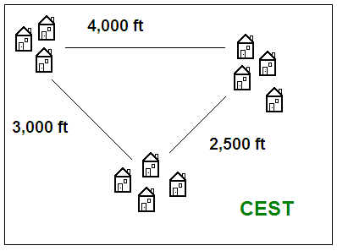
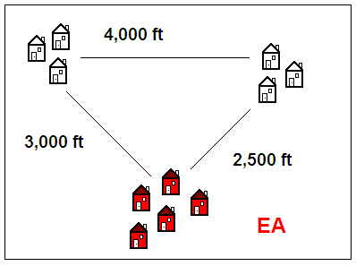
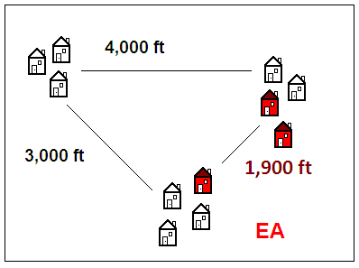
CEST Activities Continued
New Construction, Reconstruction, & Demolition
Individual action: single family residential only
  Maximum of 4 units, OR
  Scattered site: 5+ units on sites 2,000+ ft apart, with no more than 4 units per site

Slide 23


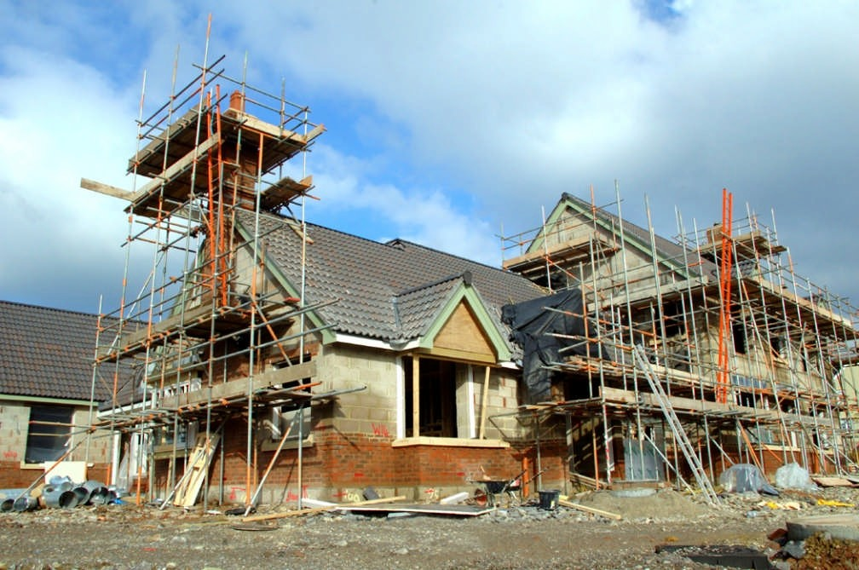
Environmental Assessment (EA)
Environmental Assessment (EA)
The default level of review
Major rehabilitation
Most new construction, reconstruction, or demolition
Any change in land use
•
Whenever no exclusion applies

Slide 24

Environmental Impact Statement (EIS)
Environmental Impact Statement (EIS)
Listed in 24 CFR 58.37:
Finding of significant impacts (FOSI)
Projects affecting 2,500+ units or beds
Recommended format: see CEQ regulations at 40 CFR 1502.10

Slide 25
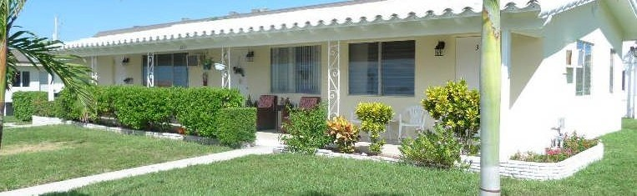
Quiz: Choose the Level of Review
QUIZ
1. Construction of a 4-unit apartment building
❖ Answer: CEST (24 CFR 58.35(a)(4)(i))

Slide 26

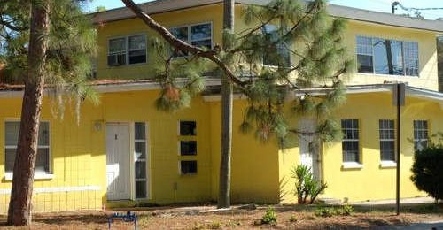
Quiz: Choose the Level of Review
2. Demolition and reconstruction of a 5-unit apartment building
Answer: EA

Slide 27

Quiz: Choose the Level of Review
3. Replacement of an office building’s plumbing system
Answer: CEST (58.35(a)(3)(iii))

Slide 28





Quiz: Choose the Level of Review
4. Office operating costs
Answer: CENST (58.35(b)(3))

Slide 29
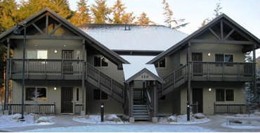
Quiz: Choose the Level of Review
5. Buying an apartment building with the intent to perform minor repairs and rent out individual apartments
❖ Answer: CEST (58.35(a)(3)(ii), 58.35(a)(5), 58.35(a)(6))

Slide 30
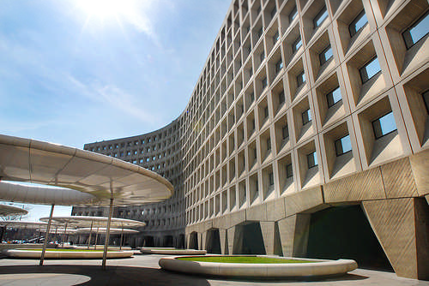
Quiz: Choose the Level of Review
6. Selling an office building to a developer who plans to demolish a portion of the building and convert residential
Answer: EA

Slide 31
The Environmental Review Process

Slide 32

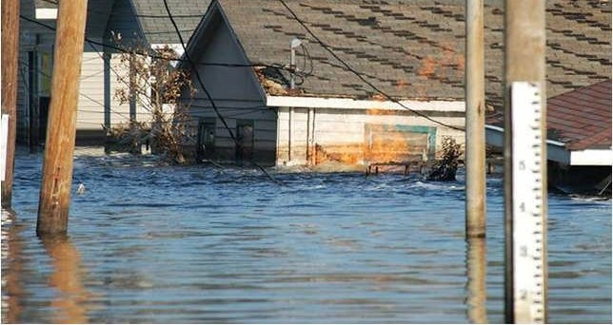

58.6 Applies to ALhttps://
Requirements in 24 CFR 58.6:
National Flood Insurance Program
Coastal Barrier Resources Act
Airport Runway Clear Zones

Slide 33
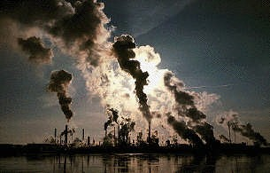

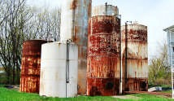

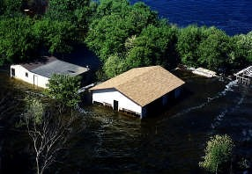
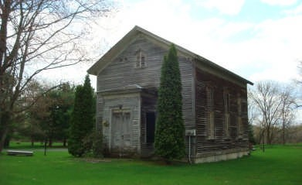
24 CFR 58.5: The fun stuff
    The “Statutory Checklist”
      Clean Air Act
      Coastal Zone Management Act
      Contamination and Toxic Substances
      Endangered Species Act
      E.O. 12898 on Environmental Justice
      Explosive and Flammable Hazards
      Farmlands Protection Policy Act
      E.O. 11988 on Floodplain Management
      National Historic Preservation Act
      Noise Abatement Regulation
      Sole Source Aquifers
      E. O. 11990 on Wetlands
      Wild and Scenic Rivers Act
37

Slide 34
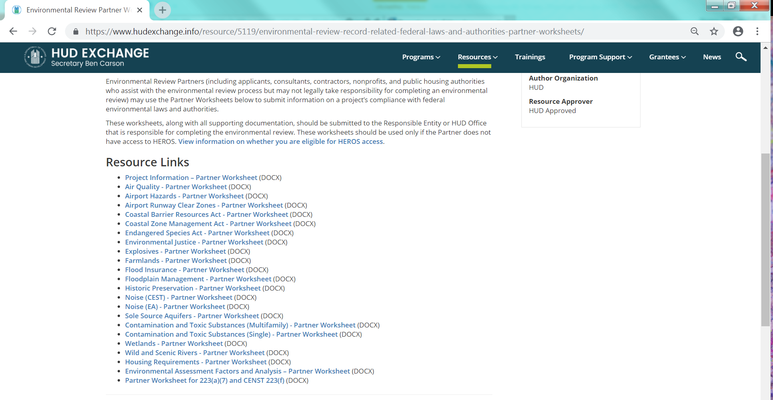
Resources

Slide 35
Suggested Formats
Formats
Exempt or Categorically Excluded, Not Subject to 58.5
Categorically Excluded, Subject to 58.5
Part 58 Environmental Assessment
Broad-Level Tiered Environmental Review for Activity/Project that is Categorically Excluded Subject to Section 58.5

Slide 36
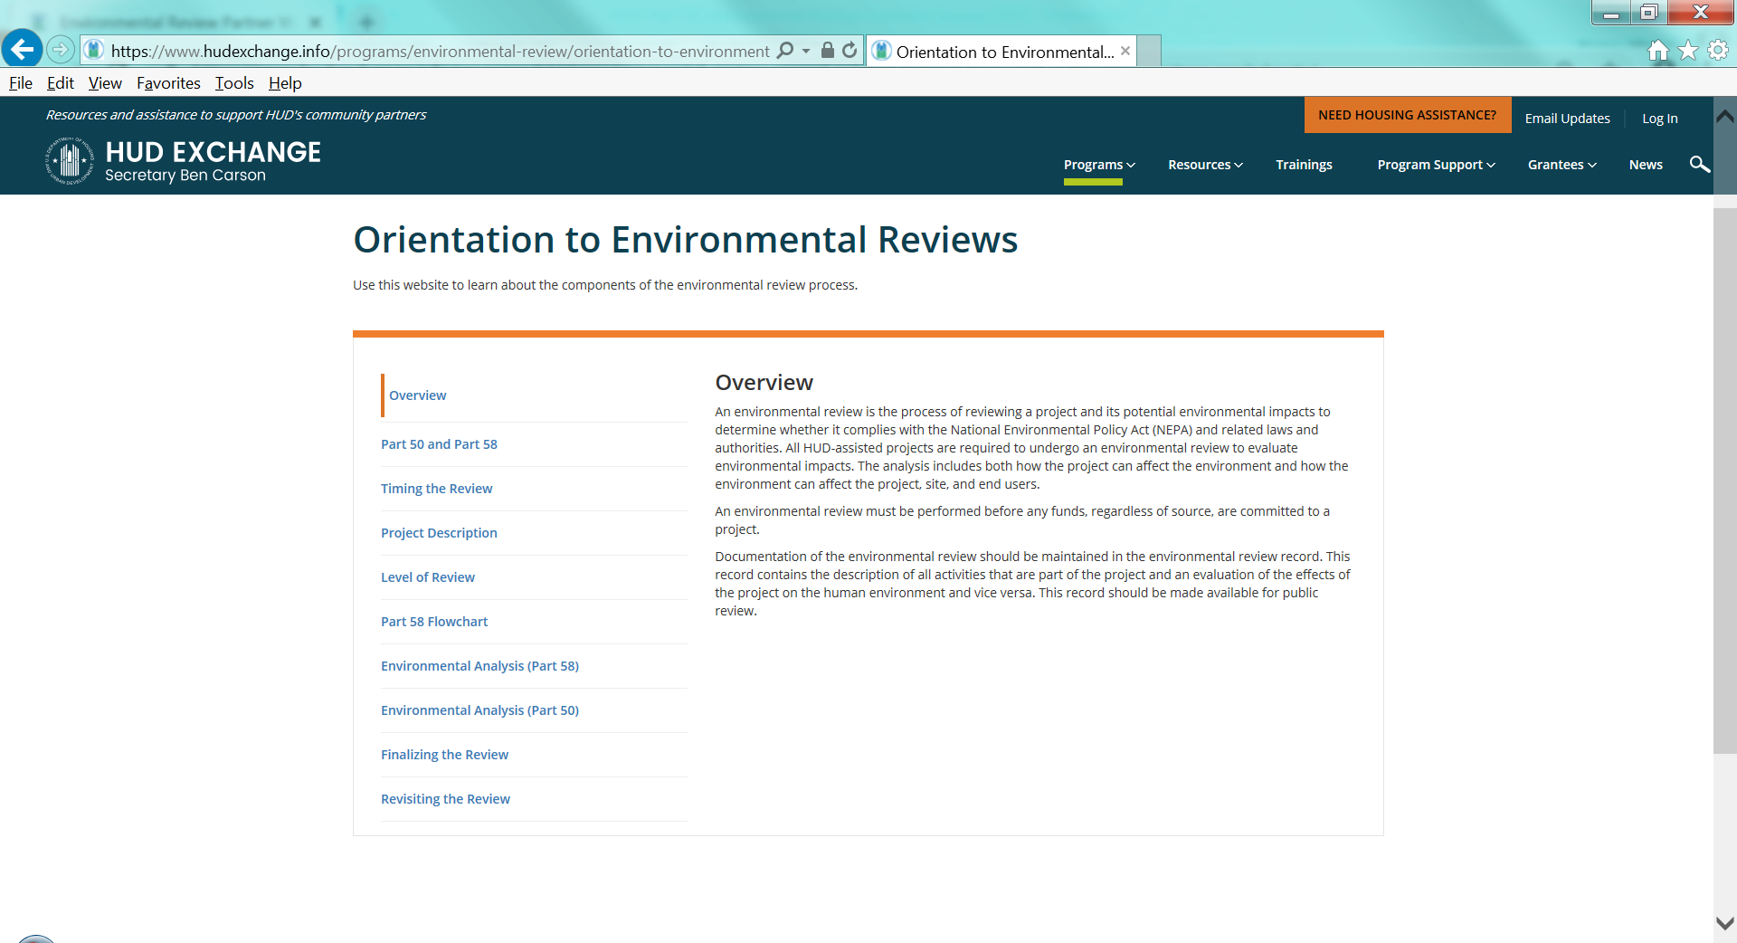

Slide 37
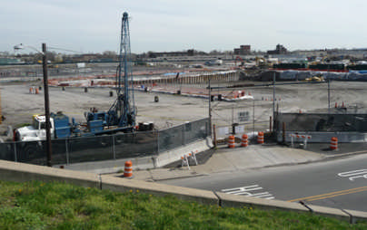
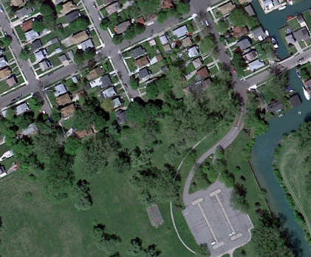
Project Description
The ERR shall:
Capture the maximum anticipated scope of the proposal
Include all contemplated actions that are a composite part of the project
Project aggregation (58.32)
Sensitive information

Slide 38
Environmental Review Record (ERR)
The ERR shall:
Describe all activities that are part of the project
Evaluate effects of project on human environment
Document compliance with applicable authorities, particularly 58.5 and 58.6.
Record determinations and findings.
Contain verifiable source documents and relevant base data.

Slide 39
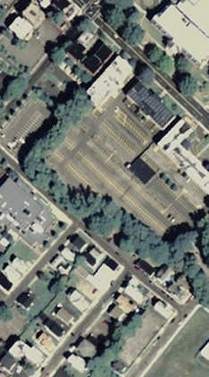
Documentation in the ERR
The ERR shall: Document how determinations were made – including but not limited to:
Maps (including the location of the project)
Letters of correspondence, approvals or required permits
Process for floodplain and wetland management
Phase I and Phase II ESA reports
Pictures of the site and future renderings

Slide 40

It’s not over yet!!!
Mitigation and Monitoring
If mitigation measures were required in any of the portion of the environmental review, make sure they are implemented.
DOH staff will be monitoring Responsible Entities for environmental compliance.
50

Slide 41
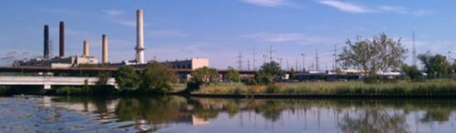
Re-evaluation of Project Changes (58.47)
RE must re-evaluate environmental findings when:
Change in nature or extent of project,
New environmental circumstances or conditions
Selection of alternative not in original finding
MUST UPDATE ERR - If FONSI is reaffirmed, no new FONSI is required If original findings no longer valid, prepare a new review at a higher
level of review.

Slide 42
Take-Away Messages
An Environmental Review (ER) is an analysis of the impacts of both the project on the environment and the environment on the project.
Under Part 58 the Responsible Entity Certifying Officer becomes the “responsible Federal Official” for NEPA responsibilities.
Funds cannot be committed, obligated, or expended prior to the completion of the environmental review.
The RE must create an environmental review record with verifiable resources and documented findings for each project.

Slide 43
Questions?
Environmental Assessment
Categorical Exclusion, Subject to 58.5
Exempt
Categorical Exclusion, Subsequently Exempt
Continued Relevance
Categorical Exclusion, Not Subject to 58.5

