Slide 1
OneRD Guarantee Loan Initiative

Slide 2
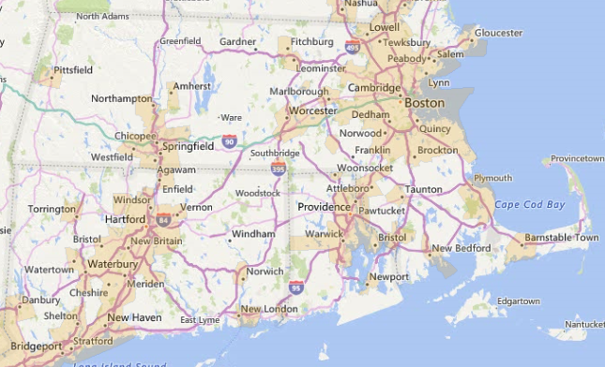
Eligible Areas
Rural and Rural Areas:
Any area of a State not in a city or town with a population of more than 50,000 people
Urban areas contiguous to cities and towns with populations of 50,000 or more are not eligible
Eligibility can be checked on our eligibility map:
http://eligibility.sc.egov.usda.gov/eligibility/welcomeAction.do

Slide 3
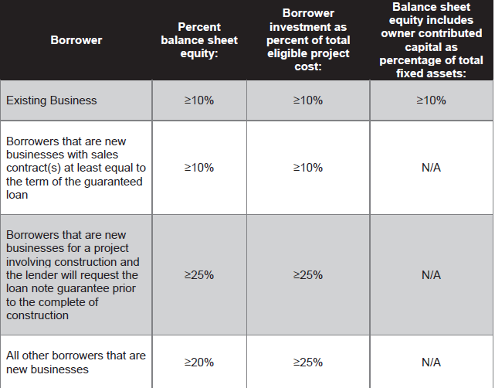
Balance Sheet Equity (B&I)
Borrower must meet one of the following at the time of closing the guaranteed loan:

Slide 4
Loan Note Guarantee (LNG) Issued Prior to Project Completion
Now available across all programs
Requirements:
Lender must request to have LNG issued prior to completion; Agency must concur
If project involves non-proven technologies, Lender cannot request to issue LNG prior to completion
Lender pays 0.5% fee upon requesting LNG
Lender must provide evidence that Borrower has entered a fixed-price construction contact
Lender must provide monthly construction reports to Agency

Slide 5
Loan Retention/Fees
Loan Retention:
Lender must retain a minimum of 7.5% of total loan amount in portfolio
Guarantee Fee
One-time guarantee fee of 3% of guaranteed amount
Retention Fee
.5% of the guaranteed amount @ 12/31 of each year
Fees will be established/revised for each fiscal year

Slide 6
Lender Eligibility
Under OneRD, Lenders must be:
Domiciled in a State
Not debarred or suspended by the federal government
Inform Agency if under a consent order from a Federal or State Agency
Maintain written standards of conduct covering conflict of interest
Maintain internal audit and management control systems
Become approved in Agency’s electronic System
Must complete Level 2 E-authentication:
https://www.eauth.usda.gov/home

Slide 7
Types of Lending Entities
Non-Regulated Lender serving Tribal Trust Lands (new)
Unregulated by Federal or State statutes and has a specific mission to make loans available only to tribal trusts
Non-Regulated Lenders
Not subject to regulatory review, examination, or oversight by Federal or State
Regulated Lenders
Organized by Federal or state statute and are subject to supervision and credit examination by an Agency

Slide 8
Non-Regulated Lending Entity
Non-Regulated Lending Entity
Any type of entity that does not meet the definition of a regulated entity
Includes CDFI lenders, who are authorized and must meet certain criteria of the U.S. Treasury
Not subject to regulatory or internal credit examination requirements
Once approved by the Agency, can make loans across all four programs

Slide 9
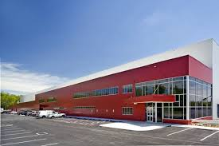
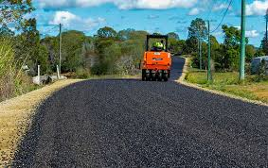
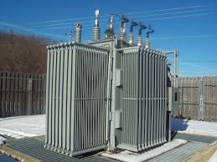
Business & Industry Loan Guarantee Program

Slide 10
Business and Industry (B&I): Eligible Borrowers
Borrower must be:
A cooperative, corporation, partnership, or other legal entity organized and operated on a profit or non-profit basis
An Indian Tribe
A public body
An individual
Borrower must engage in or promote a business which will provide employment or improve the economic or environmental climate in rural communities
Borrower who is an individual must:
Be a citizen of the US
Reside in the US after being legally admitted for permanent resident
Be a resident of the Republic of Palau, Micronesia, American Samoa, Guam, the Marshall Islands, and the Northern Mariana Islands
Borrower must demonstrate the project will primarily create new or save existing jobs for rural US residents

Slide 11
Business and Industry: Eligible Projects
Purchase, development of land, associated infrastructure, building upgrades
Business acquisitions, start-ups, expansions to create or save jobs
Purchase of machinery and equipment
Pollution Control
Education and training facilities
Cooperatives and local food projects

Slide 12
Business and Industry: Loan Highlights
No longer requires tangible balance sheet equity; new requirement to have sufficient capital or equity to mitigate ongoing risks of business
Project must be located in a rural area with less than 50,000 people
For utility projects serving both rural and non-rural areas, the Agency will guarantee only the amount necessary to finance the portion of the project in an eligible rural area
Projects must be located in rural areas; except for loans to cooperatives and for local food projects

Slide 13
Business and Industry: Loan Highlights (cont.)
Maximum Loan Amount: $25M
Up to $40M for rural cooperatives that process value-added agricultural commodities
Guarantee Fee: 3.0%
Periodic Guarantee Retention Fee: 0.5%
Loan Guarantee Percentage: 80%
Fee for LNG Prior to Construction: 0.5%

Slide 14
USDA Local Contacts
Jennifer Sharrow – Business and Community Programs, Loan Specialist
Jennifer.Sharrow@usda.gov
(413) 923-3243
Dave Brown – Business and Community Programs, Loan Specialist
David.Brown3@usda.gov
(860) 902-5377

