Slide 1

2022 Farm Viability Grant
AliRose Grabarz
Ag Development and Resource Conservation
CT Department of Agriculture
Alison.Grabarz@ct.gov

Slide 2
Today’s Agenda
Welcome
Overview of the 2022 Farm Viability Grant
  Grant Description
  Eligible Applicants
  Questions of Focus
  Match Requirement, Expenses, & Payment
  Project Duration & Post Award Requirements
  Submission Process
    Required attachments
  Evaluation Criteria and Process
Important Dates
How to Apply
Questions?

Slide 3
Grant Description
The Farm Viability Grant provides matching funds for projects that directly impact and/or foster agricultural viability.
All projects funded by the Farm Viability Grant must advance farming and agriculture.
The Farm Viability Grant Program and any awards are subject to limitations of state funding.
  Funded by the Community Investment Act
  $500,000 for the Agriculture Viability Grant Program

Slide 4
Eligible Applicants
Municipalities with a current Plan of Conservation & Development
Regional councils of governments organized under the provisions of sections 4-124i to 4-124p, inclusive
Groups of municipalities that have established a regional inter-local agreement pursuant to sections 7- 339a to 7-339l, inclusive
Agricultural non-profit organizations
  Non-profits must be registered with the CT Secretary of State and provide a copy of the federal IRS exemption letter.
  Non-profits must have submitted Form 990 and been in existence for the previous three years.

Slide 5
Eligible Applicants (continued)
Please Note: Applicants which have received two years of consecutive funding will be ineligible for an award for one year.
For example:
2019: Project awarded
2020: Project awarded
2021: Ineligible for an award
2022: Eligible for an award
If non-profits or municipalities are applying for a project relating to a farmers’ market, the market must be a certified CT Grown farmers’ market.
Applicants who have an open agreement and a project in progress are ineligible to apply.

Slide 6
Questions of Focus
Each Question of Focus addresses a specific problem, interest, or need of the CT Agricultural Industry.
Eligible applicants must describe how their proposed project will address or respond to one Question of Focus.

Slide 7
1.) Diversity, Equity, and Inclusion (DEI) in Agriculture
Question of Focus:
Please propose a project which directly impacts farmers in one or more of the following classifications: limited resource, BIPOC, veterans, members of the LGBTQ+ community or people with a disability.
Project Examples:
Developing an agriculture education/outreach program to specifically reach one of the classifications above
Redesigning a community or urban farm to be accessible to individuals with disabilities
Any agriculturally-related project which directly benefits individuals of any of the classifications listed above.

Slide 8
2. Urban Agriculture
Question of Focus:
Please propose a project that focuses on establishing or expanding support and resources for urban agriculture.
Project Examples:
Development of an urban ag master plan
Expansion of urban ag infrastructure for increased production capacity

Slide 9
3. Food Supply Chain
Question of Focus:
Please propose a project that would make kitchen space available to process CT Grown farm products or propose/develop plans for construction of meat processing facilities/food hubs or co-op operations that would increase market opportunities for CT farmers.
Project Examples:
Projects that expand food hub operations to increase distribution capacity of CT Grown farm products
Feasibility study for creation of meat processing facility in CT
Projects that increase production of value-added CT Grown farm products, and increase opportunities for farmers to create those products

Slide 10
4. Farmland Accessibility
Question of Focus:
Please propose a project which addresses farmland accessibility and pilots an effort to improve accessibility for new farmers or current producers looking to expand their operation; or supports succession strategies for farmers exiting agriculture.
Project Examples:
Working with a land trust and other partners to identify potential land for production agriculture
Inventorying land within a municipality(ies) that could be put into production agriculture
Providing support services like lease writing, transition plans, etc. for farmers

Slide 11
Match Requirement, Expenses and Payment
The amount awarded to any applicant of the Farm Viability Grant shall not exceed $49,999.00.
All grants have a match requirement.
  Matching funds from the applicant must be a minimum of 40% of the total cost of the project budget.
  The match can consist of in-kind and/or cash contributions directly related to the project.
  Employee salaries and fringe benefits to execute the project are allowable expenses, but in total cannot exceed 25% of the grant funds requested.
  If a grant is providing the match, the applicant must disclose the grantor, the grant name, and amount awarded.

Slide 12
How do I determine my match requirement? Or the grant funds I can apply for?
  Start by finding the total cost for your project.
  Grant funds will cover 60% of the project cost (up to $49,999).
  Your total match (cash + in-kind match) must equal at least 40% of the project cost.

Slide 13
Match Requirement Table
Project Total Cost | Grant Funds Available | Cash Match Required
$1,000 | $600 | $400
$5,000 | $3,000 | $2,000
$10,000 | $6,000 | $4,000
$15,000 | $9,000 | $6,000
$20,000 | $12,000 | $8,000
$30,000 | $18,000 | $12,000
$40,000 | $24,000 | $16,000
$50,000 | $30,000 | $20,000
$75,000 | $45,000 | $30,000
$83,331.67 | $49,999 | $33,332.67
$100,000 | $49,999 | $50,001
$150,000 | $49,999 | $100,001
Maximum grant award reached.

Slide 14
Match Requirement, Expenses and Payment (continued)
Expenses that CAN be reimbursed with grant funds
  Multi-media marketing expenses
  Employee salaries and fringe benefits paid to execute the project
    Cannot exceed 25% of grant funds requested
  General-purpose equipment or equipment rental
    Must directly support the project
    The eligibility of general-purpose equipment will be reviewed based on the Question of Focus and project usage
  Stipends, Honorariums
  Rental fees

Slide 15
Match Requirement, Expenses and Payment (continued)
Expenses that CANNOT be used as a match and will not be funded by the grant
  Any expense incurred prior to contract execution
  Land acquisition/mortgages
  Cost of borrowing (points and other fees)
  Expenses related to establishing a new organization/business
  Any portion of expense for which the applicant pays a contractor in merchandise or service in lieu of cash
  Tuition/tuition reimbursement or career-related/scholarship funds
  Routine business expense (utilities, office supplies, etc.)
  Disposable supplies (office, farm, otherwise) not related to the project
  Legal expenses related to litigation
  Indirect or contingency costs of any percentage

Slide 16
Match Requirement, Expenses and Payment (continued)
Expenses that are an acceptable match if they directly and meaningfully support the proposed project.
  State/local/federal permits
  Attorney’s fees (not related to litigation)
  Consumable or disposable supplies
  Employee salaries and fringe benefits paid to execute the project
    Cannot exceed 25% of grant funds requested

Slide 17
Project Duration & Post Award Requirements
Applicants of awarded projects will be responsible for the following:
  Signing an agreement with the State of Connecticut
  Providing a Certificate of Insurance listing the state as an additional insured on the grantee’s liability insurance policy
  Completing the project within the contractual timeframe
  Submitting a final project report in the required format per the executed contract.
  Submitting a final financial report itemizing actual expenses.
    Copies of invoices and proof of payment must be submitted with the payment request at the conclusion of the project
  Agreeing to a site inspection once the project is complete and prior to final payment being released
  Other requirements as outlined in the State of Connecticut contract.

Slide 18
Project Duration & Post Award Requirements (continued)
These are reimbursement grants.
Incomplete projects cannot be fully reimbursed.
After the agency issues a purchase order, one cash advance of up to 50% of the total grant award may be requested by the grantee.
The balance of the award will be reimbursed upon project completion and submission of required reporting documents.

Slide 19
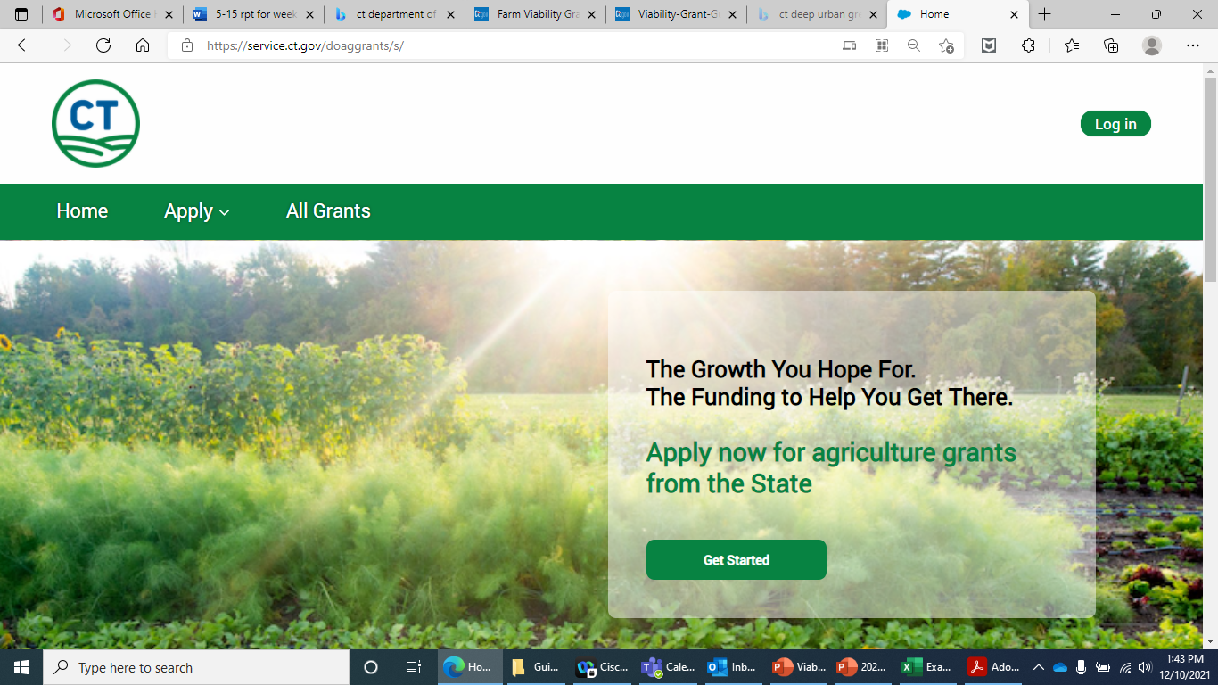
Submission Process
NEW FOR 2022: All Farm Viability Grant applications are required to be submitted through DoAg’s grant portal.
All grant funding opportunities can be found here: https://service.ct.gov/doaggrants/s/

Slide 20
Application Requirements
A complete application includes:
  Itemized Budget Form (added as an attachment)
  Completion of the Grant Narrative
  Attachment of any quotes/estimates, conceptual drawings, and other budget justification items.

Slide 21
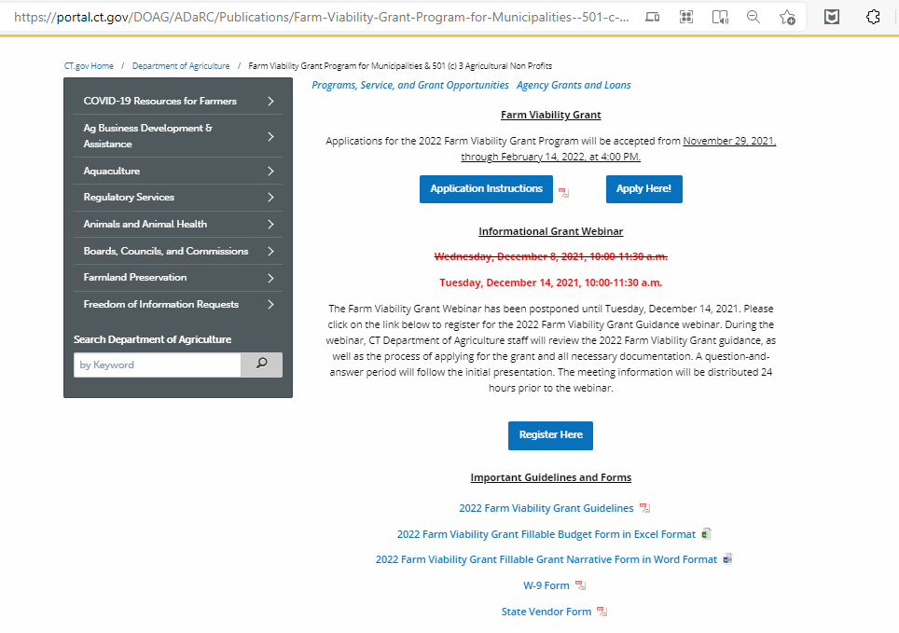
Budget Form
Go to: https://portal.ct.gov/DOAG/ADaRC/Publications/Farm-Viability-Grant-Program-for-Municipalities--501-c-3-Agricultural-Non-Profits
Look under Important Guidelines and Forms
Save a copy to your computer and attach to your application.

Slide 22
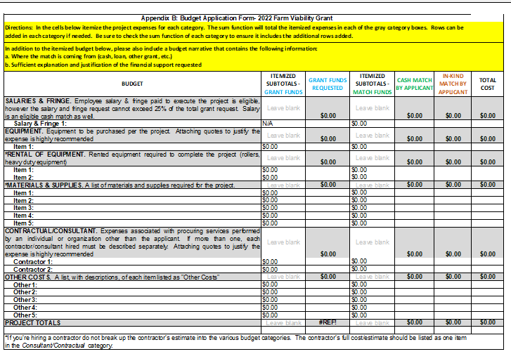
Budget Form (continued)
Your budget must contain the following itemized categories

Slide 23
What is an in-kind match?
In-kind donations= donations or services provided in place of a cash match.
An in-kind match is the value of any real property, equipment, goods, or services that would have been eligible costs if the recipient was required to pay for such costs.
    If you have volunteers assist on the completion of your grant project, their time and effort has a monetary value—even though you do not pay them for their services.

Slide 24
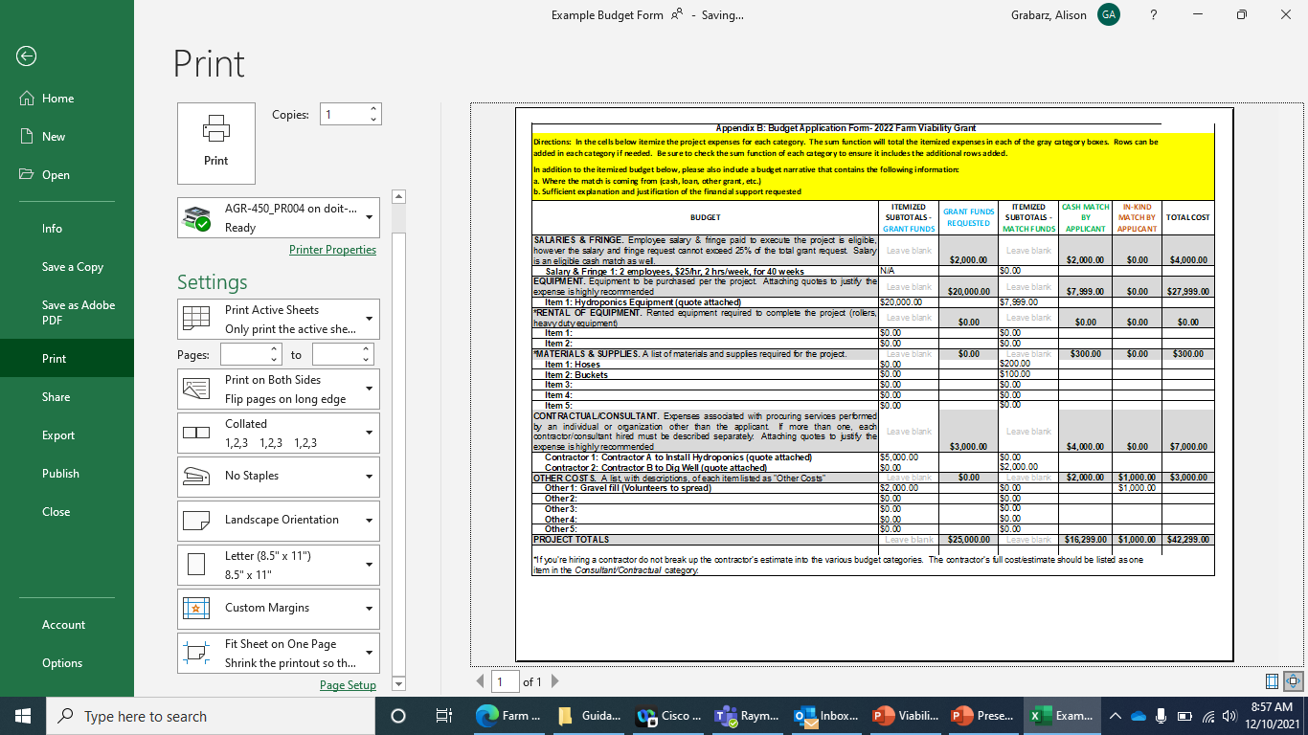
In-Kind Match Example
The current value of a volunteer is $28.50 per hour.
4 volunteers * $28.50/hr
* 8.75 hrs =$1,000
In this example,
4 volunteers worked for a total of 8.75 hours to spread gravel fill in a greenhouse.
Some volunteers may have different values for their time.

Slide 25
Budget Form (continued)
Cash Match =
(Cash Match by Applicant + In-Kind Match by Applicant)
/ Total Cost
($16,299.00 + $1,000) = $17,299.00
($17,299.00 / $42,299.00)
= 0.41 or 41%

Slide 26
Grant Narrative
Go to: https://portal.ct.gov/DOAG/ADaRC/Publications/Farm-Viability-Grant-Program-for-Municipalities--501-c-3-Agricultural-Non-Profits
Look under Important Guidelines and Forms
Save a copy to your computer and answer questions.
Copy + Paste your answers into the grant portal.

Slide 27
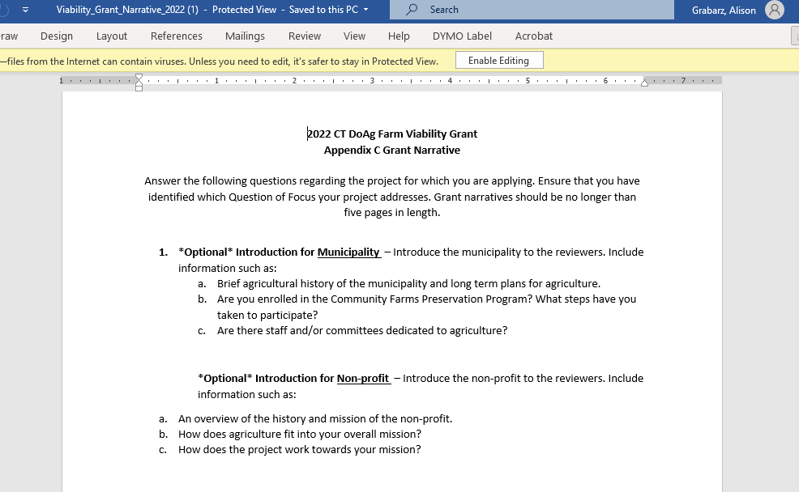
Grant Narrative (continued)

Slide 28
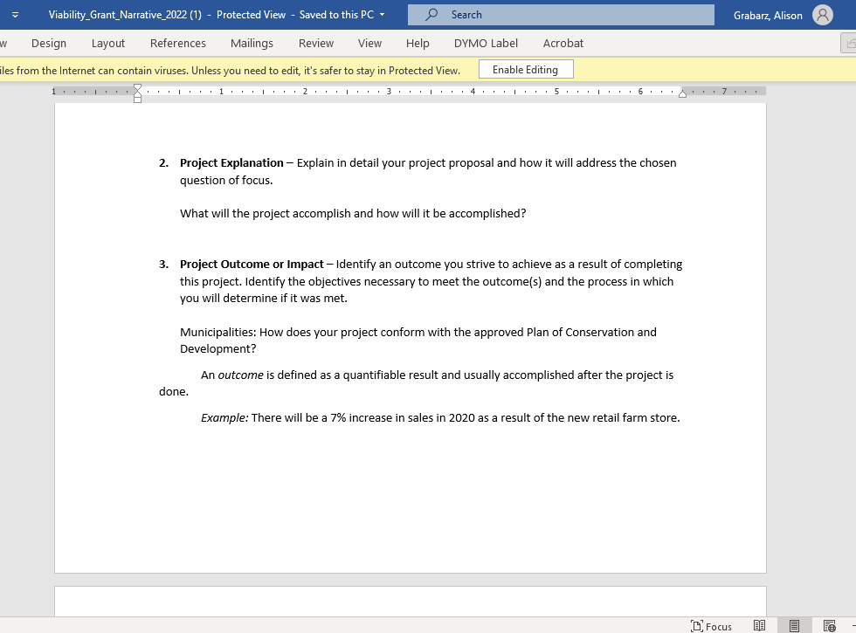
Grant Narrative (continued)

Slide 29
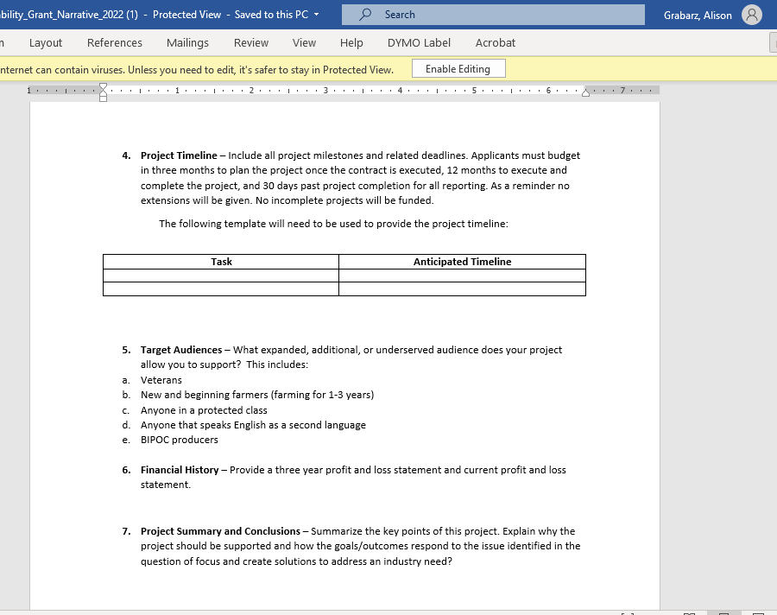
Grant Narrative (continued)

Slide 30
Other Important Forms
The DoAg Grants portal will prompt you to fill out and save a copy of your W-9 Form and State Vendor Form.
Additional copies of the blank forms can be found here: https://portal.ct.gov/DOAG/ADaRC/Publications/Farm-Viability-Grant-Program-for-Municipalities--501-c-3-Agricultural-Non-Profits
Copies of these forms MUST be attached to your grant application.

Slide 31
Evaluation Criteria and Process
The Farm Viability Grant is a competitive grant.
Only complete applications submitted on time will be evaluated.
The grant evaluation will be weighted heavily on the project plan described in the Grant Narrative.
Quotes, estimates, conceptual drawings, and other documentation justifying and supporting the budget and project are required to present a competitive application.

Slide 32
Important Dates
Application Period:
  Monday, November 29, 2021 – Monday, February 14, 2022, at 4:00 p.m.
Application Deadline:
  Monday, February 14th, 2022, at 4:00 p.m.
Project Start Date:
  June 2022

Slide 33
Grant Application and Award Process
Guidance Released — Nov. 29, 2021
Grant applications accepted until Feb. 14, 2022
Administrative review conducted
Review panel meets — Late March
Awards are determined — Late March
Contracts are drafted, reviewed, and sent for signature by awardee
Contract training workshop is held — Mid April
Internal contract signature(s) obtained, and paperwork completed
Contracts over $25,000 are sent for AG’s signature
Once all signatures are obtained the project can begin — June 2022
Purchase order generated by DoAg
Copy of the PO and original contract is returned to the awardee

Slide 34
Where can I find more information on the 2022 Farm Viability Grant?
Go to: https://portal.ct.gov/DOAG/ADaRC/Publications/Farm-Viability-Grant-Program-for-Municipalities--501-c-3-Agricultural-Non-Profits
Under “Important Guidelines and Forms” click on “2022 Farm Viability Grant Guidelines”

Slide 35
How do I apply for the 2022 Farm Viability Grant?
Two ways:
  Go to: https://portal.ct.gov/DOAG/ADaRC/Publications/Farm-Viability-Grant-Program-for-Municipalities--501-c-3-Agricultural-Non-Profits
  Click on “Apply Here!”
  Click on “All Grants”
  Choose “Farm Viability Grant”
OR
  Go to: https://service.ct.gov/doaggrants/s/
  Click on “All Grants”
  Choose “Farm Viability Grant”

Slide 36
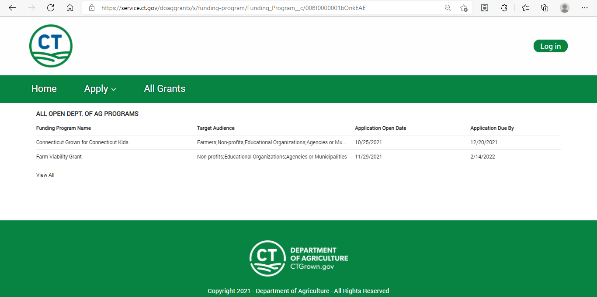
1.
2.
3.

Slide 37
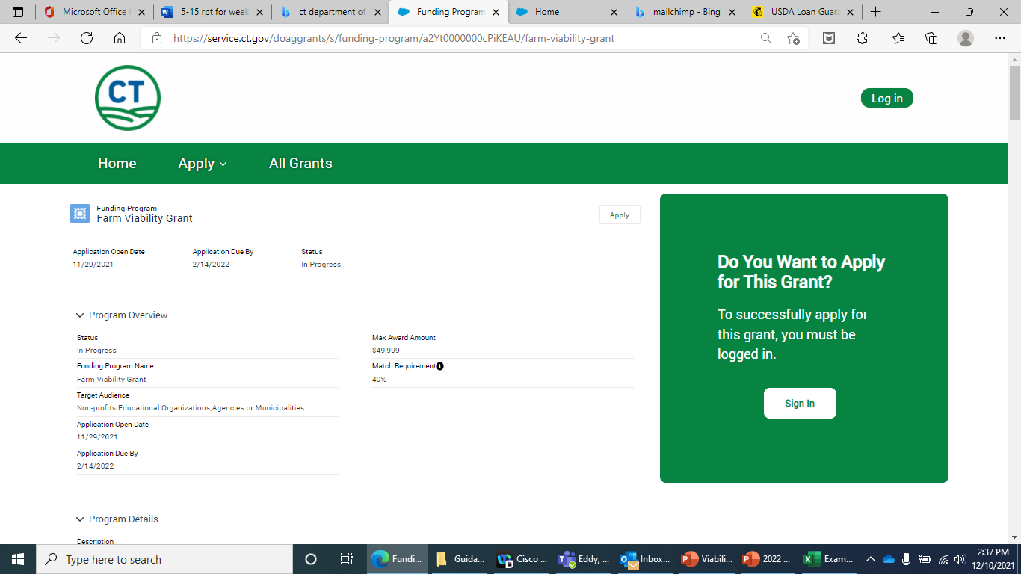
2022 Viability Grant Page
Once you click on “Farm Viability Grant” you will see this page.
You can read much more information on the grant as you scroll down the page.

Slide 38
**Please Note**
There is a strict 15-minute automatic logout on the online application portal if you are not actively typing.
Please save your application often by hitting “Save Progress” at the bottom of the pop-up screen and enter in a pause reason so that you may resume your saved application.
If you do not save often, you maybe forced to recreate your application.
All applications must be submitted by the deadline in order to be considered for funding regardless of technical difficulties.
We recommend answering the Grant Narrative questions in the Word document, and then copying and pasting your answers into the blanks on the grant portal.

Slide 39
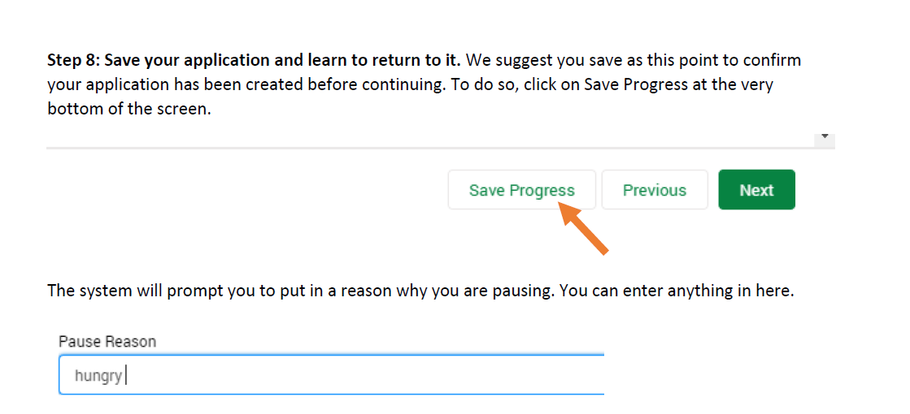
Save your application progress.

Slide 40
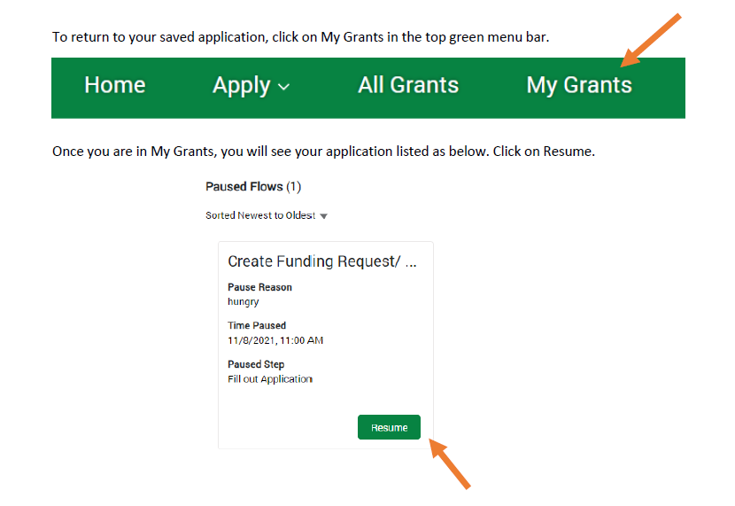
Resume working on your application.

Slide 41
Want Step-by-Step Instructions on How to Apply for a Grant through DoAg’s Grant Portal?
Visit: https://portal.ct.gov/DOAG/ADaRC/Publications/Farm-Viability-Grant-Program-for-Municipalities--501-c-3-Agricultural-Non-Profits
Click on Application Instructions.

Slide 42
Quick Recap
Grant Deadline: Monday, February 14, 2022, at 4:00pm
Applicants choose ONE Question of Focus to address with their project
Maximum grant award: $49,999.
Cash Match Required: 40% of total project cost
Applicants should attach the budget form and quotes/estimates/budget justification items to their application
The grant narrative questions will be answered within the application.
Apply at: https://service.ct.gov/doaggrants/s/
Grant Information and Application Instructions at: https://portal.ct.gov/DOAG/ADaRC/Publications/Farm-Viability-Grant-Program-for-Municipalities--501-c-3-Agricultural-Non-Profits

Slide 43
Contact Information
AliRose Grabarz
Ag Development and Resource Conservation
CT Department of Agriculture
(860) 713 - 5737
Alison.Grabarz@ct.gov
Please feel free to email me with any questions regarding the Viability Grant. While I cannot answer specific questions about your application, I am here to help you through this process. In case I am working from home, please send me an email and I will get back to you ASAP.

Slide 44
Thank you for attending.
Any questions?

