Slide 1
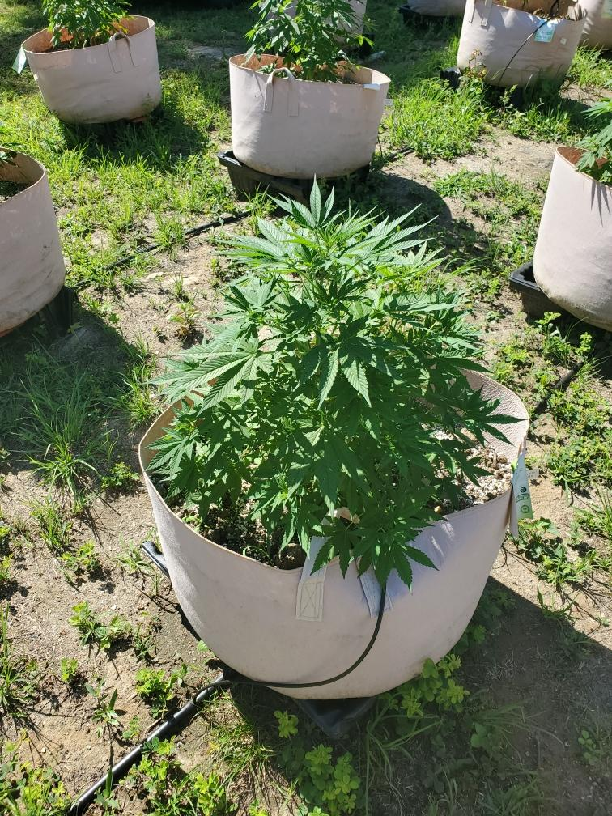
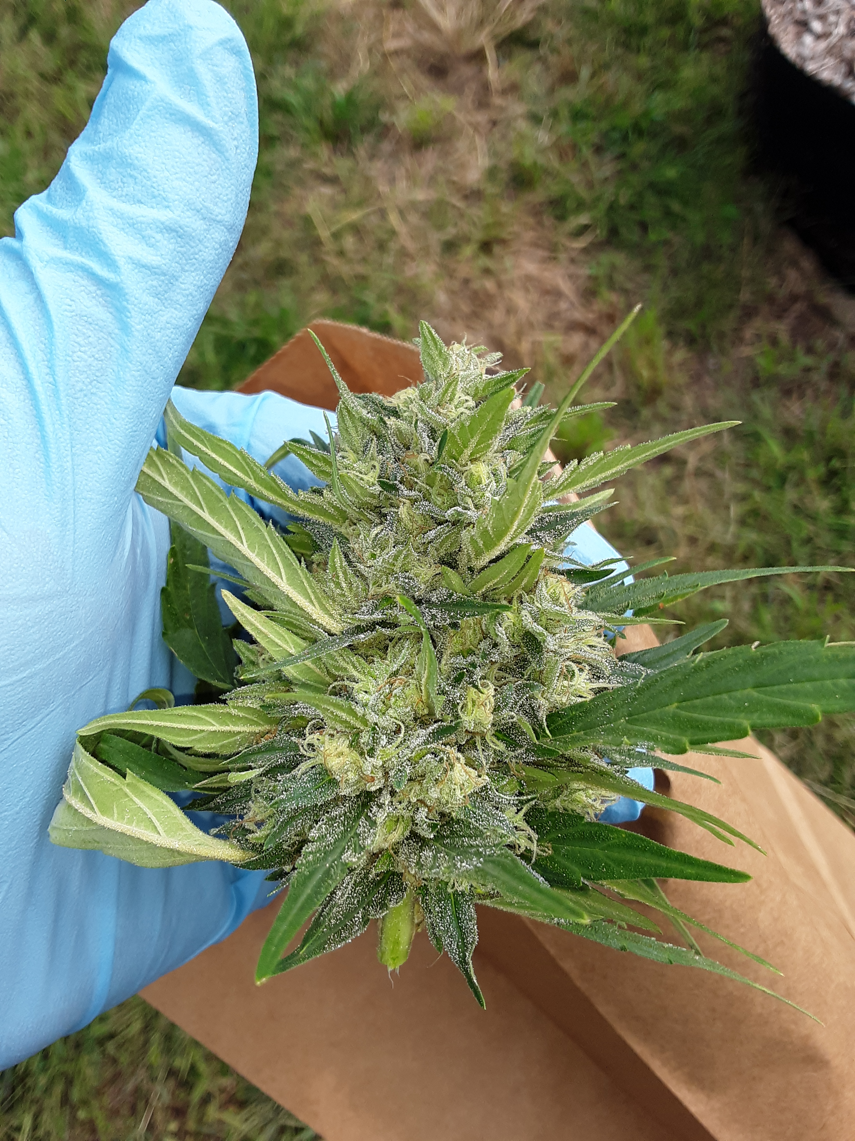
Reporting requirements for hemp producers

Slide 2
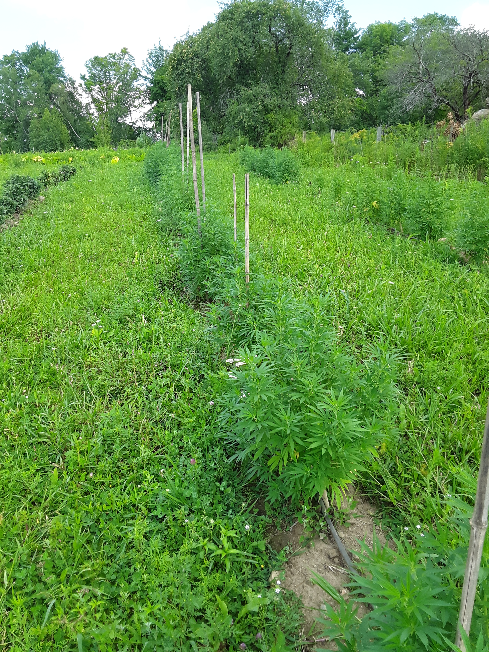
Planting reports
(indoor and outdoor)
MUST BE COMPLETED FOR EACH LOT
FSA Lot id
Date planted
Hemp variety planted
Seed or transplants
Acres or sq ft planted
If you are starting seeds indoors and then transplanting them outdoors, submit an Indoor Planting Report when you start the seeds indoors and then submit an Outdoor Planting Report when you plant the transplant outside
THIS REPORT MUST BE SUBMITTED IN ELICENSE SYSTEM

Slide 3
Harvest request
(formally “harvest report”)
MUST BE COMPLETED FOR EACH LOT
FSA Lot id
Name of laboratory
Sample date
Complete harvest (y/n)
Date when harvest will be completed (MUST BE WITHIN 15 days OF sampling date)
Hemp variety
Where will you be drying/ storing your harvested hemp (drop down list from listed drying/ storage areas)
THIS REPORT MUST BE SUBMITTED IN ELICENSE SYSTEM

Slide 4
Hemp sampling
MUST BE COMPLETED FOR EACH LOT
Growers can continue to collect their own pre-harvest samples following the CT Pre-harvest sampling procedures until
September 30,2020

Slide 5
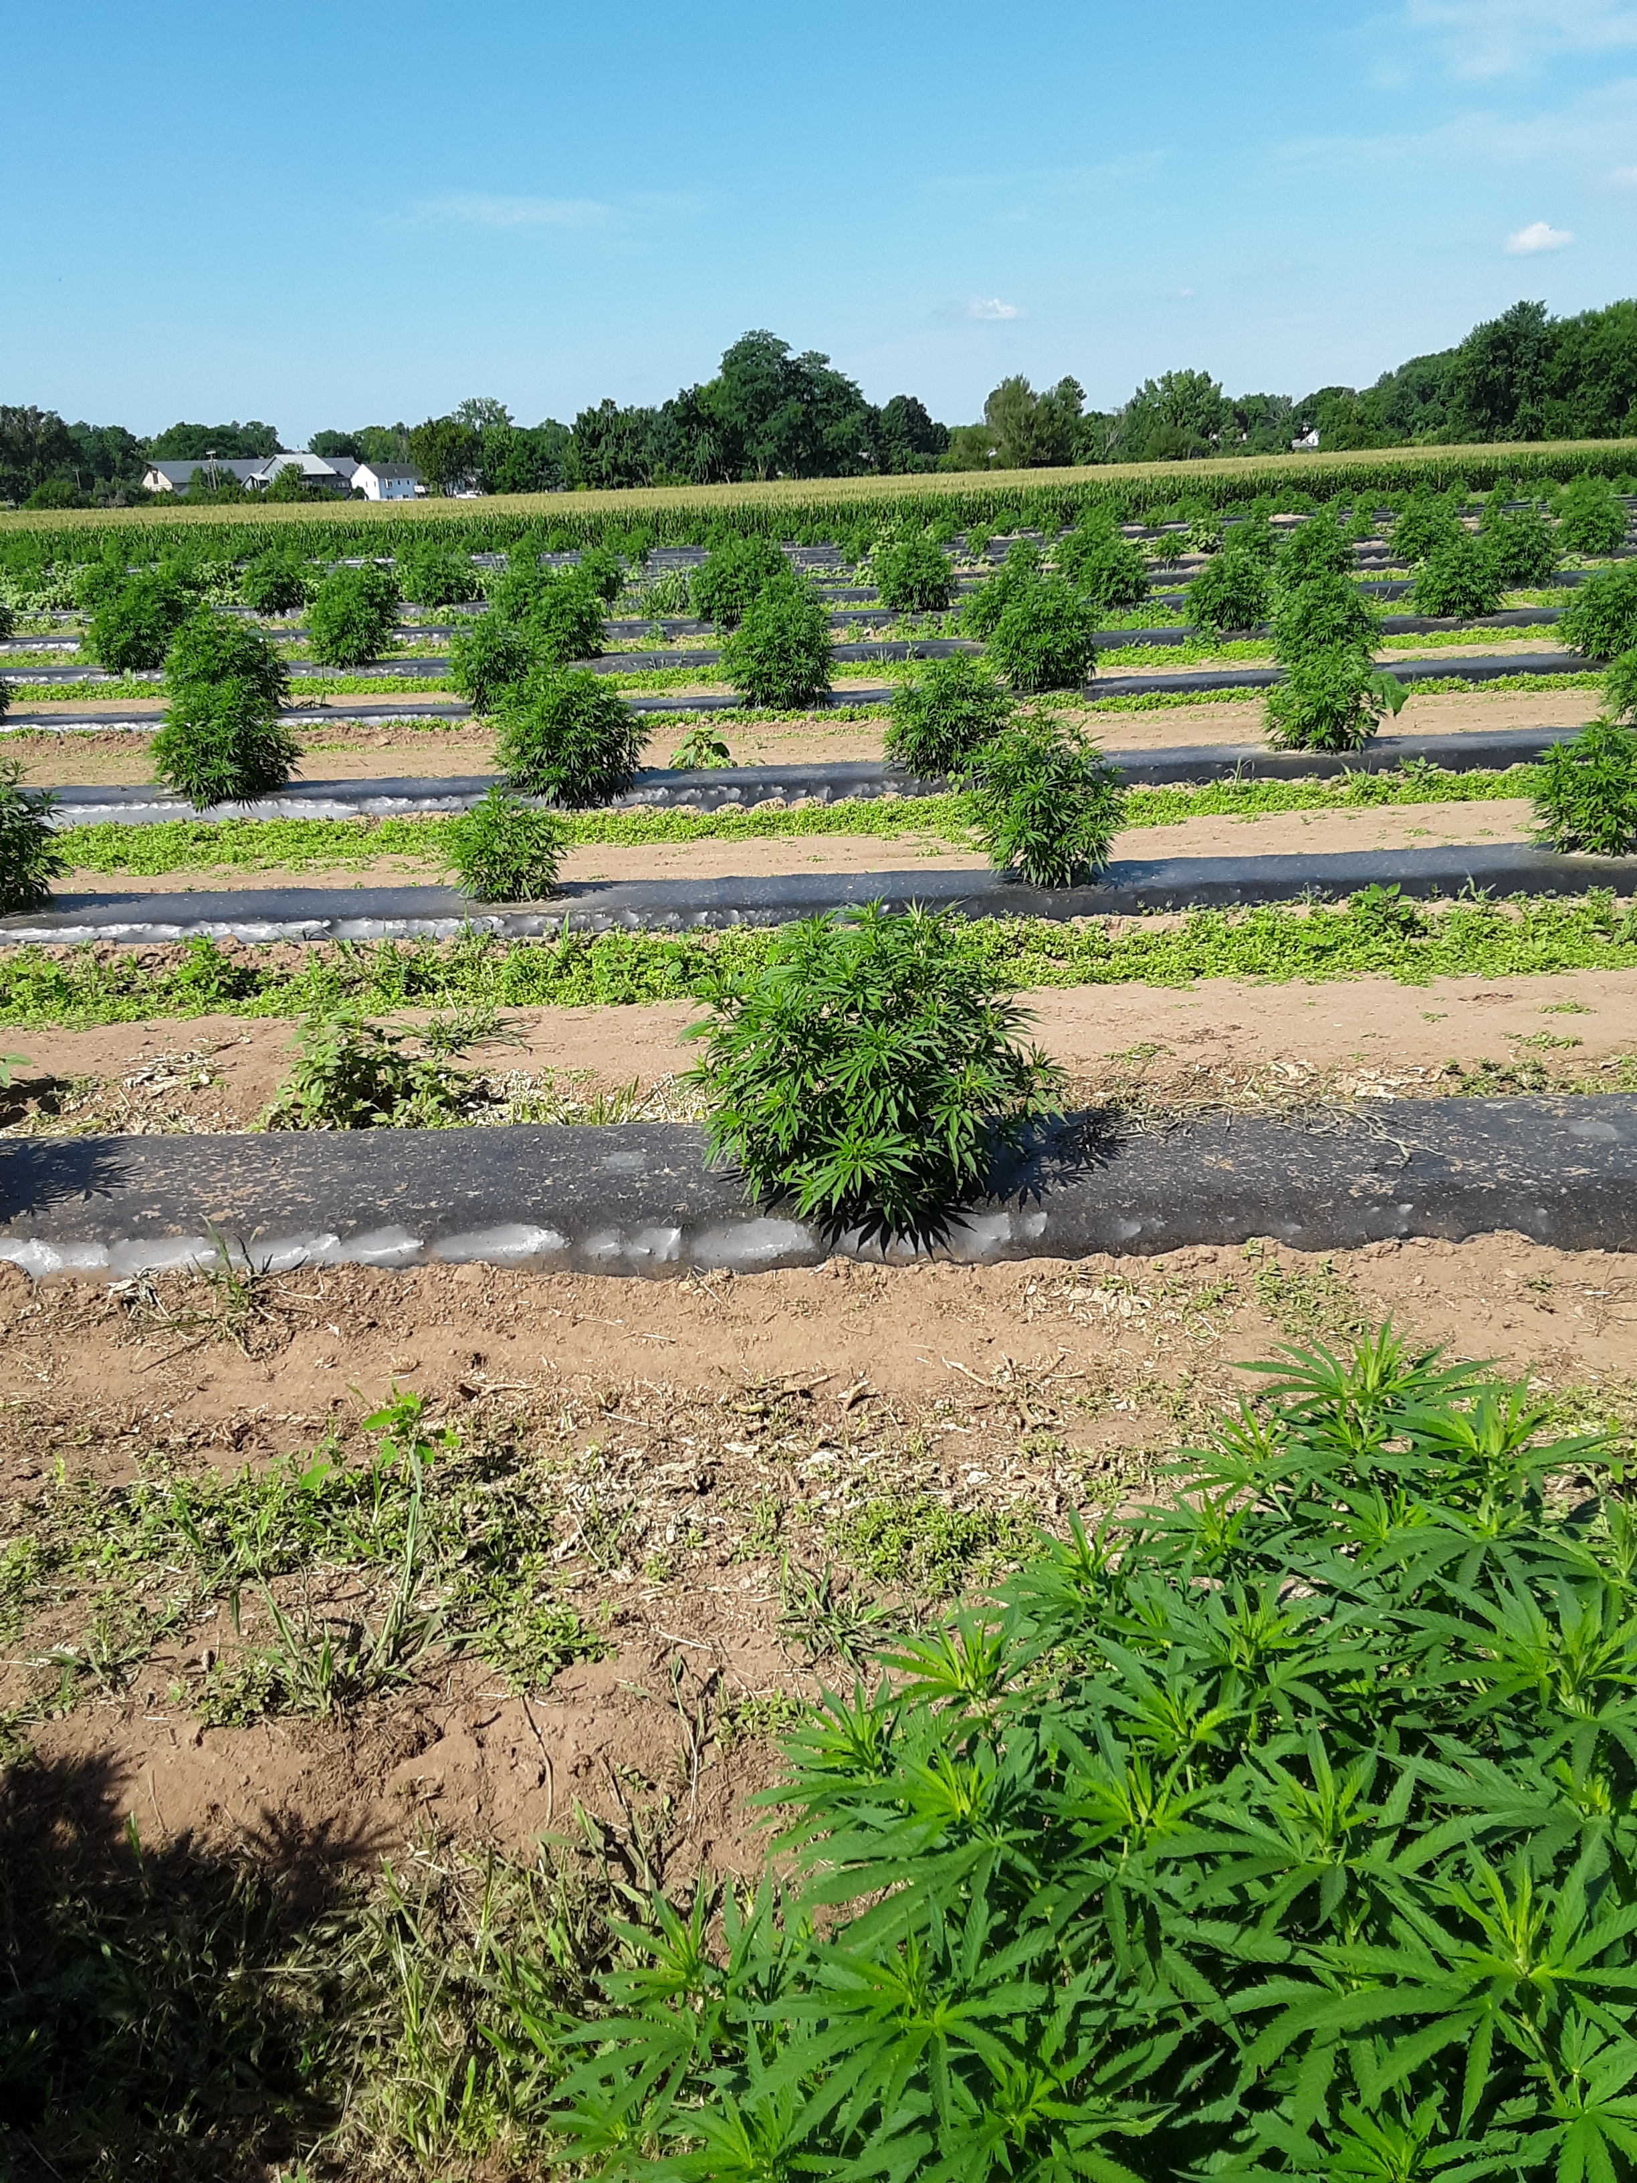
POST HARVEST REPORT
MUST BE COMPLETED FOR EACH LOT
FSA LOT ID
HARVEST HEMP ACREAGE/ SQ FT
STORED ON SITE? (Y/N)
PROCESSED ON SITE? (Y/N)
SOLD/TRANSFERRED? (Y/N)
UPLOAD SAMPLE RESULTS
SAMPLE ASSESSION/REPORT NUMBER
LABORATORY NAME
THIS REPORT MUST BE SUBMITTED IN ELICENSE SYSTEM

Slide 6
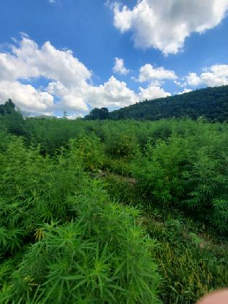
OTHER REPORTS

Slide 7
DESTRUCTION REPORT (IF NECESSARY)
FSA LOT ID
PLANNED DATE OF DESTRUCTION
CT DOAG EMBARGO NUMBER (IF UNDER EMBARGO)
ACRES/SQ FT TO BE DESTROYED
DESTRUCTION REASON
PLANNED DESTRUCTION METHOD
SALVAGE PLAN (AVAILABLE UNTIL 9/30/2021)
ATTESTATION
THIS REPORT MUST BE SUBMITTED IN ELICENSE SYSTEM

Slide 8
LOT MODIFICATION
FSA LOT ID
SITE OWNERSHIP
PERMISSION TO USE LAND IF NOT OWNED
INDOOR OR OUTDOOR
ACRES/ INDOOR SQ FT
LONGITUDE AND LATTITUDE
ADDRESS
UPLOAD MAP OF LOT
THIS REPORT MUST BE SUBMITTED IN ELICENSE SYSTEM

Slide 9
APPLICATION MODIFICATION
USED TO MODIFY KEY PARTICIPANTS AND BUSINESS INFORMATION
THIS REPORT MUST BE SUBMITTED IN ELICENSE SYSTEM

Slide 10
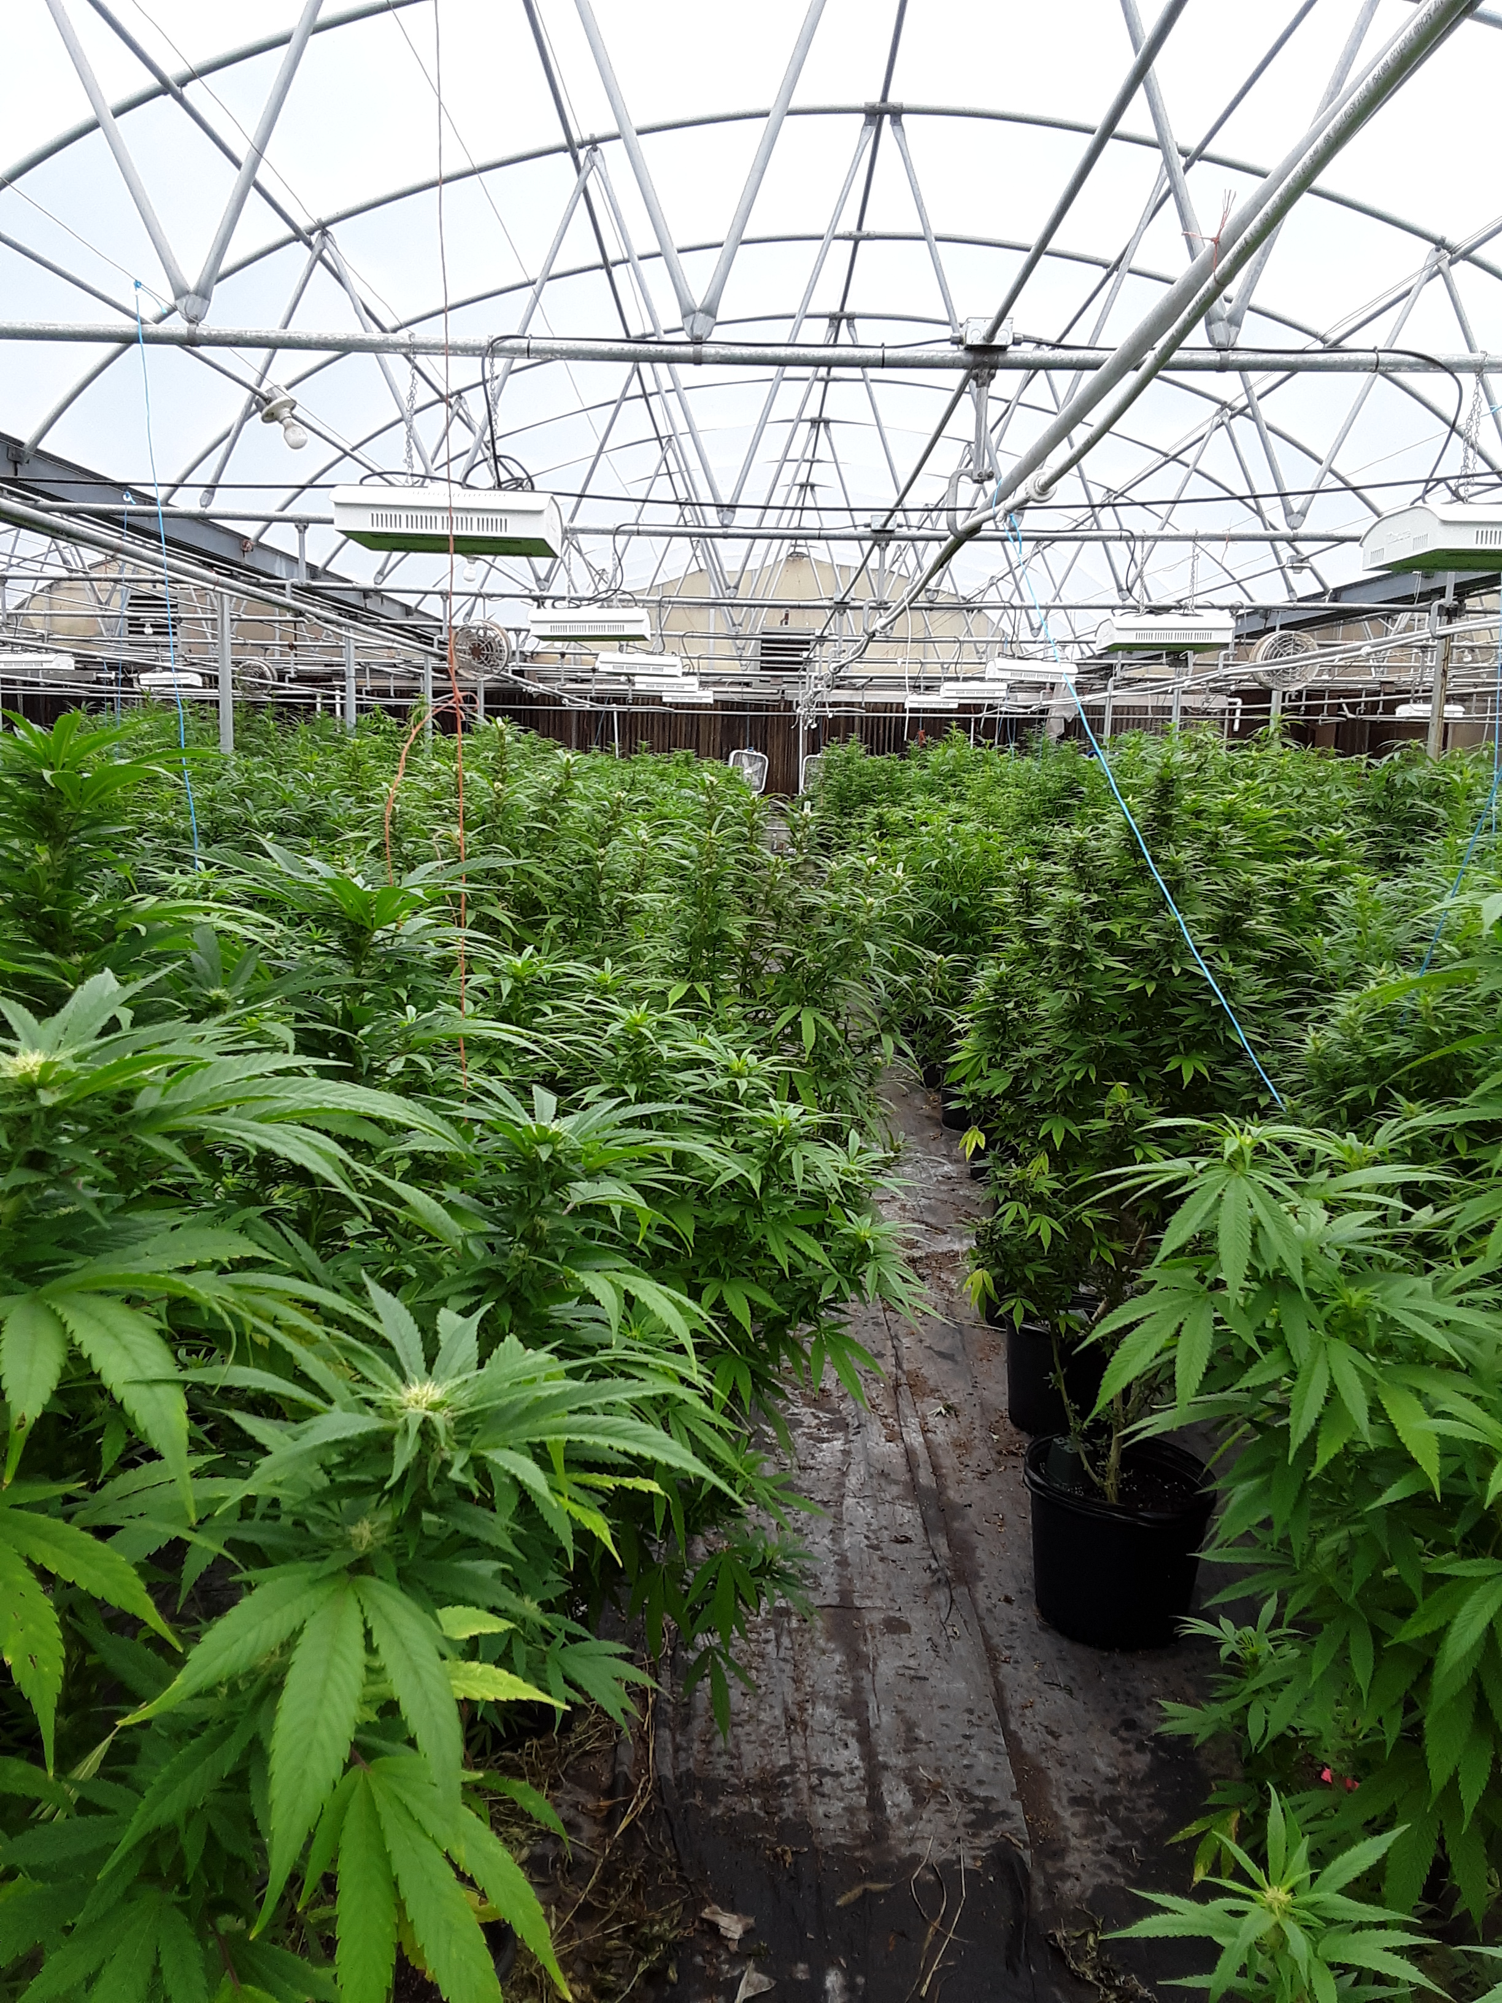
2020 Hemp Production data
140 Grower Licenses
14 processor Licenses

Slide 11
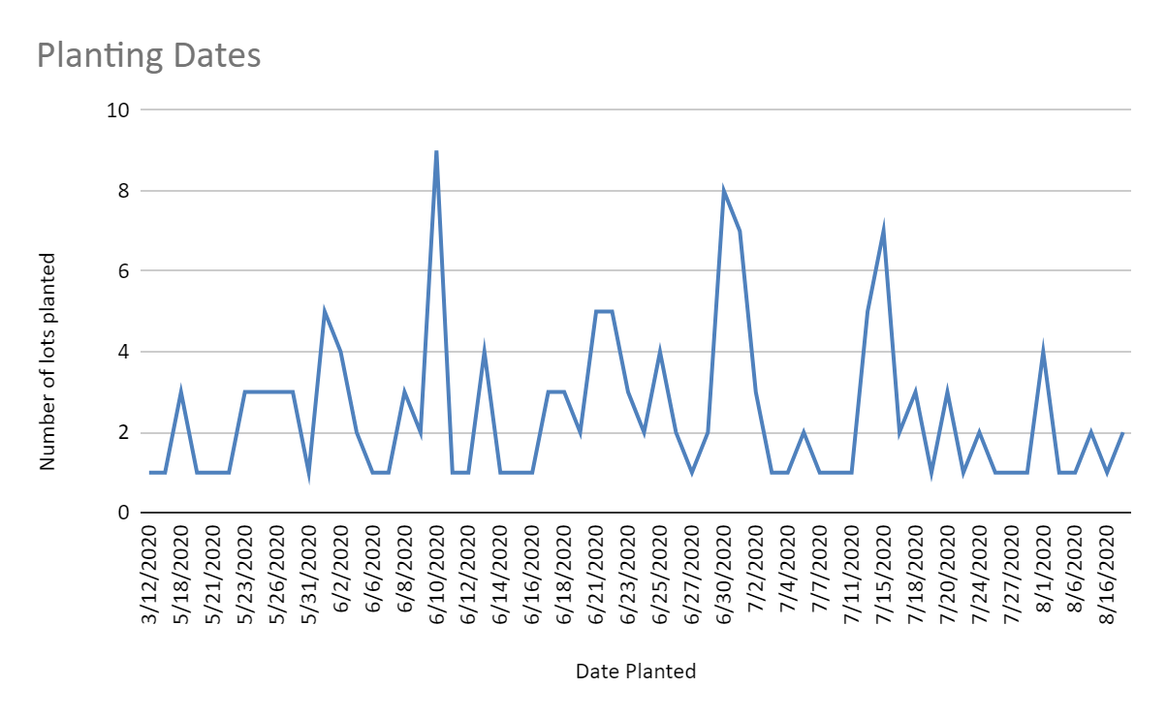
2020 Hemp Planting
156 Acres planted

Slide 12
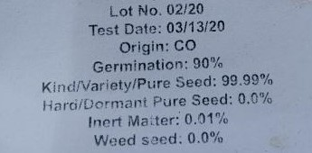
Hemp Varieties
Seed Label
58 Different varieties planted
Most common varieties planted
Cherry wine
Cherry Blossom
Youngsim 10
Mountain Mango

Slide 13
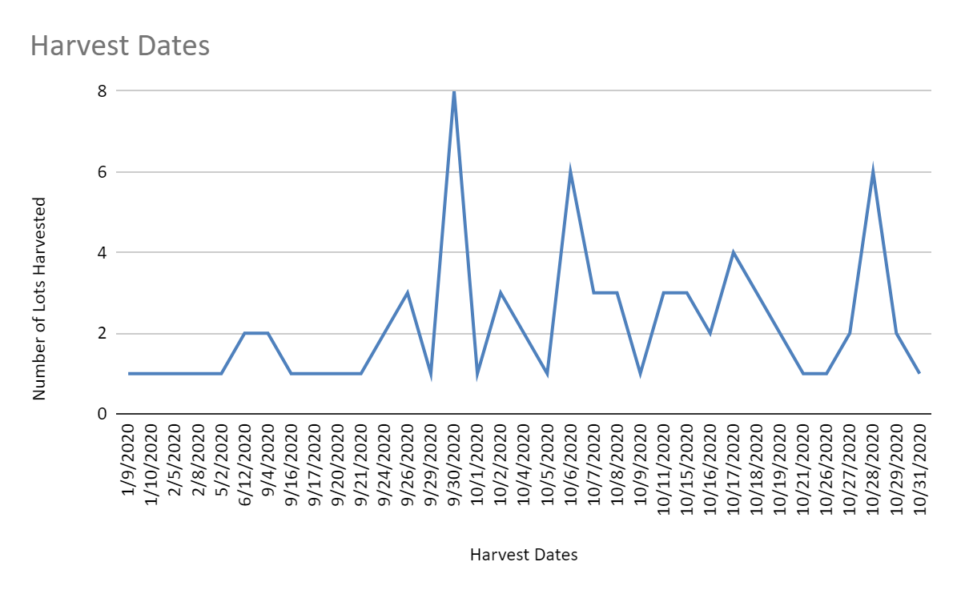
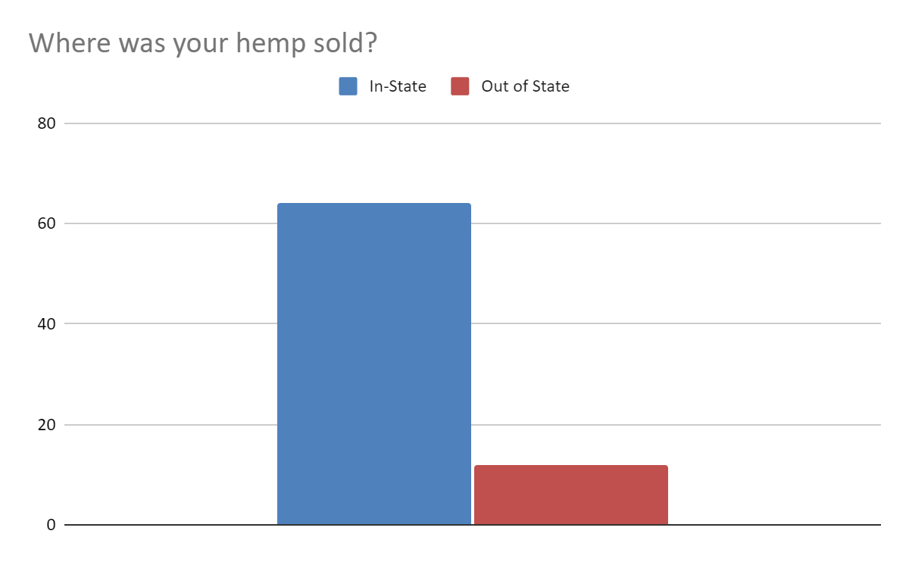
2020 harvested hemp
134 Acres Harvested

Slide 14
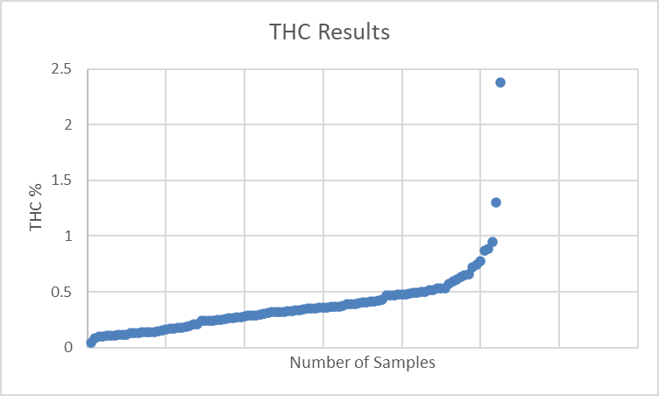
THC RESULTS SUMMARY

Slide 15
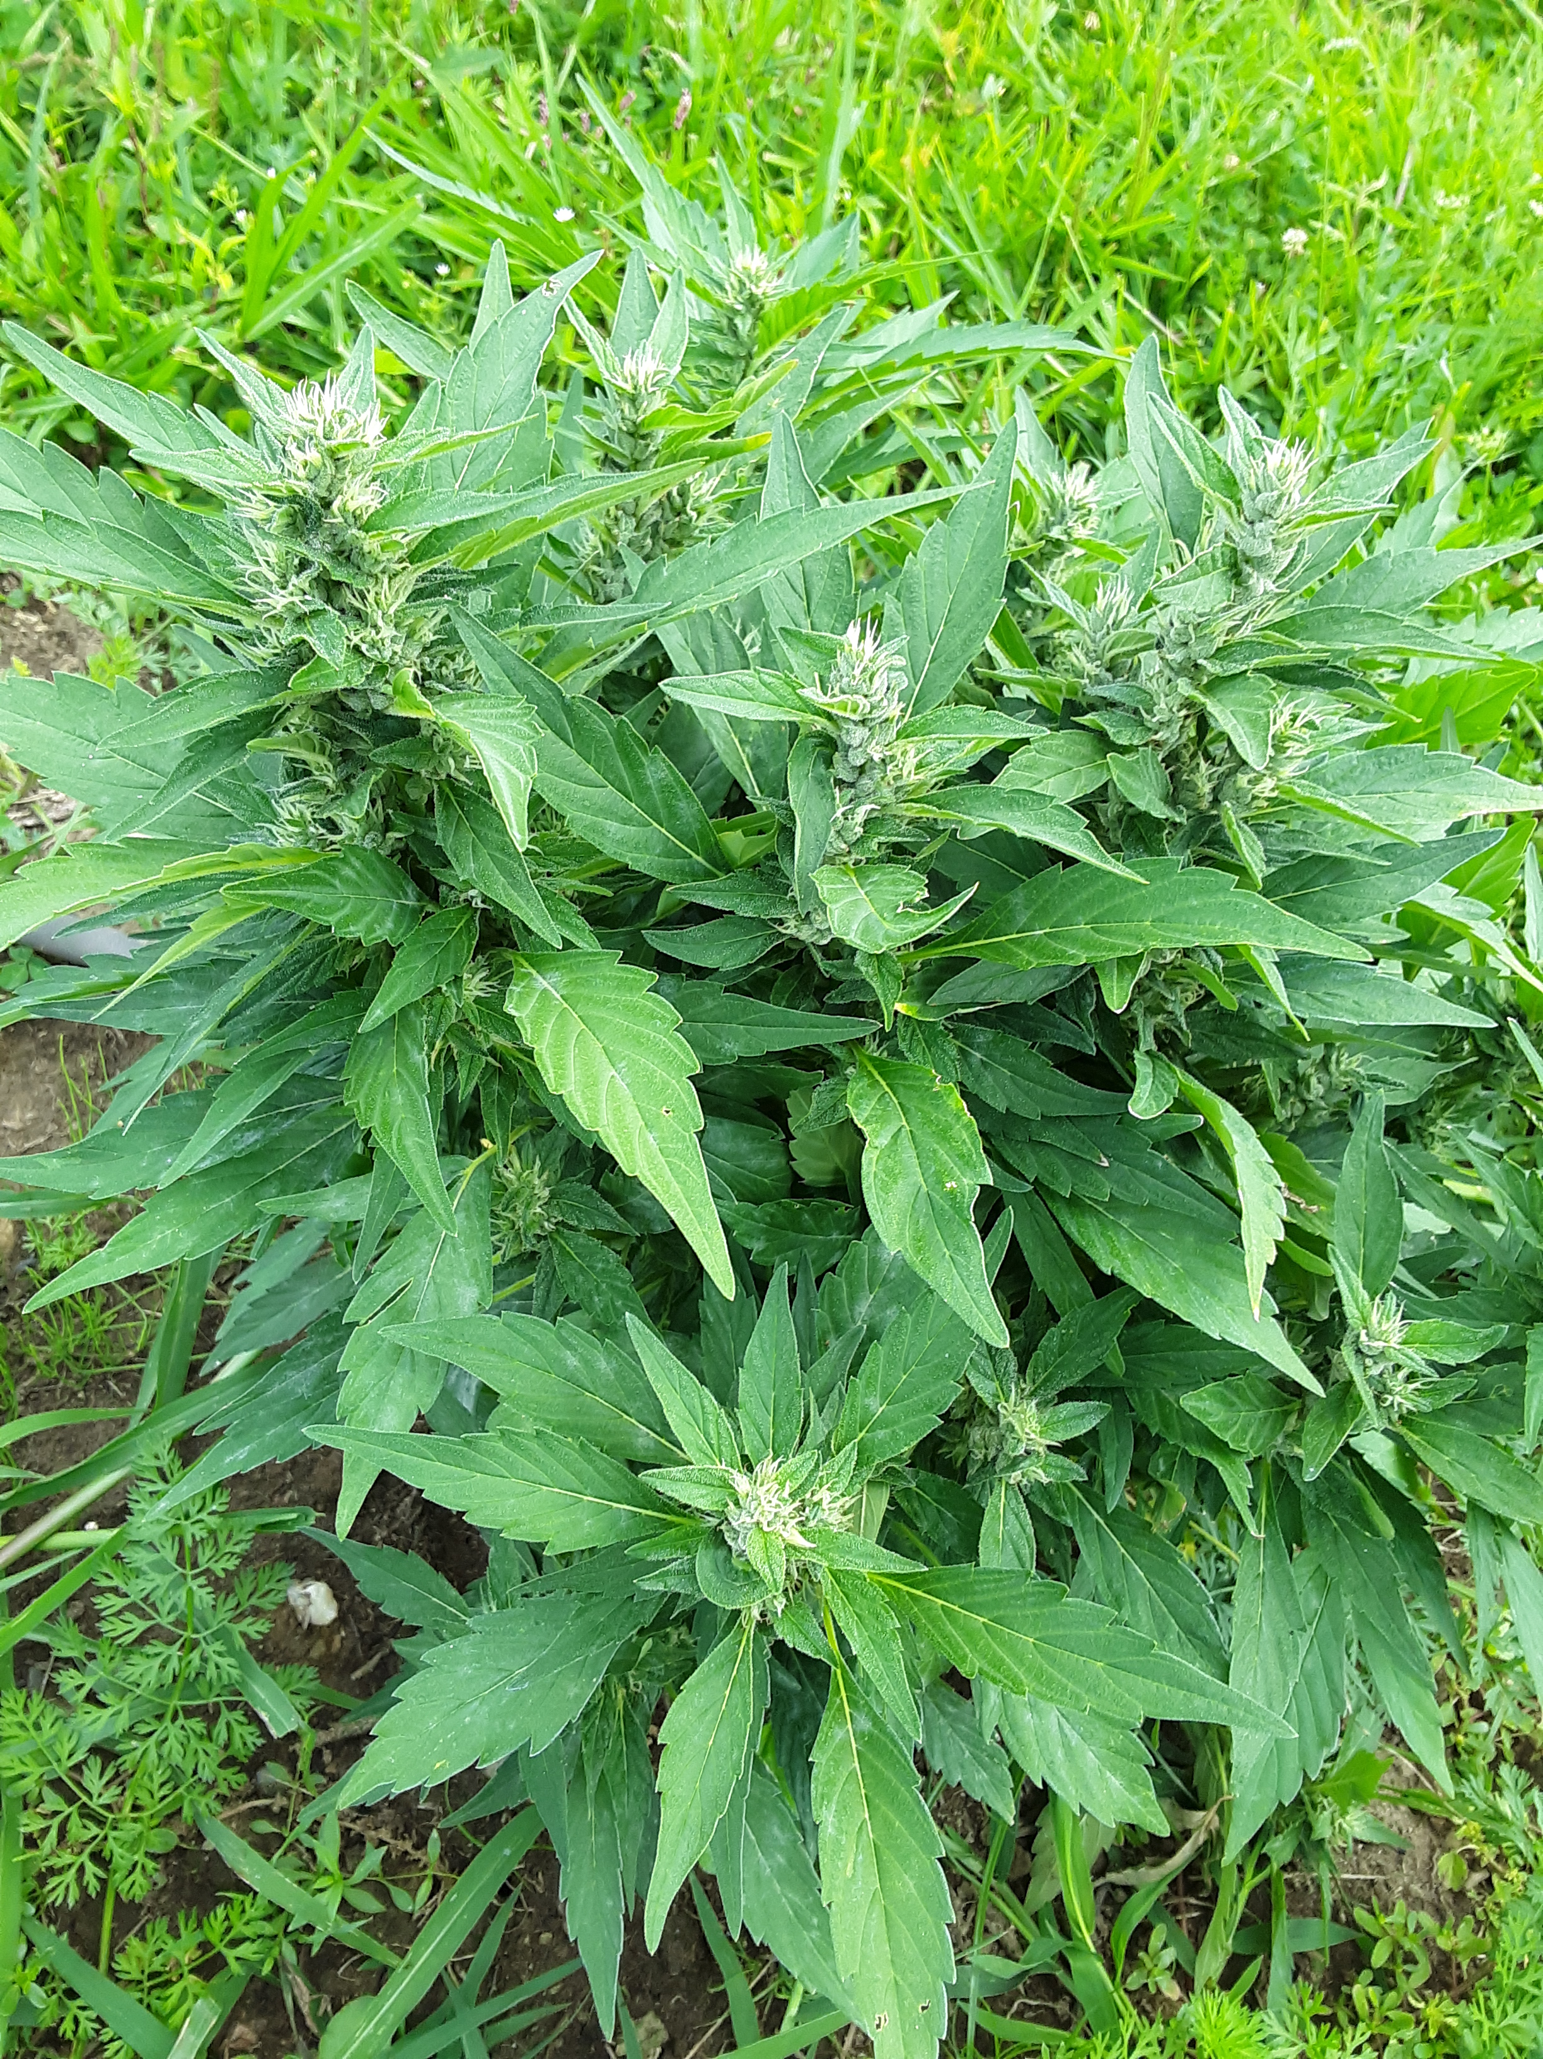
2020 Hemp Destruction
10.68 acres and 10,491 Sq Ft Destroyed
Reasons for Destruction:
Failed THC Test= 6.309 acres and 10,291 sq ft
Bud rot/ mold = 1.971acres and 200 Sq Ft
Crop damaged from storms = 2.4 acres

Slide 16
DoAg Inspection and embargoes
21 Embargoes were issued
High thc test
Unacceptable seed variety planted
Harvested without permission
GROW SITE INSPECTIONS
Confirm GPS Coordinates of Plots and Confirm the Variety of Hemp Planted

Slide 17
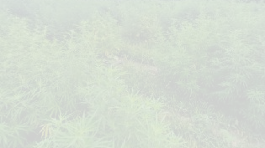
Questions?
Contact the Department of Agriculture
860-713-2502
AGR.hemp@ct.gov

