Slide 1
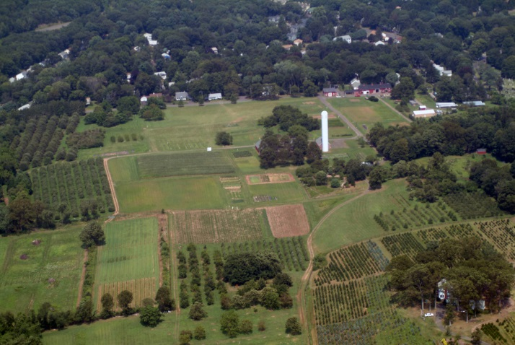
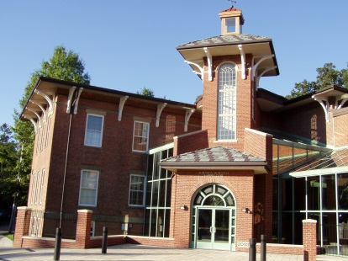
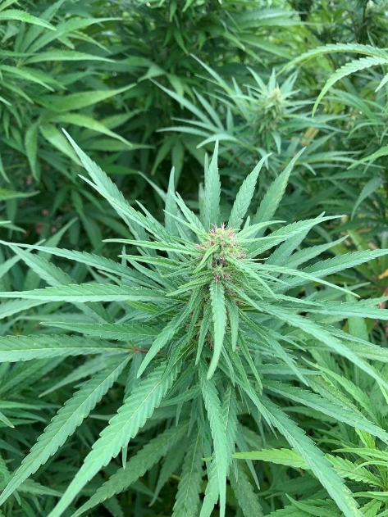

Industrial Hemp: Crop for the future?
Ms. Terri Arsenault
The Department of Analytical Chemistry
The Connecticut Agricultural Experiment Station
New Haven, CT

Slide 2
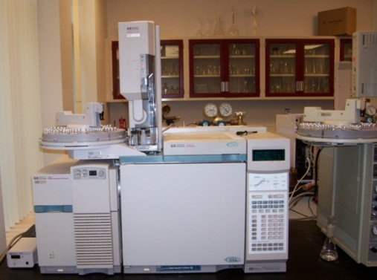
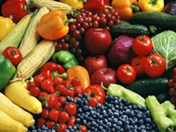
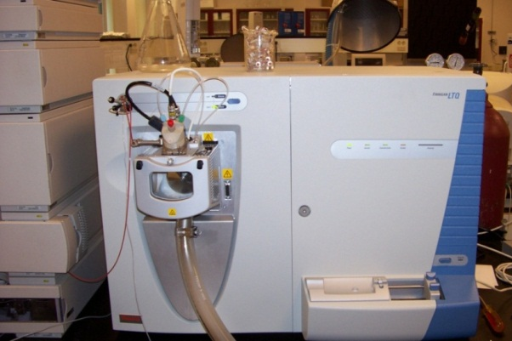
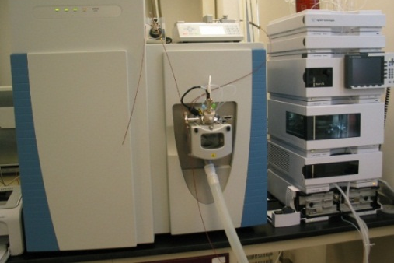

The Connecticut Agricultural Experiment Station
Analytical Chemistry Department
Accredited to ISO 17025 by A2LA since 2016
Pesticide Residues, Aflatoxins and Arsenic in Food
Expansion of our scope of accreditation to hemp testing scheduled for January of 2021
USDA interim rule most likely will require testing labs to be accredited

Slide 3
Agricultural Improvement Act 2018 Definitions
Sec. 297A Definitions – “HEMP.—The term ‘hemp’ means the plant Cannabis sativa L. and any part of that plant, including the seeds thereof and all derivatives, extracts, cannabinoids, isomers, acids, salts, and salts of isomers, whether growing or not, with a delta9 tetrahydrocannabinol concentration of not more than 0.3 percent on a dry weight basis.”
Sec. 297B. State and Tribal Plans requires: “a procedure for testing, using postdecarboxylation or other similarly reliable methods, delta-9 tetrahydrocannabinol concentration levels of hemp produced in the State or territory of the Indian tribe”
Two critical points for testing:
  Analysis of THC includes THC-A
  Dry weight is not defined
Our lab decided to test total delta-9 THC using gas chromatography with flame ionization detection. Testing is quick and easy providing total THC in one step. Testing includes analysis for CBD that includes CBD-A

Slide 4
USDA Interim Rule Considerations
Samples must be collected by a USDA-approved sampling agent or agent authorized by USDA to collect samples. USDA will issue guidance on sample collection.
USDA requires that labs be DEA registered
Requires that Measurement Uncertainty (MU) be on the test report
  CAES uses 50% MU based on issues associated with the definition of dry weight and uncertainties associated with field sampling
  The law specifies that if the range using the MU includes 0.3%, the sample meets the legal definition of hemp
  Future test reports will look something like this:
  0.40% THC +/- 0.20% THC PASS
  0.80% THC +/- 0.40% THC FAIL
Proposes a “negligent” level of <0.5% not subject to criminal enforcement
  Samples must exceed 1% to meet this threshold using a 50% MU

Slide 5
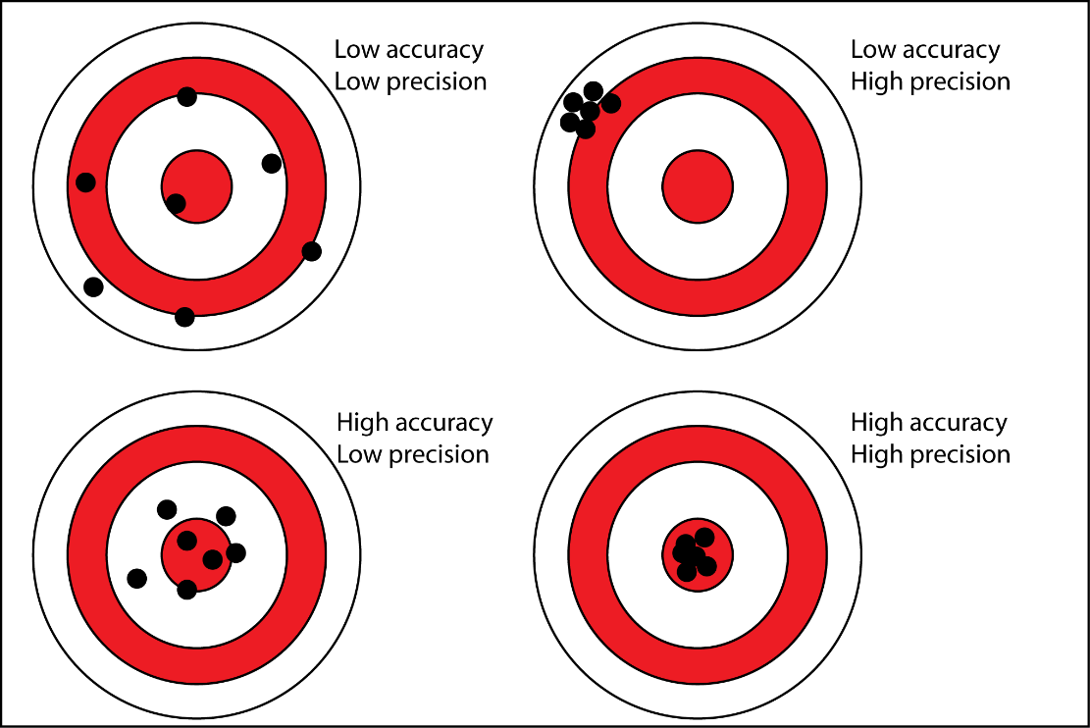
Measurement Uncertainty
Affected by both accuracy and precision
Accuracy: How close a measurement is to the true value
Precision: How close two or more measurements are to each other

Slide 6
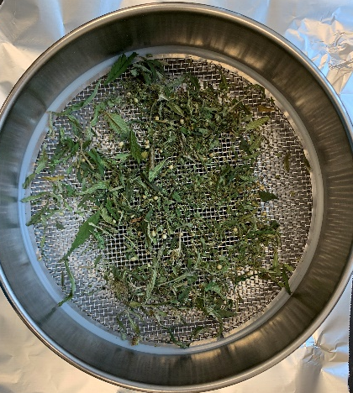
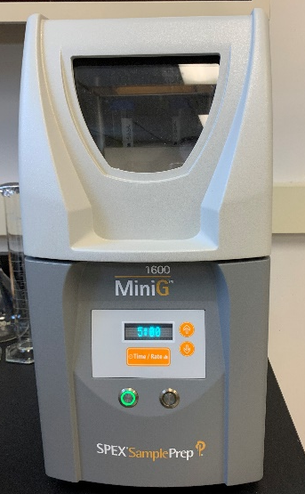
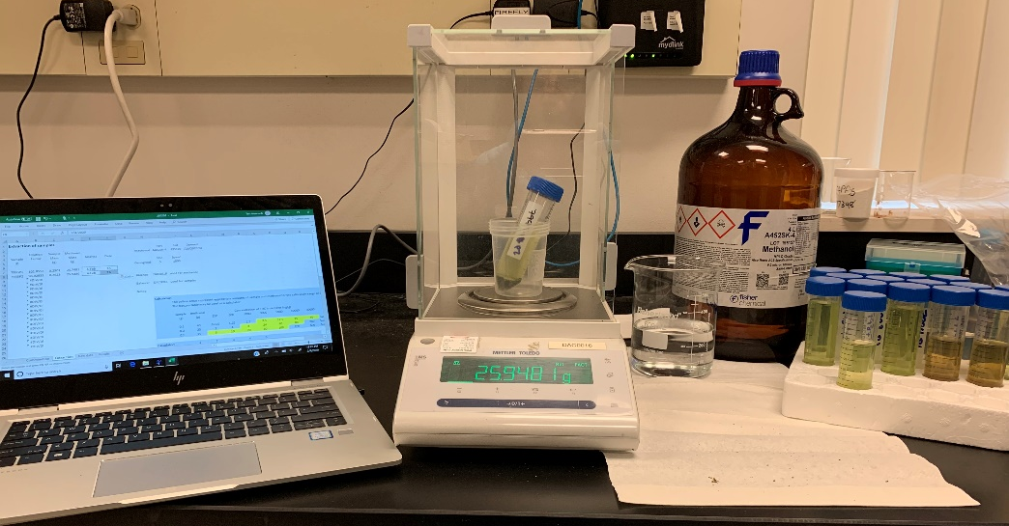
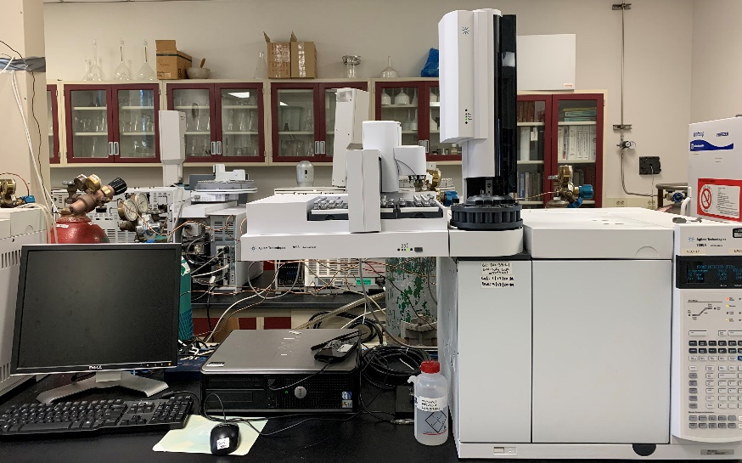

Overview of Testing
Dry sample overnight in oven at 90 ºC
Extract 0.2 grams of sample into 25 grams of methanol
Inject Gas Chromatograph-Flame Ionization Detector
run time is 10 minutes

Slide 7
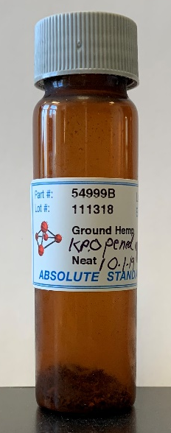
Accuracy and Precision in our Testing
Proficiency Testing-Annually
  Kentucky Hemp PT-Two rounds of two samples per year, each sample analyzed three times
  Successfully completed two rounds last year, and first round this year
  Lab Accuracy - comparison to true value based on all labs
  Lab Precision – variability around the three test results for each sample
  Test item is dried material, so does not encompass differences in drying methods used within labs
Quality Control-Every Batch
  Certified Reference Material
  Quality Control sample run with each batch
  Method Blank

Slide 8
Lockwood Farm Plot
Rows spaced 5 feet apart, Black plastic with drip irrigation
  2019 - plants spaced 2 feet apart
  2020 – plants spaced 4 feet apart
Grew five varieties in 2019:
  Non-feminized seed varieties - Cherry 307, Cherry 308, Youngsim10 lot “2018WFS1” and Youngsim10 lot “2018WFS17A” and Z-1
  planted in field on Friday, June 21, 2019
Grew eight varieties in 2020:
  Feminized seed varieties – Abacus Early Bird, Cherry Abacus, Abacus 2.0, Abacus Early Bird 2.0, Cherry Abacus 2.0, Spec 7, and non-feminized seed from 2019 - Youngsim10 lot “2018WFS17A” Youngsim10 lot “2018WFS1”
  planted in field on Friday, June 25, 2020

Slide 9
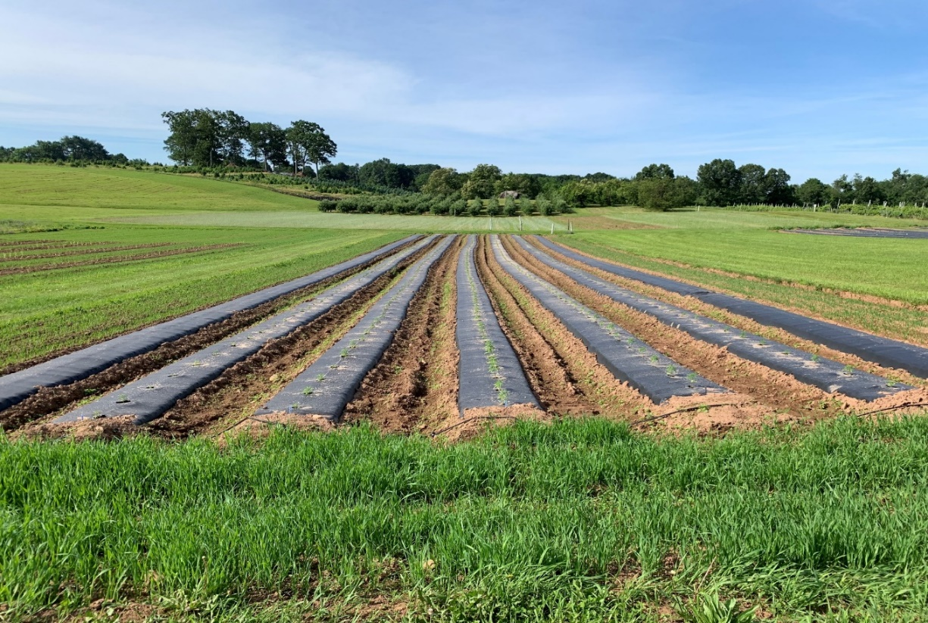
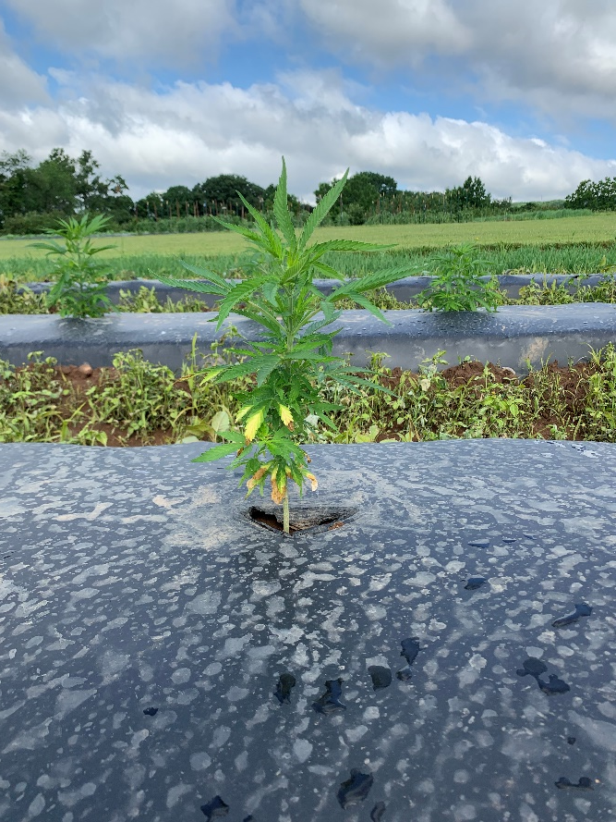
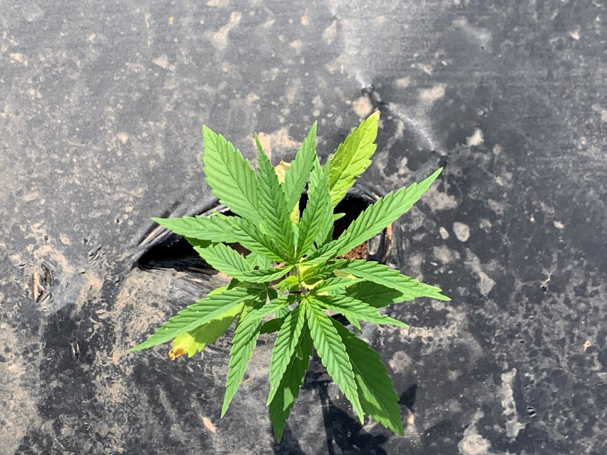
Lockwood Farm Plot
June 28, 2019
Probably root rot

Slide 10
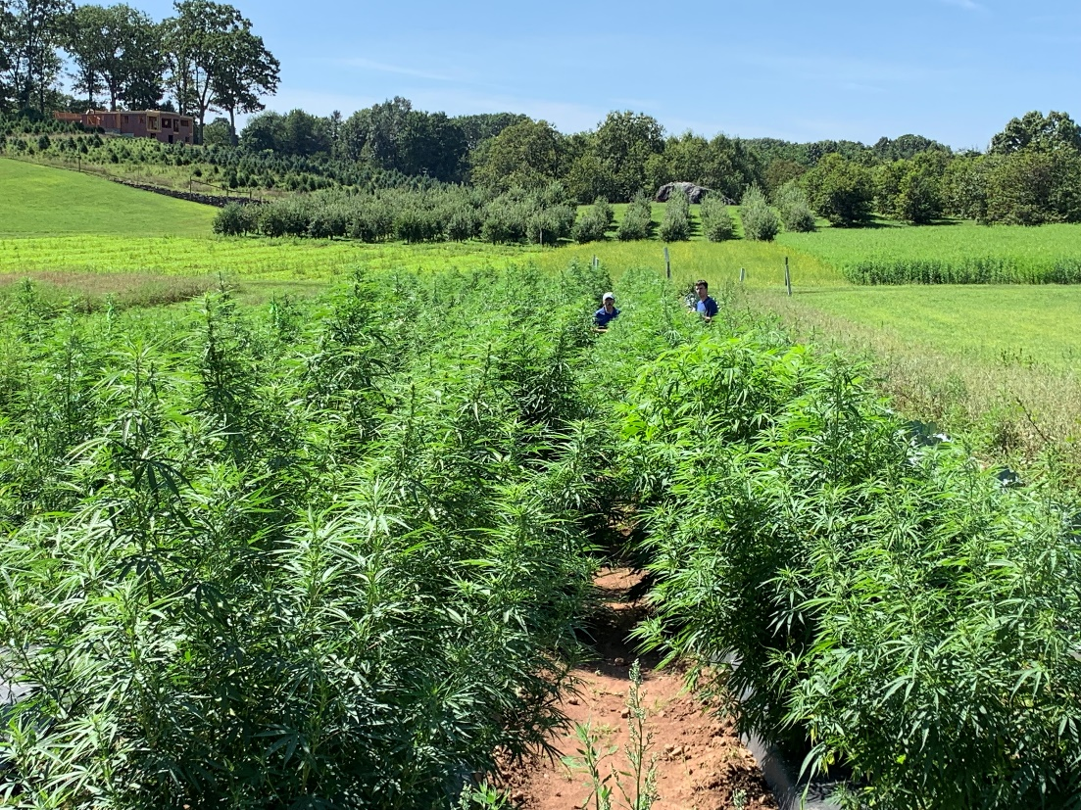
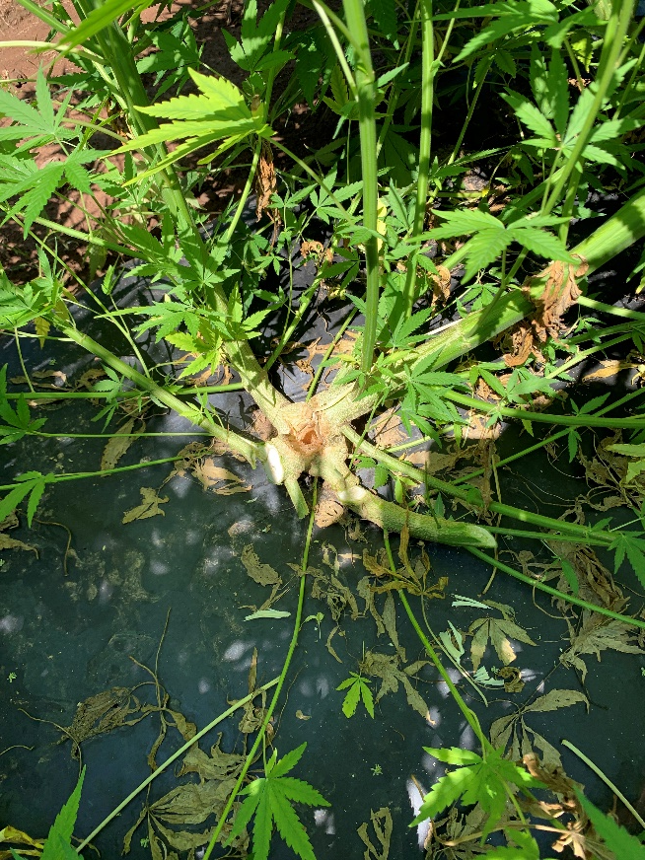
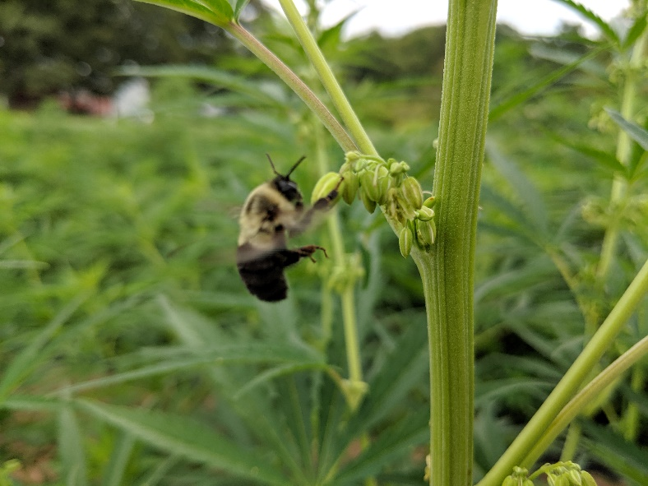
Lockwood Farm Plot
August 20, 2019
Corn borer

Slide 11
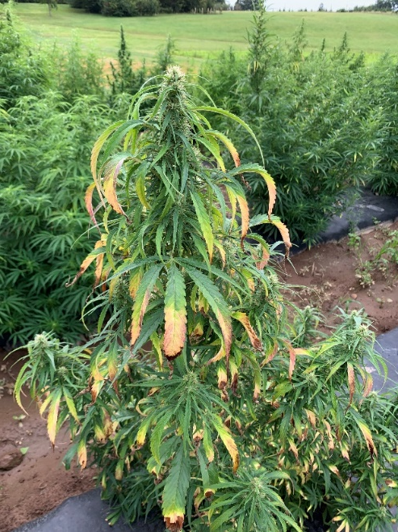
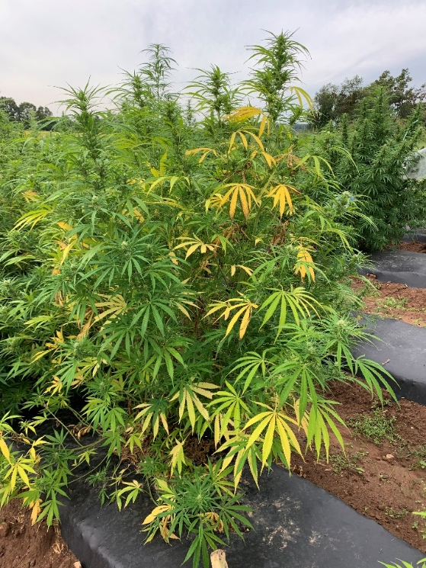
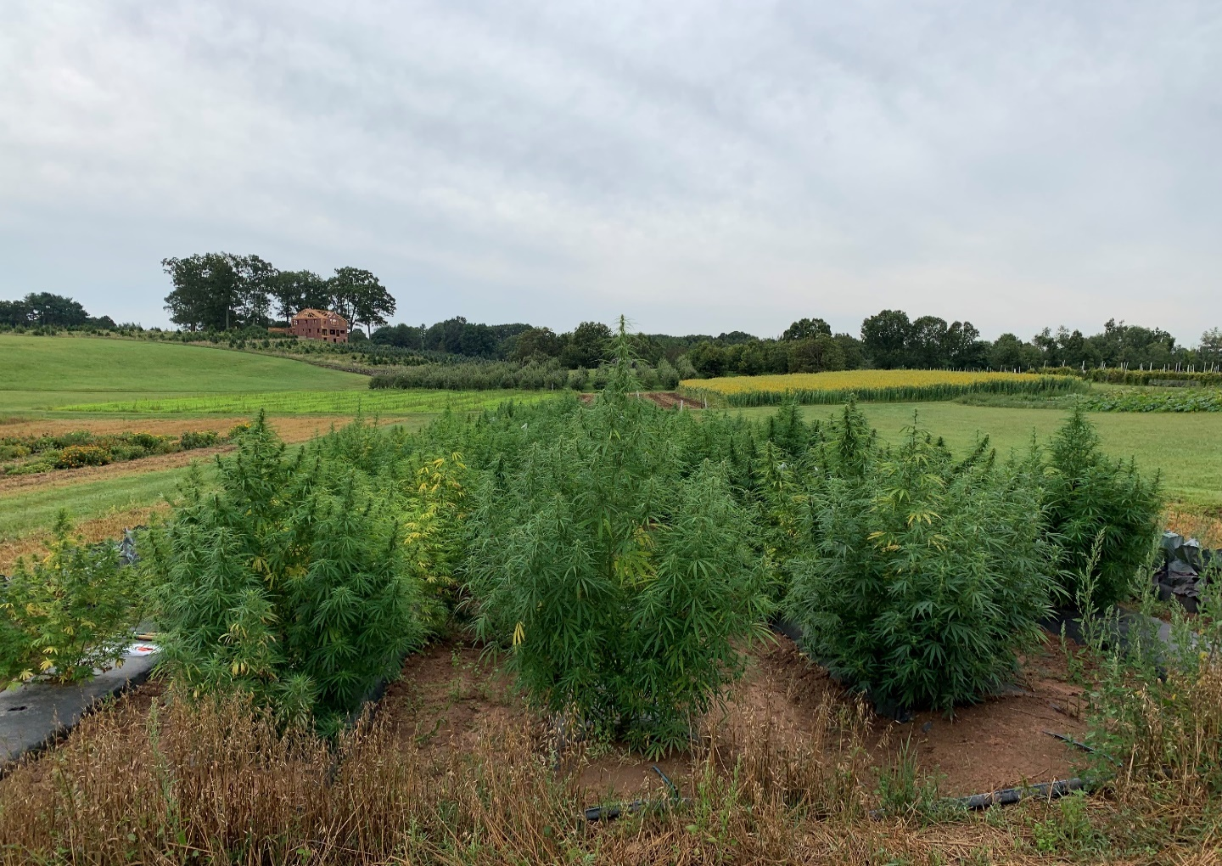
Lockwood Farm Plot
Sept 10, 2019

Slide 12
Total Delta-9 THC testing Results

Slide 13
Total CBD testing Results

Slide 14
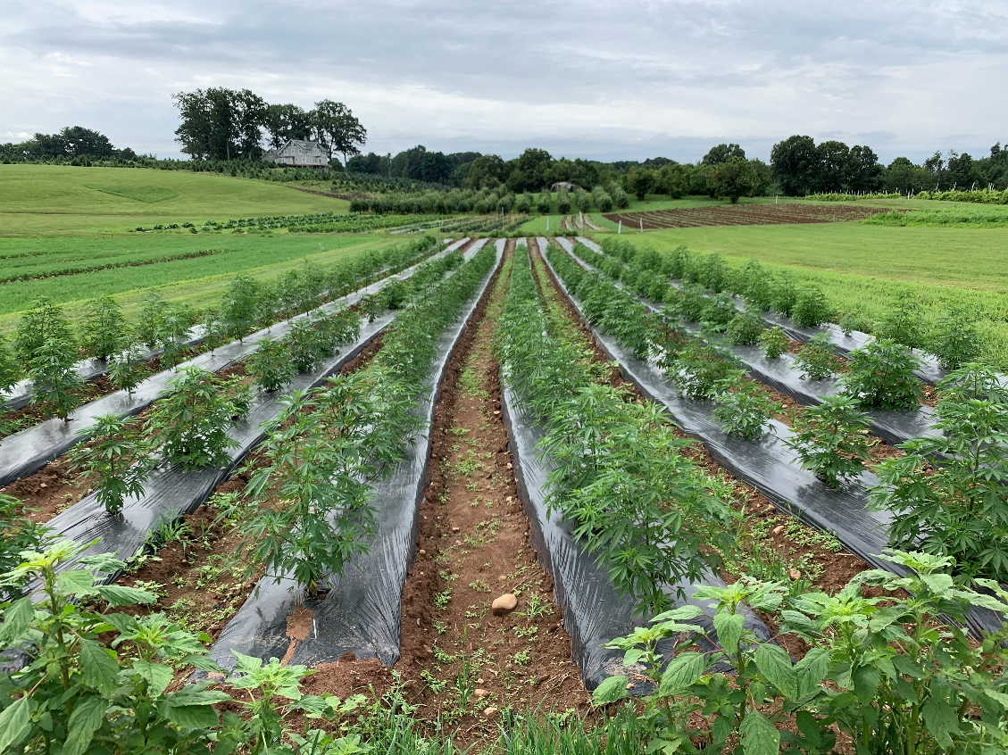
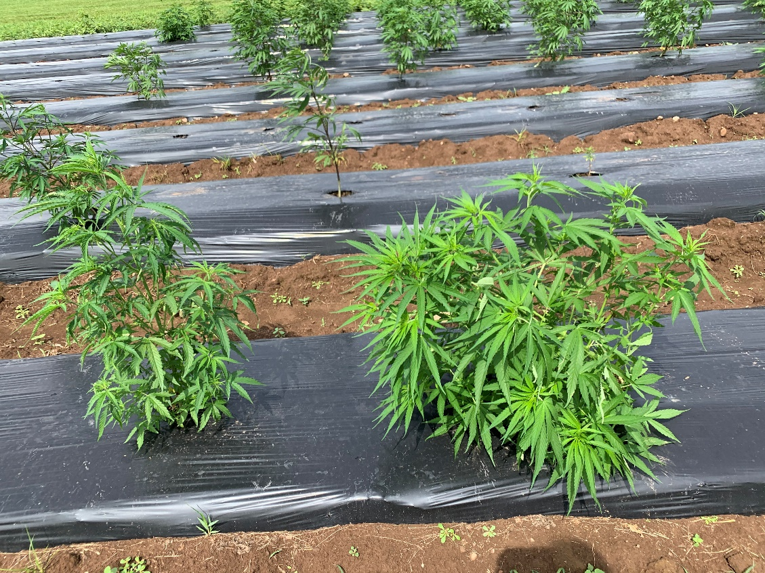
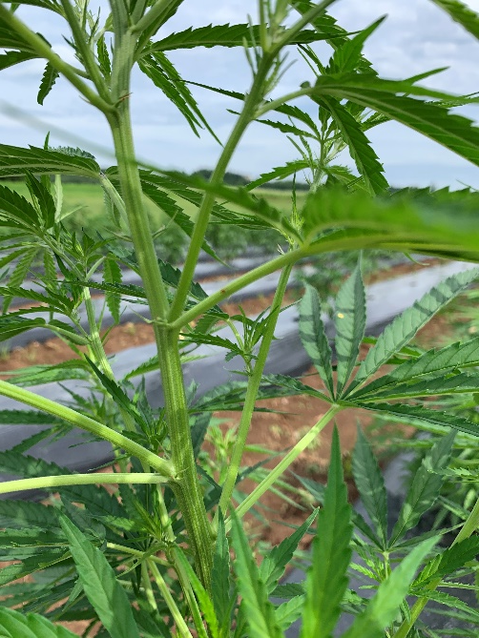
Lockwood Farm Plot
July 24, 2020

Slide 15
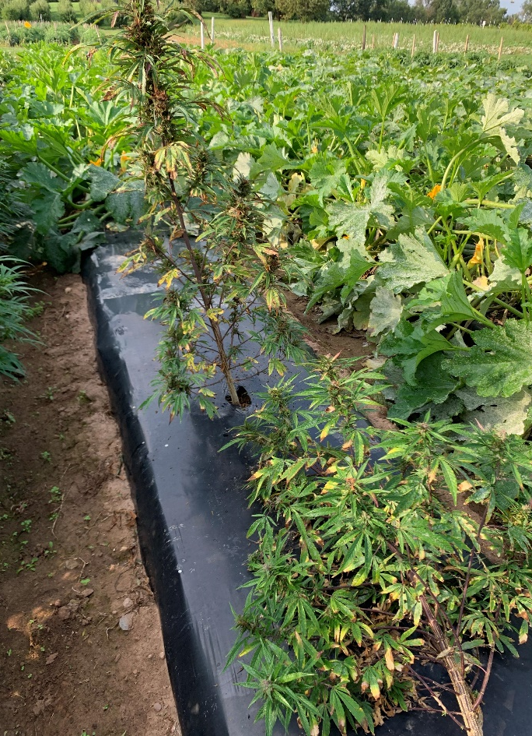
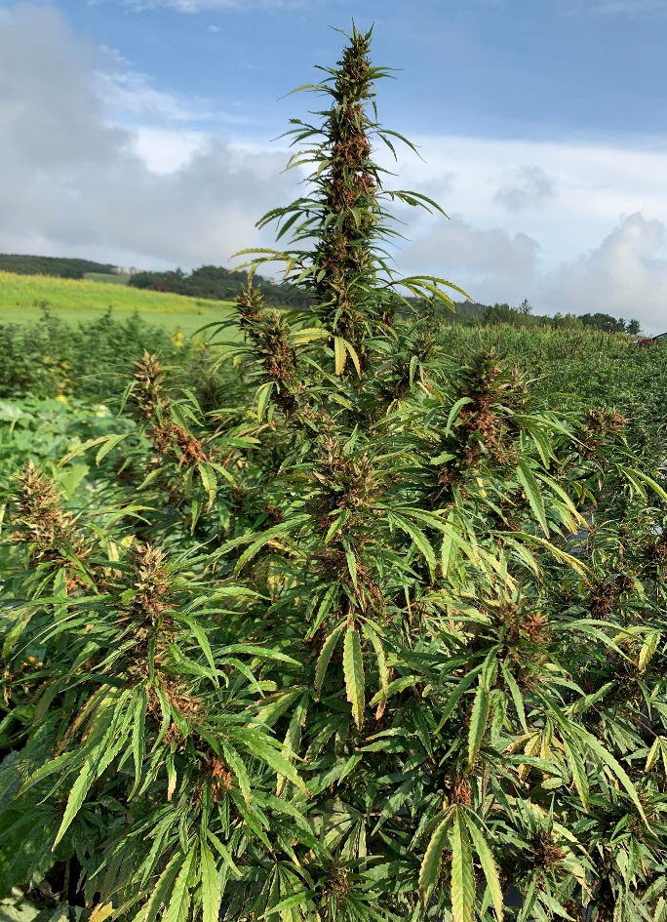
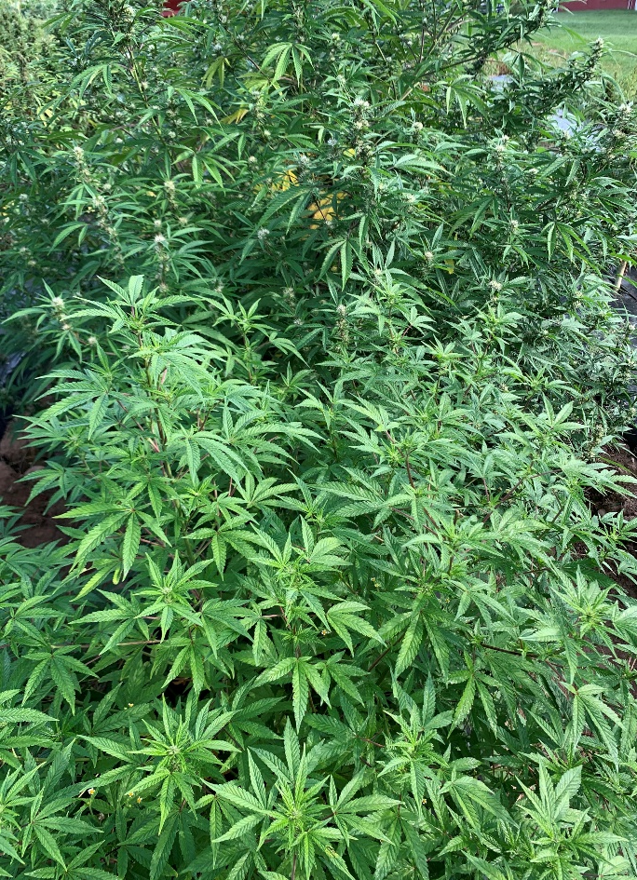
Lockwood Farm Plot
Sept. 6, 2020

Slide 16
Sampled every green plant in the row weekly at about 9 am
THC content failed for six varieties
Abacus Earl Bird hit a max 11% CBD and 0.45% THC on Sept. 16
Younsim10 lot WF hit a max 8.4% CBD and 0.58% THC on Oct. 21, then decreased the following week
Youngsim10 lot 17 had the highest THC content and the lowest CBD content

Slide 17
CBD content ranged from about 6% (Youngsim 10 lot 17) to as high as 18% (Cherry Abacus 2.0)
Abacus Earl Bird hit a max 11% CBD and 0.45% THC on Sept. 16, but was virtually dead at this point and sampling stopped
Younsim10 lot WF hit a max 8.4% CBD and 0.58% THC on Oct. 21, then decreased the following week

Slide 18
Cannabis sativa basics-Cannabinoid biosynthesis
CBG is converted based on the presence of genetically coded enzymes
  THCA in the presence of THCA synthase
  CBDA in the presence of CBDA synthase
  CBCA in the presence of CBCA synthase
Three chemotypes based on the presence of these enzymes
  Chemotype I - ~20:1 CBD:THC
  Chemotype II - ~2:1 CBD:THC
  Chemotype III - ~40:1 THC:CBD
Tracking a few individual plants through an entire season demonstrated the ratio is very consistent regardless of the CBD/THC concentration
While the genetics of this relationship are very well established, the chemotypes of individual plants within individual varieties of Cannabis sativa are less established
  Medical marijuana requires a very consistent level of THCA/THC due to its medicinal use, which may explain the use of clones and transplants vs seed
  Hemp varieties are relatively new and not necessarily true breeding

Slide 19
Sampled 3 buds per every individual plant in the row
A typical ratio of CBD to THC in hemp is ~20:1
Four plants out of 14 were not typical of hemp (0.6, 1.1, 1.2, 2.1)
  Plant 7 had THC content of 7.5% and CBD of 4.3%
Eliminating plant 7 from the analysis resulted in a passing THC level
  0.96% with plant 7, and 0.46% without plant 7

Slide 20
One plant out of 33 had a ratio of CBD to THC of ~1
  Plant 3 had THC content of 8.4% and CBD of 8.3%
32 out of 33 plants had a ratio of about 25:1

Slide 21
All plants within this variety had a ratio typical of hemp
On Oct 22, The range of CBD was 14% to 21%
On Oct 22, the range of THC was 0.54% to 0.84%

Slide 22
Summary of Growing Experiences
Culling males is laborious, requires checking every other day or so for at least a one-month period
Timing of optimal bloom varies by weeks for different varieties and for different plants
2019 issues included corn borer, but also probably viral infection, as well as root rot but mostly minor losses
2020 issues also included corn ear worm and wind damage causing significant losses
Both Youngsim 10 varieties failed the total delta-9 THC testing in 2019, other 3 varieties all passed
6 of 8 varieties in 2020 failed the total delta-9 THC testing (1 Youngsim10 and Abacus Early Bird variety passed)
Two individual plants showed potentially psychoactive levels of THC (8.4% and 7.5%)

Slide 23
Conclusions
Gas Chromatography with flame ionization detection is a robust method for analysis of total Delta-9 THC
  Quick sample run time, robust and reliable
CBD and THC began to spike around the beginning of September
  The amount of THC may increase significantly from the pre-harvest test sample until the harvest is completed
Hemp varieties are not well developed at this time
  Significant variability between plants within the variety
  Significant risk of exceeding the THC content
  Significant issues with traceability of seed varieties
Individual plants within some varieties of hemp are not chemotype I
  Inclusion (or lack of inclusion) of particular plants may significantly alter THC content leading to large differences between field samples
  Some buds are in the psychoactive range for THC which has some implications for hemp sold as smokable flower

Slide 24
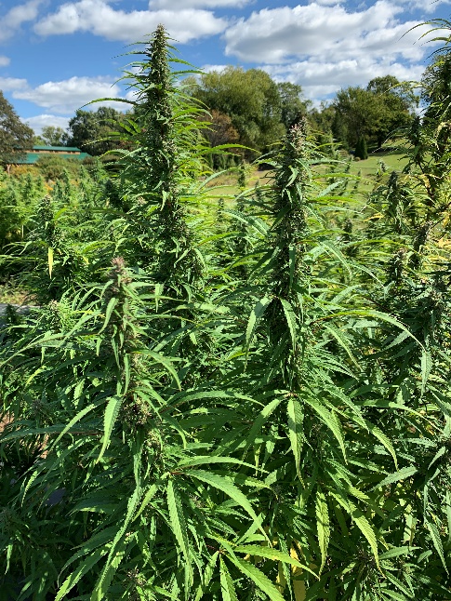
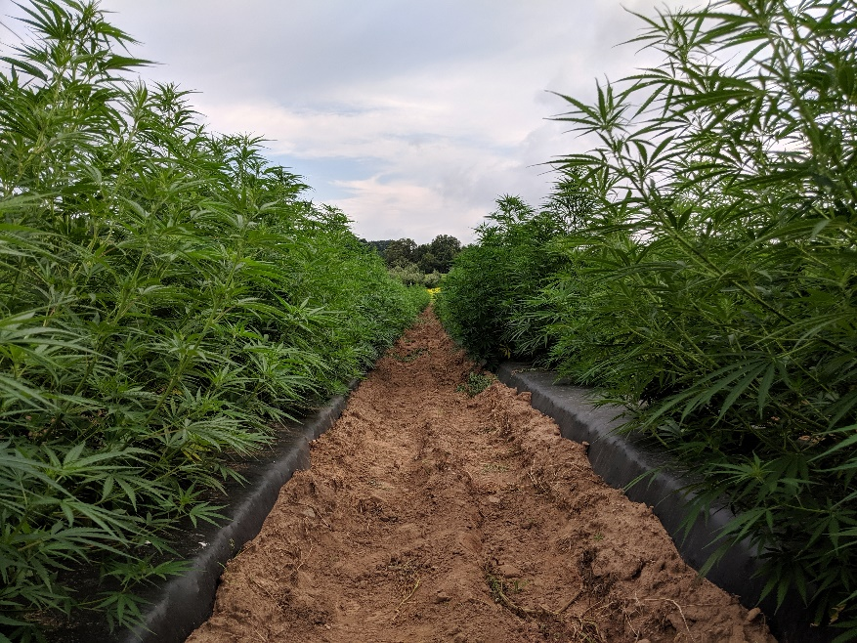
Acknowledgements
Staff of the Experiment Station
Dr. Jason C. White
Ms. Kitty Prapayotin-Riveros
Rich Cecarelli
Michael Ammirata
Thank You!!

