Slide 1
Getting Started with FSA
Notes:
GO TO VIEW > MASTER > SLIDE MASTER TO EDIT THE IMAGES ON THE TITLE AND DIVIDER SLIDES

Slide 2
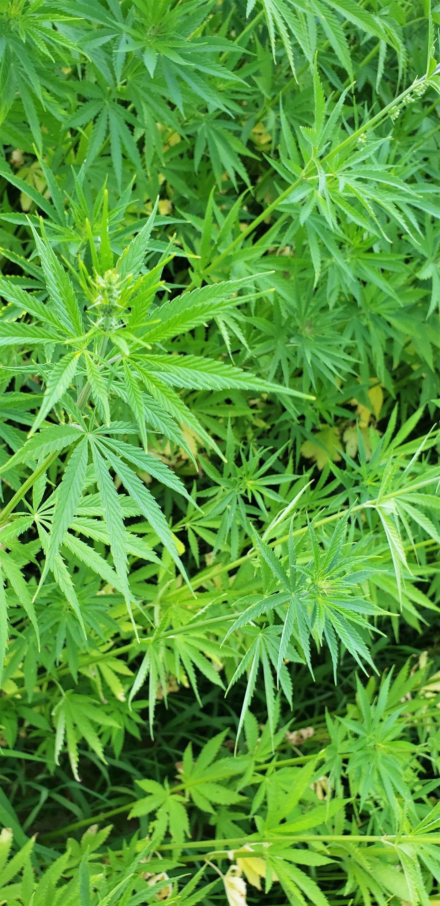
Getting Started with FSA
Setting up Farm Records and Reporting your Acreage in the Local Service Center

Slide 3
Who is FSA
The Farm Service Agency is an agency within the US Department of Agriculture in the Farm Production and Conservation mission area
Our Mission: Farm Service Agency is equitably serving all farmers, ranchers, and agricultural partners through the delivery of effective, efficient agricultural programs for all Americans.

Slide 4
FSA County Offices
FSA county offices are located in USDA Service Centers
  USDA Service centers usually also include
    Natural Resource Conservation Service
    Local Conservation District
    Sometimes Rural Development and other USDA agencies
https://farmers.gov/service-center-locator

Slide 5
Where to start?
Contact your local office farmers.gov/service-center-locator
Set up your records
  Producer record
  Farm record
2. Acreage Reporting – After planting 2021

Slide 6
Producer Record
Collected on Form AD-2047
  Name
  Business type – Individual/entity
    Members (if applicable)
  Address
  Contact info
  Participation interest
  Tax ID number (if participating in FSA programs for payment)

Slide 7
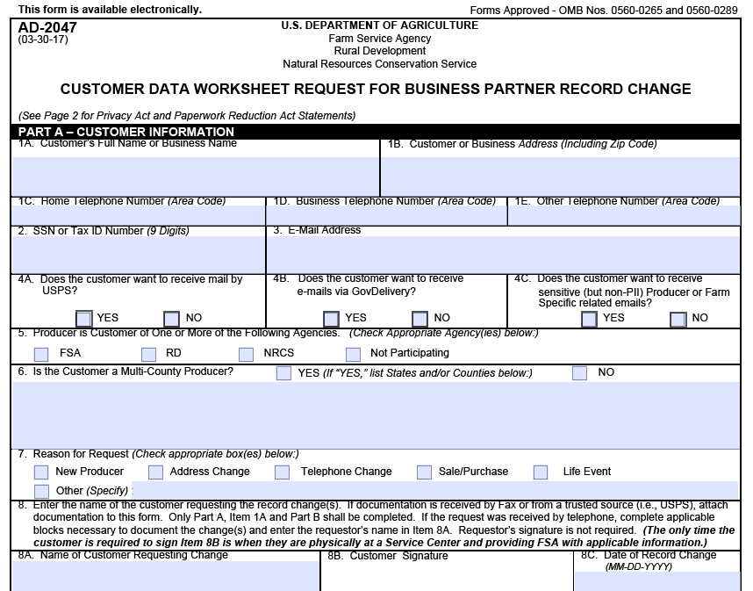

Slide 8
Create Farm Record
Land Documentation
  Proof of landowner
    deed
    assessor card
    town’s assessor website
  If land is leased
    a written lease
    letter from the landowner of record
Map
  Ownership boundaries
    Survey map
    Parcel map
  Field boundaries
    Cropland vs. forestland
    Management boundaries
  Greenhouse/Indoor growing locations and approx. area
Notes:
If you or a previous operator has participated in our programs in the past the farm record may already exist, then we may just need to update the information

Slide 9
Farm Structure
Farm# 9999 –Operator A
  Tract# 8888 – Owner A
    Field1 – 5ac cropland
    Field2 – 6ac cropland
    Field3 – 15ac forest
  Tract# 7777 – Owner B
    Field1 – 25ac cropland
    Field2 – 1ac other ag (farmstead/farm road)

Slide 10
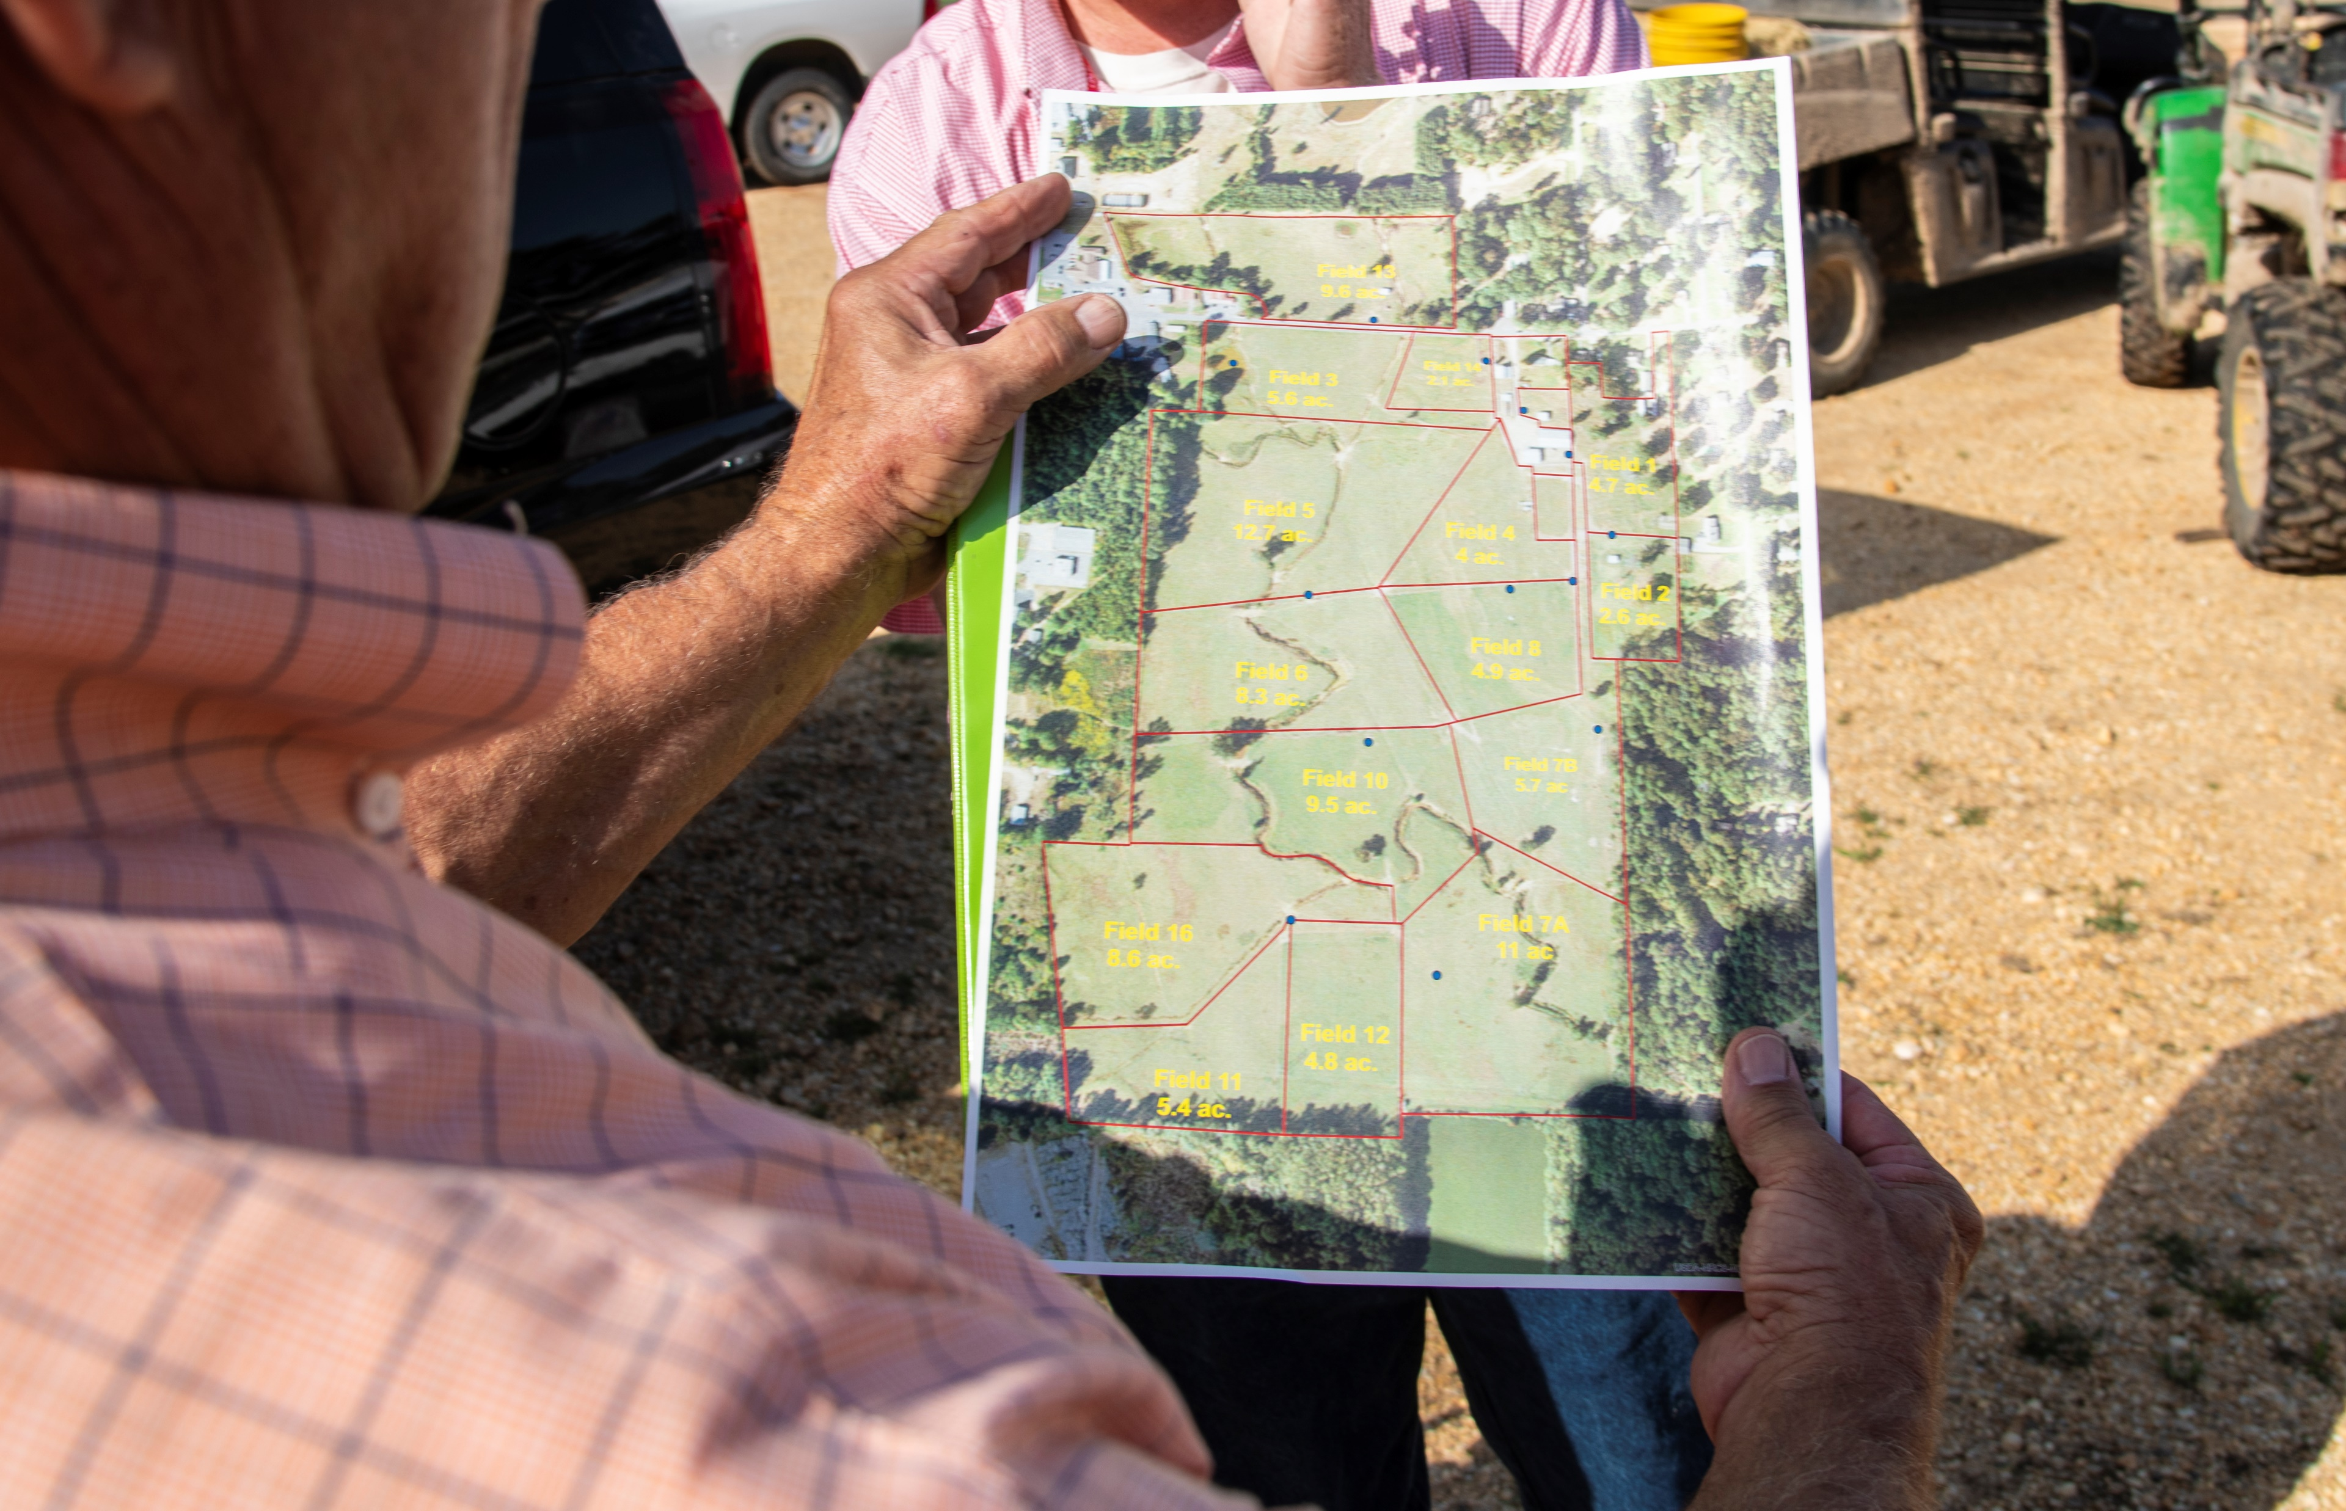

Slide 11
Acreage Reporting – by July 15 each year
Maps
  Paper maps are marked with crop data
    Crop, type, intended use, planting date, shares, any sub-field divisions as applicable and approximate area
FSA-578
  Info from the map is entered into our crop reporting software to create the Crop Acreage Report
  Acreage is certified by signing the FSA-578 and returning to office
Your State, Tribe, or USDA issued hemp growers license number is required when reporting hemp acreage
Notes:
Acreage reporting deadlines may vary by state, county, and crop. In Connecticut, the acreage reporting deadline for hemp is July 15 of the crop year in which it was planted.

Slide 12
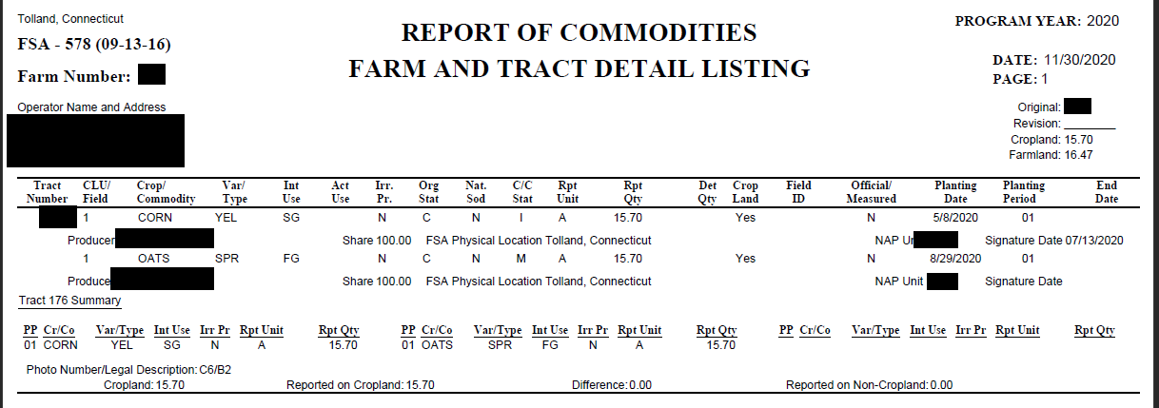
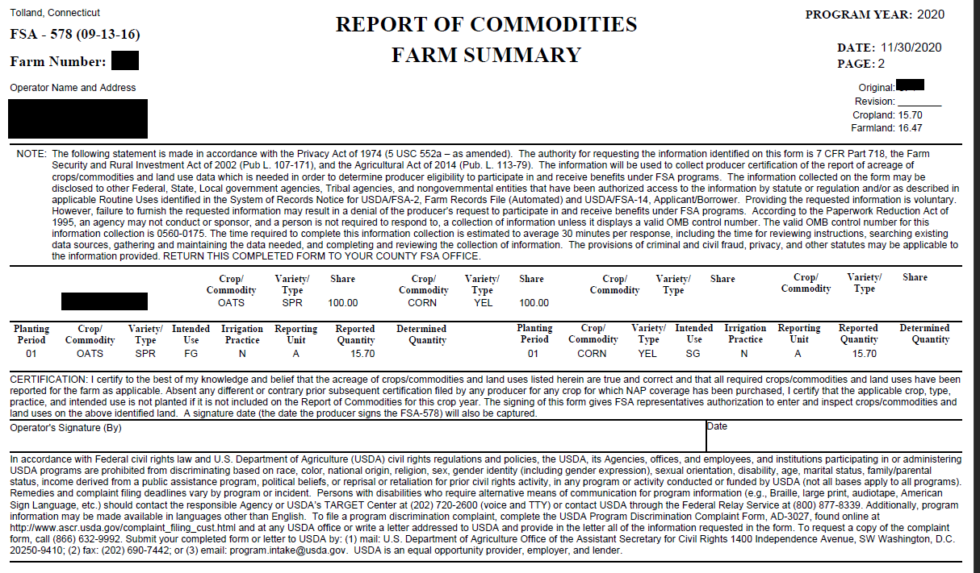

Slide 13
Why Should You Report Your Acreage?
It’s required
  The Interim Final Rule states that all hemp must be reported to the FSA
Eligibility for other USDA programs
  Acreage reports are a requirement for many FSA programs
  May be used to calculate program benefits
  Crop Insurance
Record keeping
  Acreage reports include data and maps which could be useful for your records

Slide 14
What’s next?
Hemp Producers may also be eligible for some of our programs including:
  Non-insured Crop Disaster Assistance Program (NAP)
    Catastrophic production loss for crops not covered by Crop Insurance (RMA)

Slide 15
Additional Resources
Fact Sheets - https://www.fsa.usda.gov/news-room/fact-sheets/index
Crop Acreage Reporting Fact Sheet- https://www.fsa.usda.gov/Assets/USDA-FSA-Public/usdafiles/FactSheets/2019/crop-acreage-reporting-19.pdf
AMS Hemp Program - https://www.ams.usda.gov/rules-regulations/hemp

Slide 16

Questions?

