Slide 1
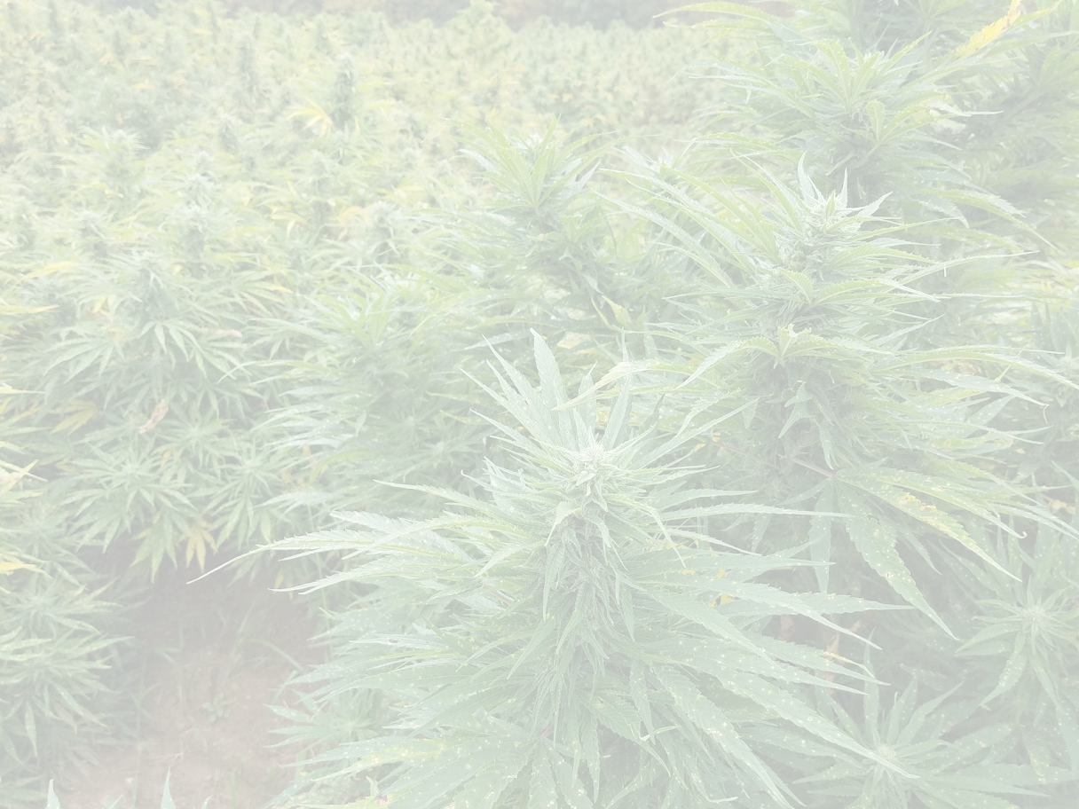
2019 Hemp Grower Survey Results
36 Growers Responded which is 53% of the growers that grew hemp this year in Connecticut

Slide 16
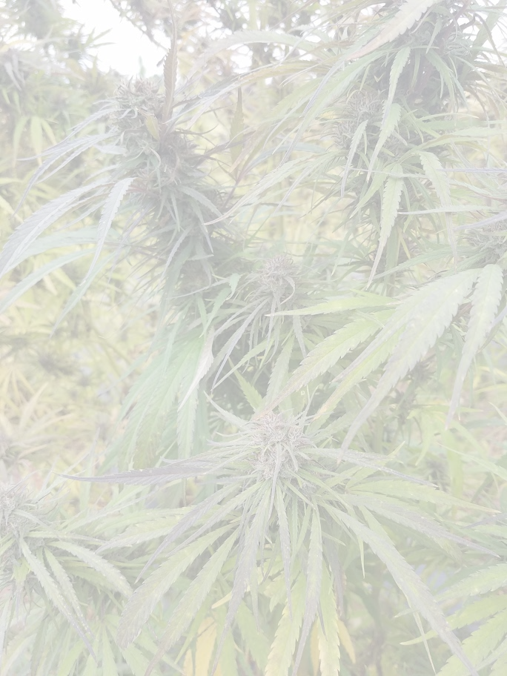
Amount of N-P-K Fertilizers at time of planting
4-12-4
7-4-2
2-1-1
18-18-18
20-20-20
Sheep manure
Fish
80-60-80
100-80-80
8-8-8

Slide 27
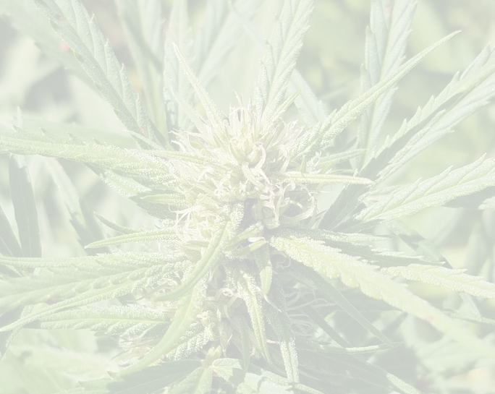
What was the most difficult issue you dealt with this season related to growing/ harvesting hemp?
Cannabinoid Levels
The regulations
Not understanding how to handle the finished product for a buyer and the panel testing
Germination rate
Corn Borers
Growing Hemp
Fertilizing Hemp
Male Plants
PH
Mold
Theft
Lack of buyers
State of CT Licensing
Harvesting Practices
No buyer/processor information
Labor
Pests
Late Planting

Slide 28
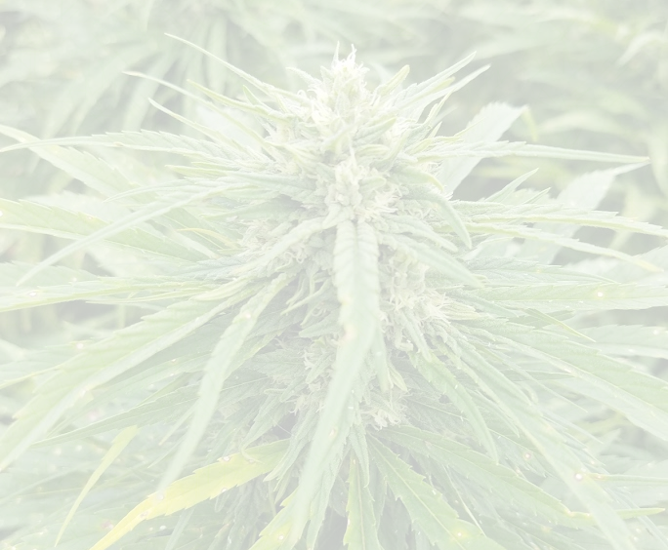
What one thing about this year’s CT Hemp Program would you like to see changed for next year and how should it be changed?
Cannabinoid testing consistency
Different reporting requirements for researchers
Better understanding of THC level increases during growing season
Better quality seeds
Location of grow sites not made public to prevent theft
testing should not be required on post-harvest material, should be focused on end products
Growing males outdoors near other farmers should not be allowed
Form fill out reminders
Simplify the website
Less paperwork and micromanagement
Online forms history to be accessible
Longer harvest than 15 days
Higher THC percentage
More info sessions and meetings

