Slide 1




CT Local Food Purchase Assistance Grant (LFPA)
FY 26
Cyrena Thibodeau
LFPA Coordinator
Cyrena.Thiobdeauf@ct.gov | CTGrown.gov/grants

Slide 2

Agenda
Review Grant Guidance ​
Review Application and Submission
Q&A (will hold off answering until the end, but feel free to put them in the chat as something comes up)

Slide 3
Overview
This competitive grant is intended for applicants including food hubs, food access organizations, and municipalities with demonstrated capacity to purchase, aggregate, and distribute Connecticut Grown food to underserved communities.
The purpose of CT DoAg’s LFPA grant program is to provide CT Grown farm products to underserved communities, at no cost to the individual, while maintaining and improving the CT agricultural supply chain resiliency. This is done through:
1. Establishing and strengthening partnerships across the food supply chain to ensure access to fresh, nutritious, culturally appropriate food in under-served communities.*
2. Purchasing from Connecticut producers to build and expand market access and opportunities.
CT DoAg has a total of $1,550,000 available to award through a competitive grant process. The selected applicant pool shall be considerate of geography and reach to ensure distribution and sourcing throughout the state.
Funding for the 2026 LFPA Grant is provided by the State of Connecticut in Special Act 25-1 through the Budget Reserve Fund.

Slide 4
Eligible Applicants
1. Food hubs and other CT aggregators
2. Food pantries, soup kitchens, and pantry networks
3. Municipalities
4. Community Health Center, hospitals, or other healthcare facilities
5. Mutual Aid networks
6. Faith based organizations
7. Senior Centers
8. Agricultural non-profits
Applicants must be located and operate in Connecticut and be considered in good standing with the state of Connecticut.

Slide 5
Project Requirements
1) All purchases and distribution of CT Grown food and farm products must occur from April 15, 2026 through June 30, 2027.
2) 100% of farm products purchased must be grown in Connecticut (CT Grown). Value-added (pickles, jams, honey, maple syrup, etc.) minimally processed products (frozen and/or cut/chopped,) and prepared meals that are produced in CT and contain predominantly CT Grown ingredients are allowable.
3) At least 90% of project funds must be spent on direct food purchases. Up to 10% of project costs directly attributable to the LFPA program may be taken to cover administrative, supply, and distribution costs. No other costs are eligible expenses!!
4) Projects that source from multiple Connecticut producers, particularly small and socially disadvantaged producers, may receive additional consideration during evaluation.
5) Target populations for distribution include any low-income food insecure household, citizen or non-citizen, who is at or below the federal poverty level or who is considered Asset Limited Income Constrained Employed (ALICE)

Slide 6
CT Grown Sourcing
All food products purchased must be grown in Connecticut.
Small producer definition- NOT exclusionary or required. Based on farm sales, not grant funding
Want to see multiple farms sourced from, this is not meant to benefit one farm/organization
Cannot source product grown by the applicant
This is not meant to establish a new farm sourcing program- you must have an established track record of working with local farms or partner with a group or does
Strongly encourage regional collaboration- there are limited funds to spread throughout the whole state!

Slide 7
Application & Submission
All applications must complete a project narrative on Cognito, the agency’s online application portal.
While the recommended materials below are not required for eligibility, they may strengthen an application’s competitiveness.
1. Letter(s) of intent from community partners that you will work with to distribute the food if applicable. A template that may be used is available for download on the DoAg LFPA webpage.
2. Documentation of interest from producers and/or vendors interested in selling products through your program. Please note that you are not limited to sourcing from the producers/vendors who express interest. CT DoAg can provide additional resources to connect with producers/vendors. Documentation can come in the form of a letter or an email.

Slide 8
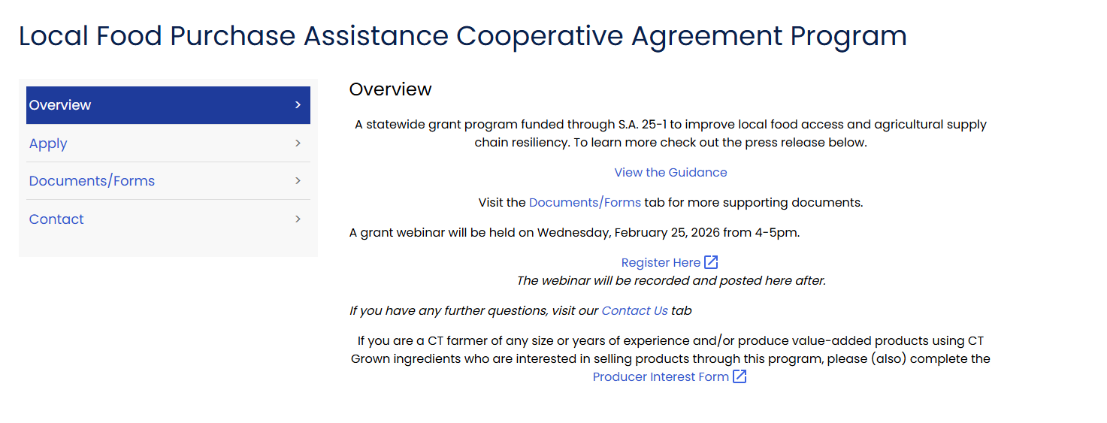
Website Overview
https://portal.ct.gov/doag/adarc/adarc/local-food-purchase-assistance-cooperative-agreement-program?language=en_US

Slide 9
Expenses & Payment
The amount awarded to an applicant through the LFPA Grant shall be a minimum of $100,000 and cannot exceed $310,000 for a 14-month award period. There is no match required for this grant.
Payment will be made to applicants in using the following payment schedule:
• Advance of 50% of project funds upon contract signing and approval of an advance request.
• Advance of 40% of project funds after proper documentation is approved from the first advance and approval of a second advance request.
• The remaining 10% of project funds will be reimbursed upon project completion and submission of final report. Please note that the burden of this remaining 10% must lie with the contract holder and cannot be at the expense of producers and/or vendors.

Slide 10
Evaluation Criteria
The LFPA Gant is a competitive grant. Only complete applications, as outlined above and submitted timely, will be evaluated.
Applications will be evaluated based on:
• Organizational capacity and past performance
• Strength of producer relationships
• Strength of community distribution partnerships
• Impact on underserved populations
• Feasibility and clarity of proposed approach
CT DoAg reserves the right to offer partial awards.

Slide 11
Project Duration & Post Award Requirements
Projects must be completed within 14 months of contract execution. Final project reports are due 30 days prior to the end of the contract period.
Applicants of awarded projects will be responsible for the following:
• Signing an agreement with the State of Connecticut,
• Providing a Certificate of Insurance holding the state harmless or listing the state as an additional insured on the grantee’s liability insurance policy,
• Completing the project within the contractual timeframe,
• Submitting a final project report
• Submitting a final financial report itemizing actual expenses. Copies of invoices and proof of payment must be submitted with the payment request at the conclusion of the project,
• Quarterly reporting and check-ins with CT DoAg program manager,
• Presentation of final project results and lessons learned to interested stakeholders at the conclusion of the project period, and
• Compliance with all applicable food safety requirements.

Slide 12
Reporting
Awardees will be provided with templates and guidance to comply with all reporting requirements for this program which shall include but not be limited to:
• Quarterly submission of producers sourced from including business name, product type, quantity, and price.
• Quarterly submission of distributions made including organization or community distributed to, and number of individuals served.
• Quarterly financial reports with paid invoices to producers and other receipts as necessary to CT DoAg program manager, templates and guidance will be provided.

Slide 13
Questions?

