Slide 1
CT Resilient Food System Infrastructure Grant Program (RFSI)
2025
www.CTGrown.gov

Slide 2
Agenda
Review Grant Types/Guidance
Review Application and Forms
Available Technical Assistance
DoAg Office Hours
Other Funding Opportunities
Grant Reviewers
Q & A

Slide 3
About RFSI
Funds will support expanded capacity for the aggregation, processing, manufacturing, storing, transporting, wholesaling, and distribution of locally and regionally produced food products, including specialty crops, dairy, grains for human consumption, aquaculture, and other food products, excluding meat and poultry.
Projects need to be focused on activities post-production but before the product reaches the retail/wholesale market or end consumers.
RFSI is federally funding through the United States Department of Agriculture authorized by section 1001(b)(4) of the American Rescue Plan (ARP) Act of 2021 (Pub. L. 117— 2), as amended, and administered by the CT Department of Agriculture.

Slide 4
Eligible Products
This program supports food system crops and products that are intentionally produced for human consumption such as Fruits and Vegetables, Honey, Maple Syrup, Aquaculture, Dairy, and Wine/Beer produced with local ingredients.
Ineligible products include meat and poultry, wild-caught seafood, exclusively animal feed and forage products, fiber, landscaping products, tobacco, or dietary supplements.

Slide 5
ELIGABLE APPLICANTS
Agricultural producers or processors, or groups of agricultural producers and processors conducting middle of the supply chain activities;
Nonprofit organizations operating middle-of-the-supply-chain activities;
For-profit entities operating middle-of-the-supply-chain activities whose activities are primarily focused for the benefit of local and regional producers and that meet the eligibility requirements of the SBA small business size standards;
Local government entities operating middle-of-the-supply-chain activities;
Tribal governments operating middle-of-the-supply-chain activities;
Institutions such as schools, universities, or hospitals bringing producers together to establish cooperative or shared infrastructure or invest in equipment that will benefit multiple producers through middle-of-the-supply-chain activities.
All applicant businesses and organizations and project beneficiaries must be domestically owned and physically located in Connecticut.

Slide 6
GRANT TYPES- You Must Pick One!
Infrastructure Grant Program
Awards from $100,000 to $250,000
Match Requirement: 50%, or 25% for qualifying applicants
Projects must benefit more than one producer or organization.
Equipment Only Grant Program
Awards from $25,000 to $100,000
No Match Required
Projects may benefit a single or multiple producers/organizations

Slide 7
Equipment Only Grant
The Equipment Only grant will fund only special purpose equipment purchases (and not associated facility upgrades, staffing, or other costs) to meet the goals of the RFSI program. Special purpose equipment is defined by the USDA as tangible, nonexpendable, personal property having a useful life of more than one year and an acquisition cost that equals or exceeds $5,000 per unit. Items under $5,000 per unit are considered supplies and not eligible for this grant.
The special purpose equipment must be used for middle of the supply chain activities, such as processing, storage, transportation, aggregation, distribution, or wholesaling and must help the applicant meet one of the following goals:
1. Increase market access, i.e. entry into new, bigger, or more profitable markets;
2. Increase production, i.e. increase the number of units moved through the supply chain; and
3. Diversify product offerings, i.e. offer new sizes, flavors, or types of products.
Additionally, applicants have the option to demonstrate how the equipment they plan to purchase with grant funds will help the organization meet one or more of the 12 secondary goals of RFSI program (see full grant guidance for list).

Slide 8
Equipment Only Grant- Example Projects
Examples of eligible projects may include but are not limited to: • Equipment that will meet standards needed to enter a new wholesale or retail outlets, such as a food safety component, packaging/labeling component, or quantity target that is required by a new market outlet. • Value-add equipment that would significantly increase production, allowing for the business to offer more units of product into the marketplace to meet demonstrated need. • Equipment that enables a new product line, such as a new size of packaging or a new variety of product that wouldn’t be able to be offered without the piece of equipment.
Projects that focus on processing or value-add of agricultural products must utilize local and/or regional ingredients. Applicants can request multiple pieces of equipment; however, they need to fall within one overarching project which has a set of outcomes that will be reported on.
Some examples of special purpose equipment include: • Upgrades or new equipment for specific agricultural products, such as: o Processing, preservation, and storage/cold storage o Post-harvest cleaning and grading o Purchase of freezing equipment, freezer, or cold storage o Processing, canning, preserving and pasteurization o Preparation and packing o Drying, hulling, shelling, and milling o Reverse osmosis systems o Egg packing machines o Flotation tanks o Roasters o Packing and labeling equipment o Cooking, baking, juicing, distilling, fermenting. • Special purpose vehicles relevant to the scope of work, such as delivery vehicles or refrigerated trucks. If the vehicle is mixed-use, it must be used primarily as a delivery vehicle and not shared between many programs or functions;

Slide 9
Equipment Only Grant- Example Projects
Additional eligible costs could include: • Equipment installation, as long as it is included in the equipment quote from the vendor and is not including any construction or additional utility-related (such as upgrading electrical outlets) activities; • Shipping and handling or delivery charges for the equipment, as long as it is included in the equipment quote and reasonable compared to the price of the equipment.
Applicants will be required to submit a recent quote for all equipment that will be purchased with grant funds. Please note that a quote cannot come from a contractor that will purchase the equipment and conduct additional activities to prepare the site for installation. Please note that grant funds can go towards pieces of equipment that are more than $100,000; however, the applicant must show how they can pay for the remainder of the equipment cost. For example, if a piece of equipment is $140,000, the applicant can ask for $100,000 in grant funds but must include $40,000 as additional funding that is committed or secured.

Slide 10
Infrastructure Grant
Applications must explain how the project affects and produces measurable outcomes for multiple Connecticut producers and/or the public rather than a single organization, institution, or individual.
We will not award grant funds for projects that primarily benefit a single business or that business’s product, organization, or individual.
FUNDING PRIORITIES
1. Projects that increase aggregation of farm products through food hubs and informal producer networks, which focuses on, but is not exclusive to, wholesale buyers.
2. Projects that increase the number of and access to processing facilities including commercial kitchens and co-packers, to preserve farm products and create value-added food products.
3. Projects that increase delivery infrastructure (such as vehicles) benefiting multiple farm business with eligible products and cold storage for aggregated produce, dairy, and aquaculture products.
4. Projects that support underserved communities and demonstrate local support for the project.

Slide 11
Infrastructure Grant- Example Projects
1. Expanding processing capacities, including adding product types, increasing production volumes, and supporting new wholesale/retail product lines;
2. Modernizing equipment or facilities through upgrades, repairs, or retooling; (e.g., adapting product lines for institutional procurement or adding parallel processing capacity);
3. Purchase and installation of specialized equipment, such as processing components, sorting equipment, packing and labeling equipment, or delivery vehicles;
4. Modernizing manufacturing, tracking, storage, and information technology systems;
5. Enhancing worker safety through adoption of new technologies or investment in equipment or facility improvements;
6. Construction of a new facility;
7. Increasing packaging and labeling capacities that meet compliance requirements under applicable laws (e.g. sealing, bagging, boxing, labeling, conveying, and product moving equipment);
8. Increasing storage space, including cold storage;
9. Development, customization or installation of climate-smart equipment that reduces greenhouse gas emissions, increases efficiency in water use, improves air and/or water quality, and/or meets one or more of USDA’s climate action goals;
10. Modernization of equipment or facilities to ensure food safety, including associated Hazard, Analysis, and Critical Control Points (HACCP) consultation, plan development and employee training; and training on the use of all equipment purchased under the grant and associated new processes.

Slide 12
Matching Funds (for Infrastructure Grant Only)
Infrastructure grant recipients are required to contribute 50% of the total project cost as a match to federal funding.
This may be as cash, in-kind, or a combination of the two.
This applies to all applicants except those who qualify for the reduced match.
All applicants will be required to certify their match through submission of a Letter of Match Verification for EACH source of match.
For historically underserved farmers and ranchers, or for other businesses that qualify under SBA categories of small, disadvantaged business, women-owned small business, or veteran-owned small business, the required match funding contribution or cost share is reduced to 25% of the project cost.
Applicants will self-certify in their Infrastructure Grant applications to being eligible for this reduced match.
For non-profits and formal cooperatives to qualify for the reduced matching funds the majority (51% or higher) of the board of directors or owners/operators need to meet the criteria.

Slide 13
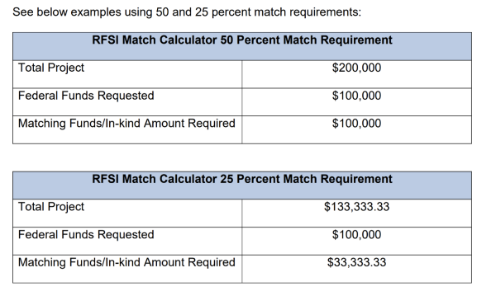
Matching Funds (for Infrastructure Grant Only)
I

Slide 14
Indirect Funds (for Infrastructure Grant Only)
Infrastructure grant recipients are allowed to request indirect. Indirect costs are any costs that are incurred for common or joint objectives that cannot be readily identified with an individual project, program, or organizational activity. They generally include facilities operation and maintenance costs, depreciation, and administrative expenses. If an applicant has a NICRA and wishes to charge that rate, a copy must be submitted as an attachment to the application on Cognito. Otherwise, applicants may elect to charge a de minimis rate of 10 percent of modified total direct costs (MTDC).
Equipment and supply costs cannot be counted in the modified total direct costs (i.e. the base rate of what indirect can be charged on).

Slide 15
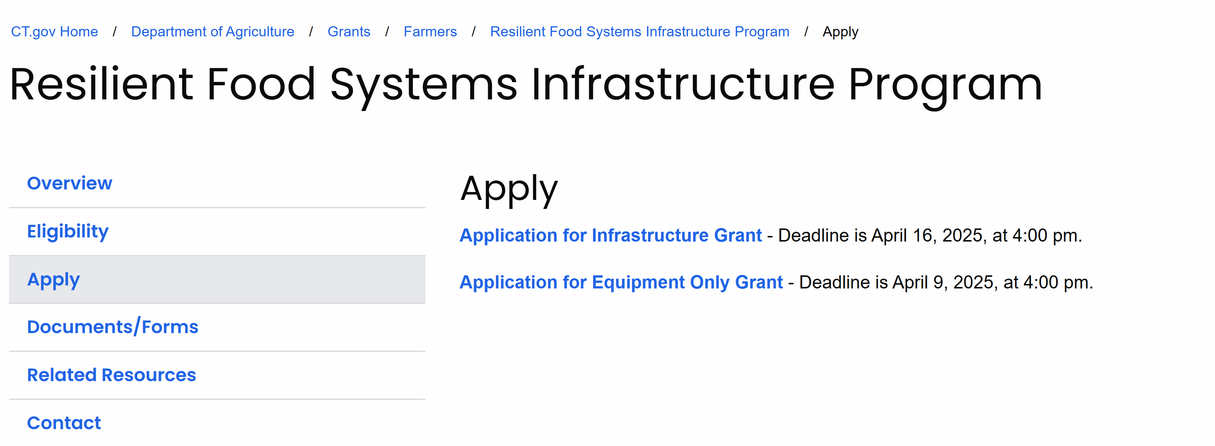
Navigating Website and Application
https://portal.ct.gov/doag/adarc/adarc/grants/resilient-food-systems-infrastructure-program/apply

Slide 16
Opening Grant Templates & Reviewing Questions
You must have adobe reader downloaded (it is free!)

Slide 17
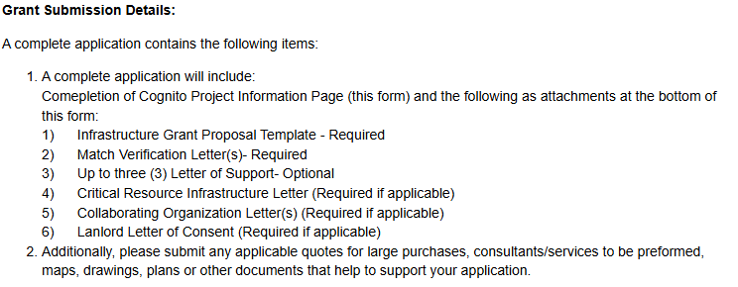
Explanation of Other Forms & Checklist
NEPA (will only be required to complete if recommended for award)

Slide 18
Anticipated Timeline
9 Apr. 2025 4pm
Deadline to submit equipment only application
16 Apr. 2025 4pm
Deadline to submit infrastructure application
May 2025
External Review and Initial Award Decision Connecticut Department of Agriculture submits State Plan to USDA-AMS
July 2025
Anticipated date of grantees notified of AMS decisions. Adjustments may be required subject to AMS approval.
Sep. 2025
Anticipated contract start date.
May 2027
Projects must be completed
Connecticut Department of Agriculture submits State Plan to USDA-AMS
May 2025

Slide 21
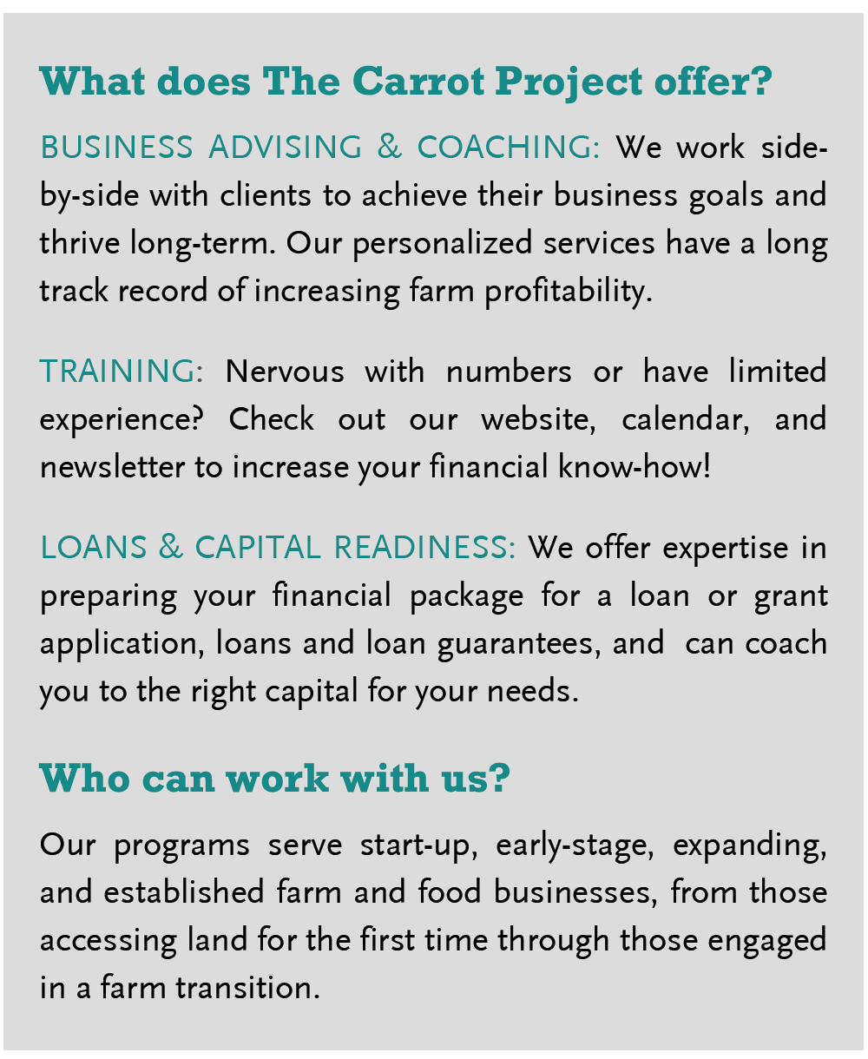
The Carrot Project

Slide 22
Tierra Viva Collective
Tierra Viva Collective, offers holistic technical assistance free to CT farm and food businesses with varying levels of support based on our current capacity. We specialize in business development planning, access to capital through grants and business development. Please fill out a consultation request form in its entirety so we can better assist you. All information will remain confidential and not be used in an identifiable way without direct permission. Interested in our services or need further assistance?
Please complete the form at this link; a Tierra Viva staff member will contact you. Tierra Viva supports the best beginning and aspiring farmers in strategies and planning for Agri/food business establishment, grand coaching, land access, and sales strategies. We speak English and Spanish. Contact: Gaby Pereyra, gaby@tierravivacollective.org, 917-935-5145

Slide 23
DoAg Open Office Hours
Weekly Open Office Hours will be available
Link will be posted to the website, drop in, no registration required
First one will be Wednesday 3/12 from 3-4 pm

Slide 24
Other Funding Opportunities
USDA Rural Development Value Added Producer Grant- OPEN Due April 11, 2024
USDA Local Food Promotion Program (and other LAMP programs)
Regional Food Business Centers
Other DoAg Grant Programs
CT Dept. Of Economic and Community Development- Small Businesses Opportunities
Women's Business Development Council

Slide 25
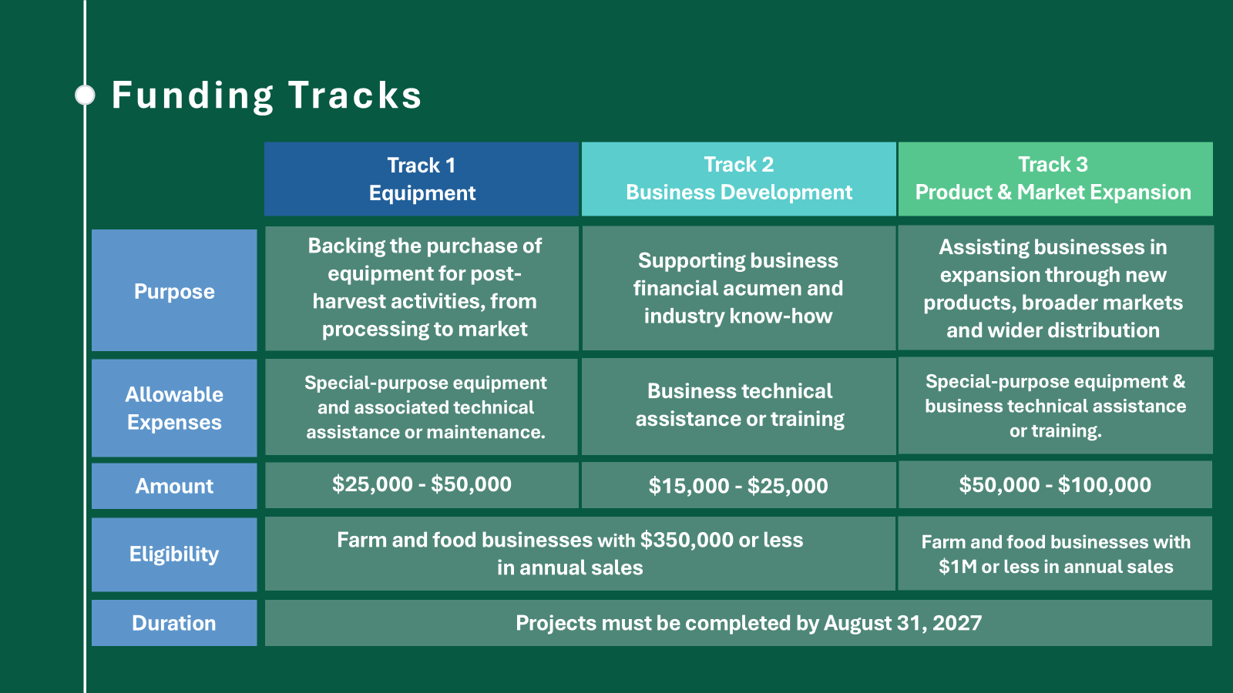

Slide 26
Questions?
Cyrena.Thibodeau@ct.govv, 860-895-3094

