Slide 1
2024 CT Resilient Food System Infrastructure Grant Program
Please keep yourself on mute and feel free to introduce yourself in the chat!
Large Infrastructure Grant Program
https://portal.ct.gov/DOAG/ADaRC/ADaRC/Grants/Resilient-Food-Systems-Infrastructure-Program

Slide 2
Agenda
Review/Clarify Grant Guidance
Review Application and Forms
Available Technical Assistance (CT SBDC, NEFOC, and Carrot Project)
Q & A
DoAg Office Hours and Assistance

Slide 3
"Middle of the Supply Chain" refers to:
Processing (step 2)
Aggregation and distribution (step 3).
Projects need to be focused on activities post-production but before the product reaches the retail/wholesale market or end consumers.

Slide 4
Program Purpose
Build and establish resilience in the middle of the food supply chain; to provide more and better markets to small farms and food businesses; to support the development of value-added products ; and create new and safe job opportunities.
Primary goal is to support CT agricultural producers
RFSI seeks to expand capacity and infrastructure for the aggregation, processing, manufacturing, storing, transporting, wholesaling, or distribution of food products grown in Connecticut.

Slide 5
Eligible and Ineligible Products
This program supports food system crops and products that are intentionally produced for human consumption such as Fruits and Vegetables, Honey, Maple Syrup, Aquaculture, Dairy, and Wine/Beer produced with local ingredients.
Ineligible products include meat and poultry, wild-caught seafood, exclusively animal feed and forage products, fiber, landscaping products, tobacco, or dietary supplements.

Slide 6
Eligible Entities
Agricultural producers or processors, or groups of agricultural producers and processors conducting middle of the supply chain activities;
Nonprofit organizations operating middle-of-the-supply-chain activities;
For-profit entities operating middle-of-the-supply-chain activities whose activities are primarily focused for the benefit of local and regional producers and that meet the eligibility requirements of the SBA small business size standards;
Local government entities operating middle-of-the-supply-chain activities;
Tribal governments operating middle-of-the-supply-chain activities;
Institutions such as schools, universities, or hospitals bringing producers together to establish cooperative or shared infrastructure or invest in equipment that will benefit multiple producers through middle-of-the-supply-chain activities.
All applicant businesses and organizations and project beneficiaries must be domestically owned and physically located in Connecticut.

Slide 7
Benefit to More Than One Business or Organization
Applications must explain how the project affects and produces measurable outcomes for multiple Connecticut producers and/or the public rather than a single organization, institution, or individual.
We will not award grant funds for projects that primarily benefit a single business or that business’s product, organization, or individual.

Slide 8
Future RFSI Rounds
Round One: Infrastructure Grant Program February 7, 2024 – April 10, 2024 Awards from $100,000 to $250,000 Match Requirement: 50%, or 25% for qualifying applicants Projects must benefit more than one producer or organization.
Round Two: Equipment Grant Program February 2025 – April 2025 Max Award: $100,000 Match Requirement: There is no required match. Projects can benefit single producer or organization only.
An applicant cannot receive a grant in both rounds

Slide 9
Available Funds & Project Length
Grant awards will be between $100,000- $250,000 per application.
Matching funds are required.
Approximately $1.7 million will be available to award to subrecipient projects this round.
Projects can be funded for up to 30 months (2 years, 6 months).
Anticipated contract start date of September 1, 2024
All contracts will end no later than May 24, 2027.

Slide 10
Definitions
Underserved Communities: Exec Order 13985, Executive Order on Advancing Racial Equity and Support for Underserved Communities Through the Federal Government, Jan 20, 2021
(a) The term “equity” means the consistent and systematic fair, just, and impartial treatment of all individuals, including individuals who belong to underserved communities that have been denied such treatment, such as Black, Latino, and Indigenous and Native American persons, Asian Americans and Pacific Islanders and other persons of color; members of religious minorities; lesbian, gay, bisexual, transgender, and queer (LGBTQ+) persons; persons with disabilities; persons who live in rural areas; and persons otherwise adversely affected by persistent poverty or inequality.
(b) The term “underserved communities” refers to populations sharing a particular characteristic, as well as geographic communities, that have been systematically denied a full opportunity to participate in aspects of economic, social, and civic life, as exemplified by the list in the preceding definition of “equity.”
Please refer to Appendix C in grant guidance document for full list of terms

Slide 11
State Funding Priorities
Projects that benefit and/or are led by individuals from the following groups will receive additional points in the grant review process:
Historically underserved farmers as defined by USDA;
Agricultural operations that qualify as small disadvantaged businesses, women-owned businesses, or veteran-owned businesses as defined by the U.S. Small Business Administration
Socially disadvantaged farmers as defined by AB 1348, the Farmer Equity Act of 2017;
Projects that don’t meet one of the funding priorities will still be considered. The priorities listed are not in order of priority or preference.

Slide 12
State Funding Priorities (Cont.)
1. Projects that increase aggregation of farm products through food hubs and informal producer networks, which focuses on, but is not exclusive to, wholesale buyers.
2. Projects that increase the number of and access to processing facilities including commercial kitchens and co-packers, to preserve farm products and create value-added food products.
3. Projects that increase delivery infrastructure (such as vehicles) benefiting multiple farm business with eligible products and cold storage for aggregated produce, dairy, and aquaculture products. (Please note that there will be a smaller no match equipment only round in 2025.)
4. Projects that support underserved communities and demonstrate local support for the project. (Encourage letters of support)

Slide 13
Matching Funds
Infrastructure grant recipients are required to contribute 50% of the total project cost as a match to federal funding.
This may be as cash, in-kind, or a combination of the two.
This applies to all applicants except those who qualify for the reduced match.
All applicants will be required to certify their match through submission of a Letter of Match Verification for EACH source of match.

Slide 14
Reduced Matching Funds
For historically underserved farmers and ranchers, or for other businesses that qualify under SBA categories of small, disadvantaged business, women-owned small business, or veteran-owned small business, the required match funding contribution or cost share is reduced to 25% of the project cost.
Applicants will self-certify in their Infrastructure Grant applications to being eligible for this reduced match.
For non-profits and formal cooperatives to qualify for the reduced matching funds the majority (51% or higher) of the board of directors or owners/operators need to meet the criteria.

Slide 15
Other Matching Fund Information
In-kind contributions are defined, when used as a cost share or match for a grant, as the value of goods or services provided for the benefit of the grant program, where no funds transferred hands.
These contributions cannot satisfy a cost sharing or matching requirement for this grant program if they are used toward satisfying a match requirement under any other Federal grant agreement to which the applicant is a party.
Indirect costs may count toward the Infrastructure Grant applicant’s match. Program income or any other Federal funds is an ineligible source of match or cost share.

Slide 16
Match Calculator-https://portal.ct.gov/DOAG/ADaRC/ADaRC/Grants/Resilient-Food-Systems-Infrastructure-Program/Documents

Slide 17
Matching Funds Verification
Review of the template and how to complete

Slide 18
Indirect Funds
Applicants can request indirect costs in their proposal.
Indirect costs are any costs that are incurred for common or joint objectives that cannot be readily identified with an individual project, program, or organizational activity. They generally include facilities operation and maintenance costs, depreciation, and administrative expenses.
If an applicant has a NICRA and wishes to charge that rate, a copy must be submitted as an attachment to the application on Cognito. Otherwise, applicants may elect to charge a de minimis rate of 10 percent (10%) of modified total direct costs (MTDC).

Slide 19
A few USDA FAQ's
Q: CAN UNRECOVERED INDIRECT COST BE USED AS PART OF THE COST SHARING OR MATCHING? A: Yes, it is allowable to use unrecovered indirect costs as part of cost sharing or matching. Unrecovered indirect cost means the difference between the amount charged to the Federal award and the amount that could have been charged to the Federal award under the potential recipients approved negotiated indirect cost rate.
Q: CAN DONATED LABOR/PERSONNEL TIME COUNT AS IN-KIND MATCH? A: Labor/personnel time may be used as a match for the percentage of time the person is working on the project. For example, if someone is only spending 15% of their time working on the project, then you can only bring that 15% to the project as a match. Also, you must ensure that what you would normally pay that individual is reasonable according to standard personnel rates for similar positions in your geographic locality.

Slide 20
Evidence of Critical Resouces and Infrastructure
Evidence of Critical Infrastructure is required if critical resources and/or infrastructure are necessary for the completion of the proposed Infrastructure Grant project.
If this is applicable to the proposed project, applicants must submit evidence (in MS Word or PDF) that critical resources and infrastructure necessary to support the initiation and completion of a project are in place.
Land, structures, and other critical resources must be in place and in working condition at the time of application submission. The letter must indicate the critical resources that are necessary for initiation and completion of the project and certify that they are in place and committed prior to the start date of the project.

Slide 21
Evidence of Critical Resouces and Infrastructure
Review Letter

Slide 22
Project Collaborators vs Letter of Support vs In-Kind Matching Funds-
Review Collaborator Organization/Business Letter

Slide 23
Definition of a Project
A project is a set of interrelated tasks with a cohesive, distinct, specified, and defined goal. It follows a planned, organized approach over a fixed period and within specific limitations (cost, performance/quality, etc.). Additionally, it uses resources that are specifically allocated to the work of the project and usually involves a team of people.
Projects are different from other ongoing operations in an organization because, unlike operations, projects have a limited duration with a definitive beginning and end. A project will also have an overarching goal that the applicant wants to accomplish through a series of individual activities or tasks.
Infrastructure Grants will fund projects that expand capacity and infrastructure for the aggregation, processing, manufacturing, storing, transporting, wholesaling, or distribution of targeted agricultural products.

Slide 24
Outcomes
Each project must include at least one of the two outcomes listed in Appendix A: USDA Performance Measures (grant guidance) and at least one of the indicators listed under the selected outcome(s). Progress toward outcomes and indicators selected will be reported in annual and final performance reports.
Please be realistic in your estimates and have some rationale to back them up.
We will go over the outcomes/indicators when we get to the application review

Slide 25
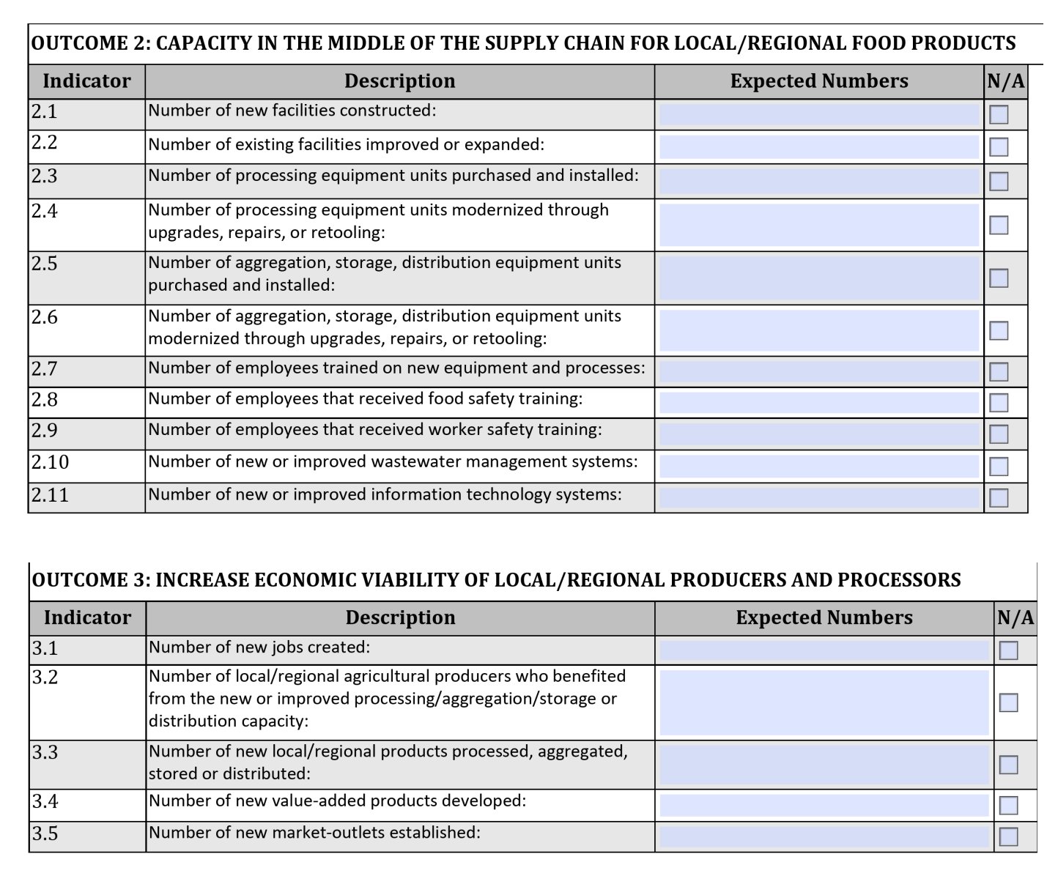

Slide 26
Example Projects A non-exhaustive list is on p. 8 of projects and activities
Q: CAN FUNDS BE USED FOR FARM PRODUCTION RELATED ACTIVITIES?
A: No, funds cannot be use for agricultural production activities/costs including farm equipment, tools, supplies, gardening, or production related labor/training.
Please note that in accordance with the Program Scope and Requirements, on-farm post-harvest processing, preservation, and storage/cold storage are allowable activities. *Remember, it must benefit multiple producers/organizations.
Q: CAN FUNDS BE USED TO PURCHASE VEHICLES?
A: Special purpose vehicles relevant to the scope of work on an Infrastructure Grant project, such as delivery vehicles or refrigerated trucks, are allowable. However, the purchase of a general use vehicles is not allowable. Please see the RFSI Program Specific Terms and Conditions for more information on general use and special purpose equipment.
Q: WHAT RETAIL RELATED ACTIVITIES ARE ELIGIBLE FOR FUNDING?
A: Eligible retail related activities can include creating distribution channels to new retail opportunities, or expanding processing and packaging capacities, including adding product types, increasing production volumes, and supporting new retail product lines.

Slide 27
Allowable & Unallowable Activities Please read Appendix B in grant guidance document!
The following activities are not eligible for funding:
Acquiring real property (including land purchases), or any interest therein;
Projects focused on meat and poultry processing or other ineligible agricultural products;
Activities that have received funding from another Federal award program;
Claim expenses that have been or will be reimbursed under any Federal, State, or local government funding; and
Projects which have already received funding from another federal grant or subaward programs may not receive funding for the same activities through an Infrastructure Grant. However, Infrastructure Grants may build on the successes of prior funding to fund subsequent activities.

Slide 28
NEPA
Q. IF INFRASTRUCTURE GRANT APPLICATIONS INCLUDE CONSTRUCTION, WILL THE PROJECTS NEED TO COMPLY WITH NATIONAL ENVIRONMENTAL POLICY ACT (NEPA)?
A: Yes, any application that may have ground disturbing activities needs to comply with NEPA, Section 106 of the National Historic Preservation Act, and other state, local and tribal laws.
If you're planning a construction project, please talk to me first!

Slide 29
Submission and Application Review
A complete application will include: 1.Cognito Project Information Page and the following as attachments on Cognito 2. Infrastructure Grant Proposal Template - Required 3. Match Verification Letter(s)- Required 4. Up to three (3) Letter of Support- Optional 5. Critical Resource Infrastructure Letter (Required if applicable) 6. Collaborating Organization Letter(s) (Required if applicable)
https://portal.ct.gov/DOAG/ADaRC/ADaRC/Grants/Resilient-Food-Systems-Infrastructure-Program

Slide 30
Anticipated Timeline
10 Apr. 2024
Deadline to submit application
May 2024
Applicants notified of preliminary funding decisions
May 2024
Connecticut Department of Agriculture submits State Plan to USDA-AMS
July 2024
Anticipated date of grantees notified of AMS decisions. Adjustments may be required subject to AMS approval.
Sep. 2024
Anticipated contract start date.
May 2027
Projects must be completed

Slide 31
Other Funding Opportunities
USDA Rural Development Value Added Producer Grant- OPEN Due April 11, 2024
USDA Local Food Promotion Program (and other LAMP programs)
Regional Food Business Centers
Other DoAg Grant Programs
CT Dept. Of Economic and Community Development- Small Businesses Opportunities
Women's Business Development Council

Slide 32
DoAg Office Hours and FAQ's Cyrena.Thibodeau@ct.gov
860-895-3094
Questions about eligibility, matching funds, the application, etc. Talk to me!
Drop in Office Hours will be held weekly on Wednesdays from 3-4pm on this open WebEx link (video or call in). You can reach out to me via email or phone at other times as well.
https://ctdoag.webex.com/meet/cyrena.thibodeau
Join by phone
+1-408-418-9388 United States Toll
Access code: 132 634 2590
FAQ's will be posted to the website and updated throughout application period

Slide 38
Northeast Farmers of Color Land Trust (NEFOC)

Slide 39
Questions

