Slide 1

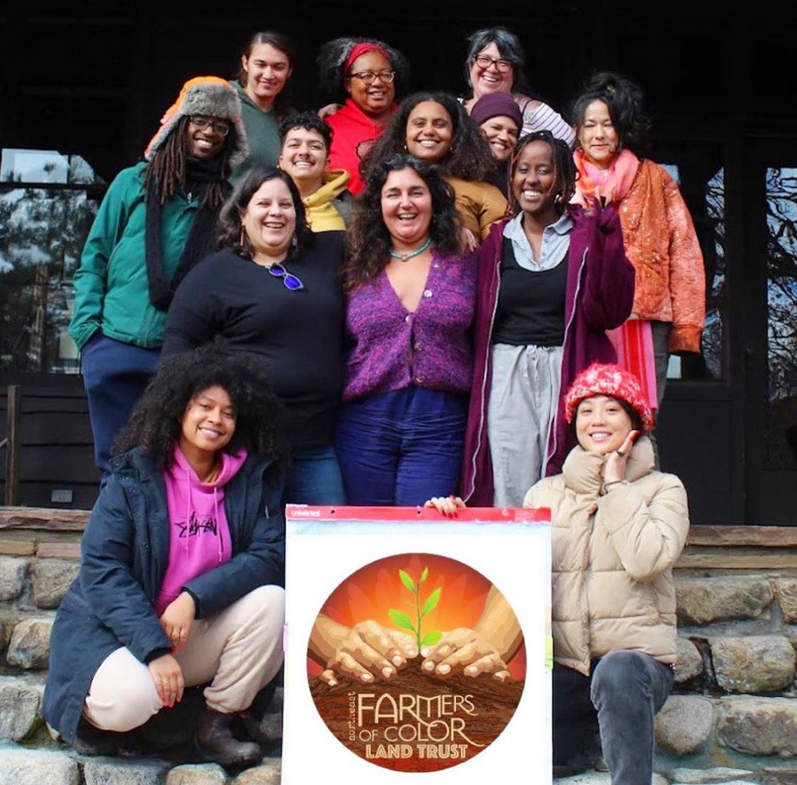

De un sistema a nuestro ecosistema
From a system to our ecosystem

Slide 2
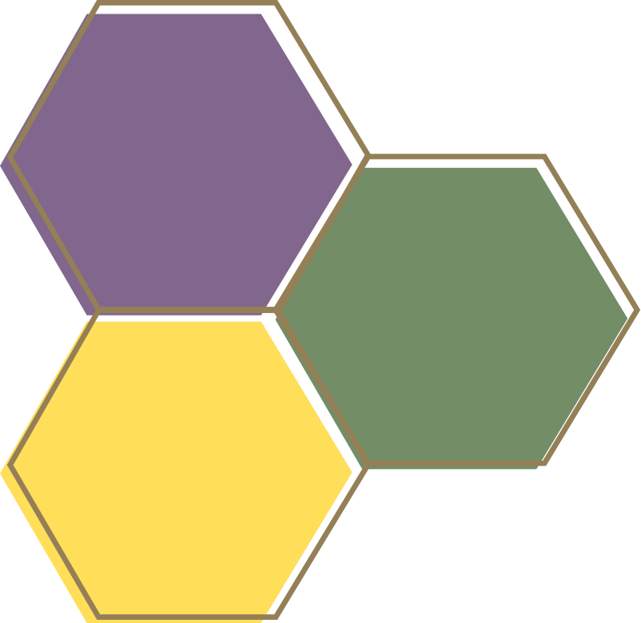


NEFOC PROGRAMS
PROGRAMAS DE NEFOC
Relationship & Reciprocity
Land Relationship
Vínculaciones con la tierra
Vínculaciones y reciprocidad
Climate
Justice &
Advocacy
Land
Network
Services
Justicia climática y advocacía
Reparations
Policy
Desagravío
NEFOC Network
Red de NEFOC
Servicios para la red
Políticas
Black Land
Stewardship
Cultivation

Slide 3
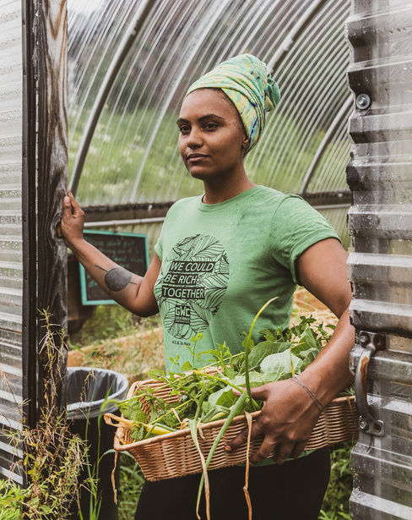
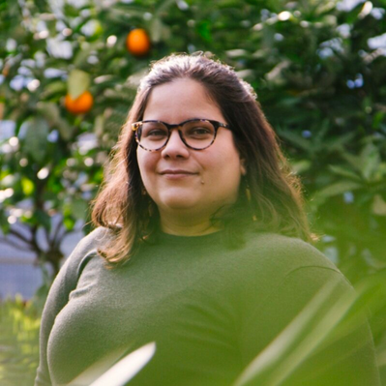
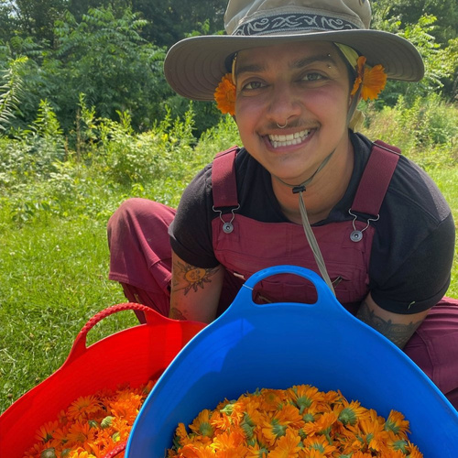
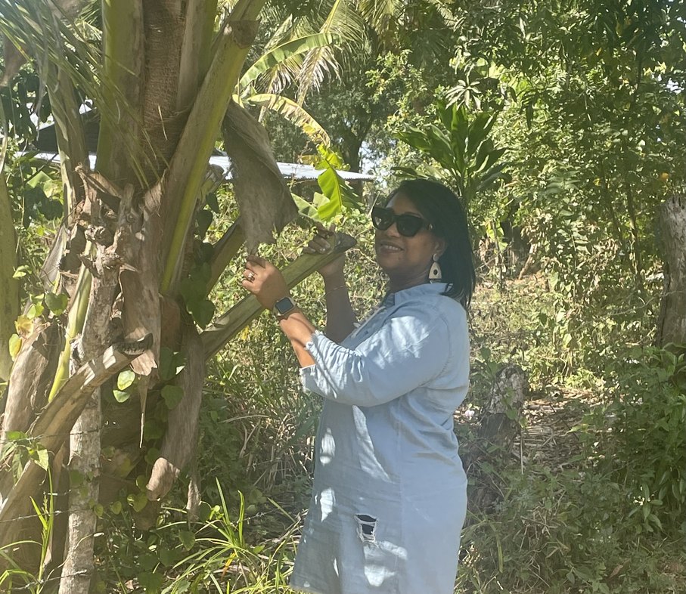
LAND NETWORK SERVICES
SERVICIOS PARA LA RED DE TIERRAS
Ysanet Batista Vargas
she/her/ella
Gaby Pereyra
Ella/her/she
Rosa Rodriguez
she/her/ella
Saka Gupta
Elle/They
Land Network Services Coordinator
Coordinadora de servicios para la red de tierras
Co-Director
Co-directora
Government Grant Manager
Gerente de subvesiones gubernamentales
Land Network Services Coordinator
Coordinadora de servicios para la red de tierras
Notes:
Ysanet and Rosa explain the differences between their roles
Ysanet - work with network
Rosa - work with services

