Slide 1
WELCOME!
Bienvenido!
Please introduce yourself in the chat as you settle in!
Please stay muted while the presentation is going on- there will be time for questions at the end. You may put questions in the Q & A box as you think of them, as many as possible will be addressed at the end. Responses will be posted on the website after.
This session is being recorded.
This presentation and recording will be posted to the grant webpage at www.CTGrown.gov/grants > CT Grown for CT Kids
There is consecutive Spanish translation happening in this webinar and as time and interest allows, a Spanish only Q & A will be held at the end.

Slide 2

A statewide Farm to School grant program administered by the CT Department of Agriculture

Slide 3
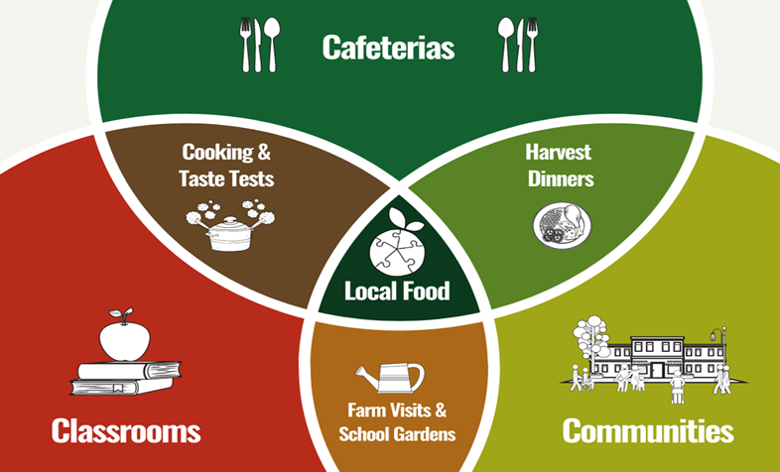
What is farm to school?
Source: Image from Food Connects

Slide 4
Eligibility
The following entities are eligible to apply:
Local or regional boards of education
Regional educational service centers
A cooperative arrangement pursuant to section 10-158a of the general statutes
Childcare centers, group childcare homes and family childcare homes as such terms are described in section 19a-77 of the general statutes
Producers
Any organization or entity administering or assisting in the development of a farm-to-school program *Entities who have received CTG4CTK funds for the past two funding rounds are not eligible to apply this year. A one-round break in funding is required.

Slide 5
Awarding Priorities
Applicants located in alliance districts and/or who are providers of school readiness programs (early childhood)
To fund applicants who demonstrate a broad commitment from school administrators, school nutrition professionals, educators, and community stakeholders.
In the grant narrative, applicants are requested to describe both the support that they have for the project and detail how input was gathered to formulate the idea. Additionally, applicants are encouraged to submit up to three letters of support, a template is provided on the grant webpage.
Please see the rubric at the end of the grant guidance document for how these priorities impact your application

Slide 6
Expenses and Payment
The amount awarded to any applicant through the CTG4CTK Grant shall not exceed $50,000.
The maximum amount for the one-time shipping container program is $250,000.
Combined employee salary and fringe paid to execute and directly administer the project cannot exceed 50% of grant funds requested. Ex. If total request is $50,000, no more than $25,000 in salary/fringe can be requested.
A 50% cash advance upon contract execution can be requested. The balance is paid, and expenses are reimbursed, upon project completion and submission of final report with documentation. Incomplete projects cannot be reimbursed.
There is no match required for either grant
Please see the grant guidance document for a list of ineligible expenses
Projects for regular CTG4CTK must be completed within 18 months of contract execution. Shipping Container Growing Grants have up to 24 months.
Application Deadline: December 14, 2023 at 4:00pm

Slide 7
Grant Tracks
Applicants must apply under one and only one of the grant tracks below. You may be involved in more than one application, just not lead.
• Track 1: Connecticut Farm to School (K-12) Local Procurement Assistance Grant
• Track 2: Connecticut Farm to School (K-12) Experiential Learning Grant
• Track 3: Connecticut Producer Capacity Building Grant
• Track 4: Connecticut Farm to Early Care and Education (ECE) Grant
Track 5: Shipping Container Growing Grant *New for FY 2024 only

Slide 8
Grant Track cont.
Each track has an option to apply for a full grant or a microgrant (up to $5,000), except track three which is a microgrant only. Both microgrants and large grants have the same 18-month timeline to complete, allow for 50% fund advance and the remainder is reimbursement. A microgrant has a simpler application and simpler reporting requirements and has a Letter of Award as opposed to a contract with DoAg. The one-time Shipping Container Growing grant program has a funding cap of $250,000 and a 24-month timeline to complete.

Slide 9
Track 1: Connecticut Farm to School (K-12) Local Procurement Assistance Grant
Purpose: To help increase the amount of CT Grown farm products incorporated into school meal programs and facilitate direct relationships between schools and producers. Applicants are strongly encouraged to incorporate engaging educational and marketing activities to educate students where the products came from and to increase exposure to agriculture.
Applicants who seek to fund a procurement focused project for K-12 should apply under this category. Producers and Early Childcare Providers should not apply under this category.
Tip: This is a great way to make the most of your Local Food for Schools Incentive Program funding through the CT Department of Education!
Additionally, in the 2023 legislative session, state funding was passed to provide reimbursement funds to schools that purchase locally grown foods. We highly encourage applications focused on equipment, training, and processing that make buying and incorporating local products more feasible.

Slide 10
Track 1: Connecticut Farm to School (K-12) Local Procurement Assistance Grant
Project Examples (projects can incorporate multiple components and please note that you are not limited to those listed):
Purchasing equipment that will enable the applicant to process and store produce during the height of the growing season for use during the school year such as a blast chiller, industrial chest freezer, vegetable slicing equipment, etc.
Professional development and skills training for food service staff in how to process and prepare fresh food.
Creation of regional producer trainings, technical assistance or the creation/expansion of aggregation groups for selling to schools.
Activities focused on increasing awareness and education about CT Grown farm products such as a community dinner or taste tests.
Funds are not intended for the outright purchase of farm products

Slide 11
Track 2: Connecticut Farm to School Experiential Learning Grant
Purpose: This grant track is for the development and/or implementation of farm to school experiential learning opportunities for students and/or educators such as school gardens, agriculture education, and professional development for educators.
Applicants who seek to fund an experiential learning focused project for K-12 should apply under this category. Producers who want to implement on farm education programs should partner with a school district to apply under this category. Producers and Early Childcare Providers should not apply under this category.

Slide 12
Track 2: Connecticut Farm to School Experiential Learning Grant
Project Examples (projects can incorporate multiple components and please note that you are not limited to those listed):
Materials and installation for a school garden. This could include, but is not limited to, materials for raised bed construction (CT Grown lumber and CT Grown compost preferred), purchase of a greenhouse or tower gardens for multiple classrooms.
Curriculum design and/or implementation of lessons to integrate a school garden into classroom learning.
Agricultural education and experiences such as farm field trips, gleaning on farms, stipends to bring a farmer to the classroom.
Professional development for educators to create/integrate farm to school education within existing curriculum.
Hands on culinary and nutrition education for students using CT Grown products. No more than 10% of the budget should be spent on local food purchases of farm products.

Slide 13
Track 3: Connecticut Producer Capacity Building Grant *Microgrants only
Purpose: This grant category provides financial resources to Connecticut producers for projects and training that must be directly associated with increasing farm sales to schools. Please note, this is a microgrant only category ($5,000 and under awards).
Producers, producer cooperatives, and farm aggregators should apply under this track. K-12 and Early Childcare Providers should not apply under this category
Microgrant projects (projects can incorporate multiple components):
Equipment costs for harvest, wash and pack, sorting, and/or transportation of farm products to schools and ECE buyers
Infrastructure such as high tunnels and/or storage to allow for season extension
  Tip: We highly recommend exploring applying to USDA Natural Resource Conservation Service’s EQIP program and using this grant funding as matching funds
Required trainings and certifications (such as food safety) needed to sell to local schools. *Note please inquire with your local school district what their requirements are.
For producers interested in projects above $5,000, please consider DoAg’s Farm Transition Grant.

Slide 14
Track 4: Connecticut Farm to Early Care and Education (ECE) Grant
Purpose: Early Childcare Education (ECE) is a critical component of farm to schoolwork, yet many operate very differently from K-12 education, thus we have created a separate track for all ECE providers and networks to apply under. Applicants under this category will only be evaluated against each other.
Only ECE providers and ECE networks should apply under this track.

Slide 15
Track 4: Connecticut Farm to Early Care and Education (ECE) Grant
Project Examples (projects can incorporate multiple components please note that you are not limited to those listed):
Purchase of Community Supported Agriculture (CSA) shares for students and families.
Purchase of CT Grown farm products for integration into student snacks/meals with clear educational farm and/or nutrition connection.
Purchase and installation of raised garden beds or indoor growing systems/container gardens, tools, and equipment for experiential learning.
Development/expansion of agriculture curriculum for students.
Establishing and expanding Farm to ECE Networks.
Professional Development Trainings for staff.
Family engagement activities such as the creation of recipe books, cooking classes and/or take-home taste tests.
Farm field trip and farmer visit to school(s).

Slide 16
Track 5: Shipping Container Growing Grant *New for FY 24
Purpose: This grant category provides funding through the American Rescue Plan Act for the purchase and installation of a shipping container farm. DoAg will award up to $250,000 per project, not to exceed $2 million dollars under this category. These projects must be completed within 24 months.
This category is open to all eligible applicants who are interested in working with a public school to sell or utilize the products grown, or for educational opportunities. Producers, schools, and non-profits may apply.
• Applicant must have a clearly established relationship with a school and a plan for how the product grown will be incorporated into the schools.
• Applicants must be able to provide evidence that proper permission is granted for the location of the unit should the project be awarded.

Slide 17
Track 5: Shipping Container Growing Grant *New for FY 24
What are additional eligible costs that this grant could cover? In addition to the cost of the unit itself, applicants are encouraged to consider and include costs related to the delivery and installation (including connecting water and electricity and solar panels if interested), any initial supplies needed, initial software management subscriptions, and initial operational costs (for the time covered under the grant).
Applicants should be able to demonstrate sufficient funding and capacity to continue the management of the unit after the grant period. Shipping Container farms should not be taken on lightly, they require a significant labor investment to manage them effectively. We will have several specific open office hours focused on shipping containers where we will bring in individuals currently growing in these units in CT to ask questions of.

Slide 18
Track 5: Shipping Container Growing Grant *New for FY 24
Project Examples:
• A producer could apply for a shipping container grant in collaboration with a school that would be a buyer of their products. The shipping container could be located either at the farm or on the school property.
• A school could apply for a shipping container grant in collaboration with a producer who would manage the operation. In this situation, the shipping container would likely be located on the school property.
Eligible Expenses:
• Purchase of a shipping container farm either as a prefabricated kit or as a build-your-own setup.
• Installation, renovations, and costs such as a water hookup, electrical hookup and/or solar panels.

Slide 19
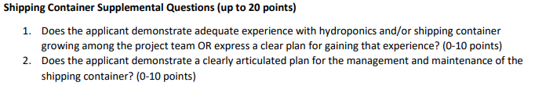
Track 5: Shipping Container Growing Grant *New for FY 24
Things to keep in mind!
*It is key to clearly communicate the relationship with a school/district and how this will continuously benefit students. This is both through the narrative and letters of support

Slide 20
Submission
All CTG4CTK Grant applications and attachments are required to be submitted through the agency’s Cognito application. For any technical questions, please contact Cyrena Thibodeau at CT DoAg.
https://www.cognitoforms.com/CTDoAg/CTGrownForCTKidsGrantApplicationFY2024

Slide 21
Application Requirements
For grant requests $5,000 and under
1. Completion of the microgrant template to be uploaded to Cognito forms. Template should be downloaded from DoAg CTG4CTK informational webpage and then uploaded to your application as an attachment.
For grant requests for $5,001-$50,000
1. Completion of the grant narrative.
2. Excel Workbook with completed Budget and Budget Narrative. Template should be downloaded from the DoAg CTG4CTK informational webpage and then uploaded to your application as an attachment in the grant portal.
For the shipping container grant program
1. Completion of the specific shipping container grant narrative.
2. Excel Workbook with completed Budget and Budget Narrative. Template should be downloaded from the DoAg CTG4CTK informational webpage and then uploaded to your application as an attachment in the grant portal.

Slide 22
For all grant requests
1.(Optional) Up to three letters of support demonstrating that there is support for this effort from applicable stakeholders such as school administration, school nutrition professionals, educators, producers, and community stakeholders. A template is available for download from the DoAg grant information webpage and then uploaded to your application in Cognito.
2. If applicable, estimates/quotes for services and infrastructure uploaded to your application in Cognito.
3. Any additional conceptual drawings, stories, videos the applicant would like to share related to the project can be uploaded to your application in Cognito.
4. W9 and Vendor form which can be found on the DoAg grant information webpage and uploaded to your application in Cognito. *Please note, K-12 public schools are already registered in the state payment system and are not required to complete this. For producers,

Slide 23
Evaluation Criteria and Process
The CTG4CTK is a competitive grant. Only complete applications, as outlined above which are submitted on time, will be evaluated. The evaluation will be weighted heavily on the project impact and work plan described in the grant narrative. Applications will be evaluated by an advisory team after an administrative review by DoAg. Please see Appendix B in the grant guidance document for the scoring rubric.

Slide 24
Where to find all information? Going through forms
www.CTGrown.gov/grants and click on CT Grown for CT Kids Grant or direct link is https://portal.ct.gov/DOAG/ADaRC/ADaRC/CT-Grown-for-CT-Kids-Grant-Program
Please read the complete guidance document

Slide 25
The Timeline
14 Dec. 2023
Applications due December 14, 2023
Jan. 2024
Anticipate awards to be announced mid-January 2024
Apr. 2024
Anticipate Projects to start April 2024

Slide 26
DoAg Open Office Hours
DoAg will hold open office hours for general and technical questions as well as specific questions about Track 5 proposals
First session will be Thursday Nov. 2 from 2-3pm
Complete schedule and meeting link will be posted on the website and emailed out

Slide 27
Grant Coaching Open Office Hours
K-12 procurement related proposals and producers (Tracks 1 and 3) will be led by Jiff Martin, UConn Extension. First session will be Friday Nov. 3 from 11am-12pm.
K-12 experiential learning proposals (Track 2) will be led by Joey Listro, New Britain Roots. First session will be Thursday Nov. 9 from 3-4pm.
All ECE proposals (Track 4) will be led by Monica Belyea, CT DPH. First session will be Wednesday Nov. 1 1:30-2:30pm.
All Shipping Container Growing proposals (Track 5) should talk to Cyrena
*Complete schedules for all will be posted on the website with meeting links and emailed out

Slide 28
Post award grant coaching
An RFP will be released to solicit proposals for statewide group (s) to conduct post award grant coaching and technical assistance by topic area.

Slide 29
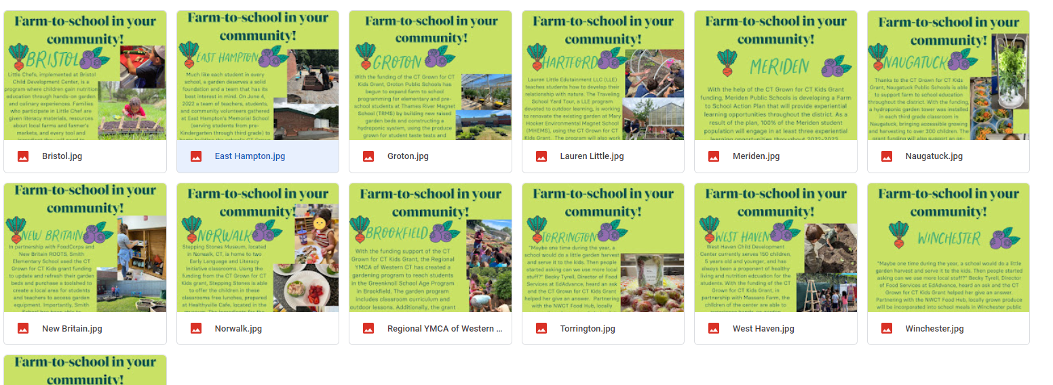
Success Stories on website as well as full 2-year report on the program
FY 22 CTG4CTK Grantees Here!
Also visit the CT Farm to School Collaborative webpage, ctfarmtoschool.org

Slide 30

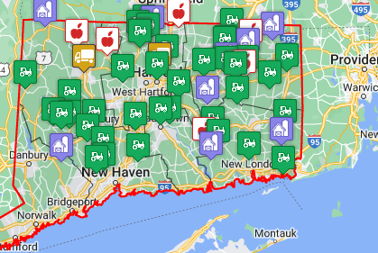
Put Local on Your Tray Farm Directory and More!

Slide 31


Slide 32


Slide 33
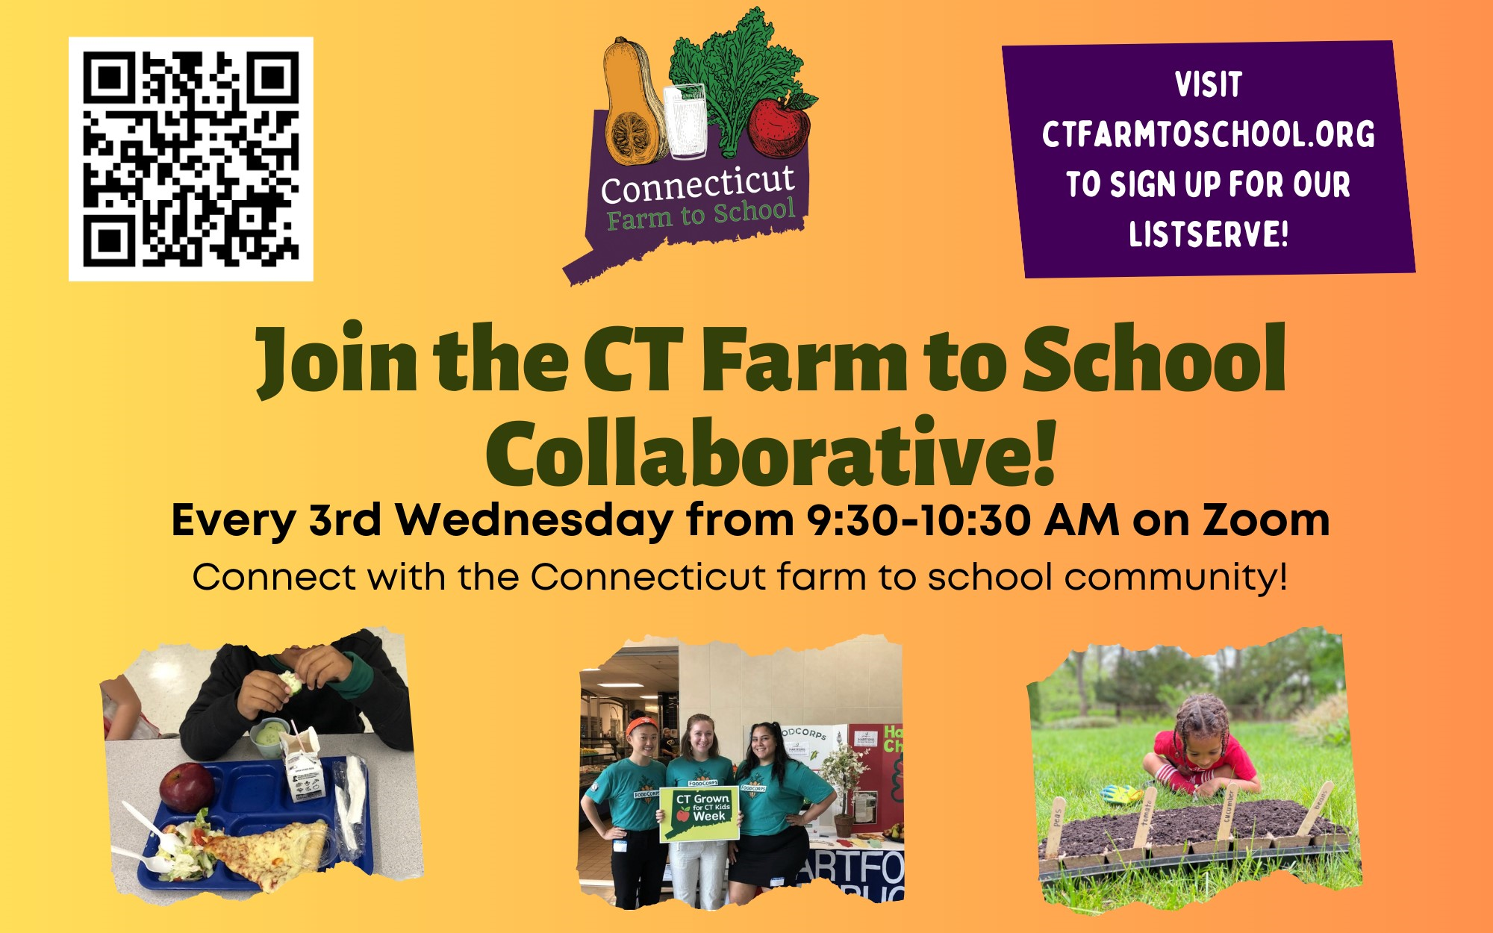

Slide 34
Questions?
This PowerPoint and recording will be made available after the webinar on the CTG4CTK Grant Page
For further questions reach out to Cyrena.Thibodeau@ct.gov or
860-895-3094

