Slide 1

2025 Agricultural
Enhancement Grant
AliRose Grabarz
Ag Development and Resource Conservation
CT Department of Agriculture
Alison.Grabarz@ct.gov

Slide 2
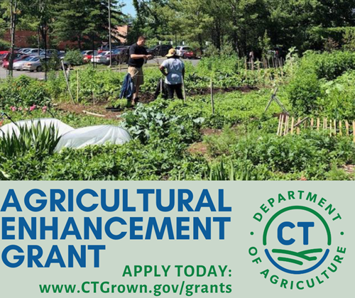
Today’s Agenda
Welcome
Overview of the Grant
  Program Description
  Eligible Applicants
  Grant Tiers
  Match Requirement, Expenses, & Payment
  Project Duration & Post Award Requirements
  Submission Process
  Evaluation Criteria and Process
Important Dates
Questions?

Slide 3
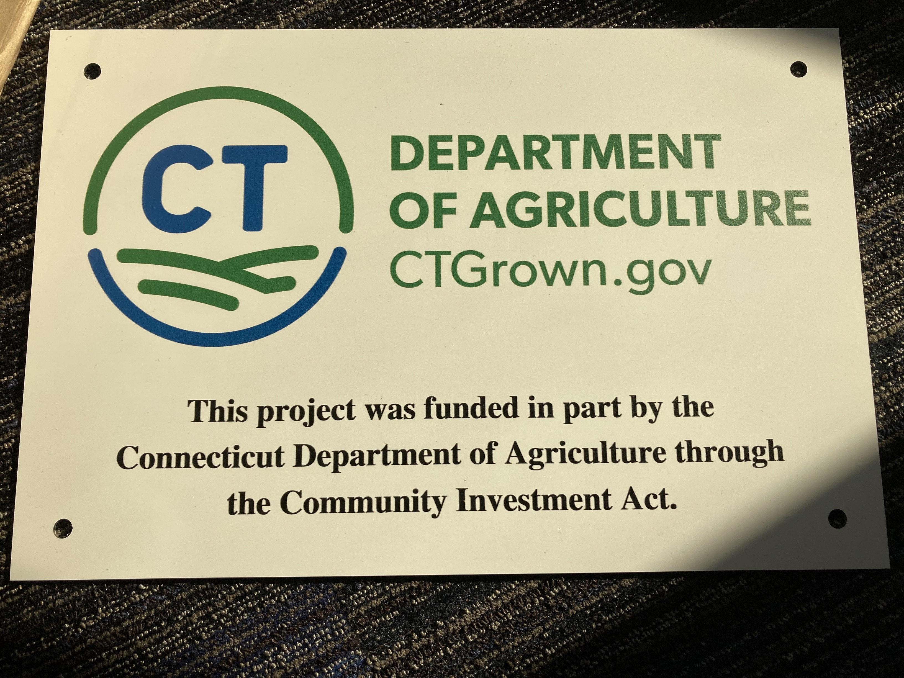
Grant Description
The Agricultural Enhancement Grant (formerly Farm Viability Grant through December 2023) provides matching funds for projects that directly impact and/or foster agricultural viability.
All projects must advance farming and agriculture.
The Ag Enhancement Program and any awards are subject to limitations of state funding.
  Annual program funded by the Community Investment Act

Slide 4
Eligible Applicants
Municipalities with a current Plan of Conservation & Development
    Please visit the CT Office of Policy and Management website to determine if your municipality qualifies.
    A waiver is available if your POCD is outdated.
Regional councils of governments organized under the provisions of sections 4-124i to 4-124p, inclusive
Groups of municipalities that have established a regional inter-local agreement pursuant to sections 7- 339a to 7-339l, inclusive
Agricultural non-profit organizations
  Must be registered with the CT Secretary of State and provide a copy of their federal IRS exemption letter.
  Must have submitted Form 990 and been in existence for the previous three years.

Slide 5
Eligible Applicants (cont.)
Each applicant may submit one application per funding cycle.
Prior awardees may reapply for an Ag Enhancement Grant.
  Open awards, past awards, and corresponding project completion will be taken into consideration.
Applicants who have received two years of consecutive funding will be ineligible for an award for one year. Applicants can reapply for funding in the following grant cycle.
For example:
2023: Project awarded (as Viability Grant)
2024: Project awarded (as Ag Enhancement Grant)
2025: Ineligible for an award
2026: Eligible for an award

Slide 6
Grant Tiers
Grant Tier | Maximum Award | Match Required (cash or in-kind) | Project Duration
1 | $5,000 | 25% | 18 months
2 | $49,999 | 40% | 24 months
Funding Priorities
Projects which impact and/or foster agricultural viability through one of the following conduits shall be prioritized. Projects involving these priorities are not guaranteed for funding.
• Youth Agricultural Education
• Diversity, Equity, and Inclusion (DEI) in Agriculture
• Urban Agriculture
• Food Supply Chain
• Farmland Accessibility

Slide 7
Food Supply Chain applicants:
Coming February – April 2025: Resilient Food System Infrastructure Program
Large-scale projects that strengthen the middle of the supply chain by expanding capacity and infrastructure for the aggregation, processing, manufacturing, storing, transportation, wholesaling, or distribution of agricultural products.
Eligible Industry: Specialty crops, dairy, grains for human consumption, aquaculture, and other food products. Meat and poultry are ineligible industries/commodities.
Equipment Only awards up to $100,000 with no match requirement.
2025: Projects are not required to impact more than one farm business, but they can!
Eligible applicants: Agricultural producers or processors, or groups of agricultural producers and processors; Nonprofit organizations; Local government entities; Tribal governments; and Institutions such as schools, universities, or hospitals.
Contact: Cyrena.Thibodeau@ct.gov or (860) 895-3094 for more info!

Slide 8
Back to Ag Enhancement- Eligible Projects
Tier 1
Tier 2
Municipal farm maps.
Marketing materials to promote Certified CT Grown farmers’ markets.
Hiring guest lecturers, hosting training workshops related to ag.
Increasing accessibility of technical materials and ag resources.
Establishing or improving an urban farm or community garden.
Offsetting expenses for new and beginning, BIPOC, or veteran farmers to participate in a Certified CT Grown farmers’ market.
Purchasing ag equipment or infrastructure for town or non-profit owned farms.
Creative, innovative projects that support the viability of local farms and/or the ag industry.
Purchasing specialized agricultural equipment.
Delivering quality, multilingual agricultural education, hands-on skill development, etc., for youth ag education.
Responding to or supporting the agency with responding to one of the recommendations identified in the DEI Working Group Report, or another area of need.
Establishing or expanding support for urban agriculture.
Strengthening the local food supply by increasing production of CT Grown products.
Proposing or developing plans for meat processing facilities.
Expanding marketing efforts to increase the purchase and sale of CT Grown farm products.
Addressing farmland accessibility or piloting an effort to inventory, survey, and/or prepare vacant farmland for ag production.
Improving farmland accessibility for new farmers, current farmers looking to expand, or supporting succession strategies for farmers exiting agriculture.
Creative, innovative projects that support the viability of local farms and/or the ag industry.

Slide 9
Match Requirement, Expenses and Payment
Grant Tier | Maximum Award | Match Required (cash or in-kind) | Project Duration
1 | $5,000 | 25% | 18 months
2 | $49,999 | 40% | 24 months
The match can consist of in-kind and/or cash contributions directly related to the project.
Employee salaries and fringe benefits to execute the project are allowable expenses, but in total cannot exceed 25% of the grant funds requested.
If a grant is providing the match, the applicant must disclose the grantor, the grant name, and amount awarded.

Slide 10
How do I determine my match requirement? Or the grant funds I can apply for?
  For Tier 1:
  Start by finding the total cost for your project.
  Grant funds will cover 75% of the eligible project costs (up to $5,000).
  Your total match (cash + in-kind match) must equal at least 25% of the project cost.
  For Tier 2:
  Start by finding the total cost for your project.
  Grant funds will cover 60% of the eligible project costs (up to $49,999).
  Your total match (cash + in-kind match) must equal at least 40% of the project cost.

Slide 11
Match Requirement Table for Tier 1
Project Total Cost | Grant Funds Eligible | Cash Match Required
$1,000 | $750 | $250
$2,000 | $1,500 | $500
$3,000 | $2,250 | $750
$4,000 | $3,000 | $1,000
$5,000 | $3,750 | $1,250
$6,000 | $4,500 | $1,500
$6,666.67 | $5,000 | $1,666.67
$7,000 | $5,000 | $2,000
$10,000 | $5,000 | $5,000
Maximum grant award reached.
Also found on the guidance document!

Slide 12
Match Requirement Table for Tier 2
Project Total Cost | Grant Funds Eligible | Cash Match Required
$1,000 | $600 | $400
$5,000 | $3,000 | $2,000
$10,000 | $6,000 | $4,000
$15,000 | $9,000 | $6,000
$20,000 | $12,000 | $8,000
$30,000 | $18,000 | $12,000
$40,000 | $24,000 | $16,000
$50,000 | $30,000 | $20,000
$75,000 | $45,000 | $30,000
$83,331.67 | $49,999 | $33,332.67
$100,000 | $49,999 | $50,001
$150,000 | $49,999 | $100,001
Maximum grant award reached.
Also found on the guidance document!

Slide 13
Expenses
Expenses that CAN be reimbursed with grant funds:
Employee salaries and fringe benefits paid to execute the project (cannot exceed 25% of grant funds requested)
Multi-media marketing expenses
Equipment and equipment rental (if it directly supports the project)
Consultant or contractor expenses directly related to the project
Materials and supplies necessary to complete the project
Stipends, honorariums
Rental fees

Slide 14
Expenses
Expenses that CANNOT be used as a match and will not be funded by the grant
Any expense incurred prior to contract execution
Land acquisition/mortgages
Cost of borrowing (points and other fees)
Expenses related to establishing a new organization/business
Any portion of expense for which the applicant pays a contractor in merchandise or service in lieu of cash
Tuition/tuition reimbursement or career-related/scholarship funds
Routine business expenses (utilities, office supplies, etc.)
Disposable supplies (office, farm, otherwise) unrelated to the project
Legal expenses related to litigation or retainers
Indirect or contingency costs of any percentage

Slide 15
Expenses
Expenses that are an acceptable match if they directly and meaningfully support the proposed project.
  State/local/federal permits
  Attorney’s fees (not related to litigation)
  Consumable or disposable supplies
  Employee salaries and fringe benefits paid to execute the project

Slide 16
What is an in-kind match?
In-kind donations= donations or services provided in place of a cash match.
An in-kind match is the value of any real property, equipment, goods, or services that would have been eligible costs if the recipient was required to pay for such costs.
    If you have volunteers assist on the completion of your grant project, their time and effort has a monetary value—even though you do not pay them for their services.
The current value of a volunteer in CT is $36.44 per hour.
    Some volunteers may have different values for their time.
In-kind expenses can contribute to the match component but grant funds cannot cover them.

Slide 17
Project Duration & Post Award Requirements
Applicants of awarded projects will be responsible for the following:
  Signing an agreement with the State of Connecticut
  Providing a Certificate of Insurance listing the state as an additional insured on the grantee’s liability insurance policy
  Completing the project within the 18-24-month contractual timeframe
  Submitting a final project report in the required format per the executed contract.
  Submitting a final financial report itemizing actual expenses.
    Copies of invoices and proof of payment must be submitted with the payment request at the conclusion of the project
  Agreeing to a site inspection once the project is complete and prior to final payment being released
  Other requirements as outlined in the State of Connecticut contract.

Slide 18
Project Duration & Post Award Requirements (continued)
These are reimbursement grants.
Incomplete projects cannot be fully reimbursed.
After the agency issues a purchase order, one cash advance of up to 50% of the total grant award may be requested by the grantee.
The balance of the award will be reimbursed upon project completion and submission of required reporting documents.

Slide 19
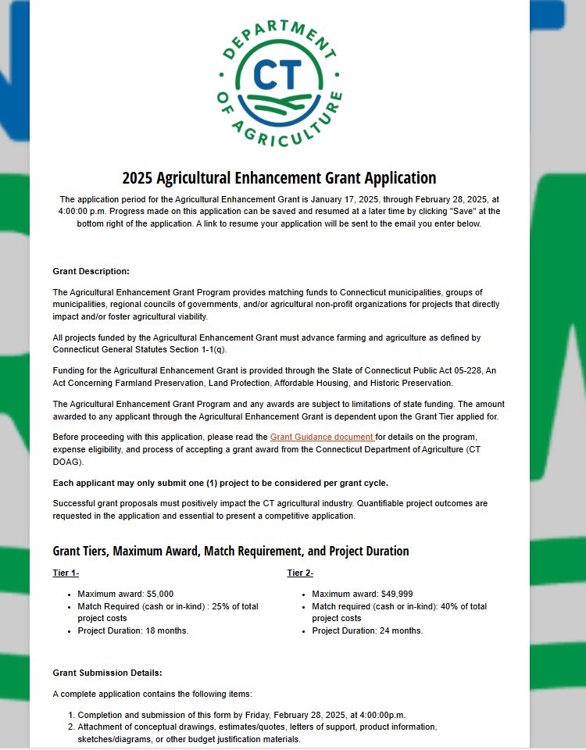
Submission Process
All Agricultural Enhancement Grant applications are required to be submitted through Cognito by February 28th at 4:00pm
The form locks at 4:00:00. Submit well before then.
The application link is available on the Ag Enhancement website.
2025 Agricultural Enhancement Grant Application

Slide 20
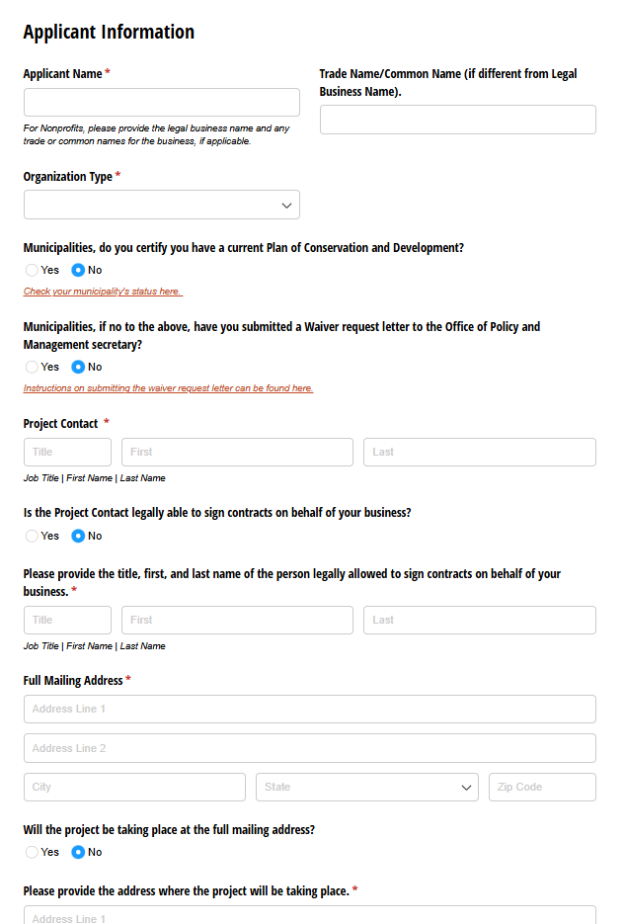
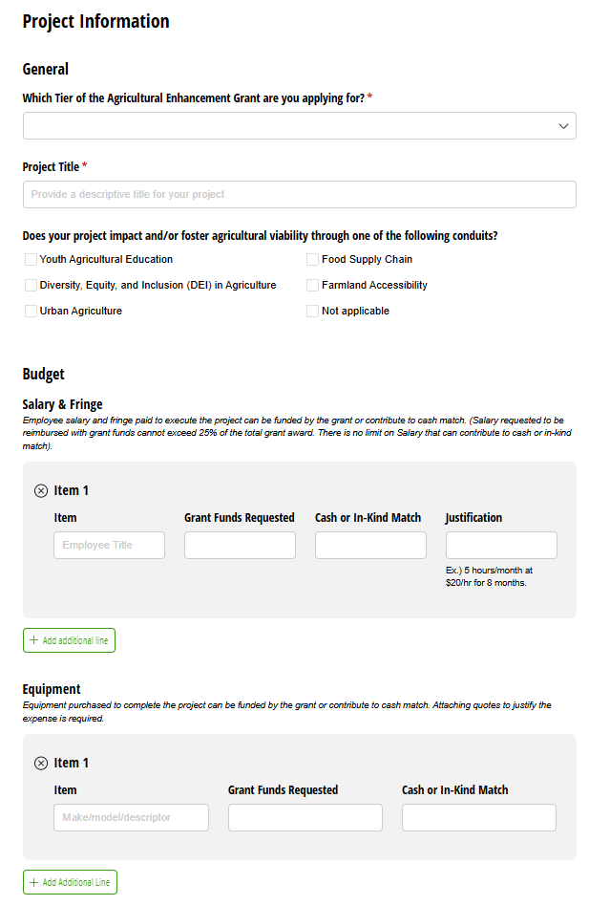
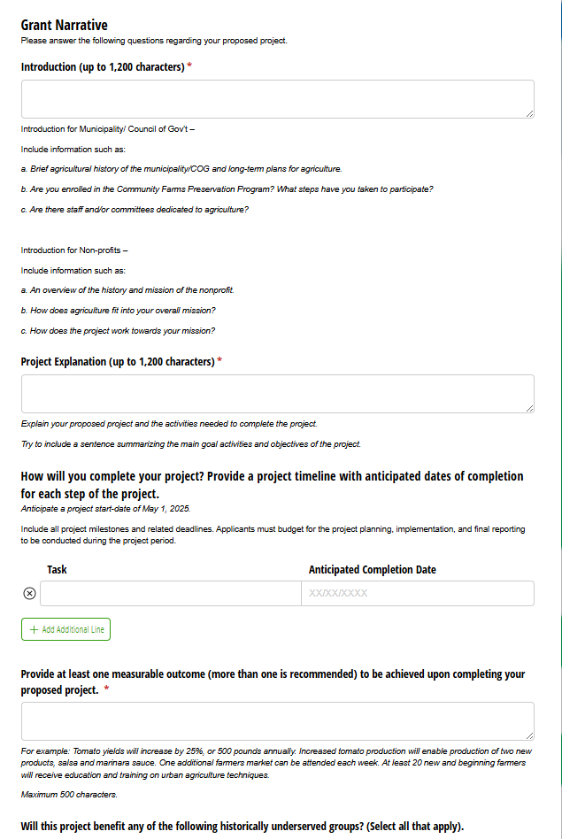
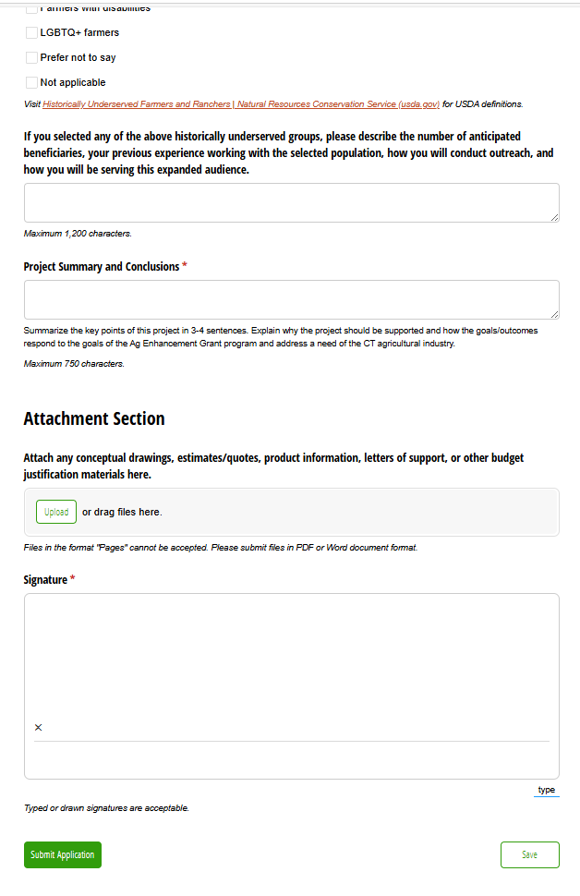
Application

Slide 21
Application Requirements
A complete application includes:
  Completion and submission of the Cognito form by February 28, 2025, at 4:00pm.
  Attachment of any quotes/estimates, conceptual drawings, and other budget justification items.
  Attachment of letters of support from project partners, if applicable.
  Attachment of a landlord consent form, if applicable.
  Attachment of a State Vendor form and W9, if applicable.

Slide 22
Evaluation Criteria and Process
The Agricultural Enhancement Grant is a competitive grant.
Only complete applications submitted on time will be evaluated.
The grant evaluation will be weighted heavily on the project plan described in the Grant Narrative.
Quotes, estimates, letters of support, conceptual drawings, and other documentation justifying and supporting the budget and project are required to present a competitive application.

Slide 23
Important Dates
Application Period:
  Friday, January 17 – Friday, February 28, 2025, at 4:00 p.m.
Office Hours:
  Tuesday, February 4th at 10am.
  Thursday, February 13 at 11am.
Project Start Date:
  May 2025

Slide 24
Contact Information
Questions?
AliRose Grabarz
Ag Development and Resource Conservation
CT Department of Agriculture
(860) 993 - 5275
Alison.Grabarz@ct.gov

