Slide 1
NRCS Climate Smart Practices 2023
December 19, 2022
Notes:
GO TO VIEW > MASTER > SLIDE MASTER TO EDIT THE IMAGES ON THE TITLE AND DIVIDER SLIDES
RIGHT CLICK ON THE INDIVIDUAL IMAGES TO CHANGE THE IMAGE

Slide 2
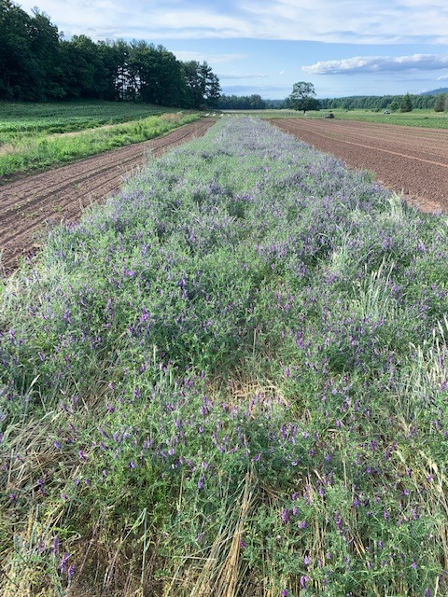
Climate Smart Ag & Forestry (CSAF)
The most current information source is
CSAF Mitigation Activities List FY2023
General Overview & Descriptions
https://www.nrcs.usda.gov/conservation-basics/natural-resource-concerns/climate/climate-smart-mitigation-activities
Specific Practice list and categories
https://www.nrcs.usda.gov/sites/default/files/2022-10/CSAF%20Mitigation%20Activities%202023_1028.pdf

Slide 3
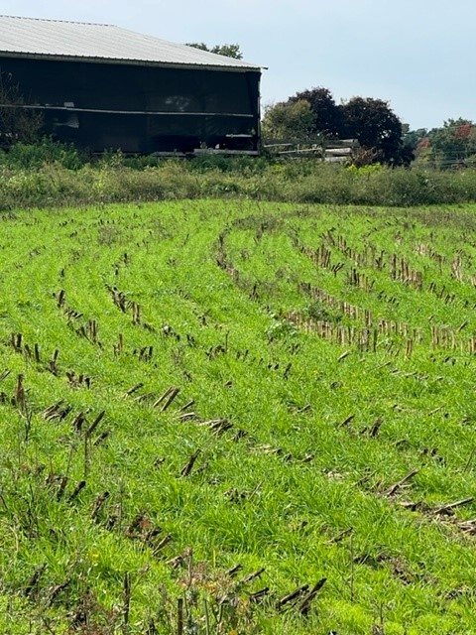
Climate Smart Ag & Forestry Practices
List was determined by quantifiable changes
as modeled by COMET-Planner
http://comet-planner.com/
Quantifiable changes are:
- reductions in greenhouse gas emissions and/or
- increases in carbon sequestration
CSAF Mitigation list is anticipated to evolve/expand as more information is collected and feedback is received
(yellow highlights are the most recent additions)

Slide 4
Climate Smart Ag & Forestry Practices
Categorized by Group
Practice Standard Name
additional, specific activities for CSP
(Conservation Stewardship Program)
Soil Health
Nitrogen Management
Livestock
Grazing
Forestry
Energy / Combustion / Efficiency
Wetlands

Slide 5
Climate Smart Ag & Forestry Practices
All Conservation Practices listed are eligible for Farm Bill & partner programs:
EQIP: Environmental Quality Incentives Program
RCPP: Regional Conservation Partnership Program
CSP: Conservation Stewardship Program
Partnerships for Climate-Smart Commodities
The listed practices are the primary targets,
additional (unlisted) supporting practices may be needed and should be included to support the primary practice.
Waste Separation Facility: pipes, pump, concrete base
Prescribed Grazing: fence, pipe, waterers
Forestry: Trails & Landings

Slide 6
Climate Smart Ag & Forestry Practices
Soil Health: practices which reduce emissions and
increases soil carbon
Establishing or Integrating perennial cover
Grasses – Buffers – Grass Strips – Pollinator areas
Traditional ag practices known to help the soil
Crop Rotations – Reduced Tillage – Cover Crops
Nutrient Management: reduce nitrous oxide loss and increase nutrient efficiency with timing, nutrient sources, rates, and placement.
Urease Inhibitors – Split Applications – Precision Ag

Slide 7
Climate Smart Ag & Forestry Practices
Forestry Management: build carbon stocks in perennial growth and in the soil
Riparian Areas
Tree/Shrub establishment
Upland wildlife management
Forest stand improvements
managing diversity
managing density
managing crop trees and mast
managing wildlife habitats

Slide 8
Climate Smart Ag & Forestry Practices
Grazing Management: reduce emissions and build soil carbon
converting to pasture
increasing forage diversity
managing for wildlife
pollinator habitat
managed grazing for
farm animals
wildlife
riparian or sensitive areas

Slide 9
More Information
Explanations of the Conservation Practices:
NRCS Conservation Practice Standards (CPS)
National List of all practices with baseline info
https://www.nrcs.usda.gov/resources/guides-and-instructions/conservation-practice-standards
State Specific practices with state specific info
Field Office Technical Guide
FOTG > Section 4
https://www.nrcs.usda.gov/resources/guides-and-instructions/field-office-technical-guides

Slide 10
More Information
CSP Enhancements & Bundles
https://www.nrcs.usda.gov/csp-enhancements-and-bundles
Climate Smart Advanced Soil Health bundle
Crop Rotation No-till Cover Crop
Nutrient Management Pest Management
Cropland Soil Health Management System bundle
Crop Rotation No-till Cover Crop
Nutrient Management
Buffer Bundle #1
Filter Strip Conservation Cover (perennial seed)
Wildlife Habitat Planting Tree/Shrub Establishment

Slide 11
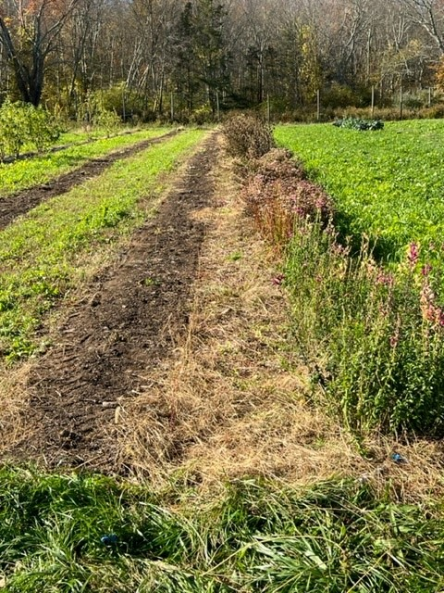
NRCS Climate Smart Practices
Questions ?

