Slide 1

Climate Smart Farming: Agriculture and Forestry Grant Writing Workshop
This presentation was edited to reflect formatting specifications for the Grant Narrative on Slide 20.
Jaime smith
Bureau Director
Agricultural Development & Resource Conservation
ALIROSE GRABARZ
AGRICULTURAL MARKETING & INSPECTION REPRESENTATIVE 1

Slide 2
Grant Description
Funding is provided through Public Act 22-118 Sec 12(b)(70) to support climate smart farming.
One-time allocation of $7 million

Slide 3
Eligible Applicants
Any agribusiness or entity in the State of Connecticut including:
    Nonprofit organizations
    Soil and water conservation districts
    Colleges and universities
    Municipalities
    For-profit organizations

Slide 4
Other Eligibility Criteria
All agricultural commodities can participate including aquaculture, agriculture, and forestry.
All production types will be supported: conventional/organic, indoor/outdoor, soil/water, urban/rural, etc.
Projects on public or privately owned land are allowed, subject to obtaining needed permissions and permitting.

Slide 5
Funding Tiers & Project Duration
Tier 1: $100,000 to $249,999
Project Duration: Up to 18 months
Tier 2: $250,000 to $499,999
Project Duration: 18 months up to 2 years
Tier 3: $500,000 to $999,999
Project Duration: 2-3 years
Tier 4: $1,000,000 and up
Project Duration: 3-5 years

Slide 6
Project Areas
Including, but not limited to:
  Providing technical assistance
  Distributing a grant to producers
  Coordinating training programs
  Coordinating projects that pilot or demonstrate water and land-based conservation practices
  Establishing equipment-sharing programs
  Other activities that will increase the number of farmers who are implementing climate-smart agriculture and forestry practices.
  Each project should address a specific problem, interest, or need regarding climate smart farming practices or the implementation of climate smart practices for CT’s agriculture industry.

Slide 7
What makes a practice “Climate Smart”?
The climate smart agriculture practices identified by USDA Natural Resource Conservation Service (NRCS) will be used as a baseline.
These include: soil health, improved nitrogen management, improved livestock waste management systems, enhanced grazing land management, improved agroforestry, forestry, and upland wildlife habitat, and restored disturbed lands.
Projects not specified by USDA NRCS shall still be considered if the need, data, and reporting to justify the practice(s) are reflected in the proposed project.

Slide 8
Expenses & Payment
There is no match requirement for this grant.
Eligible Expenses:
    Multi-media marketing expenses
    Direct administrative costs
    Equipment purchases and rentals to support implementation of climate smart farming practices
    Consultant, contractor, and attorney fee expenses
    Stipends, honorariums
    State/local/federal permits
    Indirect or overhead expense is allowed: however, it must be stated as an overall percentage for the project. The percentage may impact the competitiveness of an application.

Slide 9
Expenses & Payment (cont.)
Ineligible Expenses:
      Any expense incurred prior to contract execution
      Land acquisition/mortgages
      Cost of borrowing (points and other fees)
      Expenses related to establishing a new organization/business
      Any portion of expense for which the applicant pays a contractor in merchandise or service in lieu of cash
      Tuition/tuition reimbursement or career-related/scholarship funds
      Legal expenses related to litigation
      Disposable supplies (office, farm, otherwise) unrelated to the project

Slide 10
Evaluation Criteria and Process
The Climate Smart Farming: Agriculture and Forestry Grant is a competitive grant.
Only complete applications submitted on time will be evaluated.
The evaluation will be weighted heavily on the project plan described in the Grant Narrative.
Priority will be given to projects which support historically underserved farmers, including but not limited to:
        BIPOC producers
        Veterans
        New and beginning farmers (farming for 1-3 years)
        Anyone in a protected class
        Anyone that speaks English as a second language
Additional information (quotes, drawings, and other documentation justifying and supporting the proposed budget and project) is strongly encouraged to present a competitive application.

Slide 11
Post Award Requirements
The anticipated contract start date is May 1, 2023.
Applicants of awarded projects will be responsible for the following:
Signing a contract with the State of Connecticut.
Providing a Certificate of Insurance listing the state as an additional insured on the grantee’s liability insurance policy.
Completing the contract within the specified timeframe.
Submitting project reports in the required format per the executed contract.
Submitting regular and a final financial report itemizing actual expenses. Copies of invoices and proof of payment must be submitted with the payment request, as required by the contract.
Permit site inspections for projects.
Other requirements as stated in the State of Connecticut Contract.

Slide 12
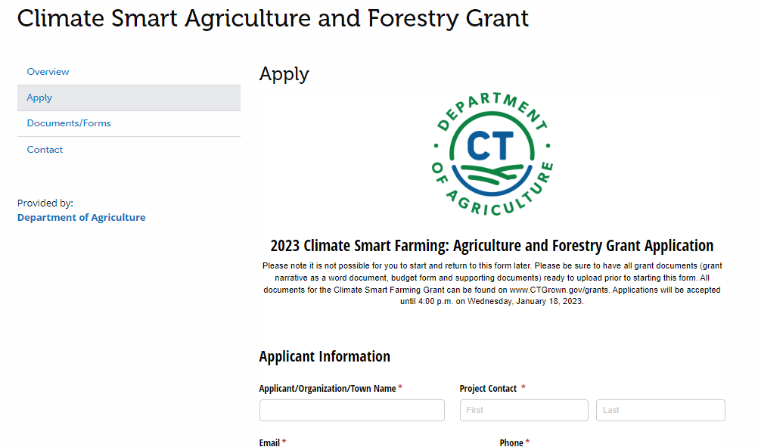
Submission Process
Step 1: Go to www.CTGrown.gov/grants
Step 2: Scroll down and click on “Climate Smart Agriculture and Forestry Grant”
Step 3: Click on “Apply”.
Step 4: The application is embedded into the website. Fill in answers to the questions, attach the required documents, attach other items as needed, and hit Submit!

Slide 13
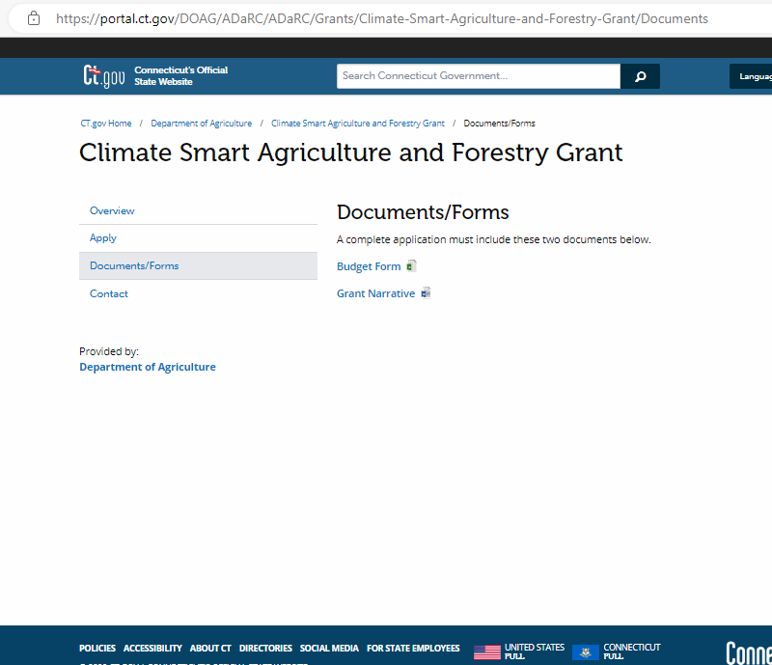
Application Requirements
Budget Form added as an attachment.
Grant Narrative added as an attachment.
Conceptual drawings, estimates/quotes, letters of support and other budget justification materials can be added as attachments.
All required documents and forms can be found under the “Documents/Forms” tab on the Climate Smart Grant page.

Slide 14
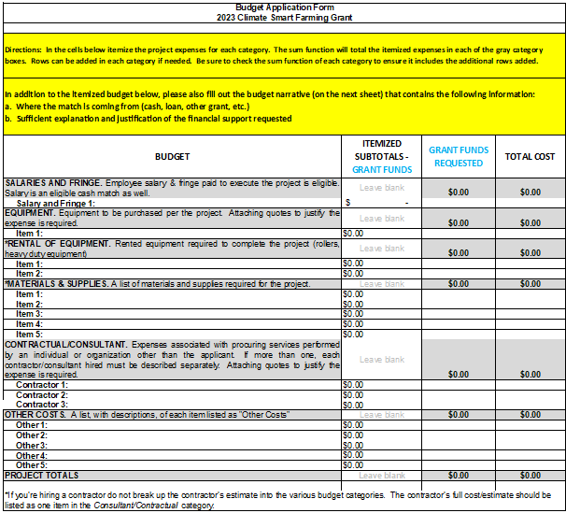
Budget Form

Slide 15
Grant Narrative
1. Introduce yourself and your organization to the reviewers. Include information such as:
An overview of the history and mission.
Brief description of agricultural experience and background and long-term plans for agriculture.
Are there staff and/or committees dedicated to agriculture and to this project?

Slide 16
Grant Narrative
2. Project Explanation – Explain in detail your project proposal and how it will address climate smart farming. Applicants must describe:
What the climate smart practices is
Why the climate smart practice(s) were chosen
How it will be implemented
Who will benefit, and are there measurable outcomes
The duration for implementation
Overall project budget

Slide 17
Grant Narrative (cont.)
3. Project Outcome or Impact – Identify an outcome you strive to achieve through completing this project. Identify the objectives necessary to meet the outcome(s) and the process.
For Municipal applicants: How does your project conform with the approved Plan of Conservation and Development?
An outcome is defined as a quantifiable result and is a result of accomplishing the project.
Example: There will be a 25% engagement of eligible producers with 100% implementation of the identified climate smart agricultural practices.
4. Project Timeline – Include all project milestones and related deadlines. No extensions will be given for projects and project timelines should reflect reasonable deadlines to accomplish objectives. No incomplete project work shall be funded.
The following template will need to be used to provide the project timeline:
Task | Anticipated Timeline

Slide 18
Grant Narrative (cont.)
5. Target Audiences – Describe your target audience. How are you ensuring equity of all producers regardless of size, years of experience and ethnicity? Are you serving any USDA identified historically underserved farmers, including but not limited to:
    BIPOC producers
    Veterans
    New and beginning farmers
    Anyone in a protected class
    Anyone that speaks English as a second language

Slide 19
Grant Narrative (cont.)
6. Project Summary and Conclusions – Summarize the key points of this project. Explain why the project should be supported and how the goals/outcomes directly support the implementation of climate smart farming and forestry practices.

Slide 20
Grant Narrative Specifications
Updated 12/22/2022
The grant narrative document should be no longer than 5 pages. Please adhere to the following format specifications:
    Single-spaced
    No font size smaller than 11 pt
    No margins smaller than 1 inch
The 5-page limit does not include the following:
    The project timeline. (Question #4)
    Letters of support, quotes, or other justification documents.
    Reference page(s) (if applicable).

Slide 21
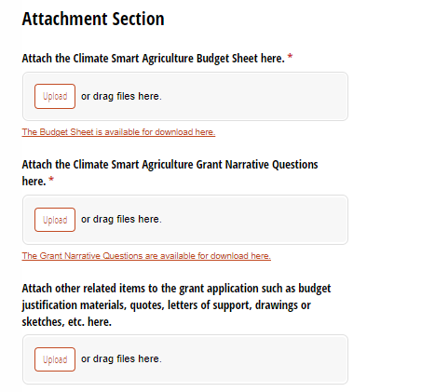
Uploading Attachments to the Application
There is no limit to the number of budget justification materials, quotes, letters of support, drawings, sketches, etc. allowed for your application.

Slide 22
Things to keep in mind:
Responses in the Cognito form application cannot be saved and returned to later.
Check out the application questions early, gather information and needed materials, then return to the application when you are ready to submit.
If you experience any difficulties with the application, contact AliRose!

Slide 23
Applications are due:
Wednesday, January 18, 2023 at 4:00p.m.

Slide 24
Questions?
Jaime Smith
Bureau Director
Agricultural Development & Resource Conservation
Jaime.Smith@ct.gov
(860) 573-1944
AliRose Grabarz
Agricultural Marketing & Inspection Representative 1
Alison.Grabarz@ct.gov
(860) 993-5275
FAQs are available on the Climate Smart website!

