Slide 1

2022 Farm Transition Grant
Writing Workshop
AliRose Grabarz
Ag Development Unit
Alison.Grabarz@ct.gov

Slide 2
Please introduce yourselves in the comments.
Feel free to include:
  Your Name
  Your Farm or Agricultural Cooperative Name
  The category of the Farm Transition Grant you intend to apply for.

Slide 3
Today’s Agenda
Welcome
Overview of the 2022 Farm Viability Grant
  Grant Description
  Eligible Applicants
  Grant Categories
  Match Requirement, Expenses, & Payment
  Project Duration & Post Award Requirements
  Submission Process
    Required attachments
  Evaluation Criteria and Process
Important Dates
How to Apply
Questions?

Slide 4
Grant Description
The Farm Transition Grant (FTG) provides matching funds to projects for the diversification of existing farm operations, transitioning to value-added agricultural production and sales, and other venues in which a majority of products sold are grown in the state.
The FTG program and any awards are subject to limitations of state funding.
  Funding provided through the Community Investment Act
  $500,000 annually for the FTG

Slide 5
Eligible Applicants
Agricultural producers, singularly or jointly, whether such producers are owners or tenants of existing agribusiness within the State of Connecticut
Agricultural cooperatives

Slide 6
Eligible Applicants (cont.)
To qualify for the New Farmer Micro Grant, eligible entities must meet the following:
  Apply for or possess a Farmers’ Tax Exemption Permit through the CT Department of Revenue Services
  Have a 2–5-year business plan drafted
  Complete a crop plan
  Be the operation owner and have been in production for a full year to three full years
  Tenants must include a written agreement between all necessary parties regarding the submitted project.

Slide 7
Eligible Applicants (cont.)
To qualify for the Infrastructure Investment Grant, Research and Development Grant, and Innovation and Diversification Grant eligible entities must meet the following:
  Be registered with the CT Secretary of State, if established as a limited liability corporation or incorporation
  Possess a Farmers’ Tax Exemption Permit
  Have submitted a Schedule F, Forms 1120S, Form 1065, or Schedule C for the previous three years
  Tenants must include a written lease agreement between all necessary parties regarding the submitted project.

Slide 8
Eligible Applicants (cont.)
Previous awardees of the Farm Transition Grant can reapply.
  Past awards and corresponding project completion will be taken into consideration when evaluating applications.
Applicants who have an open agreement and a project in progress are ineligible to apply.

Slide 9
Farm Transition Grant Categories
Four different grant categories are available for eligible applicants.
  New Farmer
  Infrastructure Investment
  Research & Development
  Innovation & Diversification
Applicants may select one category for which they think their project qualifies.
DOAG reserves the right to alter the grant category selected by the applicant.

Slide 10
New Farmer Micro Grant
Micro grants to support new individuals/partnerships who have one full year to three years of production history and are seeking long-term careers that financially support them through farming and agriculture.
    Maximum award: $5,000
    Match requirement: 25% of project costs
Examples of eligible expenses: Small equipment, buildings, greenhouses/hoop houses, irrigation, other equipment purchases related to production.
A project awarded in 2021: Purchase and installation of water pipes, pumps, fertilizer, lights, and a washing station for hydroponic greens production.

Slide 11
Infrastructure Investment Grant
To support farmers who have been in production for a minimum of three years with infrastructure to expand the farm’s production and operation.
    Maximum award: $20,000
    Match requirement: 50% of project costs
Examples of eligible expenses: New fencing, barn remodeling/ expansion, equipment that will assist in diversification of farm products, expansion of product offerings including value-added processing equipment.
A project awarded in 2021: purchase and installation of new fencing to enclose a 25-acre pasture.

Slide 12
Research and Development Grant
A grant program for farms to conduct research to assess the viability and interest for developing a new product line, service, or market.
    Maximum award: $25,000
    Match requirement: 40% of project costs
Examples of eligible expenses: Consultant fees, pilot equipment, other expenses related to exploratory product development including fees associated with product and recipe testing.

Slide 13
Innovation and Diversification Grant
A grant program for the implementation of a new product or service for market or business expansion after a research and development phase has been explored.
    Maximum award: $49,999
    Match requirement: 50% of project costs
Examples of eligible expenses: Infrastructure, equipment, software, consultant fees
A project awarded in 2021: Build-out of a retail store within an existing warehouse, purchase of necessary coolers, shelving, POS system, and hiring a marketing consultant to market the new store.

Slide 14
FAQs Regarding the Grant Categories
Can I apply for more than one grant category?
  No, you must pick one category to apply for.
Do I need to complete a Research and Development grant project before being eligible to apply for an Innovation and Diversification grant?
  No, for the I&D category the research and development phase can consist of surveys of your current customer base to gauge interest in offering new products, talking with other businesses that are offering similar new products, hiring a consultant to test your surrounding market for its willingness to try your new products, etc. You do not need to complete an official R&D project to be eligible to apply for I&D.
Does my project fall under Infrastructure Investment or Innovation and Diversification?
  The key to Innovation and Diversification projects is diversification.
  Will you be offering new products/services to your customers after the completion of the project? If so, your project is I&D.
  If your project allows you to optimize the production and operation of the products you are already offering, your project falls under Infrastructure Investment.

Slide 15
Match Requirement, Expenses and Payment
All eligible expenses funded by any Farm Transition Grant program must advance farming and agriculture.
All grant categories have a cash match requirement of which the percentage required varies.
    The cash match requirement for each program can be self-financed, bank-financed, or provided through another grant (federal, state, otherwise).
    If a grant is providing the match, the applicant must disclose the grantor, the grant name, and amount awarded.
The FTG must be paid directly to the individual or business the agreement is made with.

Slide 16
How do I determine my match requirement? Or the grant funds I can apply for?
  Start by finding the total cost to complete your project.
  Click here.
This link will open the Cash Match Requirement Tables Document for the 2022 FTG. Information on the cash match required for projects of varying total amounts for all grant categories can be found here.
Each category of the FTG has its own maximum award and match requirement. Please refer to slides 9-12 for more information.

Slide 17
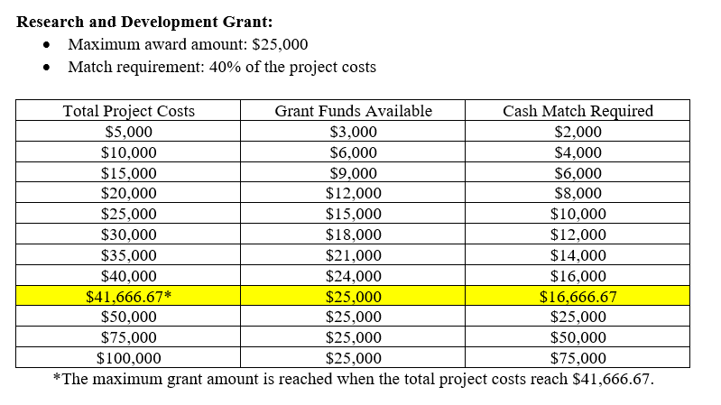
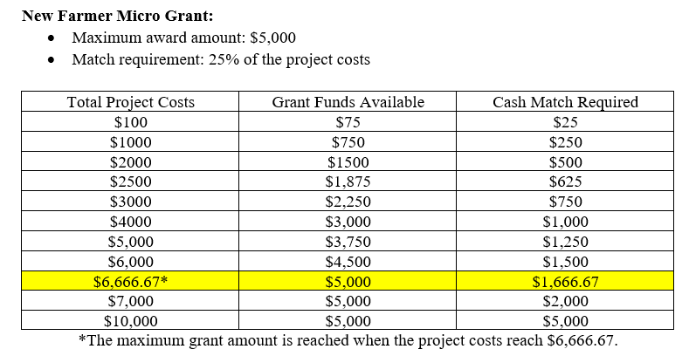
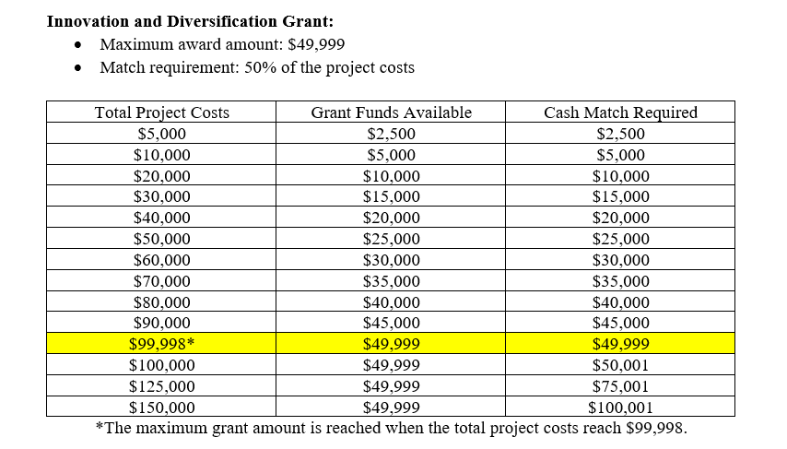
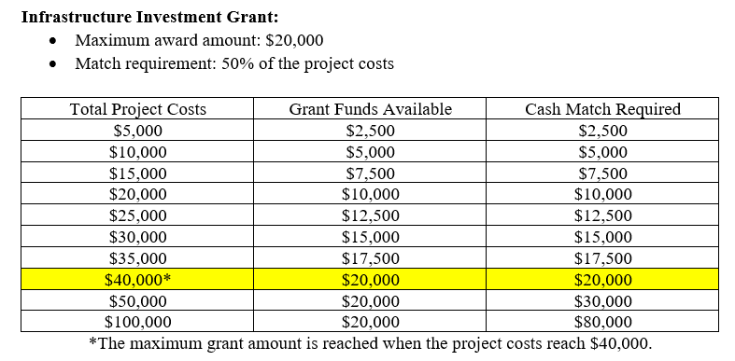
Match Requirements

Slide 18
Match Requirement, Expenses and Payment (continued)
The following expenses cannot be used as a match and will not be funded by any grant category:
    Any expenses incurred prior to contract execution.
    Land acquisition/mortgages
    Cost of borrowing (points and other fees)
    Expenses related to establishing a new organization/business
    Any portion or expense for which the applicant pays a contractor in merchandise or service in lieu of cash
    Tuition/tuition reimbursement or career-related/scholarship funds
    Routine business expenses (utilities, office supplies, etc.)
    Disposable supplies (office, farm, otherwise) unrelated to the project
    Legal expenses related to litigation
    Indirect or contingency costs of any percentage

Slide 19
Match Requirement, Expenses and Payment (continued)
The following expenses are an acceptable match if they directly and meaningfully support the proposed project:
    Employee salaries and fringe benefits paid to execute the project
    State/local/federal permits
    Attorneys’ fees (not related to litigation)
    Consumable or disposable supplies

Slide 20
Match Requirement, Expenses and Payment (continued)
These are reimbursement grants. Incomplete projects cannot be fully reimbursed.
A reimbursement of 50% of the award can be provided to New Farmer Micro Grant awardees during project work, with the remaining 50% of the award reimbursed upon project completion.
    Receipts with proof of payment to justify the first 50% of the award must be provided.

Slide 21
Project Duration
Projects must be completed within 18 months of contract execution. Contract and project extensions are not allowed.
Project cannot start prior to the Contract start date even if executed before the Contract start date.

Slide 22
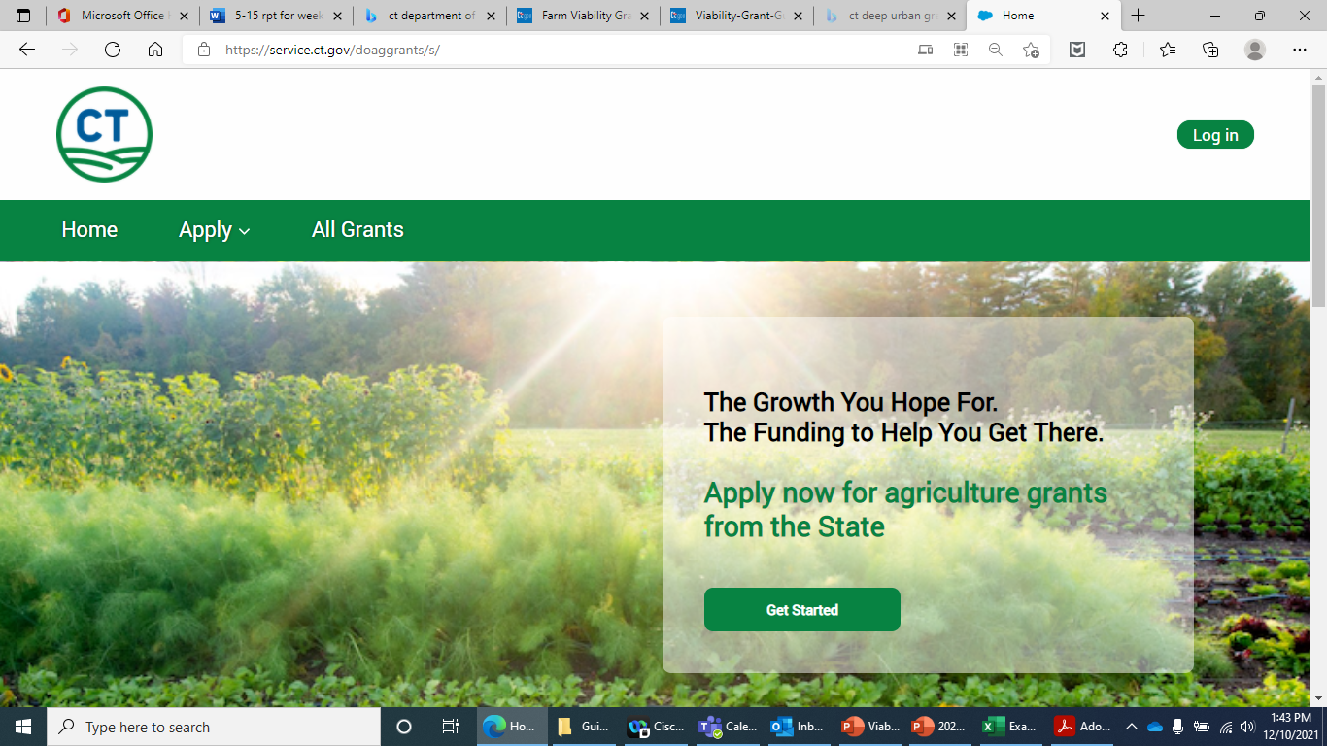
Submission Process
NEW FOR 2022: All Farm Transition Grant applications are required to be submitted through the DOAG grant portal.
All grant funding opportunities can be found here: https://service.ct.gov/doaggrants/s/
Step-by-step instructions on creating an account, and applying for grants can be found here: Application-Instructions.pdf

Slide 23
Application Requirements
New Farmer Micro Grant Applications
  Attachment of a crop plan.
  Attachment of a landlord agreement (if applicable).
  Completion and attachment of the 2022 Farm Transition Grant Budget and Project Timeline Workbook.
  Completion of the New Farmer Micro Grant Narrative.
  Attachment of a W-9 and State Vendor Form.
  Attachment of conceptual drawings, estimates/quotes, product information, or other budget justification materials.
All required forms/documents can be found here: 2022 Farm Transition Grant (FTG)--Documents (ct.gov)

Slide 24
Application Requirements
Infrastructure Investment Grant, Research and Development Grant, and Innovation and Diversification Grant Applications
  Attachment of a landlord agreement (if applicable).
  Completion and attachment of the 2022 Farm Transition Grant Budget and Project Timeline Workbook.
  Completion of the Infrastructure Investment Grant, Research and Development Grant, and Innovation and Diversification Grant Narrative.
  Attachment of a W-9 and State Vendor Form.
  Attachment of a three-year profit and loss statement and current profit and loss.
  Attachment of conceptual drawings, estimates/quotes, product information, or other budget justification materials.
All required forms/documents can be found here: 2022 Farm Transition Grant (FTG)--Documents (ct.gov)

Slide 25
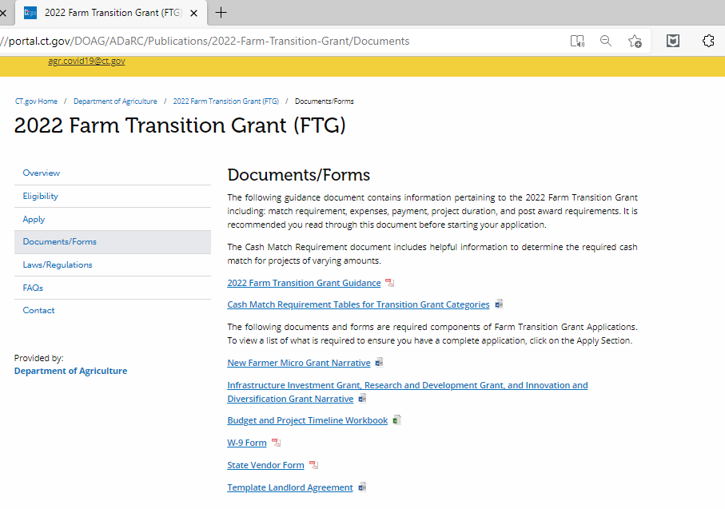
Budget and Project Timeline Workbook
Visit: 2022 Farm Transition Grant (FTG)--Documents (ct.gov)
Download a blank copy of the form and save to your computer.

Slide 26
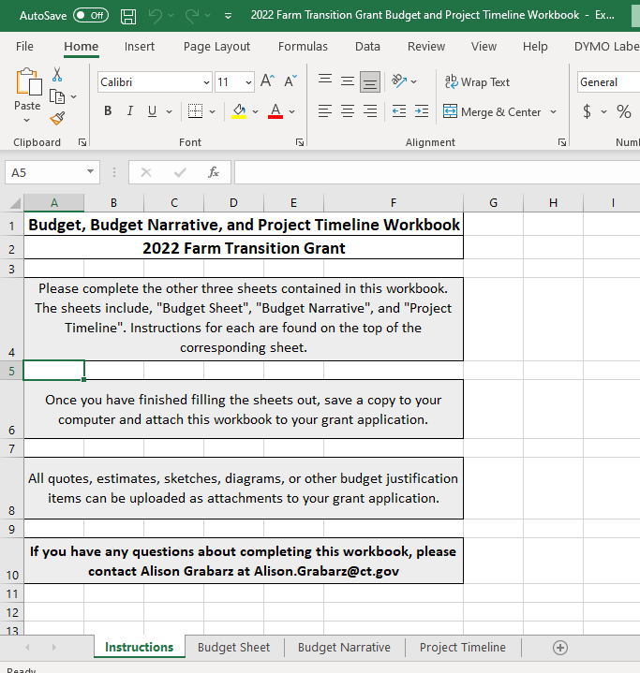
Budget and Project Timeline Workbook
There are four sheets included in this workbook:
  Instructions *you do not need to fill anything out on this sheet.*
  Budget Sheet
  Budget Narrative
  Project Timeline

Slide 27
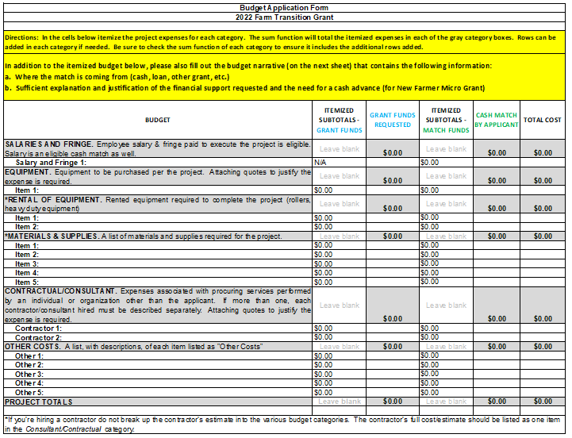
Budget Sheet
Your budget must contain the following itemized categories.
All prospective purchases for the completion of a project should be accompanied by a quote or estimate.
Projects involving hiring a subcontractor should include quotes from that subcontractor.

Slide 28
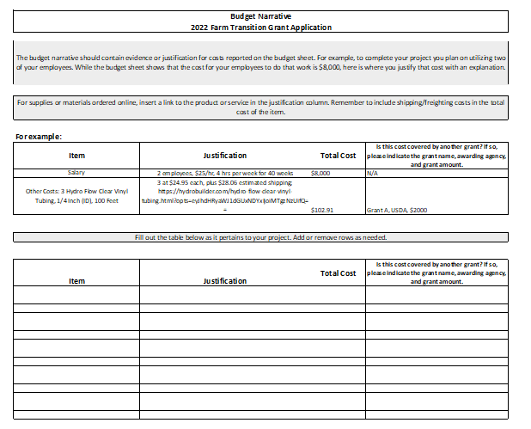
Budget Narrative
The budget narrative should contain evidence or justification for costs reported on the budget sheet.
For example, to complete your project you plan on utilizing two of your employees. While the budget sheet shows that the cost for your employees to do that work is $8,000, here is where you justify that cost with an explanation.
For supplies or materials ordered online, insert a link to the product or service in the justification column.
Remember to include shipping/freighting costs in the total cost of the item.

Slide 29
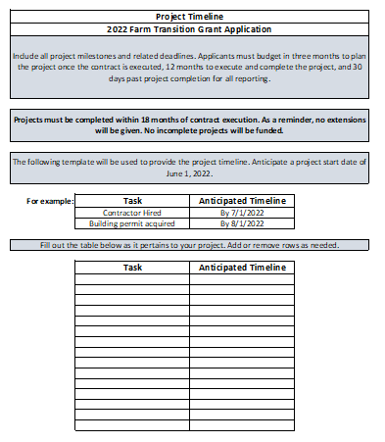
Project Timeline
Include all project milestones and related deadlines.
Projects must be completed within 18 months of contract execution.
Anticipate a project start date of June 1, 2022

Slide 30
Grant Narrative
**There are two versions of the Grant Narrative Questions**
  One for applicants to the New Farmer Micro Grant, and the other for applicants to the Infrastructure Investment Grant, Research and Development Grant, and Innovation and Diversification Grant.
These questions will be asked within the grant application itself. We recommend downloading the questions to your computer and typing your answers on Word or other word processing application.
Then, when you fill out your application, simply Copy and Paste your answers into the corresponding spaces.

Slide 31

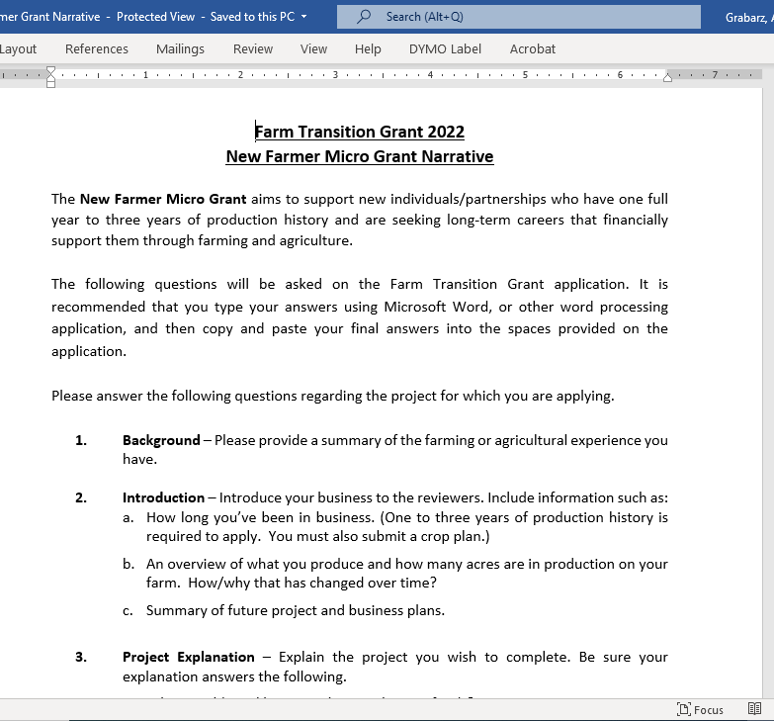
New Farmer Micro Grant Narrative
Visit: 2022 Farm Transition Grant (FTG)--Documents (ct.gov)

Slide 32
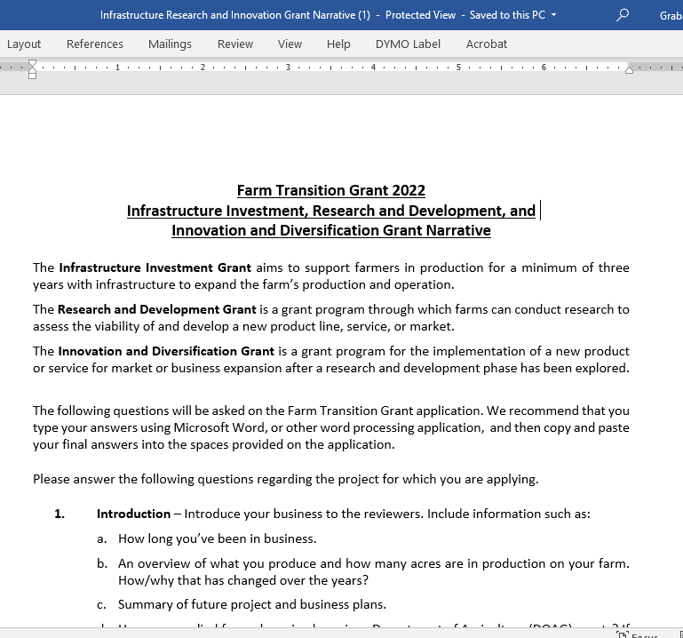
Infrastructure Investment, Research and Development, and Innovation and Diversification Grant Narrative

Slide 33
Other Important Forms: W-9 and State Vendor Form
The DOAG Grants portal will prompt you to fill out and save a copy of your W-9 Form and State Vendor Form.
Copies of these forms MUST be attached to your grant application.

Slide 34
Other Important Forms: Template Landlord Agreement
If your project will be taking place on land that is leased or rented, you will need to attach a Landlord Agreement to your application.
A template agreement can be found in the Documents/Forms section of the DOAG FTG website.

Slide 35
Evaluation Criteria and Process
The FTG is a competitive grant.
Only complete applications, as outlined on the website here: 2022 Farm Transition Grant (FTG)--Apply (ct.gov), submitted on time, will be evaluated.
The evaluation will be weighted heavily on the project plan described in the Grant Narrative.

Slide 36
Evaluation Criteria and Process (continued)
The Grant Narrative should fully answer the questions clearly and directly.
Project applications should clearly present how the project will be accomplished within a reasonable timeline.
Additional information such as: quotes, conceptual drawings, and other documentation justifying and supporting the budget and project, is required to present a competitive application.

Slide 37
Important Dates
Application Period:
  Tuesday, January 18, 2022, at 12:00 p.m. – Tuesday, March 8, 2022, at 4:00 p.m.
Application Deadline:
  Tuesday, March 8, 2022, at 4:00 p.m.
Project Start Date:
  June 2022

Slide 38
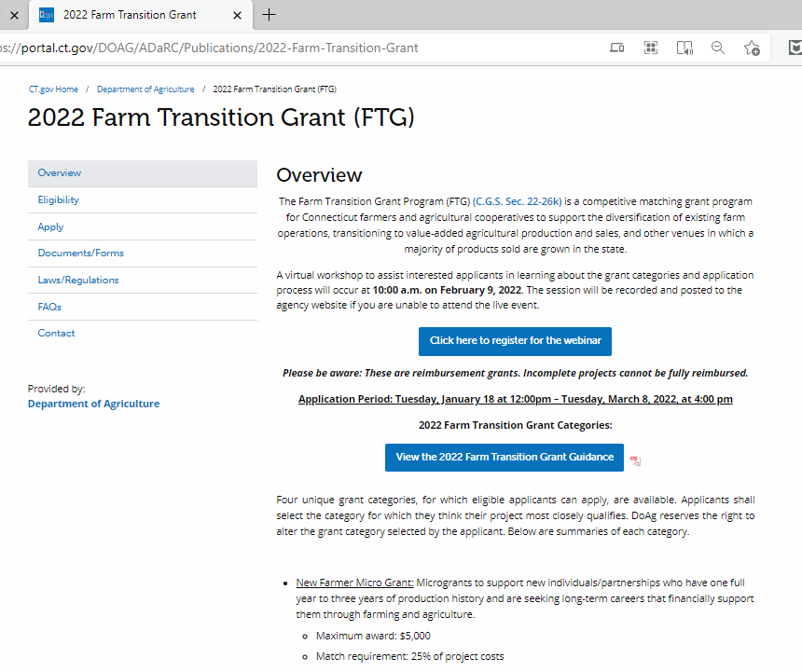
Where can I find more information on the 2022 Farm Transition Grant?
Check out the FTG page on DOAG’s website for all information on the Farm Transition Grant.
  The page is found here: 2022 Farm Transition Grant (ct.gov)
All required documents &
forms can be found here.
The grant guidance provides information on the FTG in detail for your reference.

Slide 39
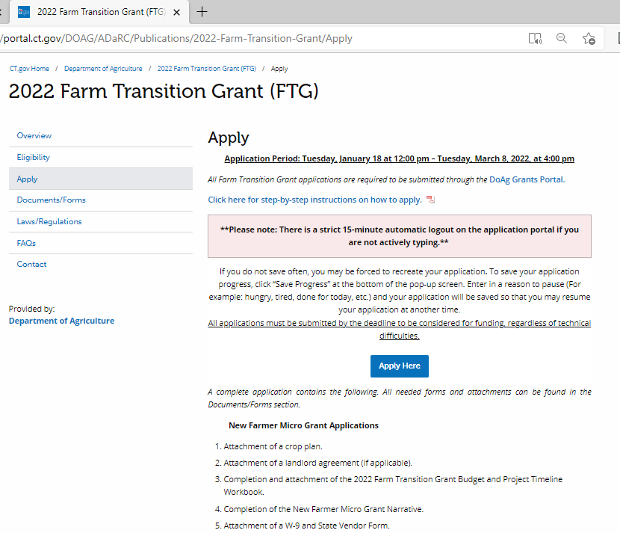
How do I apply for the 2022 Farm Transition Grant?
Visit DOAG’s FTG page here: 2022 Farm Transition Grant (ct.gov)
From the menu on the left, choose “Apply”
Once on the Apply page, click the blue button that says “Apply Here”
This will bring you to the DOAG Grants Portal.

Slide 40
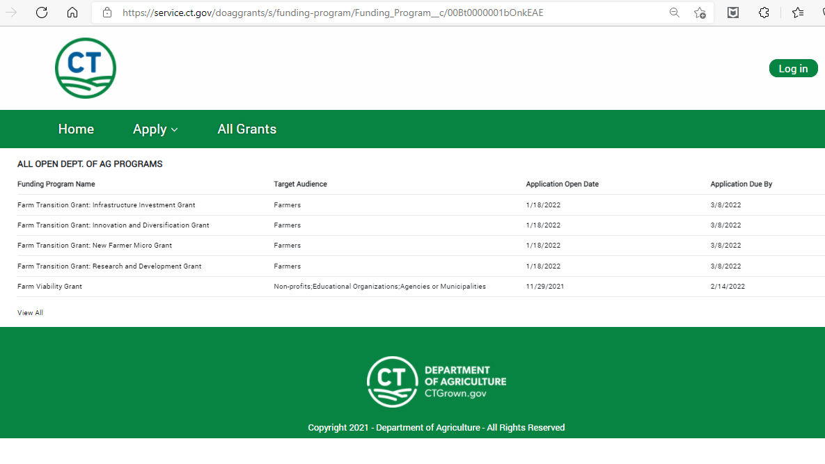
How do I apply for the 2022 Farm Transition Grant?
Once on DOAG’s Grant Portal, click on “All Grants” and choose the category of the FTG you are applying for.
All four categories are available in the list of grants.

Slide 41
**Please Note**
There is a strict 15-minute automatic logout on the online application portal if you are not actively typing.
Please save your application often by hitting “Save Progress” at the bottom of the pop-up screen and enter in a pause reason so that you may resume your saved application.
If you do not save often, you maybe forced to recreate your application.
All applications must be submitted by the deadline in order to be considered for funding regardless of technical difficulties.
We recommend answering the Grant Narrative questions in the Word document, and then copying and pasting your answers into the space provided on the grant portal.

Slide 42
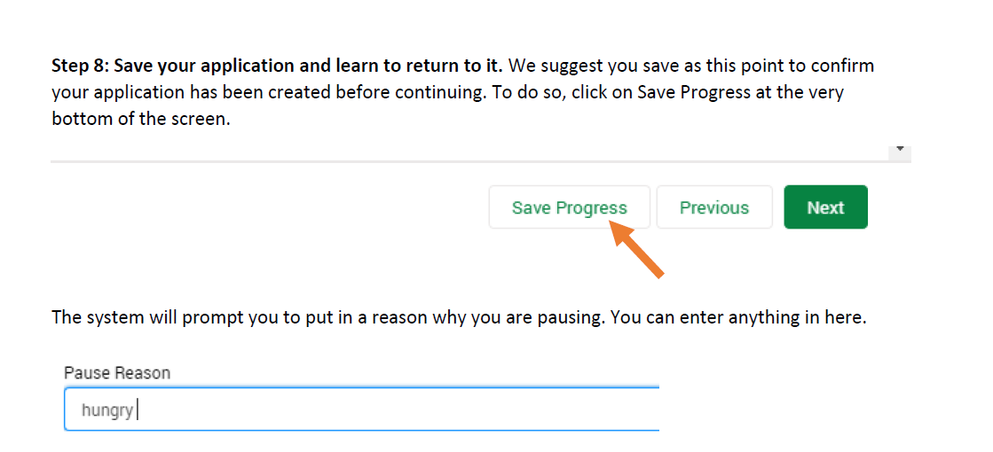
How to: Save your application progress.

Slide 43
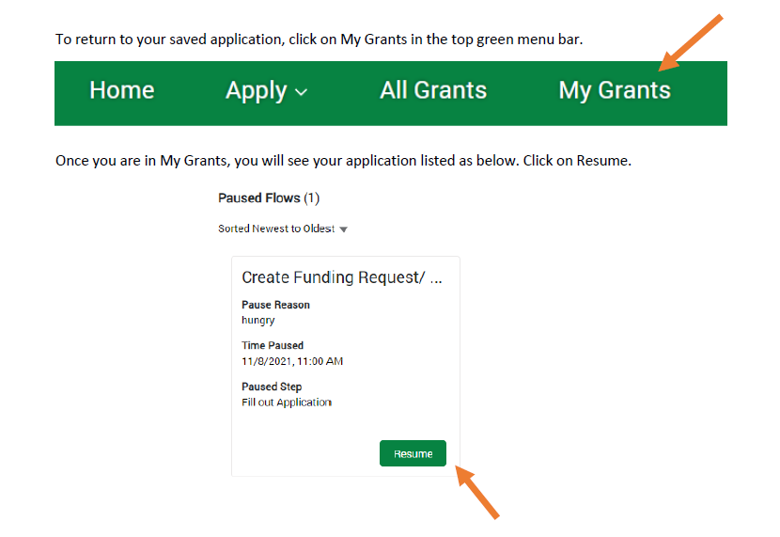
How to: Resume working on your application.

Slide 44

Want Step-by-Step Instructions on how to apply for a grant through the DOAG Grant Portal?
Go to the Apply section of the FTG website found here: 2022 Farm Transition Grant (FTG)--Apply (ct.gov)
Click on “Click here for step-by-step instructions on how to apply”

Slide 45
Quick Recap
Grant Deadline: Tuesday, March 8, 2022, at 4:00pm
Applicants choose ONE category of the Farm Transition Grant to apply for
Maximum grant award:
    New Farmer Micro Grant: $5,000
    Infrastructure Investment Grant: $20,000
    Research and Development Grant: $25,000
    Innovation and Diversification Grant: $49,999
Cash Match Required:
    New Farmer Micro Grant: 25% of project costs
    Infrastructure Investment Grant: 50% of project costs
    Research and Development Grant: 40% of project costs
    Innovation and Diversification Grant: 50% of project costs
Applicants should attach the Budget and Project Timeline Workbook and quotes/estimates/budget justification items to their application.
The grant narrative questions will be answered within the application.
Template landlord agreement available on DOAG website.

Slide 46
Contact Information
AliRose Grabarz
Ag Development and Resource Conservation
CT Department of Agriculture
(860) 713 - 5737
Alison.Grabarz@ct.gov
Please feel free to email me with any questions regarding the Farm Transition Grant. While I cannot help you write your application, I am here to assist you through this process. In case I am working from home, please send me an email and I will get back to you ASAP.

Slide 47
Thank you for attending.
Any questions?

