Slide 1
Connecticut Local Food for Schools Incentive Program
Info Session April 18, 2024

Slide 2
Connecticut Local Food for Schools Incentive Program (CT LFSIP)
Agenda
History and brief overview of CT LFSIP
How to get started
Reporting
Finding farmers and product
Tools, tips
Q & A

Slide 3
CT Local Food for School Incentive Program
A (short) story of policy and partnership in practice
Notes:
Intro to me, role, short story to t-up the specifics of the program- Why and How
Answer the “where is this come from??”
Collaborative

Slide 4
Every child, in every school, experiences the joy and power of food!
Notes:
Service Members in schools ---> Direct Impact
Policy and advocacy --->Systems Change
Lessons learned, relationship development, needs determined, advocates identified
All CT early childhood centers and K-12 schools have access to tangible, sustainable processes that connect education, agriculture and nutrition, where food served is sourced locally, and all students have access to meaningful, empowering experiences with the local food system in their classrooms, cafeterias and outdoor learning spaces.

Slide 5
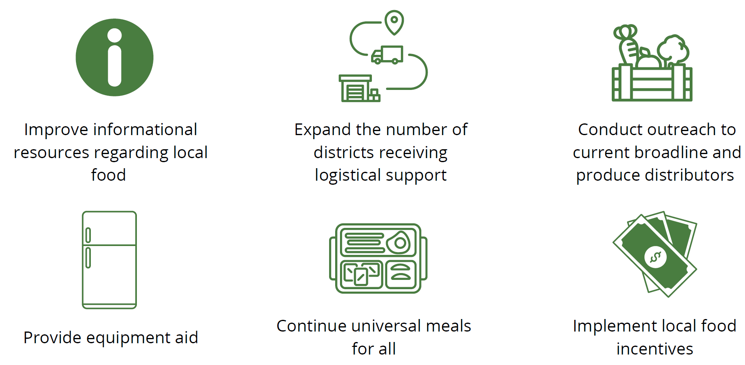
UConn Zwick Center for Food & Research Policy SFA Research on Farm to School, 2022
Notes:
Joins 18 other states with Local Food Incentive Programs
Link to the report- https://are.uconn.edu/wp-content/uploads/sites/2327/2023/04/Zwick-Center-FTS-Report-Fact-Sheet.pdf

Slide 6
Our intentions:
Meet a need for more resources for local food AND supports
Build off of Local Food for Schools (LFS) structure & learnings
Develop with and for SFAs and center students and equity
Meet state agency goals
Build more awareness and support for farm to school investments at the state legislature

Slide 7
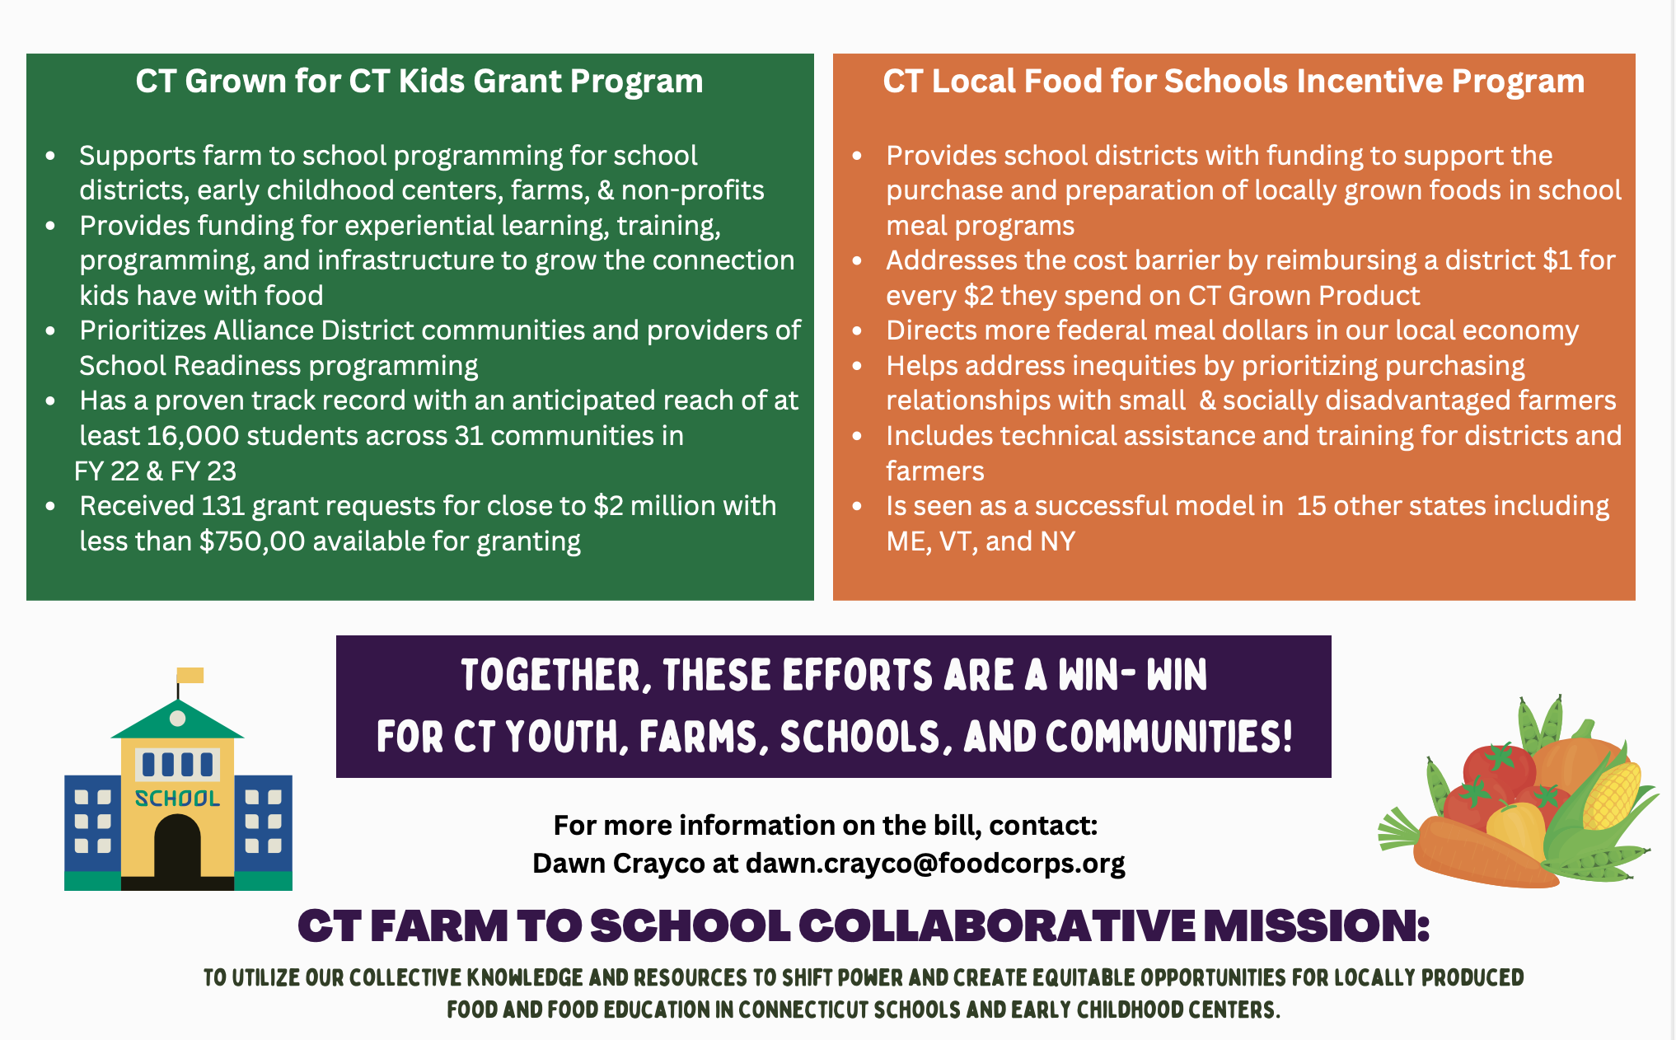
Notes:
Relates to CT Grown for CT Kids Grant Program - build demand from students
Incentive supports the supply side
Both addressing lack of resources in communities

Slide 8
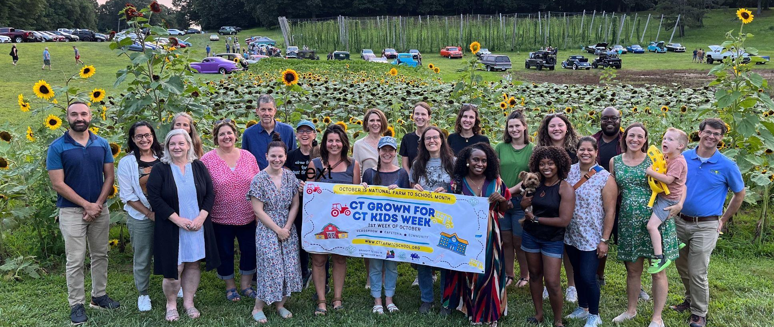
With special gratitude to:
Randall Mel
Samantha Wilson
Jen Bove (pre-CSDE)
Eileen Faustich
Christine Wallace
Maraiah Popeleski
Lonnie Burt
CT State Department of Education
CT Department of Agriculture

Slide 9
A request for partnership!
Provide feedback
Spend the $$$
Document and share the impact
Join our effort
Reach out: dawn.crayco@foodcorps.org

Slide 10
Program Overview
The Connecticut Local Food for Schools Incentive Program provides reimbursement payments to eligible boards of education for the purchase of locally sourced food and regionally sourced food to be used in an eligible meal program. An eligible board of education shall be entitled to receive reimbursement payments in an amount equal to:
(1) one-half of such board's expenditures for locally sourced foods
(2) one-third of such board's expenditures for regionally sourced foods
Example: If $2,000 was spent on locally sourced foods, the reimbursement amount would be $1,000. If $2,000 was spent on regionally sourced foods, the reimbursement amount would be $667. A combination of locally and regionally sourced foods can be purchased through the Connecticut Local Food for Schools Incentive Program and a claim for reimbursement may be submitted any quarter that eligible purchases were made.
A maximum reimbursement amount for each district will be established and published in consultation with the Connecticut State Department of Education (CSDE). The maximum reimbursement amount shall be based on the total student enrollment by district.

Slide 11
Program Definitions
Locally sourced food means produce and other farm products that have a traceable point of origin within Connecticut that are grown or produced at, or sold by, a local farm and includes, but is not limited to, value-added dairy, fish, pork, beef, poultry, eggs, fruits, vegetables, and minimally processed foods as defined below.
Regional farm means a farm, farmers' cooperative, food hub or wholesale distributor located in New York, Massachusetts, Rhode Island, Vermont, New Hampshire, or Maine.
Eligible board of education means a local or regional board of education that is participating in the National School Lunch Program.
Eligible meal program means a meal program provided by an eligible board of education to its students or a meal provided as part of such board's participation in the National School Lunch Program, School Breakfast Program, Seamless Summer Option, After School Snack Program, Summer Food Service Program or the At-Risk Afterschool Meals component of the Child and Adult Care Food Program administered by the United States Department of Agriculture.

Slide 12
Process Guidance Anticipated to be released Monday April 29
One of the two Authorized Signers for the board of education submits the Attestation Statement opting-in or-out of participating in the program.
The Microsoft Office form shall open on April 29, 2024.
Board of Education is notified of application status within ten (10) business days of submission of the Attestation Statement.
Participating boards of education may submit eligible purchases beginning with ones made and after receiving DOAG approval between May 1, 2024, and June 30, 2024, for reimbursement.
Participating boards of education begin purchase of locally and/or regionally sourced food.

Slide 13
Purchases
Purchases of food may be made direct from a farm, from a food hub, farmers’ cooperative, or from a wholesale distributor. However, the farm origin and location must be known and reflected on an itemized receipt/invoice and reported in the quarterly reimbursement form.
Boards of education are encouraged to prioritize their purchases from small farm businesses and socially disadvantaged farmers. Technical assistance to connect with producers will be made available.

Slide 14
Definitions Cont.
“Socially disadvantaged farmers” means farmers who belong to a group whose members have been subjected to racial or ethnic prejudice because of their identity as members of a group without regard to their individual qualities. (7 USC 2279 (a)).
“Small farm business” means an operation with gross cash farm income under $250,000 as defined the by United States Department of Agriculture.

Slide 15
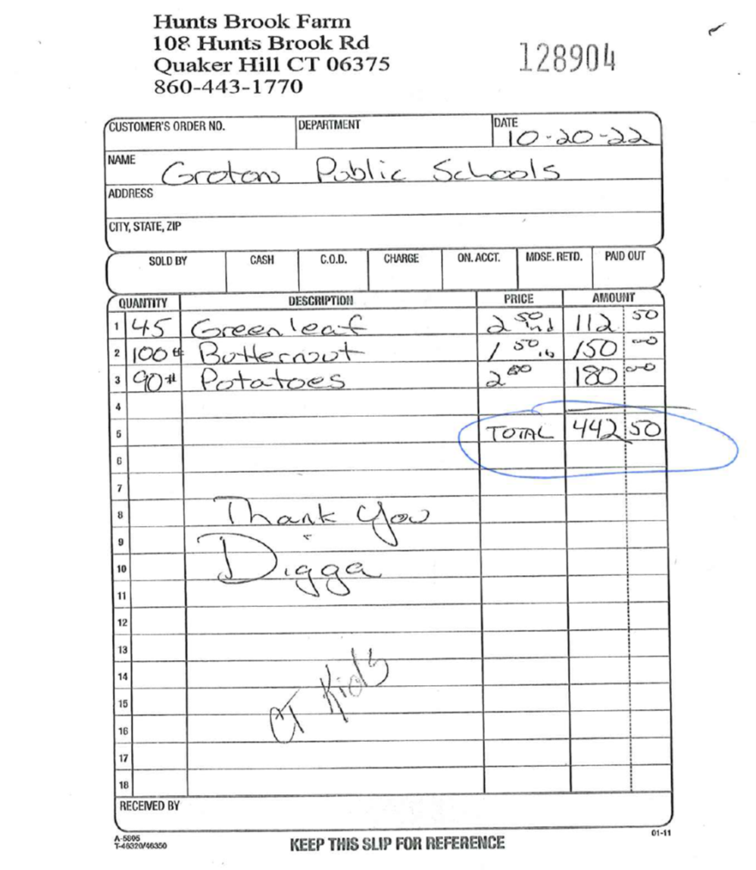
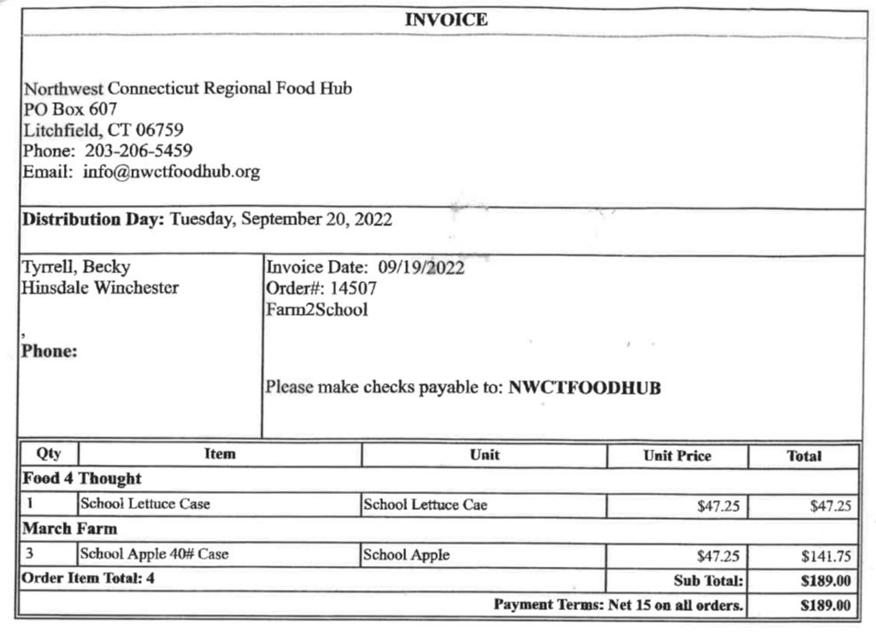

Slide 16
Reimbursements
To apply for reimbursement for eligible products, the participating board of education, or it’s designated official, shall submit a purchase report for eligible expenses to DoAg approval. Requests for reimbursement must be submitted 15 business days after the period closes.
For example, for the period of May 1-June 30, 2024, requests for reimbursement must be submitted by July 19, 2024.
Periods for reimbursement submission:
May 1 – June 30, 2024
July 1- September 30, 2024
October 1- December 31, 2024
January 1 - March 30, 2025
April 1 - June 30, 2025
The reimbursement request form will require information such as, but not limited to, the vendor purchased from, the location of the vendor/farm, the product(s) purchased, the quantity, and the cost.

Slide 17
CT LFSIP
Unprocessed and Minimally Processed Foods
Fruits and vegetables
Grain products such as pastas and rice
Meats (whole, pieces, or food items such as ground meats)
Meat alternatives such as beans or legumes, and dairy foods such as cheese and yogurt
Foods in a wide variety of minimal processing states (e.g., whole, cut) and/or forms (e.g., fresh, frozen, canned, dried)
Food is the only eligible expenditure of funds
Notes:
This is the definition used in the CCC language

Slide 18
CT LFSIP
Examples of unallowable products
Baked goods such as breads, muffins, or crackers
Prepackaged sandwiches or meals
Prepared and/or pre-cooked items that come ready-to-eat or that require no further preparation beyond heating, e.g. chicken nuggets, fish sticks, pre-made pizzas
Fluid milk

Slide 19
CT LFSIP
How do I get started?
SFAs should think about procurement:
How much is your allocation? Will be published at the end of program guidance.
What is your district’s micro purchase and small purchase thresholds?
How do I document my procurements?
Notes:
The reporting tool you use is part of the documentation of your procurements. Most of you will be able to use micro purchasing for these funds, we want to help keep this simple. We also have a simple one pager to help you organize your procurements.

Slide 20
CT LFSIP
What is coming?
Guidance released on Monday April 29 with full program details and opt in/ opt out form
ListServ- you will be added to F2S Collaborative and Farmer ListServ for contacts, and information
Promotional Materials
Networking Meetings
Procurement tips

Slide 21
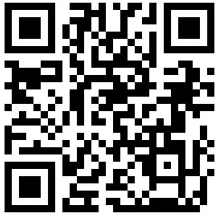
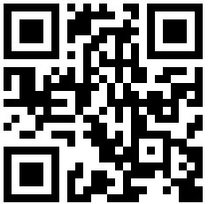
How do you find a Farm or Food Hub?
Put Local on Your Tray
CT NOFA

Slide 22
Conversations with producers
-What is a food hub or aggregator?
-Reach out early!
-Discuss specifics such as Delivery needs, Food safety or Liability, Prices and Invoices/Payments, Packaging Needs
-What if I plan to buy from my current produce distributor?
-Connect with non-produce farmers

Slide 23
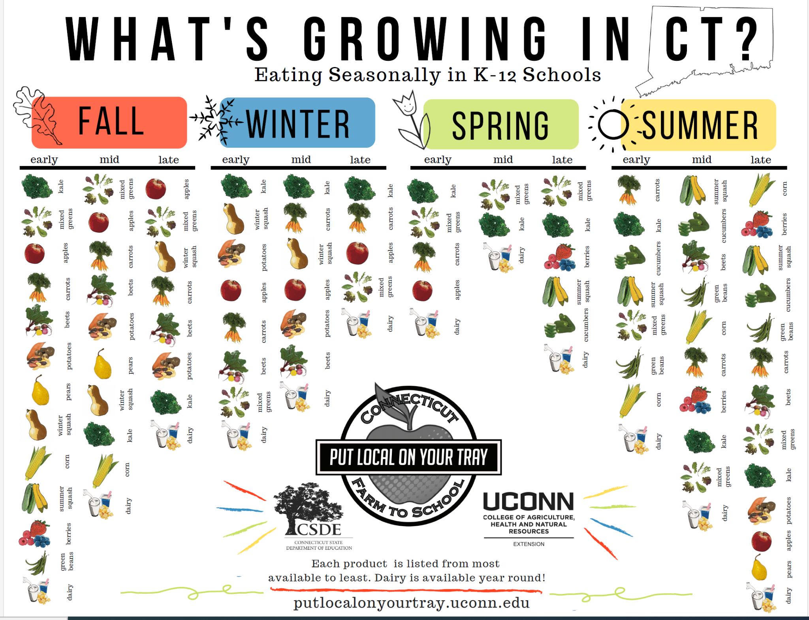
Buy,
Serve,
Celebrate!

