Slide 1

2023 Farmland Restoration Grant Writing Workshop
Lance Shannon
Simon Levesque
Holly Lalime

Slide 2
Please introduce yourselves in the comments.
Feel free to include:
Your Name
Your Farm or Agricultural Cooperative Name
The type of restoration work you are planning for your farm.

Slide 3
Today’s Agenda
Welcome
Overview of the 2023 Farmland Restoration Grant
Grant Description
Eligible Applicants
Match Requirement, Expenses, & Payment
Project Duration & Post Award Requirements
Submission Process
Required attachments
Evaluation Criteria and Process
Important Dates
How to Apply
Questions?

Slide 4
Grant Description
The Farmland Restoration Grant (FLRG) provides matching funds to Connecticut farmers, nonprofits and municipalities to increase food and fiber production in the state by restoring lands into active agricultural production. FLRG focuses on restoring and improving land with prime and important farmland soils, in accordance with a Farmland Restoration Grant Plan (FLRG Plan).
The FLRG program and any awards are subject to limitations of state funding.
Funding for the Farmland Restoration Grant is made possible by Public Act 11-1, codified in Chapter 422 of the Connecticut General Statutes. The Farmland Restoration Grant and any awards are subject to the requirements and provisions of state funding.
For the purposes of this grant, farmland restoration is the act of bringing land into agricultural production for human food, animal feed, or livestock grazing.

Slide 5
Eligible Applicants
Agricultural producers, singularly or jointly, whether such producers are owners or tenants of existing agribusiness within the State of Connecticut with at least one year of production experience.
Not for profits with a property being used for agricultural production.
Municipalities and state agencies with farmland in use by a farmer with a lease no less than five years in duration, and a five-year option to renew in place.

Slide 6
Eligible Applicants (cont.)
Producers must be registered with the Connecticut Secretary of State if established as a limited liability company or corporation and obtain or be applying to obtain a Farmer’s Tax Exemption Permit.
Farms should be a business in good standing with the Connecticut Department of Agriculture, all State, and Federal requirements.
Not for profits must be registered with the Connecticut Secretary of State and provide a copy of the federal IRS exemption letter. To be considered eligible for this grant, non-profits must have three years of consecutive 990 forms on file with the IRS (from 2017-2020).

Slide 7
Eligible Applicants (cont.)
Prior grantees may apply for a Farmland Restoration Grant.
Open awards, past awards, project completion and outcomes of current awards will be considered in the evaluation of this award application.
Applicants who have received two years of consecutive funding will be ineligible for an award for one year. Applicants can reapply for funding in the next grant cycle.

Slide 8
Farmland Restoration Grant Categories
Two different grant categories are available.
Agricultural producers (individuals, companies and corporations) and Not For Profits
Municipalities or state agencies
Applicants may select one category for which they think their project qualifies.
DOAG reserves the right to alter the grant category selected by the applicant.

Slide 9
Agricultural Producers and Not For Profits Farmland Restoration Grant
Agricultural producers must be the owner of an existing agribusiness with the State of Connecticut with at lease one year of production experience.
Not for profits must have property that is being used for agricultural production.
FLRG Grant:
Maximum award: $20,000
Match requirement: 50% of project costs
Past projects have included land clearing, stone & stump removal, drainage, irrigation wells and irrigation lines.

Slide 10
Municipalities or State Agencies
Municipalities and state agencies with farmland in use by a farmer with a lease no less than five years in duration and a five-year option to renew in place.
Maximum award: $20,000
Match requirement: 90% of project costs
Past projects have included land clearing, farm roads and drainage.

Slide 11
Match Requirement, Expenses and Payment
Projects on Publicly Owned Land: These are lands owned by a municipality or that are state-owned land – there is a 90/10 Match. 90% of project expenses may be grant funded, 10% of project expenses should be covered by the applicant as the match.
Projects on Privately Owned Land: These reference land that is owned privately by a farmer or not for profit – there is a 50/50 Match. 50% of project expenses can be grant funded, 50% of project expenses are covered by the applicant as the match.
The FLRG must be paid directly to the individual or business the agreement is made with.

Slide 12
Match Requirement, Expenses and Payment (continued)
The following expenses may not be used as a match and will not be funded by this grant:
Any expense incurred prior to contract execution
Land acquisition/mortgages
Cost of borrowing (points and other fees)
Any portion of expense for which the applicant barters/pays a contractor in merchandise or service in lieu of cash
Routine business expenses (example: equipment maintenance)
Disposable supplies (office, farm, otherwise) unrelated to the project
Legal expenses related to litigation
Indirect or contingency costs of any percentage
Land remediation expenses
Projects conducted on brownfields or contaminated lands
Purchase of general-purpose equipment (cars, trucks, boats, tractors, chainsaws, etc.)
Lobbying

Slide 13
Match Requirement, Expenses and Payment (continued)
The following expenses are an acceptable match if they directly and meaningfully support the proposed project:
Employee salaries/payroll paid to execute the project
Attorneys’ fees (not related to litigation)
Consumable or disposable supplies (example: gas, oil)

Slide 14
Match Requirement, Expenses and Payment (continued)
The FLRG is a reimbursement grant. Incomplete projects cannot be fully reimbursed.
Once awards are made no additional funds will be awarded, even if a project’s expenses increase. Conversely, if project expenses are less than originally projected, for example the project only costs $8,000 instead of $10,000, a prorated amount will be paid for completed work.

Slide 15
Project Duration
Projects must be completed within 18 months of contract execution. Contract and project extensions are not allowed.
Your project CANNOT START prior to the Contract start date even if executed before the Contract start date!
DO NOT BEGIN YOUR PROJECT UNTIL THE CONTRACT START DATE

Slide 16
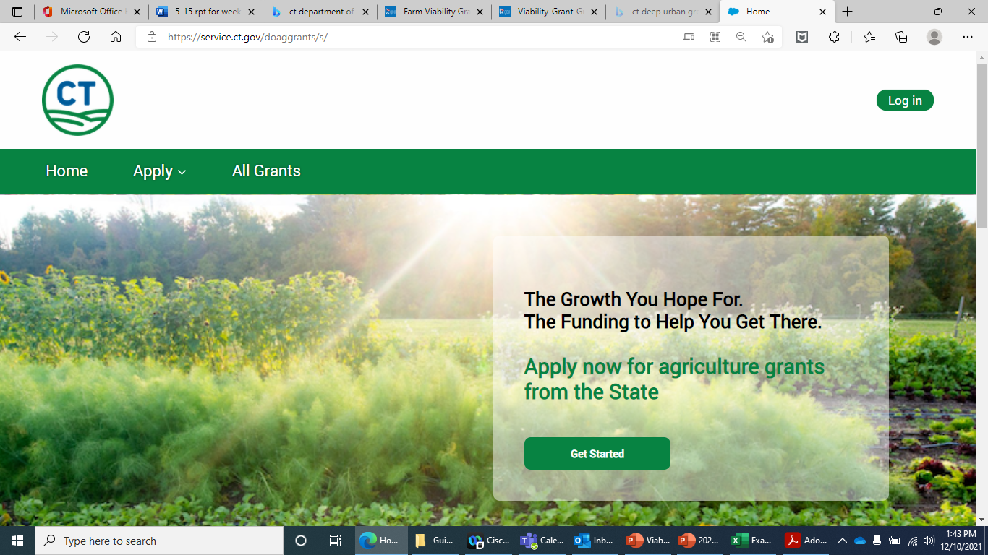
Submission Process
All Farmland Restoration Grant applications are required to be submitted through the DOAG grant portal.
All grant funding opportunities can be found here: https://service.ct.gov/doaggrants/s/
Step-by-step instructions on creating an account, and applying for grants can be found here: Application-Instructions.pdf

Slide 17
Application Requirements
A complete application includes:
Supplemental Application & Grant Narrative (please see page 13 of the guidance for more information).
Budget Form and Project Timeline Workbook
Aerial maps of the project area. Please include on this map a detailed sketch of the project, identifying what will be done to the land. The aerial maps can be obtained from Google maps or USDA.
Soil(s) map of project area. These can be obtained from NRCS or online at the Web Soil Survey
Assessor tax card and tax map for the property. These can be obtained from the municipal tax assessor’s office or possibly online.
Map identifying the common land units for the property. This map may include field locations and names, crops grown, and acres per field. These can be obtained from a local USDA Service Center. These must be scanned as pdf files for the application process.
All required forms/documents can be found here: 2023 Farmland Restoration Grant (FTG)--Documents (ct.gov)

Slide 18
Application Requirements - continued
Pictures of the project area as it currently exists, prior to the project being completed.
Profit and Loss statements for up to the previous three years.
Valid Farmer’s Tax Exemption Permit or application to obtain a Farmer’s Tax Exemption Permit.
If applicable – an approval letter from the easement holder for approval of the project. A template for the approval letter can be found on the Farmland Restoration Grant webpage at www.CTGrown.gov/grants.
If applicable – a copy of an executed lease and a statement from the owner for approval of the project. A template for the approval letter can be found on the Farmland Restoration Grant webpage at www.CTGrown.gov/grants.
If applicable – an approved copy of an NRCS Conservation Plan or Comprehensive Nutrient Management Plan.
All required forms/documents can be found here: 2023 Farmland Restoration Grant (FLRG)--Documents (ct.gov)

Slide 19
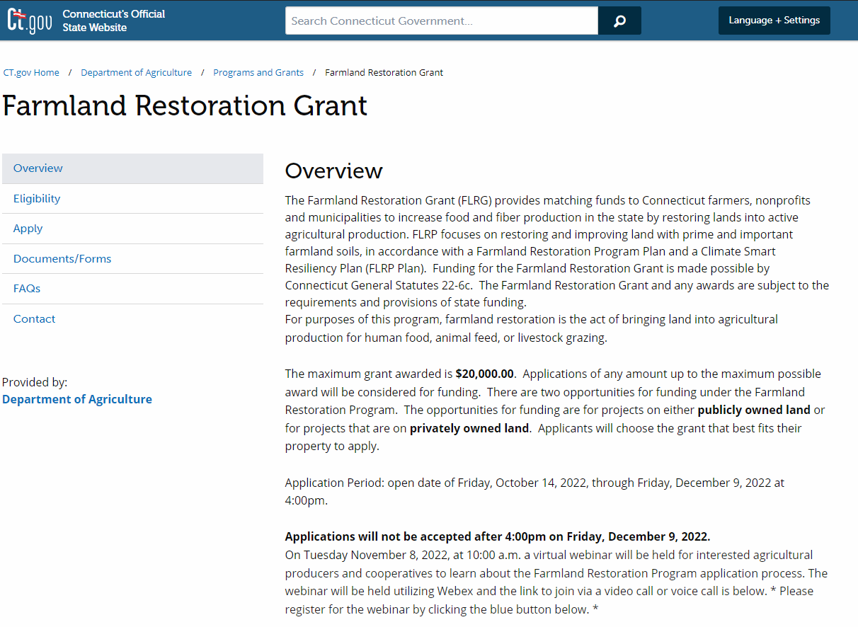
Where can I find information on the 2023 Farmland Restoration Grant?
www.ctgrown.gov
Click “Farmland Restoration Grant”

Slide 20
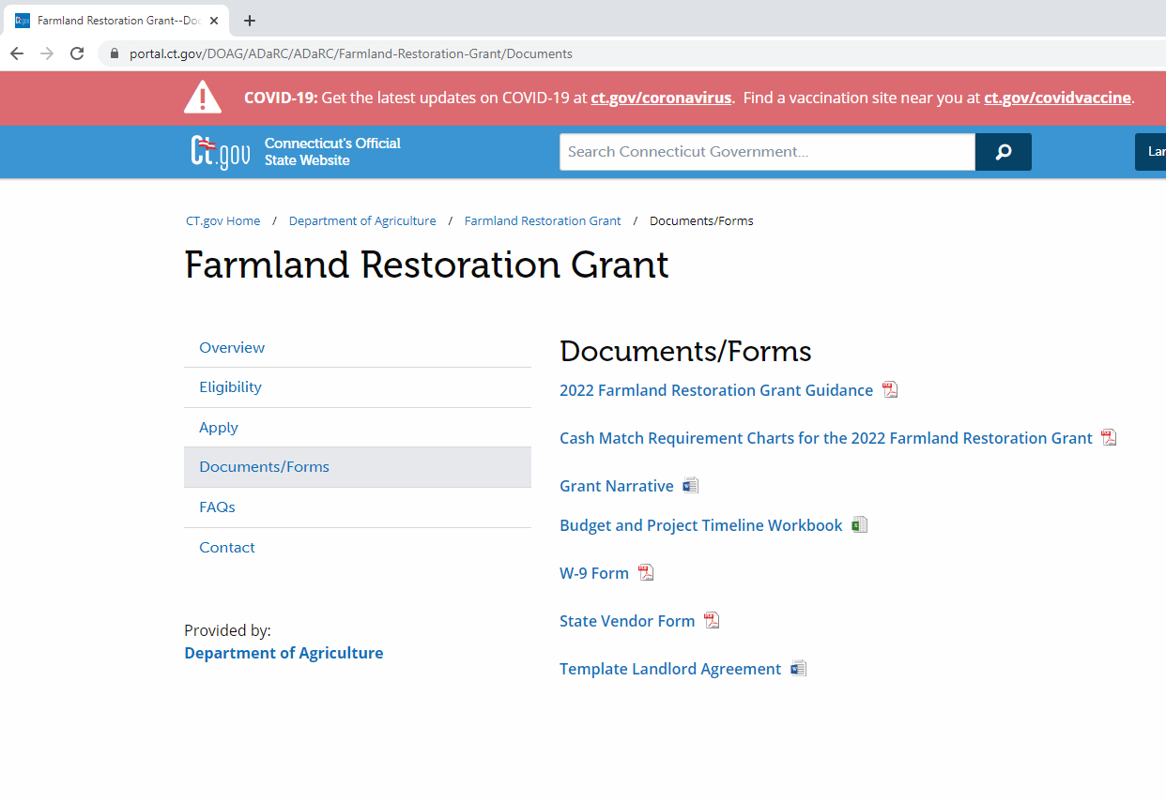
Budget and Project Timeline Workbook
Visit: 2023 Farmland Restoration Grant Program (ct.gov)
Download a blank copy of the form and save to your computer.

Slide 21
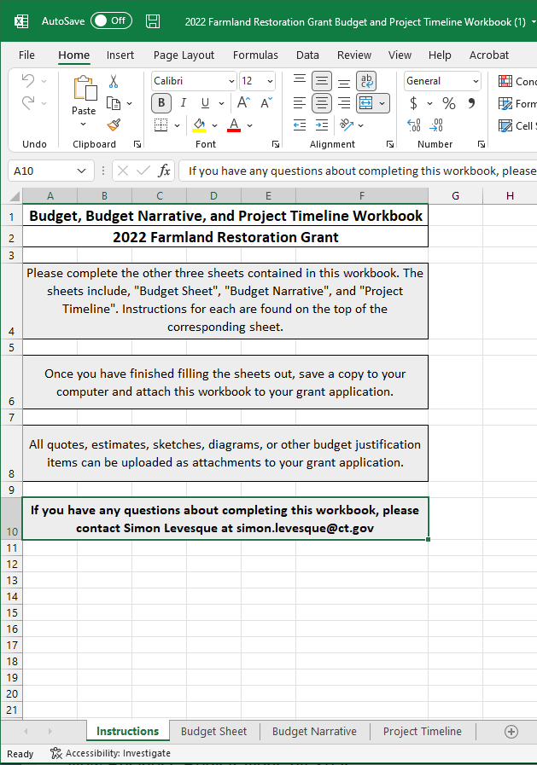
Budget and Project Timeline Workbook
There are four sheets included in this workbook:
Instructions *you do not need to fill anything out on this sheet.*
Budget Sheet
Budget Narrative
Project Timeline

Slide 22
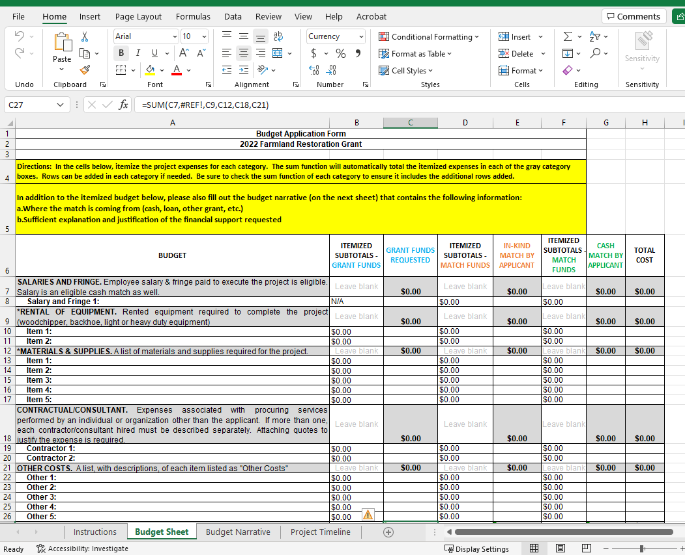
Budget Sheet
Your budget must contain the following itemized categories.
Projects involving hiring a subcontractor should include quotes from that subcontractor.
In-kind expenses must include breakdowns of hours worked, rates per hour and work performed.

Slide 23
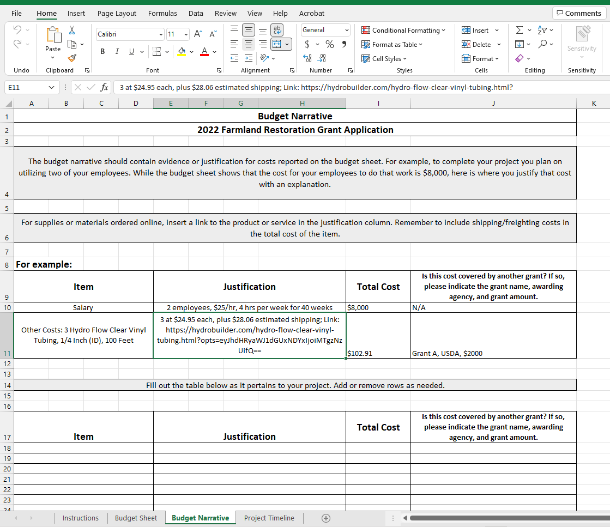
Budget Narrative
The budget narrative should contain evidence or justification for costs reported on the budget sheet.
For example, to complete your project you plan on utilizing two of your employees. While the budget sheet shows that the cost for your employees to do that work is $8,000, here is where you justify that cost with an explanation.
For supplies or materials ordered online, insert a link to the product or service in the justification column.
Remember to include shipping/freighting costs in the total cost of the item.

Slide 24
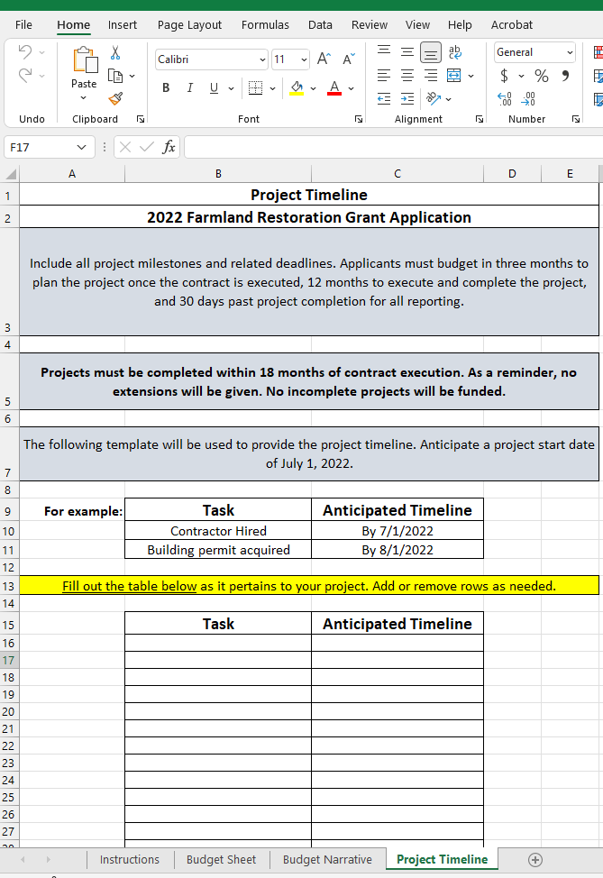
Project Timeline
Include all project milestones and related deadlines.
Projects must be completed within 18 months of contract execution.
Anticipate a project start date of April 1, 2023

Slide 25
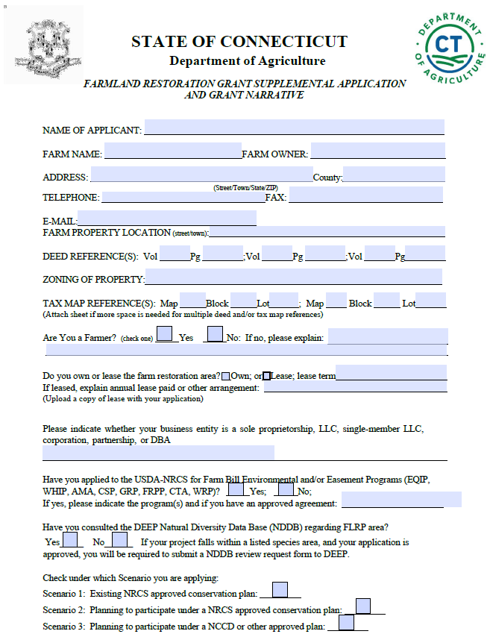
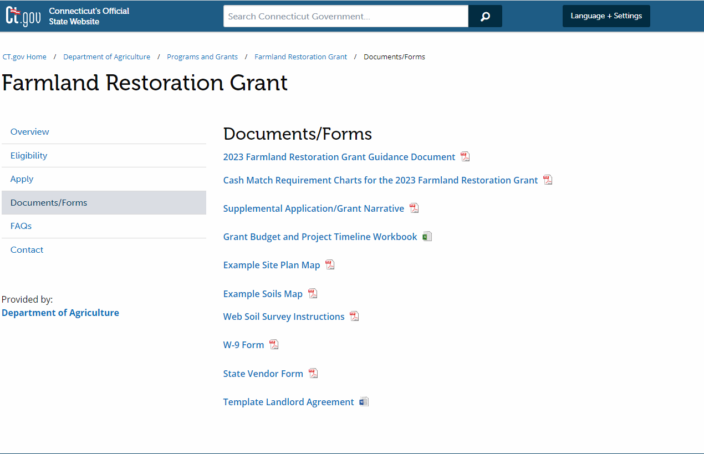
Supplemental Application and Grant Narrative
Visit: 2023 Farm Restoration Grant (FRLG)--Documents (ct.gov)

Slide 26
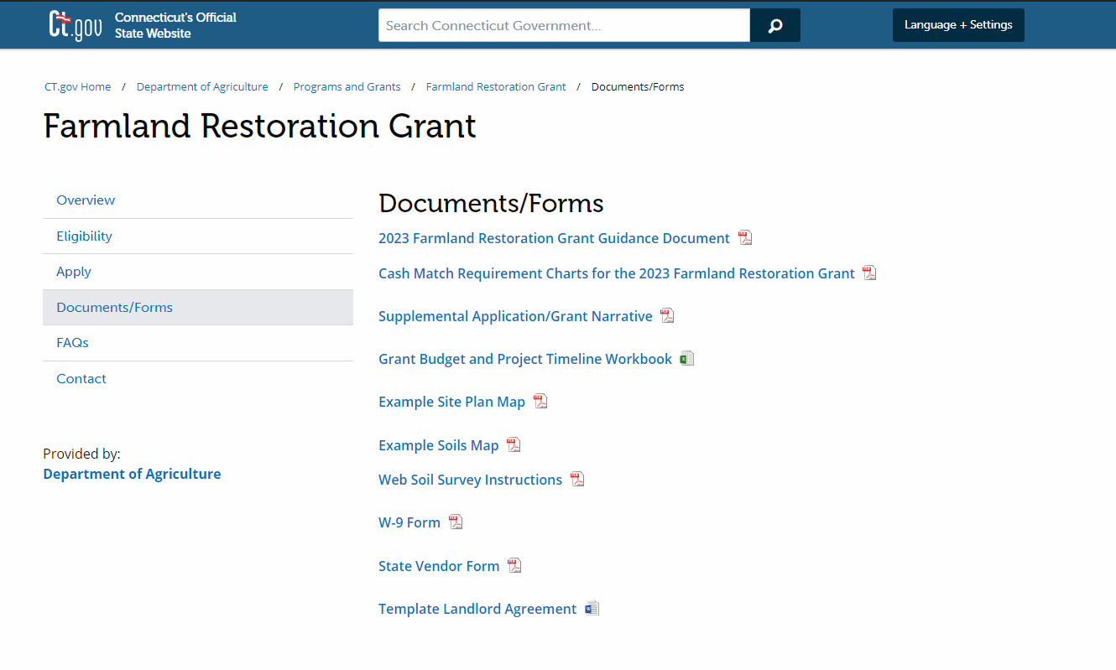
Other Important Forms: W-9 and State Vendor Form
The DOAG Grants portal will prompt you to fill out and save a copy of your W-9 Form and State Vendor Form.
Copies of these forms MUST be attached to your grant application.

Slide 27
Other Important Forms: Template Landlord Agreement
If your project will be taking place on land that is leased or rented, you will need to attach a Landlord Agreement to your application.
A template agreement can be found in the Documents/Forms section of the DOAG FLRG website.

Slide 28
Evaluation Criteria and Process
The FLRG is a competitive grant.
Only complete applications, as outlined on the website here: 2023 Farmland Restoration Grant (FLRG)--Apply (ct.gov), submitted on time, will be evaluated.
The evaluation will be weighted heavily on the project plan described in the Grant Narrative.

Slide 29
Evaluation Criteria and Process (continued)
The Grant Narrative should fully answer the questions clearly and directly.
Project applications should clearly present how the project will be accomplished within a reasonable timeline.
Additional information such as: quotes, conceptual drawings, and other documentation justifying and supporting the budget and project, is required to present a competitive application.

Slide 30
Important Dates
Application Period:
Friday, October 14, 2022, at 12:00 p.m. –Friday, December 9, 2022, at 4:00 p.m.
Application Deadline:
Friday, December 9, 2022, at 4:00 p.m.
Project Start Date (anticipated):
April 1, 2023

Slide 31
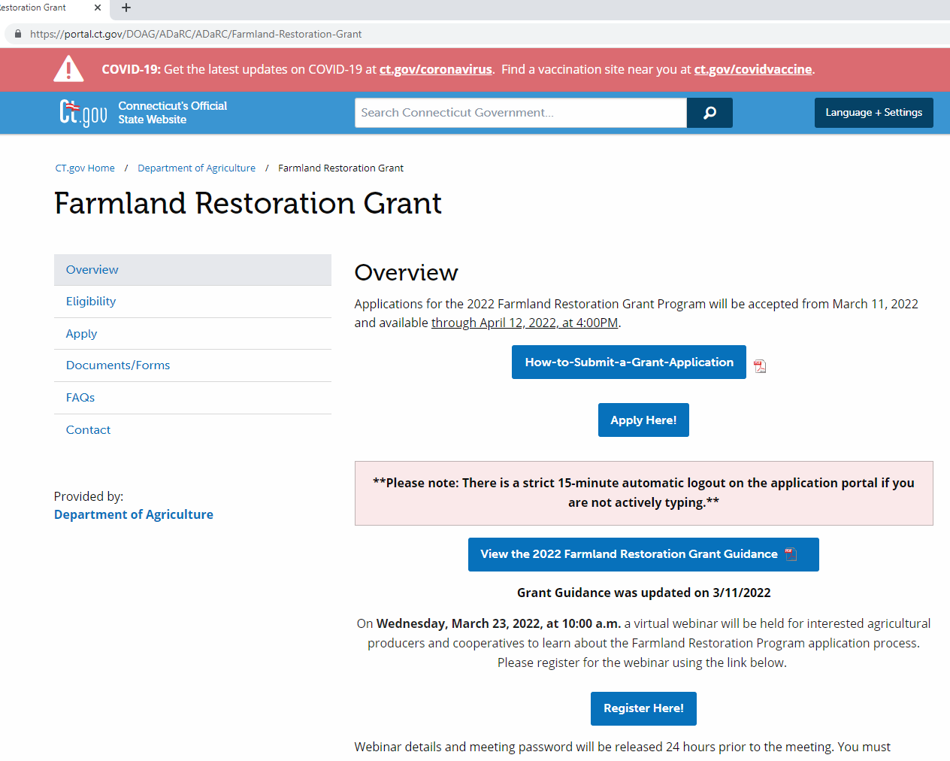
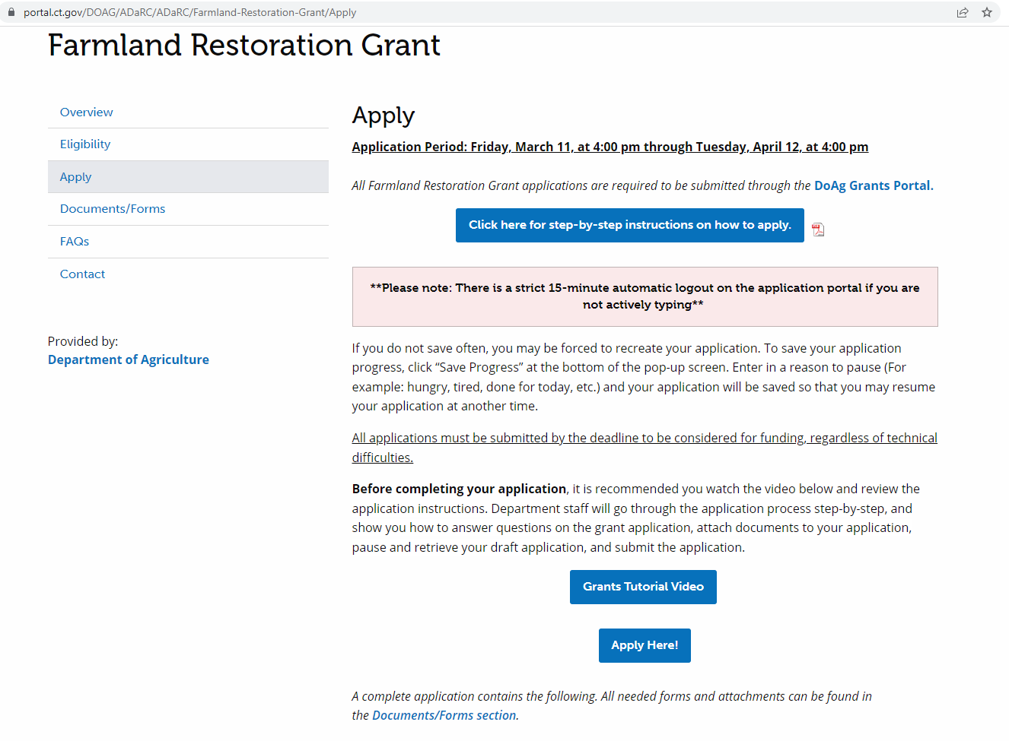
How do I apply for the 2023 Farmland Restoration Grant?
Visit DOAG’s FLRG page here: 2023 Farmland Restoration Grant (ct.gov)
From the menu on the left, choose “Apply”
Once on the Apply page, click the blue button that says “Apply Here!”
This will bring you to the DOAG Grants Portal.

Slide 32
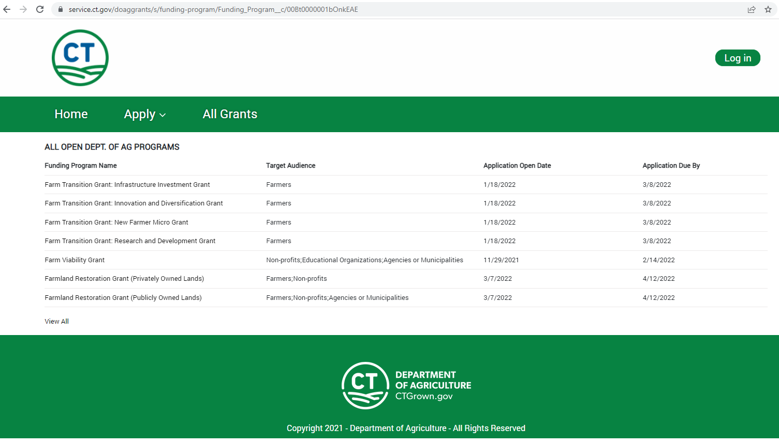
How do I apply for the 2023 Farm Restoration Grant?
Once on DOAG’s Grant Portal, click on “All Grants” and choose the category of the FLRG you are applying for.
Private landowner?
Click Farmland Restoration Grant (Privately Owned Lands)
Leasing from a municipality?
Choose Farmland Restoration Grant (Publicly Owned Lands)

Slide 33
**Please Note**
There is a strict 15-minute automatic logout on the online application portal if you are not actively typing.
Please save your application often by clicking “Save Progress” at the bottom of the pop-up screen and enter in a pause reason so that you may resume your saved application.
If you do not save often, you maybe forced to recreate your application.
All applications must be submitted by the deadline in order to be considered for funding regardless of technical difficulties.
We recommend answering the Grant Narrative questions in the Word document, and then copying and pasting your answers into the space provided on the grant portal.

Slide 34
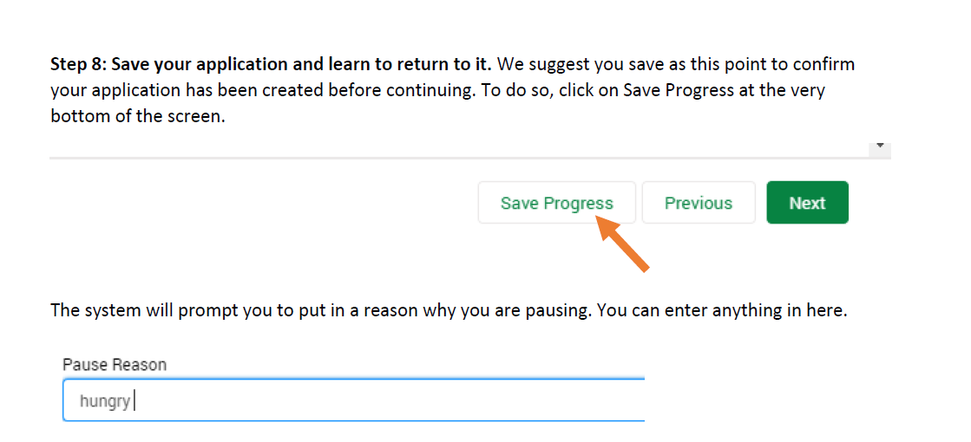
How to save your application progress.

Slide 35
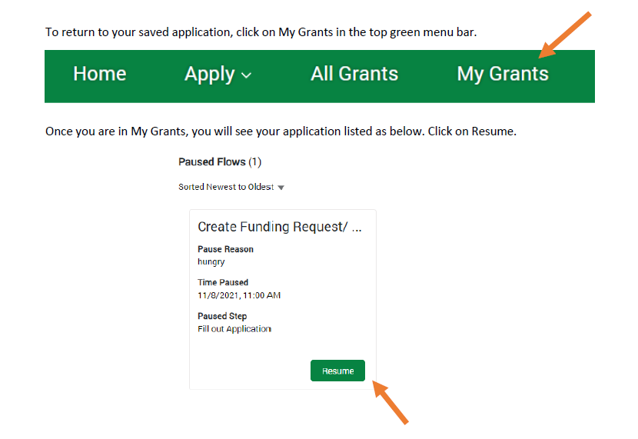
How to resume your application:

Slide 36
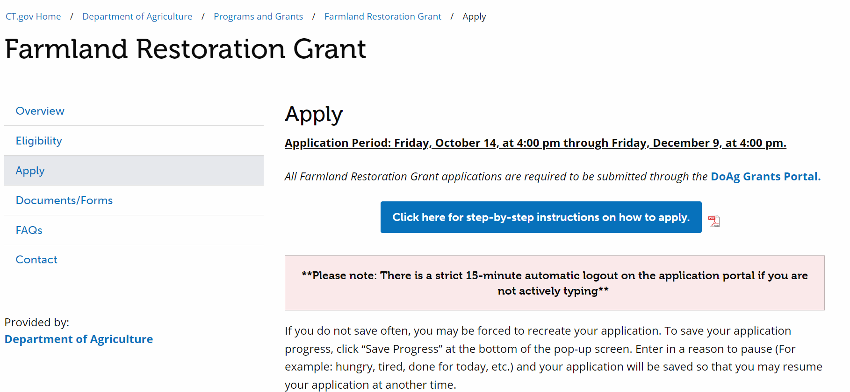
Want Step-by-Step Instructions on how to apply for a grant through the DOAG Grant Portal?
Go to the Apply section of the FLRG website found here: 2023 Farmland Restoration Grant (FLRG)--Apply (ct.gov)
Click on “Click here for step-by-step instructions on how to apply”

Slide 37
Post Award
Awardees will be notified via email in early January, 2023
Grant administrators (Simon, Lance, Holly) will contact awardees to gather additional information for Grant Contracts
Anticipated Contract start date April 1, 2023
Grant administrators will help coordinate site visits with Soil Scientists and awardees after contracts are signed
Projects may not begin until the Commissioner approves a Farmland Restoration Plan from a designated soil scientist
Expect to begin work on your project by July 1, 2023

Slide 38
Quick Recap
Grant Deadline: Friday, December 9, 2022 at 4:00pm
Applicants choose ONE category of the Farmland Restoration Grant to apply for
Maximum grant award: $20,000
Cash or In-kind Match Required:
Property owned by agricultural producers (individuals, companies and/or corporations) and Not For Profits – 50%
Property owned by municipalities and state agencies – 10%
Applicants should attach the Budget and Project Timeline Workbook and quotes/estimates/budget justification items to their application.
The grant narrative questions will be answered within the Supplemental Application.
Template landlord agreement available on DOAG website.

Slide 39
Contact Information:
Holly Lalime
Ag Development and Resource Conservation
Connecticut Department of Agriculture
C: 860-969-7053
Holly.Lalime@ct.gov
Lance Shannon
Ag Development and Resource Conservation
Connecticut Department of Agriculture
Lance.Shannon@ct.gov
Simon Levesque
Ag Development and Resource Conservation
Connecticut Department of Agriculture
Simon.Levesque@ct.gov
Please feel free to email us with any questions regarding the Farmland Restoration Grant. While we cannot help you write your application, we are here to assist you through this process. In case we are working from home, please send emails and we will get back to you ASAP.

Slide 40
Thank you for attending. Questions

