Slide 1


TCM DOCUMENTATION TRAINING
How to write TCM service notes

Slide 2
What is Targeted Case Management?
A Type of Service
  Supporting individuals in accessing needed services and supports (we’ll get into the details in a bit).
A Source of Funding
  We provide many valuable services, but not all of them generate funding for our programs.
  Medicaid will provide funding for specific services we provide (this helps make our programs sustainable).

Slide 3
TCM Providers
Qualified Providers must have
training,
experience
expertise
working with their target population.

Slide 4
Documentation:
Why is it so important?
For the Individuals we Serve
To inform healthcare needs
For ourselves
Evidence of our good work
Protection from liability
For our Programs
Financial sustainability

Slide 5
What is
“Good Documentation”?
Meets standards
Detailed
Specific to each service

Slide 6
Targeted Case Management Documentation Requirements
Must meet Medicaid Program rules.
Reflects medical necessity
Current/active Recovery plan
Thorough and detailed
Correct billing codes

Slide 7

Golden Thread of Documentation
Assessment
  Needs and diagnosis
Recovery Plan
  Clear, measurable goals
Encounter Note
  Services match recovery plan

Slide 8
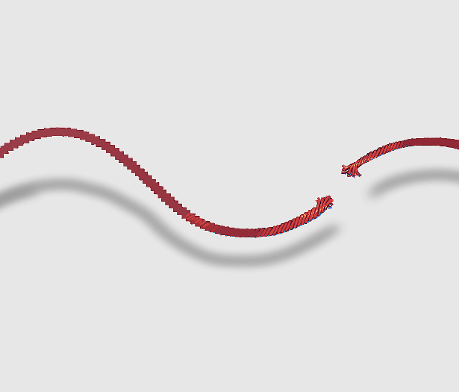
Difficulty Following The Golden Thread
Assessment deficits
No recovery plan
No baseline for progress
Unrelated goals and objectives
“conversations” vs interventions
Progress notes do not assess behavior change
No intervention specified

Slide 9
ASSESSMENTS
Information Gathering
Relationship building
Comprehensive Assessment of health and needs
History
Current mental and physical health
Financial
Housing
Educational
Social
Supports the necessity for the services you are providing.

Slide 10
Assessment Frequency
Initial Assessment
Annual assessment (or more often!)
Document it!
  Conducting an assessment should be coded as a TCM.

Slide 11
Recovery Plans
Developed from the assessment
Substantiate ongoing necessity for services
Guide treatment
A Recovery Plan is:
Individualized
Goal-oriented
Contains measurable objectives
Promotes an enhanced quality of life
Addresses the needs identified by the assessment.
Illustrates treatment process from admission to discharge.

Slide 12
Recovery Plan Monitoring
Recovery Plans are “living documents,”
Update frequently
Examples
Change in individual’s goals
Hospitalization
Change in health status
Change in services
Change in housing/employment/finances, etc.
Document changes
Recovery Plan monitoring is a TCM

Slide 13

Goals in Recovery Planning
Person Centered
Meaningful
Hopeful
Dreams and Desires
Positive
  Not just symptom reduction
Long-term, overarching and motivating to move towards something positive
  May take years to achieve

Slide 14
Goals in Recovery Planning
Goals should be Positively Stated
Not: “I want to be less depressed”
But instead: What would they do if they were less depressed?
Example: “I want to go back to school so I can be a good role model and provider to my children”
Goals should be focused
In the individuals own words
Reflected in quotes as “I” statements.

Slide 15
Challenges in Goal Setting
Takes time
Requires a good relationship
Difficult to articulate
Elicited through reflective listening
Can be helpful to make suggestions

Slide 16
Goal Examples
Instead of “ I want to be medication compliant” ask “what might be different if you were stable on your medication?” A better goal might be “ If my medications work I can go back to school and finish my degree”
Instead of “I want to stay out of jail” by staying out of jail…”I want to get my job back at the construction company so I have money for a better apartment.

Slide 17

Think about it…
Beyond US and THEM but WE
People with substance use disorders and mental health issues generally want the exact same things in life we all want.
People want to thrive not just survive.

Slide 18

The Implications in Recovery Planning Documentation
Which goal would you rather work on?
Traditional Treatment Plan Goal
Patient will achieve and maintain clinical stability and develop increased insight regarding substance use and assaultive behaviors
Person-Centered Recovery Plan Goal
“ I want family and friends back in my life”

Slide 19
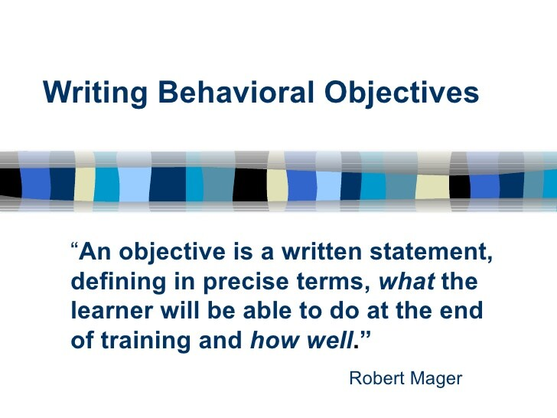

Objectives in Recovery Planning
Breaking it down
Objectives are the what-
  what is the next step towards completing the goal?
Notes:
Objectives break a large goal into manageable steps for the for the client to accomplish on the road to their recovery.
Objectives are the what-what is the next step towards completing the goal?

Slide 20
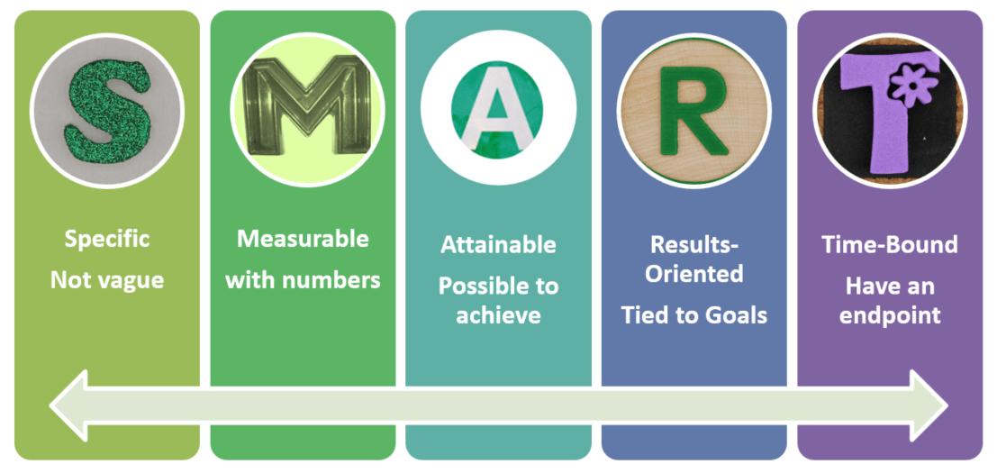
Creating SMART Objectives
Specific, written an understandable language.
Measurable; concrete change that is easily observed.
Attainable; based on the client’s desire and strengths and skills.
Relevant; meaningful to the client and helps overcome a barrier to achieving a goal.
Time-framed; achievable in a reasonable amount of time. (30 days, 60 days etc.)

Slide 21
Coordination of Care Objective
A “Coordination of Care” objective is considered a “Best Practice”
  include the barrier that is preventing the client from accessing and utilizing the services on their own.
Coordinating care should be coded as TCM

Slide 22
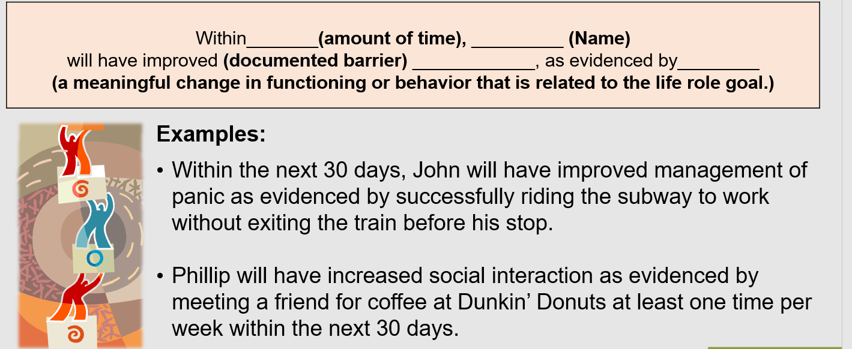
Formula for writing objectives

Slide 23
Interventions in Recovery Planning
Interventions are the How- How are we going to do it?
Interventions are the actions taken to achieve the objective- services provided by the case manager, or collateral resource.
Interventions provided by the case manager should target completion of the plan objective and be documented in a way to support the necessity of the services you are providing.

Slide 24
What Do People Want in Life?
Independence
I want to control my own money.
Work /education
I want to finish school
Spiritual connection
I want to get back to church.
Health/well-being
I want to lose weight.
Housing
I want to move out of the group home.
Social activities
I want to join a bowling league.
Satisfying relationships
I want to see my grandkids.
Valued Roles
I want to volunteer at the Senior Center.

Slide 25
Objective Examples
Karen (name) will have better control of her diabetes (improvement area) as evidenced by daily glucose readings of under 180 (accomplishing what achievement?) within the next 60 days. (time frame)
Sam(name) will decrease his anxiety (improvement area) as evidenced by attending one activity weekly at the community social club (accomplishment) for the next 90 days.(time frame)

Slide 26

INTERVENTIONS
Professional services should specify…
  WHO: will provide the service, i.e., name and job title
  WHAT: The TITLE of the service, e.g., Health & Wellness Group
  WHEN: The SCHEDULE of the service, i.e., the time and day(s)
  WHY: The individualized INTENT/PURPOSE of service

Slide 27
Types of Interventions
Examples include interventions such as;
Psychotherapy, medication, and skill building.
Self-help groups and peer run support
Exercise and nutritional advice
Developing a WRAP Plan
Involvement in Church/spiritual groups
Involvement in community/cultural activities

Slide 28
Intervention Examples
Miss Reynolds, licensed dietician(who) will provide nutritional consult and menus(what) 2x per month for the next 2 months(when) to reduce glucose readings and educate Karen on proper food choices.(why)
This case manager(who) will teach and reinforce with Sam, 3 anxiety reduction strategies(what) 1x per week for the next 90 days(when) to support community integration.(why)

Slide 29
TCM Recovery Plan Tips
Recovery Plans must be current in order to bill for TCM- don’t let your Recovery Plans expire.
Services to clients who do not have a Recovery Plan or the Recovery plan is expired should not be coded as TCM
Each time you monitor an objective on an active Recovery Plan-it should be coded as TCM
Each time you revise and update the Recovery Plan it should be coded as TCM

Slide 30
TCM Recovery Plan TIPS
For a Recovery Plan to be person-centered you need to document evidence of the client’s degree of participation and agreement with the Recovery Plan.
The best way to accomplish this is to have the client’s signature and date on the plan.
If the client is unavailable or refuses to sign, the Plan must include the case manager’s detailed explanation of why the signature could not be obtained and refer to a specific progress note that explains why.
Include documentation in the progress notes of your follow-up efforts to obtain the signature.
Also include documentation that you offered a copy of the plan to the client and their response.

Slide 31

The Encounter Note
The purpose of encounter notes is to provide an ongoing narrative of the interventions that have been utilized in your collaboration with the client.
An encounter note records the client’s progress in the small achievements towards reaching their long-term goal.
They provide an overview of the work and the progress made that is used to document Recovery Plan updates.

Slide 32
The note should reflect back to an objective in the Recovery Plan
The services you provide should be reasonably expected to improve an aspect of the client’s condition.
Designed to reduce or control symptoms
Prevent relapse or hospitalization
Improve or maintain current level of functioning.

Slide 33
The Narrative
You are telling a story with specific details.
The GIRP Format (all the elements of good documentation):
G-oal; Tie the story back to a goal in the Recovery Plan.
I-ntervention; Describe in detail what you did and why you provided the service
R-esponse; Document the client’s response to the intervention & the impact on the client’s progress.
P-lan; identify the focus of your next meeting.
Sign with credentials, date, time and duration

Slide 34
Encounter Note Example
Using the GIRP Format
Goal: Mental Health Objective#2- medication management for depression
Intervention: This case manager coordinated a medication management appointment with Dr. Suri at Bristol Hospital due to Bob’s concerns about his new medication for his depression. Accompanied Bob to the appointment where Bob expressed, he was gaining weight and didn’t like the way it made him feel. Dr. Suri let him know that these symptoms were common and usually went away within 4 weeks. He also encouraged Bob to try to eat healthier and exercise more to counteract any weight gain.
Response: Bob was happy the Dr. felt his side effects would go away but he expressed he doesn’t like to exercise.
Plan: meet next Tuesday to look at adding some light physical activity to his daily routine.
Carla Michaels, LPC, 6/10/21 start:10:13/end 10:45 33 min. total Psychiatrist office

Slide 35
GIRP Notes Helpful Tip
It is considered a documentation “Best Practice” to enter your encounter note into the client’s permanent record within one business day of providing the service.
The longer you wait the more likely you are to forget important details.
If you have to delay documenting, be sure to clearly differentiate between the date and time you are writing the note and the date and time of the event.

Slide 36
GIRP Notes Helpful Tip
All documentation is open to scrutiny by employers, accreditation bodies, and federal and state reviewers and auditors.
It is a “best practice” to conduct a self-audit.
Select a random sample for a specific amount of time( ex.10% of all charts every 3 months)
Do not audit your own charts to remove bias
Use the results you find for improving compliance. There is no real value in conducting a self-audit unless discovered issues are resolved.

Slide 37

Documentation that supports Medical Necessity
FOUND:
  “Counselor assisted client in buying summer clothes. He said he needed new shoes with the warmer weather. Counselor transported him to Walmart and helped him learn how to use the price checker. He said he had a good time.”
CORRECTED:
  Counselor arranged a trip to store where client was able to purchase seasonally appropriate clothing. Client has a history of wearing clothing that is ill-fitting and inappropriate for the season. This counselor continues to monitor his symptoms in the community as he often exhibits this when he begins to decompensate which has resulted in several hospitalizations.

Slide 38
Which Services are TCM?
Assisting individuals in accessing needed services
  What do they need?
    Information gathering to identify needs
    Assessment
  Creating a plan
    Recovery Planning
  Connecting with Services
    Coordination
  Making sure it all works
    Monitoring

Slide 39
OVERVIEW OF SERVICES
Comprehensive Assessment and Periodic Reassessment
Comprehensive Assessment and Periodic Reassessment of the individual’s needs to determine the need for medical, educational, employment, social or other services. These assessment activities include:
  Using a standardized assessment tool to take the person’s history
  Identify the person’s needs and completing related documentation and;
  Gathering information from other sources such as family members, medical providers, social workers and educators to form a complete assessment of the person.
  Periodic assessments must be repeated at least annually to be considered active. (This is a Medicaid standard; You may do these more frequently in your setting)

Slide 40
Overview of Services
Development and Periodic Revision of a Recovery Plan
Development and periodic revision of a Recovery Plan based on the information collected through the assessment that:
Specifies the goals and objectives to address the educational, employment, medical, social, and other services needed by the individual;
Includes activities such as ensuring the active participation of the person to develop those goals;
Identifies a course of action to respond to the assessed needs of the person
*Recovery plans and must be reviewed and updated at least annually to reflect the accomplishments and changing needs to be considered active. Recovery plans may be modified as needed

Slide 41
Overview of Services
Referral and Related Activities Through Collateral Contacts
Collateral contacts (entities outside of your agency such as BRS, clinical team members, family members, employers) that are directly related to identifying the person’s needs and care for the purposes of;
  Helping the person access services such as scheduling appointments for the person including:
    Activities that link the person with medical, social, employment, educational providers, or other programs and services that can provide needed services to address identified needs and achieve goals in the care plan.

Slide 42
Overview of Services
Advocate For Services Identified In The Recovery Plan
TCM providers advocate for the person served to receive the benefits identified and desired to help the person served obtain and maintain those services. They advocate for the person’s preferences regarding community living options and resources.
TCM providers break down barriers that keep the person from benefitting from all the community resources that are available to the community.
TCM providers promote the person’s self-advocacy and promote person-centered practices.

Slide 43
Overview of Services
Monitoring and Follow-Up Activities
Activities and contacts necessary to ensure the Recovery Plan is implemented and adequately addresses the person’s needs, which may be with the person, family members, service providers or other entities and conducted as often as necessary, including at least one annual monitoring to determine if the following were met:
  Services are being furnished as described in the Recovery Plan
  Services in the Recovery Plan are adequate
  Changes in the need or status or the person are reflected in the plan
  Monitoring and follow-up activities include making necessary adjustments in the Recovery Plan and service arrangements with providers

Slide 44
TCM Service Codes
DDAP TCM Codes:
TCM01 – face to face with client
TCM02 – on the phone with client
TCM03 – with collateral
TCM04- Audio and Visual with the client
There are 2 newTCM04 Location Codes that should also be used :
Audio and Visual-client at home
Audio and Visual-Client in other location
if any other location is used it will result in the billing error “Service Name and Service Location Mismatch”

Slide 45
Documentation:
Why is it so important?
For the Individuals we serve
  To inform healthcare needs
  Communication with your team
  For accurate assessments and services
  For evidence of progress

Slide 46
Documentation:
Why is it so important?
For ourselves
  Evidence of our good work
  Makes our work easier
  Protection from liability

Slide 47
Documentation:
Why is it so important?
For our Programs
  Proof of services
  Record of progress
  Financial sustainability
Notes:
For our Programs
Good documentation is required for reimbursement from Medicaid.
Billable services like TCM reimburses for your skills and your professional work.
TCM is a set of services that the federal government provides reimbursement to the states, so correct coding for TCM is important.
Ensuring that our programs are financially sustainable helps to ensure that our services continue to operate.
DMHAS is aways advocating for funding, and advocating against budget cuts.

Slide 48
THANK YOU!!!
Carleen Zambetti For TCM and Documentation questions at carleen.Zambetti@ct.gov
Visit the DMHAS TCM webpage at https://portal.ct.gov/DMHAS/Initiatives/DMHAS-Initiatives/TCM for resources including power points, billable diagnosis and TIP Sheets. Check back often as information is added and updated on a regular basis.

