Slide 1
Connecticut’s Substance Use Prevention Overview
Mental Health and Addiction Services
Building Resilient Communities Through Prevention

Slide 2

CT's Prevention Infrastructure
Community Based Programs and Initiatives
(Branches)
DMHAS: Infrastructure Support
(Trunk)
Governor’s Prevention Partnership
Youth Development
Mentorship
Regional Behavioral Health Action Organizations
Planning & Needs Assessment
Service Coordination and Leveraging
State Education Resource Center (SERC)
K-12 Development
Training & TA Service Center
- Workforce Development
CT Clearinghouse
Information Dissemination
Media Partnership
Center for Prevention Evaluation & Statistics
- Monitoring & Evaluation
IMPACT Data Collection System
Building Resilient Communities Through Prevention
Mental Health and Addiction Services

Slide 3
CT's Prevention Infrastructure
Prevention and Health Promotion
Programs & Initiatives
Mental Health & Other Cross Cutting Initiatives
Tobacco Prevention & Enforcement Initiatives
Substance Use Initiatives
State & Regional Suicide Advisory Boards
Recovery Friendly Workplace
156 Local Prevention Councils
10 PCC
Retailer Education
Police Partnerships
Discretionary Funds
Governor’s Challenge
24 Healthy Campuses
Discretionary Funds
Synar
FDA Inspections
Training & TA Service Center
FOUNDATION OF SUPPORT: RESOURCE LINKS
CT Clearinghouse
Center Prevention Evaluation & Statistics
State Education Resource Center
Gov. Prevention Partnership
Community Planning & Resources Coordination
Building capacity through Training & Technical Assistance & Information Dissemination
RBHAOs
Building Resilient Communities Through Prevention
Mental Health and Addiction Services

Slide 4
What is Prevention
Tertiary
Secondary
Primary
Health Promotion
Strategies aimed at helping individuals get treatment
Targets individuals who are at a higher risk of use to help reduce consequences of use
Proactive measures designed to prevent substance use before it begins
Multifaceted approaches to prevent substance use and promote overall health and wellness
Building Resilient Communities Through Prevention
Mental Health and Addiction Services

Slide 5
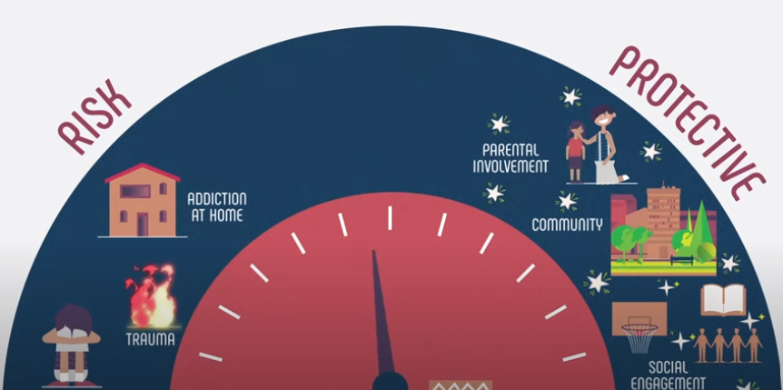
What is Prevention
Building Resilient Communities Through Prevention
Mental Health and Addiction Services

Slide 6
Primary vs. Secondary Prevention
 | Primary Prevention | Secondary Prevention
Goal | Prevent substance use before it starts | Identify and intervene early to prevent progression of use
Target Population | General population or those that are at risk (i.e youth, communities) | Individuals showing early signs of use or at high risk
Focus | Promoting healthy behaviors and environments | Early detection, brief intervention, and referral to treatment (SBIRT)
Examples of Strategies | School-based education programs Public campaigns on risks of prescription opioids Safe storage & disposal of medications Prescriber education and CPMRS use | Screenings in schools Counseling for at-risk youth Peer support groups Naloxone distribution to at risk individuals
Timing | Before any substance use occurs | After initial use or signs of risky behavior
Outcomes Sought | Prevent first use, reduce access to opioids, increase awareness | Reduce frequency and severity of use, prevent overdose, connect to treatment early
Building Resilient Communities Through Prevention
Mental Health and Addiction Services

Slide 7
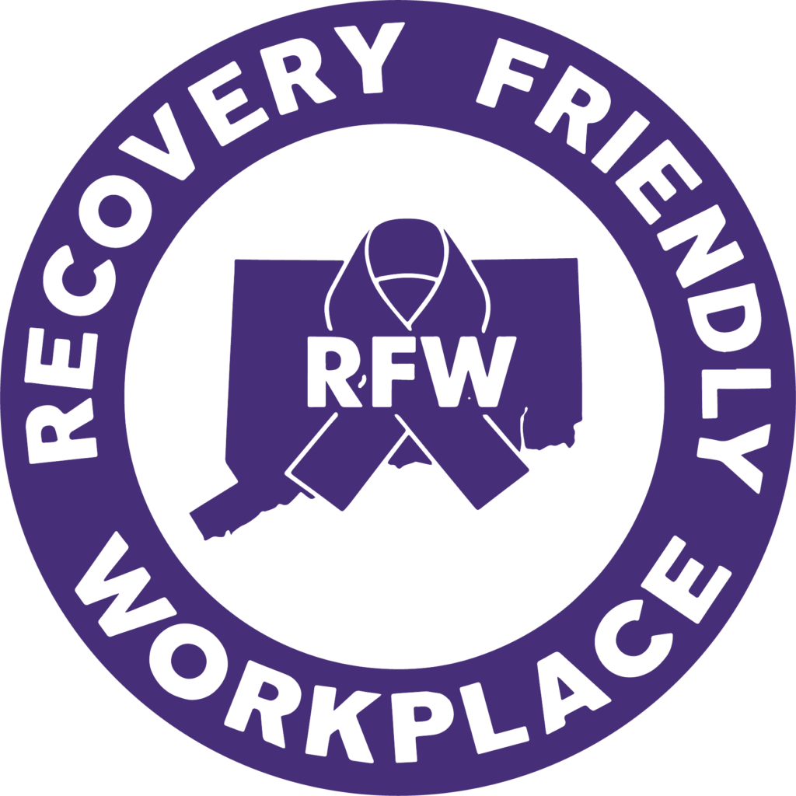
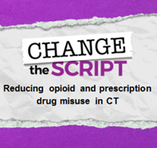
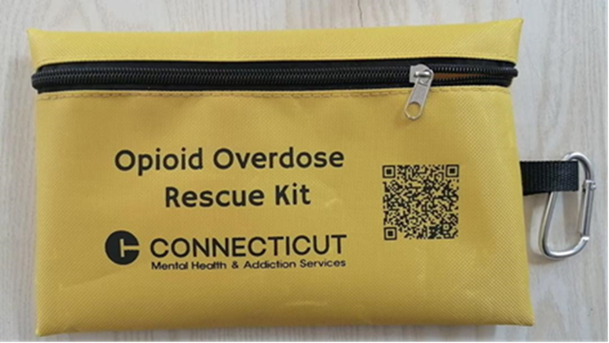
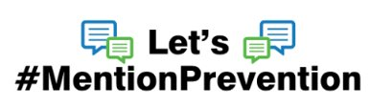
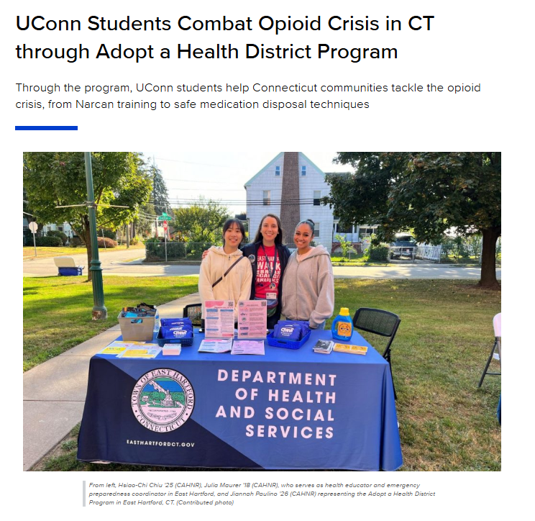
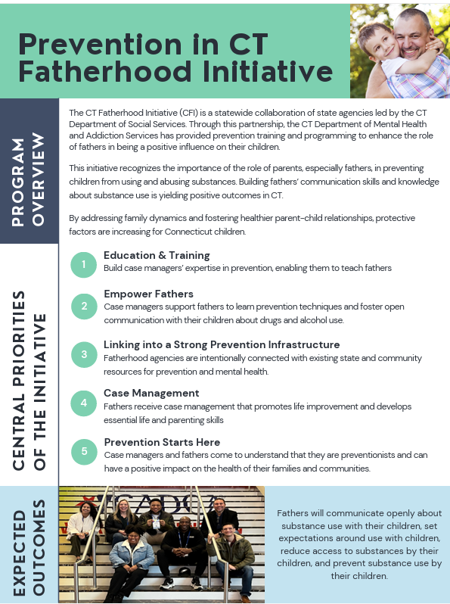
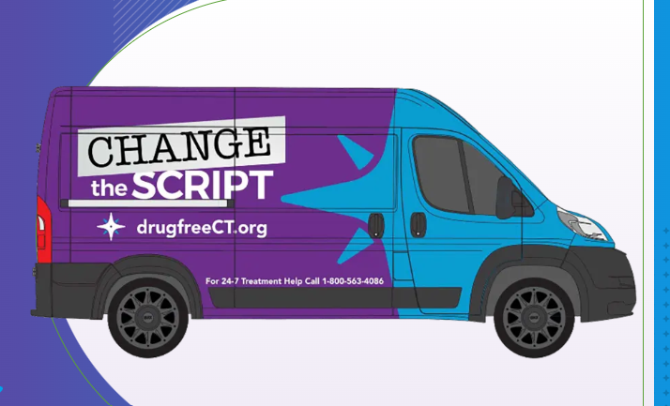
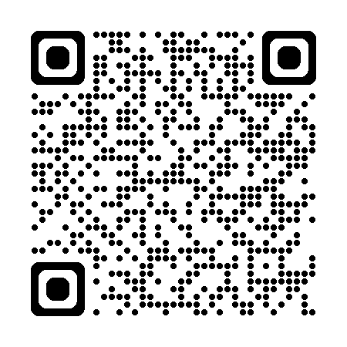
DMHAS Prevention Initiatives
Resources for Addiction Recovery | Drug Free CT
Building Resilient Communities Through Prevention
Mental Health and Addiction Services

Slide 8
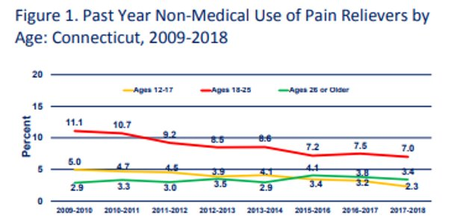
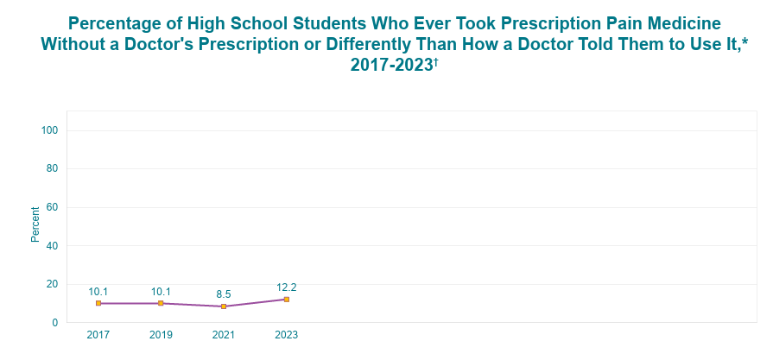

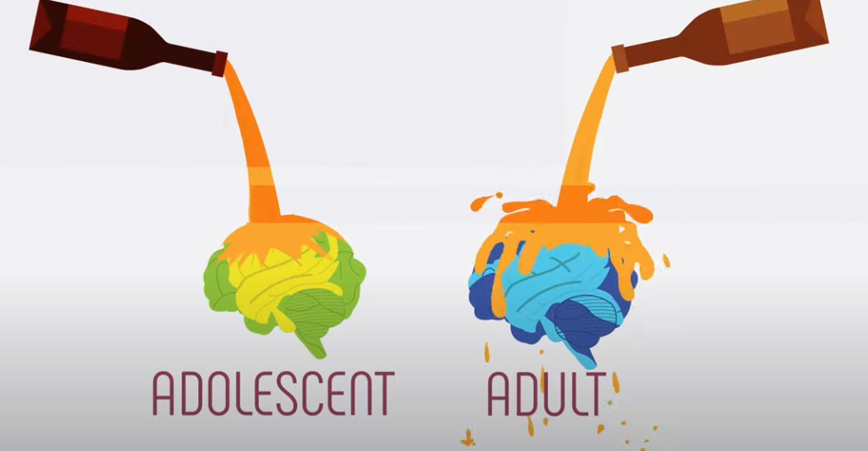
Why Prevention Matters
90% of those who have a substance use disorder started using drugs and alcohol before they turned 18.
Building Resilient Communities Through Prevention
Mental Health and Addiction Services

Slide 9
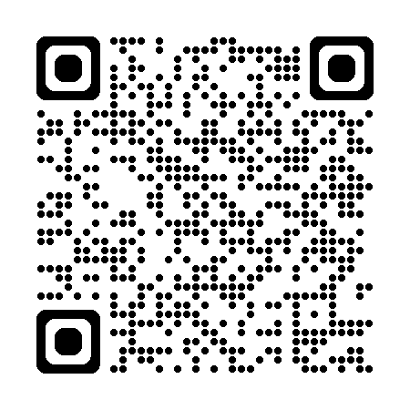
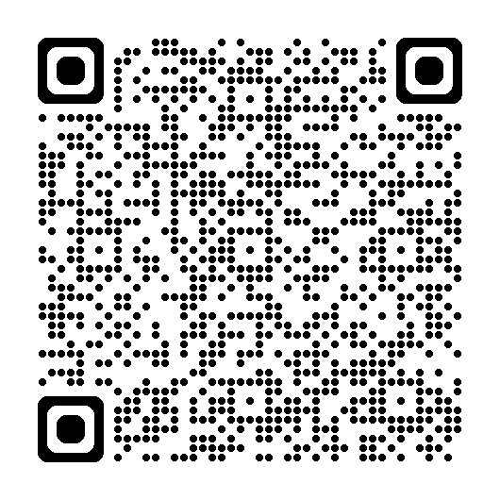
How is Data gathered and evaluated
Needs Assessments and Epidemiological Profiles
  Identifying priority issues, resources, and readiness within geographic regions to address gaps and needs.
Biennial Regional Priority Report Process 2025
  Alcohol, illicit opioids, vaping, cannabis
  Anxiety, depression
Measuring population level changes
  Prevalence vs. Incidence
  Rates of use, perceptions of harm, age of onset
  Changes in knowledge, attitudes, beliefs and skills
  Morbidity, mortality, treatment and referrals
  Identifying emerging issues and trends
Data collection
Analysis
Program Adjustment
Outcomes
Building Resilient Communities Through Prevention
Mental Health and Addiction Services

Slide 10
Challenges and Opportunities
Opportunity to braid prevention into other existing infrastructures- like the Prevention in Fatherhood model
Expansion of understanding the mental health-substance use paradigm
Building Resilient Communities Through Prevention
Mental Health and Addiction Services​

Slide 11
Sarju Shah, MPH
Division Director
Prevention & Health Promotion Division
Sarju.Shah@ct.gov
Mental Health and Addiction Services

