Slide 1
Opioid Settlement Fund
Update for OSAC
September 16, 2025
Mental Health and Addiction Services

Slide 2
As of the first week in September, the State has received a total of $161,184,046, with funding recommendations having passed for $110,818,461 leaving a balance in the fund of $50,365,858.
Budget Update
Mental Health and Addiction Services

Slide 3
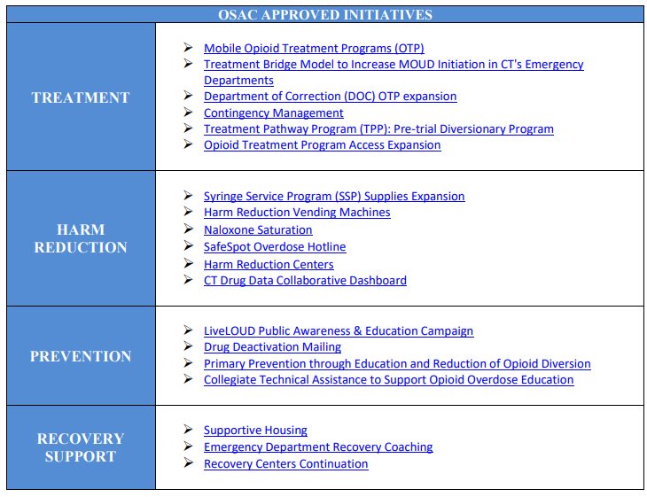
Mental Health and Addiction Services

Slide 4
Opioid Settlement Public Input on Funding of Initiatives to Combat the Opioid Crisis Summary
Report includes:
  High-level overview of the recommendation review process and progress
  Categorization of each recommendation received as of May 22, 2025
As of 5/22/25 a total of 178 recommendations were received and reviewed since October 2023
    33 recommendations were at least partially utilized for proposal development and approved by OSAC for implementation
    38 recommendations continue to undergo Subject Matter Expert review
    24 recommendations are not currently prioritized. These recommendations may be revisited in the future
    83 recommendations were not recommended to move forward for additional consideration
Available at https://portal.ct.gov/cosac
Mental Health and Addiction Services

Slide 5
Municipal Reporting—FY 25
Municipalities report on Opioid Settlement amounts received, expenditures, and process overview
Reporting portal opened on September 2
Submissions are due October 1, 2025
Survey link and previous year reports are available at https://portal.ct.gov/cosac
Mental Health and Addiction Services

Slide 6
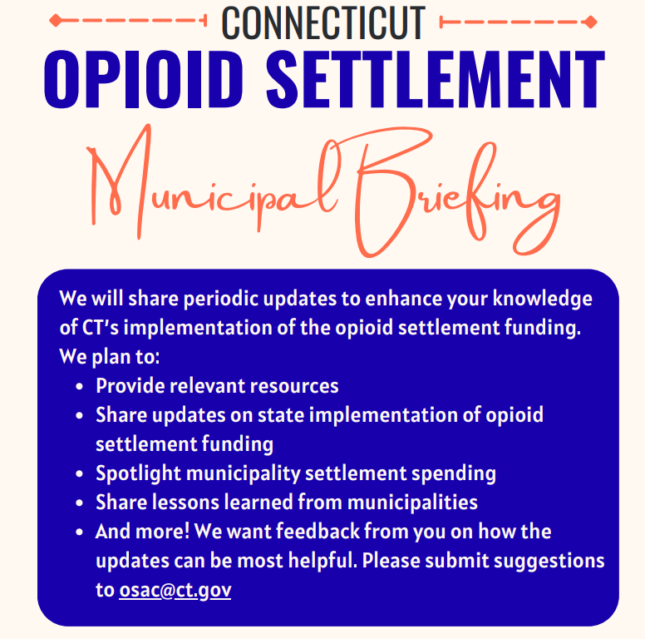
Mental Health and Addiction Services

Slide 7
Meeting Schedule
Survey sent to all members for feedback on a meeting schedule change
Majority voted to move to quarterly meetings with additional meetings scheduled as needed
New Schedule:
  2nd Tuesday of the following months from 10am-12pm:
    January 14
    April 14
    July 14
    October 13
Mental Health and Addiction Services

Slide 8
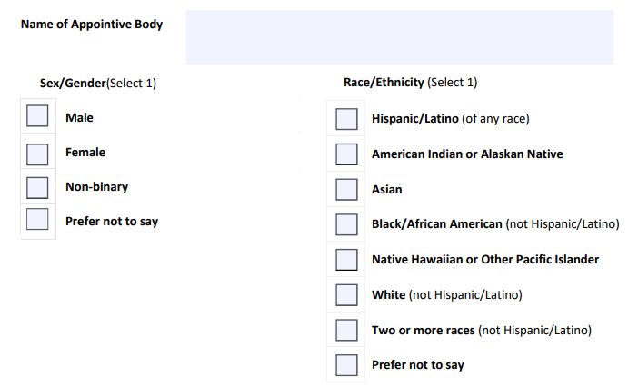
2025 Gender and Racial Composition Reporting
Connecticut law requires biannual data submission to the Secretary of the State concerning diversity in their appointed memberships
Form will be sent to all OSAC members for voluntarily completion
Questions are:
Mental Health and Addiction Services

Slide 9
COMING SOON!
CT Opioid Settlement Dashboard
Will be available at:
https://portal.ct.gov/cosac
Mental Health and Addiction Services

