Slide 1
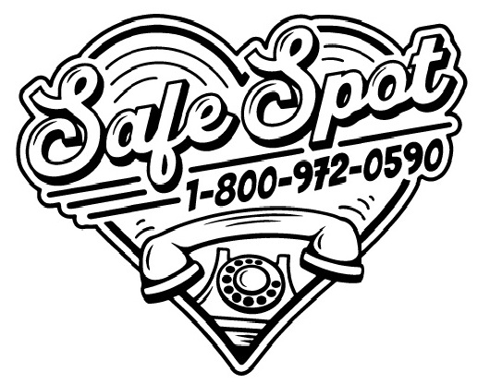
Stephen Murray, MPH, NRP
Director, SafeSpot Overdose Hotline

Slide 2
Over 63% of fatal overdoses in Connecticut happen in a private residence
Source: CT DPH 2022 Fact Sheet

Slide 3
Rationale for Virtual Overdose Prevention
Issue
Opioid-Related Overdose Deaths
Using substances alone is a major risk for overdose death.
Many PWUD are isolated socially and geographically
Opportunity
Opportunity to Engage with People who Use Alone
Offering safety and connection for isolated PWUD.
Engaging PWUD in overdose prevention, harm reduction, and access to services.
Need / Gap
Current Overdose Prevention is Insufficient!
Overdose decedents do not access treatment or harm reduction.
Naloxone only works if someone is present.
Consumption programs only help people living close by
Intervention
Tele Harm Reduction with Virtually Supervised Consumption
Free 24/7 helpline connects PWUD to trained operator and a safety plan. If a caller becomes non-responsive, the operator contacts a first responder.
Operators can connect PWUD to other services.
Notes:
c

Slide 4
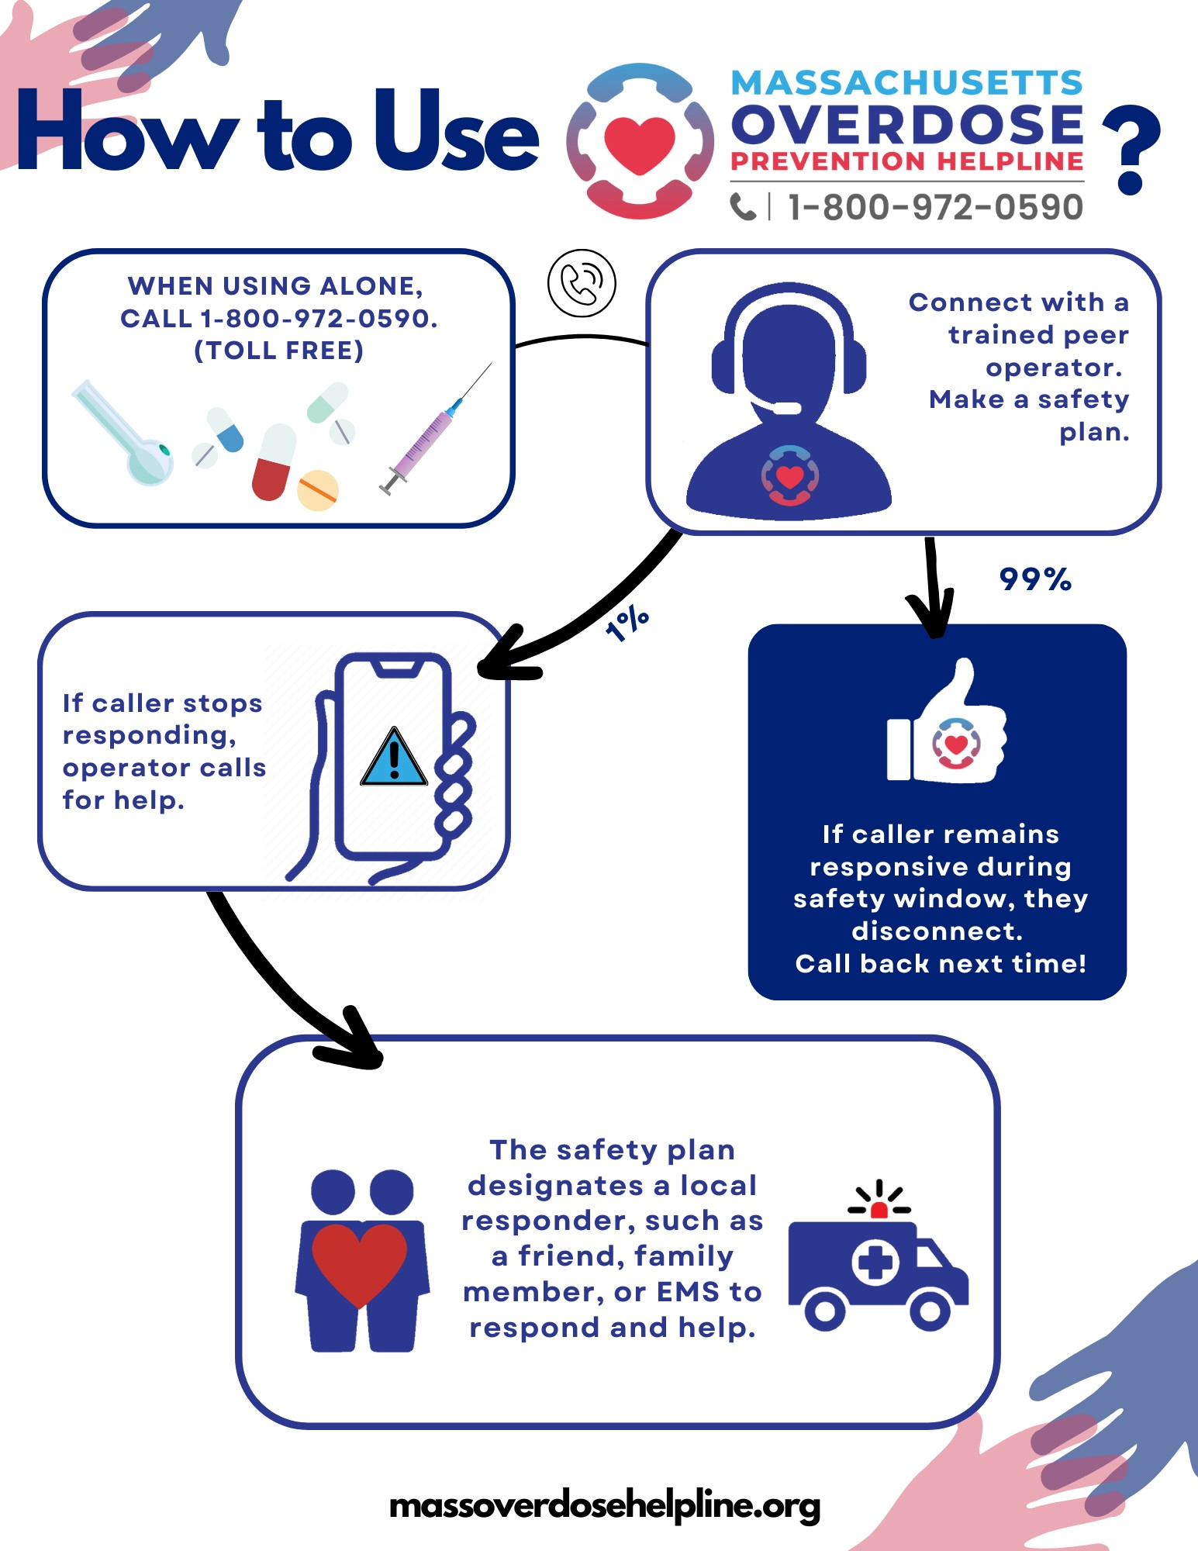
How does virtual spotting work?
If caller is going to be using alone and needs a spotter, call the 1-800 number
They are placed on hold until they can be connected with an operator/peer
Operator conducts a safety planning process including:
Name (doesn’t have to be real)
Substance / route being used (ex: IV fentanyl)
exact location, including address, door codes, apartment number, which room in the house they are in
Instructions to not sit up against a closed door
Lock up any pets
Hide any excess substances or paraphernalia in case of overdose
Most calls end without incident

Slide 5
Never Use Alone New England
Started March 2020
All volunteer (admin and operators)
Massachusetts Overdose Helpline
Received $100,000 RIZE funding in October 2022
Part time director salary and part time coordinator and paid training for all operators
SafeSpot
Received $350,000 in state funding from Massachusetts in August 2023
Full time director, call center coordinator, paid training and paid operators as of April 2024
Received $500,000/year for 2 years as of August 2024 for sustained project

Slide 6
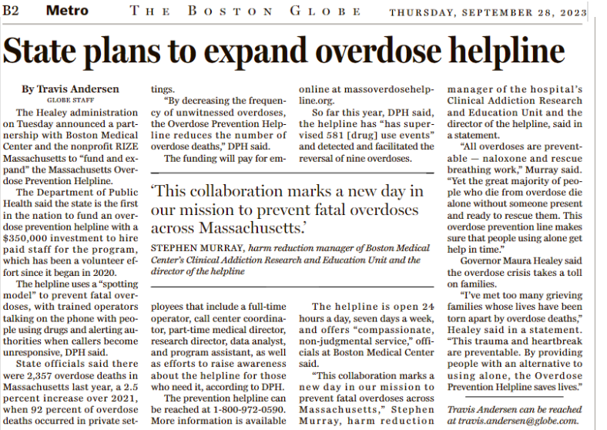

Slide 7
Engaging PWUD in Overdose Prevention
The key to successful overdose prevention training is to teach bystanders how to use naloxone and recognize the signs of an overdose, and to teach them how to identify the following risk factors:
Using alone
Using from a new source
Using after any period of abstinence:
Post-Incarceration
Post-Detox
Post-Residential Treatment
Poly-substance use (benzos, ETOH, stimulants)
Poor general health
Additives that may cause heightened reaction (xylazine)
Death or incarceration of an intimate partner
Unique domestic violence situations
People who use drugs where friends or family are unaware of use
People who use non-opioid drugs such as stimulants who may have a contaminated source
Adapted from: https://www.mass.gov/service-details/opioid-overdose-risk-factors
Notes:
It's important to also engage people in overdose prevention education, And so when you're handing out these kits, use this as an opportunity to engage the overdose survivor or their families. If you overdosed to revive you or call for help, whenever someone uses from a new source, they also are an increased risk after any period of abstinence, which we talked about earlier. So after, after they've been in incarceration, detox or residential treatment, or if they're using other sub says, along with it such as benzo stimulants or alcohol people who are in poor general health also are decreased risk and additives such as Xylazine have caused heightened reactions to have caused increased overdoses. There are some other sort of nontraditional things that we teach people to look out for, which is the death of an intimate partner. The incarceration of an intimate partner changes in housing status or returning home to parents or family. It's important that if people who use drugs are living with friends or family who unaware of their use to equip them with different tools, So that they can use in a safer way, such as using the brave app or Canary to alert someone offsite that they may have overdosed.

Slide 8
SCAN ME TO VIEW INSTRUCTIONAL VIDEO ON HOW TO USE AN OVERDOSE SAFETY HELPLINE

Slide 9
What data do we collect?
We do NOT store name or address
We do NOT collect age, DOB, gender, race/ethnicity
We do collect:
Use Events (how many times someone uses on the call)
Zip Code (for understanding how our marketing is working)
Type of Substance Used
Route of use
Hold time
Call outcome (Mark Safe vs Overdose vs Disconnect)
The service is anonymous and confidential, which makes it safe for employees alike

Slide 10
Data
Since Jan 2023
Over 4,400 calls
Over 10,500 use events supervised
21 overdoses
2,800 total hours spotting callers
Average call: 38 minutes
Average use per call: 1.94
Overdose rate by call outcome: 0.4%
Overdose rate by use event: 0.2%

Slide 11
We see a variety of types of use
Substances Used Category | count | % of Total
Alcohol | 28 | 0.3%
Opioids | 6461 | 61.6%
Stimulants | 2180 | 20.8%
Tranquilizers | 181 | 1.7%
Combination | 1234 | 11.8%
Other/Unknown | 405 | 3.9%
Total | 10489 | 100.0%
Route of Administration | Count | % of Total
Sniffing (intranasal) | 1046 | 10.0%
Smoking (inhalation) | 5382 | 51.3%
Under the tongue (sublingual) | 18 | 0.2%
Ingestion (swallowing) | 78 | 0.7%
Muscling (intramuscular) | 19 | 0.2%
Booty Bumping / Boofing (intrarectal) | 1004 | 9.6%
Injection (intravenous) | 2935 | 28.0%
Other | 5 | 0.0%
Unknown | 5 | 0.0%
Total | 10492 | 100.0%

Slide 12
Connecticut was our top state from August-October 2024
 | Count | % of Total
CT | 619 | 22.0%
WA | 559 | 19.8%
IA | 503 | 17.8%
OUT | 351 | 12.5%
VT | 345 | 12.2%
FL | 172 | 6.1%
TX | 67 | 2.4%
VA | 45 | 1.6%
MA | 36 | 1.3%
ID | 32 | 1.1%
TN | 15 | 0.5%
PA | 15 | 0.5%
IN | 15 | 0.5%
NY | 12 | 0.4%
CO | 8 | 0.3%
CA | 5 | 0.2%
NC | 5 | 0.2%
UNK | 4 | 0.1%
AZ | 3 | 0.1%
OR | 2 | 0.1%
MO | 2 | 0.1%
OH | 1 | 0.0%
DE | 1 | 0.0%
MD | 1 | 0.0%
MI | 1 | 0.0%
Grand Total | 2819 | 100.0%

Slide 13
Linkage to Care
Substance Use Helpline | 6
Crisis Hotline | 11
Community Outreach | 3
Counseling | 10
Substance Use Treatment | 6
Syringe Programs | 14
MOUD Referral | 2
Mail Naloxone | 14
Mail Testing Strips | 22
Other Services | 41

Slide 14
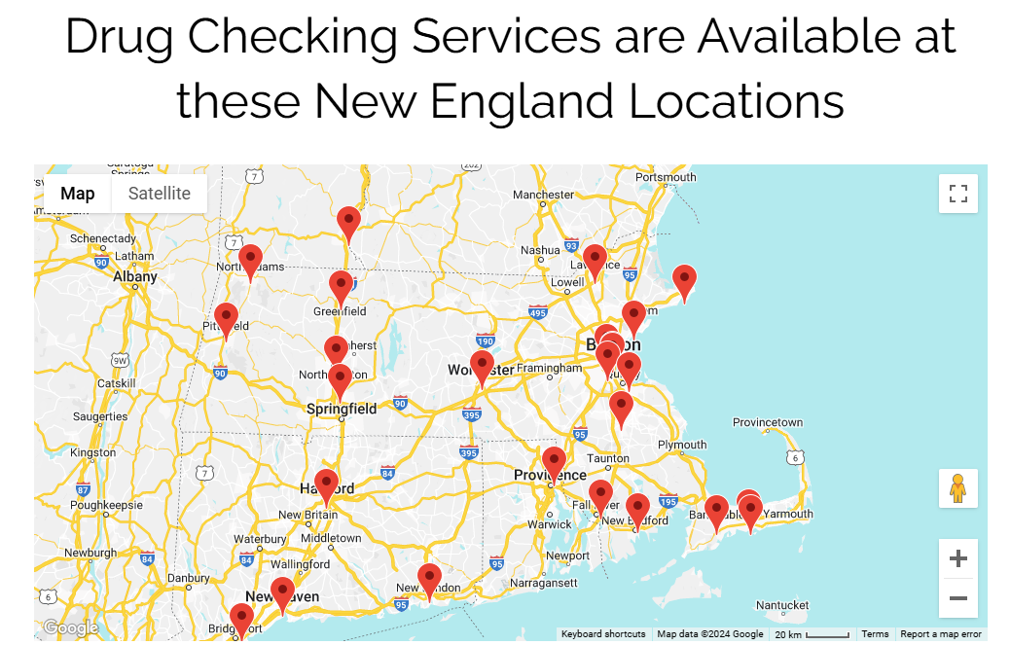

Slide 15
Some considerations for funding opportunities
While we serve a national audience, this is through organic growth and not at all targeted
Promotion of our line in your community without investment into the operation is detrimental to our long-term sustainability
Other states are having conversations with us about providing funding – we will partner with you to ensure that the workforce is reflective of your community

Slide 16
What we provide?
Unique phone number for you to promote in your state or community
Our 24/7 call center which ensures calls are answered, on average in 14 seconds
Training and Technical assistance for your outreach efforts as well as our logos and branding materials
Concerted hiring efforts to help develop your harm reduction workforce in your community

Slide 17
Implementation Timeline
We can launch a new phone number on the same day – it plugs directly into our current call center and you can start promoting it immediately
Recruitment in your state depends on interest level within your networks – hiring/onboarding is a 2-3 month process internally at BMC
Training takes about a week to complete
We work with you after that to develop your marketing materials and strategy

Slide 18
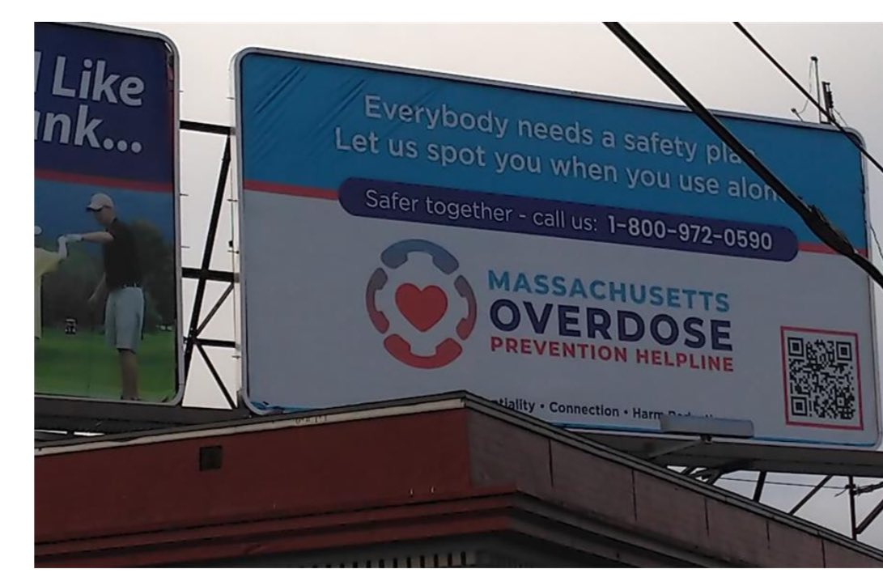
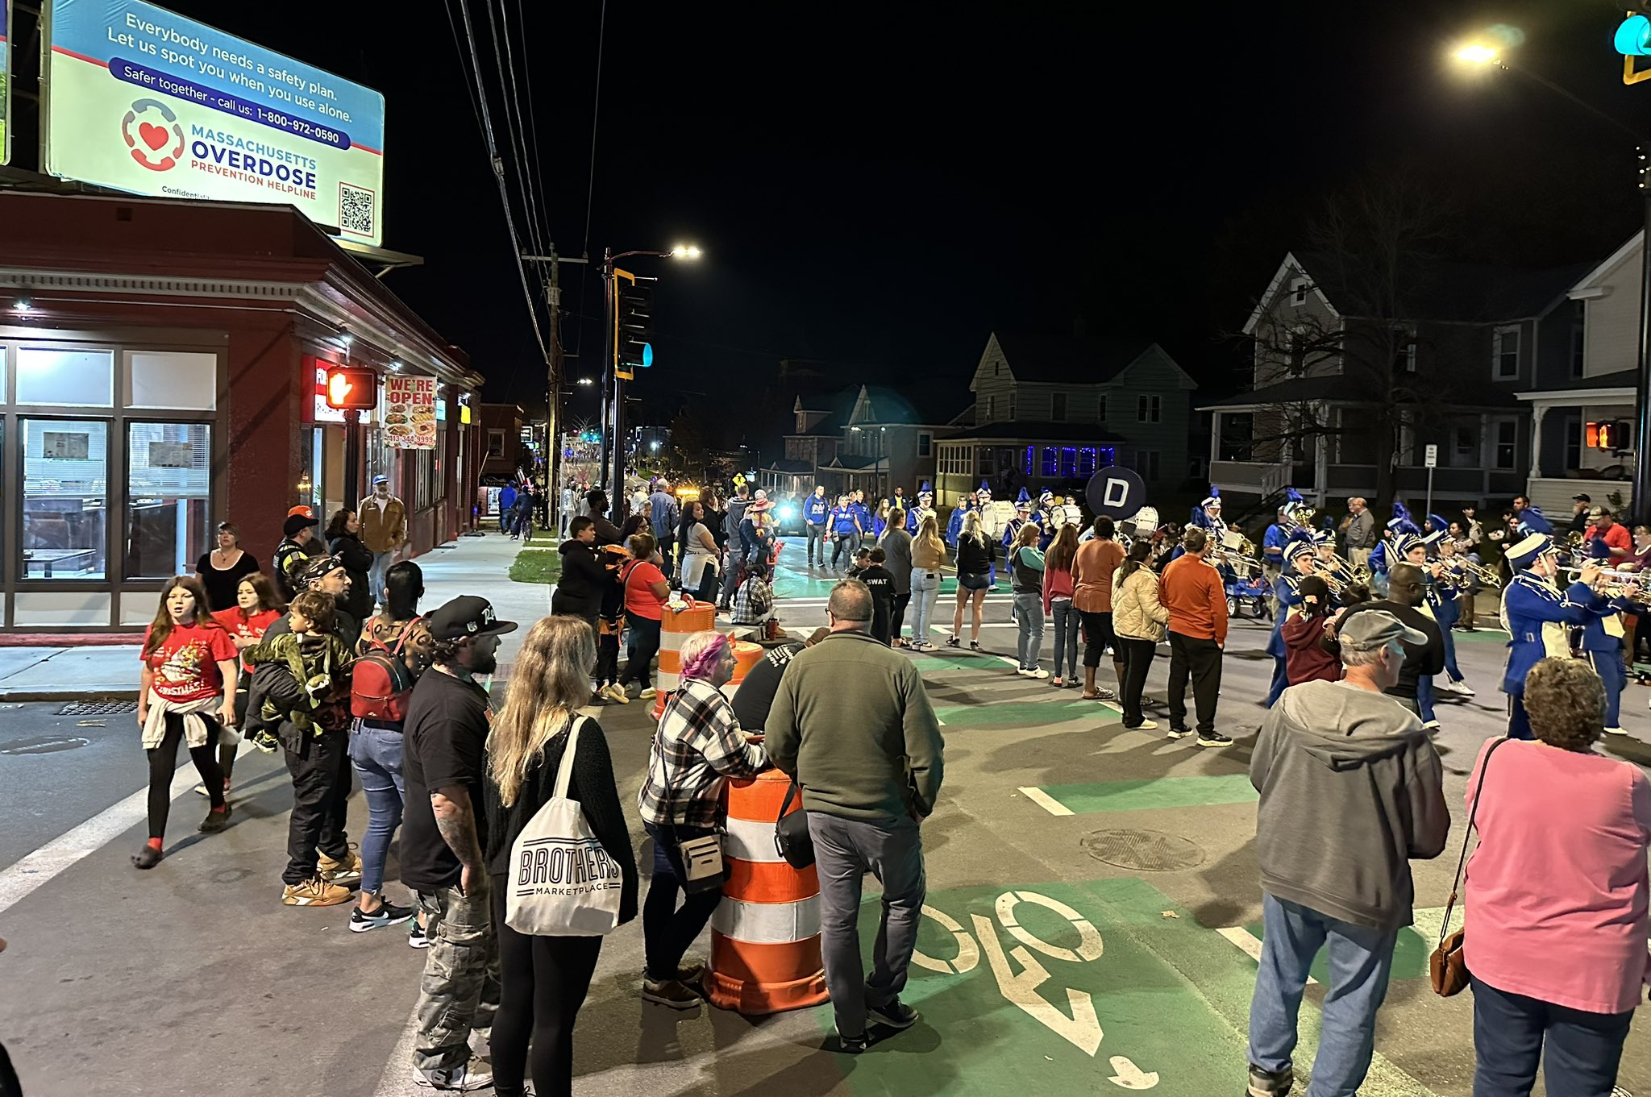
Marketing in 2023/2024
200,000 business cards and 1500 posters to 160 organizations across Massachusetts
Presented to 70 community coalitions and organizations
Billboards went up in 2 Berkshire County communities and in Franklin County

Slide 19
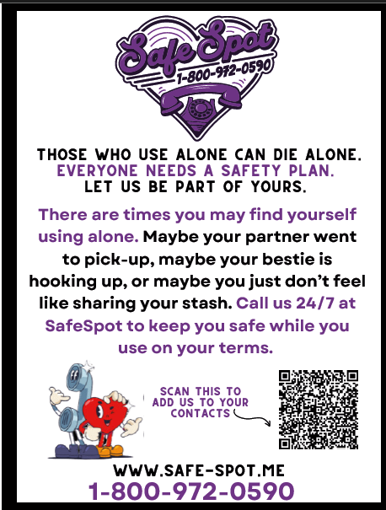
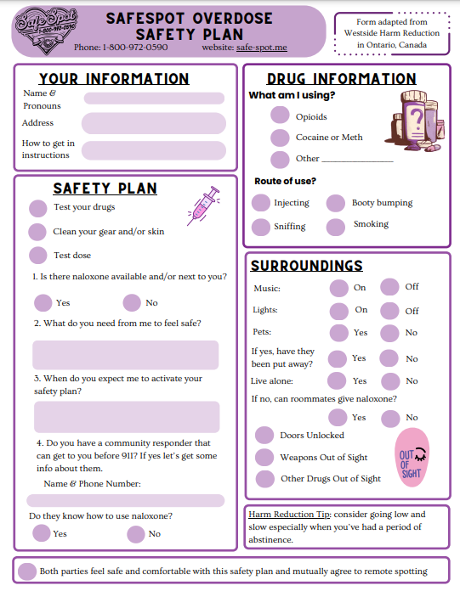

Slide 20
Please don’t hesitate to reach out: Stephen.Murray@bmc.org @StephenHRNRP /StephenHRNRP @stephenHRNRP.bsky.social

