Slide 1
Connecticut Opioid REsponse (CORE) Strategic Plan
March 11, 2023
Final Report Summary
Presenter: Benjamin Howell, MD, MPH, MHS

Slide 2
Overview
CORE Team
2024 CORE Report Funding Priorities
Guiding Frameworks
Methods
Priorities 1-7 Summaries
Appendices
Model Programs for OSAC To Highly Consider Funding to Replicate in Connecticut
Strategies that Should Not Receive Expanded Funding
Public Comments on the CORE Report Draft That Require Regulatory or Statutory Change

Slide 3
Overview
CORE Team
2024 CORE Report Funding Priorities
Guiding Frameworks
Methods
Priorities 1-7 Summaries
Appendices
Model Programs for OSAC To Highly Consider Funding to Replicate in Connecticut
Strategies that Should Not Receive Expanded Funding
Public Comments on the CORE Report Draft That Require Regulatory or Statutory Change

Slide 4
CORE Team
David Fiellin, MD
Ben Howell, MD, MPH
Emma Biegacki, MPH
Will Becker, MD
Gail D’Onofrio, MD, MS
Robert Heimer, PhD

Slide 5
Overview
CORE Team
2024 CORE Report Funding Priorities
Guiding Frameworks
Methods
Priorities 1-7 Summaries
Appendices
Model Programs for OSAC To Highly Consider Funding to Replicate in Connecticut
Strategies that Should Not Receive Expanded Funding
Public Comments on the CORE Report Draft That Require Regulatory or Statutory Change

Slide 6
2024 CORE Report Funding Priorities:
Guiding Frameworks
Exhibit E List of Opioid Remediation Use
Principles for the Use of Funds from the Opioid Settlements
Spend Money to Save Lives
Use Evidence to Guide Spending
Invest in Youth Prevention
Focus on Racial Equity
Develop a Fair and Transparent Process
Notes:
https://opioidprinciples.jhsph.edu/the-principles/
https://portal.ct.gov/-/media/DMHAS/UpcomingEvents/Exhibit-E-Final-Distributor-Settlement-Agreement-8-11-21.pdf

Slide 7
Overview
CORE Team
2024 CORE Report Funding Priorities
Guiding Frameworks
Methods
Priorities 1-7 Summaries
Appendices
Model Programs for OSAC To Highly Consider Funding to Replicate in Connecticut
Strategies that Should Not Receive Expanded Funding
Public Comments on the CORE Report Draft That Require Regulatory or Statutory Change

Slide 8
Methods
Review of progress on 2016 report recommendations
Updates on progress to-date, available data
Literature Review
Review of efforts in other states
Key informant discussions and consultations
Draft report released for comment in September, comments reviewed and report revised

Slide 9
Overview
CORE Team
2024 CORE Report Funding Priorities
Guiding Frameworks
Methods
Priorities 1-7 Summaries
Appendices
Model Programs for OSAC To Highly Consider Funding to Replicate in Connecticut
Strategies that Should Not Receive Expanded Funding
Public Comments on the CORE Report Draft That Require Regulatory or Statutory Change

Slide 10
2024 CORE Report Funding Priorities
Increase Access to the Most Effective Medications (Methadone and Buprenorphine) for Opioid Use Disorder Across Diverse Settings
Reduce Overdose Risk and Mortality, Especially Among Individuals at Highest Risk and Highest Need with Linkage to Treatment, Naloxone, and Harm Reduction
Improve the Collection, Analysis, Sharing, and Use of Data Across Agencies and Organizations Relevant to Addressing the Opioid Overdose Crisis
Invest in Training and Support to Increase the Size of the Addiction Workforce and Help Non-Specialists to Provide Services
Simultaneously Deploy and Evaluate Select Primary, Secondary, and Tertiary Prevention Strategies
Invest in Efforts to Reduce Community Stigma Against Opioid Use Disorder and Opioid Use Disorder Treatments
Address Social Determinants and Structural Needs of At-Risk and Impacted Populations

Slide 11
Priority 1: Increase Access to the Most Effective Medications (Methadone and Buprenorphine) for Opioid Use Disorder Across Diverse Settings
Strategy #1: Strategically expand methadone and buprenorphine via federally certified OTPs.
Strategy #2: Increase provision of MOUD in EDs and hospitals.
Strategy #3: Increase availability of buprenorphine in office-based settings of primary care and behavioral health, federally qualified health centers, hospital-based clinics, recovery support services, and harm reduction services.
Strategy #4: Ensure access to all FDA-approved medications for OUD for people incarcerated in and transitioning out of DOC.
Notes:
The number of individuals receiving methadone increased in the state substantially between 2012 (14,000) and 2017 (21,000), with minimal increases since that time. Similarly, the estimated number of individuals receiving buprenorphine increased in the state substantially between 2015 (21,000) and 2020 (30,000), with only modest increases since that time. There is less data on the proportion of people who are retained on either methadone or buprenorphine long-term. Nonetheless, the rising number of opioid overdoses indicates there is an unmet need for these treatments in the state. Unmet need includes individuals who use opioids or have OUD and are at risk of overdose but have not initiated MOUD, and individuals who have initiated MOUD but were not retained in treatment. There are also geographic, socioeconomic, and racial disparities in access to methadone and buprenorphine within the state. Methadone, limited to federally certified OTPs, is largely concentrated in our state’s urban centers and several portions of the state have few or very limited number of active buprenorphine prescribers.

Slide 12
Priority 1 continued: Increase Access to the Most Effective Medications (Methadone and Buprenorphine) for Opioid Use Disorder Across Diverse Settings
Strategy #5: Ensure access to methadone or buprenorphine for people engaging in inpatient or residential addiction treatment services.
Strategy #6: Provide services to improve access to MOUD (methadone and buprenorphine) and retention in MOUD across all settings via provision of community-tailored, culturally responsive, and trauma informed models, especially for populations with unique needs (e.g. psychiatric comorbidity) and those at high risk for overdose but not currently engaging in MOUD treatment, and particularly where evidence that tailored services improve outcomes such as retention and mortality.

Slide 13
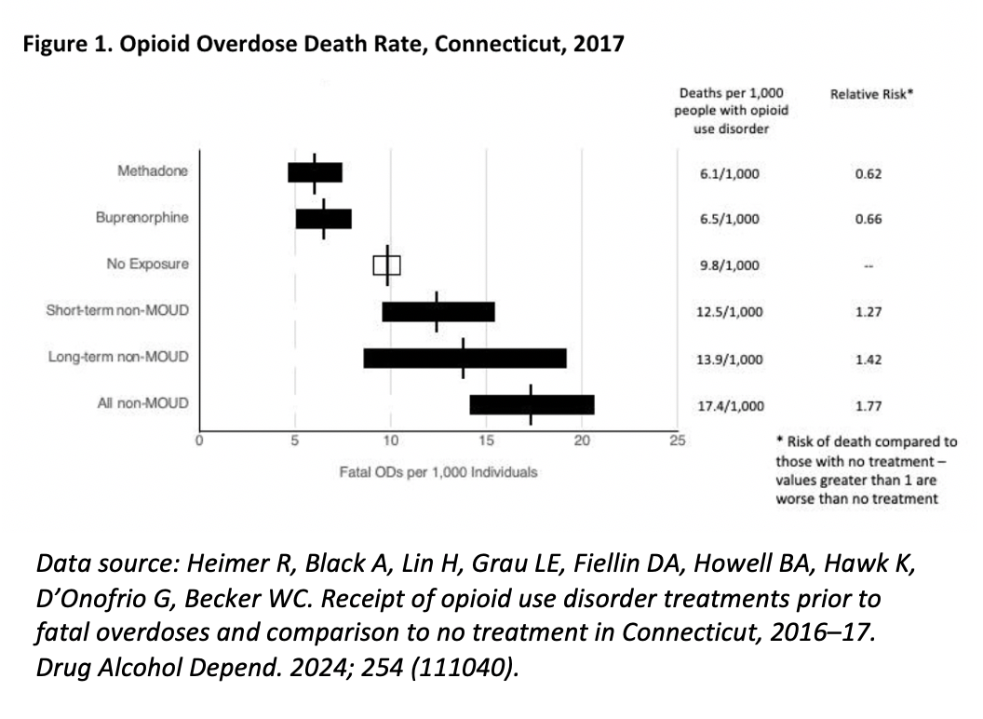
Which treatments decrease risk of fatal overdose in Connecticut?
Notes:
Data provided by Hsiu-ju
As of 2019, an estimated 0.6% of the CT population aged 12 and older have an opioid use disorder diagnosis.
1.7% of youth 18-25

Slide 14
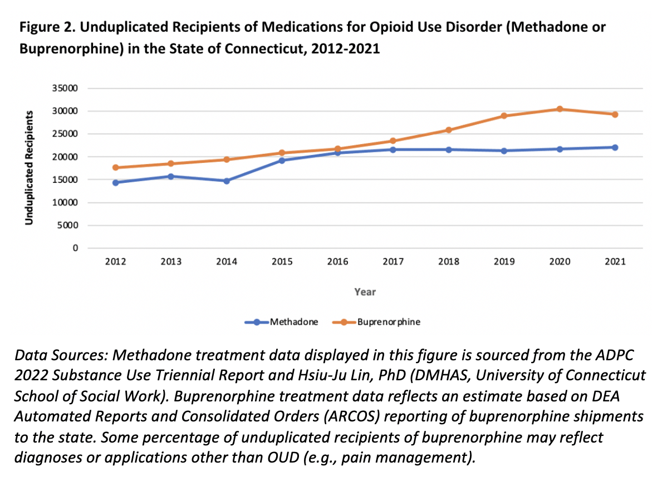
Methadone and Buprenorphine Access 2012-2021
Notes:
Data provided by Hsiu-ju
As of 2019, an estimated 0.6% of the CT population aged 12 and older have an opioid use disorder diagnosis.
1.7% of youth 18-25

Slide 15
Priority 2: Reduce Overdose Risk and Mortality, Especially Among Individuals at Highest Risk and Highest Need with Linkage to Treatment, Naloxone, and Harm Reduction
Strategy #1: Increase use of naloxone, drug supply testing, and syringe service programs.
Strategy #2: Create harm reduction centers that provide ancillary support services for people using drugs.
Strategy #3: Reduce solitary opioid use.
Strategy #4: Reduce unanticipated exposure to opioids among opioid-naïve individuals who use drugs.
Notes:
Although opioid-involved non-fatal overdoses in CT have been recorded in the thousands and every municipality in the state except two have experienced fatalities, the burden falls mostly heavily on specific cities and specific vulnerable groups of CT residents. Reviewing the scientific literature and CT-specific data, we conclude that efforts to reduce overdoses will have the greatest impact if strategies are focused on Individuals who:
have recently experienced a non-fatal overdose;
use opioids alone;
have a history of OUD and have lost tolerance to opioids;
are opioid-naïve or have low tolerance and are purchasing illicit stimulants that include fentanyl; and/or
are unhoused or marginally housed.

Slide 16
Priority 3: Improve the Collection, Analysis, Sharing, and Use of Data Across Agencies and Organizations Relevant to Addressing the Opioid Overdose Crisis
Strategy #1: Develop and report high-priority metrics pertinent to reducing overdoses and overdose mortality in Connecticut.
Strategy #2: Improve access to, analysis of, and timely reporting of existing data pertinent to reducing overdoses in the state.
Strategy #3: Develop metrics, benchmarks, and reporting systems for programs focused on reducing overdose deaths in the state, especially those funded by opioid settlement funds.
Notes:
The COVID-19 pandemic has demonstrated the need for and value of a rapid and efficient process of collecting, accessing, analyzing, and reporting data for a coordinated public health response. The same approach is needed to address the opioid overdose crisis. Important data relevant to addressing opioid overdoses includes existing data collected by state agencies (e.g., admissions into addiction treatment, opioid prescribing, use of harm reduction services, fatal and non-fatal overdoses). Confidentially tracking how individuals at risk of opioid overdose are interacting with various systems and subsequent overdose outcomes can only be elucidated by linking and merging individual existing data that currently exist across different agencies within the state. A robust data infrastructure accessible to policy makers, public health professionals, clinicians, and researchers able to produce reliable metrics pertinent to preventing overdoses can support evaluation of existing and novel programs and in so doing ensure effective, data-driven funding allocation.

Slide 17
Merged & Linked Data
DMHAS
(substance use treatment episodes)
DOC
(incarceration)
OCME
(fatal ODs)
DCP/CPRMS
(controlled substance prescriptions)
Merged & linked dataset
CHIME
(fatal & non-fatal ODs)
DSS/Medicaid
(claims data)
¹Becker WC, Heimer R, Dormitzer CM, Doernberg M, D’Onofrio G, Grau LE, Hawk K, Lin HJ, Secora AM, Fiellin DA. Merging statewide data in a public/university collaboration to address opioid use disorder and overdose. Addiction science & clinical practice. 2021 Dec;16(1):1-7.

Slide 18
Priority 4: Invest in Training and Support to Increase the Size of the Addiction Workforce and Help Non-Specialists Provide Services
Strategy #1: Grow the addiction specialty workforce in Connecticut.
Strategy #2: Improve non-specialist addiction training within the medical, mental health, and behavioral health care workforce.
Strategy #3: Increase the harm reduction workforce in Connecticut.
Notes:
Workforce: An increase in the number of certified addiction specialists (nursing, social work, physicians, etc.) will have an immediate impact on access to and the quality of treatment for CT residents. Programs to train and support non-specialist clinicians should provide timely improvements, too, particularly with respect to provision of MOUD in general medical settings.
Stigma: Public awareness of and education about OUD among healthcare professionals and the public have not been tied directly to lives saved or cost-effectiveness. However, as above, they are generally considered essential components of successful public health campaigns and may drive long-term improvements in treatment initiation, retention, and acceptability.

Slide 19
Priority 5: Simultaneously Deploy and Evaluate select primary, secondary, and tertiary prevention strategies
Primary Prevention
Strategy #1: Fund primary prevention of opioid use among youth
Strategy #2: Expand access to programs that address social determinants of health and community mental health to decrease opioid initiation and progression to OUD
Strategy #3: Support safe opioid prescribing, limit diversion of prescription opioids, and decrease the transition to OUD in those receiving chronic long-term opioids
Secondary Prevention
Strategy #4: Expand access to MOUD treatment with special attention to access for youth and young adults and individuals with co-occurring psychiatric disorders.
Strategy #5: Provide multimodal chronic pain treatment.
Strategy #6: Prevent injection-related infections.
Tertiary Prevention
Strategy #5: Expand access to naloxone, syringe services, and other harm reduction services
Notes:
Public health efforts to address the opioid overdose crisis can be categorized as primary, secondary, or tertiary prevention. Primary prevention focuses on averting the developing disease and, in the case of the opioid overdose crisis, targets preventing initiation of use of nonprescribed opioids or development of opioid use disorder. Secondary prevention focuses on early identification of people at risk for injury and can be thought of as efforts to prevent progression of use of nonprescribed opioids to opioid use disorder or early treatment for people with opioid use disorder prior to experiencing an overdose. Tertiary prevention attempts to attenuate the consequences of advanced disease and in the context of the opioid overdose crisis can include efforts to reduce the fatality of overdose events, reduce harms associated with opioid use in people who use opioids, and provide low barrier treatment to opioid overdose survivors. Primary prevention efforts are appealing as they can have important long-term benefits, but they require targeting a large number of individuals without opioid use disorder to effectively reduce overdose risk. Secondary and tertiary efforts are appealing because they target the small number of people who are at highest risk of overdose, but often require a larger per-person investment of resources to be effective.

Slide 20
Priority 6: Invest in Efforts to Reduce Community Stigma Against Opioid Use Disorder and Opioid Use Disorder Treatments
Strategy #1: Expand educational efforts regarding substance use, OUD, MOUD, and harm reduction strategies, to increase dissemination of accurate, evidence-based, non-stigmatizing information among health professionals and the public.
Strategy #2: Increase targeted educational efforts regarding substance use, OUD, and MOUD, and harm reduction to increase dissemination of accurate, evidence-based, non-stigmatizing information for individuals who interact with PWUD and those with SUD, including, but not limited to, health professionals (doctors, nurses, pharmacists, etc.) and first responders (police officers, fire fighters, EMS).

Slide 21
Priority 7: Address Social Determinants and Structural Needs of At-Risk and Impacted Populations
Strategy #1: Ensure that all individuals at risk for overdose have access to comprehensive social wraparound services including transportation, insurance, employment services, and childcare.
Strategy #2: Ensure that individuals at risk of overdose engaging in addiction treatment have access to behavioral health services including low-barrier psychiatric care.
Strategy #3: Provide affordable supportive and transitional housing for people with SUD
Notes:
Disparities in social, economic, and environmental determinants of health exacerbate adverse outcomes of substance use, including overdose mortality, and create barriers to addiction treatment, pointing to a need for interventions that address these determinants.^{68,69} In CT, the largest number of deaths and greatest burden of opioid-related morbidity is in urban centers and disproportionately falls on racially and ethnically minoritized communities; the unhoused, unemployed, and uninsured; individuals who are or were recently incarcerated; and individuals residing in geographic areas with limited access to healthcare services. Applying a health equity lens to addressing the overdose crisis and prioritizing upstream, structural solutions can meaningfully reduce morbidity and mortality, improve access to and retention in treatment, and be cost-effective in the long-term.

Slide 22
Overview
CORE Team
2024 CORE Report Funding Priorities
Guiding Frameworks
Methods
Priorities 1-7 Summaries
Appendices
Model Programs for OSAC To Highly Consider Funding to Replicate in Connecticut
Strategies that Should Not Receive Expanded Funding
Public Comments on the CORE Report Draft That Require Regulatory or Statutory Change

Slide 23
Appendix A: Model Programs for OSAC To Highly Consider Funding to Replicate in Connecticut
CA Bridge
Lifeskills Training and Project Toward No Drug Abuse
Maryland Addiction Consultation Service (MACS)
Massachusetts Chapter 55 Public Health Data Warehouse
Multidimensional Family Therapy Helping Youth and Parents Enter Recovery Treatment Model (MDFT-HYPE Recovery)
OnPoint NYC
Physician Clinical Support System-Medications for Opioid Use Disorder (PCSS MOUD)
Project ASSERT
Project ECHO
Recovery Support Services
U.S. Department of Veterans Affairs Housing First Initiatives
Vermont Hub and Spoke Model
Notes:
Disparities in social, economic, and environmental determinants of health exacerbate adverse outcomes of substance use, including overdose mortality, and create barriers to addiction treatment, pointing to a need for interventions that address these determinants.^{68,69} In CT, the largest number of deaths and greatest burden of opioid-related morbidity is in urban centers and disproportionately falls on racially and ethnically minoritized communities; the unhoused, unemployed, and uninsured; individuals who are or were recently incarcerated; and individuals residing in geographic areas with limited access to healthcare services. Applying a health equity lens to addressing the overdose crisis and prioritizing upstream, structural solutions can meaningfully reduce morbidity and mortality, improve access to and retention in treatment, and be cost-effective in the long-term.

Slide 24
Appendix B: Strategies that Should Not Receive Expanded Funding
Increasing the proportion of individuals with OUD exclusively receiving “detoxification” or inpatient and residential services as a treatment for OUD
Increasing the number of programs that exclusively or preferentially treat people with naltrexone (instead of methadone or buprenorphine)
Enhancing criminal legal efforts to reduce illicit drug supply
Increasing use of mandated addiction treatment or civil commitment
Increasing investment in novel formulations or new medications to reverse opioid overdoses
Funding primary prevention programs targeting youth substance use that are not based on evidence of efficacy or are not tied to ongoing rigorous evaluation
Funding public health programs that are not based on evidence of efficacy
Notes:
Disparities in social, economic, and environmental determinants of health exacerbate adverse outcomes of substance use, including overdose mortality, and create barriers to addiction treatment, pointing to a need for interventions that address these determinants.^{68,69} In CT, the largest number of deaths and greatest burden of opioid-related morbidity is in urban centers and disproportionately falls on racially and ethnically minoritized communities; the unhoused, unemployed, and uninsured; individuals who are or were recently incarcerated; and individuals residing in geographic areas with limited access to healthcare services. Applying a health equity lens to addressing the overdose crisis and prioritizing upstream, structural solutions can meaningfully reduce morbidity and mortality, improve access to and retention in treatment, and be cost-effective in the long-term.

Slide 25
Appendix C: Public Comments on the CORE Report Draft That Require Regulatory or Statutory Change
Regulatory and Statutory Change to Improve Methadone Access
Overdose Prevention Centers
Insurance Reimbursement and Billing Codes from Medicaid and Other Insurers
Treatment and service provider practices

Slide 26
Discussion
Further questions and requests for our team relevant to the 2024 CORE Strategic Plan Update may be directed to Emma Biegacki, MPH, at emma.biegacki@yale.edu.

