Slide 1




January 9th, 2024

Slide 2


Slide 3
HARM REDUCTION

Slide 6







Slide 7



Slide 8


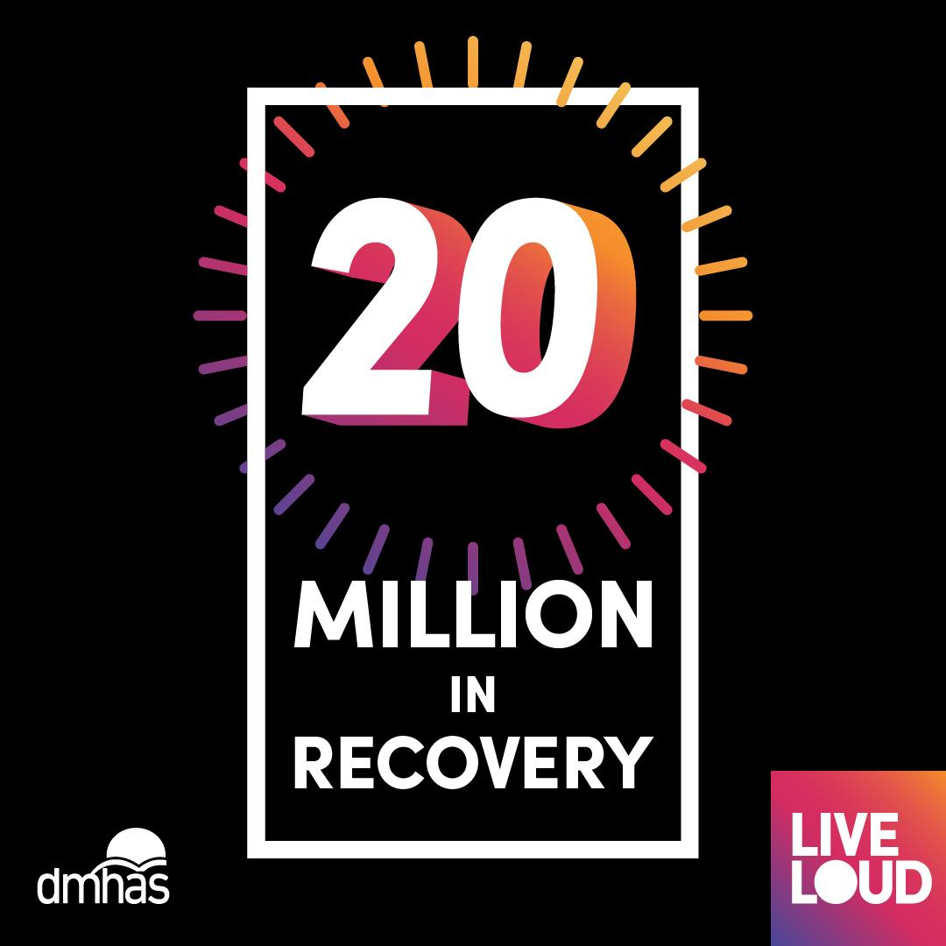

Slide 9
Next Steps
LiveLOUD.org

