Slide 1
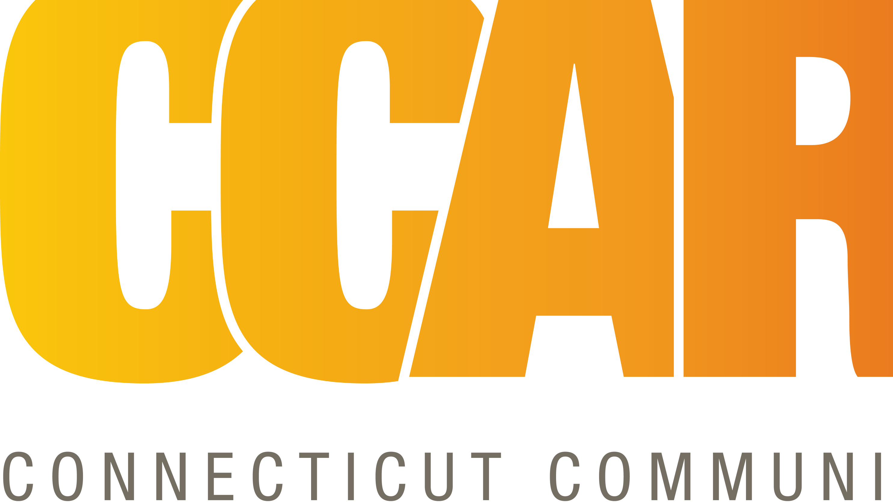
Young people and family services
Connecticut community for Addiction Recovery

Slide 2

CCAR Vision & Mission
CAR’s Vision:
"The Connecticut Community for Addiction Recovery (CCAR) envisions a world where the power, hope, and healing of recovery from alcohol and other addictions is thoroughly understood and embraced.”
CCAR’s Mission:
Put a face on recovery, and
Provide recovery support services and promote recovery from alcohol and other addictions through advocacy, education, and service.
CCAR strives to end discrimination surrounding addiction and recovery, open new doors and remove barriers to recovery, maintain and sustain recovery regardless of the pathway, all the while ensuring that all people in recovery, and people seeking recovery, are treated with dignity and respect.

Slide 3
The Young People and Family Services Program (YPFS) Mission and vision statement
YPFS Mission Statement
The mission of CCAR’s Young People and Family Services is to provide direct, recovery-focused support to individuals ages 18–32 and their families affected by addiction. Through both innovative and evidence-based practices, we utilize CCAR Recovery Community Centers to offer individualized and group-based services that foster healing, connection to sustain long-term recovery.
Vision Statement
We envision a world where every young person and family member impacted by addiction can access vibrant and engaging recovery support services that empower lasting, long-term recovery.

Slide 4

Foundational principles
Recovery First!
You are in recovery if you say you are.
There are many pathways to recovery.
Focus on the recovery potential, not the pathology.
Err on the side of the recoveree.
Err on the side of being generous.
Recovery Community – Individuals in Recovery, Family, Friends, and Allies

Slide 5
How does CCAR support young people in recovery?
Support and introduce the ‘many pathways of recovery’
Gives opportunity for young people to volunteer (give back)
Attract people in recovery, family members, friends, and allies to provide Recovery Support Services.
Every YPFS Champion is welcomed with…
HOW CAN WE HELP YOU WITH YOUR RECOVERY TODAY?
We connect with asking…
WHAT DOES RECOVERY LOOK LIKE FOR YOU?

Slide 6
The Young People and Family Services Program (YPFS) follows the CCAR recovery coach model
Research shows trained peers with shared experiences have a higher success rate at engaging individuals in need of help.
Work with people affected by substance use disorders/ co-occurring
Coaches don’t diagnose or treat addiction.
Focus on the future; they do not explore past feelings or trauma.
Help with decision making, plans towards recovery that will improve lives, one step at a time.
Provide support in following through.
Knowledgeable about “multiple pathways” of recovery and local resources

Slide 7
Young people and family services (YPFS)
Young People and Family Services Peer-run “All Recovery Meetings” (ARM)
Provide a variety of engagement activities such as recovery games, Nintendo challenges, yoga, arts and crafts, crocheting, gardening, sound healing, etc.
Getting involved with the larger “Recovery Community”, building a support system, connecting to community resources
Telephone Recovery Support/Recovery Coaching, a volunteer-based program that provides a weekly connection through call or text
YPFS Family, Friends, and Allies are all supported through the program. Contact TJ@ccar.us for more information.

Slide 8
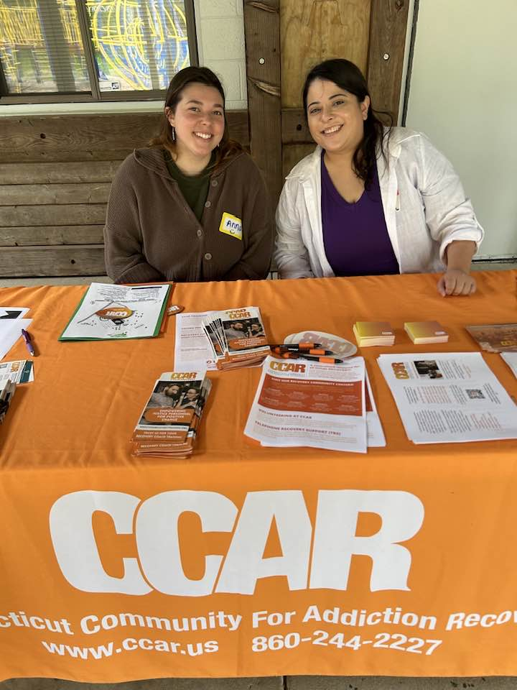



Atmosphere
Place of belonging
Inclusion
New Beginning/Second Chance
Supportive
Hope
Healing
Faith
Positive
LOVE

Slide 9
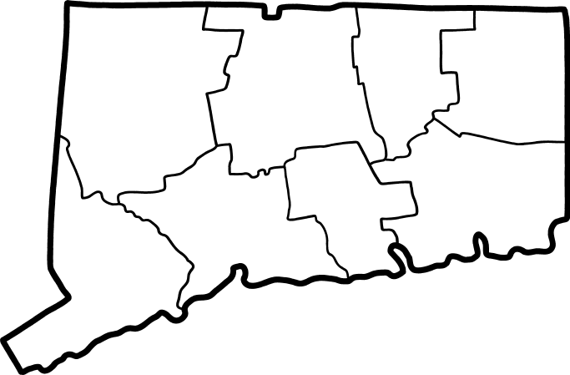
Young People and Family Services are embedded in each one of the CCAR recovery community centers. In-person services can be accessed at the following locations.
Bridgeport
Hartford
New Haven
Torrington
Waterbury
Willimantic
Danbury
New London

Slide 10
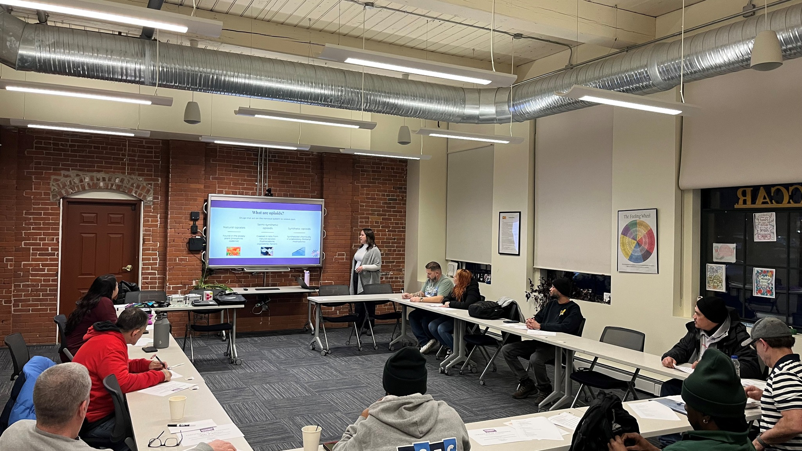
QUESTIONS?

