Slide 1


Take a trip on the
ACCESS LINE

Slide 2
Access Line
Calls are received 24 hours per day/ 7 days per week/ 365 days per year
Connection to withdrawal management/detox, medication assisted treatment (MAT), substance use residential treatment and assessment centers
Facilitates transportation to withdrawal management, DMHAS substance use disorder residential treatment and recovery houses
Provides general resource education
Provides coaching and guidance on the recovery process

Slide 3
Access Line Stats
Operates 24 hours a day-7 days per week
~3000 calls per month
~200 connections to WM beds per month
~300 transports coordinated per month
~400-500 info/resources calls per month

Slide 4
How Access Line Works
Call our toll free 24/7 number – 1-800-563-4086
Experienced Peer Recovery Telephone Specialists will assist each call
Access Line staff make direct contact with DMHAS funded facilities to determine bed availability based on the caller’s identified needs and screening completed by Access Line staff
When a Withdrawal Management Bed is available, Access Line Staff will conduct a three (3) way conference call with the facility to complete the admission screening
Access Line staff answer questions for providers and family members/concerned others about available levels of care and community resources for individuals and families dealing with substance use and mental health related challenges

Slide 5

How Access Line Works Con’t.
Once the caller has been screened and accepted at a facility, Access Line staff contacts the regional transportation providers and makes the necessary arrangements for transportation.
The caller must be ready to go at the time that transportation is confirmed and must have access to a phone
Active Rescues

Slide 6
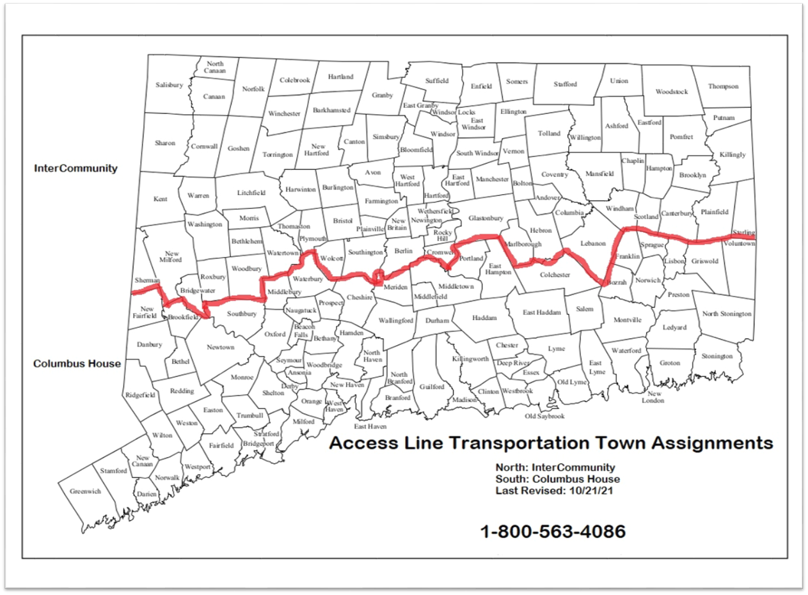
Transportation
North - InterCommunity
South – Columbus House, Road to Recovery

Slide 7

Access Line
1-800-563-4086
Access line is advertised:
DMHAS website Transportation
Wheeler website www.wheelerclinic.org
Wheeler’s Clearinghouse www.ctclearinghouse.org
Connecticut addiction website Connecticut Addiction Services
LIVE LOUD publications LiveLOUD - Life with Opioid Use Disorder

Slide 8
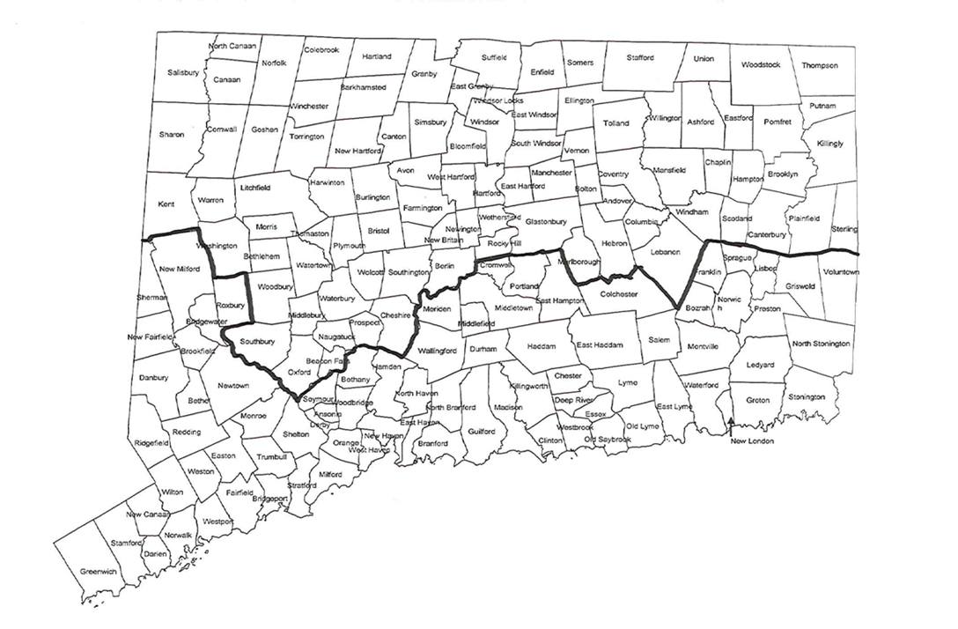
DMHAS funded facilities
First Step—Bridgeport
InterCommunity—Hartford
MCCA—Danbury
Rushford—Middletown
SCADD—New London
SCRC—New Haven
Stonington—North Stonington
Blue Hills—Hartford
CVH—Middletown

Slide 9

Questions?
Contact information
Access Line 1-800-563-4086
Derek Paplauskas 860-471-2997
Kelly Bergeron 860-418-7119

