Slide 1
Co-occurring Disorders
Oluwole Jegede MD MPH
Brian Fuehrlein MD PhD
YALE UNIVERSITY SCHOOOL OF MEDICINE

Slide 2
Disclosure
No conflicts of interest to disclose

Slide 3
Objectives
To introduce a basic overview of substance use disorders (SUD).
To provide evidence for medications for SUDs among individuals with co-occurring disorders (COD).
To introduce clinical applications of the primary medications for SUDs in patients with COD.
To introduce evidence based psychotherapies and psychosocial options among individuals with COD in clinical practice.

Slide 4
Analogy
Breath holding exercise
Notes:
This is an effective way to open a talk discussing the disease of substance use disorders. Ask the audience to hold their breath. Continue to speak to them while they are holding their breath. You can distract them with a story. Now after 30 seconds or so, people become uncomfortable. They begin to lose attention to what you are saying. Ask them to keep holding their breath. At about a minute they become very uncomfortable to the point that they need to breathe. Soon they are unable to focus on your lecture and become uninterested. The only thing that matters is the next breath of oxygen. Soon they get to a point that they must breathe. No matter what the consequences are, no matter what must happen for the breath, they will be willing to do it. When they finally take that breath, they do not feel high or on top of the world. They simply feel normal again. Now they should imagine that this is what someone with a substance use disorder suffers through every day. Constantly thinking about the next use, willing to use despite any consequences, and when they finally use, it is not to feel high or on top of the world, it is simply to feel normal again.

Slide 5
Definitions
Substance abuse and substance dependence are terminology of the DSM-IV and are no longer used
Substance use disorder is the currently used terminology in DSM-5
Physical dependence (not to be confused with substance dependence) is a physiologic phenomenon caused by chronic use of a drug in which withdrawal develops upon cessation or dose reduction
Substance use disorder is characterized primarily by loss of control, continued use despite consequences, and craving
Notes:
There are several ways to define substance use disorders. The DSM is the most widely used definition in practice today.

Slide 6
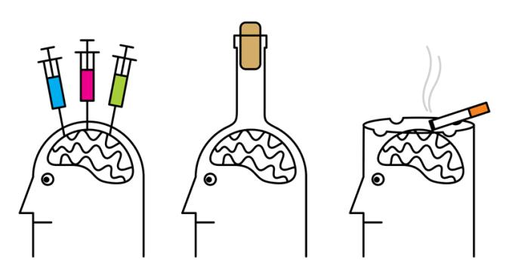
DSM-5 Criteria
Loss of Control
Taking larger amounts for
longer than intended
Wanting to cut down or quit
but unable to
Increasing time getting, using, and recovering from drug
Craving
Notes:
On the following 3 slides are the 11 criteria for substance use disorder according to the DSM 5. It is helpful to think of the criteria in categories of loss of control, adverse consequences and physical dependence. The criteria are presented on the upcoming slides.

Slide 7
DSM-5 Criteria
Adverse Consequences
Failure to carry out obligations at
work, school or home
Continued use despite social and/or
interpersonal problems
Stopping or reducing other important activities
Recurrent use in hazardous situations
Use despite medical or psychological consequences

Slide 8
DSM-5 Criteria
Physical Dependence
Tolerance
Withdrawal
2-3 = mild
4-5 = moderate
> 6 = severe
Notes:
While tolerance and withdrawal are criteria for substance use disorders, they are not necessary for the diagnosis and should not be counted as criteria if they are caused by a currently prescribed medication.

Slide 9
Reward System Basics
Image from Fuehrlein and Ross, Biological Psychiatry
Notes:
The reward system is a primitive system located deep within the brain. The ventral tegmental area and the nucleus accumbens extend to the prefrontal cortex and orbitofrontal cortex and finally to the amygdala, hippocampus and bed nucleus of the stria terminalis. The latter three areas are also referred to as the extended amygdala. While many circuits are hypothesized to be involved with the development of substance use disorders, the reward system is most commonly implicated. It is the dopaminergic firing within this system that leads to salience and pleasure sensation. This signal plays a crucial role in learning, motivation and facilitating reward-seeking behavior.

Slide 10
Reward System Basics
Biologically and evolutionarily, the primary purpose of life
is to survive and pass on genetics
The reward system is designed to
reinforce eating, drinking water, sexual
activity, and raising offspring
These are activities designed for
survival and procreation, which are the most
important things to the organism and the species
For lower level organisms, the reward system is critical to survival and drives daily activity
Notes:
Here it is important to lay the foundation that the reward system is very powerful for a reason. It is designed to reinforce behaviors that are essential for survival of the individual and the species. For mice, birds, etc, they have a very underdeveloped cortex (compared to humans). Their daily activity is driven by an instinctual drive to eat, drink water, not be eaten and to procreate. They do not engage in complex, long term planning and decision-making that the cortex is needed for. Humans, on the other hand, are primarily driven by long-term planning and decision making. For example, your decision today to attend this lecture was not driven by your desire for dopamine release in your brain. It was a part of a long-term plan to accomplish something. Similarly, from an evolutionary point of view, sex is for procreation. However, the vast majority of the time we engage in sex we are actively trying NOT to procreate. Hence, while lower level organisms may be driven primarily by the reward system, we are driven primarily by the cortex and the extended amygdala.

Slide 11
Basic Review
Reward system – Reinforce primitive behaviors designed
for survival of person and species
“GO” → Dopaminergic reward system
“STOP” → Cortex
Cortex – Higher executive planning and long-term goals
Notes:
The extended amygdala is thought to play a role in aspects of the development and maintenance of a substance use disorder. In summary, the dopaminergic reward system reinforces behaviors. In a sense it guides us to “go” seek out the things that will provide pleasure. The cortex is designed for long term thinking and planning. The cortex guides us to “stop” doing things that might give us immediate pleasure, but might cause consequences.

Slide 12
Notes:
This slide shows the effects of various drugs on the release of dopamine (DA) as well as two metabolites of dopamine (DOPAC and HVA). Various addictive drugs can cause dopamine release in the brain to far exceed any level that is achieved naturally. While sexual activity can increase dopamine levels to 200%, amphetamines can rise levels to 1000%, cocaine over 300%, nicotine over 200%. We have developed these drugs to directly impact the very system designed to provide reinforcement (amphetamines are direct dopamine agonists). The reward system suddenly experiences a rush of dopamine that it has never experienced before. It interprets that behavior as critical to the survival and seeks for it to be done again. While the cortex is able to experience the pleasure, the cortex knows that using these drugs will not help to accomplish long term goals and is not a healthy activity. Hence the cortex “wants” to do it again (much like we want to eat unhealthy foods all the time) but the cortex tries to control the behavior (like it controls the diet). But the reward system is there to push the cortex to do it again as it interprets the behavior as critical for survival. While the cortex knows it is not critical for survival and potentially dangerous, it sometimes loses the battle in those with an SUD. The extended amygdala adds a powerful emotional drive to the mix. Drugs may become overwhelming important to the exclusion of all else, and irrational fear becomes associated with going without the drug.

Slide 13
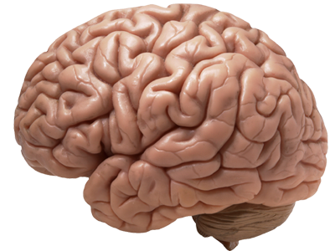
That must be critical for survival!
That felt good, but we should not do that again. Too dangerous!
Notes:
In the graphic above the reward system is urging the person to use again as it interprets the drug use as critical for survival of the organism. The cortex, while interested in the pleasure it felt, knows that drugs are dangerous and should be avoided. For powerful drugs of abuse, this battle can begin to take place after a single use. For less powerful substances, ie, alcohol, this battle may start after many years of controlled use. At some point, the reward system takes over control of the behavior from the cortex. The reward system “hijacks” the cortex. When this line is crossed, the disease of substance use disorder develops. At that point, the behavior of the person is driven by a primitive and powerful drive to use a substance. This drive to use is interpreted as critical for survival and takes priority over all other behaviors. Throughout the process, the cortex is aware that the behaviors are not good, but fails to control the behavior. The cortex does not interpret using drugs as critical to survival the way the reward system does and hence a disconnect develops. If you were to ask individuals with opioid use disorder what is more important to them, their children or heroin, the cortex would absolutely say (truthfully) that their family is far more important than using heroin. But yet, when the real threat of losing their family is present, the individual with OUD will use heroin anyway, because the extended amygdala now attributes more importance to the heroin (and going without it) than the cortex can fight. The cortex will know that the consequences of this use may be to lose the family they love. But the cortex has lost this control. The reward system interprets the drug use as even more important than family. To the individual with OUD, the next use of the substance is the single most important thing to them. The cortex would never acknowledge this, but the behavior demonstrates it.

Slide 14
Key Points
The cortex becomes “hijacked” by the reward system and the behavior of the individual is under the control of the reward system
The extended amygdala now makes sure the most important thing to individual with SUD is the next use of the substance
All consequences must take a back seat to short-term survival
Notes:
This is a summary slide to drive home the key points discussed on the prior few slides. During the development of an SUD, the reward system takes over control of the cortex. The most important concept to drive home is that the most important thing to the individual with SUD is the next use of a substance. With that concept as the framework, it is easier to understand why certain behaviors and clinical traits manifest.

Slide 15
Self-Medication Hypothesis
People often turn to drug and/or alcohol use to reduce or manage negative emotional states¹
A person’s choice of substances is related to the distressing emotional state they are trying to manage
The substance use often worsens the psychological symptoms
The cycle of worse symptoms more substance use even worse symptoms is difficult to break
¹Tomlinson, K. L., Tate, S. R., Anderson, K.G., McCarthy, D. M., & Brown, S. A. (2006). An examination of self-medication and rebound effects: psychiatric symptomatology before and alcohol or drug relapse. Addictive Behaviors, 31(3), 461-474.

Slide 16
Nosology
Dual diagnosis/Co-occurring disorders: defined when psychiatric and substance use disorder occurs in the same individual in the past year.
The relationship between psychiatric and SUD is complex in terms of etiopathology, bidirectional causality (i.e., mutual exacerbation), and shared genetic risks
This complexity is reflected in shared vulnerabilities, clinical course and treatment challenges of COD.

Slide 17
Dual diagnosis- terminological misnomer?
The field of addiction is moving toward the use of the more appropriate term co-occurring disorders and moving away from “dual diagnosis” or “co-morbid” disorders.
The definition of dual diagnosis and categorization into psychiatric disorders serves only descriptive purposes, as we recognize that both SUDs and psychiatric disorders are mental health disorders.
However, the frequent clustering of co-occurring justifies the strength of the treatment and clinical research attention that is paid to individuals who have COD.

Slide 18
Epidemiology of COD: National Comorbidity Survey
Using data from the National Comorbidity Survey (NCS), individuals with any lifetime DSM-III-R psychiatric disorder were 2.4 times more likely to have any lifetime SUD.
51.4% of participants in the NCS who reported a lifetime alcohol or SUD, also met criteria for at least one lifetime psychiatric disorder,
50.9% of those with a lifetime psychiatric disorder also had a history of SUD.
(Kessler, 2004; Kessler et al., 1996).
Notes:
Several studies have sought to explore the frequent co-occurrence of these disorders.

Slide 19
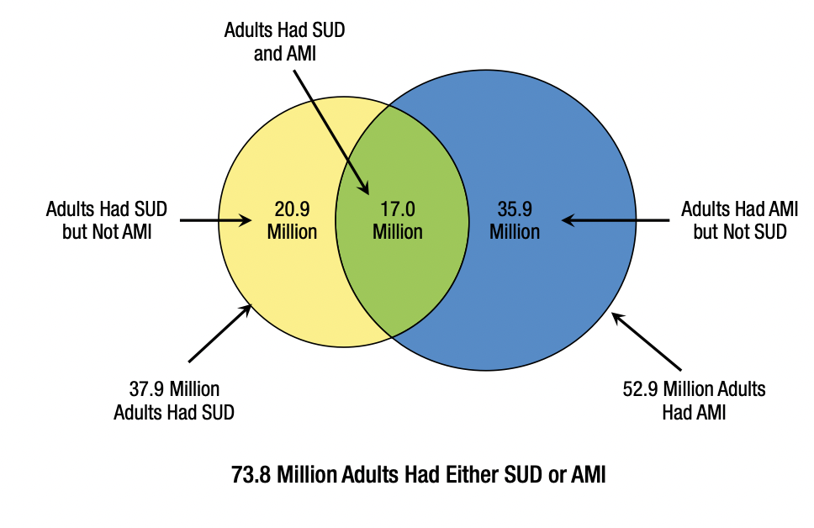
National Survey of Drug Use and Health (NSDUH)
Notes:
Among adults aged 18 or older in 2020,
Right Panel (SMI) Serious Mental Illness-
-2.2 percent (or 5.7 million people) had both SMI and an SUD
Left
- 17 million people have AMI and SUD.

Slide 20
Substance induced disorders
Recognized as a diagnosable entity in the DSM-5-TR specific for each substance use entity.
Symptoms develop during or soon after intoxication, withdrawal or exposure to a particular substance.
The specific substance must be physiologically capable of producing the observed symptoms.
Notes:
You would not diagnose a substance induced disorder if:
1. The psychiatric symptoms precede substance use
2. Symptoms persist 1 month after cessation of acute withdrawal or severe intoxication

Slide 21
Substance Induced disorders
Brown and Schuckit reported 42% of males with AUD presented with depressive symptoms. Mood symptoms rapidly resolved within the first 2 weeks of abstinence.
Over 80% of individuals experience repeated panic attacks during withdrawals.
53% of individuals with cocaine use disorder reported transient psychosis.
Amphetamine induced OCD seen in 6.9% of individuals.
43% of people who died by suicide in Finland had AUD
Brown and Schuckit, 1988; Schuckit et al., 1994; Brady, 1991; Shakeri et al., 2016; Henriksson, et al, 1993
Notes:
In another study Schuckit also showed a higher prevalence of SID than primary disorders in these populations.

Slide 22
Pathophysiology
Several hypotheses have been proposed to explain the vulnerability to substance use in patients with psychiatric disorders.
The course and progression of psychiatric disorders suggests that patients may be self-medicating their symptoms or the adverse effects of their psychotropic medications.
Shared biological vulnerability has been investigated to explain common genetic determinants.
Social acceptance theory: substance use may be the gateway for acceptance into certain social groups.

Slide 23
Siloed treatments
About half of adults aged 18 or older in 2020 with a co-occurring SUD and AMI in the past year received either substance use treatment at a specialty facility or mental health services in the past year (50.5%), but only 5.7% received both services.
About two thirds of adults aged 18 or older with a co-occurring SUD and SMI in the past year received either substance use treatment at a specialty facility or mental health services in the past year (66.4%), but only 9.3% received both services.

Slide 24
Studies of clinical samples have shown that dually diagnosed patients had more:
Severe symptoms, poorer treatment outcomes, greater risks of homelessness, involvement with law enforcement and more frequent utilization of inpatient and emergency department (ED) services than patients with either a psychiatric disorder or an SUD alone.
Siloed treatments are potential barriers to effective outpatient mental health and substance use treatment
Jegede et al., 2022; McCrone et al., 2000; Osher and Drake, 1996; Schütz et al., 2019; Trude and Stoddard, 2003; Cunningham, 2009; Walker et al., 2015; Moulin et al., 2018; Painter et al., 2018.

Slide 25
Evidence based treatments for Substance use in Co-occurring disorders

Slide 26
Substance use by type/status of mental illness
Notes:
Proportion using substances among those with any MI, SMI and those without MI.

Slide 27
Tobacco
Smoking remains the leading cause of preventable deaths worldwide. Less than one-third of smokers who tried to quit used proven smoking cessation treatments.
7 FDA-approved medications for smoking cessation, including:
Nicotine replacement therapy: nicotine patch, gum, lozenges, inhalers and nasal spray. These all offer full agonist activity at the nicotinic receptors and are started on the quit date and continued for up to 6 months.
Medications: bupropion and varenicline

Slide 28
Bupropion SR
Atypical antidepressant (phenylaminoketone)
First line for smoke cessation and FDA approved in 1997.
Blocks dopamine and NE reuptake.
Antagonism of high affinity nicotinic acetylcholine receptors.
RCTs show efficacy of bupropion (alone and in combination with NRT) among COD
George at al, 2002 and Evins et al, 2007

Slide 29
Varenicline
Alpha-4 beta-2 nicotinic receptor (α4β2) receptor nicotinic acetylcholine partial agonist.
FDA approved in 2006 for smoke cessation.
Reduces cravings and blocks reinforcing effects of smoking.
Post marketing concerns about neuropsychiatric symptoms but this was dispelled by the EAGLES trial-shows no evidence of psychotic or depressive or suicidal exacerbation in patients with psychotic spectrum disorders.
The most common side effect is nausea in up to one-third of patients, along with headache, insomnia and vivid dreams.
Anthenelli et al., 2016; Williams, et al 2012
Notes:
The study did not show a significant increase in neuropsychiatric adverse events attributable to varenicline or bupropion relative to nicotine patch or placebo.
Varenicline was more effective than placebo, nicotine patch, and bupropion in helping smokers achieve abstinence
bupropion and nicotine patch were more effective than placebo.

Slide 30
Substance use by type/status of mental illness

Slide 31
Alcohol
The 4 FDA approved medications for alcohol use disorder include
Naltrexone (oral)
Injectable naltrexone (Vivitrol)
Acamprosate and
Disulfiram.
There are additional medications (non-FDA): Topiramate, Gabapentin and Baclofen.
Naltrexone and Acamprosate have the best available evidence and are considered first line treatments

Slide 32
Naltrexone
Naltrexone is an antagonist at mu opioid receptors.
Naltrexone (PO) was initially FDA approved to treat OUD but was shown to decrease alcohol consumption through specific actions at the opioid receptors.
Naltrexone reduces likelihood of return to drinking and with fewer drinking days, decreases number of drinking days, number of heavy drinking days and the subjective experience of craving.
Naltrexone is available in both a daily oral and monthly intramuscular injection (Vivitrol).
Notes:
A MA of RCT, show that Naltrexone reduces risk of heavy drinking by 17%; decreased number of drinking days by 4%

Slide 33
Acamprosate
The mechanism of action is not clear, but it may act as a weak NMDA receptor and metabotropic glutamate receptor 5 (mGluR5) antagonist.
The main treatment effect found in clinical trials was that it helped maintain abstinence in people who had already achieved abstinence.
It reduces craving by alcohol priming (acamprosate induced modulation of dopamine release within the nucleus accumbens).
For patients with significant liver problems, Acamprosate may be more appropriate as it is largely excreted by the kidneys, and it's not metabolized through the liver.
Notes:
Acamprosate rreduces the glutamertergic excitability during withdrwals.
is effective in the treatment of alcohol use disorder at total doses around two thousand milligrams or two grams which is usually divided into 666 milligram tablets taken three times a day

Slide 34
Disulfiram
Disulfiram (Antabuse) is the oldest medication for treating alcohol use disorder.
Often considered for patients who have a goal of abstinence, who have not responded to acamprosate or naltrexone.
Disulfiram inhibits the enzyme aldehyde dehydrogenase which breaks down the ethanol byproduct, acetaldehyde. When alcohol is consumed acetaldehyde builds up or accumulates and it produces unpleasant sensations, a rapid heartbeat, flashing, headache, nausea, lowered blood pressure, and vomiting.
Other AE: optic neuritis, peripheral neuropathy, hepatotoxicity.
Psychiatric effects: from inhibition of dopamine beta-hydroxylase.
Notes:
Risk of Disulfiram reaction last 2 weeks
Patients on Disulfiram develop anticipatory fear of using alcohol and therefore, it can help reinforce motivation toward abstinence.
inhibition of dopamine beta-hydroxylase increases doapmin levels which can exacerbate psychotic symptoms in schizophrenia but may also worsen depression.

Slide 35
Cocaine
There are no FDA approved medications for treating stimulant use disorders.
Agonist treatments: Methylphenidate, amphetamine, dextroamphetamine, modafinil.
Bupropion
Cocaine vaccines: stimulates cocaine specific antibodies that bind to cocaine molecules preventing them from crossing the blood brain barrier.
Contingency Management

Slide 36
Substance use by type/status of mental illness

Slide 37
Wakeman, 2022

Slide 38
Medication treatment
The three FDA-approved medications used to treat OUD: [methadone, naltrexone, buprenorphine] improve patients’ health and wellness by:
Reducing or eliminating withdrawal symptoms
Blunting or blocking the effects of illicit opioids
Reducing or eliminating cravings to use opioids

Slide 39
MOUDs are effective
Common primary care medications:
Statins for primary prevention of CHD event NNT= 20-30
SSRIs for depression symptoms NNT= 7-9
Buprenorphine for decreased nonprescribed opioids NNT= 2
Buprenorphine for retention in treatment NNT= 2
Själander, JIM, 2007; Mattick, Cochrane Databse Sys Rev, 2014; Mortenson JAMA Cardiology 2019; Arrol, Cochrane Databse Sys Rev, 2009; Taylor, Cochrane Databse Sys Rev, 2013; Wakeman, JAMA Network Open, 2020
Notes:
coronary heart event

Slide 40
Buprenorphine
Long-acting partial opioid agonist with a high affinity at MOR (antagonist at Kappa receptors).
Buprenorphine reduces all-cause mortality among patients with OUD.
Buprenorphine is available as the mono-product (sublingual), combined with naloxone (sublingual) and in extended-release formulations (subcutaneous/implants).
Notes:
Priyanka Vakkalanka, 2021: Veterans who were not receiving buprenorphine were 4.33 (adjusted hazard ratio; 95% CI=3.60, 5.21) times more likely to die by suicide/overdose than those receiving buprenorphine pharmacotherapy on any given day, with similar protective associations with treatment across secondary outcomes.
Two forms of Long-Acting Injectable Buprenorphine: Buvidal® and Sublocade® , were made available in April 2020. They are available as weekly or monthly doses and are given as subcutaneous injections, which slowly release the buprenorphine into the body

Slide 41
Buprenorphine pharmacology
At adequate doses, buprenorphine reduces opioid withdrawal and craving and blunts the effects of illicit opioids.
Buprenorphine binds tightly to the mu-opioid receptor because of its particularly high receptor affinity. This prevents other opioids with lower affinity from binding.
Buprenorphine has a ceiling effect on respiration. Once reaching a moderate dose, its effects no longer increase if the dose is increased.
Notes:
Mean time to maximum plasma buprenorphine concentration after a single sublingual dose ranges from 40 minutes to 3.5 hours.
Elimination half-life ranges 24 to 69 hours.
Through cross-tolerance and mu-opioid receptor occupancy
Slow dissociation slowly from MOR

Slide 42
Ceiling effect

Slide 43
Methadone
Methadone has by far the largest, oldest evidence base of all treatment approaches to opioid addiction.
Methadone maintenance:
Reduced risk of overdose-related deaths.
Lower rates of HIV risk behavior.
Reduced risk of HIV and hepatitis C infection.
Lower rates of cellulitis.
Notes:
Cheap and easily scalable

Slide 44
Substance use by type/status of mental illness

Slide 45
Cannabis
Cannabis use and potency of cannabis have increased during the past 2 decades.
The endocannabinoid system has 2 receptors: CB1 and CB2 and endogenous ligands: 2 arachidonoylglycerol and anadamide.
Delta-9-tetrahydrocannabinol (THC) is responsible for the psychotropic effects of cannabis. THC is a CB1 and CB2 partial agonist.
Synthetic cannabinoid receptor agonists (“K2”/”Spice”) have a much greater potency than THC and are full agonists at the cannabinoid receptors.

Slide 46
Cannabis and psychosis
Several studies and meta-analyses have indicated that the risk of schizophrenia and related psychoses is increased for people who use cannabis.
Cannabis-induced psychosis has been found to be associated with later onset of schizophrenia.
Experimental evidence suggests that even in relatively low doses, cannabis may result psychotic-like symptoms in healthy individuals

Slide 47
Treatment for Cannabis use disorder
Most effective treatment is psychotherapy and pharmacologic approaches.
Therapies: Motivational interviewing, 12 step facilitation counseling, CBT.
No FDA approved pharmacotherapies for cannabis dependence.
Medications in clinical trials: atomoxetine, bupropion, buspirone, clonidine, dronabinol, valproic acid, rimonabant, baclofen, venlafaxine and N-acetylycyteine (NAC).

Slide 48
Drug overdose mortality by race
Friedman and Hansen, 2022
Notes:
Since 2015,overdose deaths have been rising very rapidly among Black and Hispanic populations
Overdose death rates per 100 000 among Black individuals increased from 24.7 in 2019 to 36.8 in 2020, which was 16.3% higher than that for White individuals (31.6) in 2020 (Figure). Thus, the 2020 overdose mortality rate among Black individuals was higher than that among White individuals for the first time since 1999.

Slide 49
CDC, 2022
Notes:
Latest figures from the CDC show:
-widening disparities between different population groups.
-In just one year, overdose death rates (number of drug overdose deaths per 100,000 people) increased 44% for Black people and 39% for American Indian and Alaska Native (AI/AN) people.
-Most people who died by overdose had no evidence of substance use treatment before their deaths.
-In fact, a lower proportion of people from racial and ethnic minority groups received treatment, compared with White people.
-Areas with greater income inequality—a larger income gap between the rich and the poor—have higher rates of overdose deaths.

Slide 50
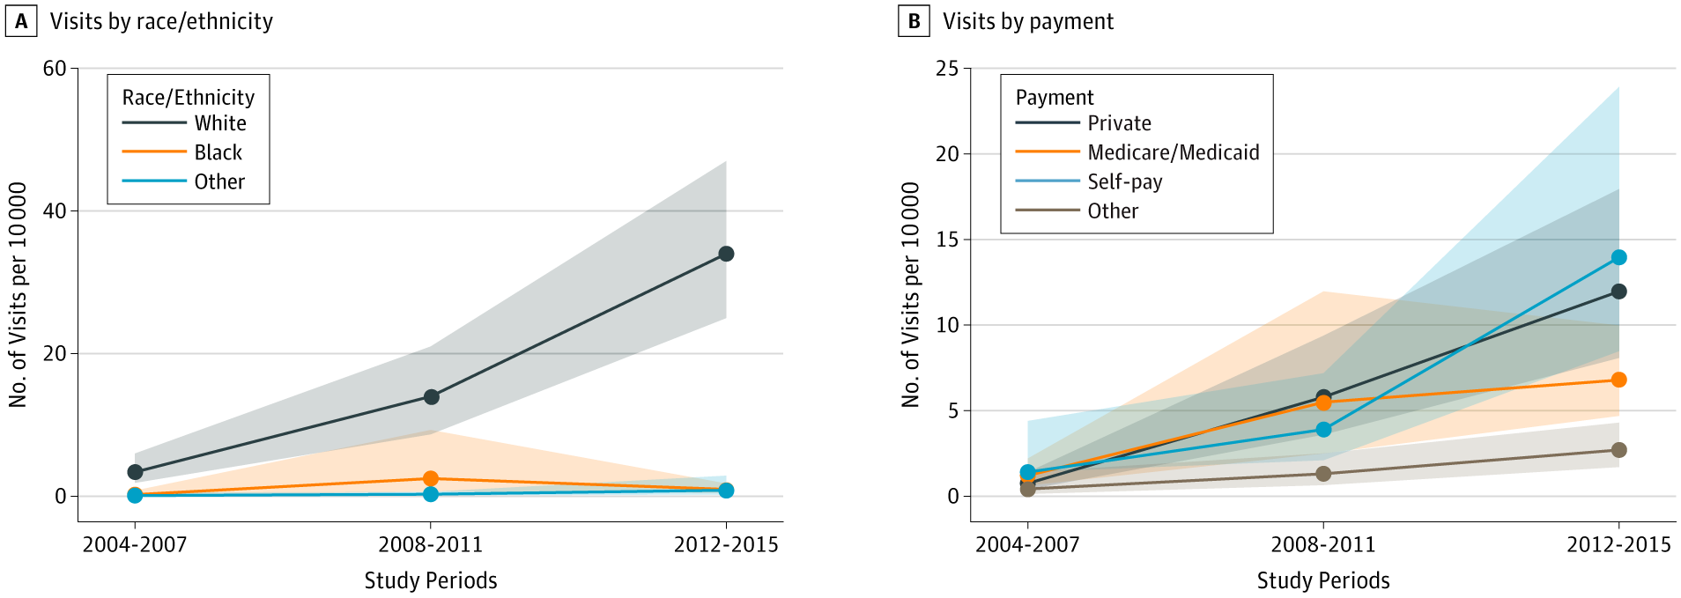
From: Buprenorphine Treatment Divide by Race/Ethnicity and Payment
JAMA Psychiatry. 2019;76(9):979-981. doi:10.1001/jamapsychiatry.2019.0876
Figure Legend:
Buprenorphine Visits by Race/Ethnicity and Payment Type, 2004-2015 Buprenorphine visits (n = 1369) and 95% CIs per 10 000 visits (shaded areas), grouped by year and stratified by race/ethnicity and payment type. Estimates account for complex survey design elements and are nationally representative.

Slide 51
Multilevel interventions for SUD
Multilevel interventions simultaneously address more than one aspect of the socioecological framework.
Single level interventions are limited in scope and approach.
Levels of socioecological framework include
Micro: intrapersonal and interpersonal
Organizational
Community and
Policy
Micro-, meso-, macro-/exo- and global/macro- systems
Notes:
Comprehensive, community-based prevention and response efforts should incorporate proven, culturally responsive actions that address disparities in drug overdose deaths and the inequities that contribute to them.

Slide 52
Evidence-Based Therapy
Evidence-based therapy should be used in conjunction with medications when possible.
For substances without an approved medication, evidence-based therapy can be one of the primary means of sobriety.
Evidence-based therapies include CBT¹, CRAFT² and CM³
Notes:
Introduction to psychosocial supports

Slide 53
Cognitive Behavioral Therapy
In maladaptive behavioral patterns, learning
plays a critical role
Teach patients to identify and correct problematic
behaviors by applying learned skills
Anticipating problems and enhancing self control by developing coping strategies
Exploring consequences, self monitoring for cravings early and identifying risky situations
Notes:
CBT is the first evidence based therapy to be discussed

Slide 54
CRAFT
Community Reinforcement and Family Training
Increase family compliance with an intervention to increase the rate of treatment for the patient
Motivation building, functional analysis,
communication skill training, life enrichment
and other skills
Targets the family of those with substance use disorders
Has been shown to improve engagement in treatment
Notes:
CRAFT is an evidence-based therapy and is primarily geared towards family members of those struggling with substance use disorder

Slide 55
Contingency Management
Highly effective in increasing treatment retention and promoting abstinence
Provides tangible rewards to reinforce positive behaviors, such as abstinence
Voucher based reinforcement involves vouchers that are exchanged for goods and services
Vouchers increase in value with more negative urine drug screens
Prize incentives provide chances to win cash prizes
Each negative urine is a chance to win
Notes:
Contingency management is the next evidence-based therapy to be discussed

Slide 56
Psychosocial Recovery Supports
Psychosocial recovery supports, while not evidence-based therapies, are potentially very important and very helpful.
When medications and other evidence-based therapies are not available, psychosocial supports may be all that is available
The primary psychosocial supports include Alcoholics Anonymous, SMART Recovery and supportive psychotherapy

Slide 57
Alcoholics Anonymous
Founded in 1935
“Primary purpose is to stay sober and help other alcoholics achieve sobriety”
“The only requirement for AA membership is a desire to stop
drinking”
No cost, no side effects, readily available and may greatly benefit the patient
Nearly all patients with a substance use disorder will be familiar with AA, their providers should be too
AA is the primary psychosocial support available
Tonigan, S., et al. Participation and involvement in Alcoholics Anonymous, 2003
Notes:
AA is being discussed in the next few slides. The concepts can be applied to the other anonymous programs as well. While AA is controversial, difficult to prove and not for all patients, it is free, has no side effects and readily available. For many patients AA may be the only thing available to them. Many people report that AA saved their life and continues to keep them sober. AA is familiar to nearly all patients with substance use disorders. All providers who care for patients with substance use disorder should be able to speak intelligently about the program of AA and assess whether the patient has been involved.

Slide 58
Alcoholics Anonymous
The recovery program
Meetings (90 in 90)
Sponsorship
Step work
Commitments
Notes:
There are 4 basic components to a recovery program and they will be briefly reviewed.

Slide 59
Alcoholics Anonymous
Meetings
90 meetings in 90 days is the minimum recommended starting point
Meetings are widely available, often
have themes and many attend daily
meetings indefinitely
Sponsorship
“A sponsor is one person to turn to without embarrassment when doubts, questions or problems linked to alcoholism arise”
Notes:
Many patients associate AA with meetings. When asked if they have ever participated in AA they will answer affirmative if they have been to a few meetings in their life. While meetings are an integral part of AA, they do not constitute the entire program. In addition, the minimum recommended number of meetings is 90 meetings in 90 days. That is daily meetings. When discussing with patients their involvement with meetings, you should assess if they have ever been to daily meetings. Major cities will have meetings around the clock. There are many themed meetings. Patients should choose meetings that feels helpful for them.

Slide 60
Alcoholics Anonymous
Step work
Step 1: We admitted we were
powerless over alcohol and our lives
had become unmanageable
There are twelve steps that should be
worked through as part of the recovery
program
Commitments
Commitment can be small, i.e., will make coffee at a particular meeting, or large, i.e., becoming a sponsor
This shows responsibility to something or someone other than self
Notes:
The twelve steps of AA are a foundation of the spiritual awakening. Providers should be familiar with the first step of AA (listed above). When patients state that they have been involved with AA but do not like it, the easiest way to assess their prior involvement is by asking them to recite the first step. If unable to recite the first step that is some evidence of lack of prior involvement and can be used as motivation for them to try it again.

Slide 61
SMART Recovery
Self Management And Recovery Training
Alternative or supplement to AA
Non confrontational motivational, behavioral and cognitive methods
Meetings are integral to the program
SMART recovery relies less on religion and
spirituality
Four point program
Building motivation
Coping with urges
Problem solving
Lifestyle balance
Horvath, T. and Yeterian, J. “SMART Recovery: Self-Empowering, Science-Based Addiction Recovery Support. Journal of Groups in Addiction Recovery, 7:102-117, 2012
Notes:
SMART recovery is also based upon meetings but not based upon the 12 steps. It is often listed as an “alternative” to AA but can also be used as a supplement.

Slide 62
Supportive Recovery Psychotherapy
The primary goal is to strengthen the ability to cope with stressors
Close, empathetic listening
Reinforcing and strengthening resilience
Building and maintaining self-esteem
Encourage sharing of feelings and thoughts

Slide 63
Questions?

