Slide 1
Substance Abuse and Addictions
DMHAS Statewide Services Nursing Home Diversion & Transition Program

Slide 2
What is Substance Abuse?
Pattern of harmful use of a substance with the purpose of altering one’s mood
Using substances in a manner that is not prescribed or intended
Repeated use that causes significant impairment such as:
Health issues, Disabilities
Failure to meet responsibilities
Impaired control, Risky use
Negatively impacts relationships

Slide 3
What is Substance Abuse? (Cont.)
Substance abuse differs from addiction
Substance abusers can quit or change their behavior
Addiction is a disease
An addicted person cannot stop using, even when the condition causes harm.

Slide 4
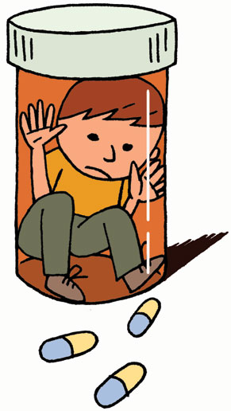
Warning Signs of a Substance Abuse Problem
Lack of interest in things one used to love
Changing friends often
Stop taking care of self
Spending more time alone
Eating more/less than usual
Sleeping at odd hours

Slide 5
Warning Signs of a Substance Abuse Problem (Cont.)
Problems at work or with relationships
Quick mood changes
Leaving empty bottles, nips, paraphernalia
Financial fallout – stealing, unpaid bills, money or family valuables go missing, chronic lying
Car accidents/fender benders
Legal issues

Slide 6
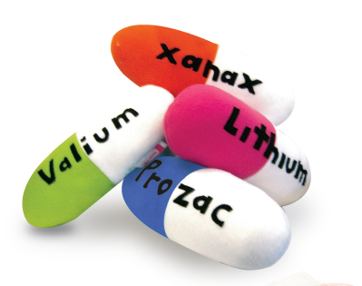
Warning Signs of Substance Abuse Problems (continued)
Using on a regular or more frequent basis
Increased tolerance for the substance
Failed attempts at stopping use
Beginning to develop psychological and/or physical need
Increased unpredictability

Slide 7
Warning Signs of Substance Abuse Problems (continued)
Red or glassy eyes, runny nose
General personality changes
Memory and concentration loss
Lack of motivation
Lowered inhibitions

Slide 8
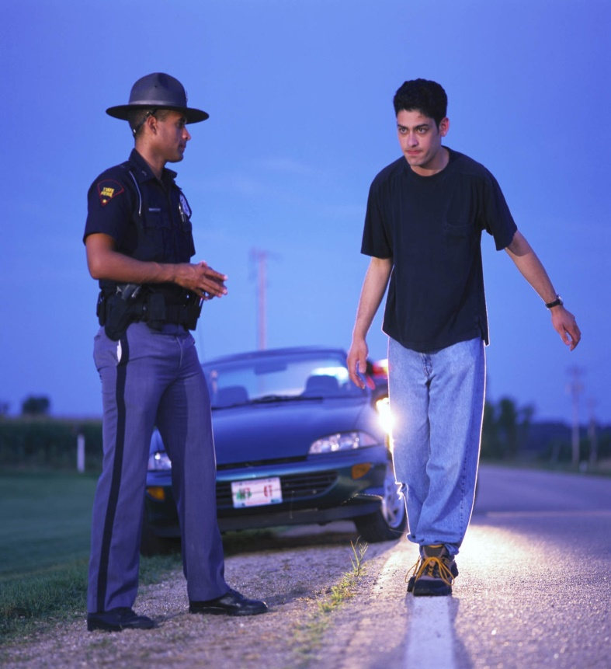
Alcohol Abuse Visible Signs of Intoxication
Glassy, red eyes
Slurred speech
Difficulty walking
Shakiness, tremors
Inability to focus
Loud volume
Decreased inhibitions
Sweating

Slide 9
Stages of Alcohol Withdrawal Not everyone experiences each stage
Stage 1
5-8 hours after last drink –
Anxiety, Restlessness
Mild nausea, Lack of appetite,
Insomnia, Sweatiness,
Mild tremors, Racing heart beat,
Raised blood pressure, Mild cognitive impairments.
Headache

Slide 10
Stages of Alcohol Withdrawal (Cont.) Not everyone experiences each stage
Stage 2,
24-72 hours after last drink –
Increased restlessness, Agitation
Increased tremors, Hallucinations
Disorientation,
Nausea, Vomiting, Diarrhea,
Heart rate greater than 120,
Seizures (grand mal).

Slide 11
Stages of Alcohol Withdrawal (continued)
Stage 3
72 to 96 hours after last drink - also known as the DT’s.
Fever
Very high blood pressure, Very fast heart rate
Delirium, Drenching sweats, Severe tremors
Death can occur at this stage
Seek medical attention immediately
Hallucinations

Slide 12
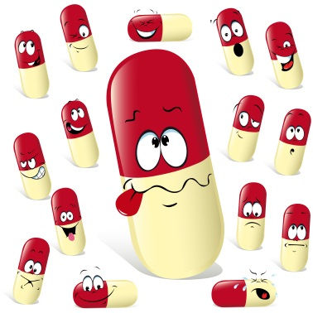
Heavy Drinking can also have adverse interactions with:
Aspirin
Acetaminophen
Cold & allergy medications
Cough syrup
Sleeping pills
Pain medication, including opioids
Antidepressants and anti-anxiety meds

Slide 13
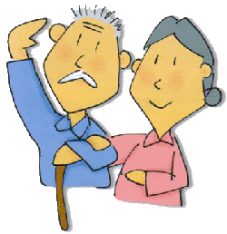
Possible Causes of Substance Abuse for Older Adults (late onset)
Retirement-Loss of identity, Loss of purpose
Death of a family member, Spouse, Pet, Friend
Change of Residence
Trouble sleeping can lead to inappropriate medication use
Post surgery, Hip/Knee replacement
Mental/Physical health decline
Increased isolation
Relocation
Family conflict

Slide 14
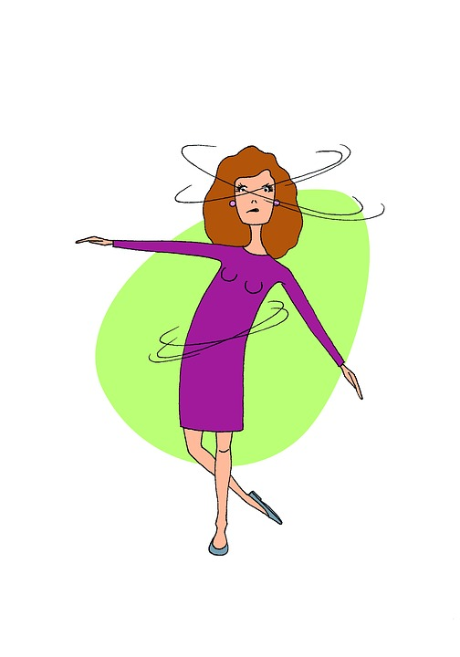
Medical Conditions that Mimic Substance Abuse
Slurred speech, Dizziness, Difficulty walking, and Confusion can all be found in:
Diabetes
Epilepsy
Parkinson’s
Multiple Sclerosis
Dementia
Infections

Slide 15
Someone Under the Influence?
Send out to Hospital
Report to Treatment Team
Rule out medical conditions
Suggest Inpatient treatment, CCAR, AA meetings
Conduct a toxicology screen
Follow your facility’s policy/procedures
Stay with the resident until medically cleared
Narcan(for Opiate overdose-keep a supply )

Slide 16
What is Addiction?
Severe cravings and compulsive substance abuse despite harmful consequences
Intense focus on using certain substances to the point that it takes over one’s life
Loss of control over the amount and frequency of use

Slide 17
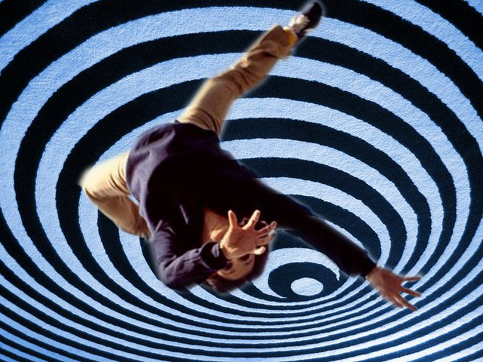
What is Addiction? (Cont.)
Continued use in the face of adverse or negative consequences
Changes in the wiring of the brain which causes intense cravings

Slide 18
What is Addiction? (continued)
Brain imaging shows changes in brain functioning that relate to:
Judgement
Decision making
Learning
Memory
Behavioral control
Addiction can run in families; 50%-60% of addiction can be related to family genetics

Slide 19
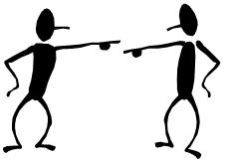
What is Addiction? (Cont.)
Addiction is progressive –
Physical tolerance increases along with the psychological need and cravings for the substance
Irritability
Inability to deal with stress
Rationalizing
Minimizing, Blaming, Defending
Inability to accept responsibility

Slide 20
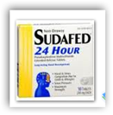
Common Addictions
Alcohol
Nicotine/Tobacco/Caffeine
Opioids/Pain Medications/Cocaine/Speed (methamphetamines), Heroin, Benzos, etc.
Over the Counter medications (cough medicine, Sudafed)

Slide 21
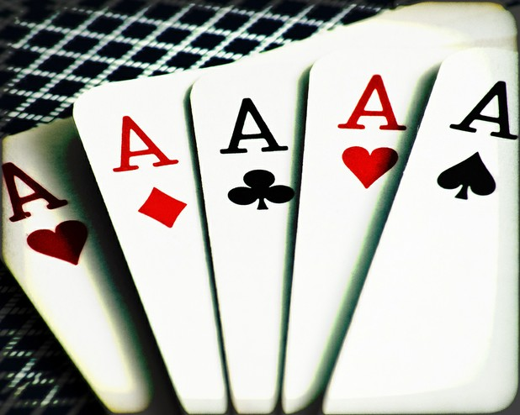
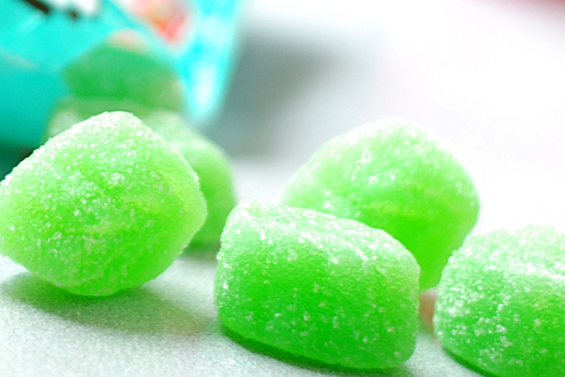
Common Addictions (continued)
Gambling
Internet/Cell phone/Gaming
Pornography/Sex
Food/Sugar
Shopping

Slide 22
Signs & Symptoms of Addiction (any substance)
Mood swings, Irritability
Multiple unsuccessful attempts to stop or limit use
Excessive time spent obtaining, using, and/or thinking about the substance
Withdrawal from usual activities- Socializing and Family relationships
Toxic relationships with other users

Slide 23
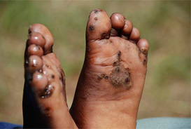
Signs & Symptoms of Addiction (any substance) (Cont.)
Stealing money, Prescriptions or Alcohol from others, lying
Physical changes in appearance, Poor hygiene, Poor dental hygiene (losing teeth)
Sweats, Fever, Chills, Nausea, Vomiting, Depression, Diarrhea

Slide 24
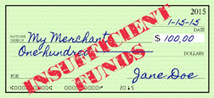
Signs & Symptoms of Addiction (any substance) (Cont.)
Financial trouble-
Passing bad checks
Excessive ATM withdrawals, overdrawing bank accounts
Selling/trading prized possessions

Slide 25
Signs and Symptoms of Benzodiazepine Addiction
Weakness
Blurred vision
Drowsiness
Blacking out
Memory lapse
Asking others for pills
Doctor shopping- to obtain multiple prescriptions
Going through others’ medicine cabinets
Inability to stop using despite attempts
Poor judgement
Passing out

Slide 26
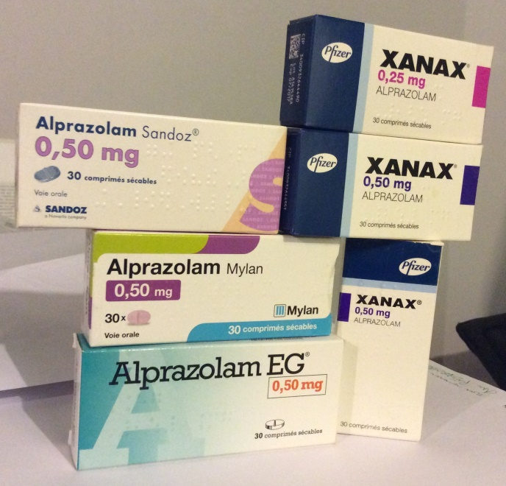
Examples of Benzodiazepines
Xanax
Klonopin
Librium
Ativan
Valium
Restoril
Halcion

Slide 27
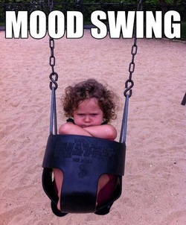
Signs & Symptoms of Benzodiazepine Addiction (continued)
Mood Changes
Mixing Benzos with other drugs
Engaging in risky behaviors
Impaired coordination
Withdrawal Symptoms

Slide 28
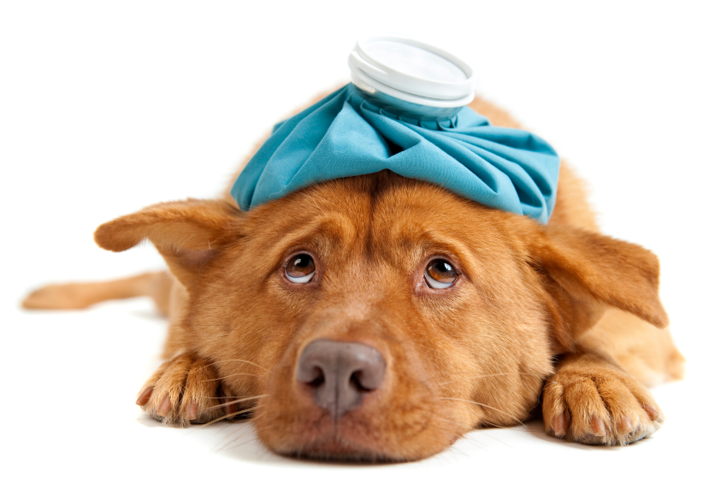
Signs of Benzodiazepine Withdrawal (within 24 hours of last use)
Problems concentrating
Sleep disturbance
Irritability
Increased anxiety
Panic Attacks
Hand tremors
Dry heaving/Vomiting
Heart Palpitations
Headaches
Muscle pain/Stiffness
Withdrawal symptoms can be dangerous, and may result in seizures, coma, and even death

Slide 29
Signs & Symptoms of Opiate Overdose
Nausea/Vomiting
Shallow or Restricted breathing
Bluish lips and fingertips
Extreme sleepiness or Inability to waken
Unconsciousness or intermittent loss of consciousness
Labored breathing
Constricted pupils
Clammy skin
Confusion

Slide 30
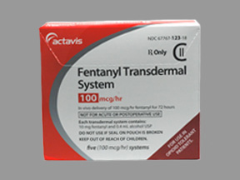
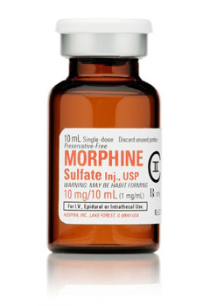
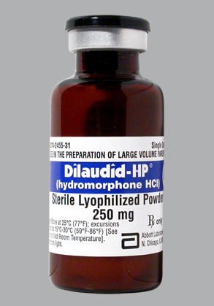
Examples of Opiates
Heroin
Morphine
Fentanyl
Hydrocodone
Methadone
Percocet
Oxycodone
Dilaudid

Slide 31
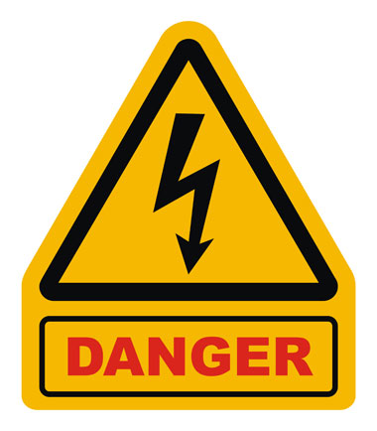
Dangers of Opiate Overuse
Chronic overuse of Opiates can cause severe and long lasting complications to the body, such as:
Heart complications like a decreased heart rate or cardiac arrest
Respiratory complications like shallow breathing or depressed respirations
Unconsciousness
Increased risk of addiction
Overdose

Slide 32
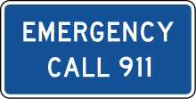
Opiate Overdose - What to Do ???
Call 911, Stay on the phone
Begin Rescue Breathing
Administer Narcan Nasal Spray, if available (often takes more than one)
Stay with the person, Roll onto their side to prevent vomiting and choking

Slide 33
BEWARE Of Prescribed MEDICATIONS that can BE
Used in the Addiction Cycle

Slide 34
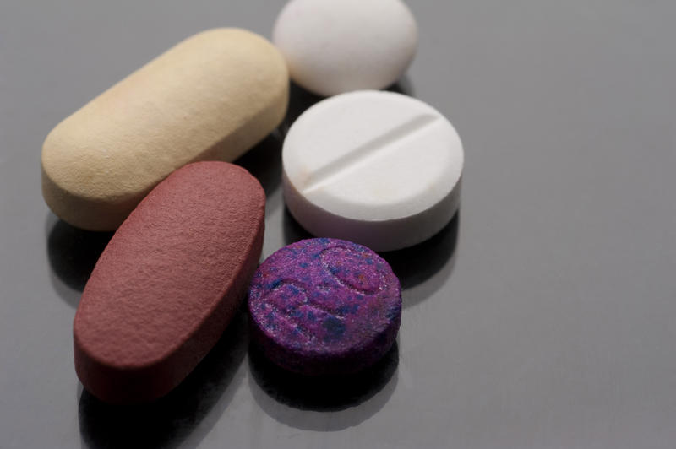
Commonly Abused Prescription and OTC Drugs
Besides marijuana-
legal medicines are the most commonly abused drugs in the U.S.
Over-the-counter and prescription drugs can help and heal us-
But some can be addictive and dangerous if they’re used the wrong way.
Drug abuse isn't just about street drugs

Slide 35
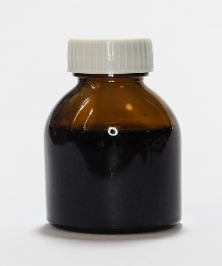
Commonly Abused Drugs
Adderall- can help people with ADHD
But some people use amphetamines to get high, to boost energy and alertness, or to keep their weight down
You can get addicted to these stimulants
A common ingredient in over-the-counter cold and cough medicines- helps stop the cough
But large doses can get you high and cause hallucinations
It's popular- since cough syrup is so easy to find in medicine cabinets

Slide 36
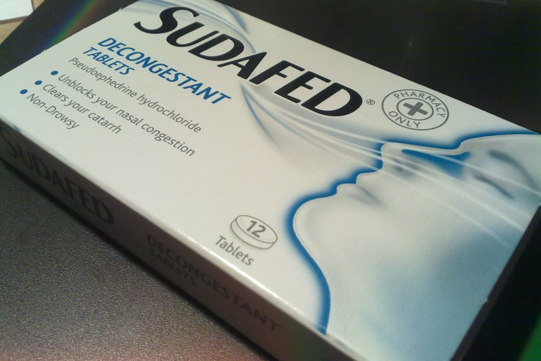
Pseudoephedrine
This is a decongestant in lots of non-prescription cold medicines.
While it helps clear up a stuffy nose, it's also an ingredient in illegal methamphetamine ("meth").

Slide 37
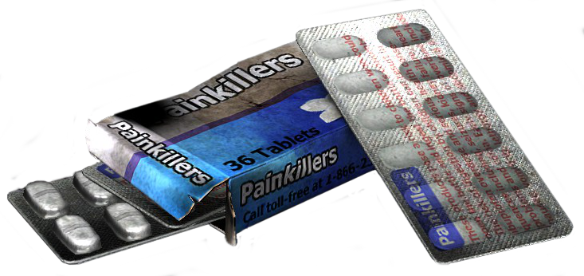
Codeine and Morphine
Some of the most commonly abused prescription meds are painkillers - specifically, opioids.
These drugs dull pain, but in large doses they can also cause a euphoric high – and have dangerous side effects.

Slide 38
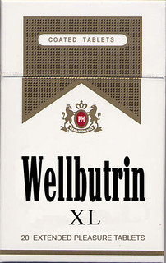
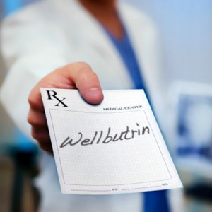
It’s one of the more popular and easily accessible prescription drugs.
Bupropion HCL- commonly known as Wellbutrin-is prescribed by doctors to patients with depression, anxiety, and seasonal affective disorder and to reduce smoking- among other conditions.
It has also been aptly named-the “Poor Man’s Cocaine”- Because it elicits stimulant effects to cocaine and crack

Slide 39
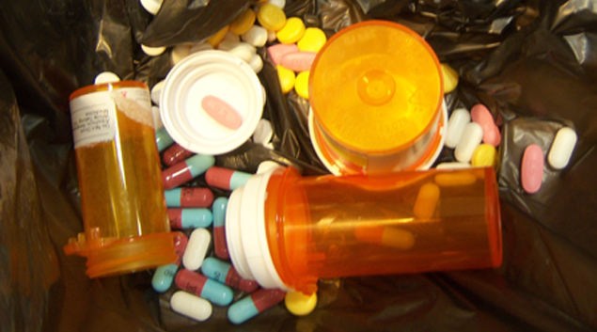
Abuse Symptoms
Constipation
Nausea
Feeling high
Slowed breathing rate
Drowsiness
Confusion
Poor coordination
Increased dose needed for pain relief
Drowsiness
Confusion
Unsteady walking
Slurred speech
Poor concentration
Dizziness
Problems with memory
Slowed breathing
Opioids
Anti-anxiety medicines and sedatives

Slide 40
Abuse Symptoms cont..
Stealing or selling prescriptions
Taking higher doses than prescribed
Being hostile or having mood swings
Sleeping less or more
Making poor decisions
Being unusually energetic, high or revved up
Being drowsy
Trying to get prescriptions from more than one prescriber
Increased alertness
Feeling high
Irregular heartbeat
High blood pressure
High body temperature
Reduced appetite
Insomnia
Agitation
Anxiety
Paranoia
Stimulants
Other signs

Slide 41
Dependence vs. Addiction
Addiction is an inability to stop.
Addiction includes a psychological hold on the person that is the result of continuous substance use.
This results in behavioral disturbances such as stealing, lying, etc.
Dependence is physical- the body adapts to the substance, requiring more and more as tolerance increases.
May not include behavioral disturbances of stealing, lying, etc.

Slide 42
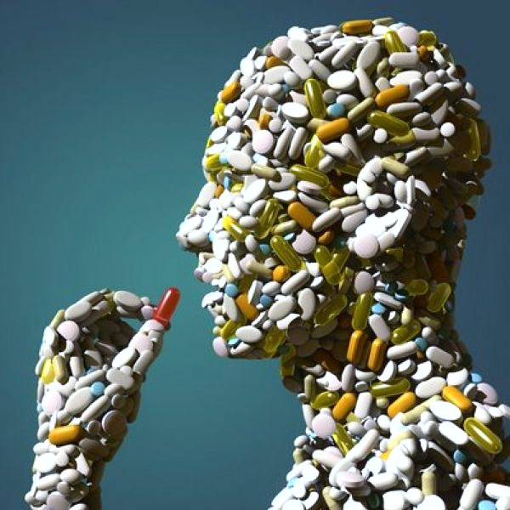
Dependence vs. Addiction (Cont.)
You can have dependence without addiction. For example, someone who is dependent on pain killers is not necessarily addicted to them.
However, someone who is addicted has some level of physical dependence as well.

Slide 43
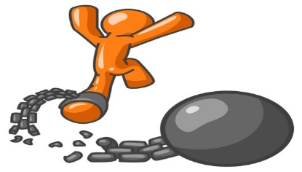
The Recovery Process
There are no “normal” or “standardized” time frames to recovery, everyone’s recovery is different.
Recovery is a lifetime commitment.
If relapse happens it should be viewed as an opportunity to bolster one’s commitment to recovery

Slide 44
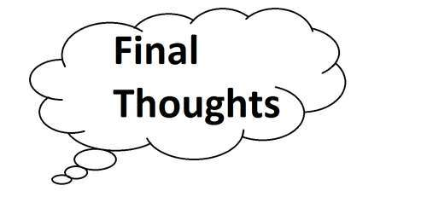
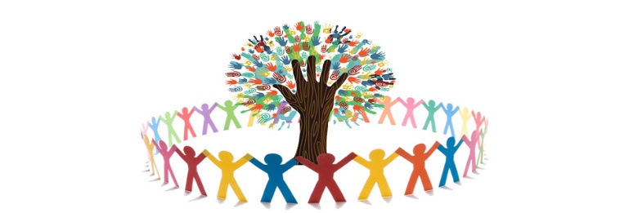
The Recovery Process
It is important to uncover the reason for the relapse.
If relapse occurs, the introduction of a new tool or strategy can help make another relapse less likely.
People are more successful in recovery when they feel supported by their community, family & friends

Slide 45
2021 WebMD, LLC.
2021 AspenRidge Recovery | Colorado Mental Health and Addiction Treatment Center. |

Slide 46
Questions??

