Slide 1
Connecticut HUSKY Health Maternity Bundle Payment Program
Doula Integration
Doula Information Webinar
June 23, 2023

Slide 2
Outline
HUSKY Health + maternity care
Planned payment pathways for doulas
Payment pathways compared
Doula services in the Maternity Bundle
Integration roles
Provider supervision
Who is eligible to participate?
What’s covered
Payment rate
Integration toolkit
How to use the toolkit
How doulas can participate
Q/A
Notes:
Learning objectives: At the end of the session, participants will be able to:
Describe changes in payment that allow doulas to begin receiving payment for supporting clients whose care is covered under the HUSKY Health Maternity Bundle Payment Program.
Identify opportunities to partner with provider practices to provide team-based care to HUSKY Health members.
Outline requirements of the relationship between healthcare providers and doulas in the Bundle Payment Program.

Slide 3
HUSKY Health + Maternity Care
At a glance

Slide 4
HUSKY Health and maternity care
HUSKY Health (run through DSS*), Connecticut’s Medicaid program, covers > 40% of all births in the state
~15,000 births annually
Covers low-income individuals, including undocumented immigrants
No cost-sharing for pregnancy-related care
Offers programs such as High-Risk Perinatal Care Management for education and service navigation
Rules for who can bill Medicaid and be reimbursed for services. >> No existing/prior mechanism to bill HUSKY for doula services
*DSS stands for the Department of Social Services

Slide 5
HUSKY Health maternity demographics
Predominant languages spoken
17.8% of pregnant HUSKY Health members’ primary language is not English
Excluding English, the predominant language spoken by pregnant HUSKY Health members is Spanish (16.5%)
Other languages spoken by pregnant HUSKY Health members, each representing <1% :
Portuguese Arabic Chinese Bosnian French Polish | Russian Vietnamese Korean Hmong Other

Slide 6
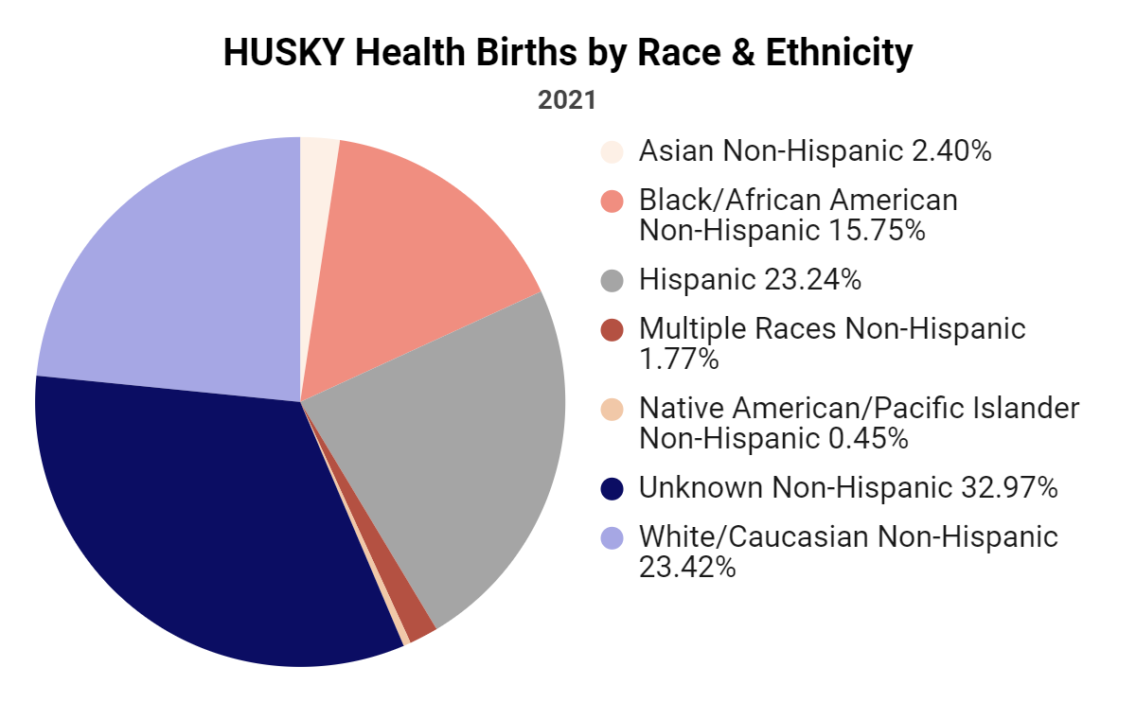
HUSKY Health maternity demographics

Slide 7
Doulas’ role in promoting equity
HUSKY Health will begin to cover doula care and breastfeeding support
Doulas help create better outcomes
Doulas help address racial and ethnic disparities in outcomes
Doulas can provide culturally matched care
Doulas promote dignity, trust, bodily autonomy, and relationship-based care
Doulas help alert providers to symptoms and concerns that can lead to severe maternal morbidity or mortality
Doulas activate community-based support networks
Doula payment through Medicaid is coming

Slide 8
Planned Payment Pathways

Slide 9
Forthcoming options for doula payment: Maternity Bundle and direct fee-for-service
Two options for payment:
Starting 1/1/2024: partnering with ob-gyn or midwife practices participating in the HUSKY Health Maternity Bundle*
Timing TBD: working with the Medicaid program directly as a contracted provider (called direct or fee-for-service)
*Enrollment in the Maternity Bundle is automatic for providers with 30 or more HUSKY deliveries in the previous year. FQHCs will not be eligible to participate in Y1 of the program.

Slide 10
Payment pathways compared
Doula Payment Pathway | Through Bundle Payment | Direct Fee-for-service
Enrolled with DSS? | No | Yes*
Certification | Through provider** | DPH***
Population served | HUSKY bundle payment participants | Any pregnant HUSKY Health member
Payor | Providers | DSS
Payment rate | $1,200 to providers | TBD
Covered services | 4 x prenatal/postpartum visits 1 x attendance at birth | TBD
*Details are not finalized, although, at a minimum, doulas can anticipate meeting all standard requirements for enrolled providers in addition to various requirements specific to doulas.
**Providers will set their own credentialing requirements, though relying on certification through DPH is highly recommended.
***DPH certification was established through Public Act No. 23-147.

Slide 11
Doula Services in the Maternity Bundle
A Closer Look

Slide 12
A focus on integration and team-based care
The Maternity Bundle is designed to better integrate clinical and non-clinical services
Team-based care has potential to address the broader needs of patients
Doulas can focus on activities that clinicians lack time or skills for:
education
community service navigation
hands-on comfort measures
continuous bedside support
Goal of including doulas and increased breastfeeding support is to remedy disparities in access, utilization, and outcomes for pregnant people, with an emphasis on people of color and people with substance use disorders

Slide 13
Integration roles
Contract with providers
Meet competencies
Communicate findings requiring clinical attention
Report visits + outcomes to providers
Invoice provider for services
Monthly payment to providers
Set bundle quality outcome goals
Set payment rate for doula services, paid to providers
Provide draft supporting materials to facilitate provider + doula partnerships
Pursuing parallel, direct doula payment pathway (fee-for-service) using DPH credentialing standard
Doulas
DSS
HUSKY Health Member
Manage doula relationship
Supervise doulas
Assist with member referrals
Set own doula rate + pay doulas
Collect and report outcomes to DSS
Providers
Notes:
DSS, Doulas, and providers all have a role to play in integration. DSS supports the effort by providing the payment authority and paying providers through the bundle payment program, via a Per member per month. DSS will determine the performance parameters and specific reporting requirements for doula services, and have a fee schedule specific to doula services for the amount that is paid to providers. As part of the doula implementation, DSS will provide draft supporting materials, which we’ll talk about on the next slides. As discussed earlier, DSS is also pursuing a parallel, direct payment pathway for doulas that is contingent upon DPH certification. Although the payment pathways have key differences, where the pathways can be aligned there is motivation to do so.
Next, for the integration effort providers will be responsible for creating relationships with doulas, they can define what type of doula program they want to create, whether it is a subcontractor relationship or employed. Providers should refer their patients to doula services, will set their own doula payment rate, and pay doulas when a patient uses doula services in accordance with their practice level doula agreements. Providers will also be collecting and reporting doula outcomes to DSS via the bundle payment encounter form.
Finally, Doulas will engage with providers directly, submit their encounter information and outcomes to the provider as necessary to inform the encounter form completion, and invoice the provider directly for any services rendered. Doulas will also be responsible for reviewing the competency requirements and ensuring they meet them, although providers should review this information as well.

Slide 14
The doula role
Doulas participating in the bundle will…
Provide non-clinical physical and emotional support
Educate about the common course of pregnancy, labor and delivery and postpartum, and help clients prepare for their pregnancy and parenting journeys
Assist pregnant and birthing people with access to community and/or social services which may be beneficial to their pregnancy and childbearing experiences
Be a continuous and consistent source of non-judgmental support
Empower clients to advocate for themselves; speak up for their healthcare needs and the healthcare needs of their babies

Slide 15
Provider supervision in bundle payment pathway
Doula services will be rendered and reimbursed under the medical provider’s supervision through the bundle payment.
Provider supervision means …
medical provider sets the overall care plan
medical provider holds professional and administrative responsibility for the doula’s services
doula uses their own professional judgment in performing services
doula works to the full extent of their scope of practice
Notes:
Include verbally that this was the best pathway available to DSS.

Slide 16
Provider supervision
What’s involved …
The organization and coordination of patient’s maternity care
Guidance on patient care doulas can provide (likely via job description and doula policy)
Respectful of the doula role and doula scope of practice
Independent contractor or employer/employee relationship
What’s not involved …
Restrictive oversight of doula/patient interaction
Limitations on doula scope of practice

Slide 17
Who is eligible to participate?
Doulas who …
Want to support childbearing HUSKY Health members
Can demonstrate that they meet the Core Competencies set forth by the CT DPH*
Are interested in a contractual relationship with a participating practice that provides maternity care services
*Best practice, not necessarily required. Each practice will set their own standards. Find the CT DPH proposed standards here.
Notes:
If you find that you are missing a necessary competency, check out CT based doula training programs, many offer standalone classes in specific topics that could fill a gap in your knowledge. If you don’t see one in an area of interest, don’t be afraid to reach out to them and ask! In just a minute we’ll also share another resource we created that shows common CT based training programs vs. the DPH core competencies

Slide 18
What’s covered?
Prenatal/Postpartum visits (including but not limited to)
Childbirth education
Birth/postpartum planning
Personal advocacy and communication skills building
Comfort measures to relieve common aches and pains
Education on newborn care
Routine lactation support
Labor and Delivery Support
Continuous support
Non-medical comfort measures
NOTE: Doula services are limited to the services covered by the supervising practice.
If doulas offer additional services (ex: belly binding, placenta encapsulation), they are not allowed to balance bill HUSKY Health members for these services.
Notes:
What is covered depends on the practice and what it chooses. For example, childbirth ed could include group childbirth ed classes. DSS will not be proscriptive in the maternity bundle doula integration because the benefit is driven by the provider. Providers can determine the site of service, like whether virtual visits are allowed, and what counts as a visit. It’s very important to remember that you are NOT allowed to bill a Medicaid member for any services provided outside of what is covered, such as placenta encapsulation or belly binding. These services can be offered if agreed upon through your collaborative practice, but you cannot charge separately for them.

Slide 19
Payment rate
Visit Type | Limit per pregnancy* | Bundle Payment Rate | Doula Subcontract Rate
Prenatal/Postpartum visits | 4 | $100 | **
Attendance at labor and birth | 1 | $800 | **
Maximum Reimbursement per Doula per member/birth |  | $1,200 | **
*Limit is per pregnancy, not per doula. If patient chooses to switch doulas during pregnancy, total number of allowed visits will be decreased based on visits rendered with original doula.
**To be completed by practice

Slide 20
Integration Toolkit
For Provider Practices and Doulas

Slide 21
Doula Integration Toolkit Components
Resources
Model Policies
Form Templates
Publicly available toolkit including key resources for providers + doulas
Notes:
The doula integration toolkit will be publicly available for all providers and doulas to use. The components of the toolkit are forms, policies, and guides which will serve as building blocks for the integration.

Slide 22
Form templates and model policies
Form Templates
Referral form
Reporting form
Invoice form
Satisfaction Survey
Model Policies
Doula job description
Hospital/provider doula policy
Fee schedule
Access the toolkit here.

Slide 23
Resources
Members
FAQ
Prenatal education - what is a doula & how to access one
Providers
Referral workflow w/ visual aid
FAQ
Payment flow example
Doula training programs vs. DPH core competencies
Educational campaign materials
Webinar recording
Doulas
Referral workflow w/ visual aid
FAQ
Webinar recording
Notes:
For providers, we’ll host a webinar on how to participate in the bundle payment, identify the role of doulas, develop an FAQ related to the bundle payment, and provide a payment flow example so they can understand how the PMPM funds will cover doula services.
For doulas, we’ll host a separate webinar on how to participate in the bundle payment, …
We know there is interest from doulas and providers to establish integrated doula relationships. We are currently seeking demonstration sites that are interested in working with us for the next couple months to build their initial doula infrastructure. Practices and doulas who participate will be able to provide input on the drafts we develop, as well as have some technical assistance in setting up their programs. If you are interested in participating you can reach out to us at info@primarymaternitycare.com
Amy, I’ll pass it off to you to discuss next steps.

Slide 24
How to use the toolkit
Review introduction section with background for the document
Make note of any questions
Update to suit your anticipated partnership

Slide 25
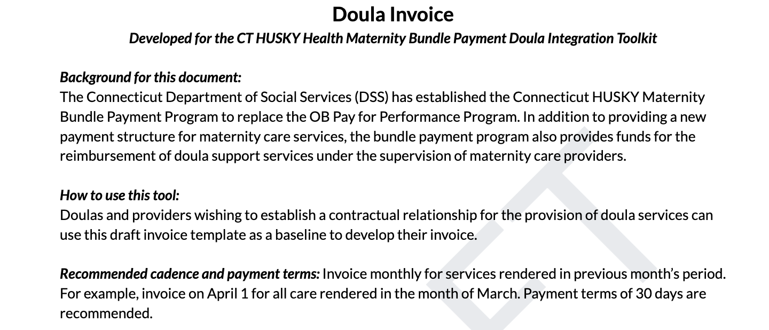
How to use the toolkit
Example: Doula Invoice

Slide 26
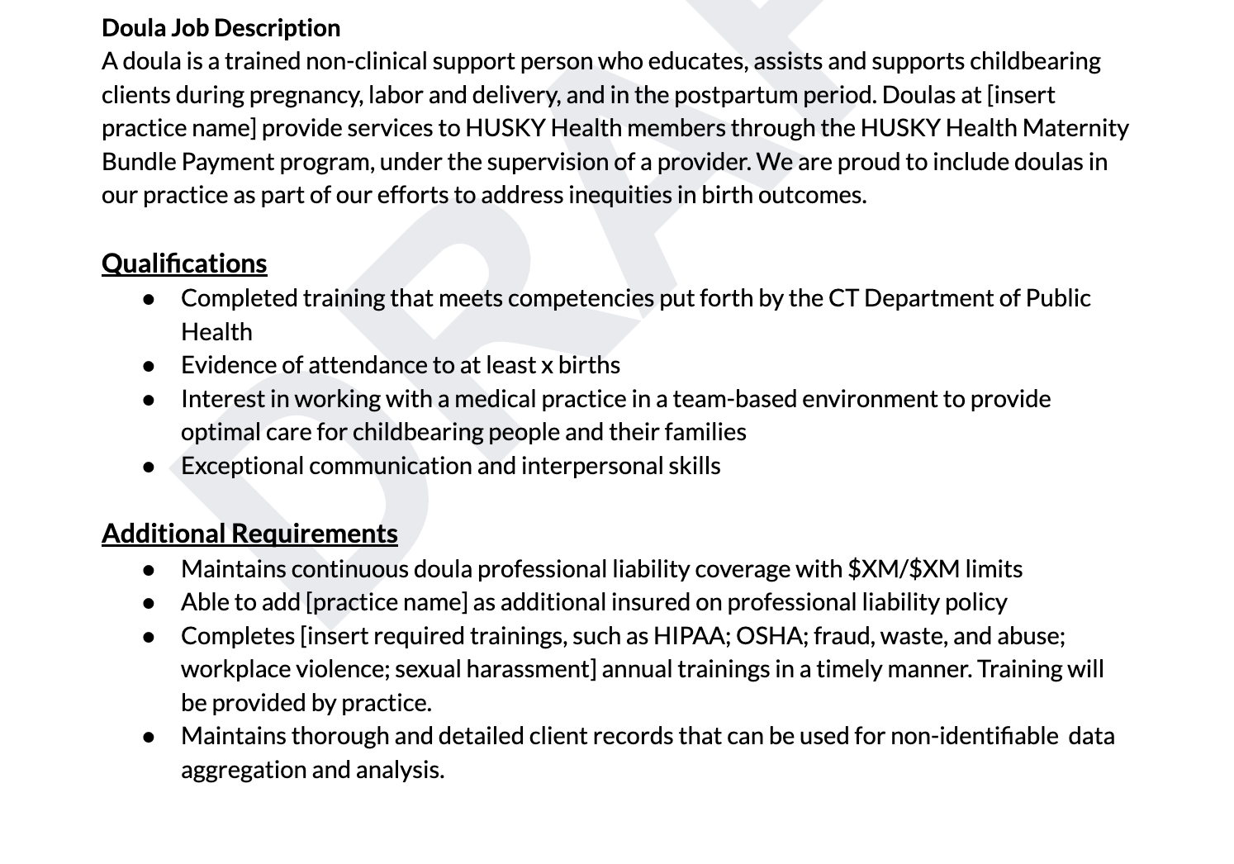
Doula job description template
Notes:
This document has not been finalized, it is in draft form

Slide 27
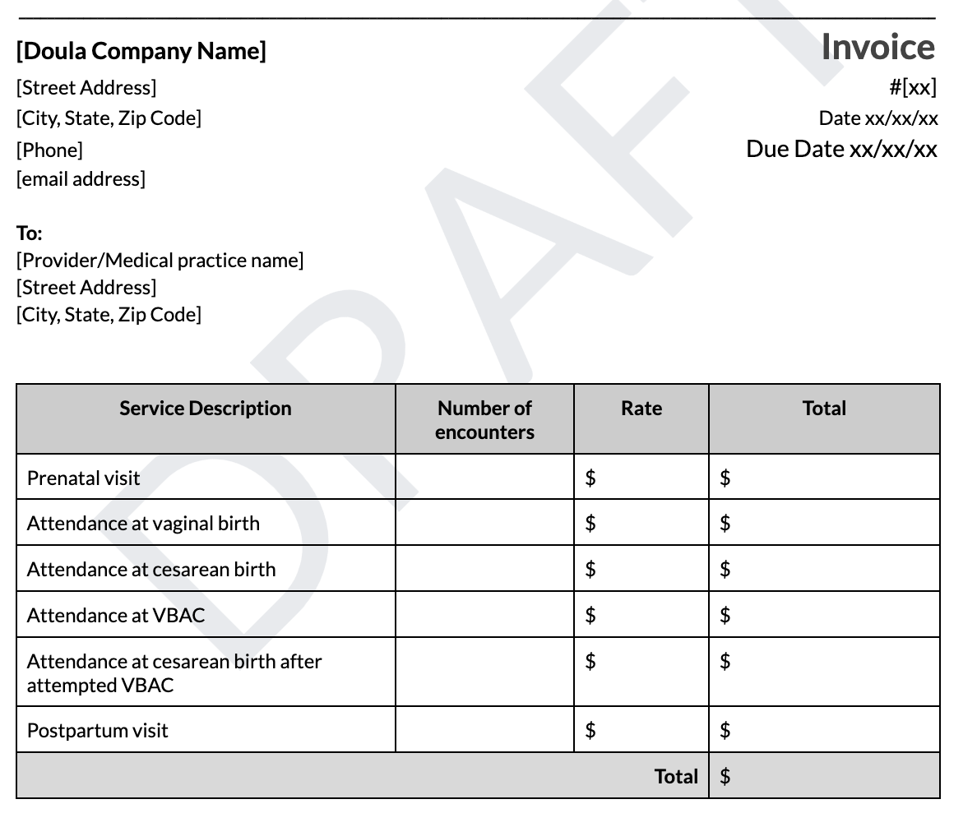
Invoice form template
Notes:
This document is in draft form, it has not been finalized.
there are spaces for you to input information to customize this form to suit your particular set up.

Slide 28
How to participate
Start getting ready now to participate next year
Align with draft Doula Certification competencies issued by CT DPH*
Explore professional liability coverage
Explore and understand toolkit
Contact practices you are interested in working with to ask to participate
Consider working with multiple practices
Consider forming or joining a doula collaborative
*DPH certification, either through DPH or in line with the DPH core competencies, is recommended as the credentialing pathway, though providers will set practice level requirements, which may vary.
Notes:
Providers set practice level requirements, no official guidelines for doula qualifications.
DPH credentialing may or may not be in place by the time providers want to build these relationships. In lieu of formal DPH credentialing we would recommend using the DPH core competencies as internal credentialing guidelines.

Slide 29
Q/A

