Slide 1
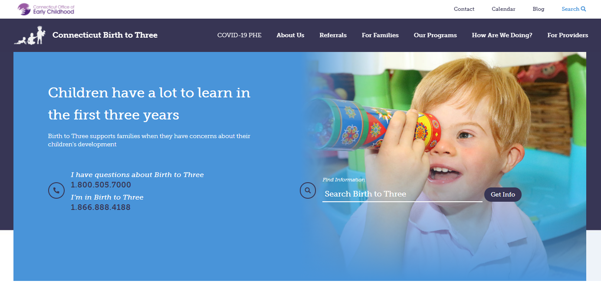
Birth23.org

Slide 2
Connecticut’s Birth to Three System
Supporting families
to enhance the development of their child
and
connect to their communities.

Slide 3
EIS = Early Intervention Services (DSS and IDEA)
Part C (of the IDEA)
Birth to Three (in CT)
It’s all the same thing

Slide 4


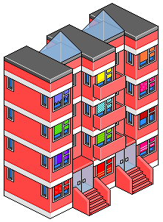






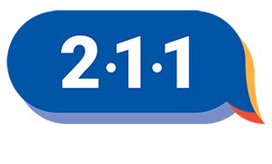

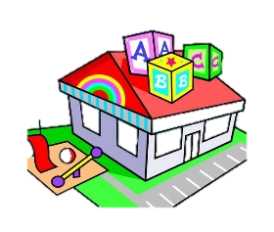



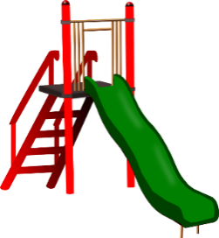




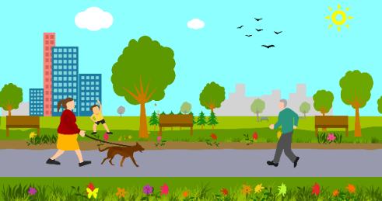
Birth to Three
A View From 10,000 Feet
OEC
Notes:
Alice

Slide 5
CT B23 System Timeline and ASD
2007
Autism Specific
Programs
1998
1st Autism
Guidelines
2003
Began Family Cost
Participation
2017-18
Converted to FFS
1993
ICD10
1996
Change in Lead Agency
2002
“36.2 Hours”
Mediation
Agreement
2005
Hearing
Requiring
ABA
2011
Three
State-wide
RFPs
2016
Change in Lead Agency
2020
One
State-wide
RFP
Deficits Every Year…

Slide 6
From Bundled Rates to Fee for Service
Medicaid
Commercial
Insurance
OEC
Payments to Programs
Before
After
Much less Medicaid
Different rates by
type of program
Different contracts
More Medicaid revenue
Same rates for all EIS
More skin in the game
Better “productivity”

Slide 8
FY19-20 RFP
Before
After
27 Programs x Type
6 “Autism Specific”
3 “DHH Specific”
16 “General”
3 of the agencies that ran
autism specific programs
also ran general programs
19 EIS Programs in Total
11 Specialize in ASD
2 Specialize in DHH
6 No specialty (yet)
The agencies that used to run
two programs only run one
Comprehensive EIS program

Slide 9
Exits from Part C at Age 3 with F84.* on the IFSP
No ADOS ~
F84 “Decrease”?
Remote EI?

Slide 10

2017
Birth Cohort
1/1/17
12/31/17
Turned 3 by 12/31/20

Slide 11
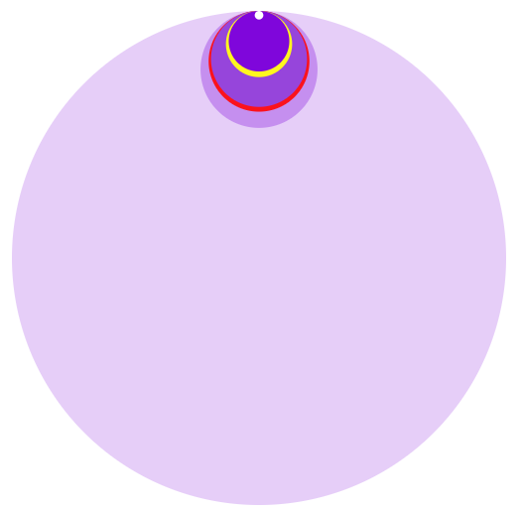
IFSP ICD = Autism
675
2014
2014 Birth Cohort
Census Estimate 36,326
1.86% 1:54

Slide 12
IFSP ICD = Autism
859
2017
2017 Birth Cohort
Census Estimate
35,560
2.42% 1:41

Slide 13
Monthly Averages from August 2019 - January 2020
Number of Children
Number of Hours ($)

Slide 14
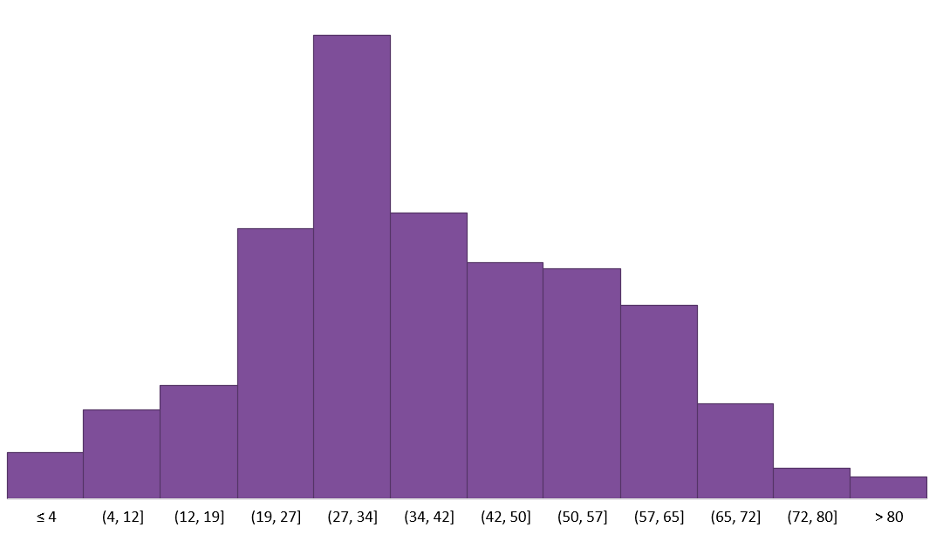
Average Hours pm
on 1st IFSP with F84.*
2014
Mean = 38.4
Median = 36.1

Slide 15
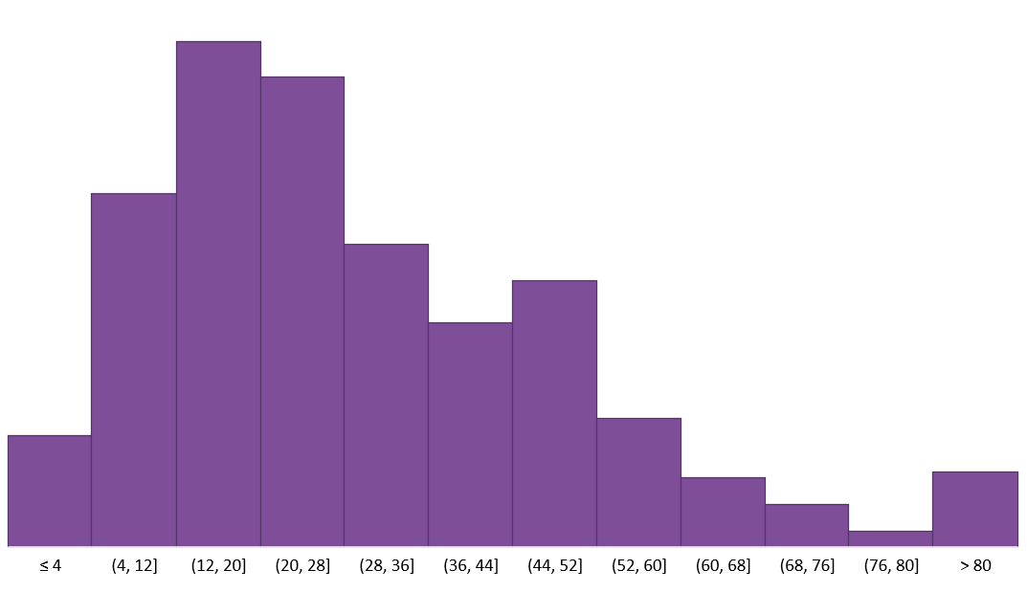
Average Hours pm
on 1st IFSP with F84.*
2017
Mean = 29.8
Median = 24.6

Slide 16
Racial /Ethnic Percentages
2014

Slide 17
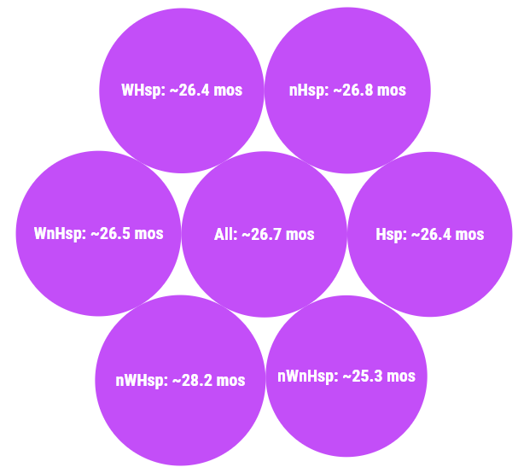
Average Age when 1St IFSP
Includes an Autism ICD
2014
2017
All 26.6

Slide 18
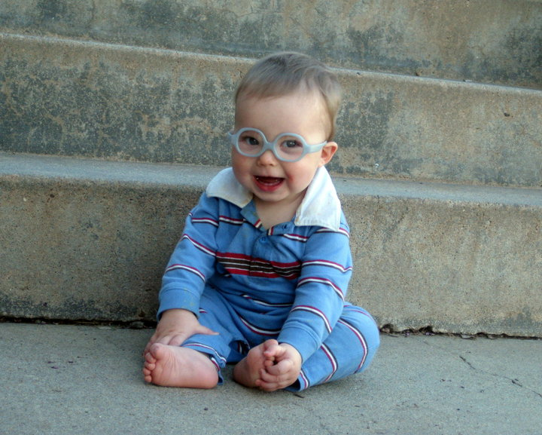
Remote EI AND In-person Visits
https://toddlerglasses.files.wordpress.com/2010/05/caleb.jpg

Slide 19
Early Intervention Supports Provided Each Month by R/E and Method*
Counts of All Children |  |  |  |  |  |  |  |  |  |  | Percent in Month
 | January 2021 |  |  | February 2021 |  |  | March 2021 |  |  |  |  | January |  | February |  | March
R/E group | In-Person | Remote | Total | In-Person | Remote | Total | In-Person | Remote | Total |  | R/E group | In-Person | Remote | In-Person | Remote | In-Person | Remote
All | 816 | 5272 | 6088 | 1013 | 5343 | 6356 | 1584 | 5506 | 7090 |  | All | 13% | 87% | 16% | 84% | 22% | 78%
Hispanic | 261 | 1828 | 2089 | 316 | 1836 | 2152 | 490 | 1888 | 2378 |  | Hispanic | 12% | 88% | 15% | 85% | 21% | 79%
Black Non-Hispanic | 95 | 636 | 731 | 109 | 646 | 755 | 169 | 681 | 850 |  | Black Non-Hispanic | 13% | 87% | 14% | 86% | 20% | 80%
White Non-Hispanic | 426 | 2488 | 2914 | 531 | 2524 | 3055 | 834 | 2591 | 3425 |  | White Non-Hispanic | 15% | 85% | 17% | 83% | 24% | 76%
Other Non-Hispanic | 34 | 320 | 354 | 57 | 337 | 394 | 91 | 346 | 437 |  | Other Non-Hispanic | 10% | 90% | 14% | 86% | 21% | 79%
Counts of Children with an Autism Spectrum Disorder |  |  |  |  |  |  |  |  |  |  | Percent in Month
 | January 2021 |  |  | February 2021 |  |  | March 2021 |  |  |  |  | January |  | February |  | March
R/E group | In-Person | Remote | Total | In-Person | Remote | Total | In-Person | Remote | Total |  | R/E group | In-Person | Remote | In-Person | Remote | In-Person | Remote
All | 167 | 685 | 852 | 183 | 653 | 836 | 237 | 615 | 852 |  | All | 20% | 80% | 22% | 78% | 28% | 72%
Hispanic | 71 | 285 | 356 | 76 | 271 | 347 | 84 | 264 | 348 |  | Hispanic | 20% | 80% | 22% | 78% | 24% | 76%
Black Non-Hispanic | 27 | 95 | 122 | 20 | 99 | 119 | 32 | 88 | 120 |  | Black Non-Hispanic | 22% | 78% | 17% | 83% | 27% | 73%
White Non-Hispanic | 58 | 256 | 314 | 72 | 237 | 309 | 99 | 218 | 317 |  | White Non-Hispanic | 18% | 82% | 23% | 77% | 31% | 69%
Other Non-Hispanic | 11 | 49 | 60 | 15 | 46 | 61 | 22 | 45 | 67 |  | Other Non-Hispanic | 18% | 82% | 25% | 75% | 33% | 67%
*Children whose families received both methods in the month are counted in both columns.
 | ALL |  |  | ASD |  |  |  |  |  |  |  | DPH
Percent of Totals | Jan | Feb | Mar | Jan | Feb | Mar |  |  |  |  | Births | 2016 | 2017 | 2018
Hispanic | 34% | 34% | 34% | 42% | 42% | 41% |  |  |  |  | Hispanic | 24% | 25% | 25%
Black Non-Hispanic | 12% | 12% | 12% | 14% | 14% | 14% |  |  |  |  | Black Non-Hispanic | 13% | 13% | 14%
White Non-Hispanic | 48% | 48% | 48% | 37% | 37% | 37% |  |  |  |  | White Non-Hispanic | 55% | 54% | 54%
Other Non-Hispanic | 6% | 6% | 6% | 7% | 7% | 8% |  |  |  |  | Other Non-Hispanic | 8% | 8% | 7%

Slide 20
Transition Out of Part C
Part C - Birth to Three | Part B - Preschool Special Education
Natural Learning Environments Naturalistic Interventions | Least Restrictive Environment
Family is the Focus for Coaching | Education of the Child
Home and Community Settings | Peers in an Early Childhood Classroom
OEC Birth to Three Autism Community of Practice
Meeting every other month
Referring families to Beacon before age 3
Sharing options with families about supports beyond what LEAs offer
State Interagency Coordinating Council public comment
Upcoming joint Early Childhood Intervention (ECI) convening with leaders in CT
about the fluidity of a DSM diagnosis during preschool years

Slide 21
Questions?
Koleen.Kerski@ct.gov
(Alice.Ridgway@ct.gov)

