Slide 1
Transparency Advisory Council Meeting
February 22, 2023

Slide 2
Agenda
Welcome
Progress So Far
Further Plans for 2023
Highlight of Challenges

Slide 3
Progress Report

Slide 4
What We’ve Done Since our Last Meeting
People Served Dashboard
Dashboard data has been refreshed with all year 2022 data
Cost Data
Published select cost benchmarks for 2020 and 2021*
In process of publishing Medicaid Category of Expenditure for state fiscal year 2013-2022 on the Open Data Portal
Quality Data
Published HEDIS medical, dental, and behavioral health quality measures from 2018-2020*
* Data can be found here

Slide 5
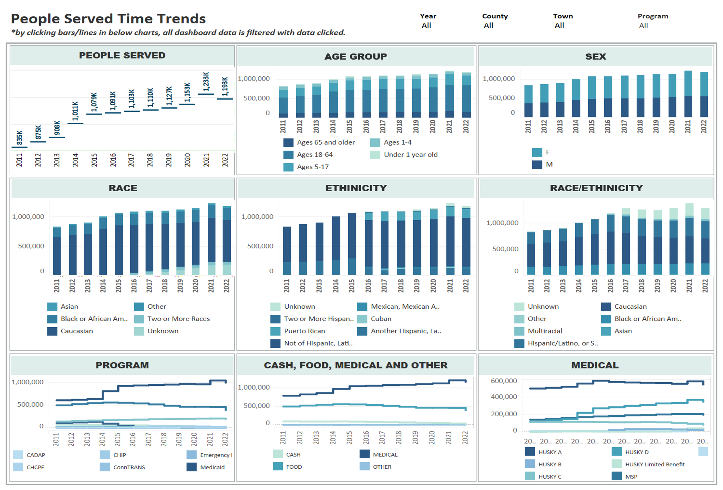
People Served – Beta Version

Slide 6
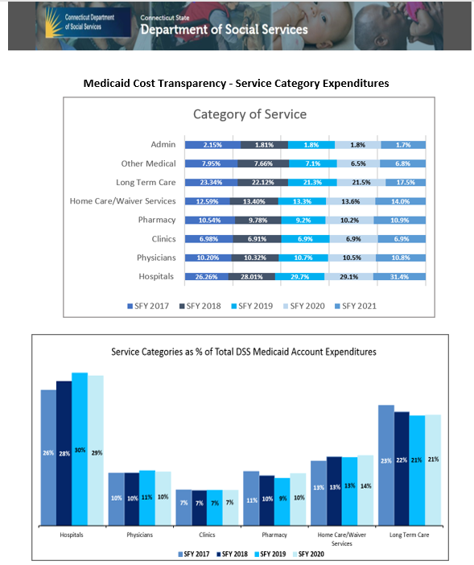
Cost Transparency
Current Data
Proposed Upgrades
Publishing 10-year Medicaid COS expenditure data on the Open Data Portal.
Create Tableau visualizations with the same dataset

Slide 7
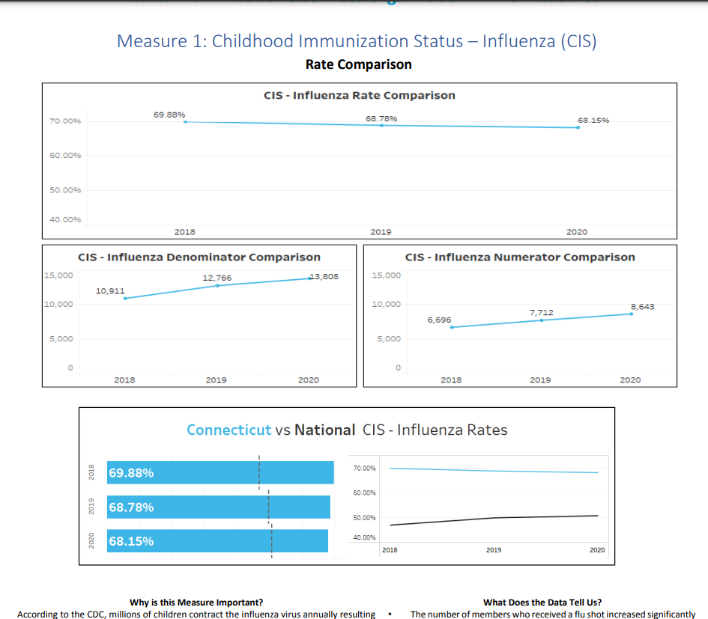
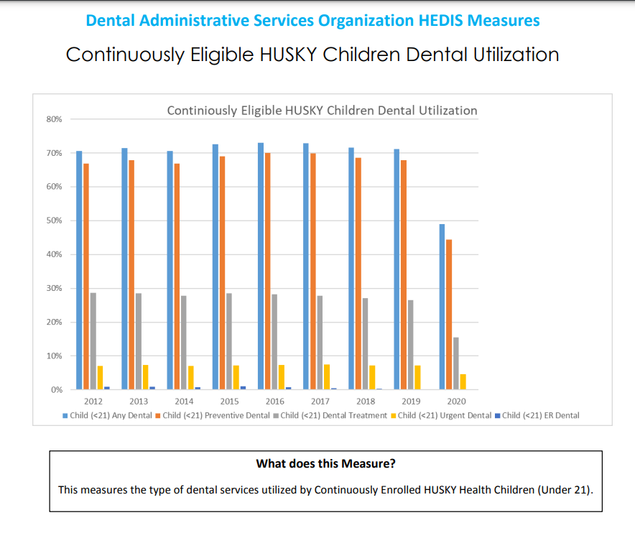
Quality Transparency
Published FY 2018-2020 HEDIS measures for:
Medical
Dental
Behavioral

Slide 8
Further 2023 Plans

Slide 9
What We Plan on Doing in 2023
Quality Data
Financial
People Served Dashboard
Update HEDIS data to include 2021 data in March
Refresh report with 2022 data in July
Expand to include new measures such as
prevalence rates of acute and chronic diseases*
utilization for chronic diseases
Inpatient utilization for chronic diseases
follow-up after ED visits
Update cost data with 2022 data by July
Refresh COS expenditure data with SFY 2023 data by July
Additional filtering parameters
Continued updating with CY 2023 data
*DM, HTN, Asthma, COPD, CAD, mental health disorders, obesity, cancer, substance use disorder

Slide 10
Highlight of Challenges

Slide 11
High-Level Challenges So Far
Technology
Data is fragmented across various internal systems ( Data warehouse, QM Eval, Exhibit E reports, MAR reports, etc.) and ASOs
People
Insufficient people with the requisite expertise to pull the data together (for instance, query the data from the warehouse) and produce the needed quality measures
People with expertise within DSS have limited bandwidth to support effort
Process
Absence of established mechanism to pull together existing data within DSS systems
Lengthy process to obtain data from various sources
Legal/procedural barriers to securing data external to DSS - for instance data held by DPH

