Slide 1

Accreditation Learning Community
June 21, 2018
1:00-2:00pm
Dial-In Number: 1 877 916 8051
Access Code: 539-9866

Slide 2
NACCHO’s Accreditation Coordinators Learning Community
Accreditation coordinators from local health departments that have applied to PHAB are invited to join NACCHO’s Accreditation Coordinators Learning Community.
This group provides a space for accreditation coordinators to network with peers, share effective practices and lessons learned, and participate in a virtual community. To learn more about the Accreditation Coordinators Learning Community, please contact accreditprep@naccho.org.

Slide 3
Effectively Managing Accreditation Teams/Documentation

Slide 4

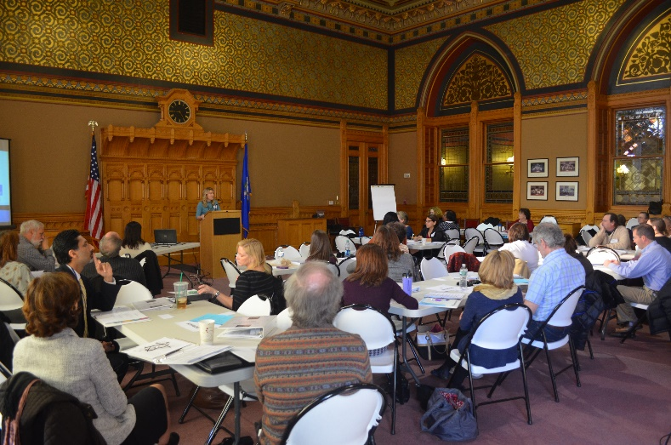
Staff Orientation on Accreditation
DPH held a Documentation Collection Kick-Off event about 18 months before we planned to submit documentation to PHAB
  Included an orientation and training session on PHAB Accreditation
Make it a special day or meeting! A Kick-Off emphasizes the importance of the event and sets the tone for the accreditation process

Slide 5
Staff Orientation (Kick Off) on Accreditation
Agenda:
    Opening Welcome by the Deputy Commissioner
    Presentation/Q&A on PHAB Accreditation
    Presentation on team roles how to review documentation
    Document Review Activity (gave samples of both good and bad documentation)
    Gave time for teams to read through measures and brainstorm documentation ideas
Be explicit about staff and team expectations
Domain Team Roles Presentation
Notes:
Here is a summary of the agenda from the Kick Off. DPH’s Deputy Commissioner at the time gave the Opening Welcome and emphasized accreditation as an agency priority. We provided an orientation and background on PHAB and how to read through the standards and measures. We then spent time setting expectations for our teams and what their roles will be going forward. With any major initiative, it is tough for staff to juggle their daily responsibilities and grant deliverables with “extra work”, and momentum from a kick off can be helpful to keep people focused. Knowing exactly what is expected of them will also help tremendously.

Slide 6
Team Roles and Responsibilities
Domain Team Leaders
  Organize and direct the team
  Ensure thorough and complete documentation review
  Moe documents into final folders when complete
  Update progress table
  Complete Measure Review Form
Domain Team Members
  Find documents from throughout accepted programs
  Review documents against measures, help complete measure review form
  Upload documents to folders

Slide 7
Tools to Give Teams
Give as much guidance and as many effective tools as possible. The easier you make it for staff, the better quality your documentation will be
DPH teams received a Binder that included:
  Guidance documentation from PHAB (Do’s and Don’ts for Preparing Documentation and Guidance on Appropriate Examples)
  Instructions and procedures for keeping track of documentation/collection examples
  Domain-specific standards and measures
“Cheat Sheet” was a popular tool that summed up important points to remember (such as Dos and Don’ts and cutoff dates for documentation)
“Quick Reference Checklist” was another good tool teams used to ensure selected examples met the basic requirements

Slide 8
Tools to Give Teams/Team Leads
Measure Review Form – used to keep track of documentation per measure and provided a central place to write in the document description
Domain Progress Table – a progress table was developed for each Domain to help Team Leads with a bird’s eye view of the documentation/example being used
  This was a critical tool for the Accreditation Coordinator and for teams preparing for the Site Visit later on

Slide 9
Accreditation Coordinator
Roles and Responsibilities
Serve as PHAB documentation subject matter expert
Attend each Domain team meeting to provide guidance and interpretation assistance (use examples from other departments to help teams get ideas for documentation: http://www.astho.org/Accreditation-Library/)
Holds teams accountable and keeps them on track
Acts as one of the final reviewers before documentation is submitted (along with health director or resident site visitor)
Fill in as team lead where gaps exist or when teams need more focused support

Slide 10
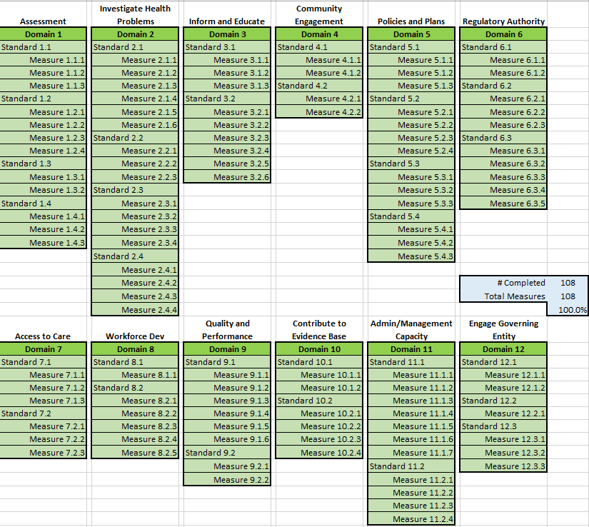
Accreditation Coordinator Tools
Progress Chart – keep track of overall progress

Slide 11
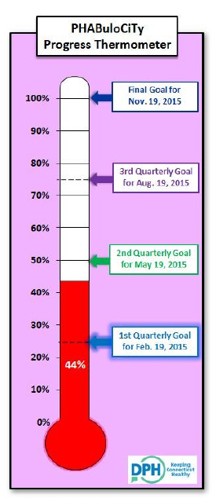
Using Visual Management
Use visual cues to keep teams on track
Progress Thermometer used to demonstrate progress on collecting documents to department
Reinforcing awareness of accreditation around department:
  “Help Wanted” Flyer
  “Fun PHAB Facts”
Celebrate your team’s hard work!

Slide 12
Lessons Learned/Tips
Supervisors/Managers are critical members of the Domain teams
As Accreditation Coordinator or part of the final Document Review Team, review each example and document description from the perspective of a Site Visitor before uploading to PHAB
You won’t have perfect documentation for every measure, submit the best example you can find (be ready to talk about it at the Site Visit)
Use highlighting, red arrows, and text boxes to direct the site visitors through your documentation (example)
Engage external consultation to review your documentation before submitting. DPH received TA from a consultant at ASTHO to review a portion of our documentation

Slide 13
NACCHO’s TA Website
  https://www.naccho.org/programs/public-health-infrastructure/performance-improvement/accreditation-preparation/documentation
  Provides resources for organizing and selecting documentation

Slide 14
Questions?

Slide 15
What topics do you want to hear about?
  What topics do you want to hear about from July to December?
  Any particular Domain?
  More health equity?
  Workforce Development or QI?

Slide 16
Up Next…
Next Meeting:
  July 27| 1-2pm

