Slide 1

Accreditation Learning Community
September 27, 2018
1:00-2:00pm
Dial-In Number: 1 877 916 8051
Access Code: 539-9866

Slide 2
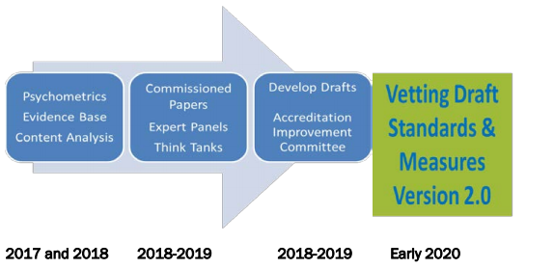
PHAB Standards and Measures Version 2.0
PHAB has begun preparations for refreshing the accreditation standards and measures
Will not take effect until at least 2020

Slide 3
Brainstorming:
Proposals for Expanding the Peer-to-Peer Network
Planning Workgroup
  -Advise on agenda and topics for the call
  -Identify to organizations or subject-matter experts for topic presentations or potential trainings
  -Issue “Spotlight” – A participant brings an issue or challenge they are facing to the group related to accreditation, PM/QI, CHA/CHIP/SP, WFD
Documentation Review Workgroup
-Peer review documentation against PHAB Standards and Measures
-Share examples/outcomes from reviews with ALC
-Practice your PHAB interpretation skills and knowledge!

Slide 4
Maintain Capacity to Engage the Public Health Governing Entity
(Domain 12)

Slide 5
Advancing Health Equity through Domain 12
Domain 12 is focused on the entity governing the public health department – e.g. Board of Health, mayor, etc.
Engage members of the governing entity in department- and jurisdiction-wide trainings on health and racial equity, the historical role of government in perpetuating inequities and how to champion transformative change across the jurisdiction.
Potential activities:
-Include governing entity in CLAS trainings
-Use communication opportunities with the governing entity to discuss how inequities are affecting the health, income, education, crime, overall economic well-being of your community

Slide 6
Advancing Health Equity through Domain 12
Be vocal with decision makers and other government agencies when policy proposals might exacerbate inequities, even when doing so is not the easy thing to do.
Potential activities:
-Tracking policy decisions and opinions of policy makers and municipal leaders to better understand where equity or social determinants of health considerations are missing
-Sharing evidence of health inequities in your community and identifying who is most at risk to be impacted by policy proposals
Health in All Policies = Embedding health considerations into decision-making processes.
-Addressing social determinants of health (upstream prevention), such as housing, transportation, education, access to healthy food, economic opportunities, and more
“Involves permanent changes in how agencies relate to each other and how government decisions are made, structures for intersectoral collaboration, and mechanisms to ensure a health lens in decision- making processes”

Slide 7
Advancing Health Equity through Domain 12
Proactively develop relationships across sectors, with sister agencies, and with elected officials and their offices, to assist in understanding the political landscape and establishing rapport and credibility.
Potential activities:
-Engaging non-traditional partners in the CHIP
-Participating in the State Health Improvement Coalition to make new connections or align strategies

Slide 8
Standard 12.1
Measure 12.1.1 – Mandated public health operations, programs, and services provided
Required Documentation 1: Authority to conduct public health activities
    CGS Section 368e for municipal health departments
    CGS Section 368f for district health department
    CT Public Health Code
    Town charters/local board of health by-laws that establish your health department’s authority
    Highlight the exact portions of the statute, regulation, law, legal citation, that grants your health department the authority to conduct public health activities. No one wants to read 30 pages of law
    Additionally provide a listing of mandated public health services (i.e. CT Public Health Code) and have the actual regulations on hand if/when PHAB asks for it during Pre-Site Visit Questions or during the Site Visit.

Slide 9
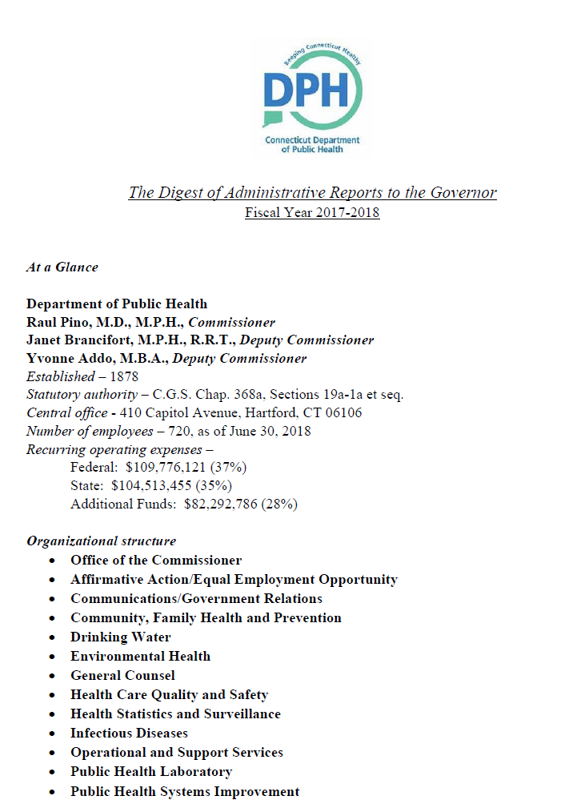
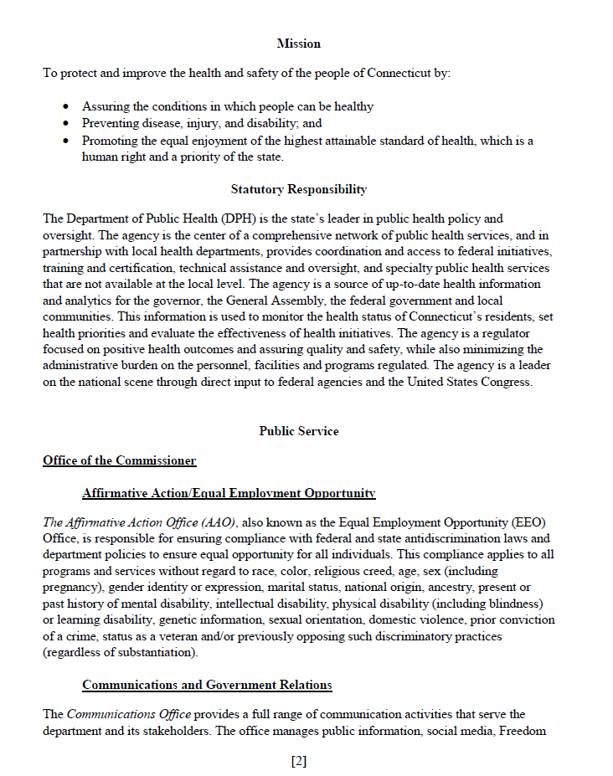
Standard 12.1
Measure 12.1.1 – Mandated public health operations, programs, and services provided
Required Documentation 2: Operations that reflect authorities
    i.e. Annual Report to CT DPH
    i.e. Annual Report to Board/Municipal

Slide 10
Standard 12.1
Measure 12.1.2 – Operational definitions and/or statements of the public health governing entity’s roles and responsibilities
Required Documentation 1: The governing entity’s authority
    CGS Section 368e for municipal health departments
    CGS Section 368f for district health department
Required Documentation 2: The governing entity’s structure and composition
    CGS Section 368e for municipal health departments
    CGS Section 368f for district health department
    Board of Health Charter? Municipal regulations? Other written document
Despite the no date restriction on the examples, be sure there is a date somewhere on the document identifying the age of the documentation

Slide 11
Standard 12.2
Measure 12.2.1 – Communication with the governing entity regarding the responsibilities of the public health department and of the responsibilities of the governing entity
Required Documentation 1: Communication with the governing entity regarding the responsibilities of the public health department
(a) Document examples of the department sharing with the governing entity about the role and responsibility of the department AND/OR about the role the governing entity plays in advancing public health
-You may choose to use the documentation you provided for Measure 12.1.1 Required Documentation 2
(b) Document its process for orientation of new members of the governing entity

Slide 12
Standard 12.3
Measure 12.3.1 – Information provided to the governing entity about important public health issues facing the community or recent actions
Required Documentation 1: Communication regarding important public health issues and/or recent actions
  2 examples dated within 2 years
  For example: Agenda/minutes from a meeting with your board or mayor

Slide 13
Standard 12.3
Measure 12.3.2 – Actions taken by the governing entity tracked and reviewed
Required Documentation 1: HD must document that it has consistently reviewed the governing entity’s 1) patterns of issues discussed; 2) opinions of the governing entity; and/or 3) positions taken
Discussion of one action or issue does not meet the intent of the measure.

Slide 14
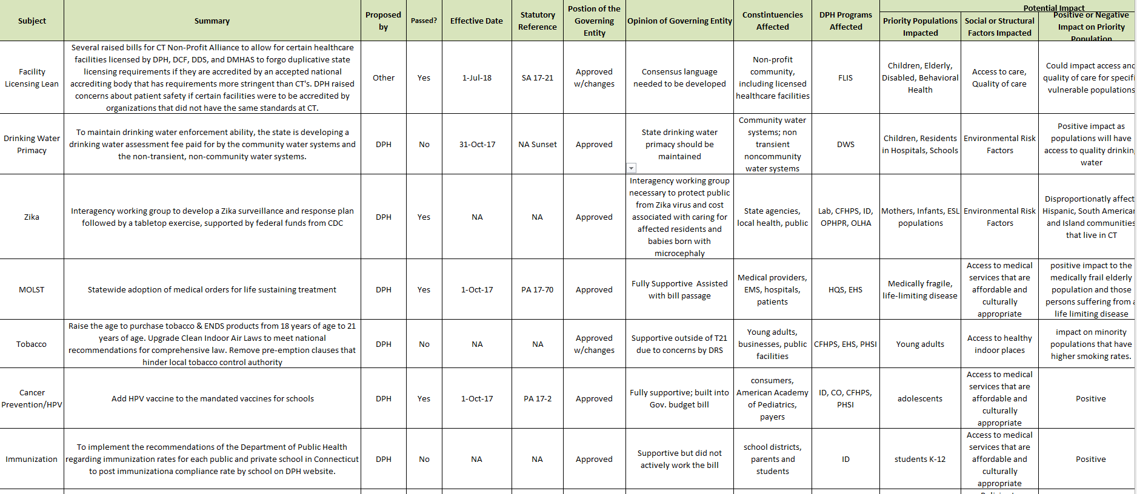
Governing Entity Actions Tracker
Health Equity impact tracked

Slide 15
Standard 12.3
Measure 12.3.3 – Communication with the governing entity about health department performance assessment and improvement
Required Documentation 1: Communication regarding assessment of health department’s performance and plans for improvement
Examples: Gaps analysis for accreditation, QI Roadmap assessment, performance dashboard review, assessment of data challenges
Required Documentation 2: Communication regarding improvement of health department’s performance as a result of improvement activities
Examples: QI project, demonstrated improvements in CHIP measures

Slide 16
Engaging the Governing Entity in Accreditation
In addition to Domain 12 documentation, a letter of support from the health department’s governing entity is required upon applying.
NAACHO Resources:
https://www.naccho.org/programs/public-health-infrastructure/performance-improvement/accreditation-preparation/local-government
Public Health 101 PowerPoint Presentation
Public Health and Accreditation Fact Sheet

Slide 17
Questions?
How have you began to engage your governing entity in accreditation? Are they generally supportive?
What processes does your health department have in place to communicate with your governing entity about public health activities?

