Slide 1
Accreditation Learning Community
October 24, 2018
1:00-2:00pm
Dial-In Number: 1 877 916 8051
Access Code: 539-9866

Slide 2
Expanding the Peer-to-Peer Network
Documentation Review Workgroup
-Peer review documentation against PHAB Standards and Measures
-Share examples/outcomes from reviews with ALC
-Practice your PHAB interpretation skills and knowledge!
Please send me an email if you are interested in partaking!

Slide 3
Promote Strategies to Improve Access to Health Care (Domain 7)

Slide 4
Domain 7
Intent is to address improved access from a community systems perspective
Not about clinical services the HD provides
About assessment and promotion of population’s access to care
Also about the structure and design of the health care system and its relationship with the community
Availability of primary care and other providers, community’s trust of the health care system, location of services, service hours
Access
“the potential for or actual entry of a population into the health system. Entry is dependent upon the wants, resources, and needs that individuals bring to the care-seeking process. The ability to obtain wanted or needed services may be influenced by many factors, including travel distance, waiting time, available financial resources, and availability of a regular source of care.”
-PHAB Acronyms and Glossary of Terms

Slide 5
Domain 7
Populations that often lack access to health care include:
Elderly
Children
Veterans
People with physical or intellectual disabilities
Homeless
Immigrants
Migrants
Non-English speaking people
LGBTQ community
People who live in rural locations

Slide 6
Advancing Health Equity through Domain 7
Create a culture of respectful co-learning, evaluation, reflection, and transparency about community and department needs/priorities to build trust between department and community partners.
Commit to developing a professional workforce that reflects the demographics of the populations served and the communities facing health inequities.
Examine public and organizational policies, rules, and regulations that facilitate or inhibit working upstream and ensure that resources are not reinforcing cultural bias, barriers, and inequities.

Slide 7
Advancing Health Equity through Domain 7
Work to address the availability of health care services to the population should be connected to ongoing analysis and systems-change work related to the social determinants of health.
Advance language justice by improving department’s interpretation and translation practices by: gaining a better understanding of internal capacity, streamlining processes with vendors, finding opportunities for professional development; and developing consistency through policies and protocols.

Slide 8
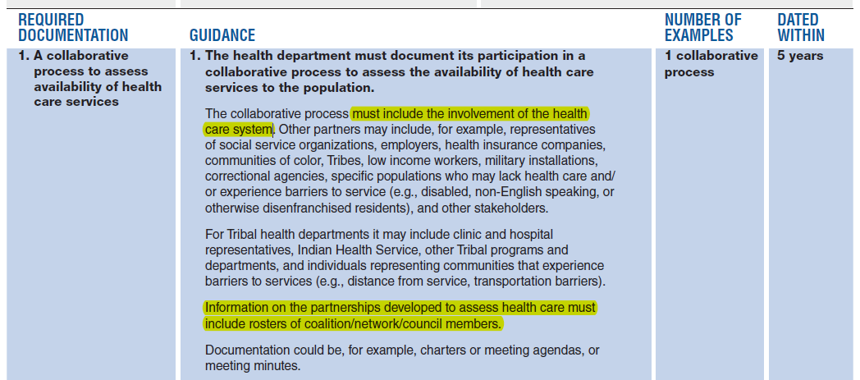
Measure 7.1.1 – Process to assess the availability of health care services
Potential Examples:
-Participation in Community Health Needs Assessment
-Participation with the CT State Innovation Model (SIM)
-Community Health Assessment

Slide 9
Measure 7.1.1 – Process to assess the availability of health care services
Potential Examples:
-Meetings with coalition partners to share data
-Sharing data with the state or local healthcare organization
-Community Health Assessment community/public forums

Slide 10
Measure 7.1.1 – Process to assess the availability of health care services
Potential Examples:
-Assessment of emerging issues in community health assessment, or even agency strategic plan
-Minutes from a meeting reporting or discussing health care mergers in your community

Slide 11
Measure 7.1.2 – Identification of populations who experience barriers to health care services
Potential Examples:
-Community Health Assessment
-Community Health Needs Assessment with health care system
-Focus groups/surveys with specific, vulnerable populations
-Secondary data from the Census Bureau

Slide 12
Measure 7.1.2 – Identification of populations who experience barriers to health care services
Potential Examples:
-Community Health Assessment
-Community Health Needs Assessment with health care system
-Report on focus groups/surveys with specific, vulnerable populations
-Report on secondary data from the Census Bureau that your health department developed and shared with partners

Slide 13
Measure 7.1.3 – Identification of gaps in access to health care services and barriers to receipt of care
Potential Examples:
-Community Health Assessment
-Community Health Needs Assessment with health care system
-Focus groups/surveys with specific, vulnerable populations
-Work with FQHCs, SBHCs, CHCs

Slide 14
Measure 7.1.3 – Identification of gaps in access to health care services and barriers to receipt of care

Slide 15
Standard 7.2 – Identify and Implement Strategies to Improve Access to Health Care Services

Slide 16
Measure 7.2.1 – Process to develop strategies to improve access to care

Slide 17
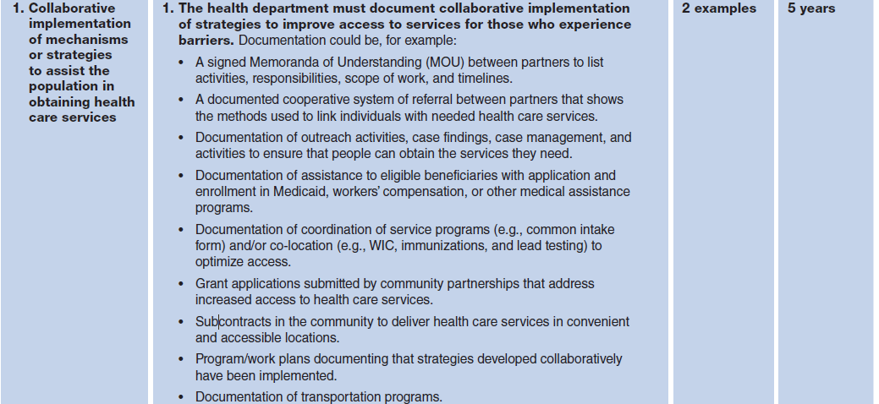
Measure 7.2.2 – Implemented strategies to increase access to health care services

Slide 18
Measure 7.2.3 – Implemented culturally competent initiatives to increase access to care
https://portal.ct.gov/DPH/Workforce--Professional-Development/Office-of-Health-Equity/Office-of-Health-Equity

Slide 19
Questions?

Slide 20
Issue Spotlight
Performance Management and QI Trainings
Course # 1063722 Connecticut Department of Public Health, A High Performance Organization
Course # 1059243 Introduction to Quality Improvement in Public Health
Course # 1030628 Quality Improvement Quick Guide Tutorial
Managing Effectively: Quality Improvement in Public Health (NEPHTC)
https://phtc-online.org/learning/?courseId=48&status=all&sort=group

Slide 21
Issue Spotlight
Measure 2.2.2 RD1:
How much detail from the state’s emergency SOPs did the state submit?
DPH submitted the CT Reportable Diseases Reference Manual, which primarily identifies disease case investigation and follow for routine reportable infectious diseases. The manual also includes attachments/appendix in Section 7 that provide information on the process for reporting infectious diseases, case report and contact management forms, and other key protocols related to cluster investigations, Ebola Traveler Monitoring and Zika Virus surveillance and response.
Page 12 of that document describes when the EOP is implemented, so we highlighted that section to point Site Visitors to the content.

Slide 22
Next Meeting
Next Meeting Date:
November 28, 2018 | 1:00-2:00pm
Topic:
Standard 1.1 – Community Health Assessment

