Slide 1
Accreditation Learning Community
November 28, 2018
1:00-2:00pm
Dial-In Number: 1 877 916 8051
Access Code: 539-9866

Slide 2
SHA 2.0 Indicator Prioritization Criteria
SHA 2.0 Indicators
All indicators must be:
Reliable or validated (studies in the larger literature show strong consistency and validity)
Available over time (5 years ago or newer)
Available by population sub-group and/or geography (e.g., county level)
Other Criteria include:
Magnitude (size)
Seriousness
Ability to change (feasibility)
Health Equity
Root cause or social determinant that affects multiple health issues
Quality of data
Trend data available
Comparison data available

Slide 3
Participate in or Lead a Collaborative Process Resulting in a Comprehensive Community Health Assessment (Standard 1.1 – Measure 1.1.1, Measure 1.1.2)

Slide 4
Advancing Health Equity through the Community Health Assessment
Create a table for CHA and CHIP engagement that centers on community voice – partner with individuals or organizations that represent populations most impacted by health inequities
Include data and data analysis from other government agencies, such as housing, transportation, police, parks and rec, etc.
Actively engage community members most impacted by health inequities in:
Selecting focus areas and project-specific and department-wide indicators, data, and priority measures
Data analysis - as they have key insights, history, stories, and information about why we see inequities.
Highlight data and stories on community resiliency and community-led efforts to achieve health equity

Slide 5
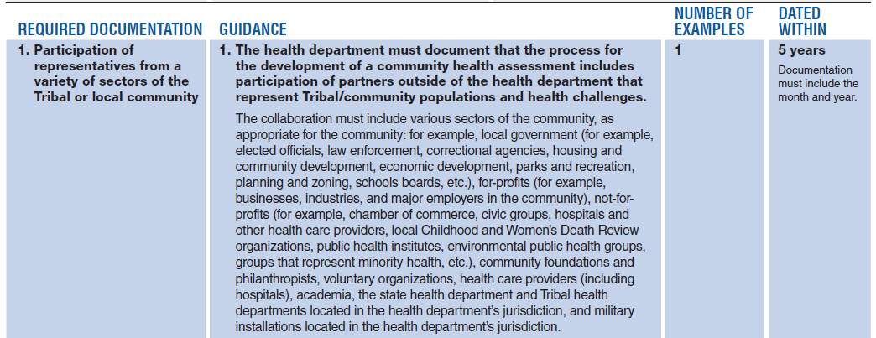
Measure 1.1.1 T/L: Partnership that develops a comprehensive community health assessment
Required Documentation 1
The partners you engage should represent the community and stakeholders you serve
Stakeholders are any person or organization affected by a decision or policy or who may have information that affects the decision or policy
Participation from diverse stakeholders enrich the CHA and bring depth to the document beyond the data collected.

Slide 6
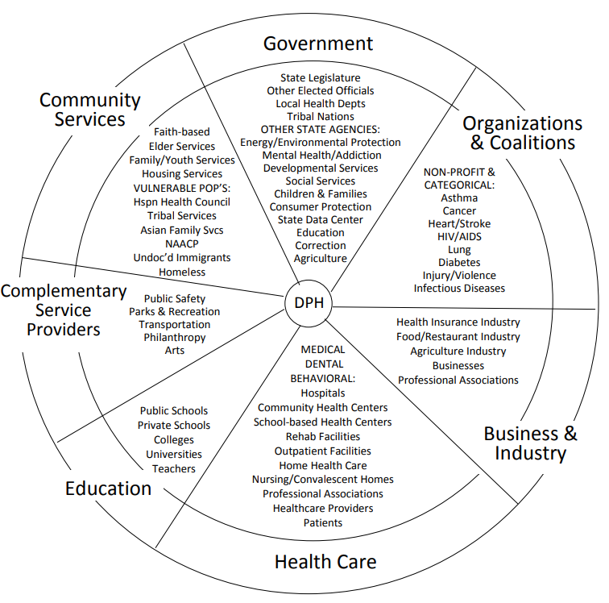
DPH’s Approach – Sector and Stakeholder Wheel
Sector and Stakeholder Wheel is a different way to look at the public health system
Ensures inclusion of a diverse group of stakeholders for participation in the SHA
Other connections may not be as intuitive, but engagement of those stakeholders is really essential for addressing social, economic, and environmental determinants of health.

Slide 7
Measure 1.1.1 T/L: Partnership that develops a comprehensive community health assessment
Required Documentation 2
Must document that partnership meets and communicates on a regular basis
Documentation should be supportive enough to demonstrate what was accomplished at the meeting or during the communications

Slide 8
Measure 1.1.1 T/L: Partnership that develops a comprehensive community health assessment
Required Documentation 3
Must document the process used to identify and collect data/information
There is no prescribed model agencies must use, but whichever process an agency chooses should engage partners throughout the process and address social determinants of health

Slide 9
Measure 1.1.2 T/L: A tribal/local community health assessment
Required Documentation 1a
Must document the identification and description of the community’s health and areas for health improvement, the factors that contribute to the health challenges, and the existing community resources that can be mobilized to address them.

Slide 10
Measure 1.1.2 T/L: A tribal/local community health assessment

Slide 11
Measure 1.1.2 T/L: A tribal/local community health assessment
Required Documentation 1b
Provides the health department with knowledge of who their community is and where socioeconomic inequities may exist

Slide 12
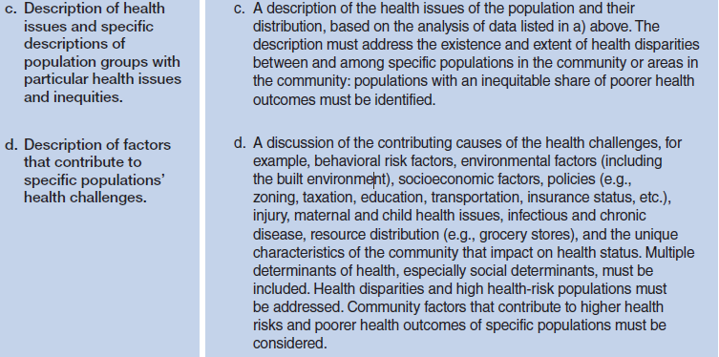
Measure 1.1.2 T/L: A tribal/local community health assessment
Required Documentation 1c and 1d

Slide 13
Measure 1.1.2 T/L: A tribal/local community health assessment
Required Documentation 1e
Intent is to identify and map resources that can be leveraged to improve health
Community Asset: A quality, person, or thing that is an advantage, a resource, or an item of value to an organization of community.
Public Health Assets can include individuals, organizations, institutions, and environmental assets

Slide 14
Measure 1.1.2 T/L: A tribal/local community health assessment
Required Documentation 2
Benefits of engaging the community in the development of the assessment increases awareness of the assessment, communicates the value of public health, and provides stakeholders the opportunity to contribute to the report
The health department could collect primary data and qualitative data during events that seek community input

Slide 15
Engaging Stakeholders in the CHA
Methods of engagement:
Survey (via mail, phone, web, or in person)
Recruit community partners who work with priority populations to post the survey on their websites or provide them at their locations (i.e. associations, physician offices)
Community Forums/Listening Sessions
Could be considered town hall meetings or other public event
Focus Groups
Key Informant Interviews

Slide 16
State Health Assessment
SHA 1.0
Public Forums on the 2014 SHA Draft
Hosted one in each CT county
Spanish Webinar
Special forum for other state agencies
SHA 2.0 Plan of Action
Online Survey (February 2019)
Coalition Summit (Spring/Summer 2019)
Public Input Survey (Summer 2019)
Community Forums in each county (Fall 2019)

Slide 17
Discussion Questions
How have you identified partners and stakeholders to bring to the table in the development of the SHA?
How have you sought public input to supplement your CHA and/or to receive feedback on preliminary findings?
What have you found to be the most effective way to engage the community in the development/sharing of your CHA?

Slide 18
Issue Spotlight

Slide 19
Next Meeting – January 2019
December ALC will be canceled due to scheduling conflicts and holidays
An evaluation on the ALC will become available in the next few weeks. Please take 5 minutes to complete it and be honest! The goal of the ALC is to be as helpful as possible to you and your team on your accreditation journey.
Next meeting will be January 23, 2019. A new calendar series will be sent out for 2019.

