Slide 1

Accreditation Learning Community
March 28, 2018
1:00-2:00pm
Dial-In Number: 1 877 916 8051
Access Code: 539-9866

Slide 2
Agenda
March 28, 2018 | 1:00pm-2:00pm
Dial-In Number: 1- 877-916-8051
Access Code: 539-9866
1:00 – 1:15 | Topics Calendar/Updates
1:15 – 1:35 | PHAB Six-Pack: Quality Improvement Plan
1:35 – 2:00 | Open Discussion

Slide 3
Topic Calendar
 | Topic
March | PHAB 6-Pack: Quality Improvement Plan
April | Adopting a Performance Management System
May | Effectively Managing Accreditation Teams/Documentation
June | Developing and Implementing Operational and Health Equity Policies to Support Public Health
July | Emergency Operations Plan and Supporting Documentation
August | Improving Access to Health Care

Slide 4
Accreditation Considerations for Shared Services and Mergers
Shared Services
  Essential services can be provided by other health departments or organizations
    Documentation examples should include:
      evidence the service is provided to your population/community
      a partnership and your local health department’s involvement
      Example: CHAs conducted by a hospital/healthcare organization should list your HD as a contributing organization, or even better, include your HD’s logo as a partner, especially if you provided funding
  Multijurisdictional Accreditation: Two or more health departments that demonstrate a high degree of inter-dependence and formally share resources for essential services may apply together

Slide 5
Accreditation Considerations for Shared Services and Mergers
Mergers
Merger | Action/Impact
Accredited HD + Accredited HD | Report to PHAB
Non-Accredited HD + Non-Accredited HD | Merger plans should include accreditation considerations
Accredited HD + Larger Non-Accredited HD | Contact PHAB ASAP; some additional accreditation review may be necessary to ensure standards are met for entire population
Accredited HD + Smaller Non-Accredited HD | Consider how continued conformity with standards will be impacted; may not require additional accreditation review
PHAB primary staff contact for consultation:
Robin Wilcox, Chief Program Officer (rwilcox@phaboard.org or 703-778-4549, ext. 106)

Slide 6
PHAB Six-Pack -
Quality Improvement Plan
Notes:
One of the 6 major plans required for accreditation – CHA/CHIP/Strategic Plan, QI Plan, Workforce Development Plan, Emergency Operations Plan
Once developed, your quality improvement project can be updated, so if you are starting to conduct quality improvement projects, remember they need to be based on your QI plan, per Measure 9.2.2 requirements. QI projects started after the date the QI plan was finalized do not fully conform to the Measure 9.2.2 requirements. Be sure to keep the finalized date on your plan and add revision dates as they occur.

Slide 7
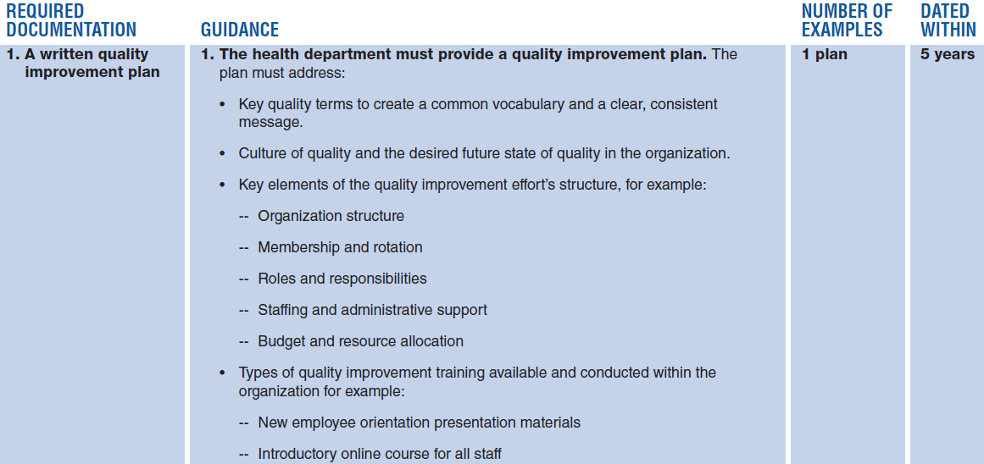
QI Plan Requirements
Notes:
requirements listed under Measure 9.2.1 A

Slide 8
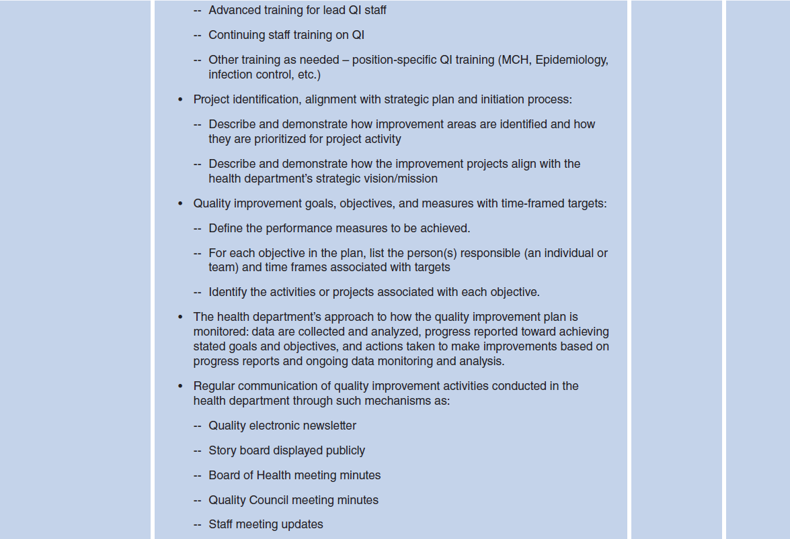
QI Plan Requirements

Slide 9

QI Plan Requirements

Slide 10
QI Plan Requirements
Key quality terms to create a common vocabulary and a clear, consistent message
  Use terms relevant to your agency and goals
    i.e. process improvement vs. quality improvement
      Plan-Do-Check-Act (PDCA) vs. Plan-Do-Study-Act (PDSA)
  Describe the common language/terms your agency will use
  Include an Appendix or Definitions section to ensure staff and partners understand your terms
Notes:
For example, at the state-level, after Gov. Malloy instituted the Lean Initiative, the terms “process improvement”, “Lean”, “Plan-Do-Check-Act”, and others, were adopted by the state agencies. Where DPH differs, however, is often on using the term “quality improvement” rather than “process”, or “Plan-Do-Study-Act” instead of “Check” because we like to study things in Public Health, not just check. Now, this doesn’t mean you can’t use those other terms, but your QI Plan should describe terms and definitions that are relevant to you and your agency. You can refer to the PHAB glossary of terms document located on their website for additional terms and definitions.
It is also a good practice to use the same language in all your agency plans, including the Strategic Plan and Workforce Development Plan.

Slide 11
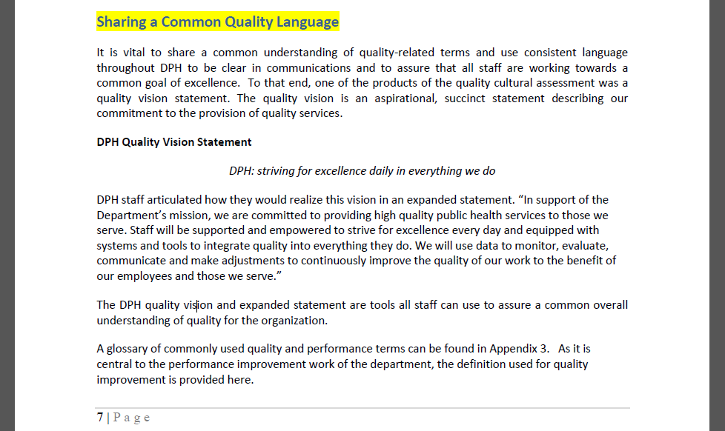
QI Plan Requirements
Notes:
For example, here is an excerpt from DPH’s QI Plan. This is not a requirement, but DPH found it helpful to develop a DPH Quality Vision Statement to support the agency’s mission of providing high quality services to CT residents. We go on to define quality improvement as the use of a deliberate and defined improvement process, such as Plan-Do Study-Act that focuses on activities that address community needs and population health improvement (you’ll note in the copy you have that we wrote Plan-Do-Check-Act, but we are updating that to say “Study”). The reason we need to define QI is because DPH also utilizes quality assurance and quality control practices throughout the lab and other regulatory functions, so we needed to distinguish between the terms.

Slide 12
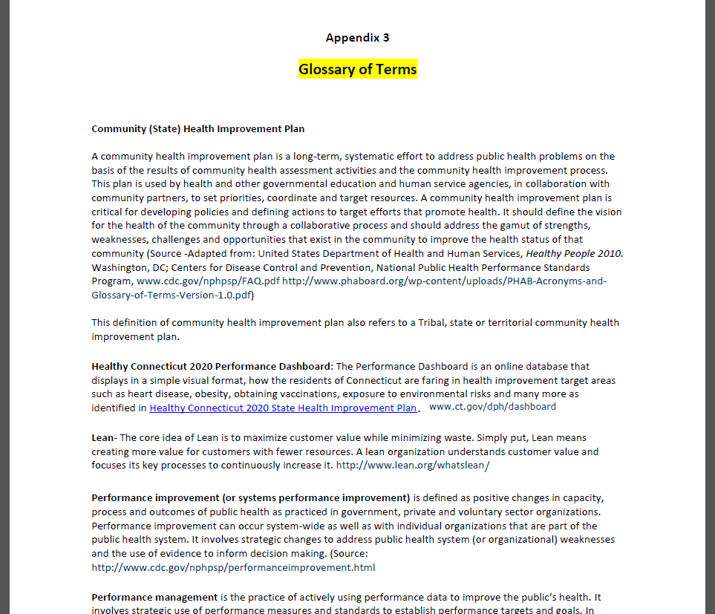
QI Plan Requirements
Notes:
A glossary of terms is located at the end of the Quality Plan and specifically defines the language we use at DPH

Slide 13
QI Plan Requirements
Culture of quality and the desired future state of quality in the organization
  Describe your agency’s current culture of quality (i.e. quality/performance management assessments, position in the Roadmap to a Culture of Quality Improvement, % of staff who have been trained in QI, current infrastructure)
  Describe where your agency would like to be relative to QI (your future or desired state)
Notes:
The plan must also address your agency’s culture of quality and the desired future state of quality in the organization. A great way to describe your agency’s current culture of quality is through the Roadmap to an Organizational Culture of QI developed by NACCHO. When we did our assessment with staff in 2013, participants rated DPH to be on Exit 4, generally indicating that some formal QI activities take place in the agency but not on a widespread basis.
You can identify the percent of staff currently train in QI or leadership and establish a goal for future state. You can also describe what your current infrastructure is for QI and what you would like to do to improve it in the next 5 years. For example, you might want to allocate or apply for funds for a full time accreditation coordinator, or you would like to train a current staff member to be a QI Coordinator. Or maybe you want to eventually include all staff on a QI Council.

Slide 14
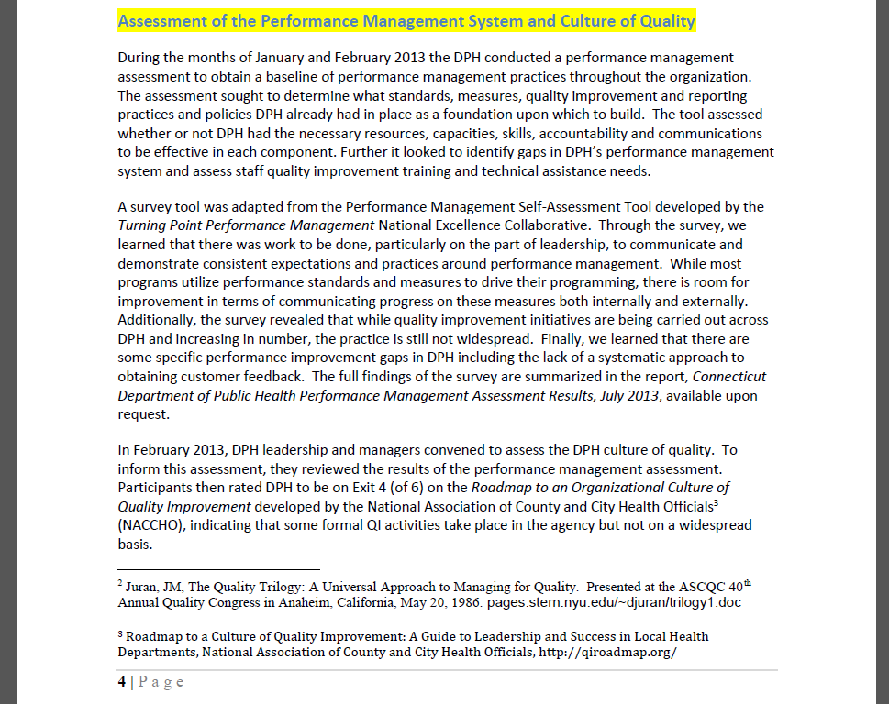
QI Plan Requirements
Notes:
PDF pg 8-10

Slide 15
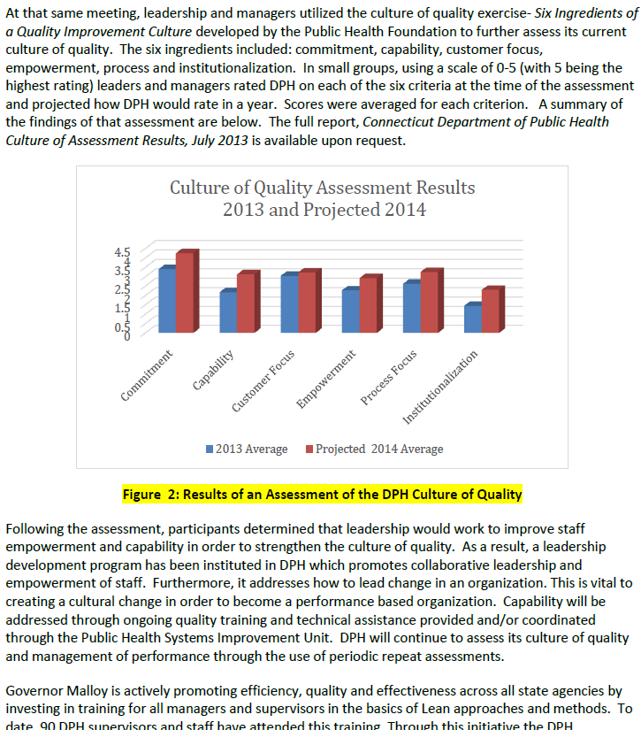
QI Plan Requirements
Notes:
For a description of a desired future state, we pointed PHAB to our vision statement, performance dashboard with targets for the % of staff trained in QI and trained in leadership development

Slide 16
QI Plan Requirements
Key elements of the quality improvement effort’s structure
  Describe how your quality program is, or will be, structured and managed (i.e. committee, responsibilities of staff positions, etc.)
Example from LA County QI Plan
At DPH
  Office of Public Health Systems Improvement directs, manages, coordinates strategic planning, health improvement planning, quality improvement, performance management and accreditation efforts
  Public Health Strategic Team (PHST) made up of department staff and senior leadership assures alignment of all major planning and strategic initiatives
  Quality Improvement Council, Workforce Development Committee, Customer Service Committee, Advisory Council of CT Health Improvement Coalition

Slide 17
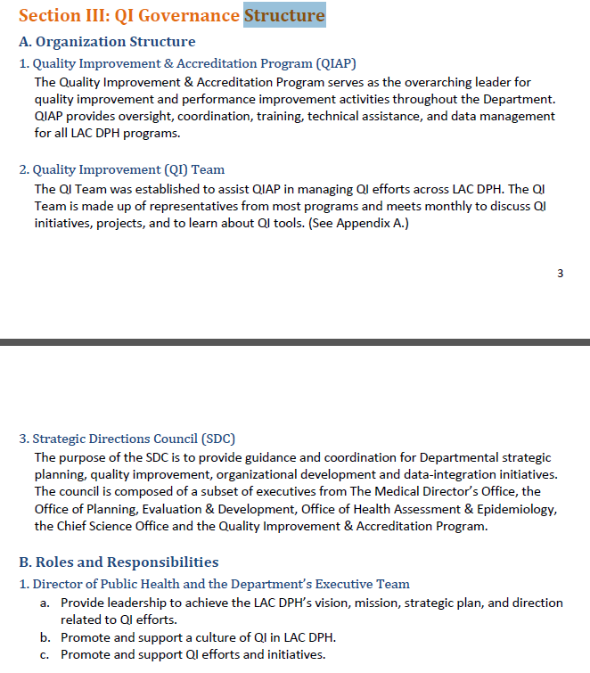
QI Plan Requirements

Slide 18
QI Plan Requirements
Types of quality improvement training available and conducted within the organization (i.e. new employee orientation, online courses, advance training for lead staff, continuing training)
  Public Health Foundation Tutorial
  Utilize offerings on CT TRAIN:
    CT DPH, A High Performance Organization (# 1059810)
    Intro to Quality Improvement in Public Health (#1059243)
    Many others

Slide 19
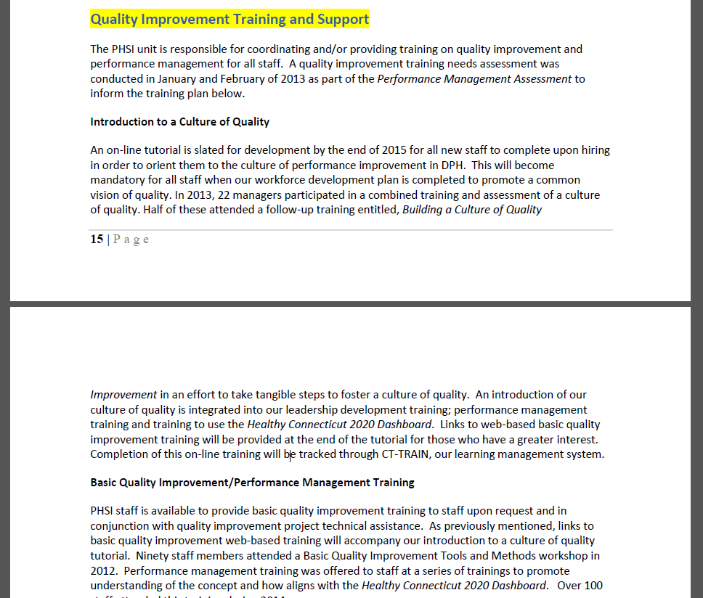
QI Plan Requirements
Notes:
In DPH’s plan, we describe the various training opportunities available, including information provided at the New employee orientation and the required training plan that new employees must completed on CT TRAIN.

Slide 20
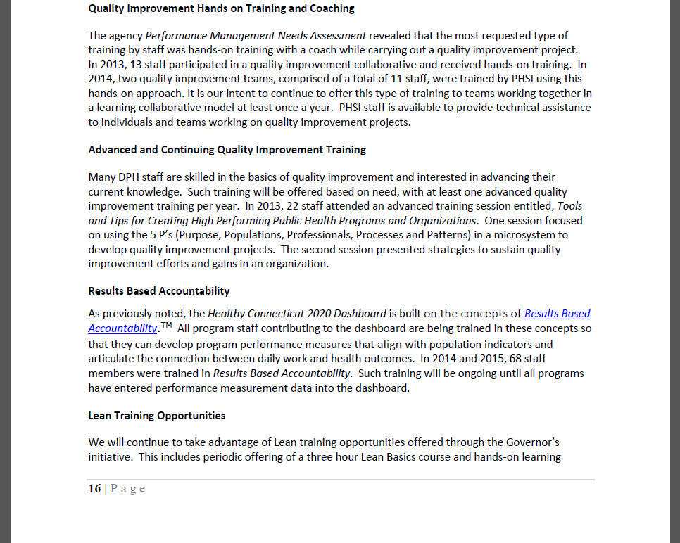
QI Plan Requirements
Notes:
We provide annual QI 101 training for staff, and advanced training for programs who request it. Every program has a license for the healthy Connecticut 2020 performance dashboard which is based on the concept of Results Based Accountability, and training or help is available every quarter for staff inputting data or developing performance measures.

Slide 21
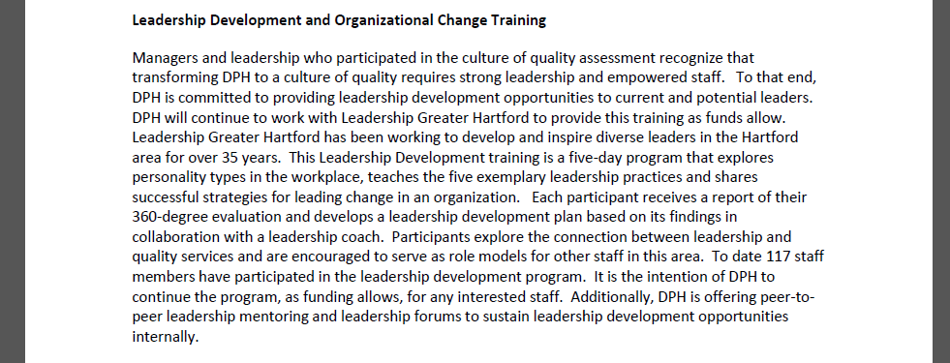
QI Plan Requirements
Notes:
Leadership development opportunities are also available twice a year with Leadership Greater Hartford. We’ve been able to open these sessions to local health in the past, so be sure to keep an eye out for an email about the next one (I think it is planned for early this summer)

Slide 22
QI Plan Requirements
Project identification, alignment with strategic plan and initiation process
  Describe how QI projects will be selected; Who will identify projects and how will you prioritize projects, identify team members
  Describe how this plan ties to other agency plans/initiatives, such as the Strategic Plan or Performance Management System
Notes:
Consider: Who will identify projects and how you will prioritize projects, identify team members, and address other specialized staffing that might be needed (such as support or data).
To identify potential projects, consider:
Performance reflected in Ohio’s Health Department Profile and Performance Database, Ohio’s Public Health Quality Indicator reports, and/or within your own performance management system,
Alignment with your agency’s strategic plan and mission,
After-action reports,
Customer satisfaction surveys,
Staff survey results/suggestions (see project nomination form in User & Resource Guide),
Program evaluations,
Needs related to accreditation preparation,
Community health assessment or systems performance assessment findings,
Community health improvement plans, and/or
Audit or compliance issues.
When selecting or prioritizing from among several identified project ideas, you may consider additional criteria:
Alignment with agency’s mission or strategic plan,
Number of people affected,
Financial consequence,
Timeliness,
Capacity,
Availability of baseline data or present data collection efforts, and/or
Alignment with PHAB Domains or prior review feedback.

Slide 23
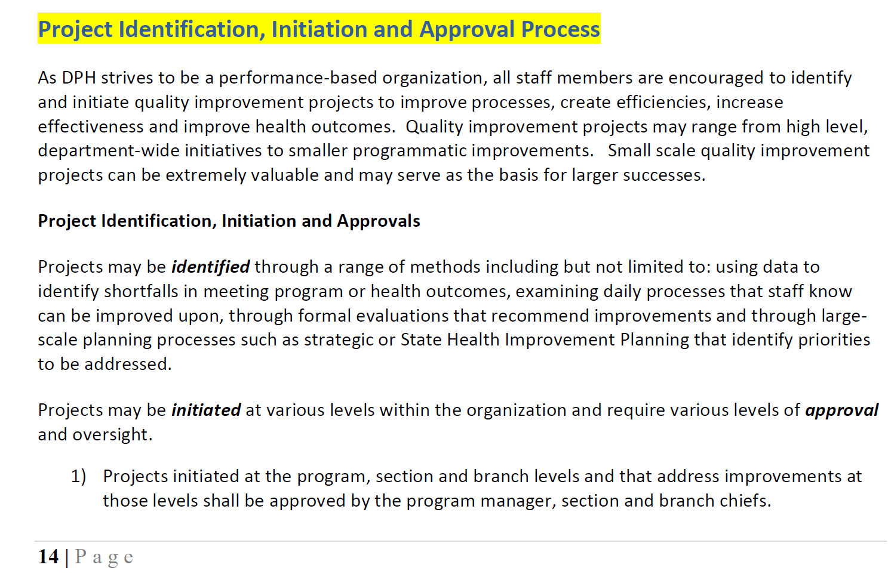
QI Plan Requirements

Slide 24
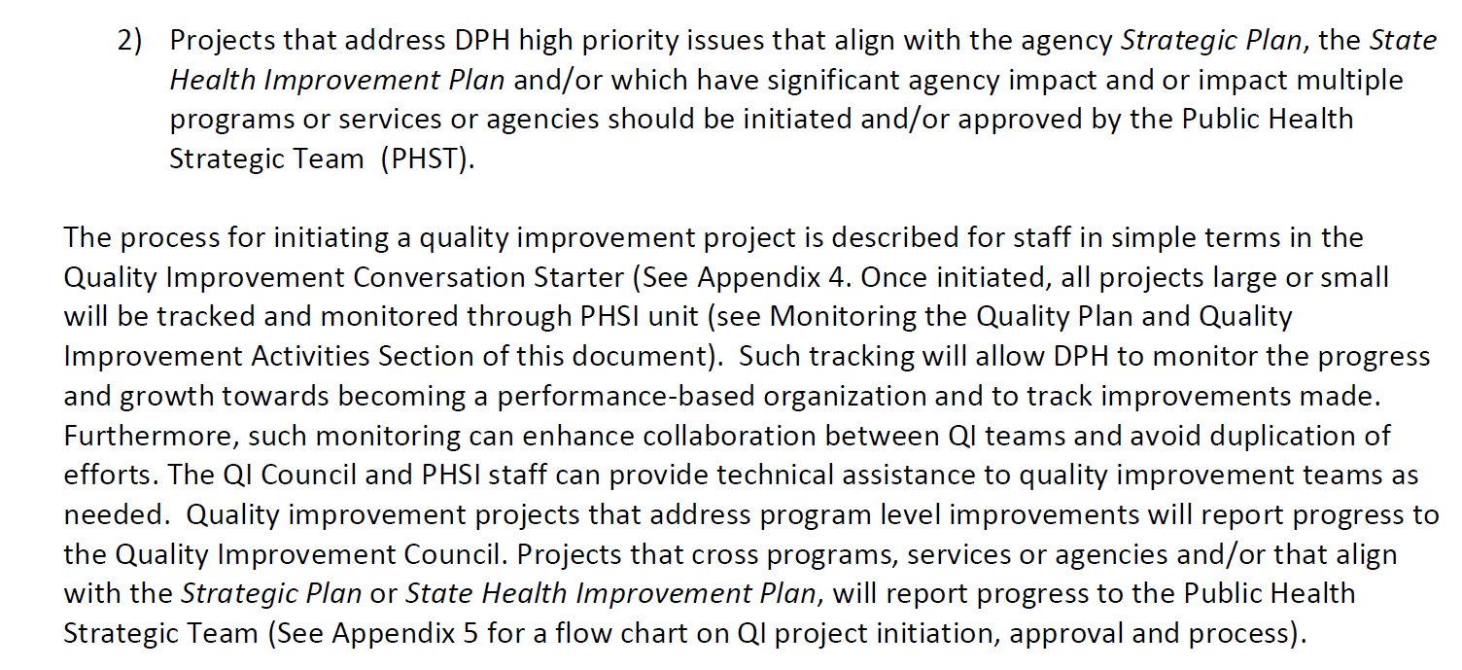
QI Plan Requirements

Slide 25
QI Plan Requirements
Quality improvement goals, objectives, and measures with time-framed targets
  Objectives should be SMART: Specific, Measurable, Achievable, Realistic, and Time-bound
  Could be: capacity (i.e. hire/assign a QI Coordinator; train # or % of staff in Lean)
  outcome (i.e. QI projects will result in $60,000 of cost savings)
  process (i.e. collect % of accreditation documentation)

Slide 26
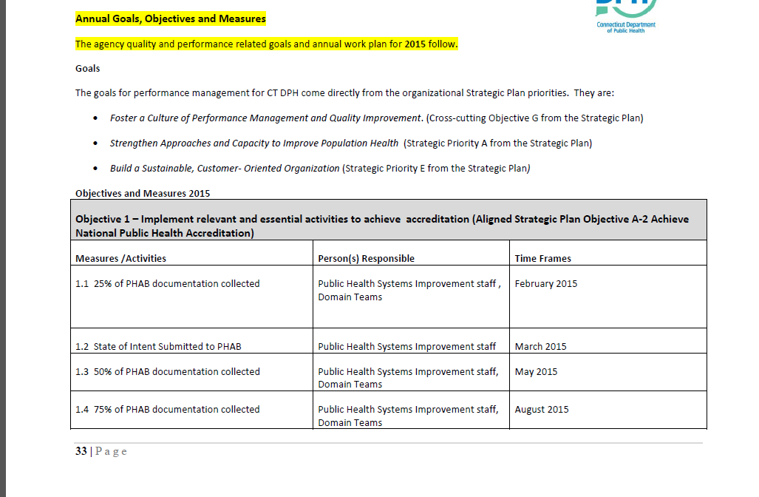
QI Plan Requirements
Notes:
workplan

Slide 27
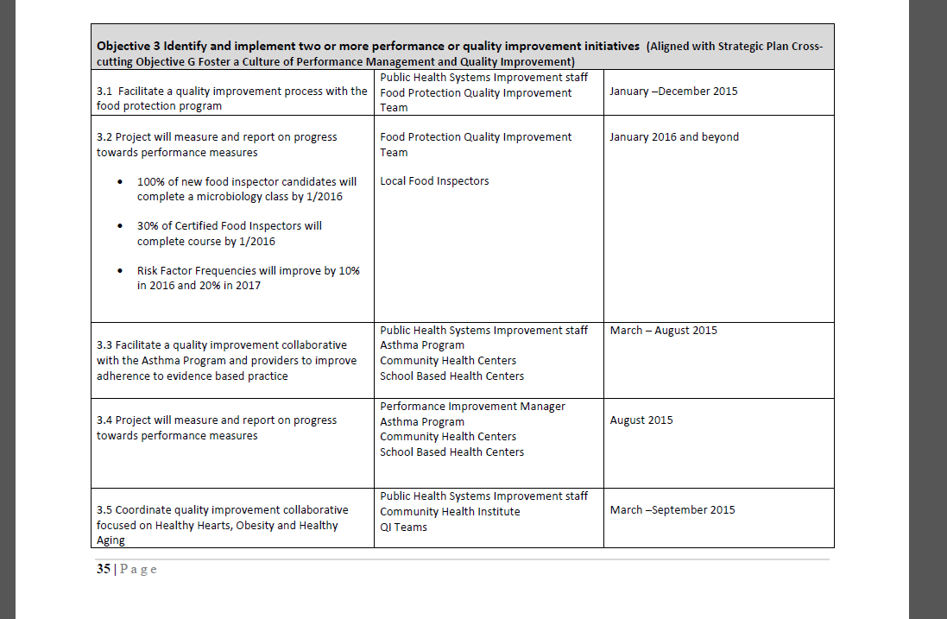
QI Plan Requirements

Slide 28
QI Plan Requirements
Approach to how the QI Plan is monitored: data collection/analysis, progress reported toward achieving goals, actions taken to make improvements
  Indicate how the plan will be tracked, reviewed, evaluated and revised, and at what frequency
  Indicate how QI projects will be tracked and evaluated

Slide 29
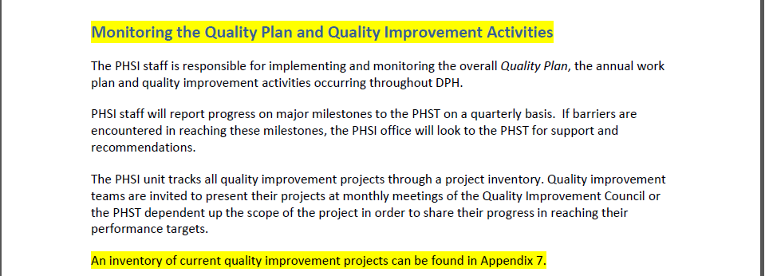
QI Plan Requirements

Slide 30
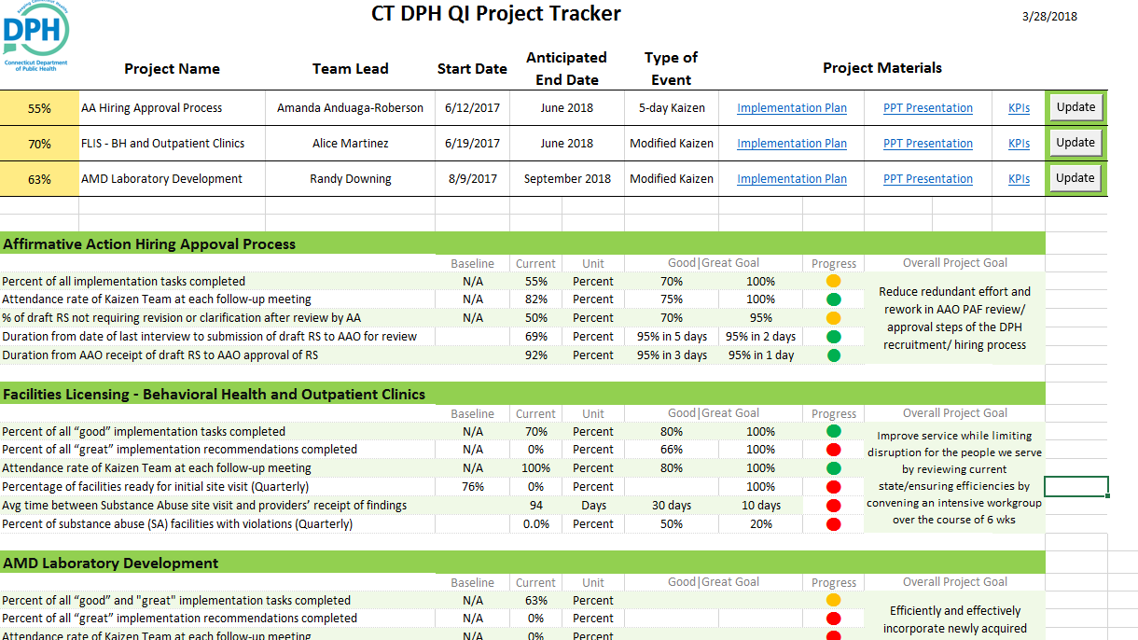
QI Plan Requirements

Slide 31
QI Plan Requirements
Regular communication of quality improvement activities conducted in the health department
  Could be through QI newsletters, storyboard displays, QI Council meeting minutes, staff meeting updates
Notes:
Describe how you will communicate about quality initiatives

Slide 32
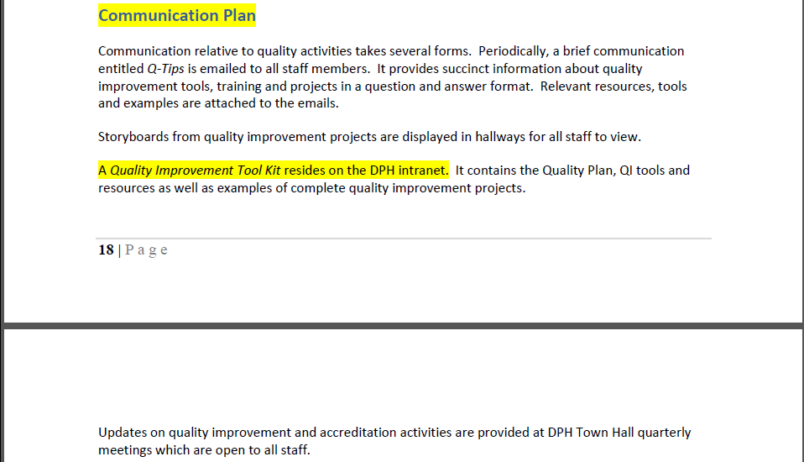
QI Plan Requirements

Slide 33
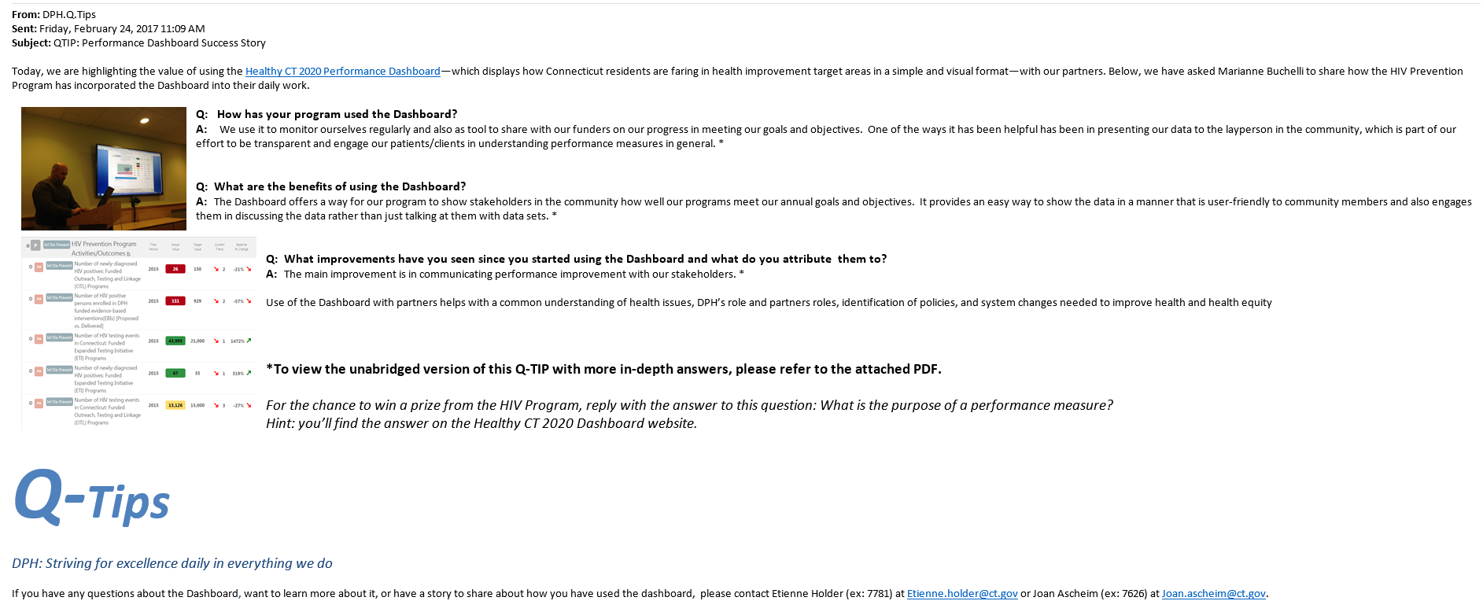
QI Plan Requirements

Slide 34
QI Plan Requirements
Process to assess the effectiveness of the quality improvement plan and activities
  Could be described in same section as QI plan/project monitoring
  Indicate how the plan will be assessed for effectiveness

Slide 35
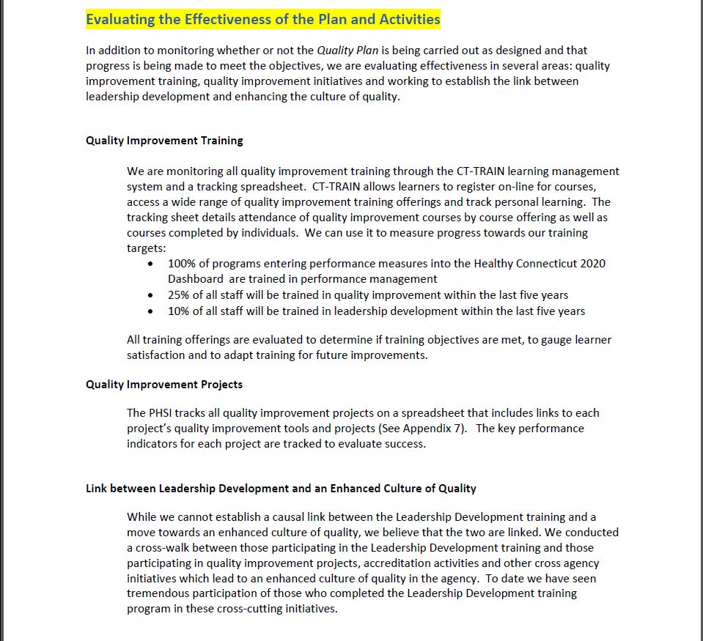
QI Plan Requirements

Slide 36
QI Plan Requirements
Questions?

Slide 37
Open Discussion
Which templates or guides are you utilizing to develop your QI Plan?
What are some challenges in developing or implementing your QI Plan?

Slide 38
Up Next…
Next Meeting:
  April 25 | 1-2pm
  Topic: Adopting a Performance Management System

