Slide 1
Accreditation Learning Community
January 24, 2018
1:00-2:00pm
Dial-In Number: 1 877 916 8051
Access Code: 539-9866

Slide 2
Agenda
January 24, 2018 | 1:00pm-2:00pm
Dial-In Number: 1- 877-916-8051
Access Code: 539-9866
1:00 – 1:15 | Updates/Evaluation Results
1:15 – 1:35 | CHIP Requirements and Documentation Considerations | Melissa Touma
1:35 – 2:00 | Open Discussion | ALC

Slide 3
Evaluation Results
Topics to hear more about:
Development of Key Documents/Plans
Performance Management/QI
Workforce Development
Specific Domains to Review:
Domain 9
Domain 10
Domain 5
Domain 4
Domain 8
Domain 1
Notes:
The open-ended response also included requests to hear more about specific QI projects and cultural awareness, and from someone with expertise on finding/conducting evidence-based programs and reps from grant-making organizations which have supported LHD programming.
Another common request sought information about how to fund the accreditation process and other budget information.

Slide 4
Accreditation Landscape in CT
Notes:
This graph is meant to give you an idea of the accreditation landscape across CT based on the Local Health Department Survey responses in 2017. We have 3 accredited local health departments, and one that has recently applied for accreditation. There are seven or eight other local health departments that indicated they plan to officially apply for accreditation in 2018.
As you know, our goal for this learning community is to improve local health capacity and readiness for accreditation through peer collaboration and resource sharing, and increase the number of accredited health departments in the state. This is also an activity that supports a State Health Improvement Plan objective in the Health Systems focus area, which is to increase the percentage of governmental public health jurisdictions that meet PHAB standards, and aligns with the national Healthy People 2020 objective to increase the number of local and tribal health agencies that are accredited.
http://www.portal.ct.gov/DPH/State-Health-Planning/Healthy-CT-2020-Dashboards/48-HLTHSYS-Infrastructure

Slide 5
CHIP Requirements: Measures 5.2.2L, 5.2.3A, 5.2.4A

Slide 6
Healthy People 2020 Objective
PHI-15.4: Increase the proportion of local public health agencies that have health improvement plans linked to their State plan
SHIP/CHIP Linkages: Crosswalk of Priorities and Strategies
Why link to State plan?
Strategic way to leverage, coordinate, and target resources
Increases awareness of health issues and demonstrates multiple communities need these issues addressed
Build your health improvement strategies and objectives off lessons learned at the state-level (and from other local health improvement plans)
Notes:
As you develop or revise the objectives, strategies, and even activities, for the implementation of your community health improvement plan, consider establishing alignment with the state health improvement priorities and strategies. Linking local health improvement plans with their state plans is a best practice reflected in the Healthy People 2020 Objective in Public Health Infrastructure – Increase the proportion of local public health agencies that have health improvement plans linked to their state plan.
To help this process, and to align our own efforts at the state with local efforts, we developed the SHIP/CHIP Linkages: Crosswalk of Priorities and Strategies, which I’ve shown here before. I provided the document as a handout, which you can access in your gotowebinar navigation panel. It is also online on the SHIP Coalition website. I will bring it up in a few slides as we walk through the requirements of Measure 5.2.2.
Cross-jurisdictional sharing promotes a more robust public health infrastructure

Slide 7
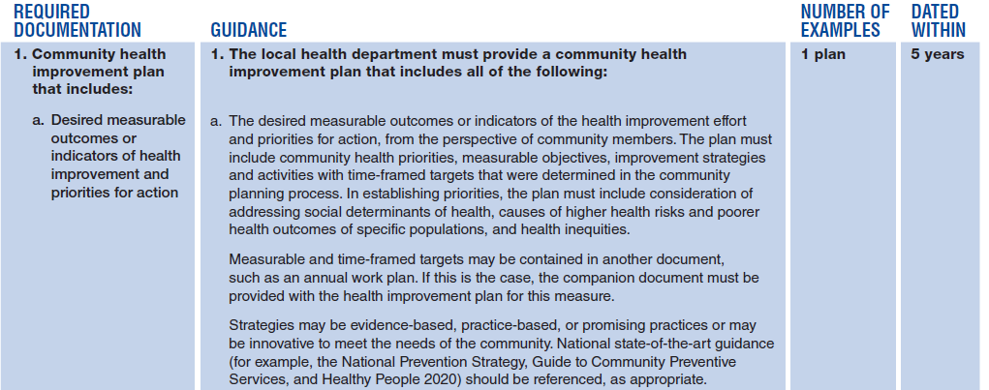
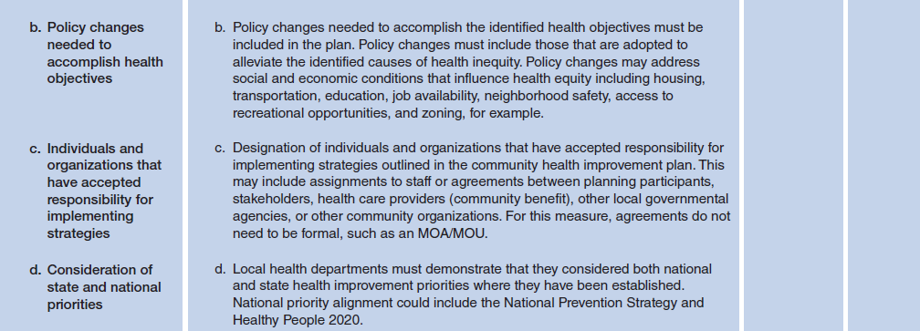
From the date of submission of the documentation to PHAB
Notes:
Whether you complete a CHIP with a hospital or develop one on your own, the plan must include the following components.
The documentation must be dated within 5 years previous from the date of submission of the documentation to PHAB. For example, CT DPH set a goal submission date of March 31, 2017 when we started collecting documentation at the end of 2014. This meant that documentation dated within 5 years could be as old as March 31, 2012. Fortunately we didn’t have too many that were that old. By starting to collect our documentation so early, we were able fix or develop documentation for gaps as we came across them. While I don’t believe local health departments will need as much time as we did to collect documentation, it isn’t a bad idea to start early, get an inventory of what you have or don’t have in place, and give yourselves time to develop documentation for implementation of CHA/CHIP/Strategic Plan.
Its also a good idea to highlight or point out the date in a document you submit so that the reviewer does not have to go searching for it.

Slide 8
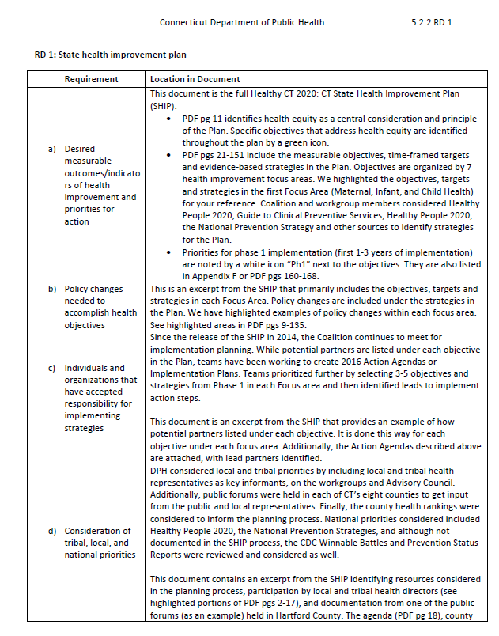
Notes:
To guide the site visitors through a long, multi-page and multi-component document, we added a cover page that acted as our documentation description in addition to directing the site reviewers. Even though most of this information can be found in the SHIP, we provided four files that specifically point to each component in the document.

Slide 9
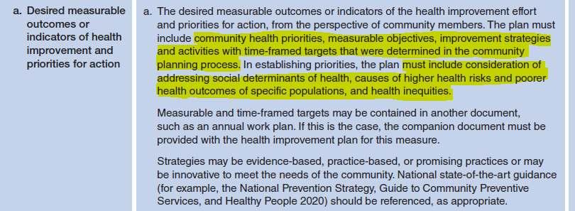
Measure 5.2.2L RD1a

Slide 10
Measure 5.2.2L RD1b

Slide 11
Measure 5.2.2L RD1c
Notes:
Because the plan listed potential partners, and did not specifically designate organizations that have accepted responsibility for implementing strategies, CT DPH provided the Action Agendas as additional documentation to demonstrate which organizations were responsible for priority objectives. The Action Agendas are the implementation worksheets of the state health improvement plan.

Slide 12
Measure 5.2.2L RD1d
SHIP/CHIP Linkages: Crosswalk of Priorities and Strategies
Notes:
For state documentation, we needed to show consideration of local and tribal priorities in addition to national priorities.
Following our site visit, we focused on developing a formal process of identifying and documenting linkages between the State Health Improvement Plan and local Community Health Improvement Plans. I’ve shown this document on these webinars before and as you know, it is a working document, constantly being updated as we are made aware of completed CHIPs. It is available on the Connecticut Health Improvement Coalition’s webpage and could be a good tool for your department to use when considering state health improvement priorities for your CHIP.
In addition, we plan to use and align with these local level priorities and strategies as we update our own SHA/SHIP over the next two years.

Slide 13
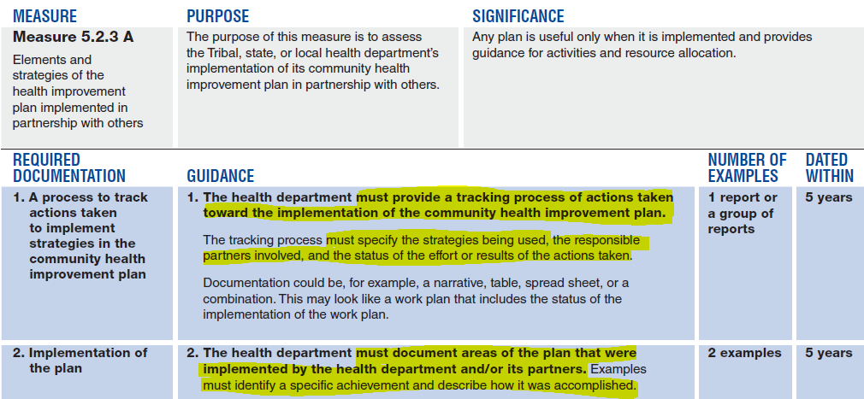
Measure 5.2.3A

Slide 14
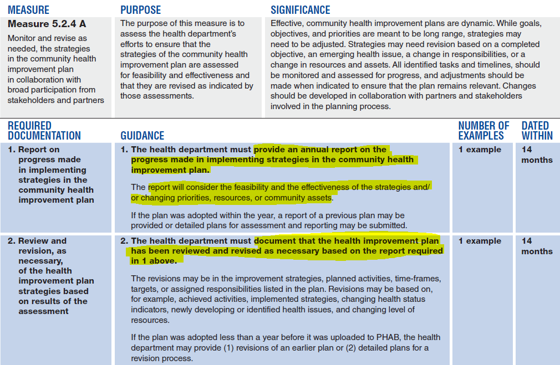
Measure 5.2.4A

Slide 15
Questions?

Slide 16
Open Discussion
For LHDs who have developed a CHIP or are currently developing one, what have been your challenges? Successes?
Where has your health improvement plan linked with the state health improvement plan?
Has anyone worked with a hospital in developing their CHA/CHIP? Please describe your experience(i.e. level of participation, if developing a supplemental plan)

Slide 17
Up Next…
Next Meeting:
February 28 | 1-2pm

