Slide 1
Accreditation Learning Community
January 23, 2019
1:00-2:00pm
Dial-In Number: 1 877 916 8051
Access Code: 539-9866
https://attendee.gotowebinar.com/rt/6051024100385559565

Slide 2
SIM – Health Enhancement Communities (HEC) Public Comment Period Extended
State Innovation Model (SIM) is a Center for Medicare and Medicaid Innovation initiative to support the development and implementation of state-led, multi-payer healthcare payment and service delivery model reforms.
Health Enhancement Community (HEC): a place-based initiative will support long-term, collaborative, and cross-sector efforts that improve community health in defined geographies through broad, systemic change (proposal recommends establishing 8-12 HECs across the state)
HEC Health Priority Areas:
Adverse Childhood Events (ACEs) – Improving child well-being for Pre-Birth to Children Age 8 years
Improving Health Weight and Physical Fitness for All Connecticut Residents

Slide 3
SIM – Health Enhancement Communities (HEC) Public Comment Period Extended
CT Team looking for feedback on the proposed framework and strategy
https://portal.ct.gov/OHS/SIM-Work-Groups/Population-Health-Council/Public-Comment
Public comments and questions can be sent to OHS@ct.gov
Comment period extended to February 13, 2019

Slide 4
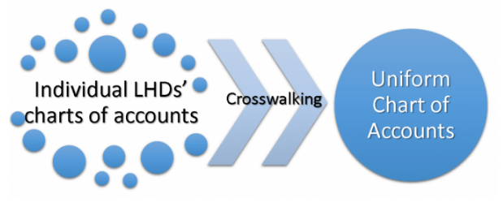
PHAB Update – Uniform Chart of Accounts Available for Local Health Departments
The Public Health Activities and Services Tracking (PHAST) team at the University of Washington, with support from the Robert Wood Johnson Foundation, invites LHDs to join the second phase of the Uniform Chart of Accounts (UCOA) project as practice partners and help them set the standard for comparing expenditures and revenues in public health.
To learn more about participating in the project, visit coa.phastdata.org or email phast@uw.edu.

Slide 5
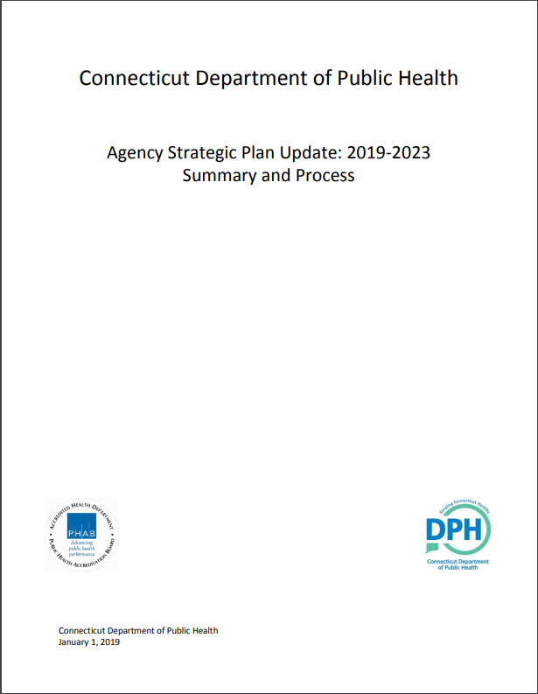
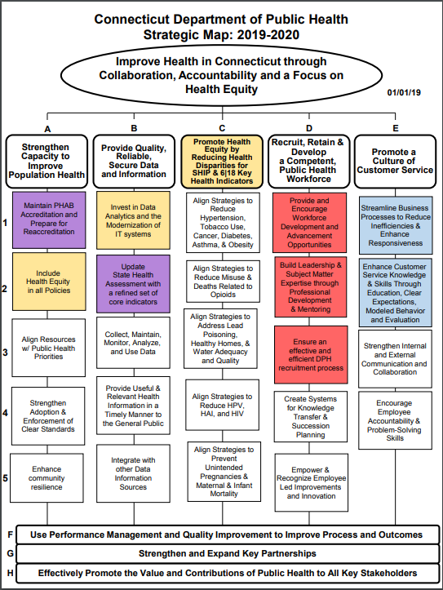
DPH Strategic Plan 2019-2023
http://www.portal.ct.gov/AboutDPH
2019-2023 Strategic Plan
2018 Strategic Plan Process
2019-2020 Strategic Map

Slide 6
ALC Evaluation Results

Slide 7
2019 Plan for ALC
Performance Measures
Increase average # participating departments on monthly calls/webinars
Data Source: GoToWebinar
Increase effectiveness of monthly calls/webinars
Data Source: ALC Evaluation
Increase % of participating LHDs with the PHAB six-pack in place
Data Source: Local Health Annual Survey
Notes:
Provisional:
Increase capacity measures for participating LHDs

Slide 8
2019 Plan for ALC
Topics - January to June
January – Aligning Key Plans with the Performance Management System
February – Writing an Agency’s Workforce Development Plan
March – Health Equity (specific focus TBD)
April – Promoting the Value of National Public Health Accreditation
May – Procedure for Collecting Population-level Surveillance Data
June – Writing an Agency’s Quality Improvement Plan

Slide 9
Aligning Key Plans with the Performance Management System

Slide 10
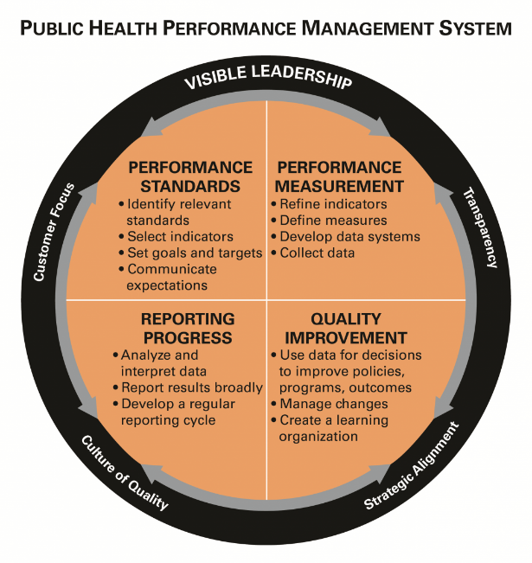
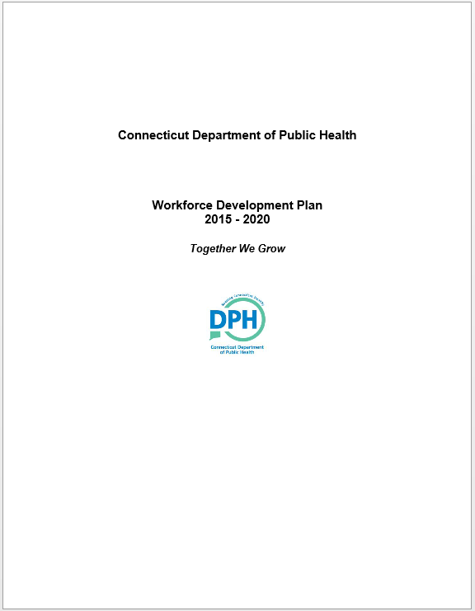
Aligning with Performance Management

Slide 11
Agency Plan Alignment
Community Health Assessment (CHA)
Community Health Improvement Plan (CHIP)
Partners
Public Health Department
Strategic Plan
Performance Management System
QI Plan
Implementation
Plans
WDP

Slide 12
Starting with the CHIP and the SP…
CHIP is the driver behind the health department’s strategic plan, so in some way, all items in the strategic plan should be aligned with the CHIP, even if indirectly
This could mean your agency’s strategic priorities around human resources, workforce development, or technology are linked to your agency’s ability to address the health issues identified in the CHIP
Your performance management system provides the connection between your agency strategic plan and your programs conducting the work
This concept still applies to agencies developing their CHA, CHIP, and/or SP –
Your performance management system can drive your work in order to complete those major plans

Slide 13
…and thinking about the WDP and QIP…
With the Workforce Development Plan and Quality Improvement Plan, you are planning at the programmatic level
In order to improve, programs need items to measure on regularly
Program process measure will eventually impact population health outcome indicators
The WDP assures training and development for staff and is the final link in PHAB’s quantitative analysis of productivity and results
The agency can measure and develop workforce performance through three primary means: an annual performance appraisal (individual), biannual performance management reporting (program), and an employee engagement and organizational culture assessment (agency-wide).
The dashboard your agency creates should allow for easy measuring of progress and assessment toward reaching targets. The most important thing is not the system that is used, but the ease of its use.

Slide 14
Performance Management Example
CHIP Priority
Prevention and Wellness
Strategic Plan Goal
Reduce the incidence of infectious diseases
Program Performance Measure
Decrease by 5% the rate of adolescents and adults who have a reportable STI by December 2020
QI Goal
Staff will identify and complete ≥1 QI project to increase efficiency in the STI program by Dec. 2019
WD/Employee Goal
Collaborate with 20 new private medical providers to provide education on STI prevention and testing
Example from Blueprint to Align Local Public Health Systems by LakeCounty Health Department and Community Health Center

Slide 15
Performance Management Example
CHIP Priority
<<Still in Development>>
Strategic Plan Goal
Ensure Programmatic Excellence
Program Performance Measure
Apply for national public health accreditation by December 2020
QI Goal
95% of staff will meet mandatory QI training goals by January 2020
WD/Employee Goal
Complete online training plan within 6 months of onboarding or by December 2019

Slide 16
Local Health Spotlight:
Naugatuck Valley Health District

Slide 17
Aligning Your Department’s Tools for Measuring Success
Joan Lane, Accreditation Coordinator
Naugatuck Valley Health District

Slide 18
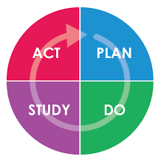
What are our department’s “guideposts”?
Strategic Plan
Community Health Improvement Plan
Quality Improvement Plan
Workforce Development Plan
Performance Management Plan

Slide 19
How do we “connect the dots” among these guideposts?
Does our organizational Strategic Plan align with our local CHIP (which for us represents 6 municipalities)?
Does our Workforce Development Plan support the work indicated in the Strategic Plan and the CHIP?
Do the measures on our Performance Management System dashboard capture the key goals and objectives in our Strategic Plan and our CHIP?
Are we effectively using our Performance Management dashboard to identify Quality Improvement opportunities?

Slide 20
NVHD Example
Strategic Priority 5: Maintain high quality mandated services and implement evidence-based programs based on community needs assessments
CHIP goal: Reduce asthma-related visits to Griffin Hospital ER
NVHD PM dashboard measure: Deliver asthma management programs to childcare providers, parents/guardians
WD goal: Ensure expertise of program delivery staff through ongoing training and skills enhancement
QI opportunity: Measure satisfaction of program participants and modify program as indicated

Slide 21
Challenges!
Ensuring that what we’re doing and measuring is what’s important to the health of the community
Ensuring that what we’re doing and measuring is attentive to PHAB emerging requirements
Continued focus on alignment among the components

Slide 22
Questions?

Slide 23
Discussion
Share one successful strategy you’re using now to align plans
What are some challenges for incorporating the Performance Management System into your core plans?
How does your agency staff connect their programmatic work to agency goals?
What is your process for reviewing your performance measures?

Slide 24
Issue Spotlight

Slide 25
Next Meeting
February 27, 2019 1-2pm
Writing an Agency’s Workforce Development Plan

